Slide 2
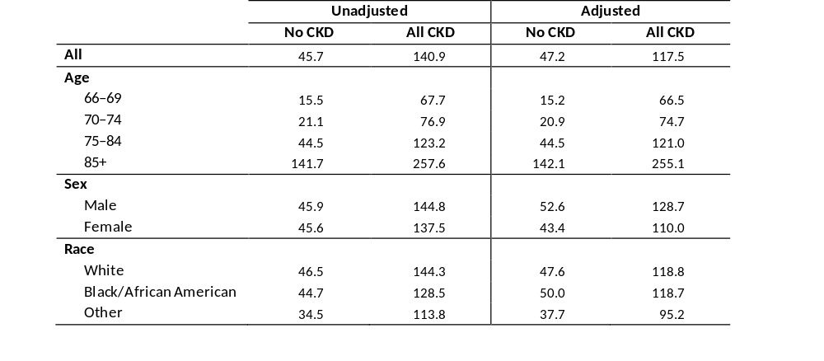
Table 3.1 Unadjusted and adjusted all-cause mortality rates (per 1,000 patient years
at risk) for Medicare patients aged 66 and older, by CKD status, 2013
Data source: Medicare 5 percent sample. January 1, 2013 point prevalent patients aged 66 and older. Adj: age/sex/race. Ref: all patients, 2013. Abbreviation: CKD, chronic kidney disease.

Slide 3
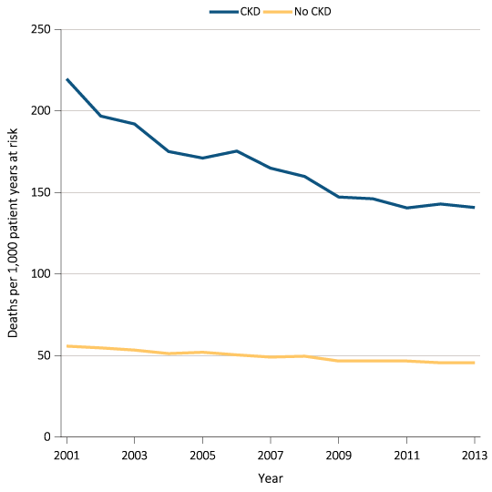
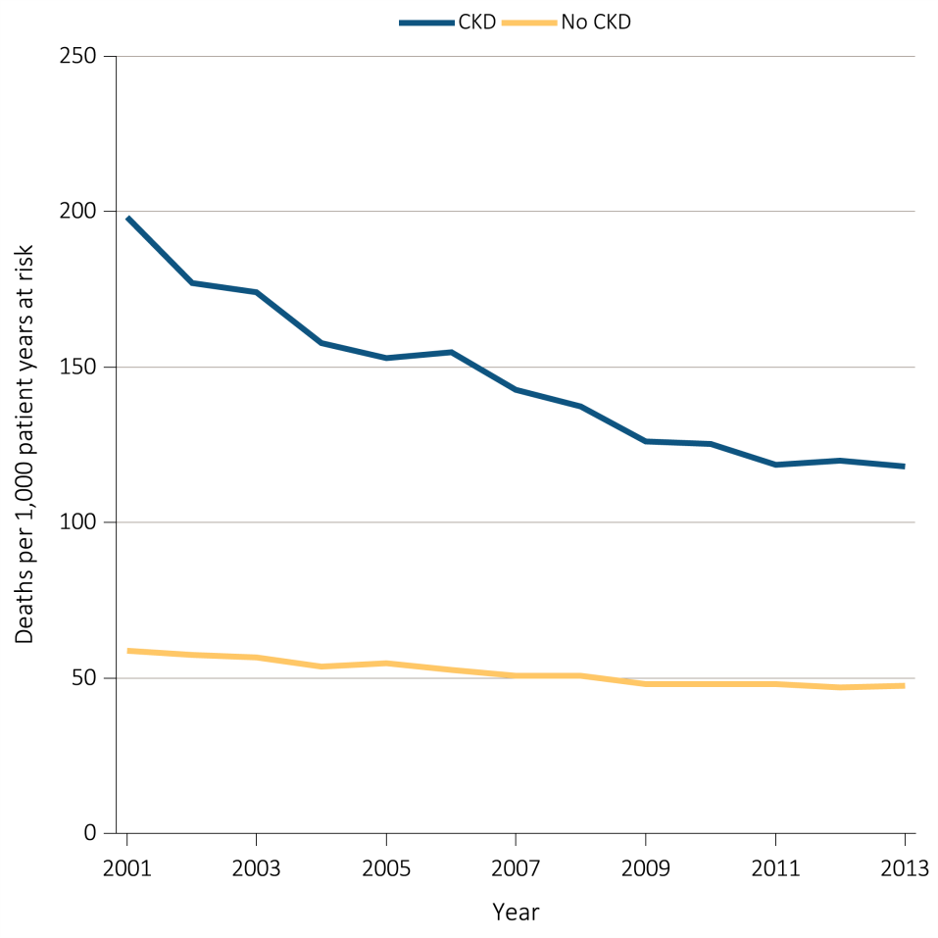
Figure 3.1 Unadjusted and adjusted all-cause mortality rates (per 1,000 patient years
at risk) for Medicare patients aged 66 and older, by CKD status and year, 2001-2013
^{(a) Unadjusted}
^{(b) Adjusted}
Data source: Medicare 5 percent sample. January 1 of each reported year, point prevalent Medicare patients aged 66 and older. Adj: age/sex/race. Ref: 2012 patients. Abbreviation: CKD, chronic kidney disease.

Slide 4
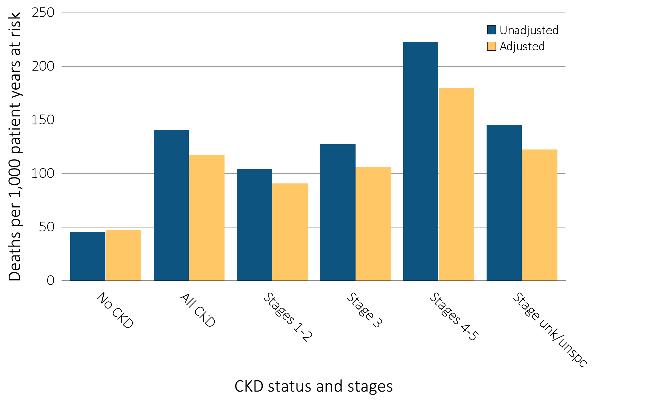
Figure 3.2 Unadjusted and adjusted all-cause mortality rates (per 1,000 patient years
at risk) for Medicare patients aged 66 and older, by CKD status and stage, 2013
Data source: Medicare 5 percent sample. January 1, 2013 point prevalent Medicare patients aged 66 and older. Adj: age/sex/race. Ref: all patients, 2013. See Table A for CKD stage definitions. Abbreviations: CKD, chronic kidney disease; unk/unspc, CKD stage unidentified.

Slide 5
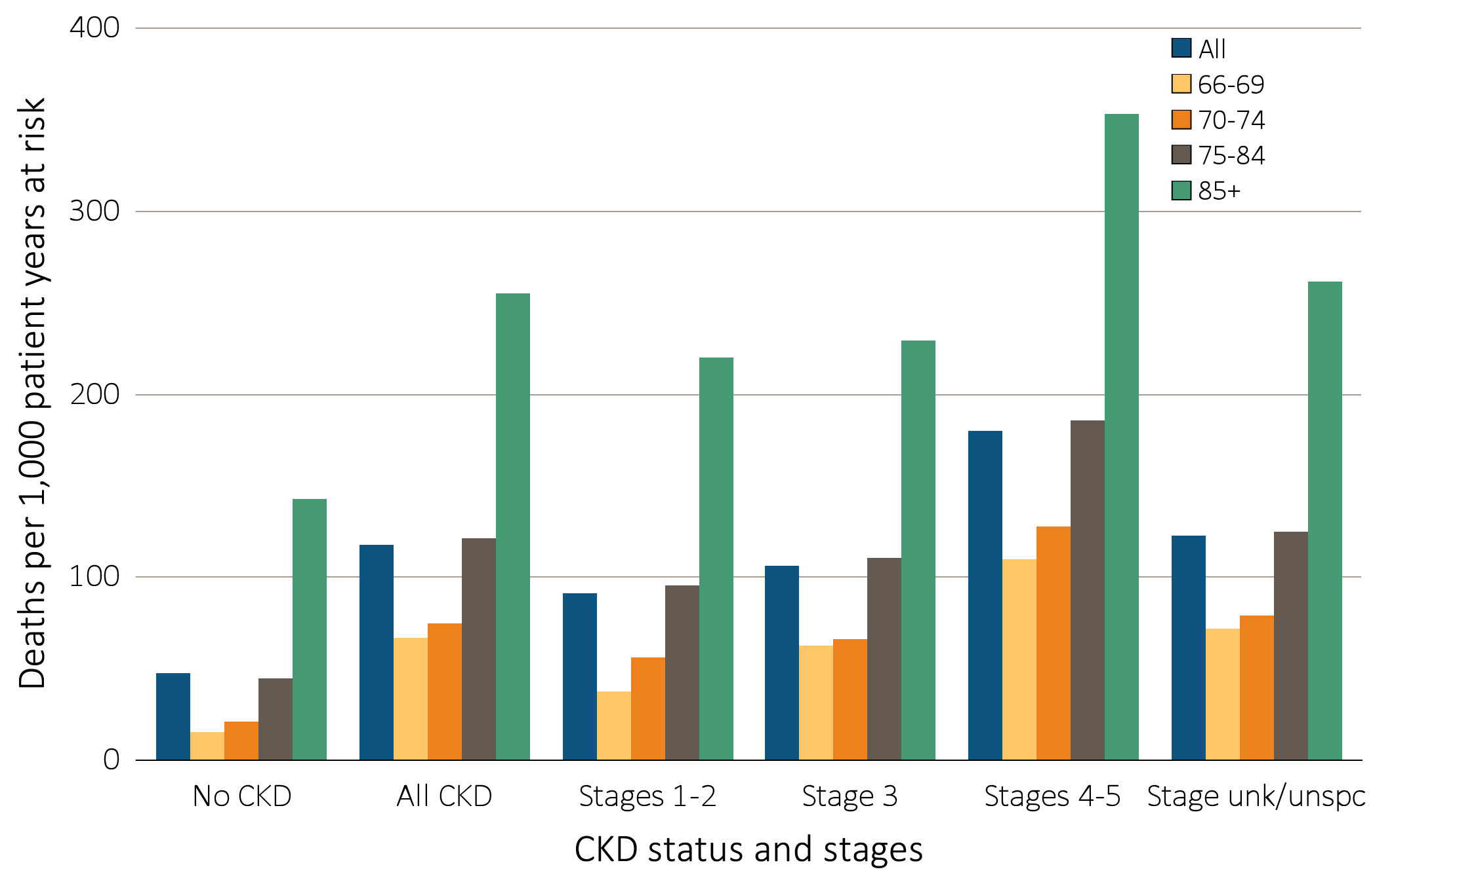
Figure 3.3 Adjusted all-cause mortality rates (per 1,000 patient years at risk) for
Medicare patients aged 66 and older, by age, CKD status, and stage, 2013
Data source: Medicare 5 percent sample. January 1, 2013 point prevalent patients aged 66 and older. Adj: age/sex/race. Ref: all patients, 2013. Abbreviations: CKD, chronic kidney disease; unk/unspc, CKD stage unidentified.

Slide 6
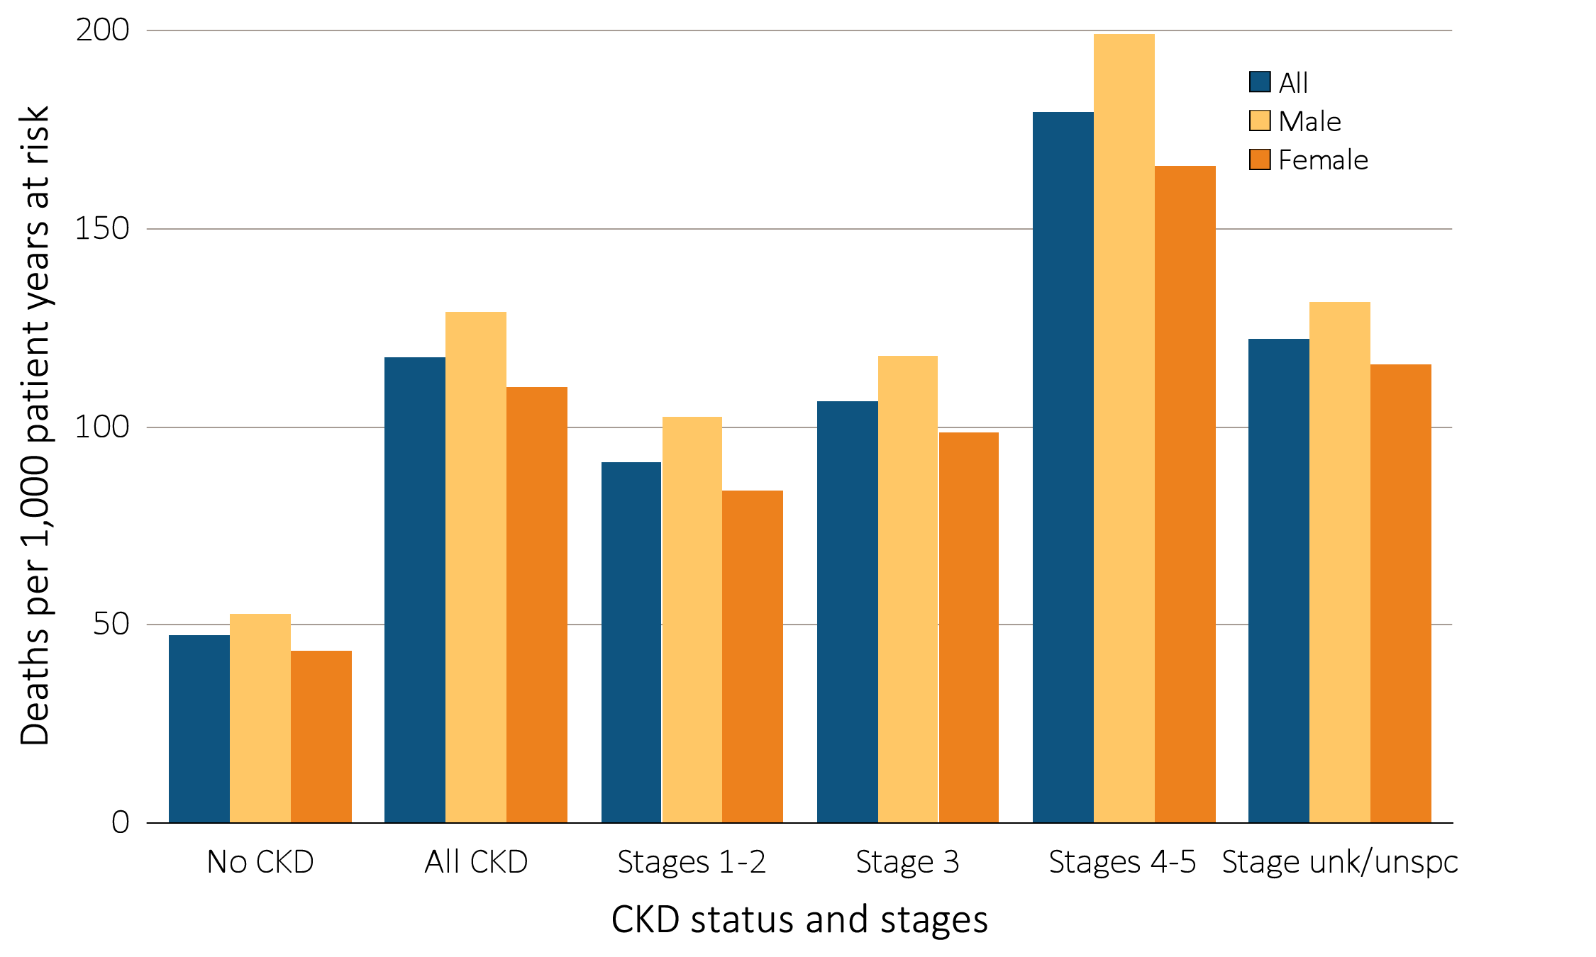
Figure 3.4 Adjusted all-cause mortality rates (per 1,000 patient years at risk) for
Medicare patients aged 66 and older, by sex, CKD status, and stage, 2013
Data source: Medicare 5 percent sample. January 1, 2013 point prevalent patients aged 66 and older. Adj: age/sex/race. Ref: all patients, 2013. Abbreviations: CKD, chronic kidney disease; unk/unspc, CKD stage unidentified.

Slide 7
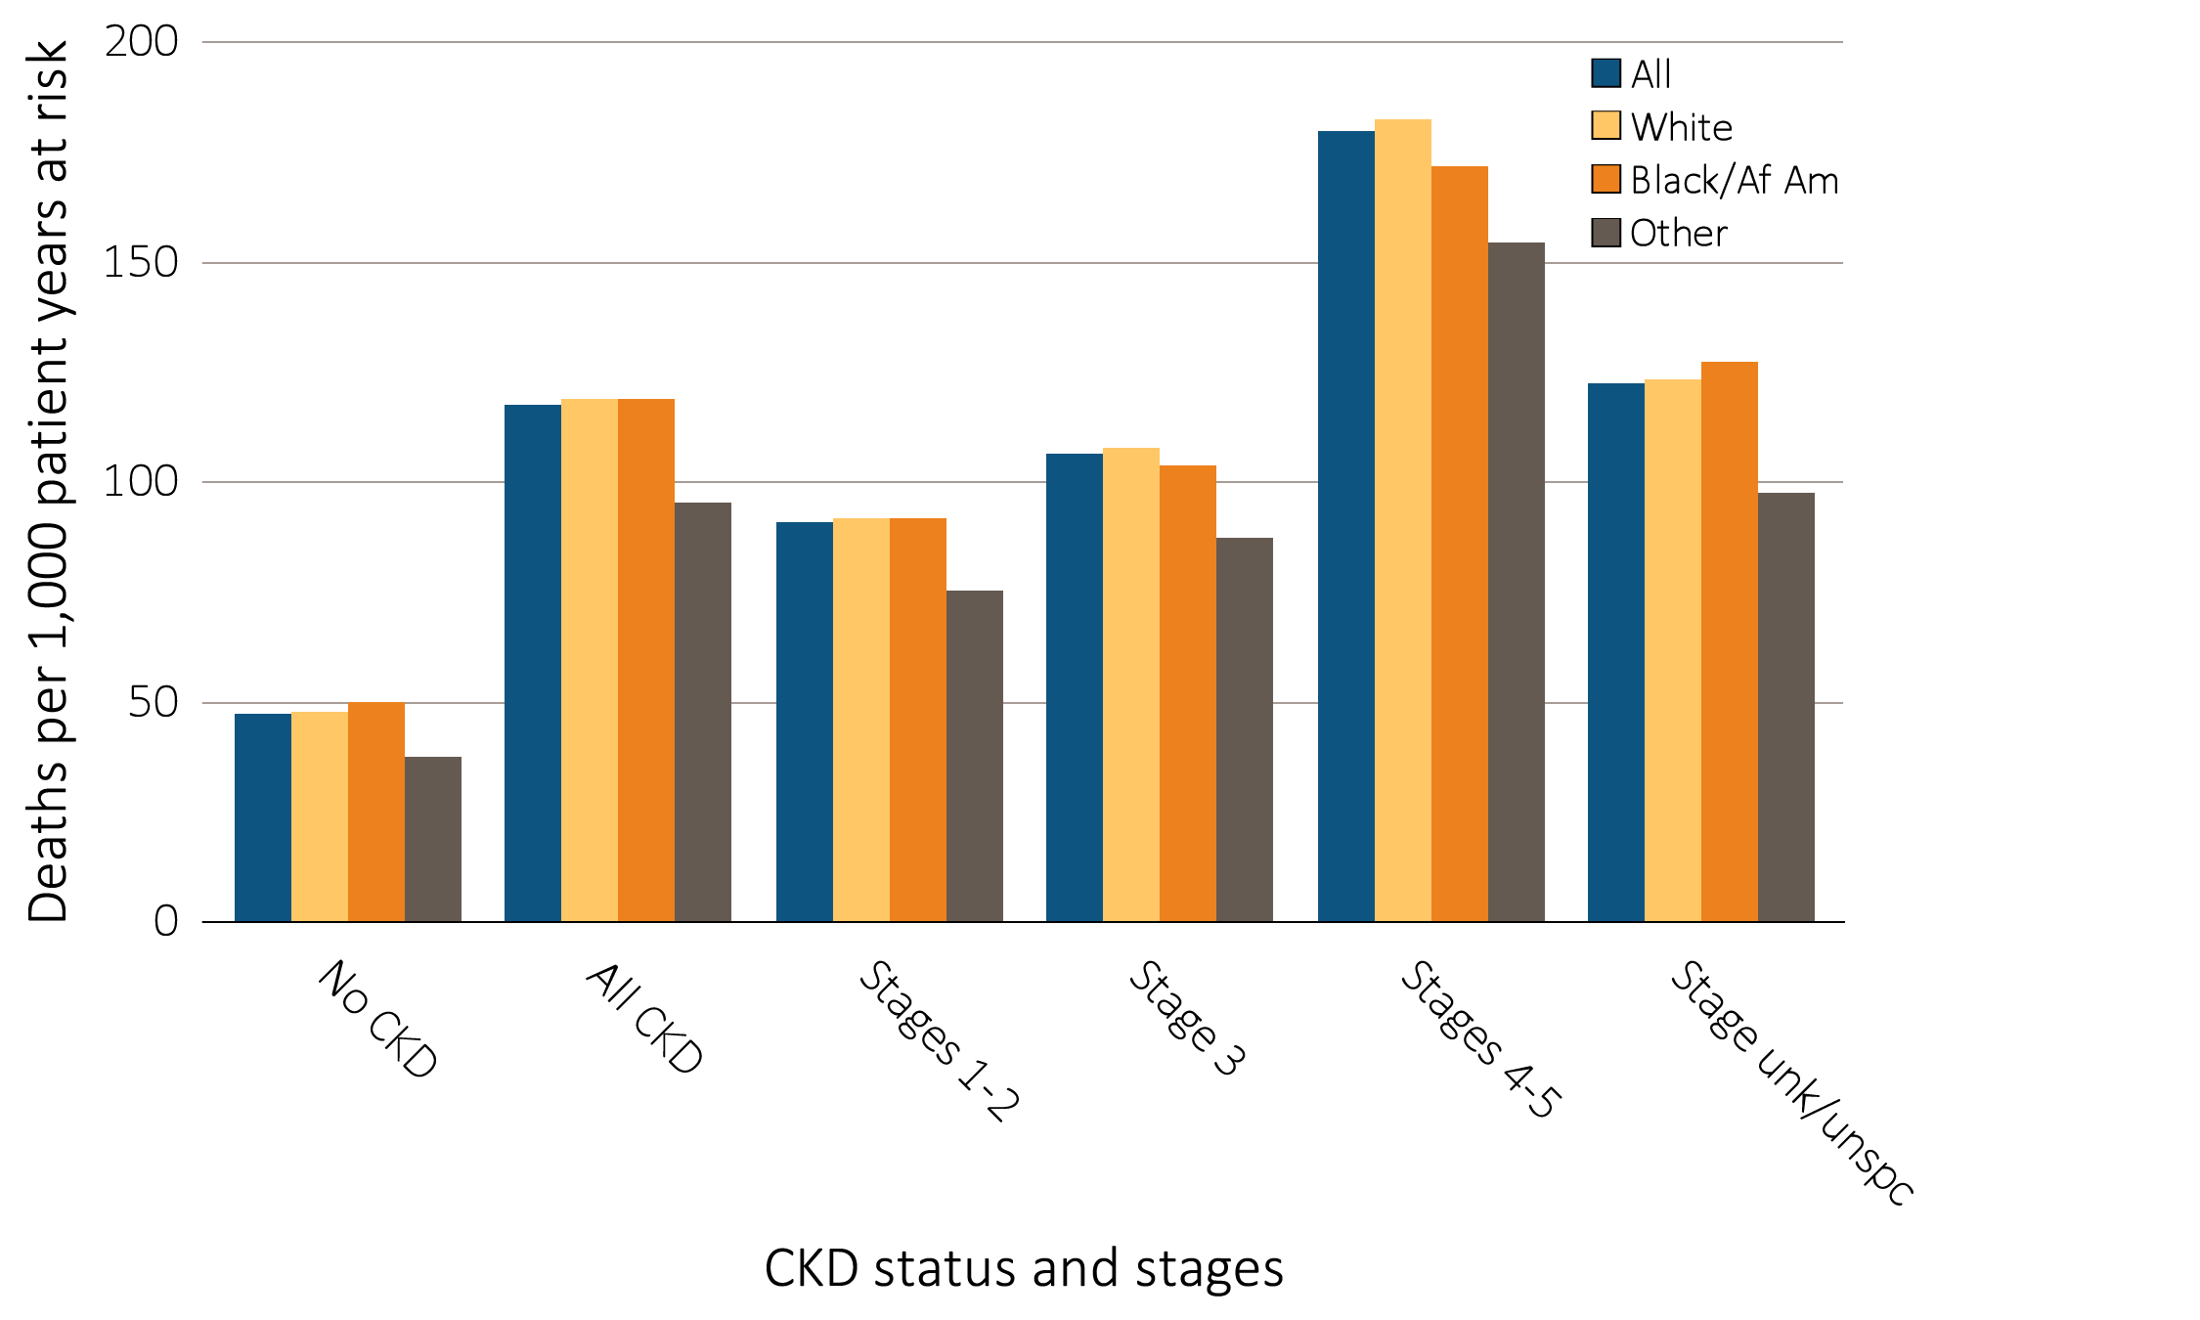
Figure 3.5 Adjusted all-cause mortality rates (per 1,000 patient years at risk) for
Medicare patients aged 66 and older, by race, CKD status, and stage, 2013
Data source: Medicare 5 percent sample. January 1, 2013 point prevalent patients aged 66 and older. Adj: age/sex/race. Ref: all patients, 2013. Abbreviations: Af Am, African American; CKD, chronic kidney disease; unk/unspc, CKD stage unidentified.

Slide 8
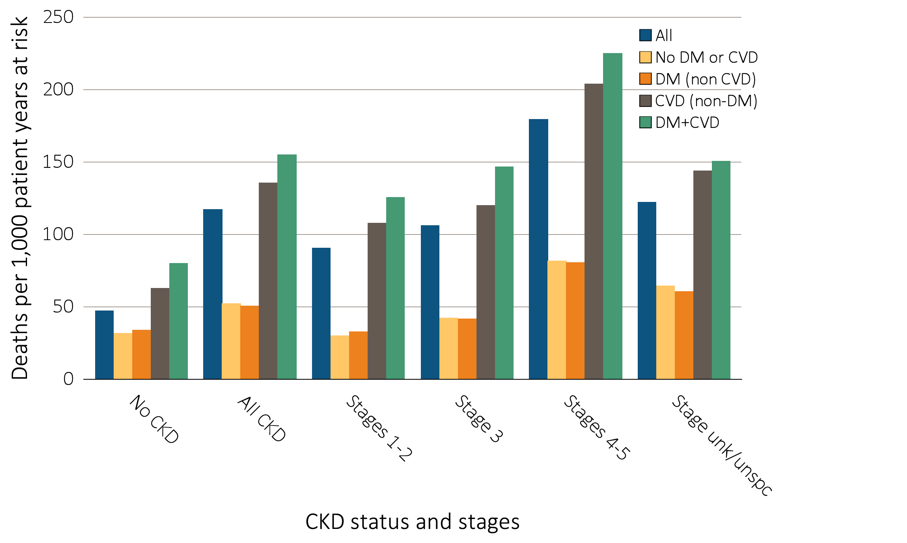
Figure 3.6 Adjusted all-cause mortality rates (per 1,000 patient years at risk) for
Medicare patients aged 66 and older, by cardiovascular disease and diabetes mellitus,
^{CKD status, and stage, 2013}
Data source: Medicare 5 percent sample. January 1, 2013 point prevalent patients aged 66 and older. Adj: age/sex/race. Ref: all patients, 2013. Abbreviations: CKD, chronic kidney disease; CVD, cardiovascular disease; DM, diabetes mellitus.

Slide 9
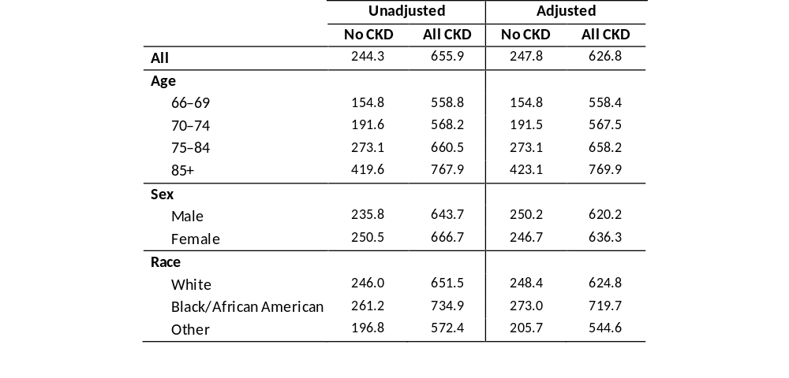
Table 3.2 Unadjusted and adjusted all-cause hospitalization rates (per 1,000 patient years at risk) for Medicare patients aged 66 and older, by CKD status, 2013
Data source: Medicare 5 percent sample. January 1, 2013 point prevalent Medicare patients, aged 66 and older. Adj: age/sex/race; rates by one factor are adjusted for the others. Ref: all patients, 2013. Abbreviations: CKD, chronic kidney disease.

Slide 10
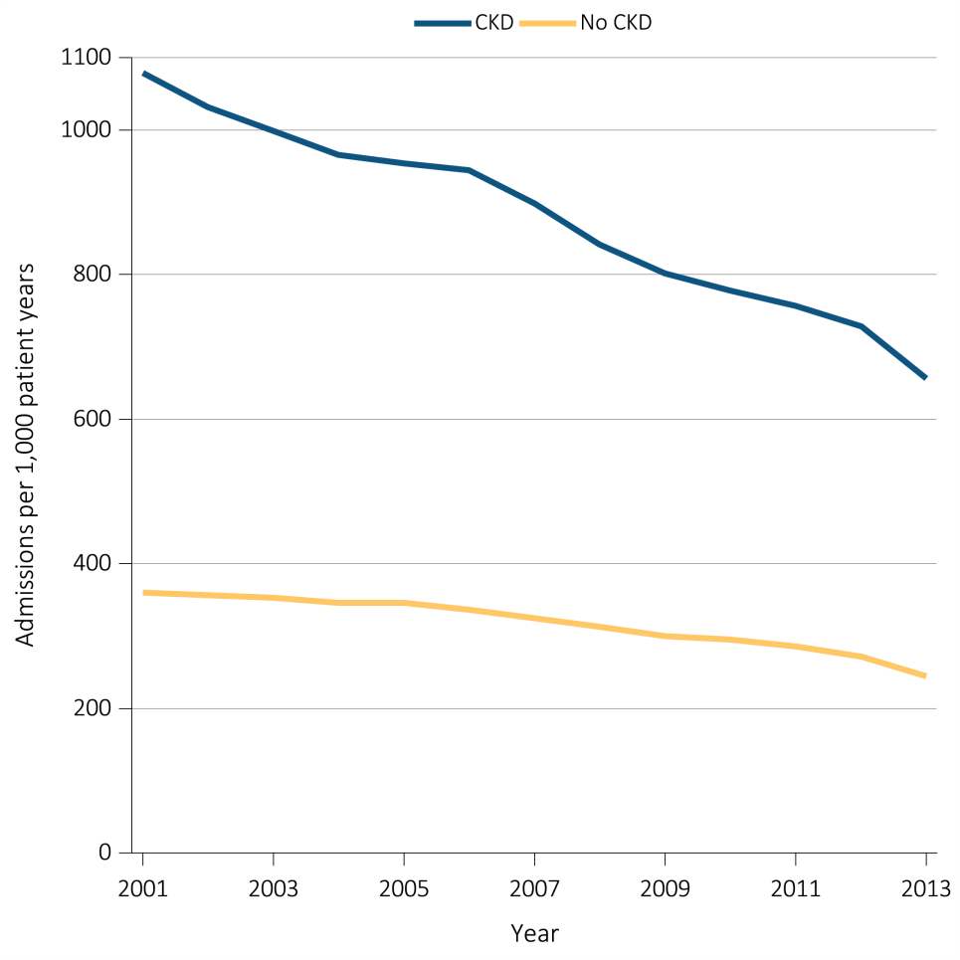
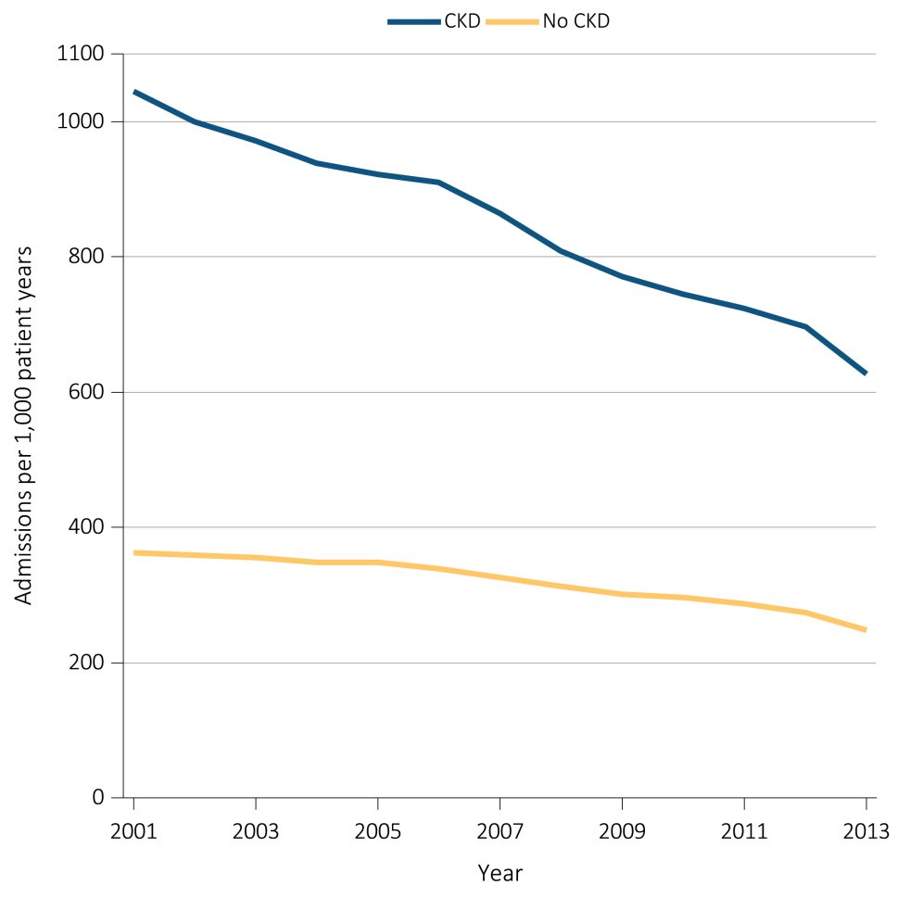
Figure 3.7 Unadjusted and adjusted all-cause hospitalization rates (per 1,000 patient years at risk) for Medicare patients aged 66 and older, by CKD status and year, 2001-2013
^{(a) Unadjusted}
^{(b) Adjusted}
Data source: Medicare 5 percent sample. January 1 of each reported year point prevalent Medicare patients aged 66 and older. Adj: age/sex/race. Ref: 2013 patients. Abbreviations: CKD, chronic kidney disease.

Slide 11
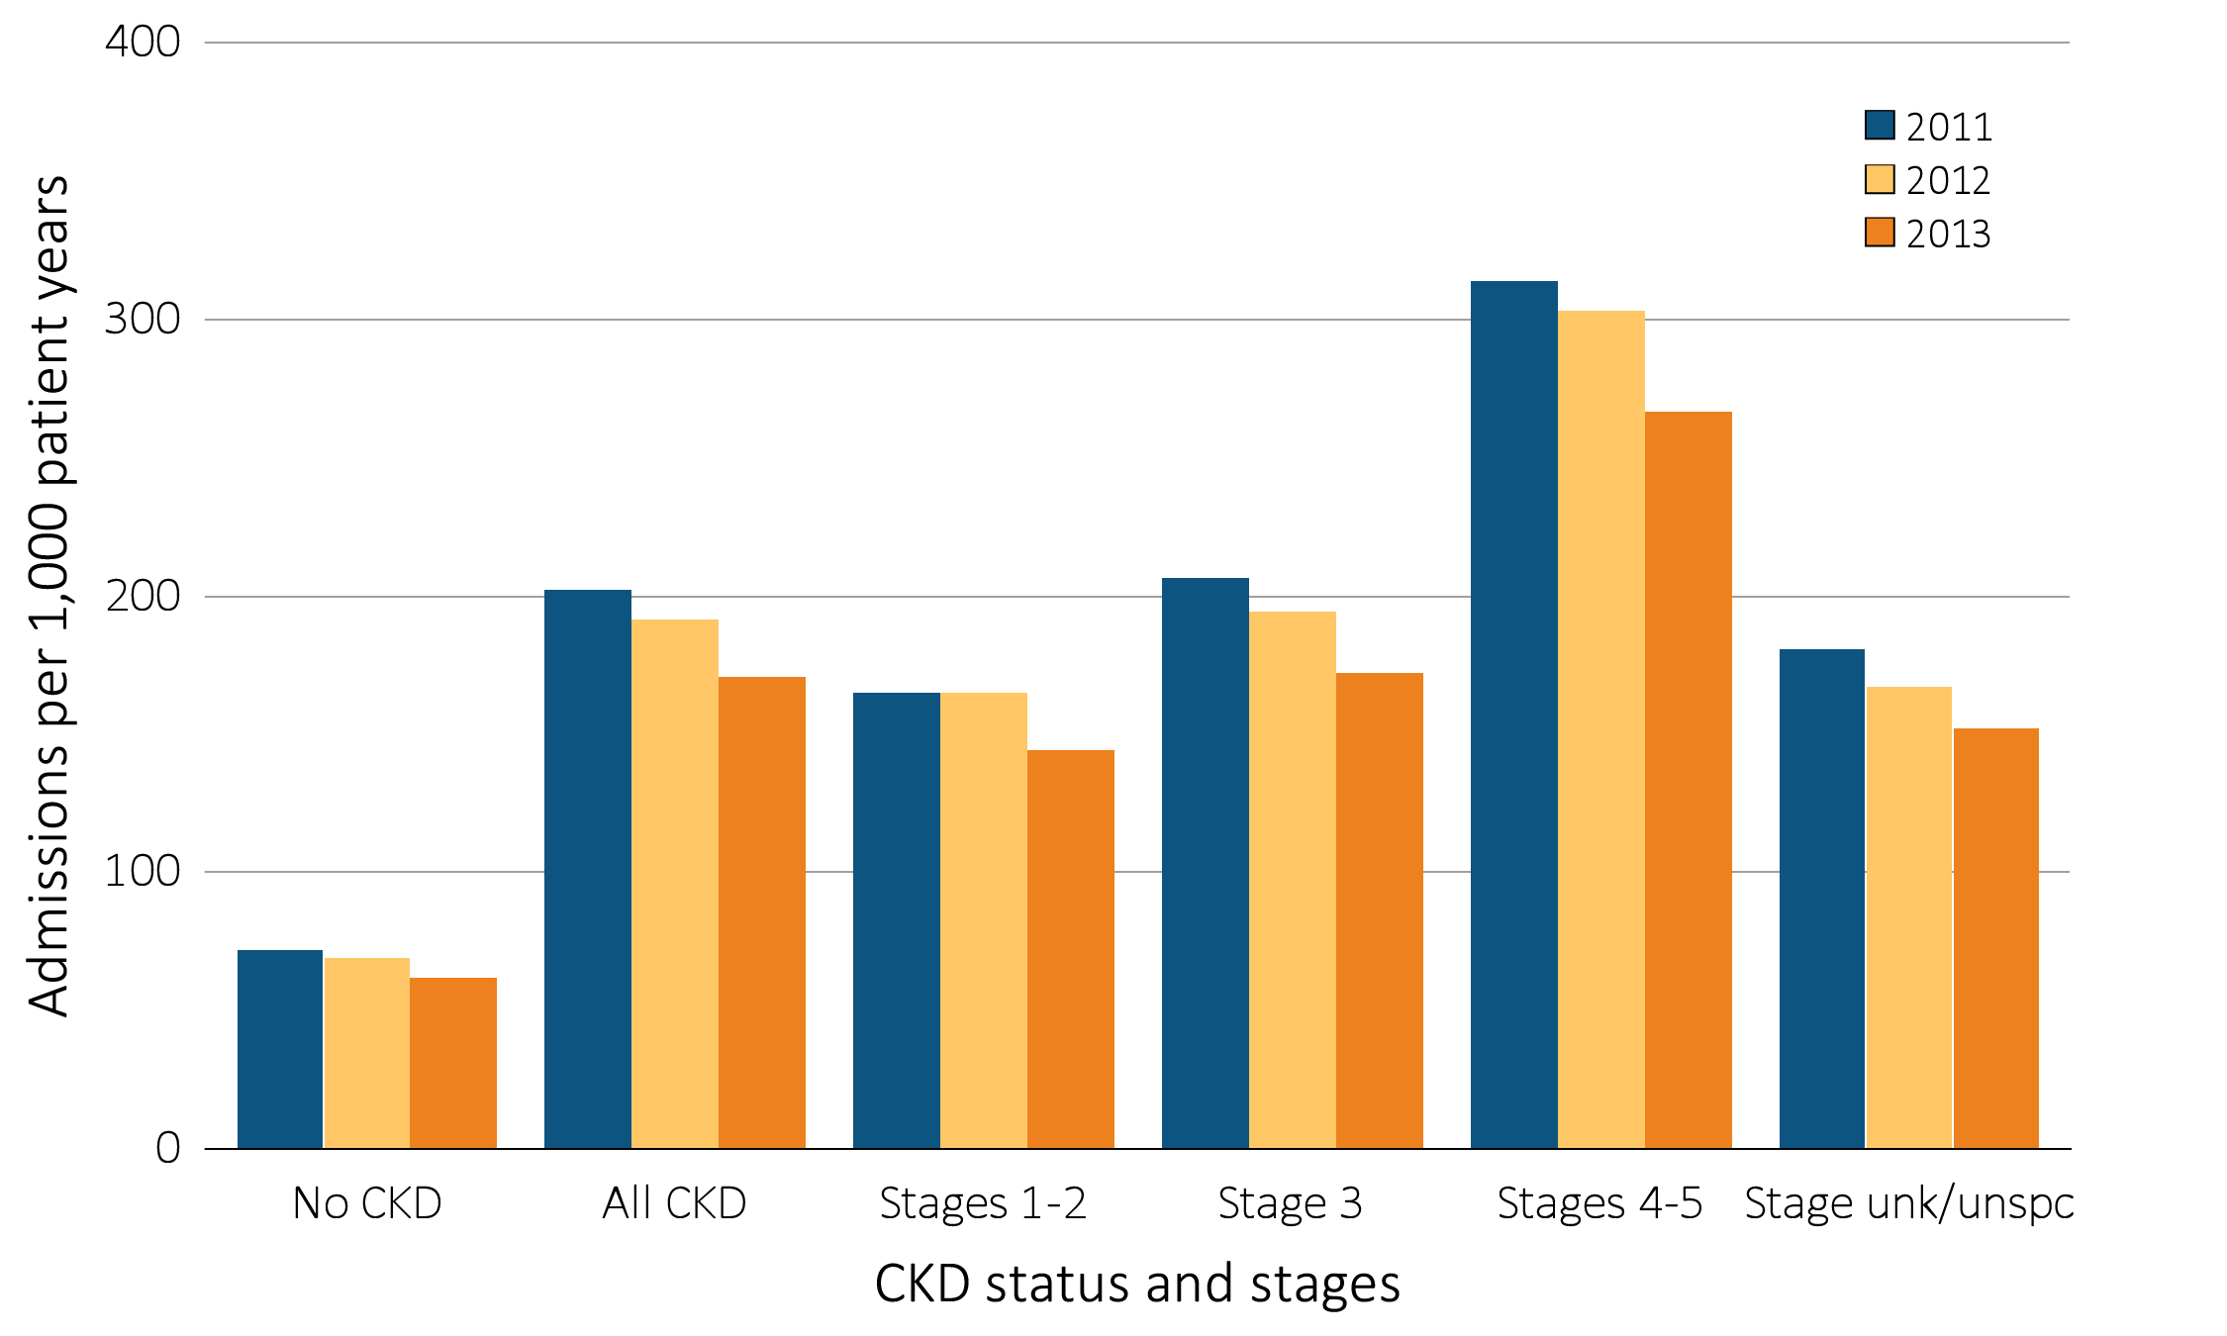
Figure 3.8 Adjusted all-cause hospitalization rates (per 1,000 patient years at risk) for Medicare patients aged 66 and older, by CKD status and stage, 2011-2013
Data source: Medicare 5 percent sample. January 1 of each reported year, point prevalent Medicare patients aged 66 and older. Adj: age/sex/race. Ref: all patients, 2013. See Table A for CKD stage definitions. Abbreviations: CKD, chronic kidney disease; unk/unspc, CKD stage unidentified.

Slide 12
Figure 3.9 Adjusted rates of hospitalization for cardiovascular disease (per 1,000 patient years at risk) for Medicare patients aged 66 and older, by CKD status and stage, 2011-2013
Data source: Medicare 5 percent sample. January 1 of each reported year, point prevalent Medicare patients aged 66 and older. Adj: age/sex/race; rates by one factor are adjusted for the others. Ref: all patients, 2013. See Table A for CKD stage definitions. Abbreviations: CKD, chronic kidney disease; unk/unspc, CKD stage unidentified.

Slide 13
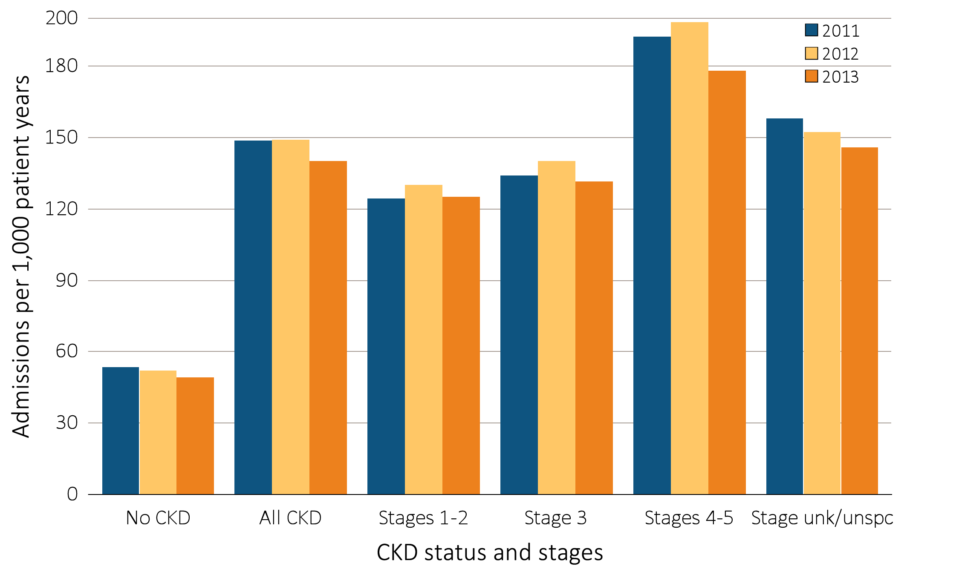
Figure 3.10 Adjusted rates of hospitalization for infection (per 1,000 patient years at risk) for Medicare patients aged 66 and older, by CKD status and stage, 2011-2013
Data source: Medicare 5 percent sample. January 1 of each reported year, point prevalent Medicare patients aged 66 and older. Adj: age/sex/race; rates by one factor are adjusted for the others. Ref: all patients, 2013. See Table A for CKD stage definitions. Abbreviations: CKD, chronic kidney disease; unk/unspc, CKD stage unidentified.

Slide 14
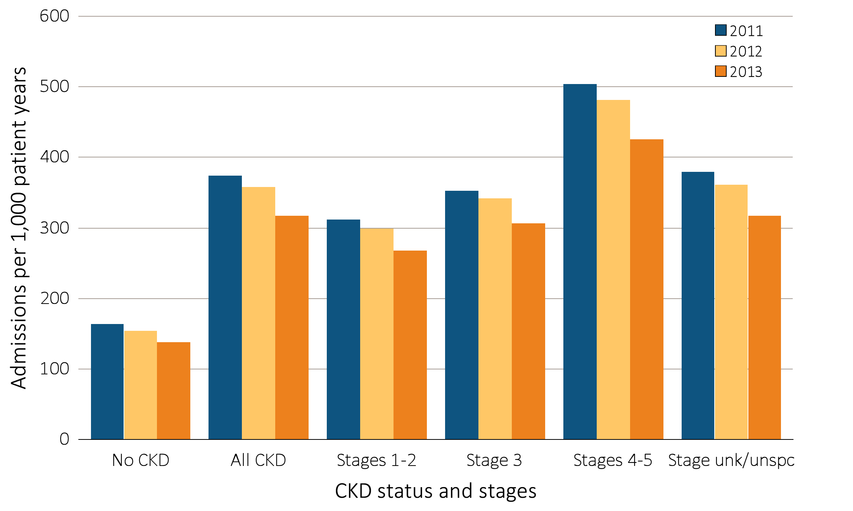
Figure 3.11 Adjusted rates of hospitalization for causes other than cardiovascular disease and infection (per 1,000 patient years at risk) for Medicare patients aged 66 and older,
by CKD status and stage, 2011-2013
Data source: Medicare 5 percent sample. January 1 of each reported year, point prevalent Medicare patients aged 66 and older. Adj: age/sex/race; rates by one factor are adjusted for the others. Ref: all patients, 2013. See Table A for CKD stage definitions. Abbreviations: CKD, chronic kidney disease; unk/unspc, CKD stage unidentified.

Slide 15
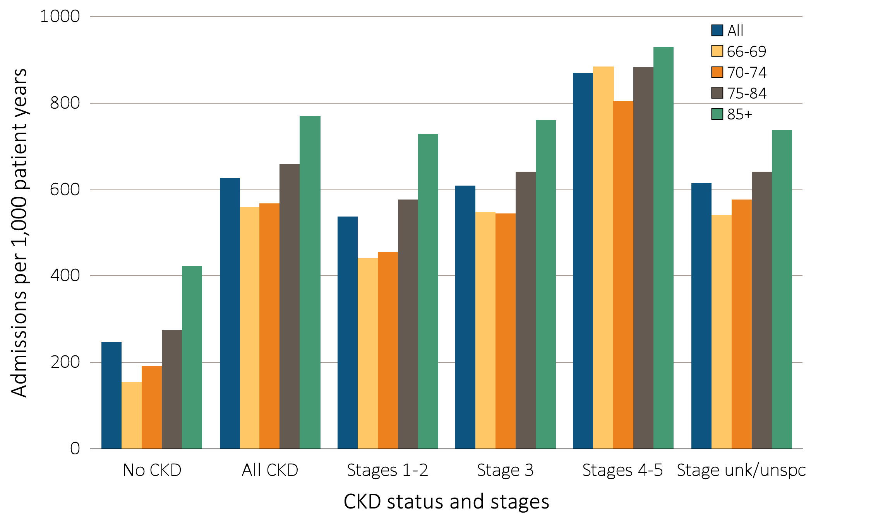
Figure 3.12 Adjusted all-cause hospitalization rates (per 1,000 patient years at risk) for Medicare patients aged 66 and older, by age, CKD status, and stage, 2013
Data source: Medicare 5 percent sample. January 1, 2013 point prevalent Medicare patients aged 66 and older. Adj: age/sex/race; rates by one factor are adjusted for the others. Ref: all patients, 2013. See Table A for CKD stage definitions. Abbreviations: CKD, chronic kidney disease; unk/unspc, CKD stage unidentified.

Slide 16
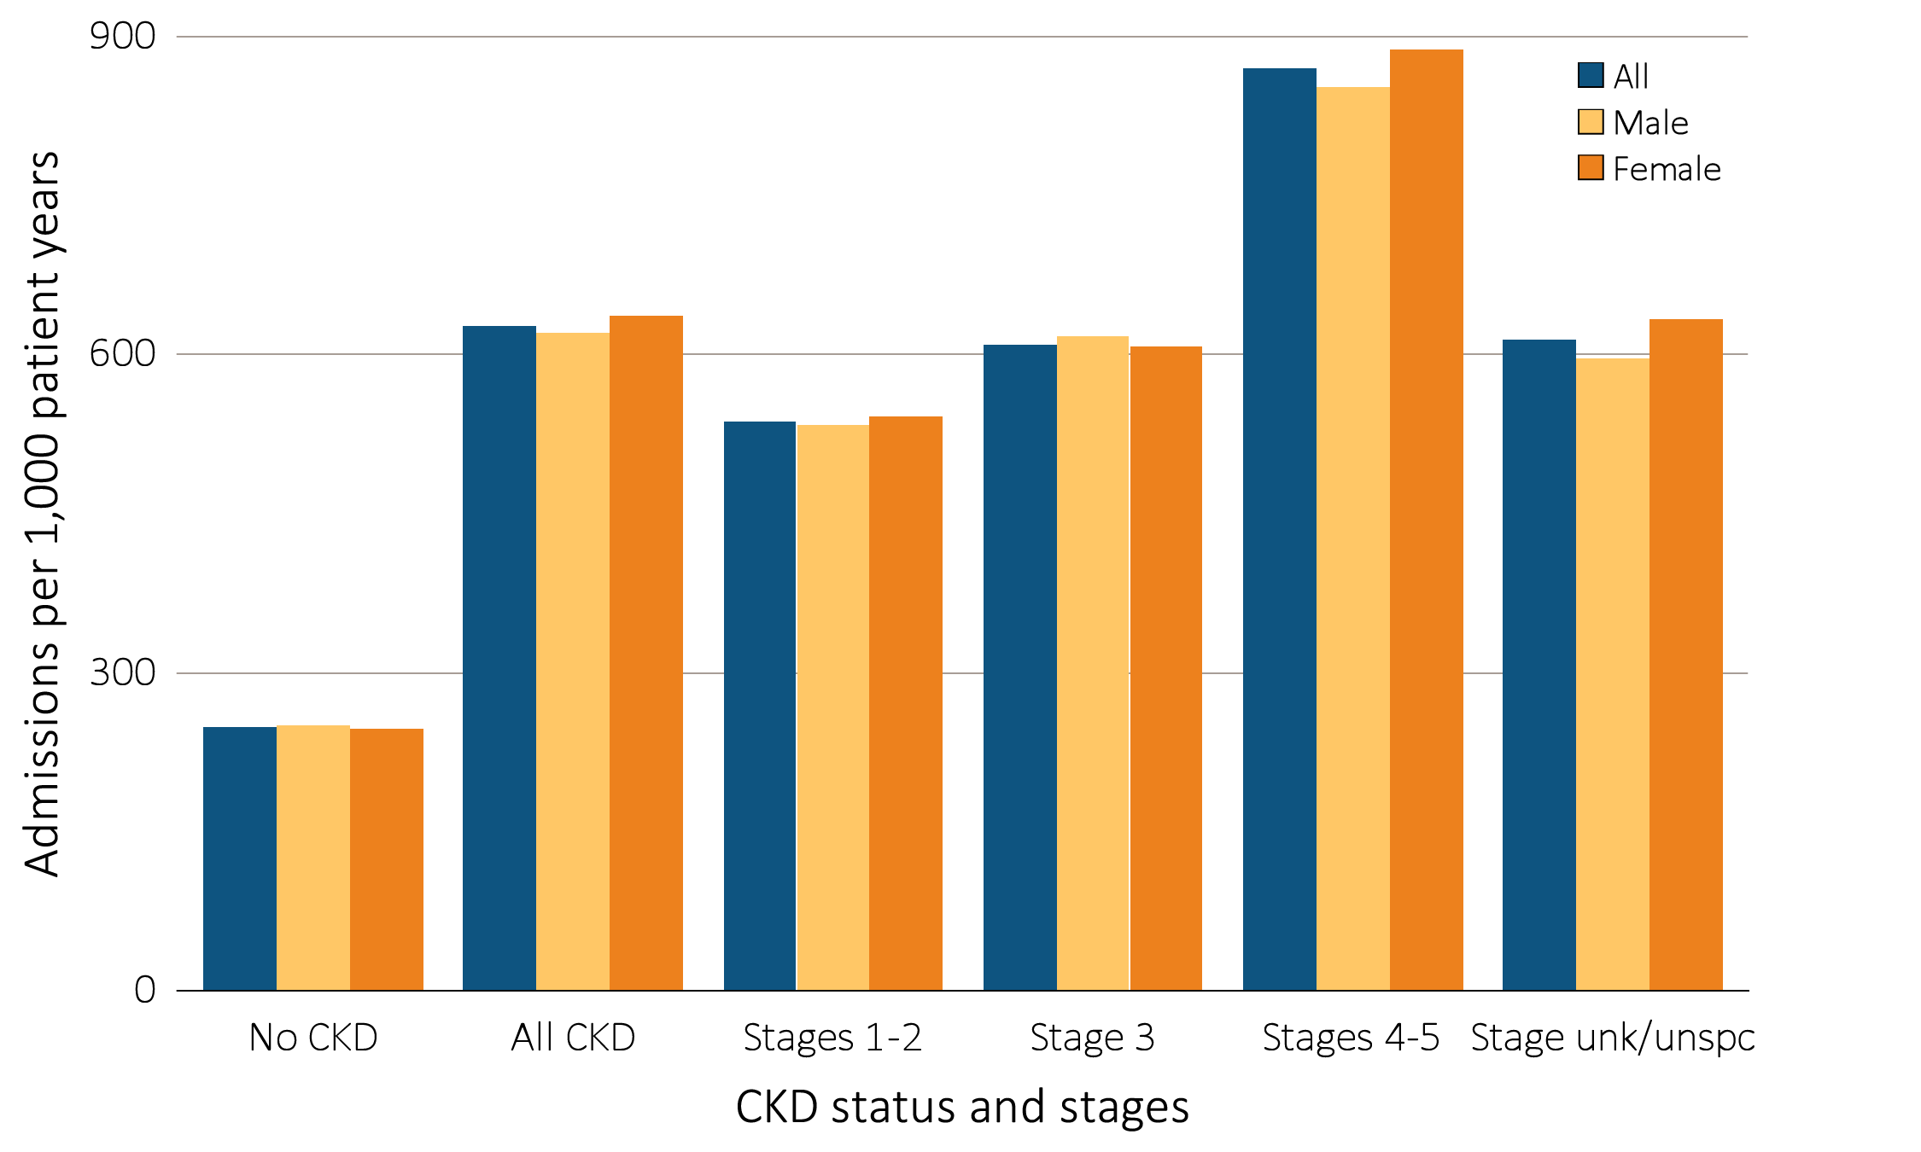
Figure 3.13 Adjusted all-cause hospitalization rates (per 1,000 patient years at risk) for Medicare patients aged 66 and older, by sex, CKD status, and stage, 2013
Data source: Medicare 5 percent sample. January 1, 2013 point prevalent Medicare patients aged 66 and older. Adj: age/sex/race; rates by one factor are adjusted for the others. Ref: all patients, 2013. See Table A for CKD stage definitions. Abbreviations: CKD, chronic kidney disease; unk/unspc, CKD stage unidentified.

Slide 17
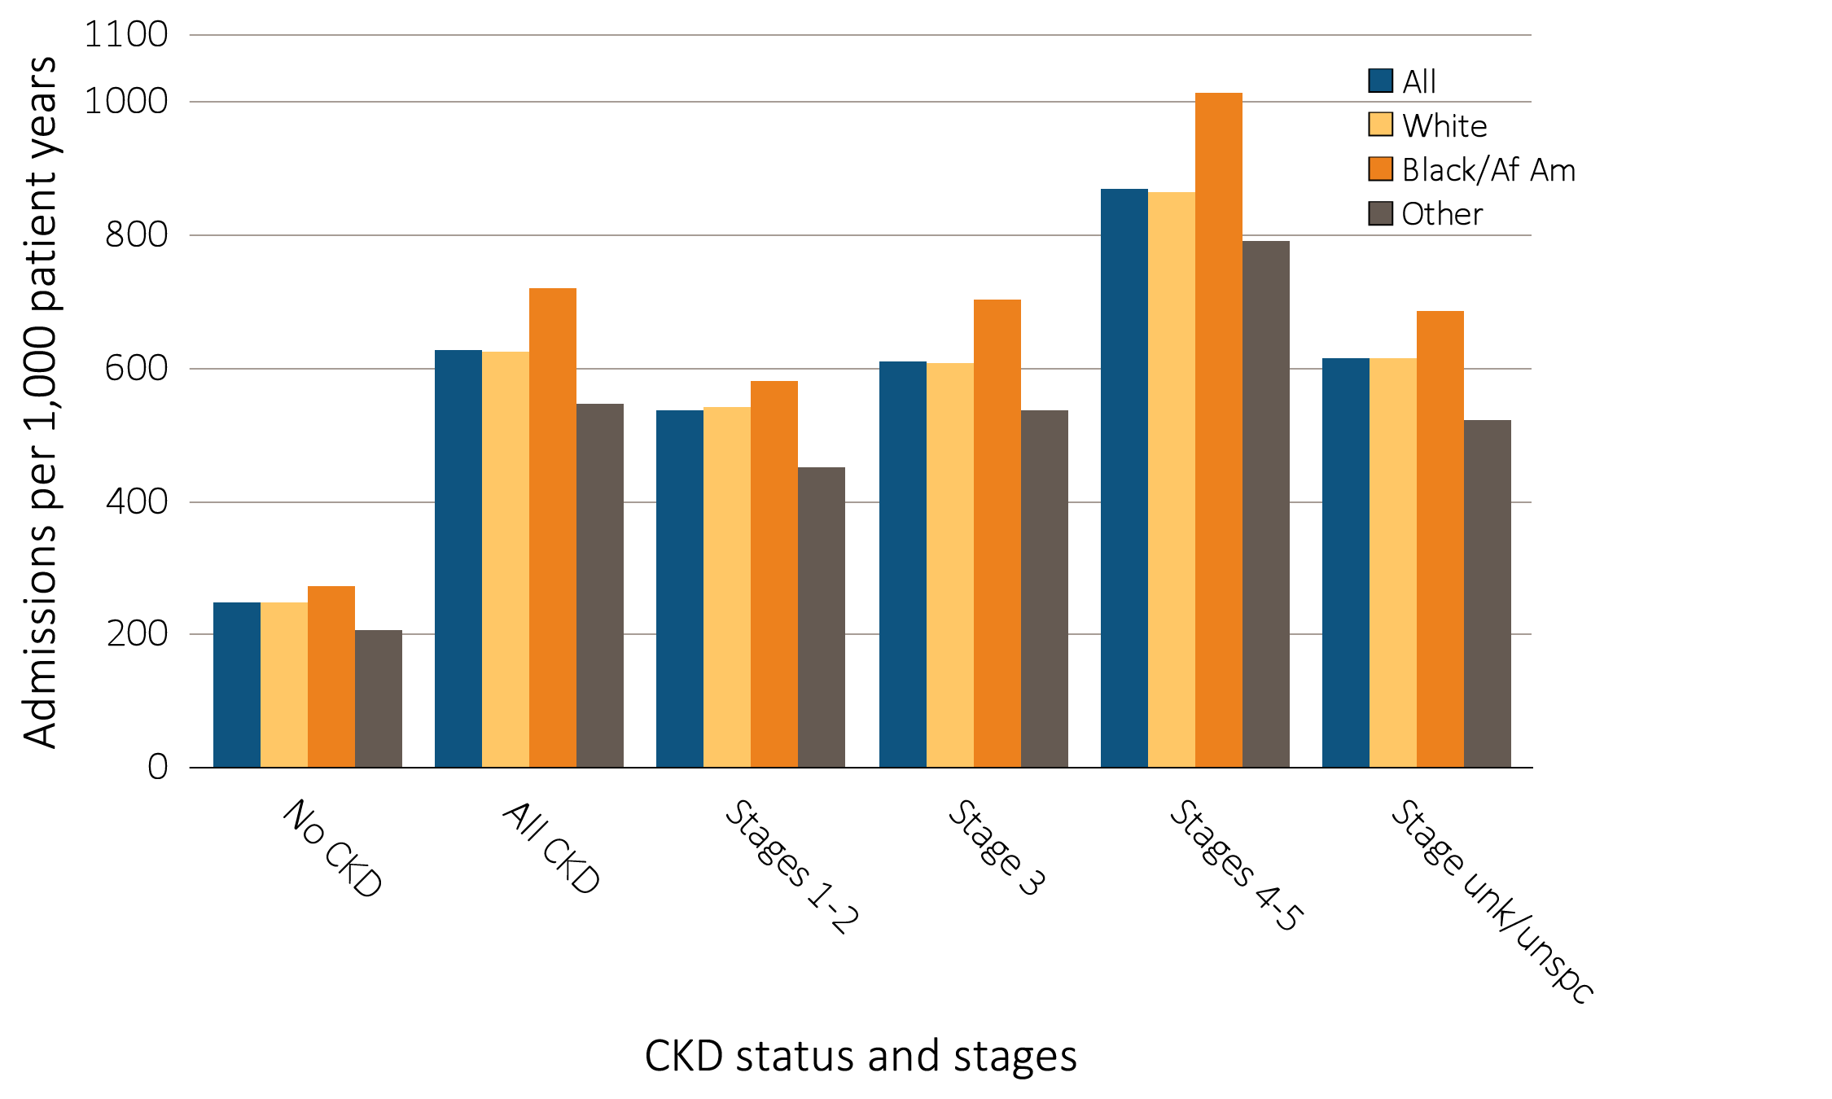
Figure 3.14 Adjusted all-cause hospitalization rates (per 1,000 patient years at risk) for Medicare patients aged 66 and older, by race, CKD status, and stage, 2013
Data source: Medicare 5 percent sample. January 1, 2013 point prevalent Medicare patients aged 66 and older. Adj: age/sex/race; rates by one factor are adjusted for the others. Ref: all patients, 2013. See Table A for CKD stage definitions. Abbreviations: Af Am, African American; CKD, chronic kidney disease; unk/unspc, CKD stage unidentified.

Slide 18
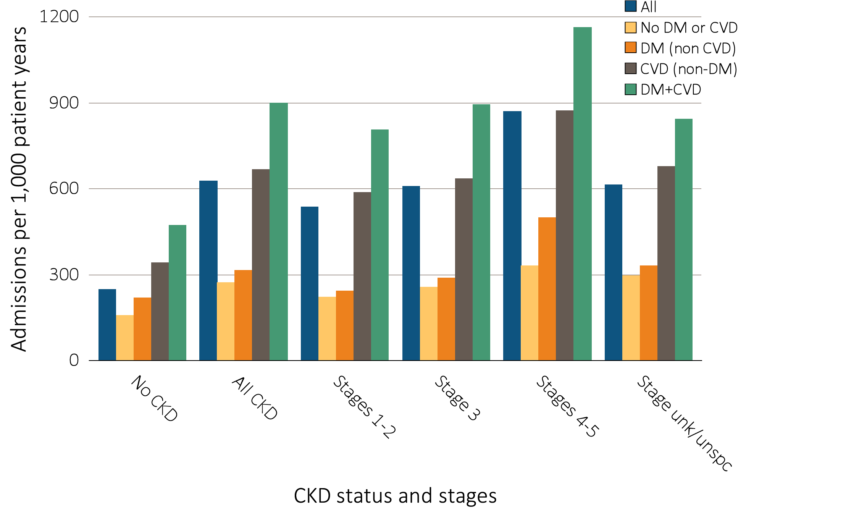
Figure 3.15 Adjusted all-cause hospitalization rates (per 1,000 patient years at risk) for Medicare patients aged 66 and older, by cardiovascular disease and diabetes mellitus,
^{CKD status, and stage, 2013}
Data source: Medicare 5 percent sample. January 1, 2013 point prevalent Medicare patients aged 66 and older. Adj: age/sex/race; rates by one factor are adjusted for the others. Ref: all patients, 2013. See Table A for CKD stage definitions. Abbreviations: CKD, chronic kidney disease; CVD, cardiovascular disease; DM, diabetes mellitus; unk/unspc, CKD stage unidentified.

Slide 19
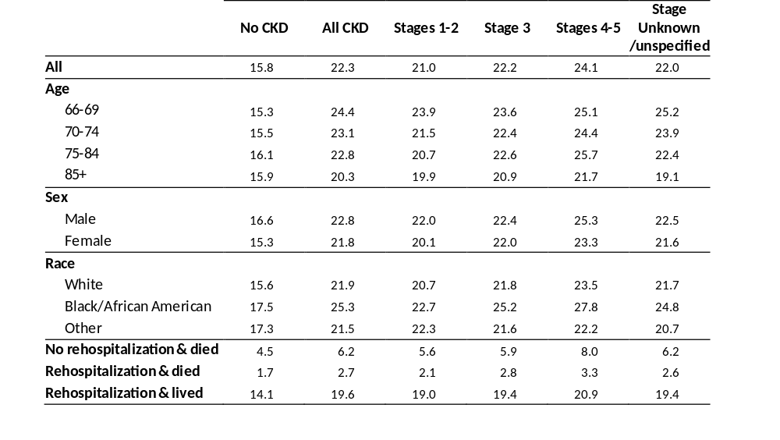
Table 3.3 Unadjusted percentage of patients readmitted to the hospital within 30 days of discharge, among Medicare patients aged 66 and older who were discharged alive from an all-cause index hospitalization between January 1 and December 1,
^{by CKD status and stage, 2013}
Data source: Medicare 5 percent sample. January 1, 2013 point prevalent Medicare patients aged 66 and older, discharged alive from an all-cause index hospitalization between January 1, 2013, and December 1, 2013; unadjusted. See Table A for CKD stage definitions. Abbreviations: CKD, chronic kidney disease.

Slide 20
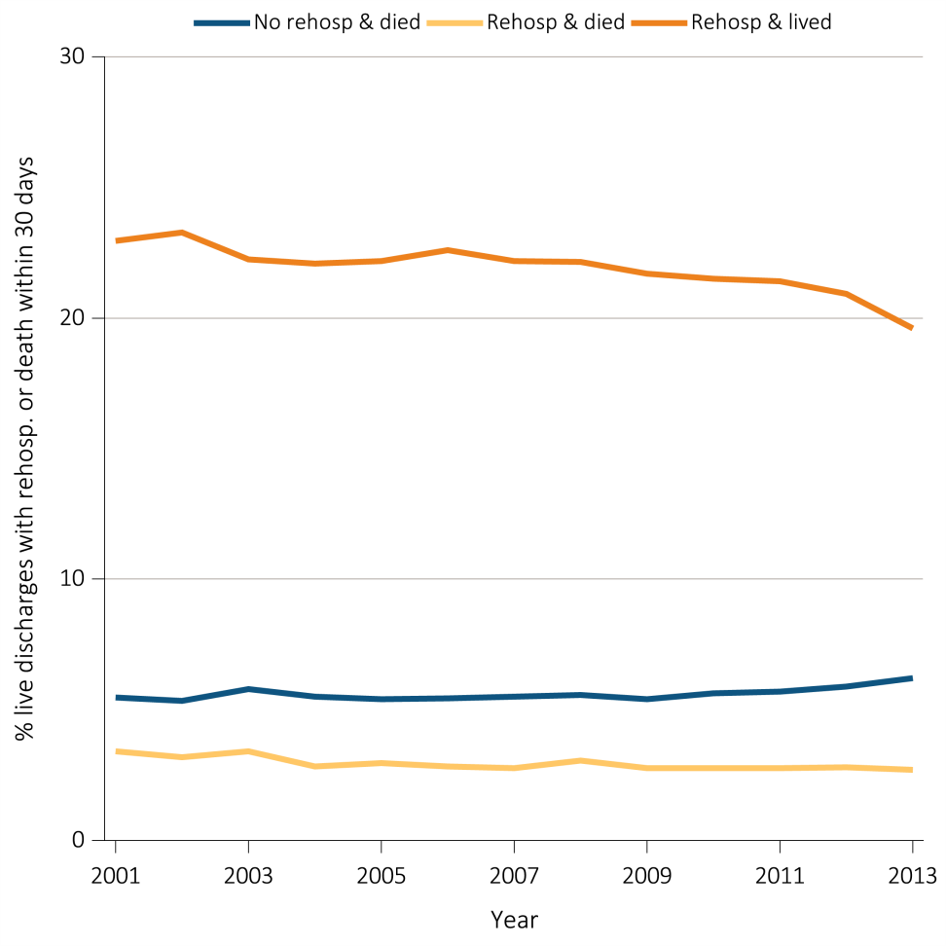
Figure 3.16. Adjusted percentage of patients readmitted to the hospital within 30 days of discharge, among Medicare CKD patients aged 66 and older who were discharged alive from an all-cause index hospitalization between January 1 and December 1,
^{by year, 2001-2013}
Data source: Medicare 5 percent sample. January 1 of each reported year, point prevalent Medicare patients aged 66 and older with CKD (defined during the prior year), discharged alive from an all-cause index hospitalization between January 1 and December 1 of the reported year. Adj: age/sex/race. Ref: 2013. Abbreviations: CKD, chronic kidney disease; Rehosp, rehospitalized.

Slide 21
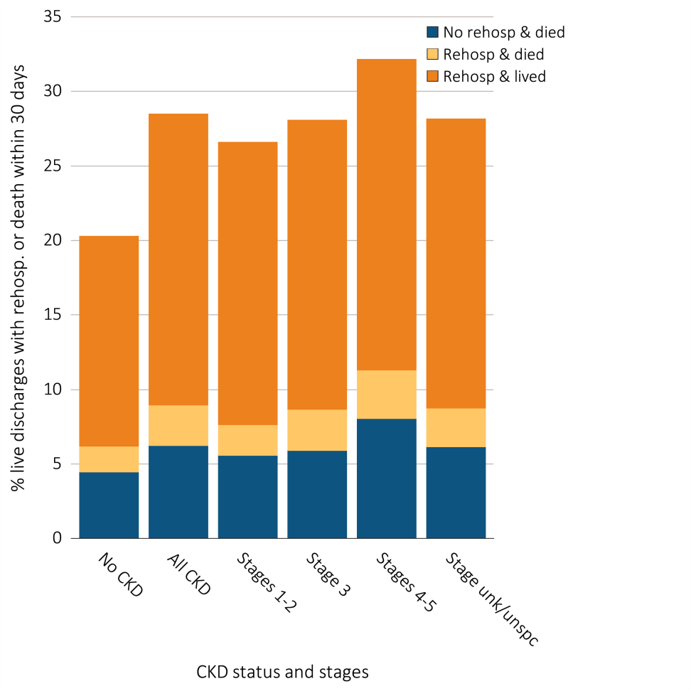
Figure 3.17 Unadjusted percentage of patients readmitted to the hospital within 30 days of discharge, among Medicare patients aged 66 and older who were discharged alive from an all-cause index hospitalization between January 1 and December 1,
^{by CKD status and stage, 2013}
Data source: Medicare 5 percent sample. January 1, 2013 point prevalent Medicare patients aged 66 and older, discharged alive from an all-cause index hospitalization between January 1, 2013, and December 1, 2013, unadjusted. Abbreviations: CKD, chronic kidney disease; Rehosp, rehospitalized; unk/unspc, CKD stage unidentified.

Slide 22
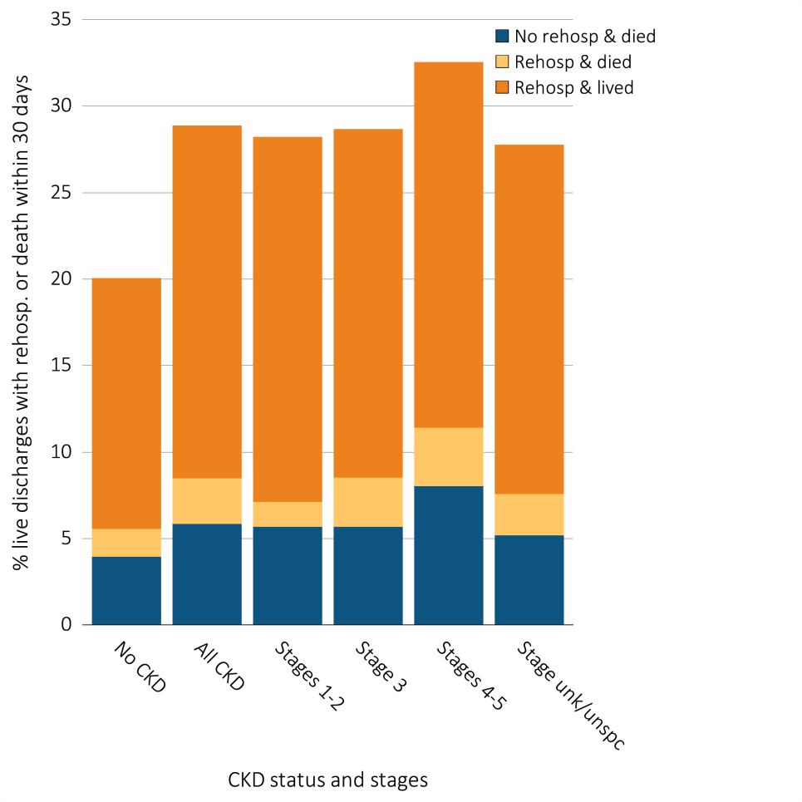
Figure 3.18 Unadjusted percentage of patients readmitted to the hospital within 30 days of discharge, among Medicare patients aged 66 and older who were discharged alive from a cardiovascular-related index hospitalization between January 1 and December 1,
^{by CKD status and stage, 2013}
Data source: Medicare 5 percent sample. January 1, 2013 point prevalent Medicare patients aged 66 and older, discharged alive from an all-cause index hospitalization between January 1, 2013, and December 1, 2013; unadjusted. Abbreviations: CKD, chronic kidney disease; Rehosp, rehospitalized; unk/unspc, CKD stage unidentified.

Slide 23
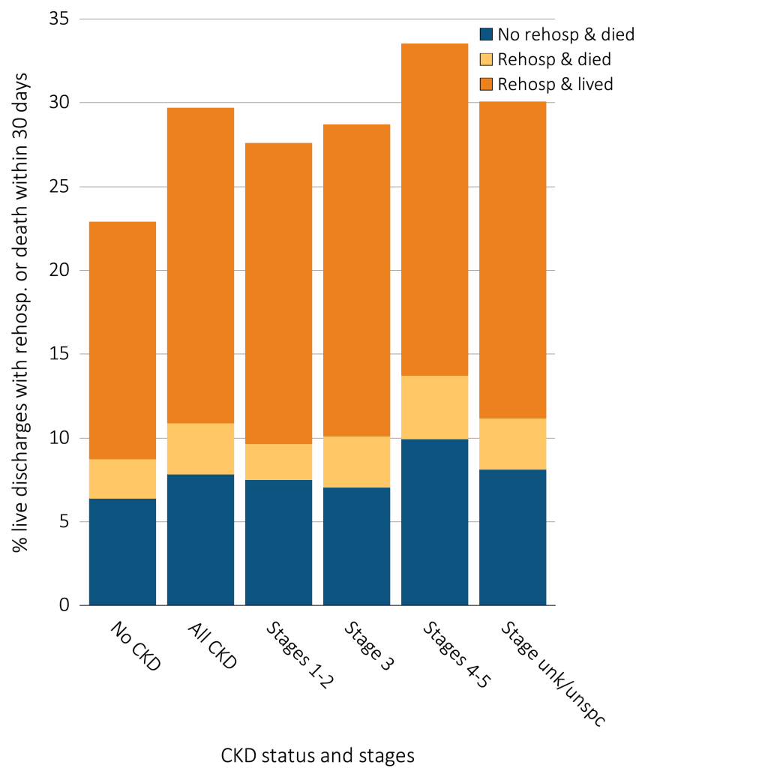
Figure 3.19 Unadjusted percentage of patients readmitted to the hospital within 30 days of discharge, among Medicare patients aged 66 and older who were discharged alive from an infection-related index hospitalization between January 1 and December 1,
^{by CKD status and stage, 2013}
Data source: Medicare 5 percent sample. January 1, 2013 point prevalent Medicare patients aged 66 and older, discharged alive from an all-cause index hospitalization between January 1, 2013, and December 1, 2013, unadjusted. Abbreviations: CKD, chronic kidney disease; Rehosp, rehospitalized; unk/unspc, CKD stage unidentified.

Slide 24
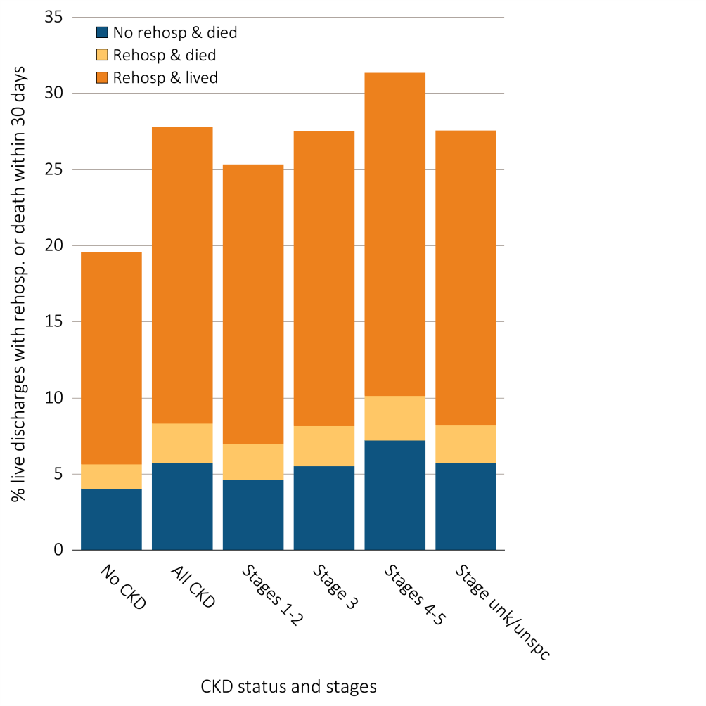
Figure 3.20 Unadjusted percentage of patients readmitted to the hospital within 30 days of discharge, among Medicare patients aged 66 and older who were discharged alive from
a non-cardiovascular and non-infection related index hospitalization
between January 1 and December 1, by CKD status and stage, 2013
Data Source: Medicare 5 percent sample. January 1, 2013 point prevalent Medicare patients aged 66 and older, discharged alive from an all-cause index hospitalization between January 1, 2013, and December 1, 2013; unadjusted. Abbreviations: CKD, chronic kidney disease; Rehosp, rehospitalized; unk/unspc, CKD stage unidentified.

Slide 25
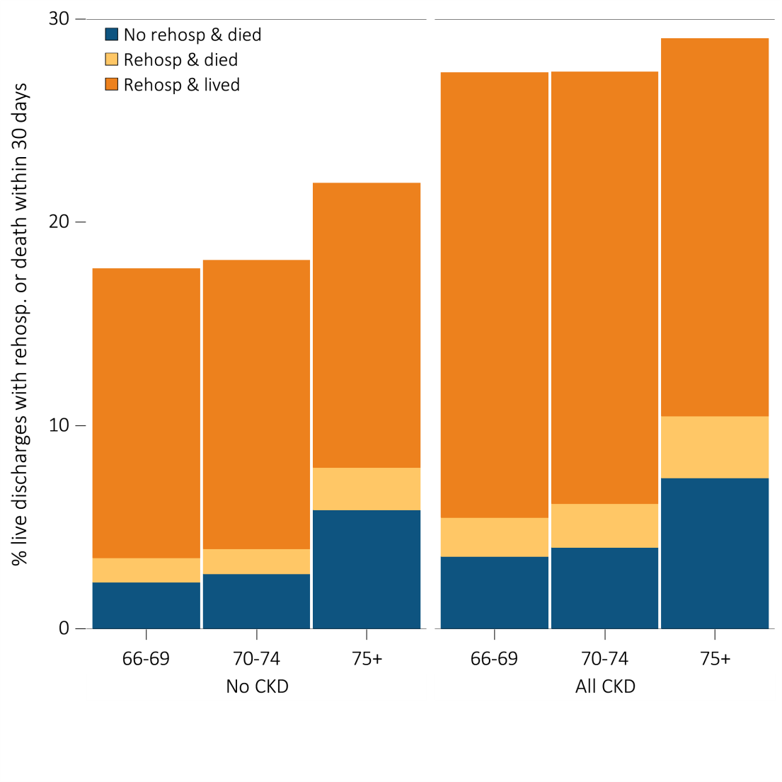
Figure 3.21 Unadjusted percentage of patients readmitted to the hospital within 30 days of discharge, among Medicare patients aged 66 and older who were discharged alive from an all-cause index hospitalization between January 1 and December 1,
^{by age and CKD status, 2013}
Data source: Medicare 5 percent sample. January 1, 2013 point prevalent Medicare patients aged 66 and older, discharged alive from an all-cause index hospitalization between January 1, 2013, and December 1, 2013; unadjusted. Abbreviations: CKD, chronic kidney disease; Rehosp, rehospitalized.

Slide 26
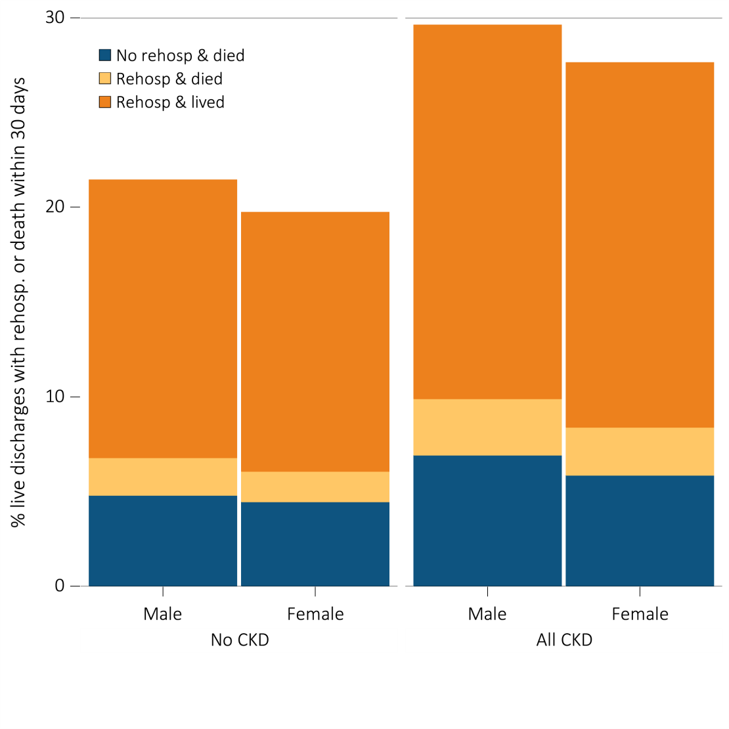
Figure 3.22 Unadjusted percentage of patients readmitted to the hospital within 30 days of discharge, among Medicare patients aged 66 and older who were discharged alive from an all-cause index hospitalization between January 1 and December 1,
^{by sex and CKD status, 2013}
Data source: Medicare 5 percent sample. January 1, 2013 point prevalent Medicare patients aged 66 and older, discharged alive from an all-cause index hospitalization between January 1, 2013, and December 1, 2013; unadjusted. Abbreviations: CKD, chronic kidney disease; Rehosp, rehospitalized.

Slide 27
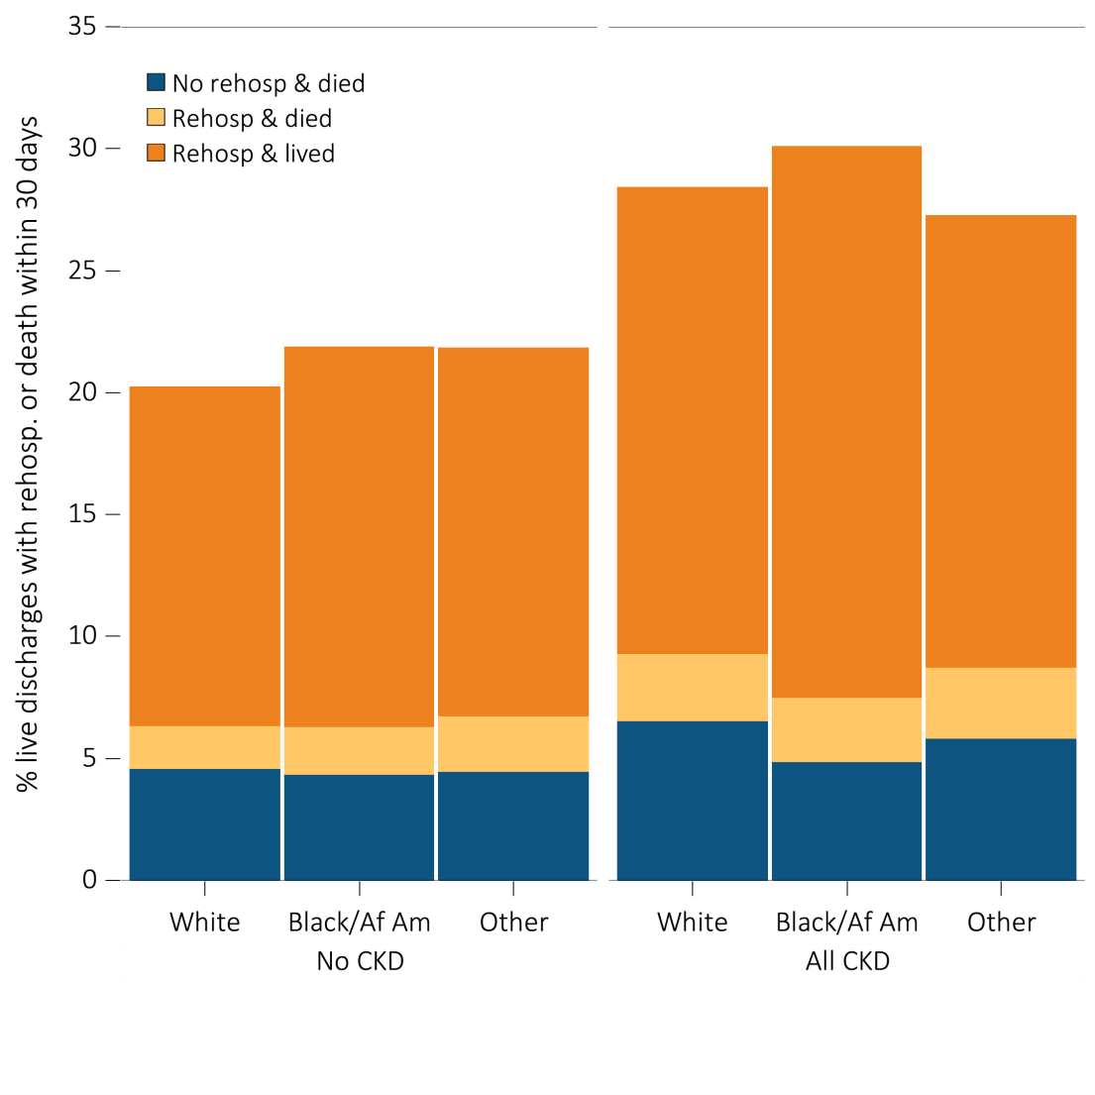
Figure 3.23 Unadjusted percentage of patients readmitted to the hospital within 30 days of discharge, among Medicare patients aged 66 and older who were discharged alive from an all-cause index hospitalization between January 1 and December 1,
^{by race and CKD status, 2013}
Data Source: Medicare 5 percent sample. January 1, 2013 point prevalent Medicare patients aged 66 and older, discharged alive from an all-cause index hospitalization between January 1, 2013, and December 1, 2013; unadjusted. Abbreviations: Af Am, African American; CKD, chronic kidney disease; Rehosp, rehospitalized.

