Slide 1
CSR Advisory Council Update
September 2018
Noni Byrnes, Ph.D.
Acting Director
Center for Scientific Review

Slide 2
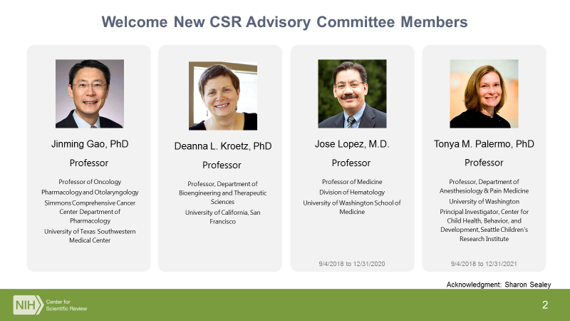

Slide 3

CSR News
Notes:
.

Slide 4
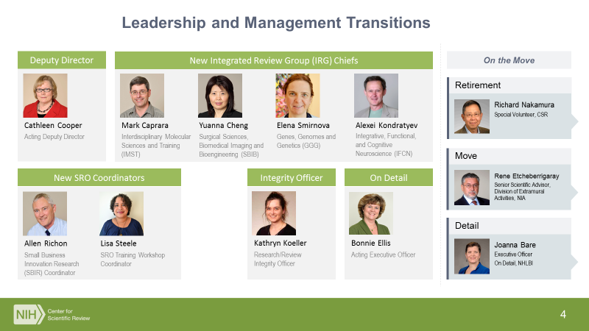

Slide 5
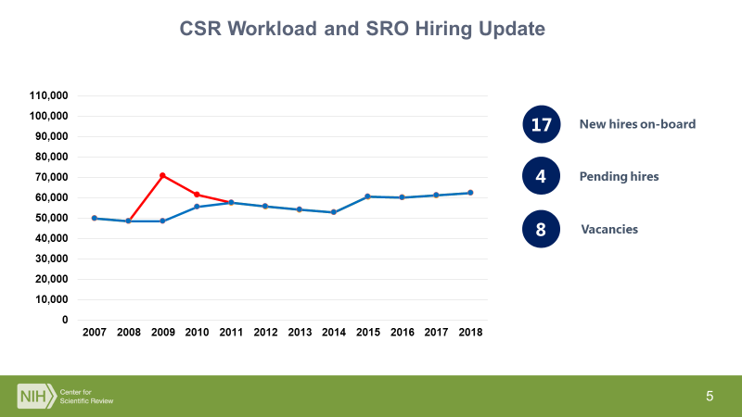

Slide 6

Summer 2018: Incoming Study Section Chair Orientations
Included:
Role of the chair
Fostering a culture of review integrity
Upcoming NIH policies affecting review
Getting at significance/impact in scoring
Facilitated breakout sessions

Slide 7


Slide 8
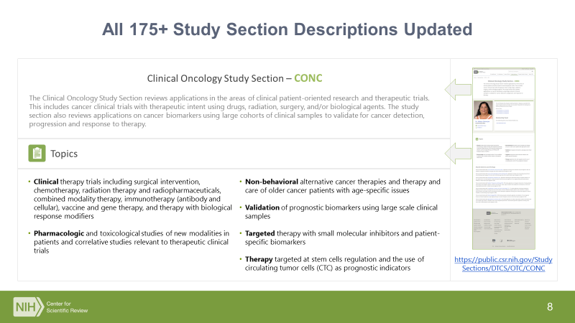

Slide 9
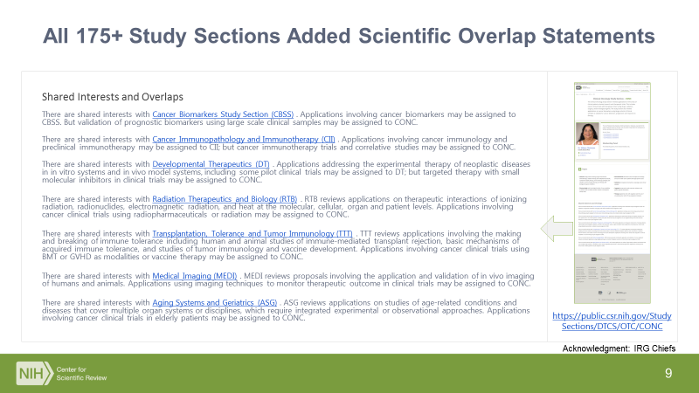

Slide 10

Budget Update

Slide 11
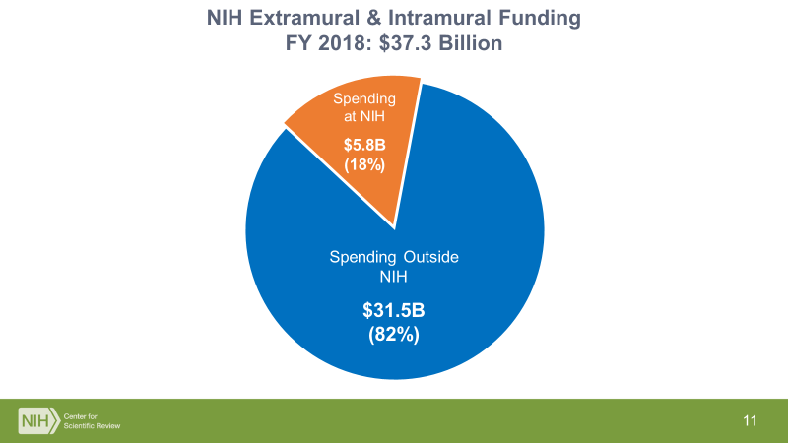

Slide 12
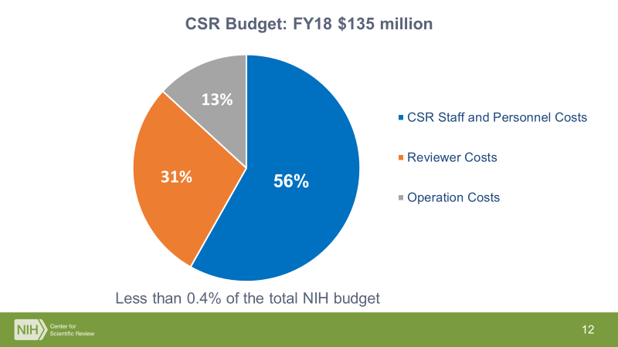

Slide 13
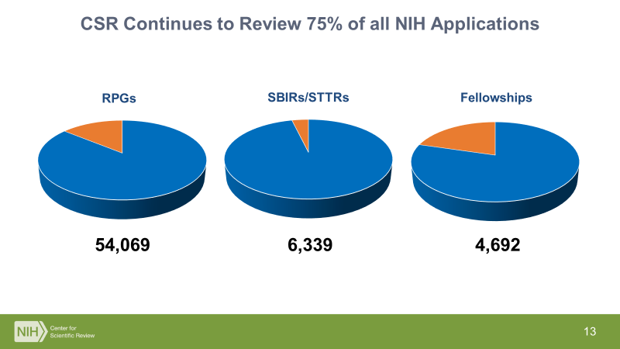
v

Slide 14
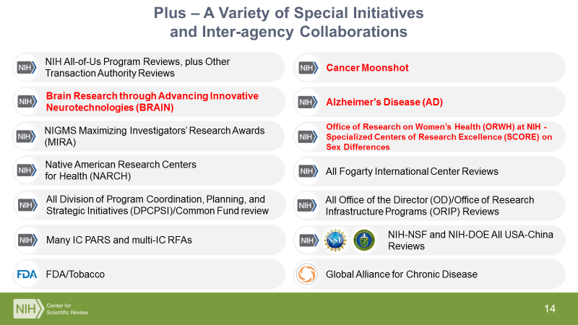

Slide 15
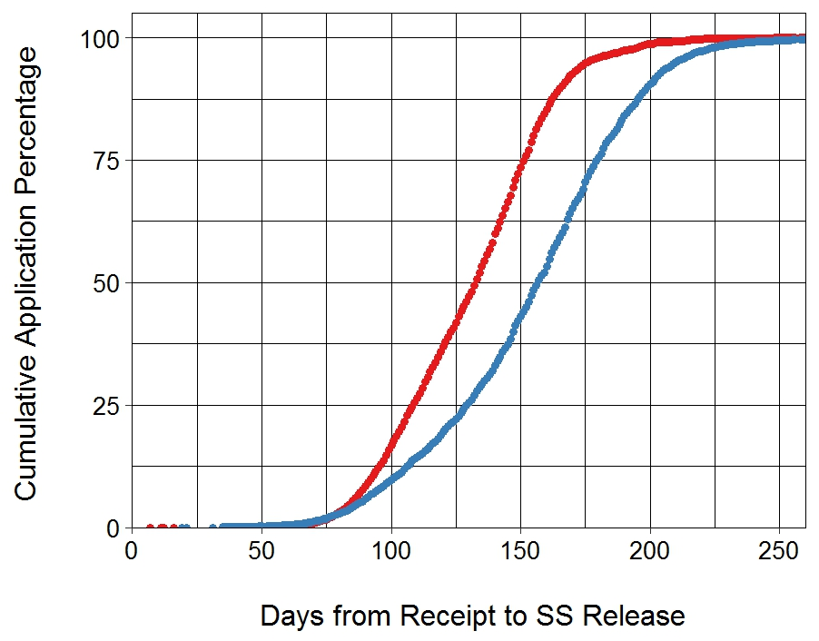
CSR Continues to Lead in Efficiency/Timeliness
CSR 120,872
ICs 35,749

Slide 16

CSR Evaluations Update

Slide 17
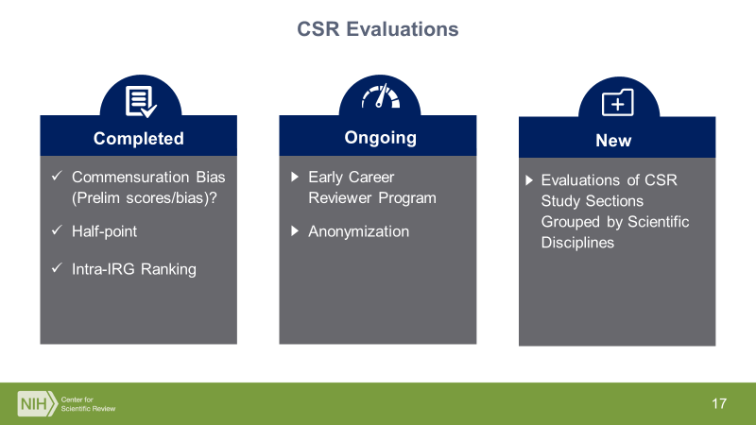

Slide 18
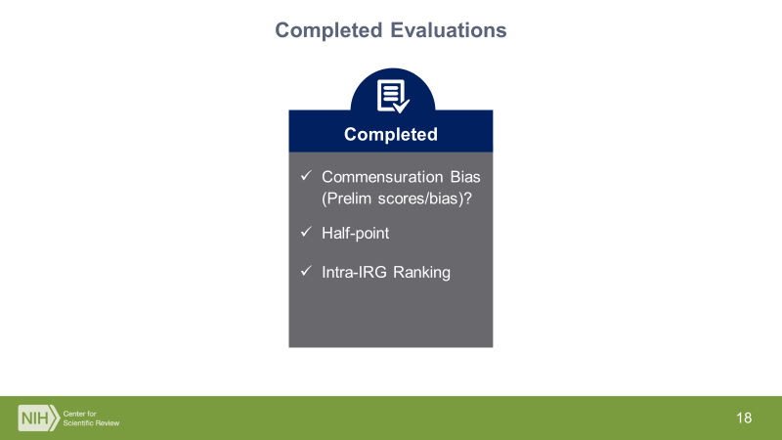

Slide 19
Update on Completed Studies
Commensuration Bias Study: Do reviewers use criteria scores to derive overall impact scores differently for black versus white applicants?
  Outcome: Small but statistically significant commensuration bias, but these effects are very small and do not account for the much larger disparities in overall impact scores between applications from white and black applicants. Publication in preparation
Half Point Pilot: Will allowing reviewers to use 0.5 increments for scoring (e.g. 1.5, 2.0, 2.5) improve score compression?
  Outcome: Half-point option did not significantly improve score compression for most study sections or significantly alter rank order of applications under evaluation. CSR will not implement.
Intra-IRG Ranking Study: Will reviewer rankings of the top 20% of applications across study sections within an IRG (CSR management cluster) reveal differences in the quality of science among the study sections?
  Outcome: No large differences in quality evident among study sections. Rankings were also related to the reviewers’ familiarity with the science of each application and adjusting for reviewer familiarity further reduced the size of the differences in rankings between SRGs. CSR will critically evaluate study design.

Slide 20
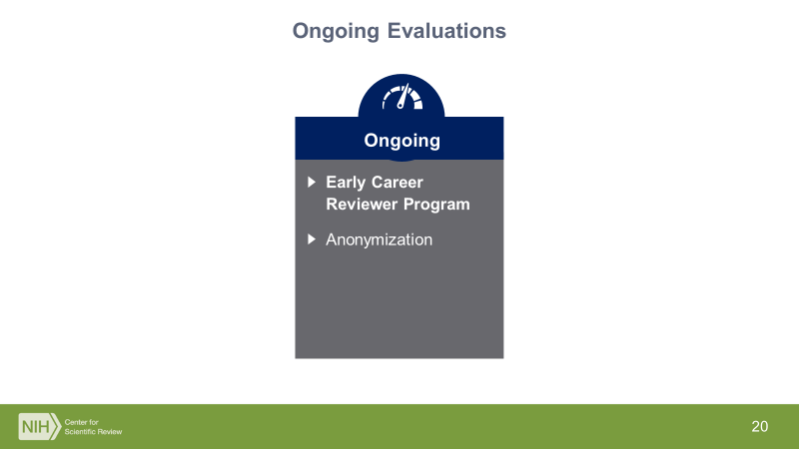

Slide 21
CSR Early Career Reviewer (ECR) Program
Established in late 2011 – first ECRs served in the Oct 2011 meetings.
Main goals: Expose scientists to the peer review experience to help make them more competitive as applicants and enrich the pool of NIH reviewers
3111 individuals have received ECR training and have served on study sections
19% of ECRs who have served on study sections are from under-represented racial/ethnic groups, 47% are women
143 former ECRs are now members of standing study sections

Slide 22
CSR Early Career Reviewer (ECR) Program
Planned Analyses
Demographic analysis: gender, race, ethnicity, geographic distribution, institution type for both database and ECRs used in review
Analysis of success rates for R01s submitted by ECRs compared to early career researchers matched for relevant demographic and career characteristics
Survey ECRs re: their experience to identify areas of improvement for program

Slide 23
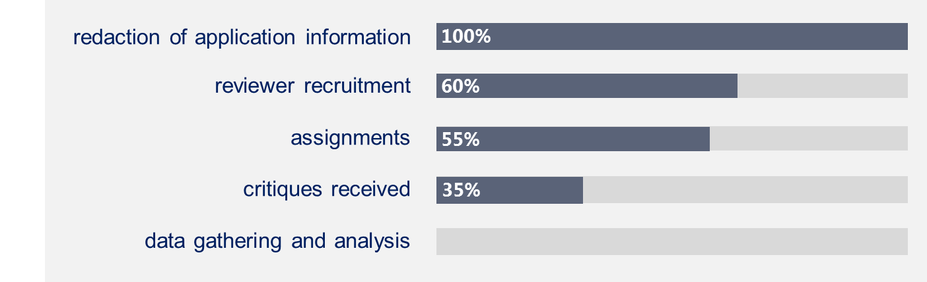
CSR Anonymization Study Update
Examines various potential sources of bias – race, gender, career-stage and institutional
1200 previously-reviewed applications in both full and redacted forms
Being conducted by contractor, SSI, which is handling:
Experimental approach, results and data will be peer-reviewed and shared – anticipated date of completion (Summer/Fall 2019)
Acknowledgment: Lee Mann & Richard Nakamura

Slide 24
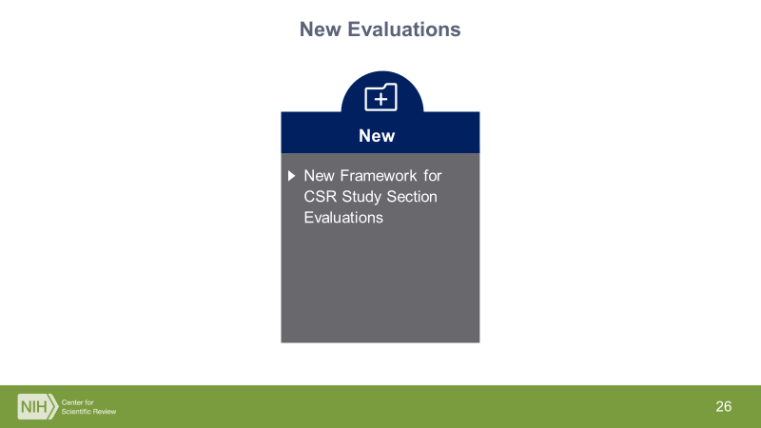

Slide 25
Background of CSR’s Evolving Study Section Evaluations
1998-2003: Panel on Scientific Boundaries of Review (PSBR) mandated recurring evaluations of study sections: “As recommended by the PSBR Report and the CSR Advisory Committee, CSR will examine the functioning of the new IRGs and study sections…...”
2003-2015
By Integrated Review Group (IRG), internal review only
By IRG, teleconference input from Chairs, email input from selected reviewers, white paper by IRG Chief, internal review
By IRG, outside scientific working group (WG), provided bibliometric and scientific overlap data, met with SROs, asked questions about quality, process
Output:
By IRG – WG commented on operations in IRG, rosters, balance between regular/adhoc members, diversity, etc.
Discussed several issues – use of surveys, exit interviews, ranking, H-indices, bibliometrics, should Chairs be used to recruit new members, % ND, private discussion with SROs without management to assess IRG function, NIH A2 policy….
Only scientific changes recommended were endorsement of proposals made by the IRG Chief during his/her presentation of the science

Slide 26
CSR SRG Reviews, 2015 - current
Review by scientific clusters, not IRGs (12-20 SRGs)
Assemble blue-ribbon Working Group (WG) of scientifically broad, senior scientists (with interest in more than one SRG)
Provide enough information (current scientific guidelines for all study sections, titles, abstracts, specific aims, workload trends)
Provide enough time and guidance for meaningful evaluation and recommendation by WG
Ask 1 question designed to focus discussion on science, not process

Slide 27
How well does the scientific scope of the study sections align with the current state of the science?
Recommend modifications if:
A study section is currently over- or under-subscribed
The scope of the science reviewed by a study section is not adequately representative of the scope of the field and emerging fields

Slide 28
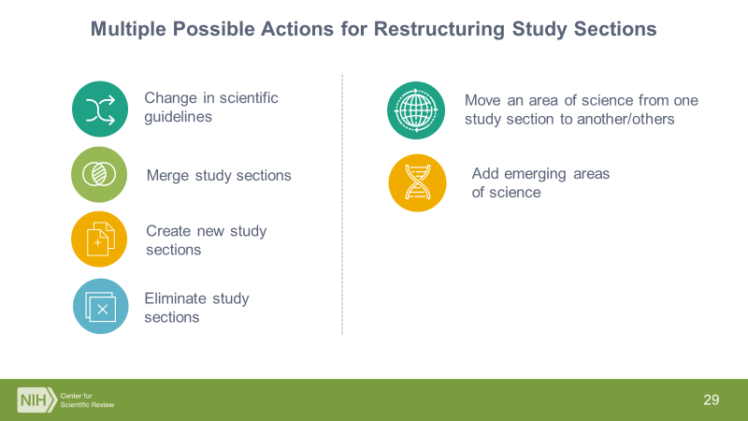

Slide 29
CSR SRG Reviews Thus Far
Bioengineering (Pilot, 2015)
Basic Cancer Biology (2016)
Imaging Technologies (2017)
HIV/AIDS (2017)
Vision Sciences (2018) – tomorrow!

Slide 30
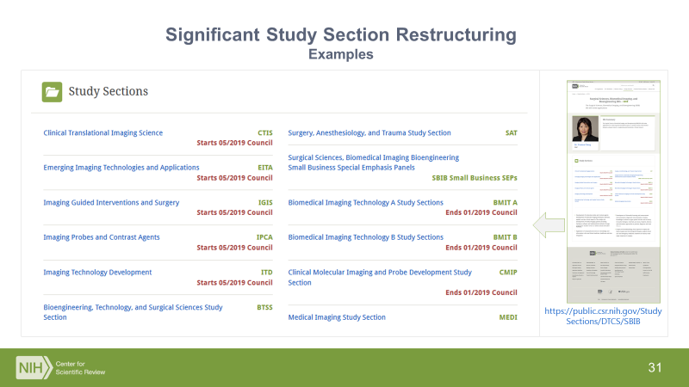

Slide 31
Better Scientific Alignment, Accommodation for Emerging Fields
Examples
Redistribute basic biomaterials/biomimetics/fluidics in neural systems from BMBI (Biomaterials and Biointerfaces) to BNVT (Bioengineering of Neuroscience, Vision and Low Vision Technologies) – CSRAC approved/implemented 2016
Move emerging area of microphysiological systems from BMBI to form new study section called CMT (Cellular & Molecular Technologies) - CSRAC approved 2016/implemented 2017
Expand scope of BCHI (Biomedical Computing and Health Informatics) to include extraction of data from EHR, clinical decision support systems, telemedicine, large image databases, image informatics to guide decision-making – CSRAC approved/implemented 2016

Slide 32
New Framework/Process for Study Section Evaluation
December 2017 – June 2018: Trans-NIH Working Group on Peer Review developed a robust study section evaluation process.
The Working Group, co-led by CSR and IC representatives, carefully considered data/metrics, multiple inputs and measures to design a process that could be practically implemented by CSR.

Slide 33
New Framework/Process for Study Section Evaluation
Largely builds on CSR’s existing successful model of scientific SRG Reviews - external panel to evaluate science by examining workload trends, guidelines, random sample abstracts/specific aims, adds in publication/bibliometric data.
Adds in a process evaluation component - internal NIH panel to look at process issues e.g. IC distributions, scoring patterns, reviewer/PO surveys, discussions, rosters, ESI application/award rates, etc.

Slide 34
Key Aspects of Evaluation Process
Combines strength of expert opinion and objective metrics
Stakeholder engagement – external scientific community, Council and ICs
Continuous and systematic approach - Evaluate ~20% of the study sections each year (i.e. a study section is evaluated every 5 years).
Addresses both NIH Strategic Plan element “Optimize approaches to inform funding decisions” and CSR’s mandate to continuously examine the function

Slide 35
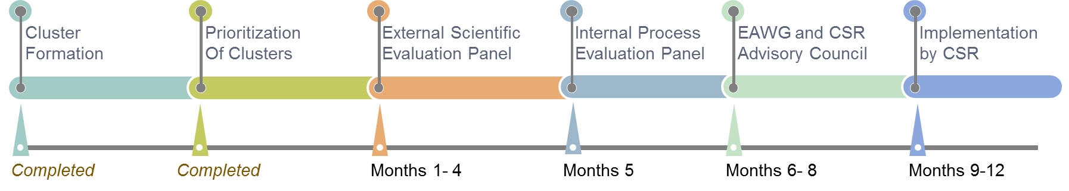
Timeline
Two clusters are planned for this fall to pilot test the process
External Scientific Evaluation Group Meeting: December 2018
Internal Process Evaluation Group Meeting: January 2019
Presentation to report back to the CSR AC: March 2019
Iterative Approach – Continuous refinement/modification of process based on experience and feedback

Slide 36

Peer Review Integrity

Slide 37

CSR’s Mission
To see that NIH grant applications receive fair, independent, expert, and timely reviews – free from inappropriate influences – so NIH can fund the most promising research.

Slide 38
Integrity of the Peer Review Process
Critically important for all of us
Maintaining the public trust in the NIH’s stewardship of taxpayer dollars to support U.S. biomedical science research
Confidentiality is critical for candor in discussion and evaluation, and thus impacts the very basis of the peer review process
Will take the support of the entire research community – investigators, reviewers, chairs, NIH staff, institutional officials
NIH is taking this issue very seriously– not widespread problem, but increased reporting/action – culture change

Slide 39
Integrity of the Peer Review Process
What is the NIH Doing? More reporting/action
Following up on every allegation
Referral to Office of Management Assessment (OMA) – independent of CSR - investigative unit conducts fact-finding, investigations, issues report with finding.
Actions have included deferral of application, withdrawal of application, removal from serving on a peer review committee, notifying the institution of the PI or reviewer which has led to personnel actions, pursuing government-wide suspension and disbarment, or referral to other agencies for criminal violations

Slide 40
Making Reporting Easier – Required Signature Line for SROs
Jill Scientist, Ph.D.
Scientific Review Officer
Center for Scientific Review (CSR)
National Institutes of Health
301-555-1234
jill.scientist@mail.nih.gov
Integrity matters. Say something! For concerns or questions about possible violations of peer review integrity, please contact your Scientific Review Officer, or the CSR Review Integrity Officer at csrrio@mail.nih.gov, or the NIH Review Policy Officer at reviewpolicyofficer@mail.nih.gov. See the NIH Guide Notice on integrity in review.
Notes:
Change links to standard blue for links

Slide 41
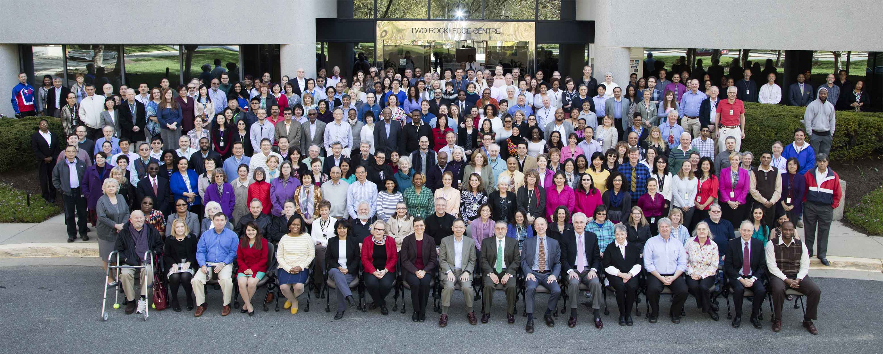
This Is CSR

Slide 42

Discussion

Slide 43
Extra Slides

Slide 44
Cluster 9
Study Section
Integrative Physiology of Obesity and Diabetes (IPOD)
Pathobiology of Kidney Disease (PBKD)
Hepatobiliary Pathophysiology (HBPP)
Cellular Aspects of Diabetes and Obesity (CADO)
Clinical and Integrative Diabetes and Obesity (CIDO)
Gastrointestinal Mucosal Pathobiology (GMPB)
Integrative Nutrition and Metabolic Processes (INMP)
Molecular and Cellular Endocrinology (MCE)
Clinical, Integrative and Molecular Gastroenterology (CIMG)
Kidney Molecular Biology and Genitourinary Organ Development (KMBD)
ZRG1 DKUS R 90 S - Urology and Urogynecology (previously ZRG1 DKUS-G 90, and UGPP)

Slide 45
Cluster 16
Study Section
Health Services Organization and Delivery (HSOD)
Community-Level Health Promotion (CLHP)
Behavioral Medicine: Interventions and Outcomes (BMIO)
Psychosocial Risk and Disease Prevention (PRDP)
Nursing and Related Clinical Sciences (NRCS)
Health Disparities and Equity Promotion (HDEP)
Dissemination and Implementation Research in Health (DIRH)
Biomedical Computing and Health Informatics (BCHI)
Clinical Management of Patients in Community-based Settings (CMPC)
Nursing and Related Clinical Sciences 2 (NRCS2)

