Slide 1



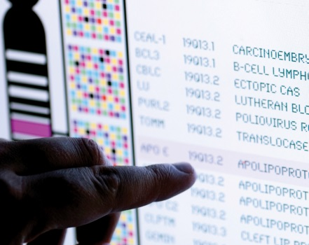
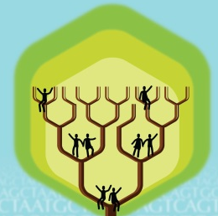
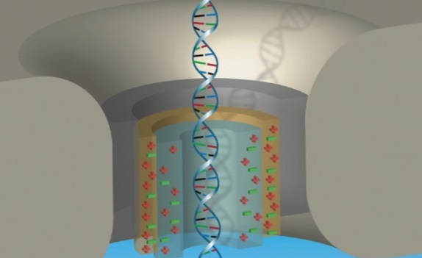


DIRECTOR’S REPORT
Eric Green, M.D., Ph.D.
Director, NHGRI
September 2021
Document #
Notes:
I would like to again welcome all of you to this Open Session of the National Advisory Council for Human Genome Research meeting. As you can see, the current situation with the COVID-19 pandemic has once again led me to give my Director’s Report while sitting alone in my conference room. In addition (and to accommodate a shorter Council meeting), my Director’s Report is a bit briefer than the norm. Nonetheless, it contains an informative collection of updates that we wanted to share with you.
As with the rest of the Open Session, my Director’s Report presentation is being videotaped, and that recording will be made available as a permanent archive on NHGRI’s website (genome.gov).
1

Slide 2
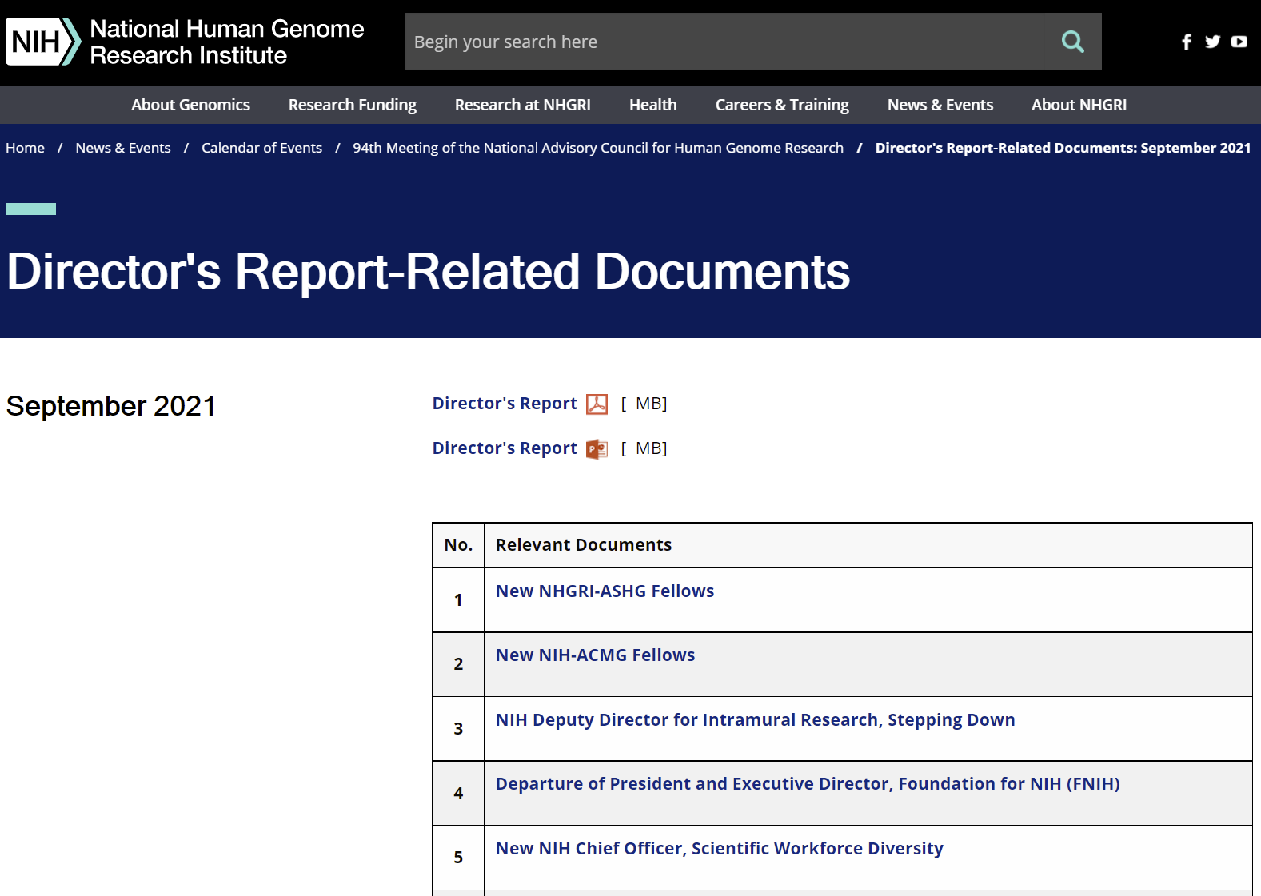
genome.gov/DirectorsReport
Document #
Notes:
For those who are new to our Council meetings, I want to make you aware of the ‘electronic resource’ that is developed for my Director’s Report. Analogous to the supplemental materials of a published paper, this resource can be accessed at the URL shown here.
The slides that I will show during my Director’s Report are also available electronically at this site – * both in PDF and PowerPoint formats.
* When there are documents or relevant websites associated with a particular slide, you will find a ‘Document #’ indicated on the bottom right of that slide; that ‘Document #’ references materials that can be accessed and/or downloaded from the webpage shown here. This dedicated webpage and all linked documents will be archived on genome.gov as part of the historic record of this Council meeting.
2

Slide 3
Open Session Presentations
  Presentations:
    The National Cancer Institute: Leading Cancer Research
    in 2021 and Beyond
    Ned Sharpless
    Genomics, Genetics, and the Eye
    Michael Chiang
Notes:
There will be a number of other presentations during the Open Session of this Council meeting. My Director’s Report is tailored around those presentations, and I will not discuss in detail the topics that others will cover.
Following my Director’s Report, there will be presentations from two other NIH Institute directors.
* First, Ned Sharpless, Director of the National Cancer Institute, will speak about “The National Cancer Institute: Leading Cancer Research in 2021 and Beyond.”
* Next, Michael Chiang, Director of the National Eye Institute, will speak about “Genomics, Genetics, and the Eye.”
3

Slide 4
Open Session Presentations
  Concept Clearances:
    Initiative to Maximize Research Education in Genomics: Courses
    Tina Gatlin
    Enhancing Diversity in Cloud-based Genomic Data Science Education
    Shurjo Sen
Notes:
There will then be two concept clearances presented by NHGRI extramural program directors.
* First, Tina Gatlin will present a concept clearance on an “Initiative to Maximize Research Education in Genomics” that is focused on courses.
* Second, Shurjo Sen will present a concept clearance on “Enhancing Diversity in Cloud-based Genomic Data Science Education.”
4

Slide 5
Open Session Presentations
  Presentations:
    Data Science Working Group
    Mark Craven
    Community Engagement in Genomics Working Group
    Greta Goto
    Maya Sabatello
    Report on Multi-Omics in Health and Disease Workshop
    Joannella Morales
    Howard Chang
Notes:
There will then be two annual Council working group reports and a workshop report.
* First, Council member Mark Craven will present a report from this Council’s Data Science Working Group.
* Second, working group co-chairs Greta Goto and Maya Sabatello will present a report from this Council’s Community Engagement in Genomics Working Group.
* Finally, NHGRI extramural program director Joannella Morales and Council member Howard Chang will present a report from the recent NHGRI Multi-Omics in Health and Disease Workshop.
5

Slide 6
Director’s Report Outline
General NHGRI Updates
General NIH Updates
General Genomics Updates
NHGRI Extramural Research Program
NIH Common Fund/Trans-NIH
NHGRI Communications, Policy, and Education
NHGRI Intramural Research Program
Notes:
For the rest of my Director’s Report, I will cover the 7 areas listed here, which reliably provide a useful framework for reviewing the relevant topics.
6

Slide 7
Director’s Report Outline
General NHGRI Updates
General NIH Updates
General Genomics Updates
NHGRI Extramural Research Program
NIH Common Fund/Trans-NIH
NHGRI Communications, Policy, and Education
NHGRI Intramural Research Program
Notes:
7
And I will start with some general NHGRI updates.

Slide 8

Retirement of Scientific Review Officer
Ken Nakamura, Ph.D.
Notes:
After 26 years in the NHGRI Scientific Review Branch, Ken Nakamura will retire at the end of this calendar year. Ken came to NIH via the Grants Associates Program and joined NHGRI in 1995. His accomplishments in the NHGRI Scientific Review Branch have been truly impressive. He has organized over 160 peer review meetings that required the recruitment of over 1,600 panel members. His review panels evaluated over 1,000 applications, with the requested budgets for those applications exceeding $5.4 billion. He has organized review panels for many high-profile NHGRI and NIH programs, including the Clinical Sequencing Evidence-generating Research (or CSER) program, the Electronic Medical Records and Genomics (or eMERGE) Network, the Centers of Excellence in Genomic Science (or CEGS) program, the Knockout Mouse Project (or KOMP), and the Human Heredity and Health in Africa (or H3Africa) program. Finally, he has single-handedly organized all the reviews for the Technology Development Program since its inception.
Ken’s integrity, professionalism, calm approach, and sense of humor made him a source of reassurance for both the program and review components of our Extramural Research Program. We thank him for his service and wish him all the best in his future endeavors.

Slide 9
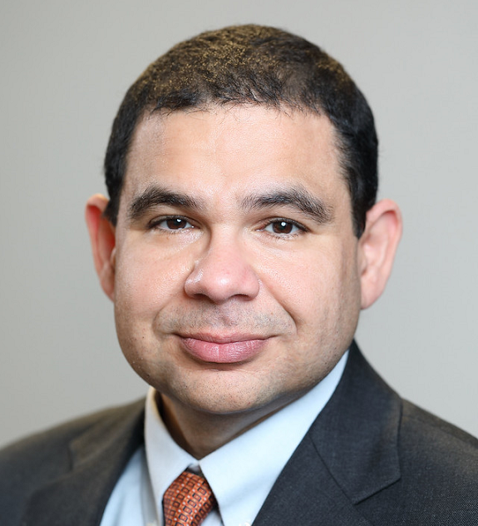
Departure of Extramural Program Director
Luis Cubano, Ph.D.
Notes:
Luis Cubano, who until last month was NHGRI’s Lead Extramural Training Program Director, has accepted a new position at the National Science Foundation as Director of the Hispanic-Serving Institutions Program.
During his nearly two years at NHGRI, Luis and the NHGRI training team led an extensive effort to implement this Council’s 2020 Training Task Force Report as well as components of NHGRI’s new Action Agenda for Building a Diverse Genomics Workforce. As part of these efforts, the training team has released a number of notices and funding opportunities, including those focused on supplement requests and research opportunities for genetic counselors and genomic data scientists – in some cases, using novel funding mechanisms to promote diversity. We are grateful to Luis and all of the NHGRI training team for their strong contributions to NHGRI’s training and diversity programs, and we wish Luis much success at the National Science Foundation.

Slide 10
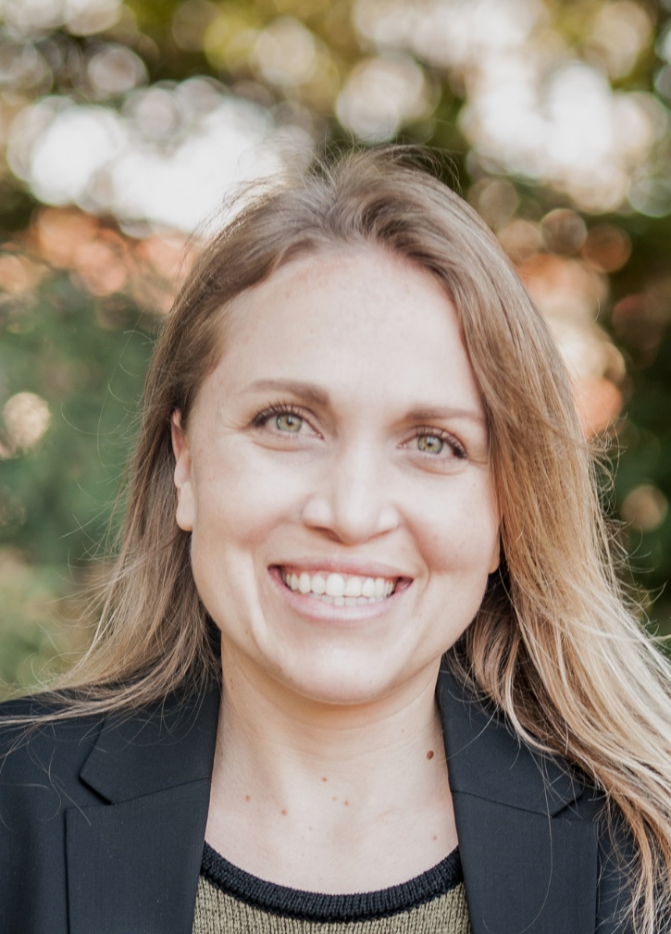

New NHGRI-ASHG Fellows
Nichole Holm, Ph.D.
Genetics & Public Policy Fellow
Delaney Pagliuso, Ph.D.
Genetics Education & Engagement Fellow
Document 1
Notes:
NHGRI’s Division of Genomics and Society partners with the American Society of Human Genetics (or ASHG) in sponsoring two fellowships each year.
* The Genetics & Public Policy Fellowship provides fellows an opportunity to work in NHGRI’s Policy and Program Analysis Branch, at ASHG, and in Congress. This year’s fellow is Nichole Holm. Nichole completed her Ph.D. in Integrative Genetics and Genomics at the University of California-Davis and recently finished a Science and Technology Policy Fellowship in the California State Assembly.
* The Genetics Education & Engagement Fellowship provides fellows an opportunity to work in NHGRI’s Education and Community Involvement Branch and at ASHG in developing educational programs for a wide range of audiences; the fellow may also do a rotation with a public or private organization involved in genetics and genomics education. This year’s fellow is Delaney Pagliuso. Delaney recently completed her Ph.D. in Biological Sciences from the University of California-San Diego.

Slide 11

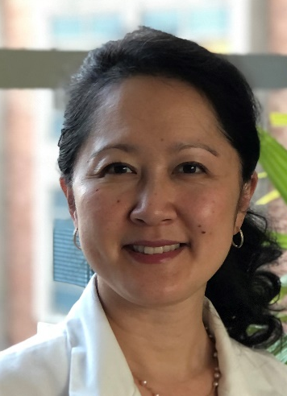

New NIH-ACMG Fellows
    Deepika Burkhardt, D.O.
    Nguyen Park, M.S., PA-C
Document 2
Notes:
NIH partners with the American College of Medical Genetics and Genomics (or ACMG) in sponsoring a Fellowship in Genomic Medicine Program Management. There are two new NIH-ACMG Fellows for the 2022-2024 cohort.
* Deepika Burkhardt is a clinical and biochemical geneticist and a recent graduate of the NIH-NHGRI Medical Biochemical Genetics Residency Program. She completed her medical training at Michigan State University's College of Osteopathic Medicine and a general surgical internship at Wright State University's Boonshoft School of Medicine.
* Nguyen Park is a physician’s assistant who comes to NHGRI from the NIH nephrology consult service team and has worked in cardiology and environmental medicine. She previously taught pediatrics at the University of New Mexico and was an assistant professor at Wayne State University’s Physician’s Assistant Program. She is also the founder and President of the Society of Physicians Assistants in Genetics and Genomics.

Slide 12
Director’s Report Outline
General NHGRI Updates
General NIH Updates
General Genomics Updates
NHGRI Extramural Research Program
NIH Common Fund/Trans-NIH
NHGRI Communications, Policy, and Education
NHGRI Intramural Research Program
Notes:
Moving on to general NIH updates.
12

Slide 13
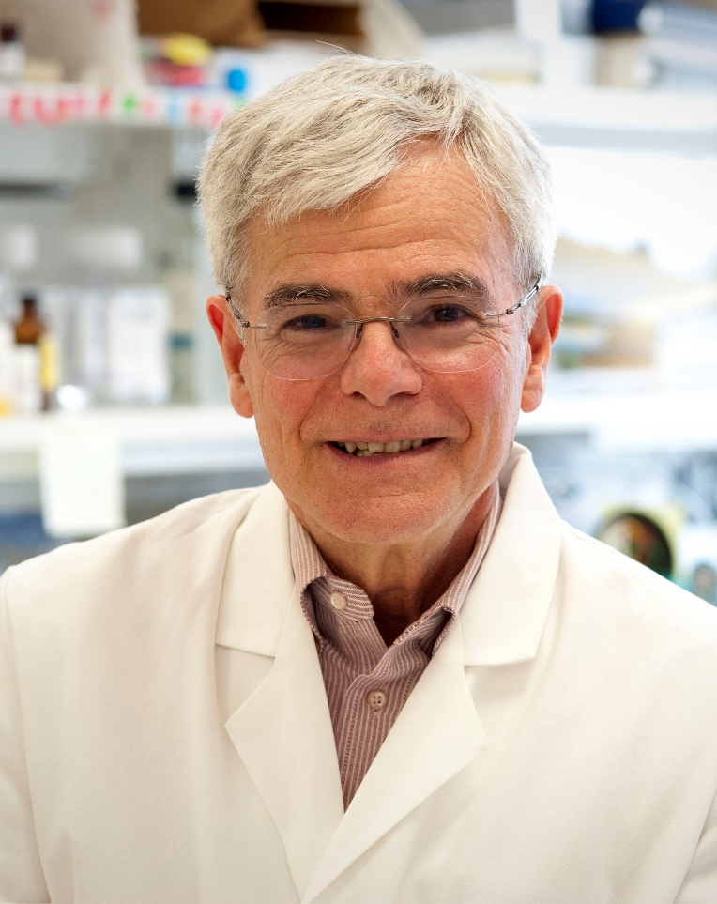

NIH Deputy Director for Intramural Research,
Stepping Down
Michael Gottesman, M.D.
Document 3
Notes:
Michael Gottesman will step down as NIH Deputy Director for Intramural Research after 28 years of remarkable service in this role. Michael was appointed to this position in 1993 after a brief stint as Acting Director of our institute, then-named the National Center for Human Genome Research. As NIH Deputy Director for Intramural Research, Michael has provided overall stewardship of the broader NIH Intramural Research Program, which is made up of the individual programs of 24 of the 27 NIH institutes and centers. For example, he oversees and approves the hiring and review of all NIH investigators and is the NIH institutional official responsible for human subjects research protection, research integrity, technology transfer, and animal care and use.
Michael will stay as the NIH Deputy Director for Intramural Research until a search for his successor is completed, after which he will focus on his research at the Center for Cancer Research at the National Cancer Institute, where he is also Chief of the Laboratory of Cell Biology.
13

Slide 14
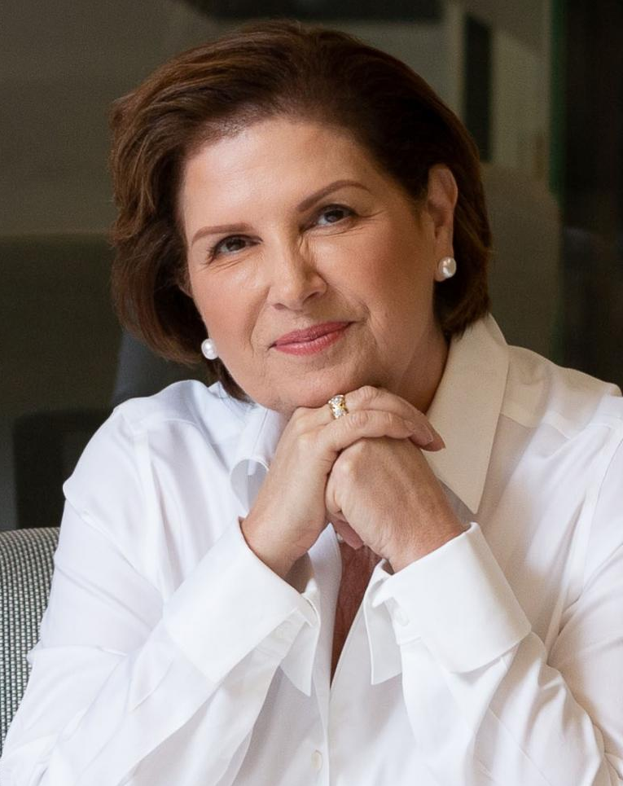


Departure of President and Executive Director,
Foundation for NIH (FNIH)
Maria Freire, Ph.D.
David Wholley, M. Phil.
Document 4
Notes:
This month, Maria Freire will step down as the Foundation for NIH (or FNIH) President and Executive Director. Maria has served in this role since 2012, making her the longest-serving FNIH leader since its inception 25 years ago. Under her leadership, the FNIH has become an innovative and impactful organization within the national and international ecosystem of biomedical research and is an established world leader in pioneering public-private partnerships.
* David Wholley, currently Senior Vice President for Research Partnerships, will serve as Interim President and Executive Director while a national search is conducted for the next FNIH President and Executive Director.
14

Slide 15
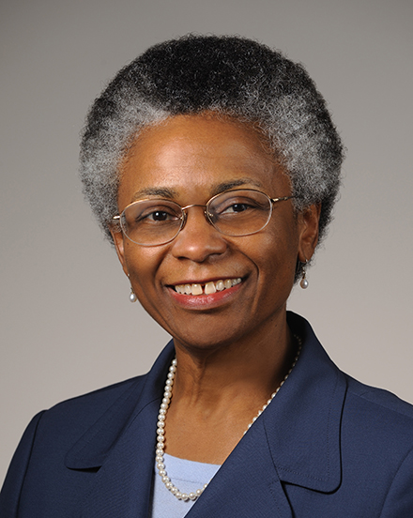

New NIH Chief Officer, Scientific Workforce Diversity
Marie Bernard, M.D.
Document 5
Notes:
Marie Bernard has been selected as the new NIH Chief Officer for Scientific Workforce Diversity. Marie had been the Acting Chief Officer since October 2020. She has championed diversity and inclusion efforts over her entire career, including in her earlier position as the Deputy Director of the National Institute on Aging and more recently in a key leadership role in NIH’s UNITE initiative, which aims to end structural racism in biomedical research.
15

Slide 16
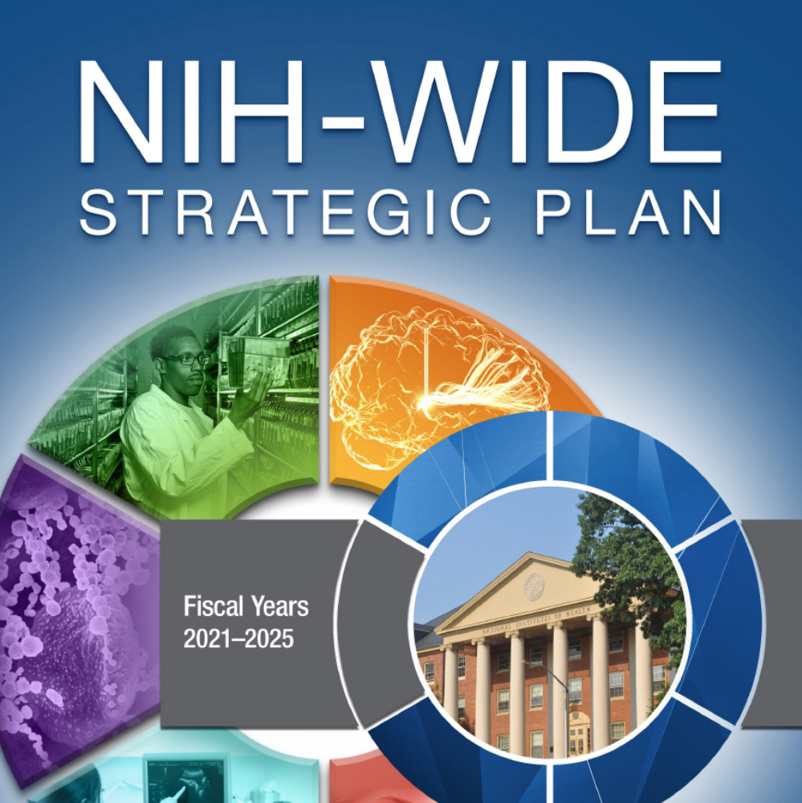
2021-2025 NIH-Wide Strategic Plan
Document 6
Notes:
In July, NIH released the 2021-2025 NIH-Wide Strategic Plan, which aims to guide NIH research efforts over the next five years. The new strategic plan seeks to advance NIH’s vision for biomedical research direction, capacity, and stewardship, with a focus on five cross-cutting themes: improving minority health and reducing health disparities; enhancing women’s health; addressing public health challenges across the lifespan; promoting collaborative science; and leveraging data for biomedical discovery.
The NIH-Wide Strategic Plan was developed through a collaborative process involving leadership and staff across NIH and informed by input from key stakeholders, including the research community, professional societies, advocacy groups, and the public.
16

Slide 17



NIH-FDA Next-Generation Sequencing and Radiomics Workshop
    Resource Requirements for Acceleration
    of Clinical Applications
    September 29-30 Virtual Workshop
    Related Requests for Information (RFIs):
    Open until November 1
    Critical Resource Gaps and Opportunities to Support:
      NOT-OD-21-162: Next generation sequencing
      NOT-OD-21-163: Radiological tool development and clinical data interpretation
Document 7
Notes:
The NIH and FDA Joint Leadership Council’s Next-Generation Sequencing and Radiomics Working Group is hosting a workshop on resource requirements for accelerating clinical applications of next-generation DNA sequencing and radiomics, including those using artificial intelligence. The virtual event will take place September 29-30 and is being hosted by the National Cancer Institute. This meeting will bring together members of the scientific community to discuss how to overcome the ‘ground truth gap’ that has frequently been identified as one of the limiting factors impeding high-quality research, development, validation, and regulatory science in next-generation DNA sequencing and radiomics.
* There are two companion requests for information open until November 1 seeking input on critical resource gaps and opportunities. The first targets next-generation DNA sequencing test development, validation, and data interpretation, including through the use of technologies such as artificial intelligence and machine learning. The second focuses on radiological tool development and clinical data interpretation using artificial intelligence and machine learning.

Slide 18
Fiscal Year 2022 Appropriations
 | Fiscal Year 2021 Enacted Labor-HHS Appropriation | Fiscal Year 2022 House Labor-HHS Appropriation | $ Increase | % Increase
NIH | $42.9 B | $49.4 B | $6.5 B* | 15%
NHGRI | $615.8 M | $646.3 M | $30.5 M | 5%
*House language designates that ARPA-H would receive $3 billion of the increase for NIH
Document 8
Notes:
Government funding will run out September 30 unless a new budget or a Continuing Resolution (or CR) is passed. As of now, a new budget by that time is uncertain because Congress is so busy negotiating an infrastructure bill and a potential second reconciliation package. However, earlier this summer, there was movement in the House on a minibus of seven Fiscal Year 2022 spending bills, including that for Labor-HHS (which includes the funding for NIH).
* The House proposed an increase for NIH of $6.5 billion (or a 15% increase compared to last year). While this is lower than the $9 billion increase for NIH requested in President Biden’s budget, the House language includes a different distribution of funds, with a lower allocation for ARPA-H and a higher minimum increase of 5% for all NIH institutes and centers.
* The House report language would give NHGRI an additional $30.5 million (or a 5% increase compared to last year). This increase would be much higher than the annual 1-2% increases seen in recent years.
The Senate is scheduled to return from its August recess today; it remains to be seen how the Senate language and numbers will differ from that of the House – so stay tuned!
18

Slide 19
Director’s Report Outline
General NHGRI Updates
General NIH Updates
General Genomics Updates
NHGRI Extramural Research Program
NIH Common Fund/Trans-NIH
NHGRI Communications, Policy, and Education
NHGRI Intramural Research Program
Notes:
Moving on to general genomics updates.
19

Slide 20
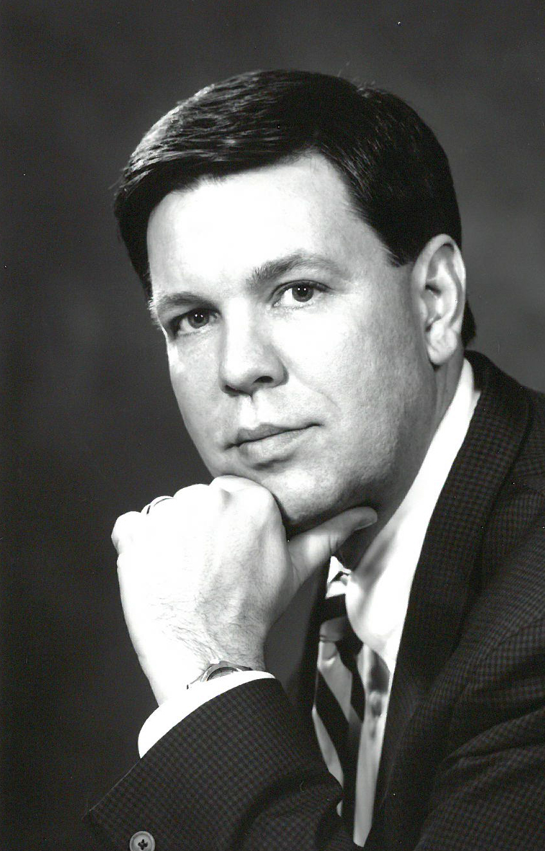

Mourning the Loss of Steve Warren
Document 9
Notes:
Unfortunately, I start this section with sad news…
Steve Warren, the founder of the Emory Department of Human Genetics, passed away on June 6. Steve’s research focused on the mechanistic understanding of fragile X syndrome. In 1991, he led an international effort that identified the gene mutation responsible for the syndrome, later developing diagnostic tests and leading clinical trials for the development of drugs to treat the condition. Apart from his research contributions, Steve was also known for his generosity and commitment to the nurturing of the next generation of scientists.
20

Slide 21
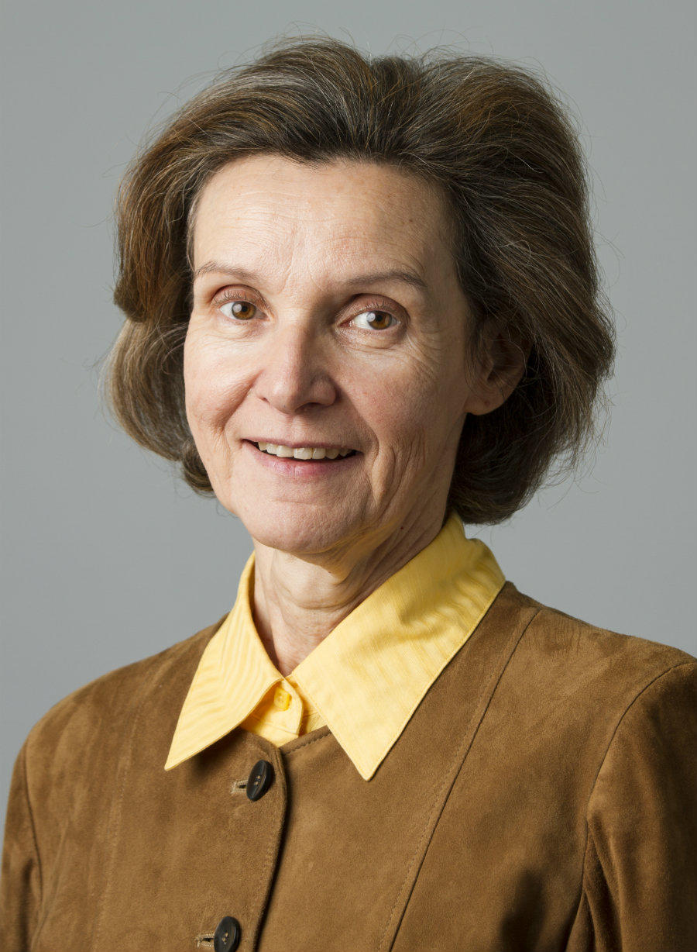
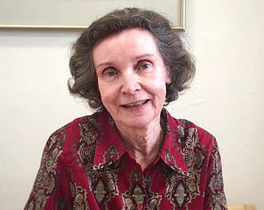
Mourning the Loss of Daniela Gerhard
Document 10
Notes:
Daniela Gerhard passed away suddenly on June 25. Daniela was the Director of the Office of Cancer Genomics at the National Cancer Institute and a pioneer in functional genomics research. Daniela came to NIH in 2004 to direct large-scale genomic research programs at the National Cancer Institute.
Over the years, NHGRI staff members have worked with Daniela on several major research programs, including the Mammalian Gene Collection and The Cancer Genome Atlas. Some her recent work focused on precision oncology –
translating lab discoveries into new treatments that can be used in the clinic.
At a personal level, Daniela and I were both Assistant Professors and colleagues in the Department of Genetics at Washington University School of Medicine in the early 1990s; in fact, our laboratories were adjacent to one another. She was a dedicated and enthusiastic researcher and also had a terrific sense of humor. It was purely ironic that we both ended up at NIH (10 years apart) after leaving Washington University.
21

Slide 22
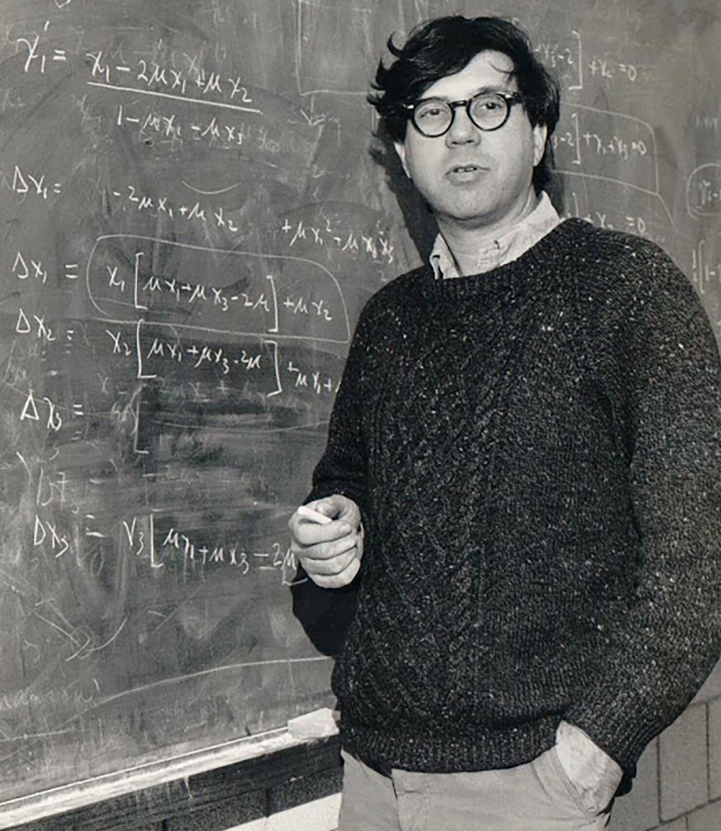
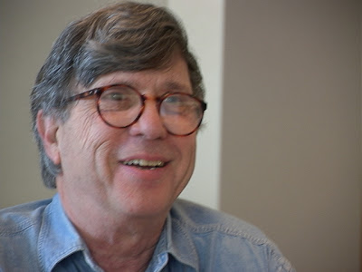
Mourning the Loss of Richard Lewontin
Document 11
Notes:
Richard Lewontin passed away on July 4. Richard was a pioneer in the study of molecular evolution, best known for bringing molecular tools into evolutionary biology and campaigning against biological racism. He identified that most human genomic variation is found within human populations, not between them, and therefore doesn’t support the social concepts of race. From 1973 to 1998, he held the position of Endowed Chair in Zoology and Biology at Harvard University, and from 2003 until his death had been a research professor there.
22

Slide 23
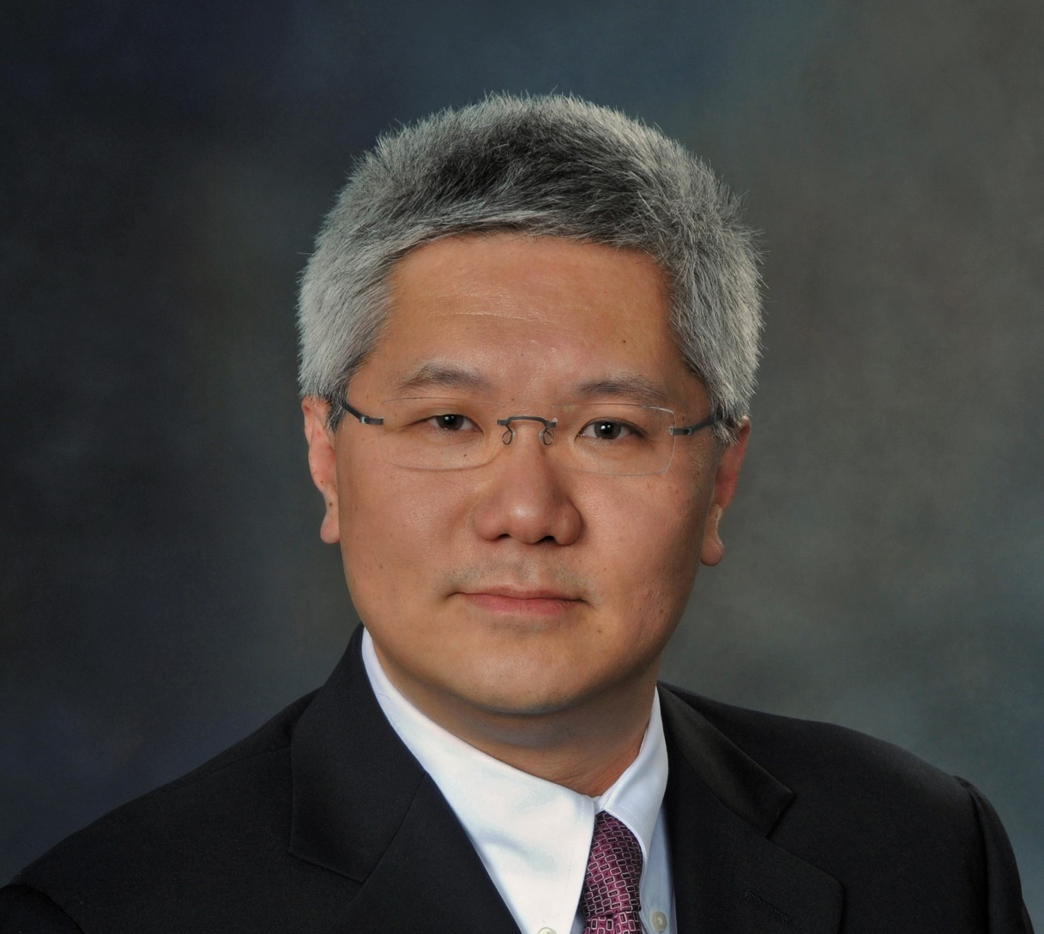

New President-Elect,
American Society of Human Genetics
Brendan Lee, M.D., Ph.D.
Document 12
Notes:
Brendan Lee has been elected the 2023 President (and 2022 President-Elect) of the American Society of Human Genetics. Brendan is Professor and Chairman of the Department of Molecular and Human Genetics at Baylor College of Medicine. He is a good friend, grantee, and major contributor to NHGRI, most recently serving as Chair of the Board of Scientific Counselors that provides oversight to NHGRI’s Intramural Research Program. Congratulations to Brendan for this honor.
23

Slide 24
Director’s Report Outline
General NHGRI Updates
General NIH Updates
General Genomics Updates
NHGRI Extramural Research Program
NIH Common Fund/Trans-NIH
NHGRI Communications, Policy, and Education
NHGRI Intramural Research Program
Notes:
Moving on to the NHGRI Extramural Research Program.
24

Slide 25

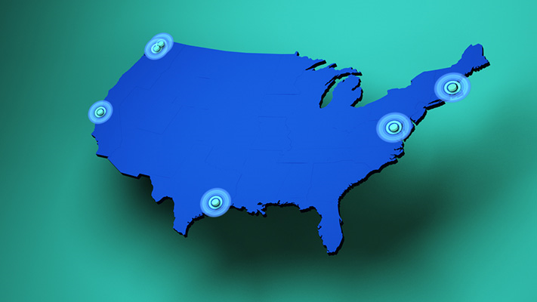





    Genomics Research Elucidates Genetics of Rare Disease (GREGoR) Consortium
    Program launched in Summer 2021
    New approaches to find genetic bases of rare diseases
Document 13
Notes:
This summer, NHGRI launched the Genomics Research Elucidates Genetics of Rare Disease (or GREGoR) Consortium (formerly called the Mendelian Genomics Research Consortium).
Past efforts in discovering the genomic bases of rare diseases have primarily relied on whole-exome sequencing. Although these exome-sequencing efforts have been quite successful, the bases for more than half of rare diseases have not yet been determined using this approach. GREGoR will develop new ways for tackling those harder-to-determine cases. In addition to identifying the causative genes, the consortium hopes to create a new paradigm for rare disease gene discovery.
GREGoR is made up of five research centers at the University of Washington, Stanford University, Baylor College of Medicine, the Broad Institute, and a collaboration between Children’s National Hospital and the company Invitae. Because data sharing is so important in rare-disease gene discovery, this program also has a Data Coordinating Center at the University of Washington.
25

Slide 26

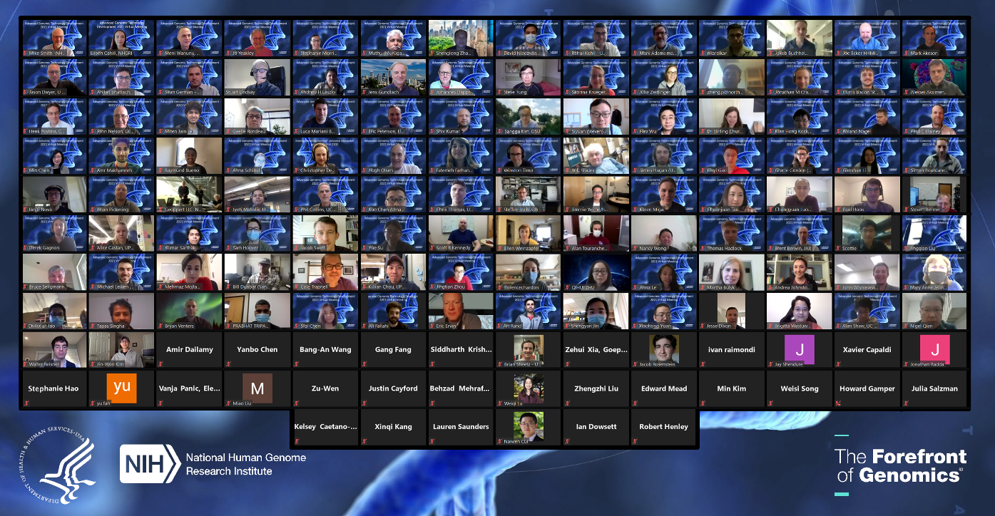
Technology Development Program
Advanced Genomic Technology Development Meeting
Technology Development Coordinating Center
    Facilitating collaborations
    Promoting standards
    Developing resources
    Disseminating information
May 2021
Document 14
Notes:
NHGRI’s Technology Development Program continues to promote technological advances and innovations, fueling genomic discoveries.
* The annual Advanced Genomic Technology Development Meeting was hosted virtually by Northeastern University this past May, attracting over 150 attendees. Grantees and trainees presented their work in sessions on nucleic acid sequencing innovation and across broad areas of genomic technology development. A high point of the meeting was a set of breakout sessions in which smaller groups discussed needs and opportunities in single-cell analysis, multi-omics, editing for genomics, enzymes as tools, and DNA sequencing innovation.
* Also, this spring, a coordinating center was established to support our Technology Development Program.
* The center, which is led by the Jackson Laboratory, is facilitating opportunities for collaboration, promoting standards in genomic technologies, developing resources to share with the research community, and disseminating information about program advances
26

Slide 27
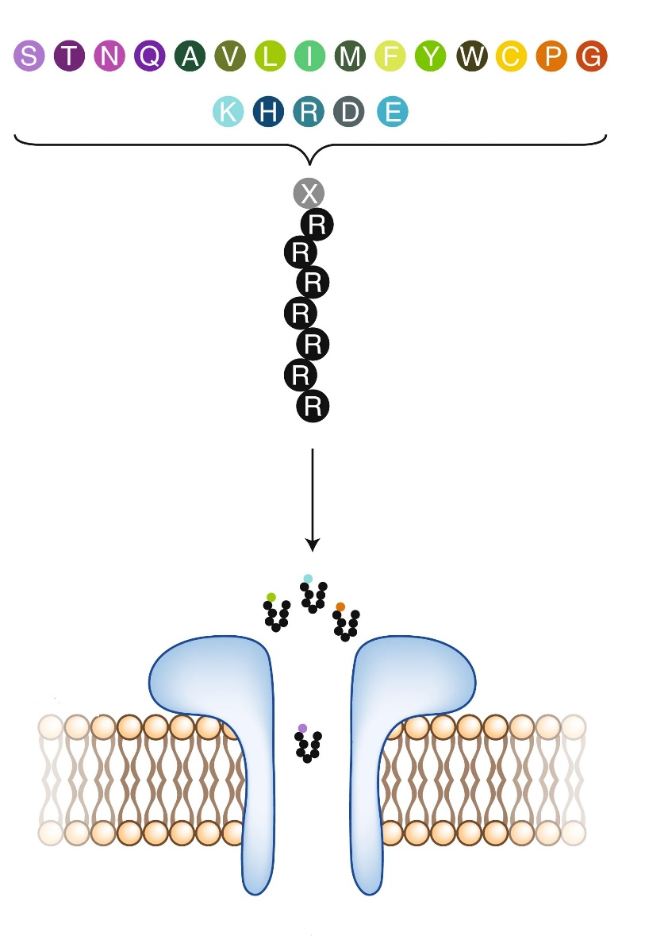
Technology Development Program
Funding Opportunities:
    Technology Development for Single-Molecule Protein Sequencing
      Collaboration with NCI and NIAID
      RFA-HG-21-001 (R01, also linked R21 RFA and R43/R44 PAR)
      First due date: October 1, 2021
Courtesy of Stefan Howorka & Zuzanna Siwy
Document 14
Notes:
NHGRI recently released a series of funding announcements to accelerate innovation and early development in the emerging field of single-molecule protein sequencing, in collaboration with the National Cancer Institute and the National Institute of Allergy and Infectious Diseases. The goal is to stimulate improvements in throughput, cost, accuracy, sensitivity, dynamic range, and scale. Breakthroughs in this area would enable routine use of single-molecule protein sequencing in basic and clinical research.
Three funding opportunity announcements are now published: an R01, R21, and R43/44, with the first due date being October 1, 2021.
27

Slide 28

Technology Development Program
Funding Opportunities:
    Novel Synthetic Nucleic Acid Technology Development
      RFA-HG-20-014 (R01, also linked R21 and R43/R44)
      Next due date: February 4, 2022
    Transformative Nucleic Acid Sequencing Technology Innovation and Early Development
      RFA-HG-21-006 (R01, also linked R21 and R43/R44)
      Next due date: March 1, 2022
    Advancing Genomic Technology Development for Research and Clinical Application
      NOT-HG-21-018, Notice of Special Interest (NOSI)
      Standard receipt dates
Document 14
Notes:
There are currently three additional active funding opportunities through the NHGRI Technology Development Program.
* First, applications for the novel synthetic nucleic acid technology development request for applications are due February 4, 2022.
* Second, the program continues to support nucleic acid sequencing innovation and early development, with applications due on March 1, 2022.
* Finally, there is a Notice of Special Interest (or NOSI), highlighting our broader interest in advancing genomic technology development for research and clinical applications and using standard receipt dates.
28

Slide 29

Small Business Program
Funding Opportunities
    Development of Highly Innovative Tools and Technology for Analysis of Single Cells
      PA-20-025 (STTR R41/R42 and linked SBIR R43/R44)
      Standard receipt dates
    Small Business Initiatives for Innovative Diagnostic Technology for Improving Outcomes for Maternal Health
      NOT-EB-21-001, Notice of Special Interest (NOSI)
      STTR R41/R42 and SBIR R43/R44
      Standard receipt dates
Document 15
Notes:
NHGRI provides U.S. small businesses support for technology transfer of both academic innovation and company research en route to the commercialization of genomics products. As discussed in previous slides, our Technology Development Program has recently released four sets of funding announcements, and each of these includes opportunities for small businesses.
I would also like to draw your attention to two additional small business funding opportunities that are relevant to the genomics community. * The first focuses on development of highly innovative tools and technology for analysis of single cells, and * the second focuses on innovative diagnostic technology for improving outcomes for maternal health. Both of these FOAs have standard receipt dates.
29

Slide 30
    Impact of Genomic Variation on Function (IGVF)
Effects of Genomic Variation
Genome Function
Health & Disease
Award Locations in U.S.
Notes:
The Impact of Genomic Variation on Function (or IGVF) Consortium is one of NHGRI’s newest research programs.
IGVF will develop a framework for systematically understanding the effects of genomic variation on genome function and determining how these effects shape phenotypes in health and disease.
* NHGRI issued 26 awards earlier this month for this program, for a total investment of up to $185 million over 5 years. These IGVF awards will support coordinated activities of 5 program components focused on variant characterization, functional element mapping, predictive modeling, regulatory networks, and data coordination.
IGVF investigators are located in the U.S., Canada, and Germany, with the locations of the U.S. institutions shown here.

Slide 31

    Molecular Phenotypes of Null Alleles in Cells (MorPhiC)
  Funding Opportunities:
  Data Production Research and Development Centers
    RFA-HG-21-029
  Data Analysis and Validation Centers
    RFA-HG-21-030
  Data Resource and Administrative Coordinating Center
    RFA-HG-21-031
  Application Due Date: November 1, 2021
Document 16
Notes:
The long-term goal of the Molecular Phenotypes of Null Alleles in Cells (or MorPhiC) is to develop a consistent catalog of molecular and cellular phenotypes for null alleles of every human gene using in vitro cellular systems. The catalog will be made available for broad use by the biomedical research community. The program will start with an initial phase to optimize available methods to create null alleles and to measure their phenotypic effects for a target subset of 1000 protein-coding genes.
* In August, NHGRI published three funding opportunities for the initial phase of MorPhiC, which will include three components: * Data Production Research and Development Centers will develop diverse systems and assays to explore and compare approaches to produce MorPhiC data at scale and to maximize its informativeness. * Data Analysis and Validation Centers will undertake applicant-proposed analyses of the data in order to characterize its quality and utility for multiple purposes. * Finally, there will be a Data Resource and Administrative Coordinating Center.
A pre-application webinar was held last Friday, September 10. Materials from that webinar, including answers to Frequently Asked Questions, will be made available.
* The application due date for all three funding announcements is November 1, 2021.
31

Slide 32
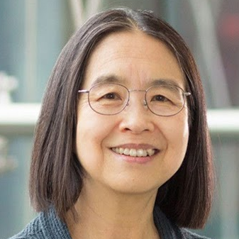
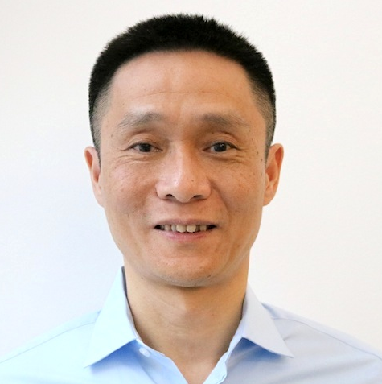
    Centers for Excellence in Genomic Science (CEGS)
Chao-Ting Wu (Harvard Medical School)
  Center for Genome Imaging
Chuan He (University of Chicago)
  Center for Dynamic RNA Epitranscriptomes
Document 17
Notes:
The Centers for Excellence in Genomic Science (or CEGS) program supports interdisciplinary research teams for developing highly innovative approaches in genomics research. Since the last Council meeting in May, the CEGS program has made two new awards.
* The first was to Chao-Ting Wu from Harvard Medical School for the Center for Genome Imaging. This effort will develop methods to image the three-dimensional organization of entire genomes at very high resolution in individual cells, with applications to understanding the relationship between genome organization and function.
* The second was a renewal to Chuan He at the University of Chicago to continue the Center for Dynamic RNA Epitranscriptomes. The center will expand quantitative methods for mapping of multiple RNA modifications and their changes over time, with high sensitivity and single-base resolution. The goals of the work are to deliver high-throughput methods that simultaneously map multiple RNA modifications in any biological context and to enable studies to characterize the biological functions of these multiple RNA modifications.

Slide 33
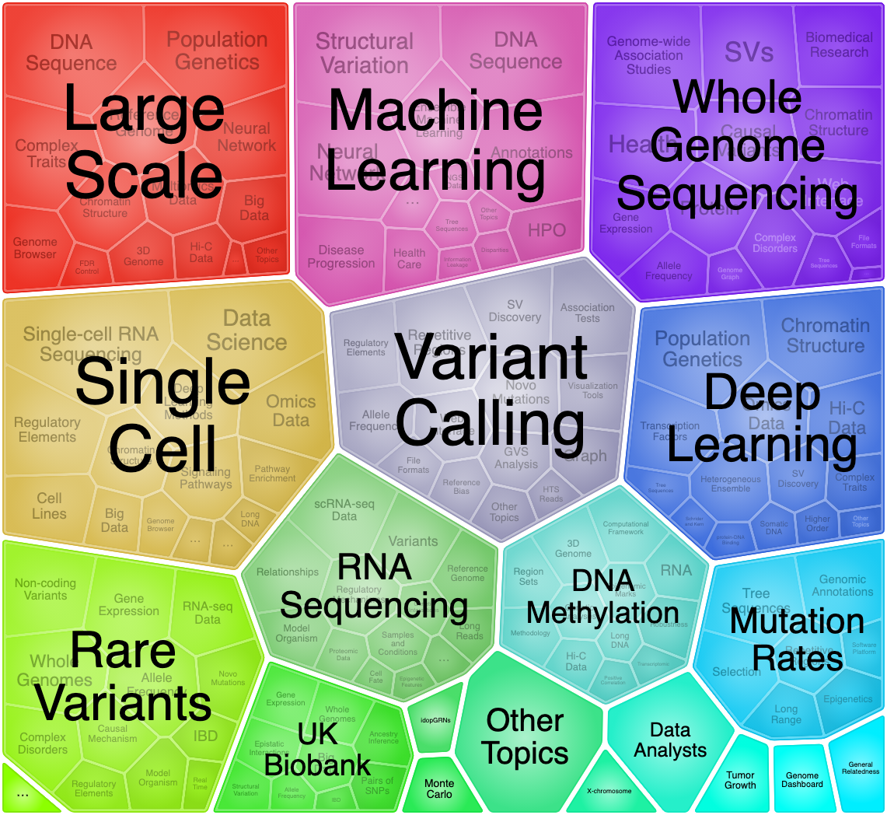
Computational Genomics and Data Science Program
    New funding opportunities released in July
    Support innovative research in computational genomics and data science
    First due date: October 5, 2021
Document 18
Notes:
The NHGRI Computational Genomics and Data Science Program supports research and development of data science methods, resources, and tools that maximize the integration of genomics data into biomedical research. The image shown illustrates common topics in applications submitted to the Computational Genomics and Data Science Program.
* In July, the program released the renewals of two funding opportunities to increase the pool of investigator-initiated applications for a broad range of innovative research efforts in computational genomics, data science, statistics, and bioinformatics for basic and/or clinical genomics.
* The first due date for applications is October 5, 2021.

Slide 34
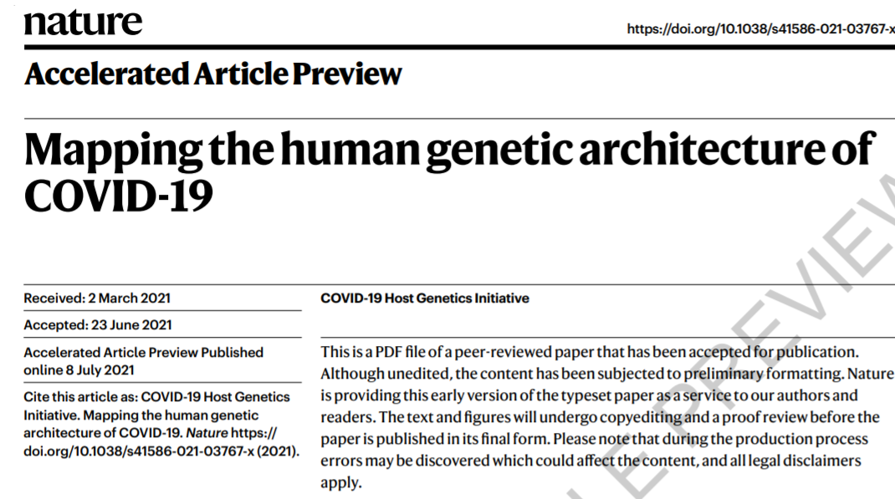
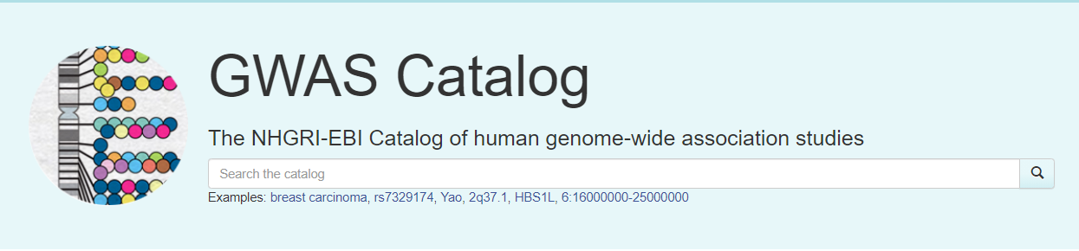
    GWAS Catalog
As of August 16, 2021, the GWAS Catalog contains 5,273 publications and 276,696 associations.
    Repository for summary statistics from COVID-19 Host Genetics Initiative
    Curation team reached milestone of curating >5,000 papers
Document 19
Notes:
The GWAS Catalog provides a searchable and freely available database of single-nucleotide polymorphism (or SNP)-trait associations for scientists, clinicians, and other users worldwide.
* Findings from the COVID-19 Host Genetics Initiative were recently published in Nature. The GWAS Catalog is serving as a repository for summary statistics for that initiative, which can be found on the GWAS Catalog’s website.
* Additionally, the curation team of the GWAS Catalog recently reached the milestone of having curated >5,000 papers since the program’s inception in 2008.
34

Slide 35
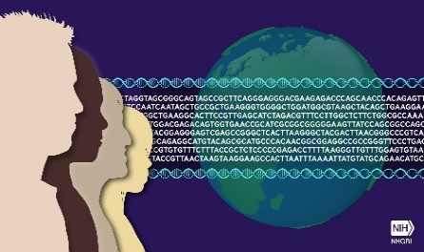
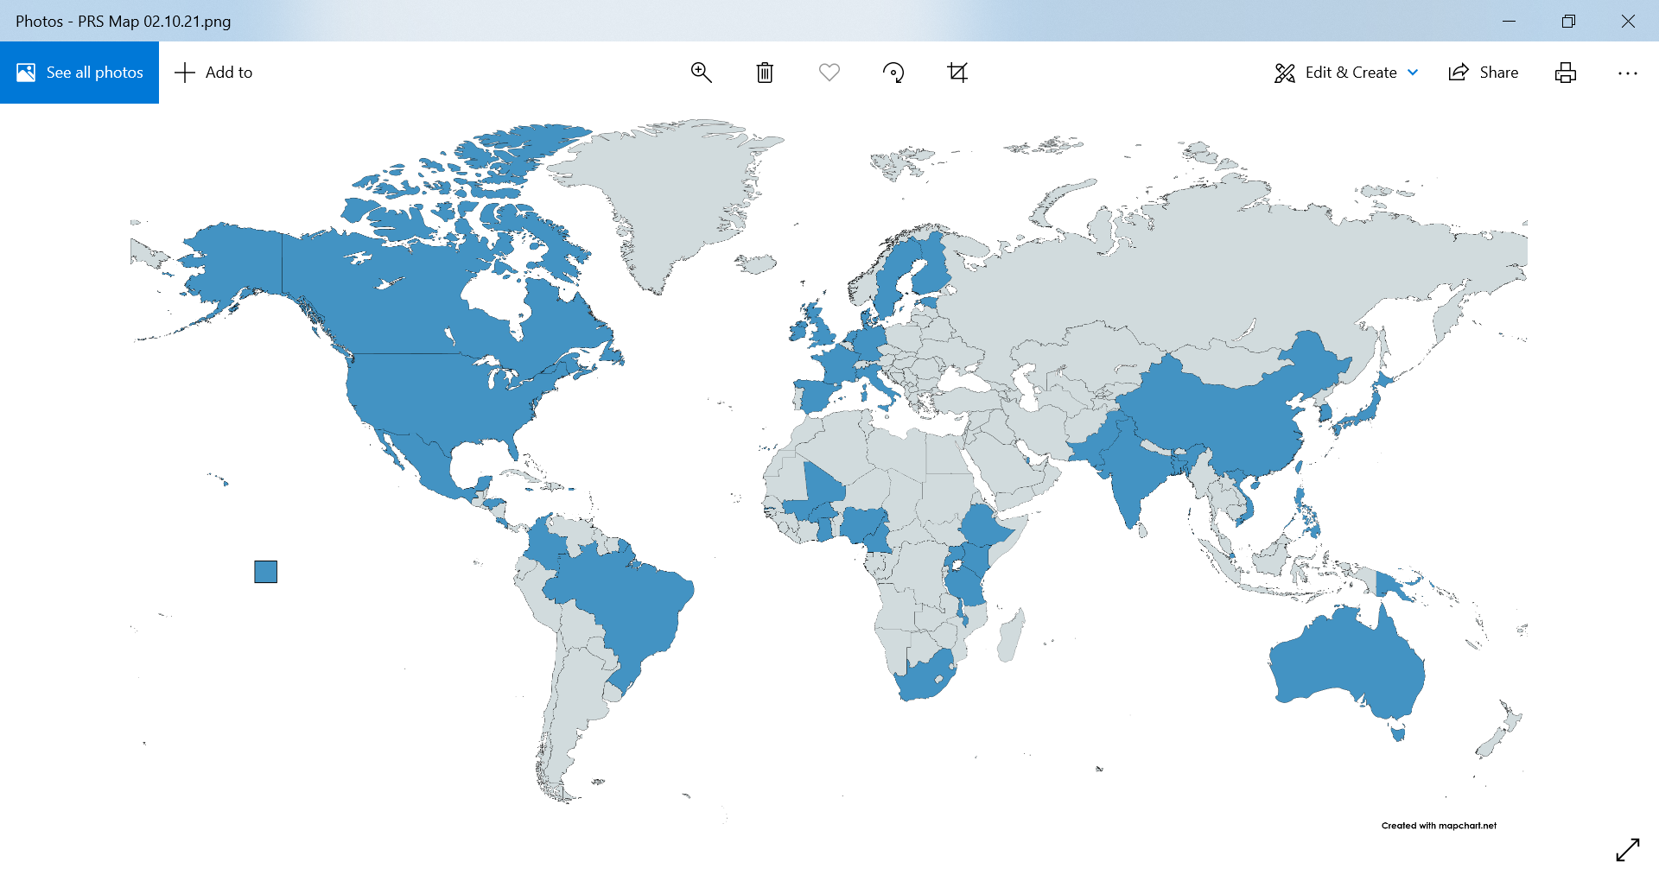

    Polygenic Risk Methods in Diverse Populations (PRIMED) Consortium
Improve applicability of PRS in diverse populations
Optimize the integration of large-scale, harmonized genomic and phenotype data
128 datasets, 45 countries
Sally Adebamowo (U. of MD)
David Conti (U. of Southern California)
Amit Khera (Massachusetts General and Broad Institute)
Yun Li (U. of North Carolina)
Josep Mercader (Broad Institute)
Bogdan Pasaniuc (U. of California, Los Angeles)
Kenneth Rice (U. of Washington; Coordinating Center)
Document 20
Notes:
The Polygenic Risk Methods in Diverse Populations (or PRIMED) Consortium is developing methods and refining polygenic risk scores (or PRS) to improve prediction of health and disease in diverse populations.
* This summer, NHGRI in partnership with the National Cancer Institute, launched the PRIMED Consortium with two broad goals: improve the applicability of PRS in diverse populations through methods development and collaborative analysis of genetically diverse datasets, and optimize the integration of large-scale, harmonized genomic and phenotype data.
* Six study sites and one coordinating center, listed here, will work together over the next 5 years to accomplish these goals and disseminate data to the scientific community.
* Collectively, the group will work to integrate data from 128 datasets from 45 countries across a broad range of phenotypes.
35

Slide 36


Clinical Genome Resource (ClinGen)
Virtual Retreat 2021
~ 470 registrants from 38 countries
Topics:
Best practices for gene and variant curation
Curator perspectives
ACMG/AMP updated guidelines
Engaging under-represented Groups
Navigating ClinGen resources
Document 21
Notes:
The Clinical Genome Resource (or ClinGen) evaluates and disseminates the clinical relevance of genes and genomic variants for use in precision medicine and research.
ClinGen hosted a virtual two-day retreat in June, providing opportunities for the sharing of best practices with the broader clinical and research communities. * The meeting attracted approximately 470 registrants from 38 countries. The two-day retreat included lecture-based and interactive sessions and abstract-driven presentations, as well as social and networking opportunities.
* The retreat sessions focused on best practices for gene and variant curation expert panels, curator perspectives, ACMG/AMP updated guidelines, engaging under-represented groups in ClinGen, navigating ClinGen resources, and more. Meeting videos and supporting material are available on the ClinGen website.
36

Slide 37

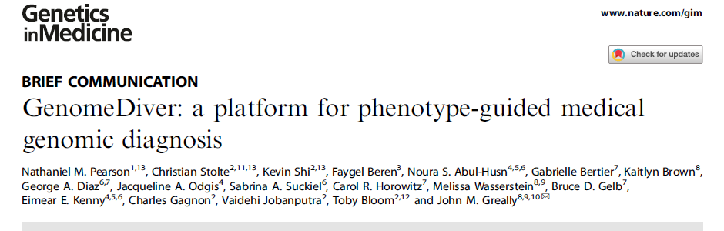
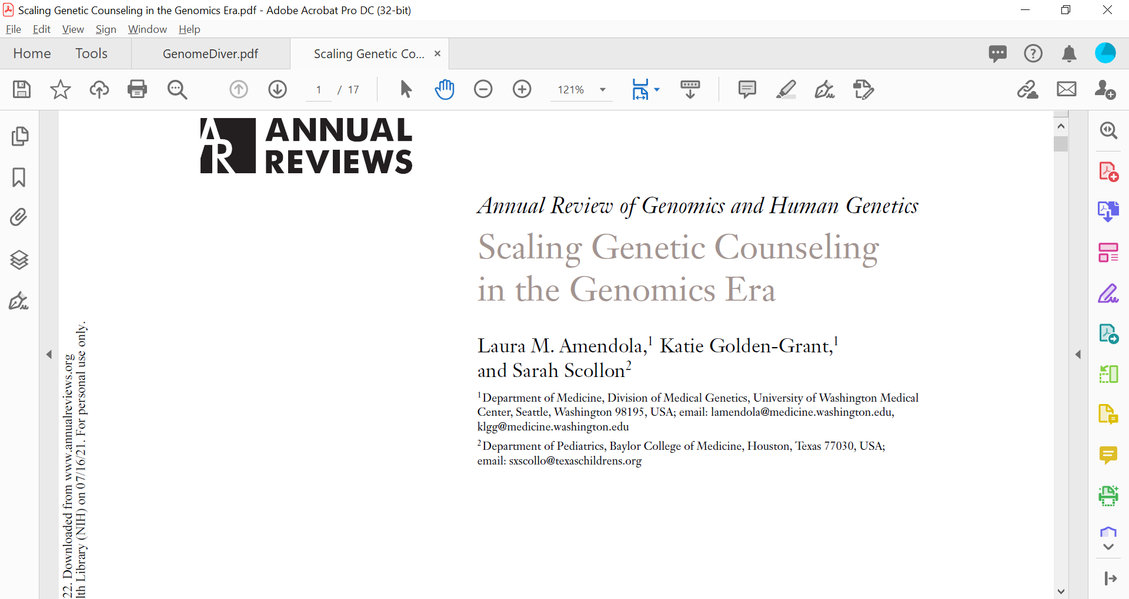
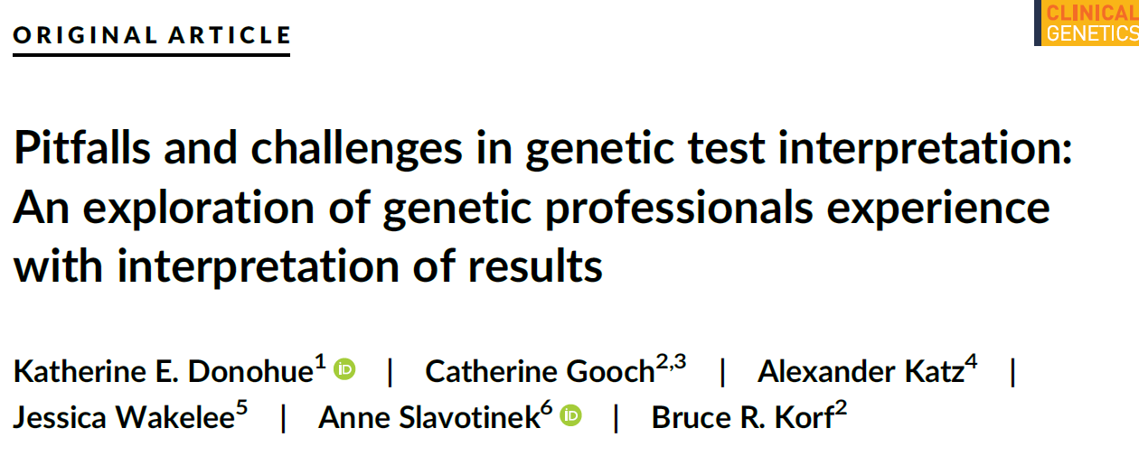
Clinical Sequencing Evidence-Generating
Research (CSER) Program
    Survey sent of genetics professionals asking about experiences with test result misinterpretation
        83% of respondents described at least one example of misinterpretation
        Incorrect result interpretation is biggest perceived factor leading to misinterpretation
        Results highlight need for better communication among labs, providers, and families
Document 22
Notes:
The Clinical Sequencing Evidence-Generating Research (or CSER) program aims to generate evidence related to the clinical utility of genome sequencing, with a major emphasis on participant diversity and engagement.
In the past quarter, CSER investigators published papers on topics as varied as * the GenomeDiver platform to facilitate genomic diagnosis, * scaling genetic counseling in the genomics era, * and challenges in genetic test interpretation.
* The latter paper was a survey of genetics professionals asking them about experiences with test result misinterpretation and how this affected patient care. * Of the 360 respondents, 83% described at least one example of misinterpretation of a test result, which involved professionals with and without genetic training. Respondents were then asked to list perceived contributions to these instances of misinterpretation. * Incorrect result interpretation is the biggest perceived factor leading to misinterpretation. Not all cases were due to provider error; in fact, many cases were complicated by external communication factors on the part of the laboratory. * Overall, this survey highlighted the need for better communication among labs, providers, and families.
37

Slide 38

Multi-omics in Health and Disease Workshop
Document 23
Notes:
In June, NHGRI virtually convened leaders in multi-omics technologies and observational studies for a two-day workshop to provide guidance on developing a multi-omics research agenda that would align with the 2020 NHGRI Strategic Vision.
All workshop materials, including the agenda, executive summary, and recommendations, can be found on the meeting’s website, with videos of the presentations and discussion available on our NHGRI’s YouTube channel, GenomeTV. Council member Howard Chang will provide a summary of the workshop later in this Open Session.
38

Slide 39
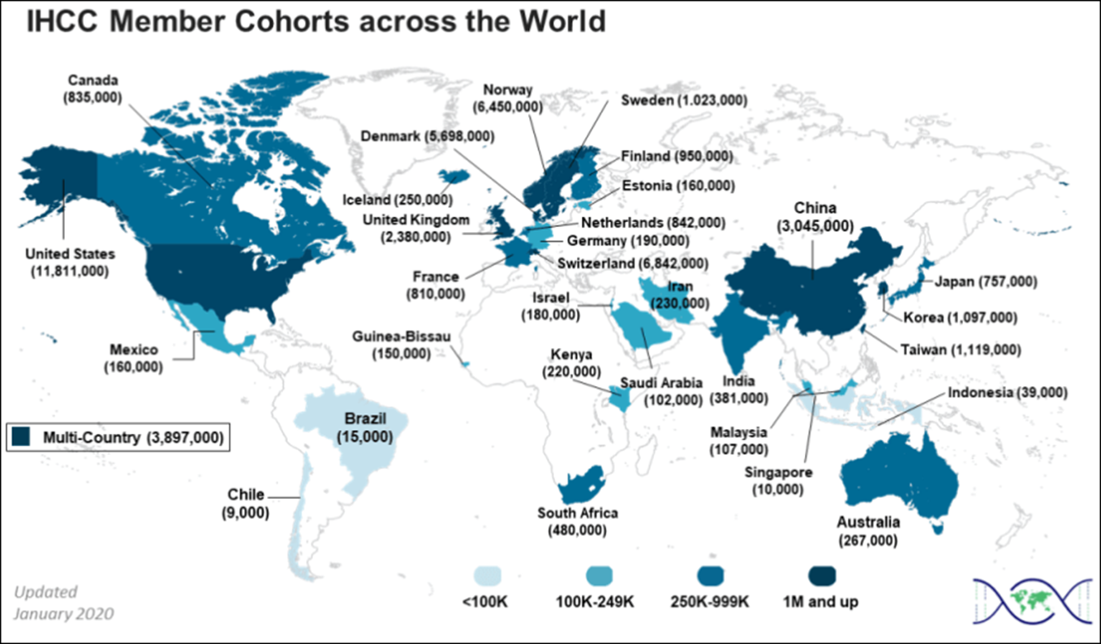
International 100K+ Cohort Consortium (IHCC)
4th International Cohorts Summit
Galvanize IHCC around a long-term strategic plan
Training, Sharing, and Capacity Development Working Group
N | 2019 | 2021
Total | 71 | 109
LRS/LMIC | 10 | 43
Document 24
Notes:
The International 100K+ Cohort Consortium (or IHCC) was established by NIH and the Wellcome Trust to bring together investigators around the world involved in large cohort studies to study questions none of them can answer alone. * The number of IHCC cohorts continuously increases, especially in low resource settings and low- and middle-income countries. Currently, IHCC consists of 109 participating cohorts in 43 countries, with 43 of those cohorts being from low resource settings and low- and middle-income countries.
* The IHCC held its 4th International Cohorts Summit in May, focused on * galvanizing the IHCC around a long-term strategic plan that sets its future directions. Videos of the summit’s virtual sessions are available online. * One of the outcomes of the summit was to form a new Training, Sharing, and Capacity Development Working Group.
39

Slide 40

The 5th ELSI Congress
Save the Date
June 1-3, 2022
Columbia University
Abstract Submission: Open from September 13 – December 1, 2021
Document 25
Notes:
The Ethical, Legal, and Social Implications (or ELSI) Research Program supports research that anticipates, explores, and addresses implications of genomics for individuals, families, and communities.
The 5th ELSI Congress will be held June 1-3, 2022 at Columbia University in New York City, featuring both in-person and virtual components. ELSIcon2022 invites researchers, practitioners, trainees, and other scholars to share their latest ELSI research. The theme for the 2022 Congress is “Innovating for a Just and Equitable Future.” Abstract submission opens today, September 13, and closes December 1, 2021.

Slide 41
Training and Career Development
New Diversity-Focused FOAs
PAR-21-143 Next due date: December 8, 2021
NHGRI Predoctoral to Postdoctoral Transition Award for Diverse Genomics Workforce (F99/K00)
PAR-21-214 Next due date: February 12, 2022
Short-term Mentored Research Career Enhancement Award to Promote Diversity (K18)
Document 26
Notes:
Since the release of NHGRI’s Action Agenda for Building a Diverse Genomics Workforce in January, the institute has launched several new initiatives to attract, develop, and retain a diverse research and clinical genomics workforce that more closely resembles the U.S. population.
Initiatives developed by our Training and Career Development Program include: * first, an F99/K00 funding opportunity entitled “NHGRI Predoctoral to Postdoctoral Transition Award for Diverse Genomics Workforce.” This is a two-phase award to support graduate students from diverse backgrounds in their transition to postdoctoral positions; and * second, a career development K18 funding opportunity that will provide support for short-term training in genomics of faculty members from diverse backgrounds.
Both of these program announcements were published last spring and have already had their first receipt date.

Slide 42
Training and Career Development
New Diversity-Focused FOAs
RFA-HG-21-033 Due date: December 1, 2021
Genome Research Experiences to Attract Talented Undergraduates into the Genomics Field to Enhance Diversity (GREAT, R25)
RFA-HG-21-041 Due date: February 22, 2022
New Investigators to Promote Workforce Diversity in Genomics, Bioinformatics, or Bioengineering and Biomedical Imaging Research (R01 Clinical Trial Optional)
Document 26
Notes:
A third funding opportunity is using an R25 mechanism and is entitled “Genome Research Experiences to Attract Talented Undergraduates into the Genomics Field to Enhance Diversity,” also known as the GREAT program. This program will support collaborative institutional partnerships to provide research education programs for undergraduates at minority-serving institutions or Institutional Development Award (or IDeA)-eligible institutions. The lead applicant must be at a minority-serving or IDeA-eligible institution, and they will then partner with others at research-intensive institution or organization that has a substantial genomics-training environment.
* A fourth funding opportunity is using an R01 mechanism and is entitled, “New Investigators to Promote Workforce Diversity in Genomics, Bioinformatics, or Bioengineering, and Biomedical Imaging Research.” This funding opportunity is soliciting grant applications that propose independent research projects that are within the scientific mission areas of NHGRI, the National Institute of Biomedical Imaging and Bioengineering, or the All of Us Research Program; this program is intended to support early-stage investigators and new investigators from diverse backgrounds, including those from groups underrepresented in the health-related sciences.

Slide 43
Director’s Report Outline
General NHGRI Updates
General NIH Updates
General Genomics Updates
NHGRI Extramural Research Program
NIH Common Fund/Trans-NIH
NHGRI Communications, Policy, and Education
NHGRI Intramural Research Program
Notes:
Moving on to the NIH Common Fund and other trans-NIH efforts.
43

Slide 44
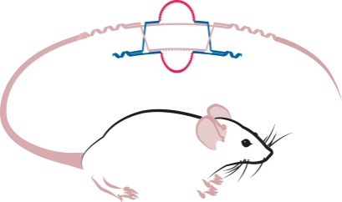

Knockout Mouse Phenotyping Project (KOMP2)
Limited Competition Funding Opportunities:
  RFA-HG-21-036
    Knockout Mouse Production and Phenotyping Project (UM1)
  RFA-HG-21-037
    Knockout Mouse Phenotyping Project Data Coordination Center and Database (UM1)
    Application due date: November 1, 2021
Document 27
Notes:
The Knockout Mouse Phenotyping Project (or KOMP2) will create and phenotype 3,000 strains of knockout mice using CRISPR technology between 2016 and 2022. The project is now in an extension phase with funding due to COVID-19 disruptions and is on track to meet its goals for 2022. This project is part of the larger International Mouse Phenotyping Consortium (or IMPC).
For the KOMP effort, September 2021 marks the close of the 10th year of support from the NIH Common Fund and, therefore, the project transitions to a trans-NIH framework for future funding. With support from 18 NIH institute, center, and office directors, KOMP is being renewed for a final five-year project period. * Thus, following the approval of concepts at the May 2021 Council meeting, two funding opportunities have been published, which solicit applications to support knockout mouse production and phenotyping centers and a data coordination center and database. * The application receipt date is November 1, 2021.
44

Slide 45
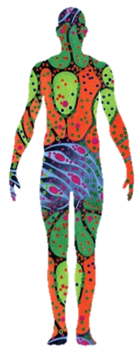
Human Biomolecular Atlas Program (HuBMAP)
    Two funding opportunities:
      HuBMAP Integration, Visualization, & Engagement (HIVE) Collaboratory
        OTA-21-012
        Application due date: December 3, 2021
      Demonstration Projects
        RFA-RM-21-027
        Application due date: November 19, 2021
Document 28
Notes:
The NIH Common Fund Human Biomolecular Atlas Program (or HuBMAP) aims to develop an open, global framework for creating comprehensive mappings of the human body at cellular resolution, which will help determine how the relationships between cells affect the health of an individual.
* The NIH Common Fund recently announced two HuBMAP funding opportunities.
* The goal of the HuBMAP Integration, Visualization, & Engagement (or HIVE) is to develop and transform the existing data portal and manage all HuBMAP data as a community resource. The due date for applications is December 3, 2021.
* The goal of the Demonstration Projects is to creatively use datasets and resources from HuBMAP to address significant biomedical and biological questions. The due date for applications is November 19, 2021.
Applicant informational webinars will be organized prior to the due dates for each of these funding opportunities.
45

Slide 46

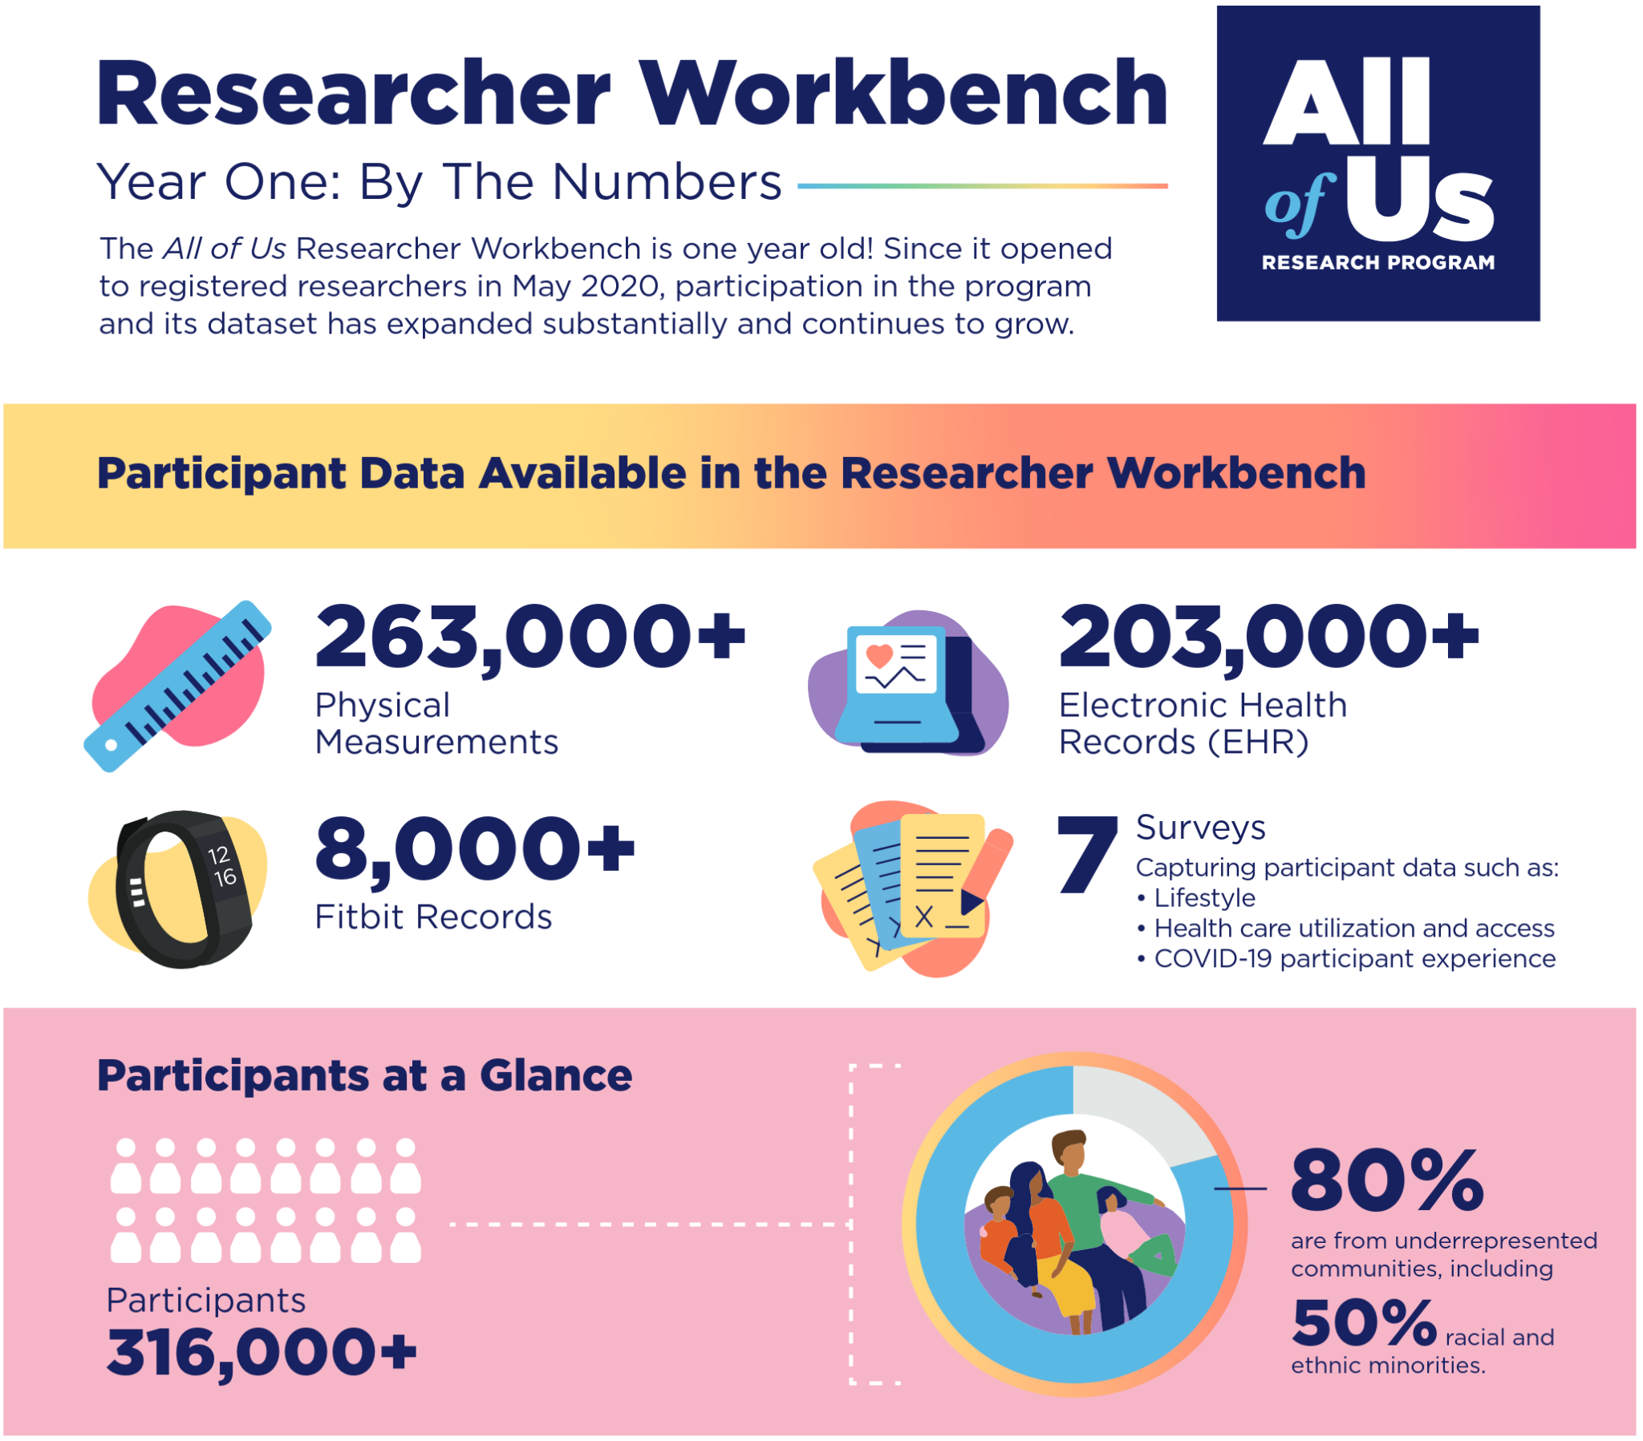
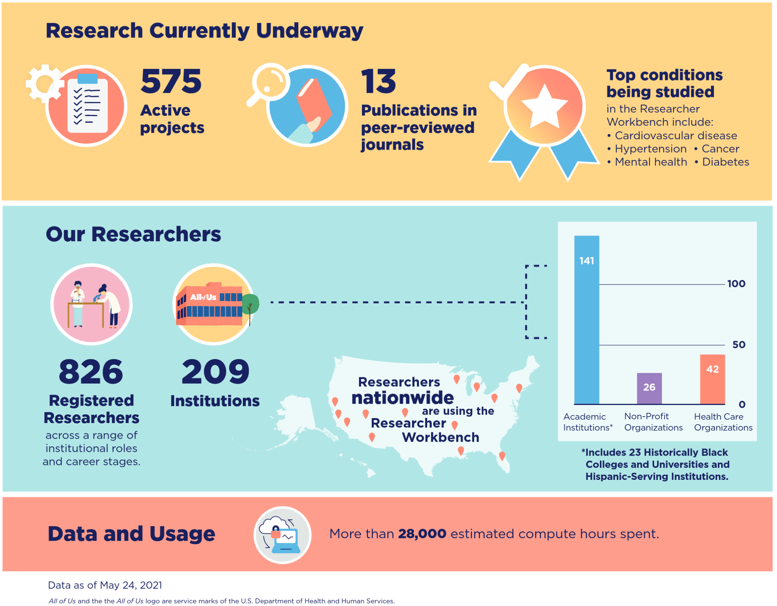
Document 29
Notes:
The All of Us Research Program is an ambitious effort to gather health data from one million or more people living in the United States to accelerate research that may improve health.
* It has been more than a year since All of Us launched its Research Workbench, providing access to over 300,000 participant records. 80% of participants are from communities underrepresented in biomedical research, with 50% of All of Us participants representing racial and ethnic minorities.
* The Researcher Workbench currently includes physical measurements, electronic health record data, limited Fitbit data, and responses from seven different surveys. These surveys capture participant data on lifestyle factors, healthcare utilization and access, and COVID-19 participant experiences.
In this first year alone, * over 800 researchers from 209 different institutions have collaborated on * 575 active projects, studying a range of conditions, including cardiovascular disease, cancer, mental health, diabetes, infectious diseases, and more.
New data and tools are being added all the time. At NHGRI, we are especially interested about the upcoming release of genomic data. The first batch of genomic data is expected to be released in 2021 to approved “alpha users” of the Controlled Access Tier.
46

Slide 47
Director’s Report Outline
General NHGRI Updates
General NIH Updates
General Genomics Updates
NHGRI Extramural Research Program
NIH Common Fund/Trans-NIH
NHGRI Communications, Policy, and Education
NHGRI Intramural Research Program
Notes:
Moving on to NHGRI activities in the areas of communications, policy, and education.
47

Slide 48
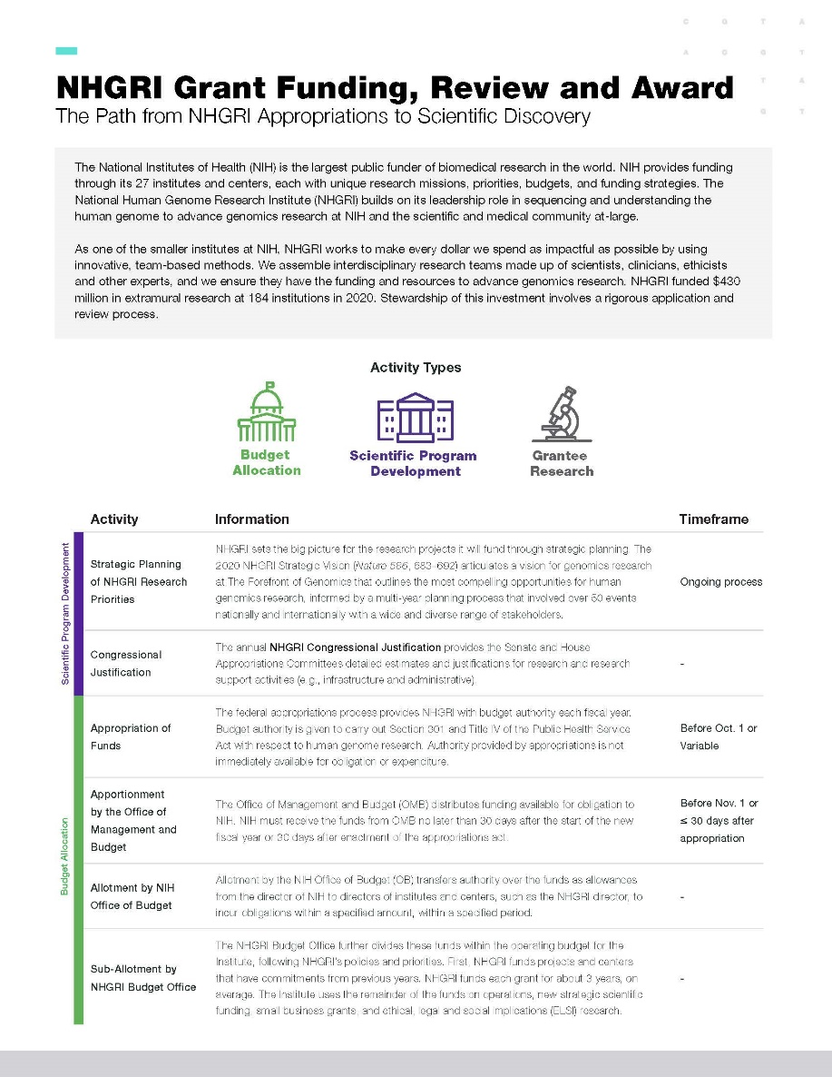

    New Resource on NHGRI Grant Funding Process
Document 30
Notes:
The NHGRI Policy and Program Analysis Branch, in collaboration with the Communications and Public Liaison Branch, has developed a two-page resource that succinctly describes the NHGRI grant funding process. Starting with ongoing strategic planning and the setting of research priorities, the document covers the Congressional budget allocation process, program development, grant review, and grantee research. Written for a general audience, this document aims to demystify the grant-funding process and to be useful for several purposes related to understanding NIH’s process for enabling scientific discoveries. The document is available on NHGRI’s website genome.gov.

Slide 49


Previous events
    Conversations with trailblazing science communicators
Document 31
Notes:
Throughout 2021 and 2022, NHGRI will host the Genomics and the Media virtual lecture series featuring trailblazers in science communication. Each distinguished speaker is an expert in communicating about genomics across media, including radio, podcasting, writing, speaking, publishing, and everything in-between. The series aims to demonstrate the various approaches for communicating information about genomics as well as the unique challenges and opportunities that each medium can bring. The next event will feature Amy Harmon from the New York Times on Monday, September 20.

Slide 50
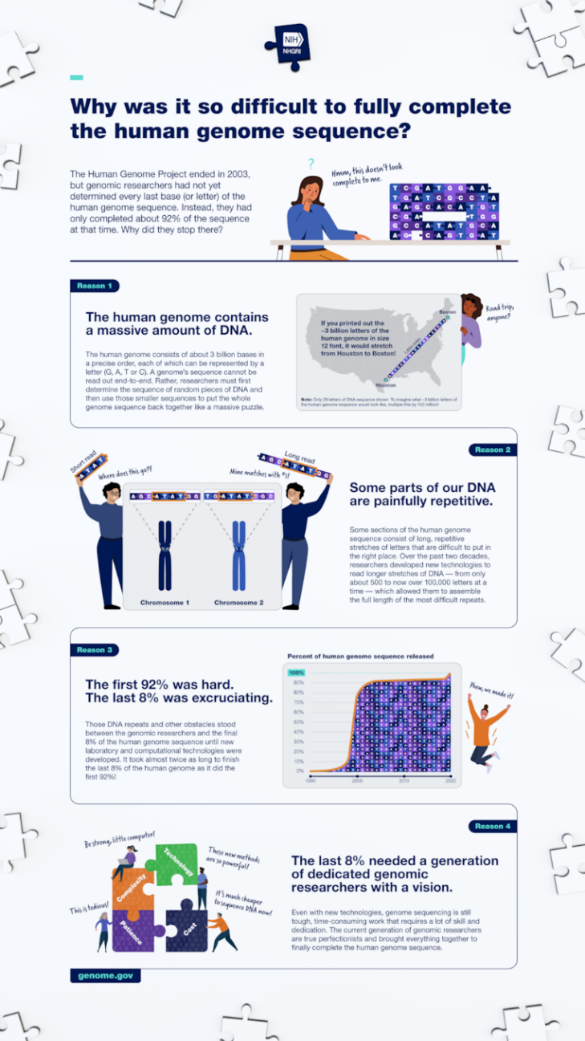
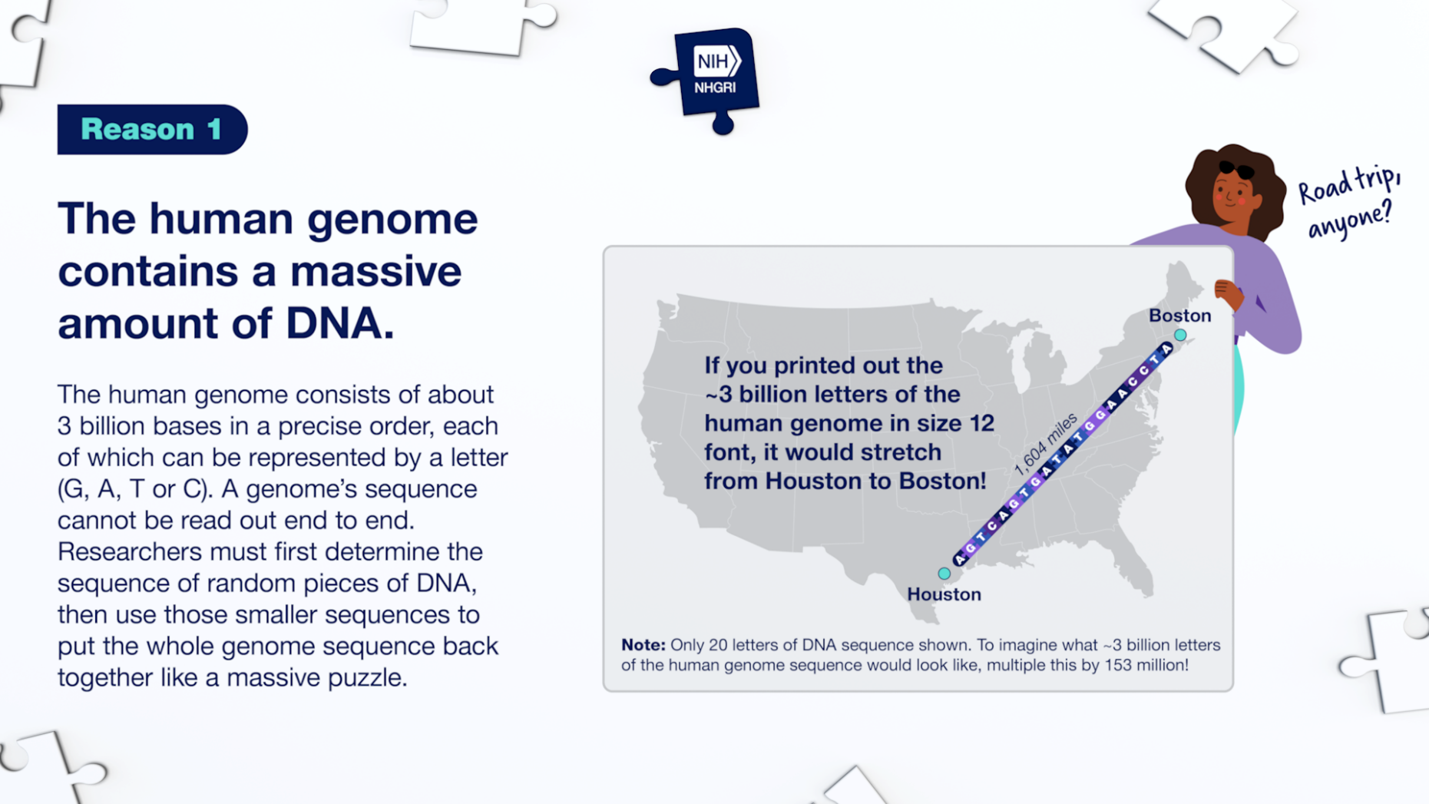
Infographic on Completing the
Human Genome Sequence
Document 32
Notes:
This past summer, researchers in the Telomere-to-Telomere Consortium posted a preprint in BioRxiv describing the generation of a truly complete sequence of a human genome. To illustrate some of the challenges associated with reaching this milestone, NHGRI’s Communications and Public Liaison Branch designed an entertaining and engaging infographic to share with the public. This infographic provides a simplified explanation of what the Telomere-to-Telomere Consortium aims to accomplish and why this work has proven so difficult.

Slide 51
NHGRI History of Genomics Program
Conference Celebrating the Work of David Depew
    Eight internationally recognized scholars
    Presentations drawing from themes in Depew’s work
    108 total attendees
Document 33
Notes:
In July, NHGRI’s History of Genomics Program hosted a one-day virtual conference entitled “From the Baldwin Effect to Genes of Small Effect: Celebrating the Work of David Depew.”
David Depew, Professor Emeritus at the University of Iowa, was among the first philosophers and historians of genetics. His work addresses some of the foundational questions that have emerged out of the evolutionary synthesis as well as the social and political implications of genetics and geonomics – things that continue to be relevant in today’s genomic era.
* The conference gathered eight internationally recognized scholars who drew from themes in Depew’s work to present on several areas of the history and philosophy of biology and genetics. A total of 108 people attended the virtual event. By bringing together historians and philosophers of biology, the conference helped increase the understanding of genomics, genetics, and molecular biology, including its history and its philosophical and ethical implications in the scholarly community and among the wider public.
A scholarly volume of papers on the themes of the meeting is in the planning stages. A full video recording of the conference can be viewed on NHGRI’s YouTube channel, GenomeTV.

Slide 52
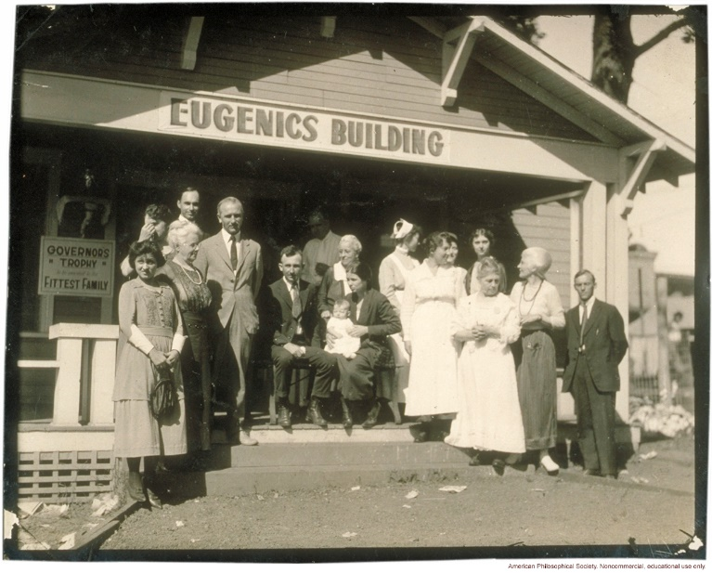
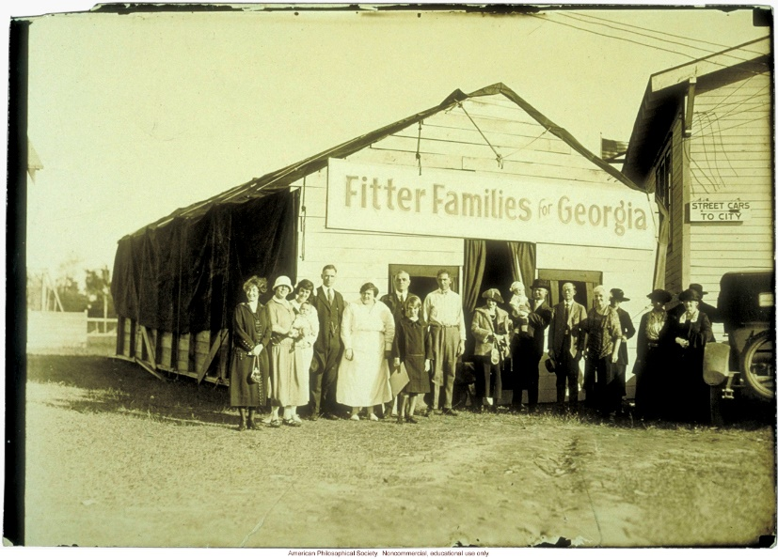


NHGRI History of Genomics Program
Symposium on the History of Eugenics and Scientific Racism
December 2-3, 2021​
Examine history of eugenics, scientific racism, and complex legacies in the modern health sciences
Document 33
Notes:
As part of NHGRI’s ongoing efforts to confront systemic racism in genomics, the institute will host a “Symposium on the History of Eugenics and Scientific Racism” on December 2-3. Led by NHGRI historian Christopher Donohue and Oxford Brookes Professor Marius Turda, the event will feature preeminent historians of science and medicine, who will examine the history of eugenics, scientific racism, and its complex legacies in the modern health sciences. Staff from the United States Holocaust Memorial Museum and the American Museum of Natural History will also present their own work on these topics and describe freely available educational and scholarly materials.
52

Slide 53
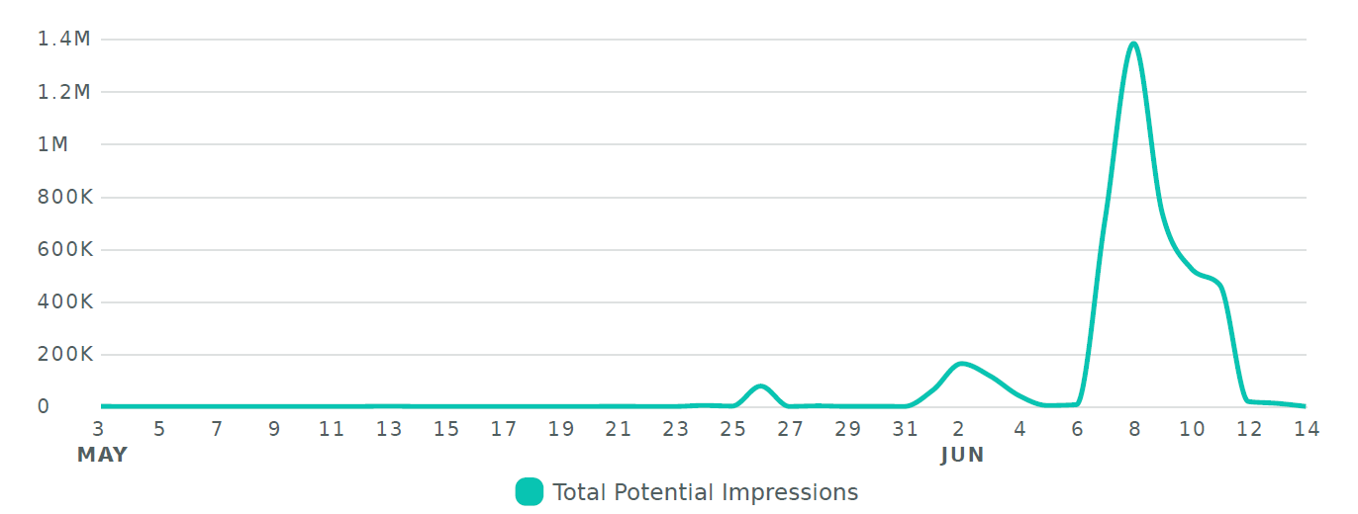
Healthcare Provider Genomics Education Week 2021
Social Media Campaign
# of impressions
    #MedGeneEd21
Date
Document 34
Notes:
In June, NHGRI hosted a week-long social media campaign to showcase the availability of genomics educational resources to healthcare providers, students, and the public. NHGRI’s Education and Community Involvement Branch engaged members of the Inter-Society Coordinating Committee for Practitioner Education in Genomics. As a result, over 50 professional organizations and universities participated in the campaign. A social media toolkit provided guidance and templates, including videos, zoom backgrounds, and sample tweets, which helped organizations advertise their events.
An event webpage on genome.gov listed live events that occurred during the five days, each with a specific topic: Pharmacogenomics, Inclusive Genetics, Rare Diseases, Cancer Genomics, and Direct-to-Consumer Genetic Testing. This social media campaign broke records within not just our organization, but also our partner organizations. The graph on the right demonstrates that content marked with the hashtag #MedGeneEd21 garnered over 4 million impressions during the week of the program, more than eight times that observed for previous events. We plan to make this a yearly campaign and will use lessons learned to have an even bigger campaign next year.
53

Slide 54
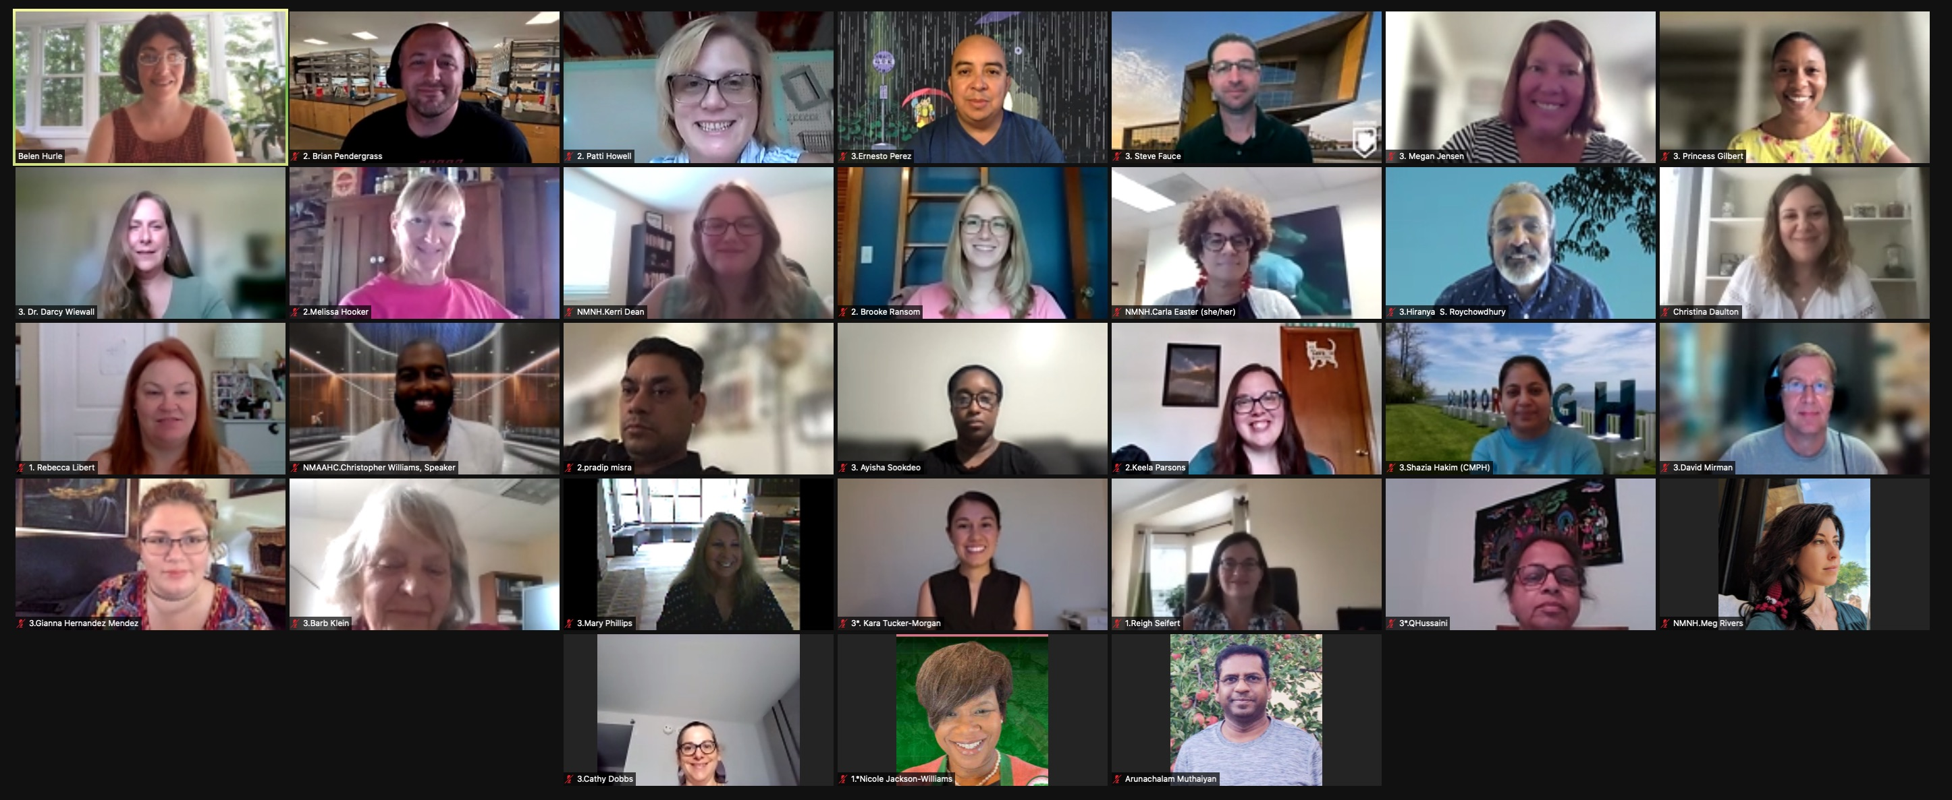
2021 Short Course in Genomics
Document 35
Notes:
In August, NHGRI’s Education and Community Involvement Branch hosted its annual Short Course in Genomics for middle school, high school, community college, and tribal college science educators. This year, NHGRI welcomed 26 educators from 13 states. The course provided an opportunity for STEM educators across the United States to hear lectures and receive teaching resources from leading researchers, clinicians, and staff from NHGRI, NIH, and our partners. Much like the 2020 course, this year’s virtual format built an engaged educator community through pre-taped lectures, live lectures, Q&A sessions, and hands-on virtual activities in such areas as complex genetic diseases, gene editing, the human microbiome, and ethical issues in genomics research.
54

Slide 55
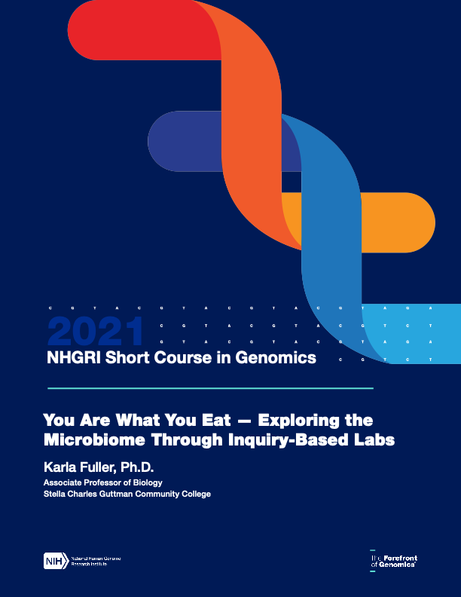
Microbiome Lesson Plans
A Glimpse Into the Microbiome: An Introductory Lecture
You Are What You Eat – Exploring the Microbiome Through Inquiry-Based Labs
Microbiome Virtual Lab Exploration!
Exploring the Microbiome and Its Connection to Metabolic Syndrome
Document 35
Notes:
This year’s Short Course in Genomics also featured four new microbiome lesson plans, which were developed by Short Course alumni from the past five years based on provided lectures and resources. The efforts of these educators were supported by staff from the Education and Community Involvement Branch and the Communications and Public Liaison Branch. The lesson plans cover the following: * an introductory lecture, * inquiry-based labs, * a computational lab, and * a case study on the microbiome and metabolic syndrome. The plans are now available for free download from NHGRI’s website genome.gov.

Slide 56
Director’s Report Outline
General NHGRI Updates
General NIH Updates
General Genomics Updates
NHGRI Extramural Research Program
NIH Common Fund/Trans-NIH
NHGRI Communications, Policy, and Education
NHGRI Intramural Research Program
Notes:
56
And finally, moving on to NHGRI’s Intramural Research Program.

Slide 57
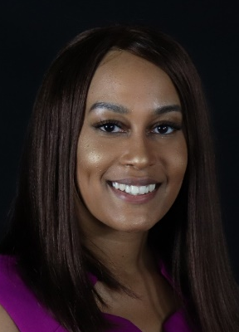
NHGRI-FDA Genomic Science and
Health Equity Postdoctoral Fellowship
Raven Hardy, M.S., Ph.D.
Document 36
Notes:
In January 2021, the NHGRI Division of Intramural Research and the FDA Office of Minority Health and Health Equity established a new joint training fellowship, the Genomic Science and Health Equity Postdoctoral Fellowship. This fellowship prepares and trains fellows to use genetic, genomic, and pharmacogenomic approaches to advance minority health and health equity while developing skills to translate laboratory research in practice.
* Our first Genomic Science and Health Equity Postdoctoral Fellow, Raven Hardy, started in August 2021. Raven was a Robert Wood Johnson Health Policy Research Scholar, who received her Ph.D. in Neuroscience from Emory University in 2021, where she conducted research on sickle cell disease and cognitive and behavioral deficits. Prior to pursuing her Ph.D., she attended Spelman College and the Scripps Research Institute, where she obtained bachelor’s and master’s degrees in Biology, respectively.
Applications are now being accepted for the second Genomic Science and Health Equity Fellow, who will start in the summer 2022.
57

Slide 58
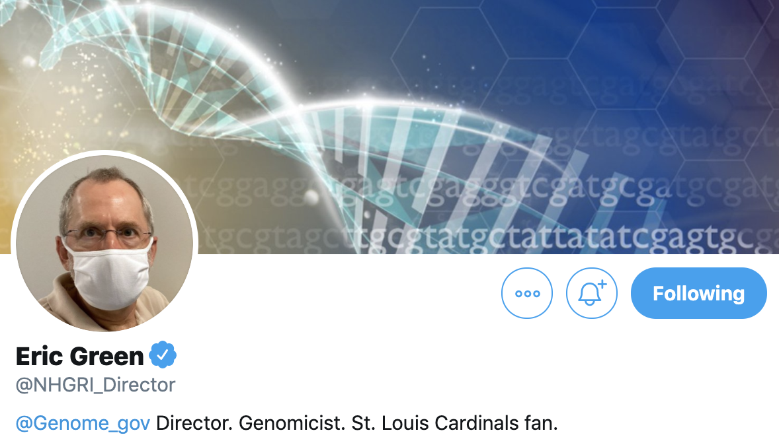
NHGRI Director on Twitter
Document 37
Notes:
Before closing, let me remind you that I can be followed on Twitter at @NHGRI_Director, where I communicate regularly about NHGRI and genomics to various stakeholders.

Slide 59

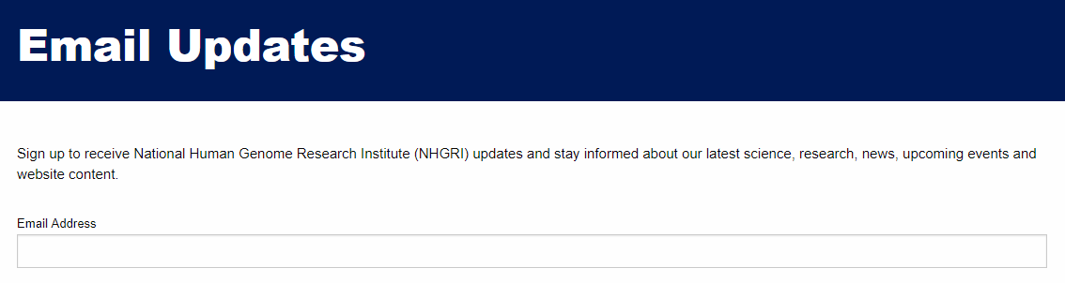
Document 38
Notes:
And for those of you who only want to hear from me once a month, you are welcome to sign up to receive my monthly email update (called The Genomics Landscape) on the NHGRI website (genome.gov) by subscribing under “Email Updates.”
59

Slide 60

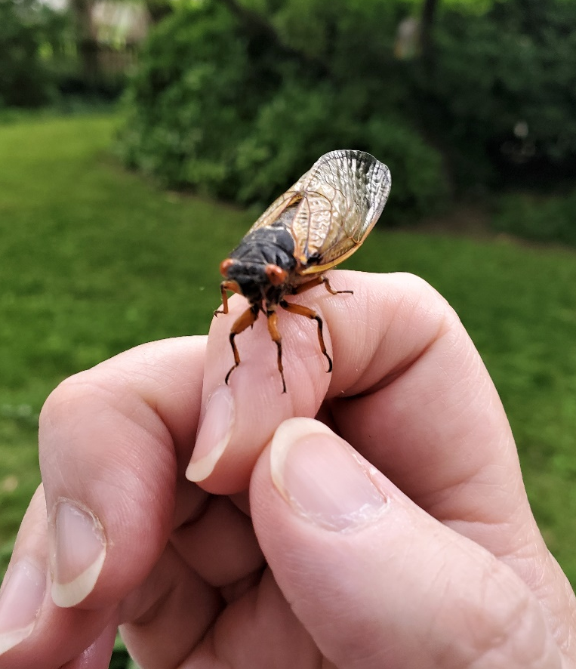
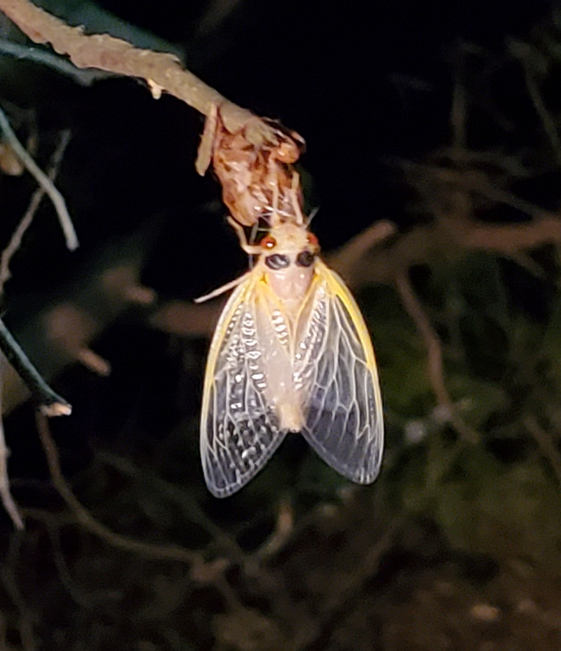
Thanks!
Special Thanks!
Notes:
Finally, a personal thanks to the many NHGRI staff members who contributed the slides and associated materials that I just reviewed in my Director’s Report. As always, a group effort is essential for getting such a large amount of information conveyed efficiently at each Council meeting.
An additional thanks to the NHGRI communications group and web team for creating the electronic resource associated with my Director’s Report.
And * a special thanks to the usual ‘ringleader’ for helping me prepare my Director’s Report, Kris Wetterstrand, * who opted not to include a picture of herself (although that is her hand on the left), but instead to include photos featuring members of Brood X (the 17-year cicadas) that visited the DC area earlier in the summer.
60

Slide 61
Notes:
61

