Slide 1
Mindful Printing Campaign 2015
Presentation by:
Office of Research Facilities

Slide 2

Mindful Printing Campaign 2015
NIH is kicking off a Mindful Printing Campaign for the month of February 2015.
Purpose: We would like to encourage everyone to minimize their printing, and thank those of you who already minimize your printing and maximize your recycling.
Facts about NIH printing:
In 2014, NIH recycled 660 tons of paper which is equivalent to 16,500 sheets of paper per employee.
This is a massive amount of printing per person.
We would like to encourage everyone to consider ways to minimize their printing and paper use.

Slide 3
Mindful Printing Toolbox
Fact Sheet – How to Host Paperless Meetings
Fact Sheet – Paper Reduction
Flyer – Thank you for Using a Network Printer
Quiz with answers
Presentation – Mindful Printing
Global Email
All items can be found at:

Slide 4

Paper Reduction Tips
Adopt and promote a Mindful Printing attitude. Think twice before you print. When less than the full document is needed, print a custom range of only the pages that are needed.
Share documents with your colleagues as electronic files, rather than as paper copies.
For items that must be printed, confirm the number of copies that are needed to avoid making extra copies.
Adopt an organizational policy which instructs employees to use duplex printing and requires the procurement of copiers and printers that have the capability to duplex print. Then ensure that computer and copier default settings are set to duplex print.

Slide 5

Paper Reduction Tips
Preview and proofread documents as much as possible on the computer monitor before printing.
Keep copiers and printers in good repair. Schedule maintenance for copiers that are performing poorly, and report error and alert messages, such as low toner warnings. Copiers operating with low toner jam more frequently and waste paper.
To avoid paper jams which waste paper, fill copier trays correctly. Some paper is directional, and should be loaded into the copier tray according to the arrows shown on the packaging.
Learn to host paperless meetings. Project the meeting agenda and materials on a screen, rather than distributing paper copies. Share materials electronically with meeting attendees before the meeting. Take notes on a laptop, and distribute them to the attendees electronically.

Slide 6

Printer Reduction
Encourage employees to use network printers and reduce individual printers.
NIH has approximately 12,000 network printers, and a staggering 14,000 individual printers.
The cost to print per page is approximately 30x cheaper with a network printer than an individual printer!
Ratio of people to printers at NIH is 1:1
Using network printers saves the NIH money

Slide 7
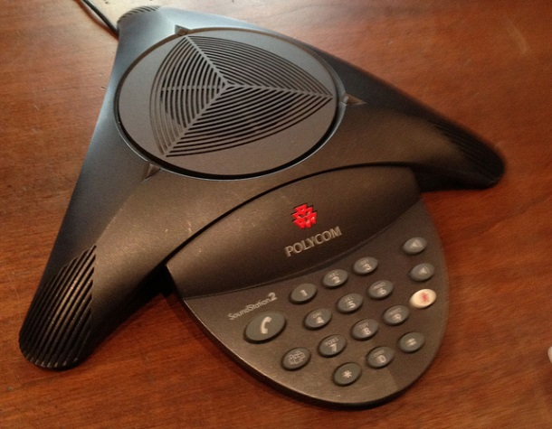
Paperless Meetings
Use emails, or a web application like Microsoft SharePoint to share meeting materials prior to the actual meeting. As the host, let your meeting attendees know that you will not be providing paper copies of the materials at the meeting. Meeting attendees can bring paper copies if necessary.
During the meeting, display the meeting agenda and the presentation materials on the screen.
Provide options for members to attend the meeting remotely. Implement a conference call number and/or an online meeting space.

Slide 8
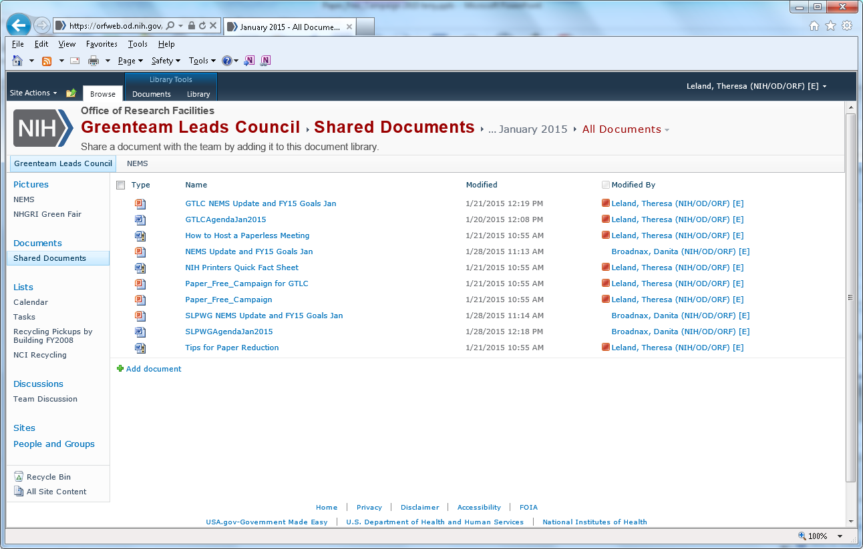
Paperless Meetings
Take meeting notes and attendance with your laptop or a hand held device. After the meeting, post the meeting notes on a SharePoint site or distribute them through email.
If you need volunteer participation, try using online sign up tools such as “Sign-up-Genius”.
If you need to collect data, try using an online survey tool, such as “Survey Monkey”.

Slide 9
Guide to Printing and Publication Services
Most NIH traditional printing and publishing procurement such as employee newsletters, pamphlets, brochures, advertisement, graphic art work, research posters and outreach materials etc., are readily adaptable to green printing practices – often at no or low cost. Many federal print contractors offer green printing services, if you ask! When considering a new print job, ask for the following:
Responsible Paper Sourcing (see http://www.rit.edu/upub/going-green-glossary-terms-and-marks):
  Specify paper with 30% or GREATER post-consumer recycled fiber – PCW
  Use Processed Chlorine Free – PCF or Totally Chlorine Free – TCF paper (dioxin, a carcinogen is often used to bleach paper and lasts forever),
  Consider specifying certified papers with logo to indicate paper from well managed forests adhering to strict environmental standards, such as:
  Forest Stewardship Council (FSC),
  Program for the Endorsement of Forest Certification (PEFC)
  Sustainable Forestry Initiative (SFI)

Slide 10
Guide to Printing and Publication Services
Environmentally Friendly Inks:
  Vegetable oil-based inks that are made with < 3% volatile organic compounds (VOC) (still produces great images but pollutes less)
  Low VOC print processes e.g. solvent-free UV or water-based aqueous coatings
Sustainability Messaging:
  Make the health and sustainability connection, enhance your product and acknowledge green printing with a foot note on the finished product.
  Example: “Promoting health through responsible printing: 100% Recycled Content, 100% post-consumer waste, processed chlorine free using low VOC vegetable based inks” [Include appropriate logos)

Slide 11
Guide to Printing and Publication Services
Environmentally Friendly Inks:
  Vegetable oil-based inks that are made with < 3% volatile organic compounds (VOC) (still produces great images but pollutes less)
  Low VOC print processes e.g. solvent-free UV or water-based aqueous coatings
Sustainability Messaging:
  Make the health and sustainability connection, enhance your product and acknowledge green printing with a foot note on the finished product.
  Example: “Promoting health through responsible printing: 100% Recycled Content, 100% post-consumer waste, processed chlorine free using low VOC vegetable based inks” [Include appropriate logos)

Slide 12
NIH Sustainability Goals
Federal sustainability requirements include:
Reduce greenhouse gases
Advance sustainable acquisition of products and services
Promote and prevent pollution, and minimize the toxics acquired, used, or disposed
Increase use of acceptable alternative chemicals
Use 30% or > recycled content paper and reduce printing paper use
For more information see Executive Order 13514 and 13423.

Slide 13
Reducing Paper before a Move
Is your office moving? Is your office too crowded?
  Sort your paper into 3 piles
    Recycle/ Shred
    Scan (then shred)
    Retain and keep
Be careful! Read NIH Manual Chapter 1743
More information can also be found with Records Management

Slide 14
Questions
Danita Broadnax or Terry Leland
Division of Environmental Protection, ORF, NIH
(301) 496-7775

