Slide 1

NIH Director’s New Innovator Award (DP2)
Srikanth Ranganathan, PhD
Scientific Review Officer, New Innovator Award Review
Musculoskeletal, Oral and Skin Sciences IRG,
CSR, NIH
CSR Advisory Council Meeting
September 24, 2018

Slide 2

Program Details
Launched in 2007: Minimum of 33-35 awards
Exceptionally creative “Early Stage Investigators” (No Multi-PI applications)
Bold and highly innovative research with significant impact
$1.5 million in direct costs for a 5-year grant
500-600 applications each year

Slide 3
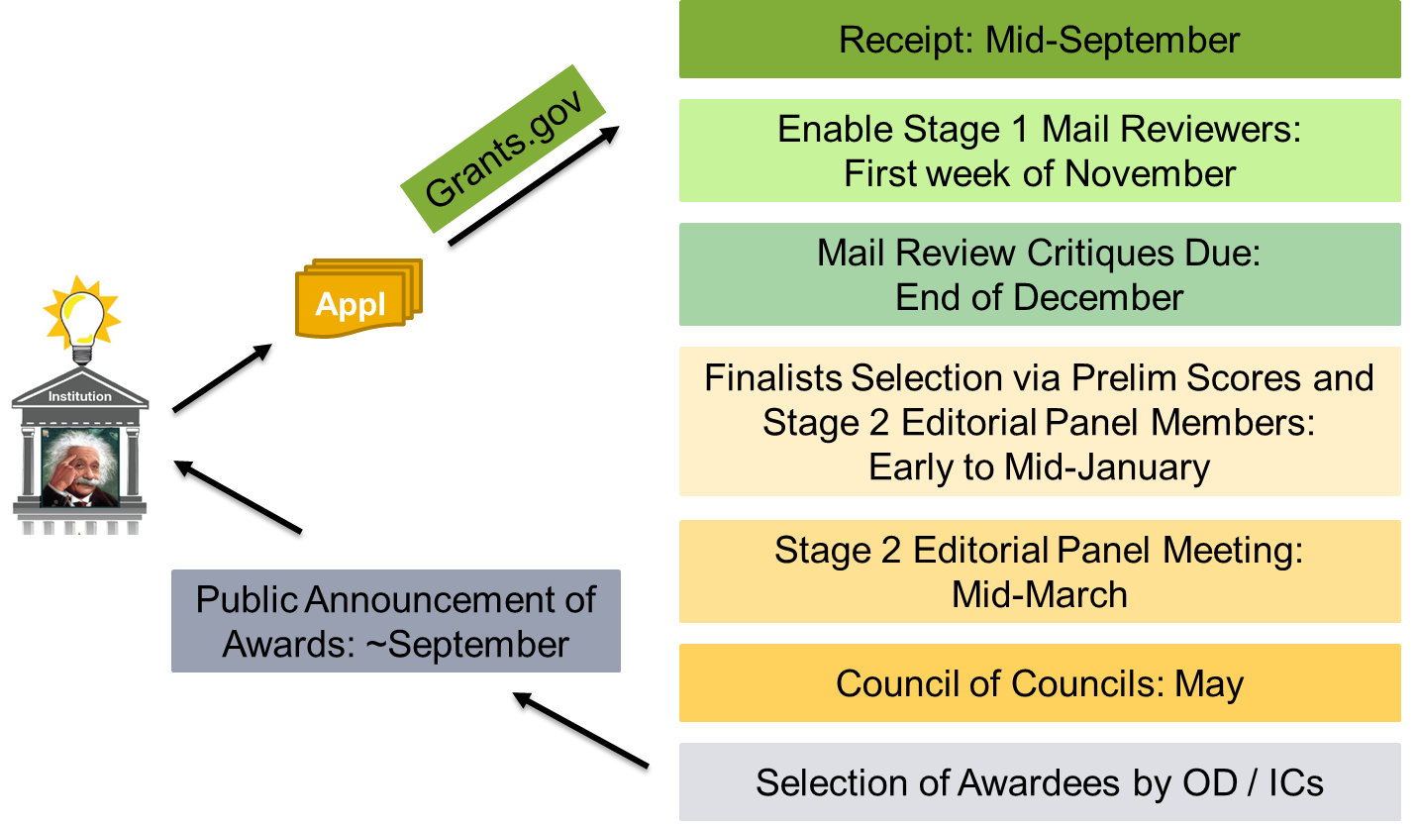
New Innovator Award Review and Funding Proc

Slide 4
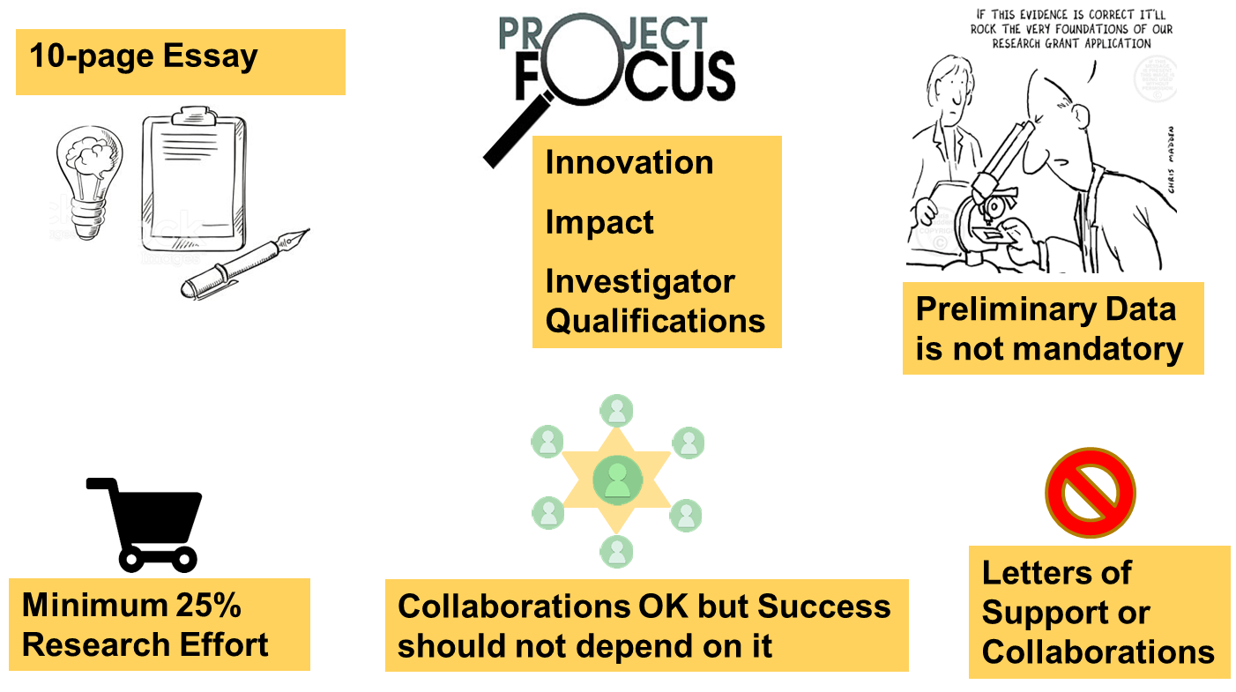
Application Details

Slide 5
Scientific Areas
Behavioral and Social Science (BBS)
Chemical Biology (CB)
Clinical and Translational Research (CTR)
Infectious Disease and Immunology (IDI)
Instrumentation and Engineering (IE)
Molecular and Cellular Biology (MCB)
Neuroscience (NS)
High Throughput and Integrative Biology (HIB)
Bioinformatics and Computational Biology (BCB)

Slide 6
Peer-Review Process: Stage 1 (Mail Reviews)
~200 Mail Reviewers
Up to 10 Assignments / Rev
3 Reviewers / Application
Three Criteria and an Overall Impact Score (1-9)
      “Importance and Potential Impact of the Scientific Problem”
      “Novelty / Innovativeness of Approach”
      “Creative Potential of ESI”
      Overall Impact Paragraph

Slide 7
Selection of Finalists
      Rank order list of the Mail reviewers’ Overall Impact Scores
      Any application with a score better than a set threshold is an automatic finalist
      An unbiased selection of applications by the editorial panelists from the rest of the applications (they are provided access to the overall impact scores and the critiques)
      The editorial panelists do not need to provide a justification
      About 20% of applications selected for Stage 2

Slide 8
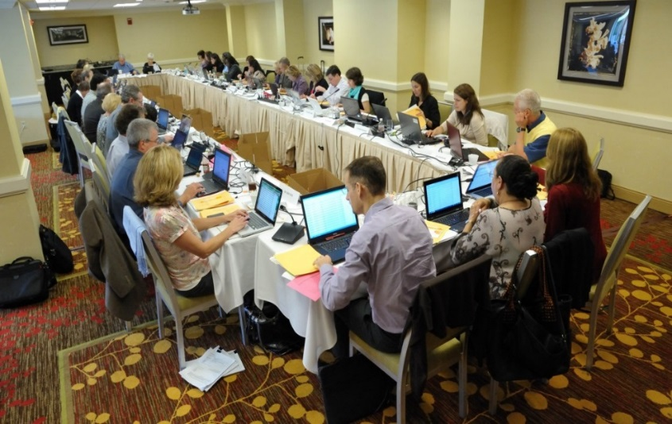
Stage 2: Final Meeting
26-27 panelists
Experts with broad scientific understanding
~110 applications (All discussed)
2 days
3 Discussants / Application
First 2 discussants are generally covering the science areas of the application
Scoring is focused on Impact & Innovation
Release of final scores and Summary statements

Slide 9
Thank You
Rajiv Kumar, PhD
Chief, MOSS IRG
Support Staff (MOSS IRG)
Ms. Lynda Robinson
Ms. Lauren Nazzel
Ms. Beverly Cleveland
Ms. Latonya Carter

Slide 10
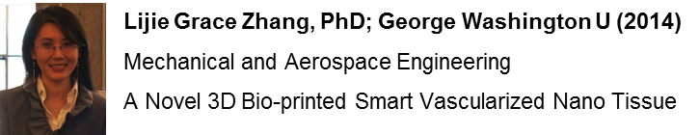
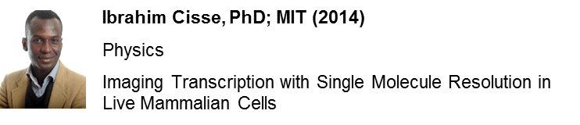
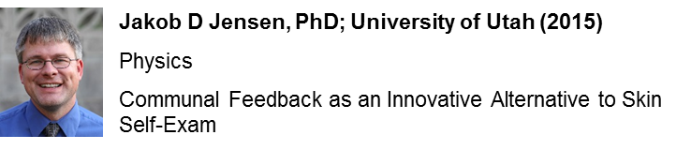
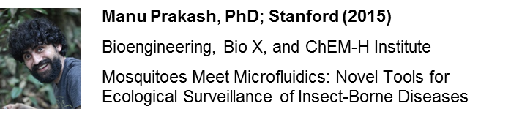
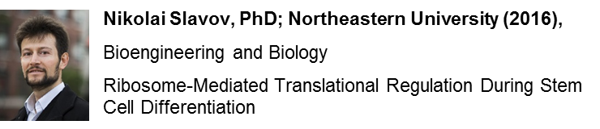
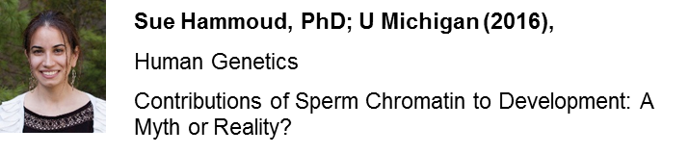
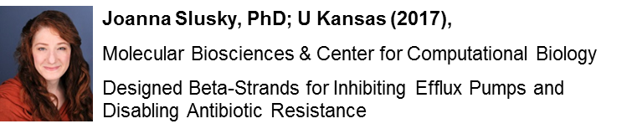
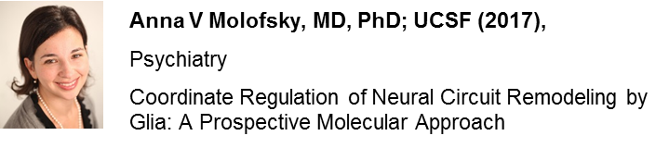
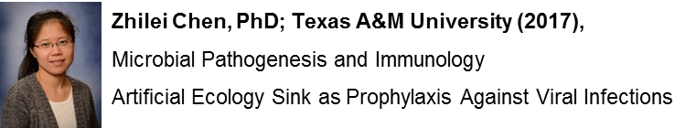
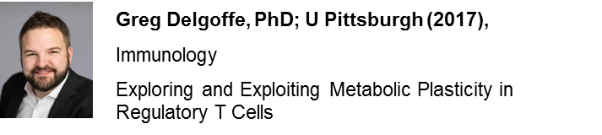
Sampling of Awardees

