Slide 1
NIH Director’s Early Independence Award Review
Weijia Ni, Ph.D
Suzanne Ryan, Ph.D
CSR Advisory Council
September 24, 2018

Slide 2


High-Risk, High-Reward Research Program
Enables outstanding early career scientists to move rapidly into independent research positions by skipping the traditional postdoc
Applicants in non-independent position at time of application; within one year before or after obtaining terminal degree (or clinical training)
Limited to 2 applications per institution
Commit minimum 80% effort each year for first 2 years
R01-like applications; No preliminary data required
Awards up to $250,000 per year for 5 years
Initiated in 2011; 110 awards have been made

Slide 3
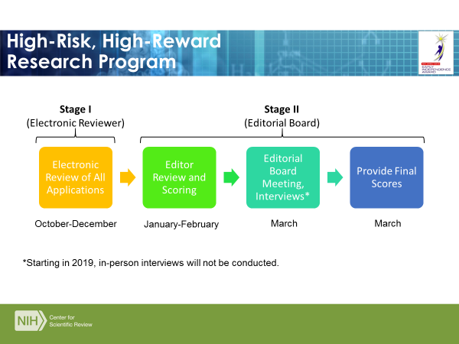

Slide 4
Unique Application Components
Standard R01 application format with some unique components:
Research Strategy with subsections
  Rationale for omitting post-doc
  Evidence of transition to an independent position
  Personal/career development plan
  Evidence of training capability and leadership
  Host institution interactions
  Research challenge
  Approach
  Innovation
  Relationship to previous work
  Timeline
Facilities and other resources – substantial presentation of Institutional support
Three to five letters of recommendation

Slide 5
Stage 1 Electronic Review
  All CSR Integrated Review Groups (IRGs) Participate in recruiting and assigning subject matter experts. Standard R01 criteria, scoring procedure, and critique template are used.
  The Principal Investigator is at a very early stage of research career development. No preliminary data or extensive publications are expected.
  Emphasis is on the strengths of “Investigator” (biosketch and letters of reference) and “Environment” (institutional support).
  Evaluate potential impact of the award to the scientific field, as well as the promise and prospect of the Principal Investigator.

Slide 6
Stage 2 Editorial Board Review
  Editorial Board consists of 10-15 broad-vision scientific leaders in basic, clinical and behavioral sciences.
  Each Editor is assigned to read ~20-30 applications and Stage 1 review critiques. They assign a preliminary overall score to each application. No written critique is provided.
  Editorial Board meeting to consider for final scoring:
    Is the Principal Investigator an exceptional individual with scientific creativity and intellectual sophistication to launch and accelerate an independent research career?
    Has the host institution committed to providing the Principal Investigator scientific freedom, ample resources, collaborating faculties, and protected time to develop an independent research program?
    Who are the top outstanding applicants with the best research prospect for exerting a sustained impact to the field?

Slide 7

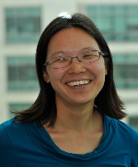
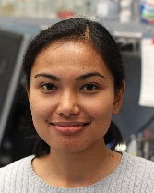
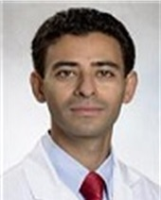
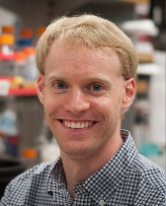

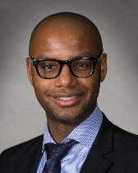
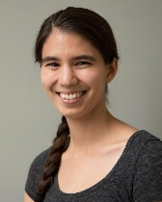
Some Examples of DP5 Awards
Daniela Witten, PhD; University of Washington (2011)
High-dimensional unsupervised learning, with applications to genomics
Ellen Yeh, PhD; Stanford University (2012)
Defining the novel eukaryotic biology of the Apicomplexan plastid
Isabelle Baconguis, PhD; Oregon Health & Science University (2013)
Structure and Function of Epithelial Sodium Channels
John Hanna, MD/PhD; Brigham and Women’s Hospital (2014)
New Ubiquitin-Proteasome System Components that Protect against Proteotoxicity
Andrew Kruse, PhD; Harvard University (2015)
Molecular mechanisms of adiponectin signaling and PAQR function
Aaron Ring, MD/PhD; Yale University (2016)
Uncoupling pleiotropy in the LIGHT/HVEM/LTBetaR signaling network
Jonathan Abraham, MD/PhD; Brigham and Women’s Hospital (2016)
Antibody therapeutics for human viral hemorrhagic fevers and prevention of late neurological syndromes
Hilary Finucane, PhD; The Broad Institute (2017)
Identifying disease-relevant cell types by integrating genetic and functional genomics data

