Slide 1



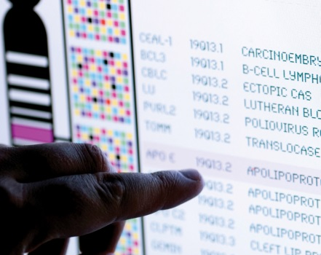
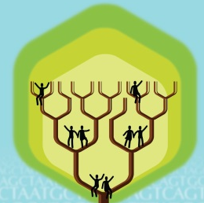
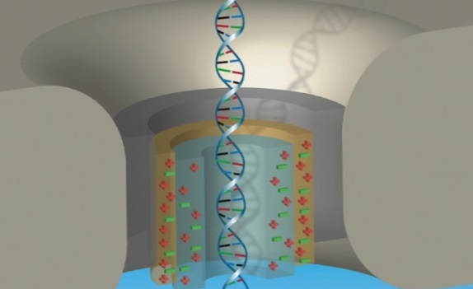


DIRECTOR’S REPORT
Eric Green, M.D., Ph.D.
Director, NHGRI
September 2020
Document #
Notes:
Once again, I would like to welcome all of you to this Open Session of the National Advisory Council for Human Genome Research meeting. As you can see, the current situation with the COVID-19 pandemic has led me to present my Director’s Report while sitting alone in my conference room. In addition (and to accommodate a shorter Council meeting), my Director’s Report is a bit shorter than the norm. Nonetheless, it contains an informative collection of updates that we wanted to share with you.
As with the rest of the Open Session, my Director’s Report presentation is being videotaped, and that recording will be made available as a permanent archive on NHGRI’s website (genome.gov).
1

Slide 2
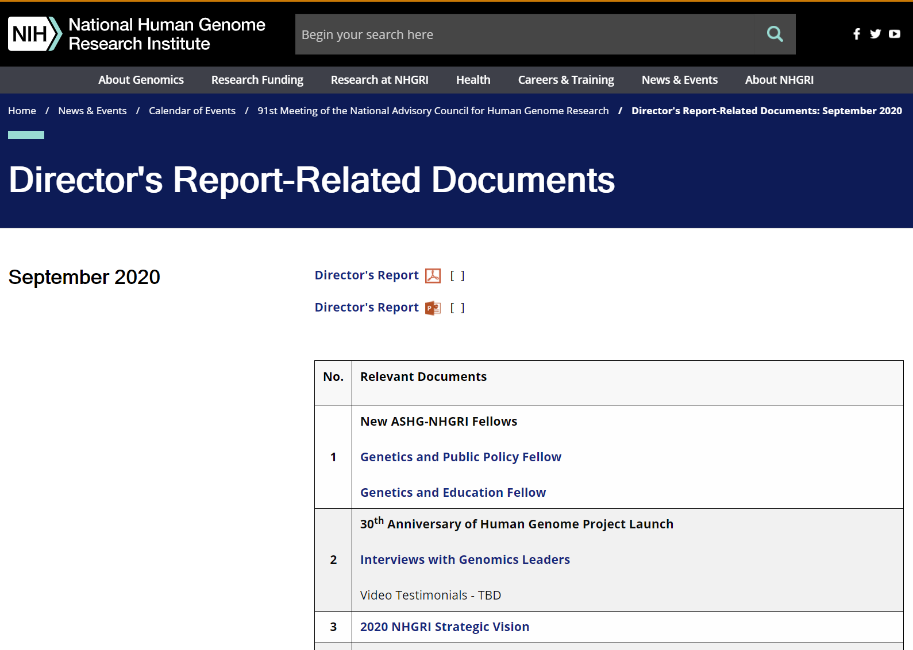
genome.gov/DirectorsReport
Document #
Notes:
For those who are new to our Council meetings, I want to make you aware of the ‘electronic resource’ that is developed for my Director’s Report. Analogous to the supplemental materials of a published paper, this resource can be accessed at the URL shown here.
The slides that I will show during my Director’s Report are also available electronically at this site – * both in PDF and PowerPoint formats.
* When there are documents or relevant websites associated with a particular slide, you will find a ‘Document #’ indicated on the bottom right of that slide; that ‘Document #’ references materials that can be accessed and/or downloaded from the web page shown here. This dedicated web page and all linked documents will be archived on genome.gov as part of the historic record of this Council meeting.
2

Slide 3
Open Session Presentations
  Presentation:
    Foreign Interference on Research Integrity: NIH Experience and Advice
    Michael Lauer
  Concept Clearances:
    Predoctoral to Postdoctoral Transition Award (F99/K00) to Promote Diversity
    Luis Cubano
    Short-Term Research Career Enhancement Award for Established Investigators (K18) to Promote Diversity
    Luis Cubano
Notes:
There will be a number of other presentations during the Open Session of this Council meeting. My Director’s Report is tailored around those presentations, and I will not discuss in detail the topics that others will cover.
* Following my Director’s Report, Michael Lauer, NIH Deputy Director for Extramural Research, will give a presentation on “Foreign Interference on Research Integrity: NIH Experience and Advice.”
Next, NHGRI Extramural Program Director Luis Cubano will present * Concept Clearances for two related training proposals, * one on a “Predoctoral to Postdoctoral Transition Award (F99/K00) to Promote Diversity“ and * one on a “Short-Term Research Career Enhancement Award for Established Investigators (K18) to Promote Diversity.”
3

Slide 4
Open Session Presentations
  Presentations:
    Perspectives in Comparative Genomics and Evolution
    Elinor Karlsson
    ELSI Research Activities across NIH
    Lawrence Brody
Notes:
Two final * presentations will then follow: * one by Elinor Karlsson, Director of the Vertebrate Genomics Group at the Broad Institute of MIT and Harvard, on “Perspectives in Comparative Genomics and Evolution” and * one by Larry Brody, Director of NHGRI’s Division of Genomics and Society, on “ELSI Research Activities across NIH.”
4

Slide 5
Director’s Report Outline
General NHGRI Updates
General NIH Updates
General Genomics Updates
NHGRI Extramural Research Program
NIH Common Fund/Trans-NIH
NHGRI Communications, Policy, and Education
NHGRI Intramural Research Program
Notes:
For the rest of my Director’s Report, I will cover the 7 areas listed here, which reliably provide a nice framework for reviewing the relevant topics.
5

Slide 6
Director’s Report Outline
General NHGRI Updates
General NIH Updates
General Genomics Updates
NHGRI Extramural Research Program
NIH Common Fund/Trans-NIH
NHGRI Communications, Policy, and Education
NHGRI Intramural Research Program
Notes:
6
And I will start with some general NHGRI updates.

Slide 7

New Deputy Director,
NHGRI Division of Genomic Medicine
Erin M. Ramos, Ph.D., M.P.H.
Notes:
It is my great pleasure to announce the appointment of Erin Ramos as the new Deputy Director of NHGRI’s Division of Genomic Medicine.
Erin joined NHGRI in 2007, shortly after completing her Ph.D. in Public Health Genetics at the University of Washington. Soon after her arrival, she stepped up to design and launch the Phenotypes and Exposures (or PhenX) Toolkit. She later established and co-chaired the first trans-NIH Data Access Committee for the Genetic Association Information Network (or GAIN), which provided access to some of the first genome-wide association studies available in dbGaP.
Even today, she continues to play a key role in data sharing policy and implementation as Co-Chair of NHGRI’s Genomic Data Sharing Governance Committee. In 2012, Erin led the establishment of the Clinical Genome Resource (or ClinGen), an authoritative central resource for establishing the clinical relevance of genes and genomic variants for use in precision medicine and research.

Slide 8

New Extramural Program Director
Rene Sterling, Ph.D., M.H.A.
Notes:
Rene Sterling is a new Program Director in NHGRI’s Division of Genomics and Society. Rene is a postdoctoral graduate of one of our Centers for Excellence in ELSI Research, where she focused on public opinion, direct-to-consumer marketing, and biobanking. She has over 15 years of federal service with one of NIH’s sister agencies, the Health Resources and Services Administration (or HRSA), where she held program officer, senior advisor, and deputy director positions. Through this work, she has acquired expertise in healthcare and public health systems, health policy, and health disparities. Rene will manage a portfolio of grants within the Ethical, Legal, and Social Implications (or ELSI) Research Program and advise on related issues.
8

Slide 9
New ASHG-NHGRI Fellows
Emma Alme, Ph.D.
Genetics & Public Policy Fellow
Tiffany Rolle, Ph.D.
Genetics & Education Fellow
Document 1
Notes:
NHGRI’s Division of Genomics and Society partners with the American Society of Human Genetics (or ASHG) in sponsoring two fellowships each year.
* The Genetics and Public Policy Fellowship program provides fellows an opportunity to work in NHGRI’s Policy and Program Analysis Branch, at ASHG, and in Congress. This year’s fellow is Emma Alme. Emma recently completed her Ph.D. in Biochemistry and Molecular Biology at the University of California, San Francisco.
* The Genetics and Education Fellowship program provides fellows an opportunity to work in NHGRI’s Education and Community Involvement Branch and at ASHG in developing educational programs for a wide range of audiences; the fellow may also do a rotation with a public or private organization involved in genetics and genomics education. This year’s fellow is Tiffany Rolle. Tiffany recently completed her Ph.D. in Molecular and Human Genetics from Baylor College of Medicine.

Slide 10
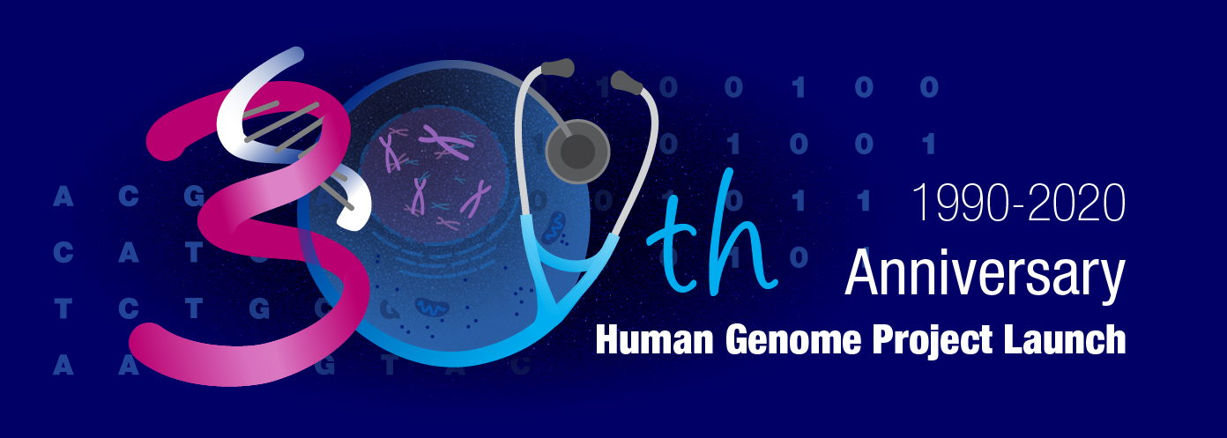
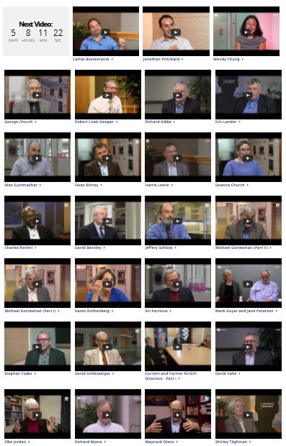

30th Anniversary of Human Genome Project Launch
Document 2
Notes:
October 1, 2020 will mark the official 30th anniversary of the launch of the Human Genome Project. Recognizing the significance of this milestone, NHGRI’s History of Genomics Program and Communications and Public Liaison Branch have been busy producing outreach materials to commemorate this anniversary and to celebrate the Human Genome Project and its legacy.
* Starting back in March, we have been showcasing 30 of our oral histories with prominent genomicists – specifically highlighting one per week for 30 weeks, leading up to the 30th anniversary itself. Some of the interviewees are shown here.
Then in October, there will be an extensive social media campaign for the 30th anniversary that will feature video testimonials about the impact of the Human Genome Project from many genomics and genetics researchers. * A preview of the testimonial from Francis Collins is shown here. NHGRI is recording some of the testimonials for this campaign, but we will also be encouraging others to make their own videos that we will then post on the NHGRI Twitter feed.
10

Slide 11

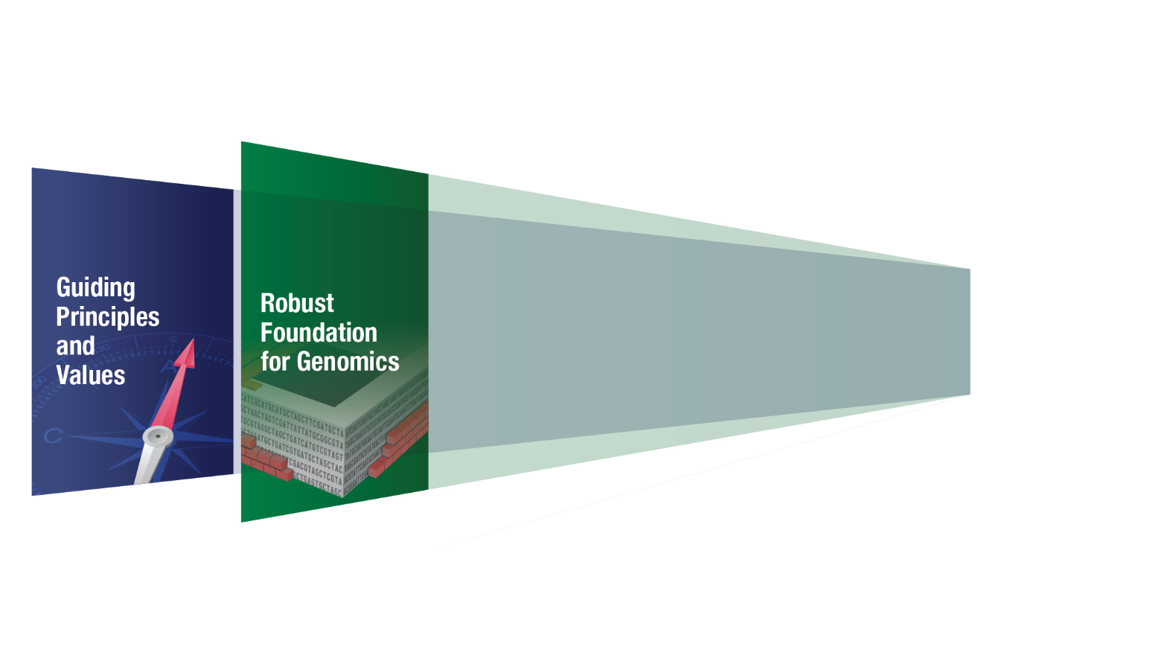
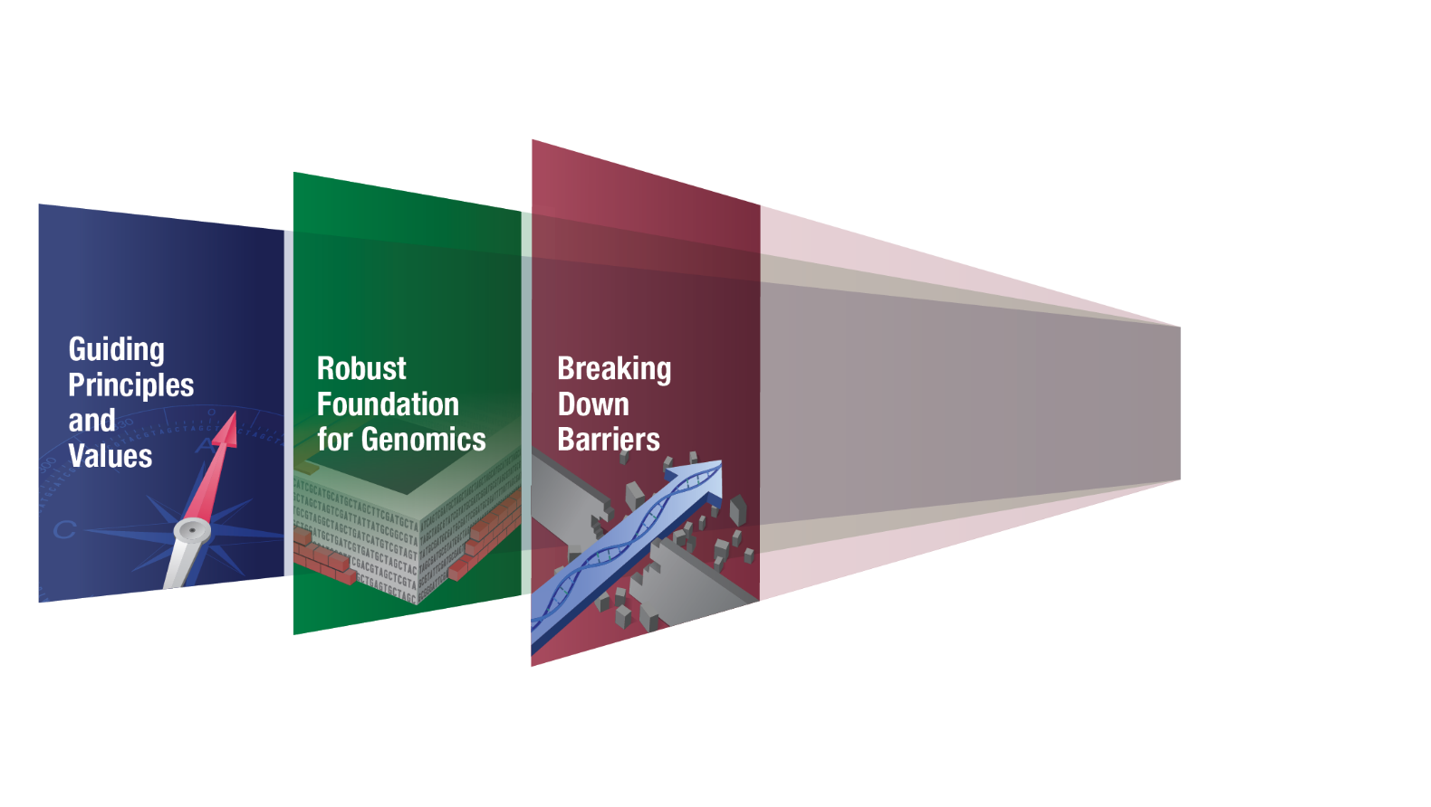
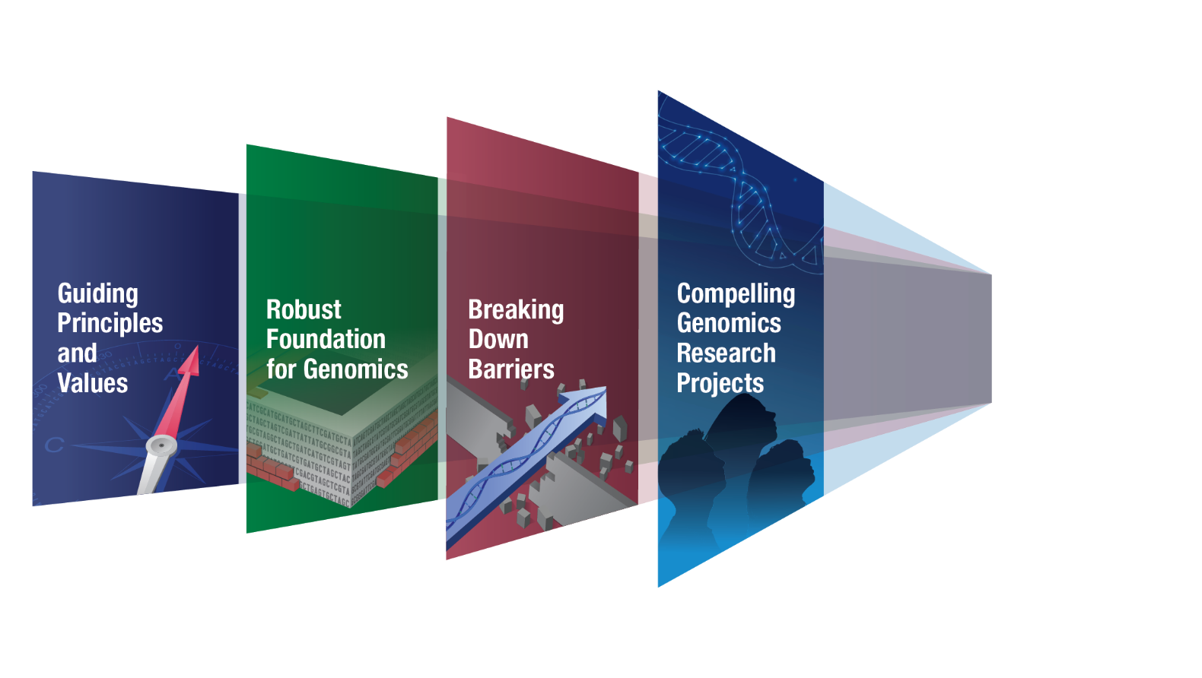
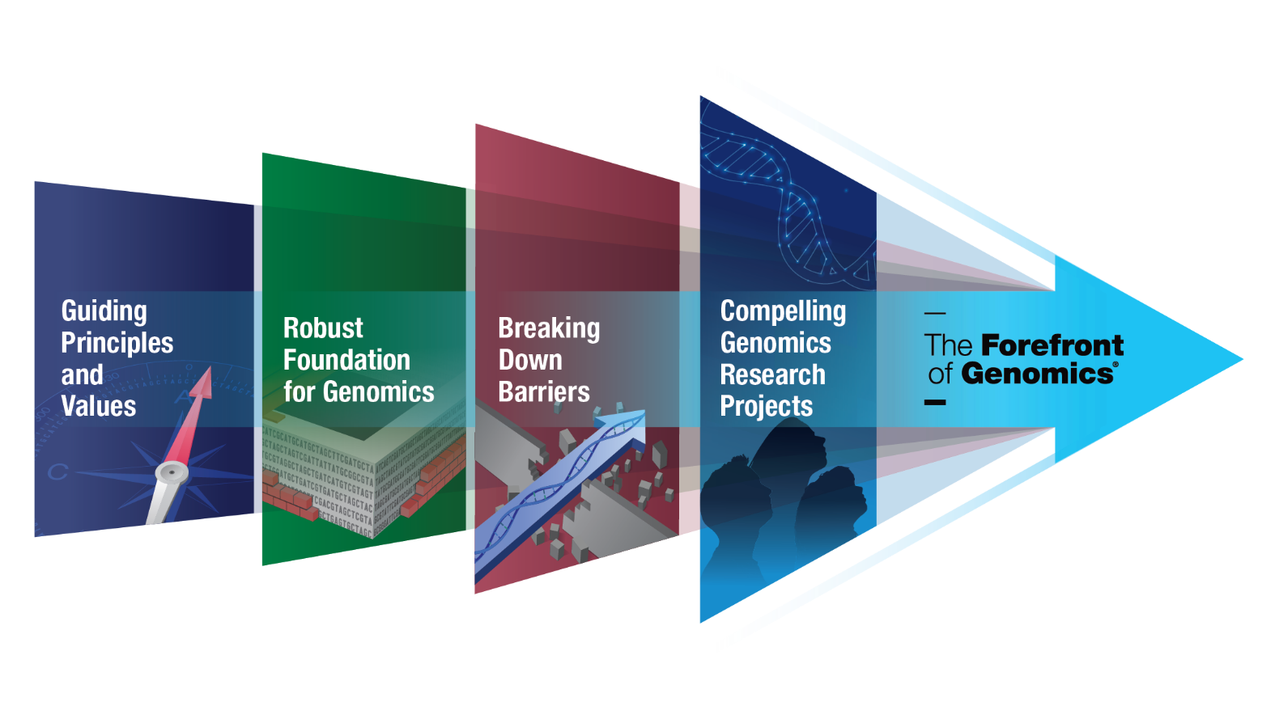
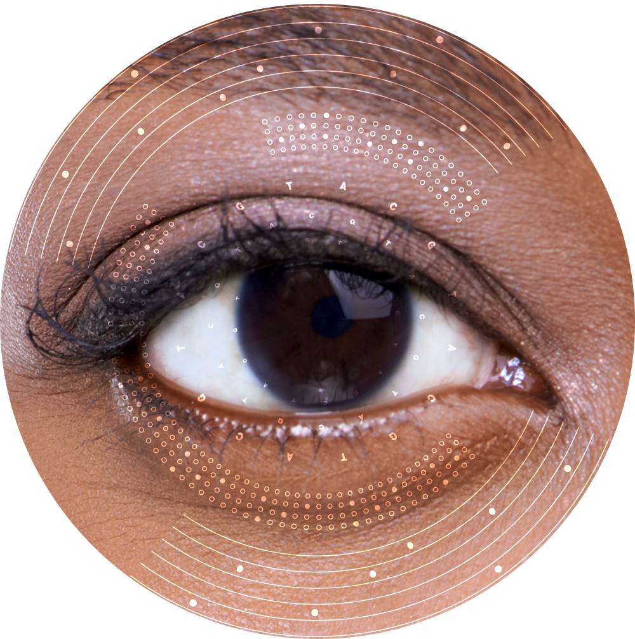
2020 NHGRI Strategic Vision
Strategic Vision for Improving Human Health
at The Forefront of Genomics
Genomics2020 Strategic Planning Process
Document 3
Notes:
The highlight of our commemoration of the 30th anniversary of the Human Genome Project’s launch next month will be the publication of the new 2020 NHGRI Strategic Vision.
* Recall that NHGRI embarked on a new strategic planning process in 2018, dubbed Genomics2020. That process involved over 50 events with numerous stakeholders and communities as well as extensive engagement with all of the institute’s advisory groups, in particular this Advisory Council. Many NHGRI staff members worked tirelessly to collect input along the way and to synthesize that input into a compelling and informative vision for the future of human genomics. We released a draft version of the strategic vision manuscript back in April and received extensive feedback that allowed us to refine it further. The manuscript was then submitted for publication in mid-summer, * and I am pleased to say that this paper, entitled “Strategic Vision for Improving Human Health at The Forefront of Genomics,” is now in press in the journal Nature and will be published in late October. Shown here is the centerpiece figure from that paper, which depicts the four major areas of the new strategic vision.
My profound thanks to many of you, both inside and outside of the institute, who contributed to the Genomics2020 Strategic Planning Process and the crafting of the 2020 NHGRI Strategic Vision paper. A special shout out to all of the current and former Advisory Council members who, for the past two-plus years, have provided invaluable advice, input, and encouragement.
11

Slide 12
Director’s Report Outline
General NHGRI Updates
General NIH Updates
General Genomics Updates
NHGRI Extramural Research Program
NIH Common Fund/Trans-NIH
NHGRI Communications, Policy, and Education
NHGRI Intramural Research Program
Notes:
Moving on to general NIH updates.
12

Slide 13


New Director, National Institute of
Environmental Health Sciences
Rick Woychik,
M.D., Ph.D.
Document 4
Notes:
Despite the COVID-19 pandemic, Francis Collins has been amazingly successful at completing recruitments of new Institute Directors to NIH, with five being announced since the last Council meeting in May.
For starters, Rick Woychik has been appointed Director of the National Institute of Environmental Health Sciences (or NIEHS). Rick joined NIEHS in 2010 as the institute’s Deputy Director and then served as Acting Director starting in October 2019. His appointment as NIEHS Director began in early June. Located in Research Triangle Park, North Carolina, NIEHS conducts and supports environmental health sciences in alignment with real-world public health needs and translates science findings into knowledge that can inform real-life individual and public health outcomes.
13

Slide 14


New Director, National Institute of
Nursing Research
Shannon Zenk,
Ph.D., M.P.H., R.N., F.A.A.N.
Document 5
Notes:
Shannon Zenk has been selected as the new Director of the National Institute of Nursing Research (or NINR). Shannon, a registered nurse and leading nurse researcher, is currently a Nursing Collegiate Professor in the Department of Population Health Nursing Science at the University of Illinois at Chicago College of Nursing. Her research focuses on social inequities and health, with a goal of identifying effective, multi-level approaches to improve health and eliminate racial/ethnic and socioeconomic health disparities. She will begin her new role as the NINR Director later this year.
14

Slide 15


New Director, National Eye Institute
Michael Chiang,
M.D.
Document 6
Notes:
Michael Chiang has been selected as the new Director of the National Eye Institute (or NEI). A practicing ophthalmologist, Michael is currently the Knowles Professor of Ophthalmology & Medical Informatics and Clinical Epidemiology at Oregon Health and Science University and is Associate Director of the university’s Casey Eye Institute. His research focuses on telemedicine and artificial intelligence for diagnosis of retinopathy of prematurity and other ophthalmic diseases, implementation and evaluation of electronic health record systems, and modeling of clinical workflow and data analytics. He will begin his new role as the NEI Director later this year.
15

Slide 16


New Director, National Institute of
Arthritis and Musculoskeletal and Skin Diseases
Lindsey Criswell,
M.D., M.P.H., D.Sc.
Document 7
Notes:
Lindsey Criswell has been selected as the new Director of the National Institute of Arthritis and Musculoskeletal and Skin Diseases (or NIAMS). Lindsey is a rheumatologist with experience as a clinician, researcher, and administrator. She currently serves as the Vice Chancellor of Research at the University of California, San Francisco, where she is also Professor of Rheumatology in the university’s Department of Medicine as well as a Professor of Orofacial Sciences in its School of Dentistry. Her research focuses on the genetics and epidemiology of human autoimmune diseases, particularly rheumatoid arthritis and systemic lupus erythematosus. She will begin her new role as the NIAMS Director in early 2021.
16

Slide 17
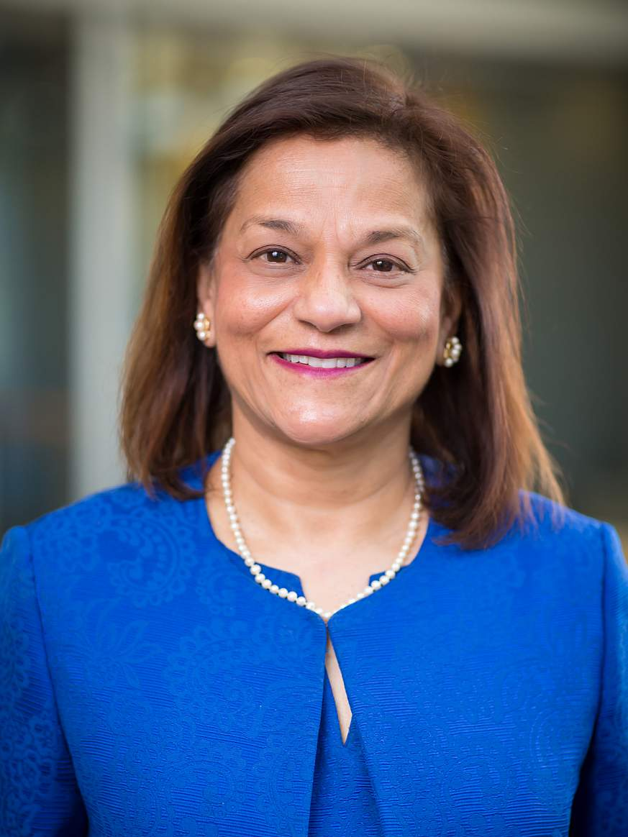

New Director, National Institute of
Dental and Craniofacial Research
Rena D’Souza,
D.D.S., M.S., Ph.D.
Document 8
Notes:
And finally, Rena D’Souza has been selected as the new Director of the National Institute of Dental and Craniofacial Research (or NIDCR). Rena currently serves as the Assistant Vice President for Academic Affairs and Education for Health Sciences at the University of Utah. There, she also serves as a Professor of Dentistry; the Ole and Marty Jensen Chair of the School of Dentistry; and Professor of Neurobiology and Anatomy, Pathology, and Surgery in the School of Medicine and the Department of Biomedical Engineering. She is a devoted mentor and champion of diversity in the biomedical research workforce. She will begin her new role as the NIDCR Director later this year.
17

Slide 18



Hannah Valantine Departs as Chief Officer
for Scientific Workforce Diversity
Hannah Valantine, M.D.
Marie Bernard, M.D.
Notes:
Later this month, Hannah Valantine will retire from NIH as the Chief Officer for Scientific Workforce Diversity. Hannah joined NIH in the spring of 2014. Since then, she has worked to develop and implement a comprehensive strategy for promoting inclusiveness and equity at NIH and throughout the biomedical research enterprise. Her accomplishments include establishing the NIH Distinguished Scholars Program; creating the NIH Equity Committee; developing and implementing the first NIH Workplace Climate and Harassment Survey; designing the Faculty Institutional Recruitment for Sustainable Transformation (or FIRST) Program; and guiding the National Research Mentoring Network. She has also led a highly productive research program within the National Heart, Lung, and Blood Institute. After departing NIH, Hannah will return home to California, Stanford University, and her family.
* Marie Bernard, Deputy Director of the National Institute on Aging, will serve as the Acting Chief Officer for Scientific Workforce Diversity while the search for a permanent successor is conducted.

Slide 19
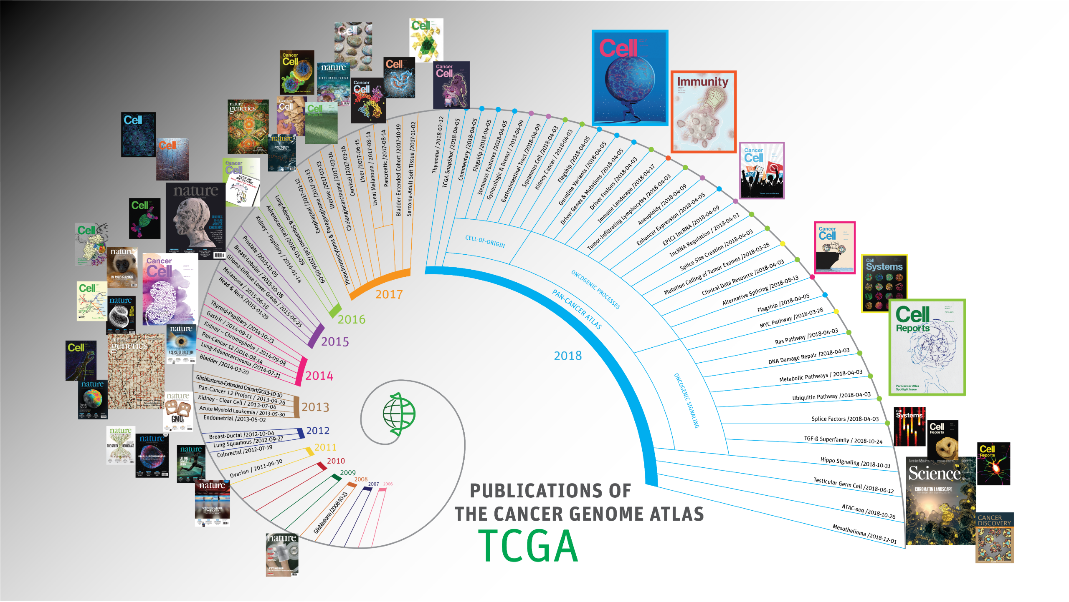
AACR 2020 Team Science Award
Document 9
Notes:
The American Association for Cancer Research (or AACR) recently recognized The Cancer Genome Atlas (or TCGA) through the AACR 2020 Team Science Awards. Specifically, awards were given to the founding members of TCGA and to the current project team. Both groups were recognized during the AACR Virtual Annual Meeting in late June.
* TCGA was a coordinated program led jointly by NHGRI and the National Cancer Institute, which brought together researchers from diverse scientific disciplines and multiple institutions to create a detailed catalog of genomic modifications associated with specific types of cancer. TCGA has played a major role in advancing cancer genomics, as illustrated by the TCGA publications highlighted in this figure. The individuals recognized as part of these 2020 Team Science Awards include current NHGRI staff members Carolyn Hutter and Heidi Sofia as well as former NHGRI staff members Jane Peterson, Mark Guyer, Peter Good, and Brad Ozenberger.

Slide 20


Templeton Prize 2020
Francis Collins, M.D., Ph.D.
Document 10
Notes:
In May, NIH Director and NHGRI Senior Investigator, Francis Collins, was named the recipient of the Templeton Prize for 2020. The Templeton Prize is an annual award granted to a person "whose exemplary achievements advance Sir John Templeton's philanthropic vision: harnessing the power of the sciences to explore the deepest questions of the universe and humankind’s place and purpose within it."
20

Slide 21
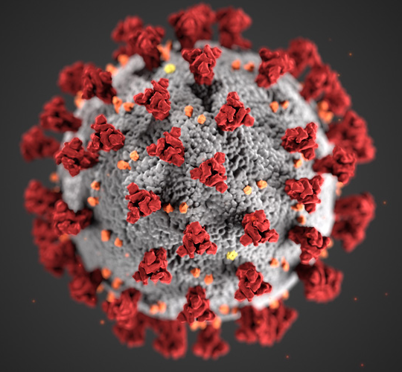
NIH COVID-19 Information Resources
Document 11
Notes:
I would like to remind you that several government websites are available that provide relevant information about COVID-19, such as those at the Centers for Disease Control and Prevention and at NIH. For NIH grantees and applicants, a COVID-19 resource is available on the NIH Grants and Funding website. In addition, NIH regularly issues news releases regarding COVID-19-related research findings. Additionally, NIH Director Francis Collins’s blog provides another good source of updated information.
21

Slide 22
Fiscal Year 2021 Appropriations
 | Fiscal Year 2020 Labor-HHS Appropriation | House Proposed Fiscal Year 2021 Labor-HHS Appropriation | $ Increase | % Increase
NIH | ~$41.7 B | ~$42 B | ~$275 M | ~0.65%
NHGRI | ~$606 M | ~$612 M | ~$6 M | ~1.0%
    House appropriations bill: Additional $5 billion of emergency funds to be spent by Fiscal Year 2025 (providing each institute/center a ~7% increase for Fiscal Year 2021)
Document 12
Notes:
Finally, it is an interesting time on Capitol Hill. Congress is facing an election year, is trying to pass another COVID-19-related supplemental spending package, and is also hoping to pass a Fiscal Year 2021 budget – all before both chambers leave in mid-October to go campaign through election day.
Government funding will run out September 30 unless a budget or a Continuing Resolution (that is, a CR) is passed. As of now, a new budget is uncertain since Congress is focusing on a COVID-19 relief package. There have been discussions of attaching a CR to the COVID-19 relief package or passing a CR separately. Additionally, the length of the CR is yet to be determined, with the expectation being that it would run at least through the election, but there is much debate about how much past the election a CR might extend.
* Still, there was movement in the House on an Fiscal Year 2021 Labor-HHS spending package earlier this summer. The house proposed an increase for NIH of $275 million or about a 0.65% increase. This would give NHGRI additional $6 million or about a 1% increase. * The House appropriations bill also includes $5 billion of emergency funds to help address the negative consequences of the COVID-19 pandemic on the biomedical research enterprise. These emergency funds would be available for use through Fiscal Year 2025. Furthermore, that House bill stipulates that these emergency funds would provide each NIH institute and center a 7% increase in funding for Fiscal Year 2021.
We have yet to see language from the Senate side, though, and there are many steps before a final Fiscal Year 2021 budget may be passed, so stay tuned.
22

Slide 23
Director’s Report Outline
General NHGRI Updates
General NIH Updates
General Genomics Updates
NHGRI Extramural Research Program
NIH Common Fund/Trans-NIH
NHGRI Communications, Policy, and Education
NHGRI Intramural Research Program
Notes:
Moving on to general genomics updates.
23

Slide 24

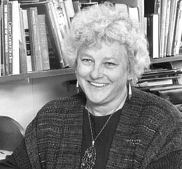
Mourning the Loss of Beverly Paigen
Document 13
Notes:
Beverly Paigen, a longtime researcher at The Jackson Laboratory, passed away in June at the age of 81. She died a few months after the passing of her husband Ken Paigen, also a longtime Jackson Laboratory researcher and the laboratory’s Director throughout the 1990s. Beverly revolutionized the study of heart disease and pioneered the promotion of the mouse for cardiovascular research. Her research into the Love Canal toxic waste dump in New York state has been credited with spurring the creation of the federal Superfund Program. She was also an early adopter of computational biology and statistical genetics.
24

Slide 25






ASHG Podcast Series: Genetically Speaking
Host: Chris Gunter, PhD
Senior Advisor to the Director, NHGRI
Document 14
Notes:
Our colleagues at the American Society of Human Genetics (or ASHG) have worked with my Senior Advisor Chris Gunter, in her role as the Chair of the ASHG Online Programs & Professional Education Working Group, to create a podcast series. Each podcast features Chris in a 15-20 minute informal conversation with an ASHG member about their career in genetics. Four examples are shown on the right.
The importance of mentoring has been a common theme throughout these initial episodes, as has the reality of career paths that go in directions that were never expected. Listeners will hear about the amazing work being done by these interviewees, their paths that got them to where they are now, and their personal lives outside the lab – including what it is like to be featured in a PBS documentary from Council member Wendy Chung. The episodes are free with registration on the ASHG website.

Slide 26


Next Steps for Functional Genomics NASEM Report
Document 15
Notes:
In July, the National Academies of Sciences, Engineering, and Medicine (or NASEM) published a report from a workshop sponsored by the National Science Foundation on Next Steps for Functional Genomics. The workshop was held to determine research needs to advance the field of functional genomics across the life sciences over the next 10-20 years.
26

Slide 27

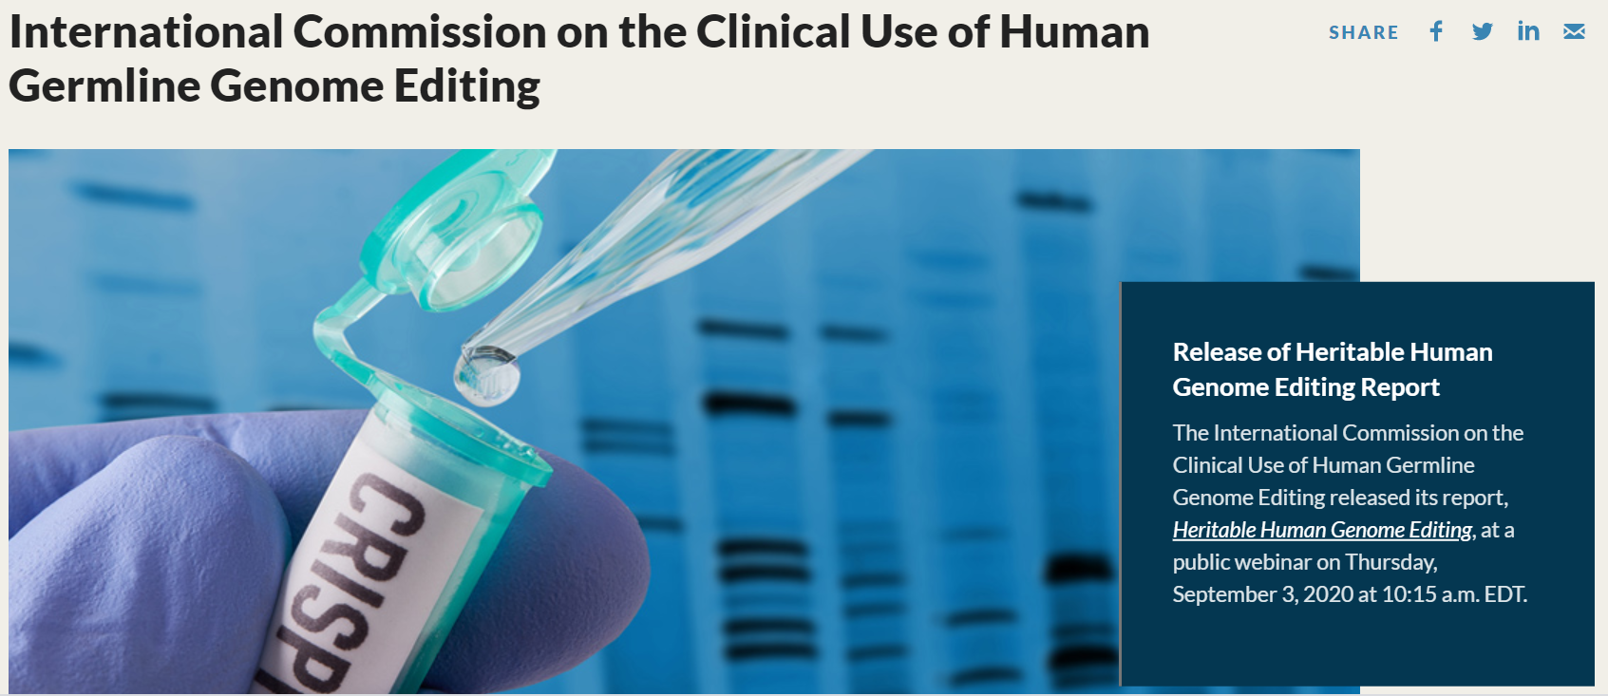
Heritable Human Genome Editing Report
Document 16
Notes:
Last week, the National Academy of Medicine, the National Academy of Sciences, and The Royal Society released a consensus report entitled “Heritable Human Genome Editing.” The report is the culmination of a year of work by the International Commission on the Clinical Use of Human Genome Editing and describes “the state of the science,” finding that heritable human genome editing cannot currently be performed safely and should not be attempted until safety and efficacy are established. The report also provides a framework for scientists, clinicians, and regulatory authorities to consider when assessing clinical applications of heritable human genome editing should a country ultimately decide to permit it.
27

Slide 28


FNIH Lurie Prize in Biomedical Sciences 2020 Winner
Aviv Regev, Ph.D.
Document 17
Notes:
Earlier this summer, the Foundation for the National Institutes of Health (or FNIH) named former Council member Aviv Regev the winner of the 2020 Lurie Prize in Biomedical Sciences for laying the foundation for the field of single-cell genomics, spearheading leading-edge technologies that enable a sharper perspective on human cells, and applying those technologies to revolutionize our understanding of biology and disease.
28

Slide 29
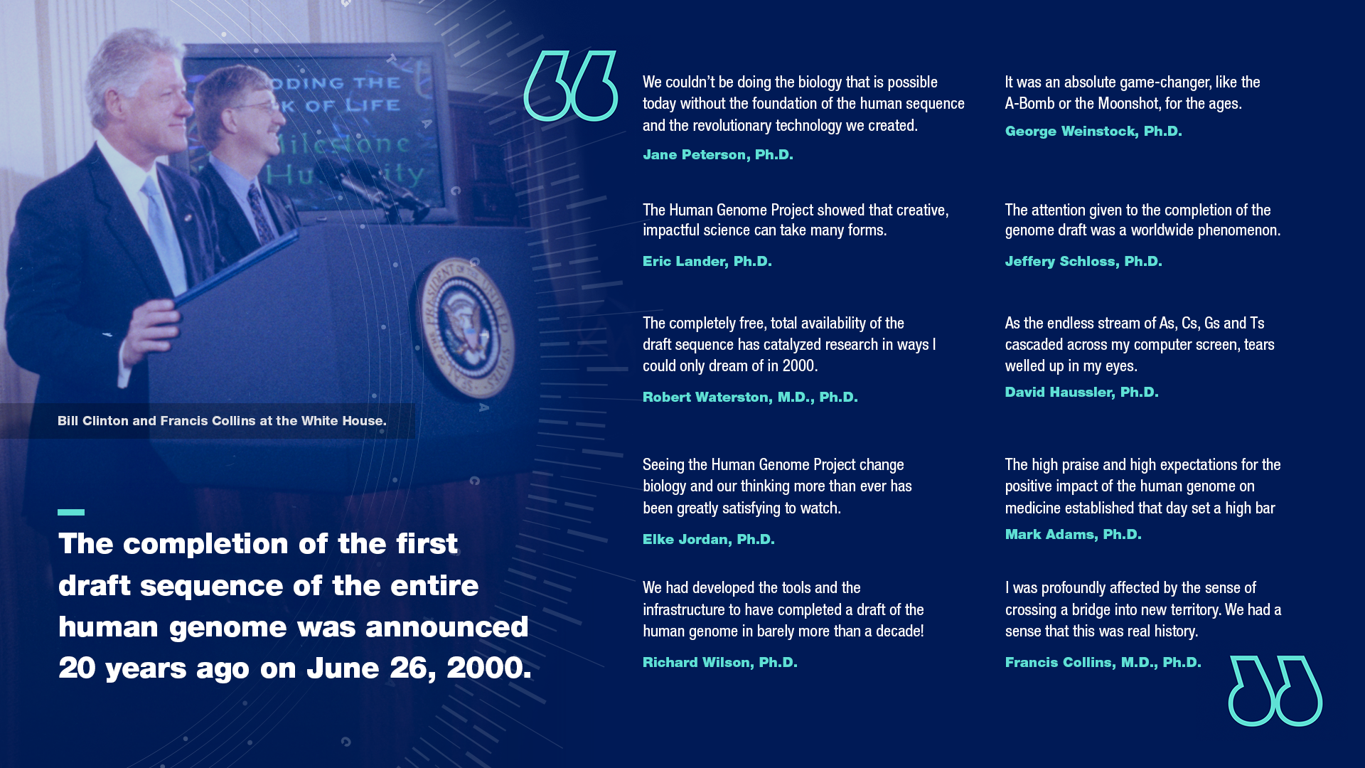
20th Anniversary of White House Event Announcing Draft Human Genome Sequence
Document 18
Notes:
Finally, June 26, 2020 marked the 20th anniversary of the White House Event at which President Bill Clinton announced the completion of a draft human genome sequence. That day will always have a special place in NHGRI’s history, and so to commemorate the event, NHGRI’s Communications and Public Liaison Branch developed dedicated web and social media content, which garnered over 5,000 views. The content included written memories of former NHGRI staff and Human Genome Project researchers who were present at the White House event on that day.

Slide 30
Director’s Report Outline
General NHGRI Updates
General NIH Updates
General Genomics Updates
NHGRI Extramural Research Program
NIH Common Fund/Trans-NIH
NHGRI Communications, Policy, and Education
NHGRI Intramural Research Program
Notes:
Moving on to the NHGRI Extramural Research Program.
30

Slide 31
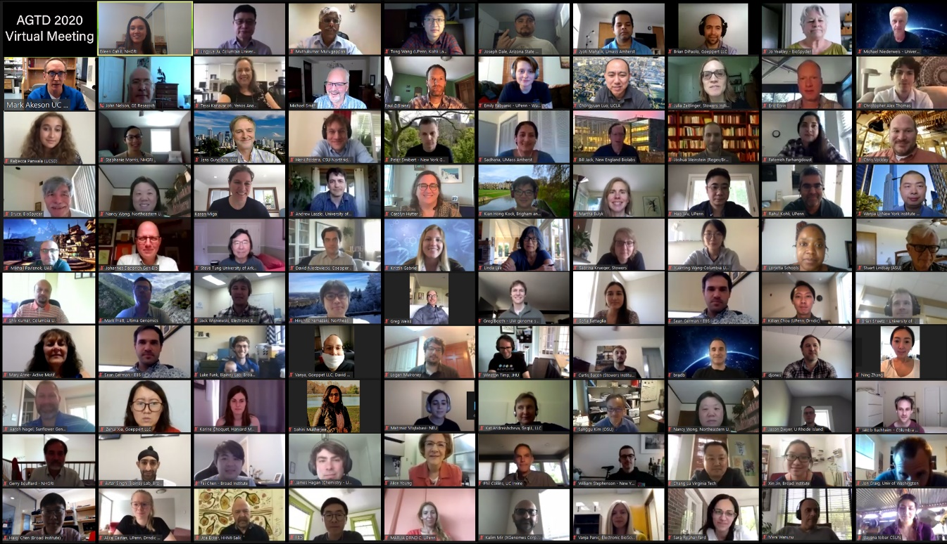
Technology Development Program
Funding Opportunity Announcements
Virtual Advanced Genomic Technology Development Meeting 2020
Novel Genomic Technology Development
  R01 (PAR-18-777) & linked R21, R43/R44
  Due date: Oct 2, 2020
Novel Synthetic Nucleic Acid Technology Development
  R01 (RFA-HG-20-014) & linked R21, R43/R44
  Due date: Feb 1, 2021
Document 19
Notes:
NHGRI’s Technology Development Program supports the development of new and innovative technologies to enable genomic discoveries and to accelerate the adoption of genomics in medicine.
* Through Funding Opportunity Announcements, * NHGRI continues to fund novel genomic technology development work to catalyze major advances in genomics beyond nucleic acid sequencing. Applications for this funding opportunity are due on October 2, 2020.
* The program’s newest funding opportunity is for novel synthetic nucleic acid technology development. The purpose of this effort is to improve the quality, capability, and efficiency of nucleic acid synthesis and production of synthetic constructs at reasonable and decreased costs. Applications for this funding opportunity are due on February 1, 2021.
* The program hosted the Advanced Genomic Technology Development Meeting 2020 through virtual means this past May. The meeting included a session on the application of genomic technologies to COVID-19, talks from grantees and trainees on their technology development innovation and development work, and trainee career-development sessions aimed to establish and improve scientific collaborations, foster open data sharing and exchange, and provide information on funding next career steps.
31

Slide 32
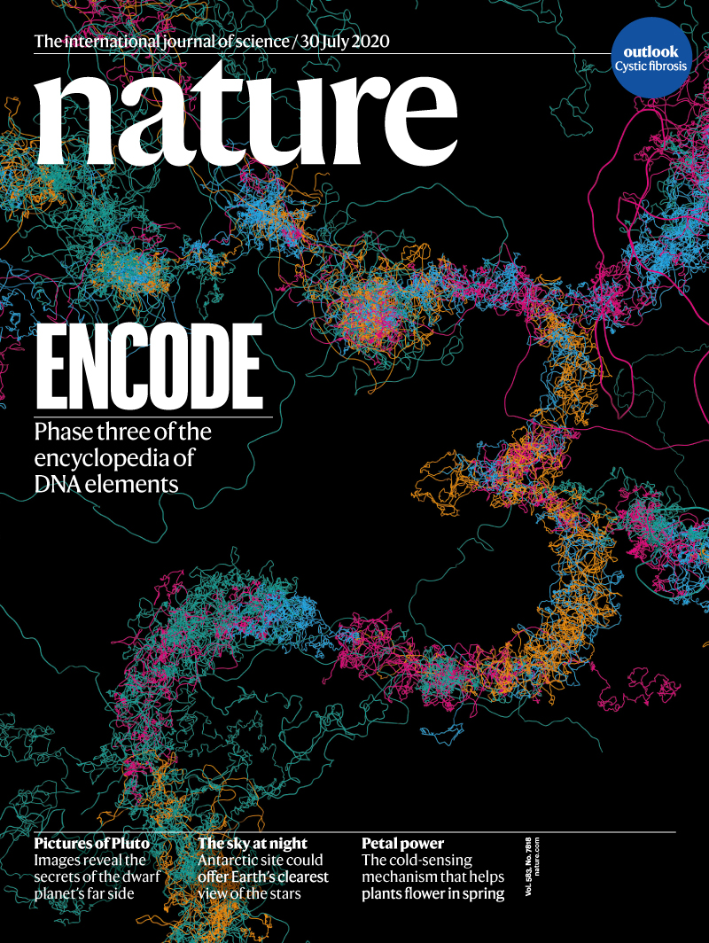
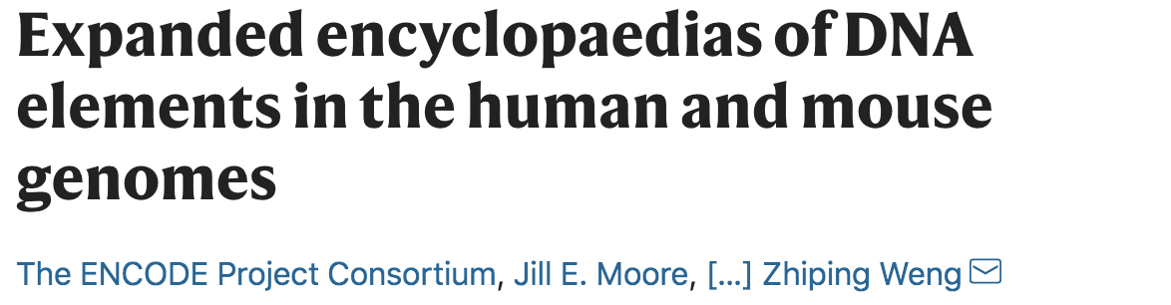
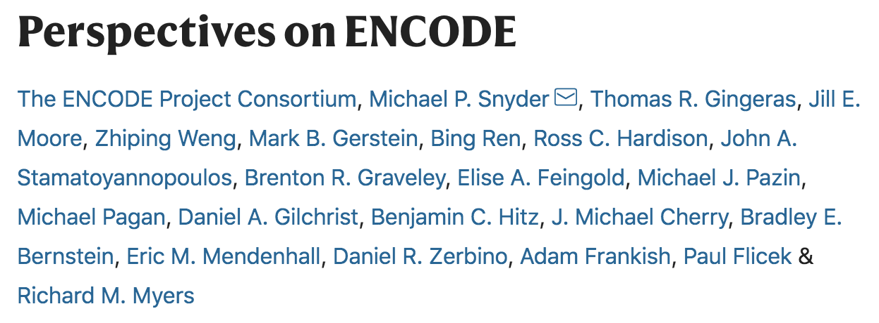
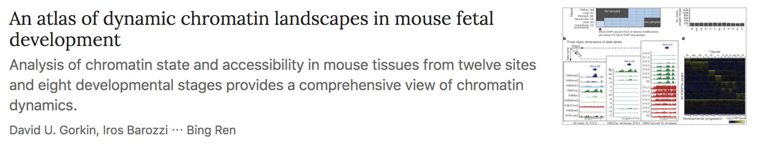
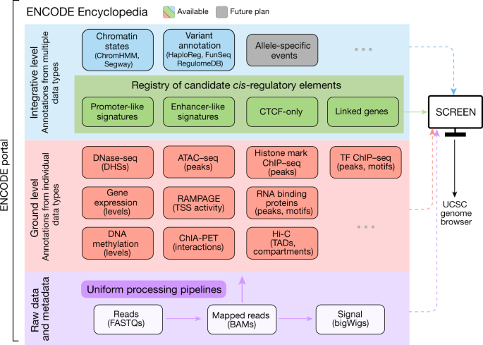
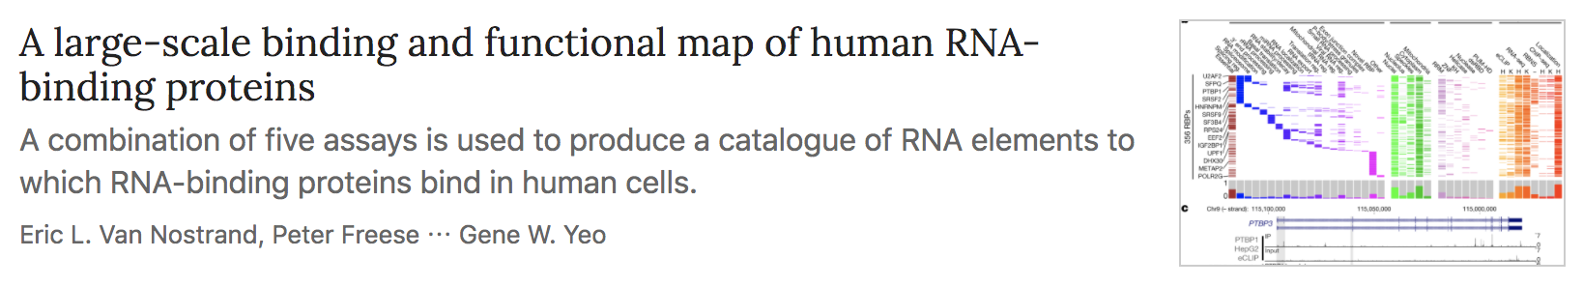
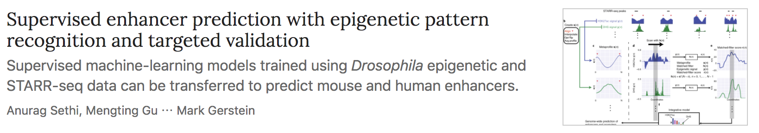
ENCyclopedia of DNA Elements (ENCODE)
Document 20
Notes:
The goal of the Encyclopedia of DNA Elements (or ENCODE) project is to create catalogs of all functional elements in the human and mouse genomes and to make those catalogs freely available as a resource to the biomedical research community.
The ENCODE Phase 3 Consortium published a package of papers in late July, which featured 14 papers in Nature and other major journals. These papers are a subset of the over 500 ENCODE Consortium papers published during ENCODE Phase 3. The package featured a main paper that highlights the expansion of ENCODE’s catalog, identifying candidate cis-regulatory elements and creating a comprehensive registry of these elements. During ENCODE Phase 3, the Search Candidate cis-Regulatory Elements by ENCODE tool (or SCREEN) was developed as a user-friendly way to navigate the extensive catalog.
* The Consortium also published a Perspectives of ENCODE paper, which provides an overview of the history of the project and its growth during Phase 3, reflections on the impact of ENCODE, and future directions.
* The package contains additional publications spanning topics of human and mouse gene expression, regulation, epigenetics, human disease, and software tools.
32

Slide 33
ENCyclopedia of DNA Elements (ENCODE)
Workshops:
ENCODE Portal
Navigating the ENCODE Encyclopedia with SCREEN
An interactive introduction to Factorbook
Document 20
Notes:
The ENCODE Consortium will hold a virtual Research Applications & Users Meeting from September 30 to October 2. The meeting will be held at times compatible for both U.S. and European participants, and the sessions will be recorded to broaden access to this meeting. The goal is to expose new users to ENCODE and provide them with the skills to use ENCODE data with guidance from current Consortium members.
* Planned workshops include an introduction to the ENCODE portal, navigating the ENCODE Encyclopedia with SCREEN, and an interactive introduction to Factorbook, which provides information about transcription factor-binding sites in various biological contexts. Registration for this meeting is open and can be completed via the meeting website – encode2020.org.
33

Slide 34
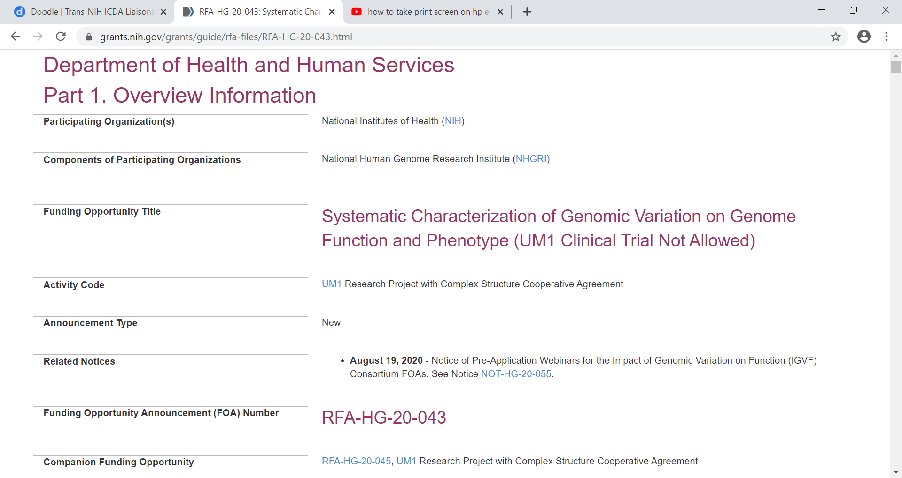
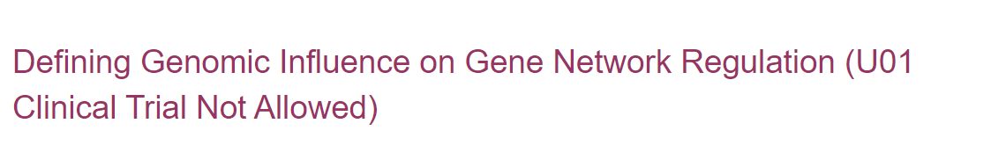
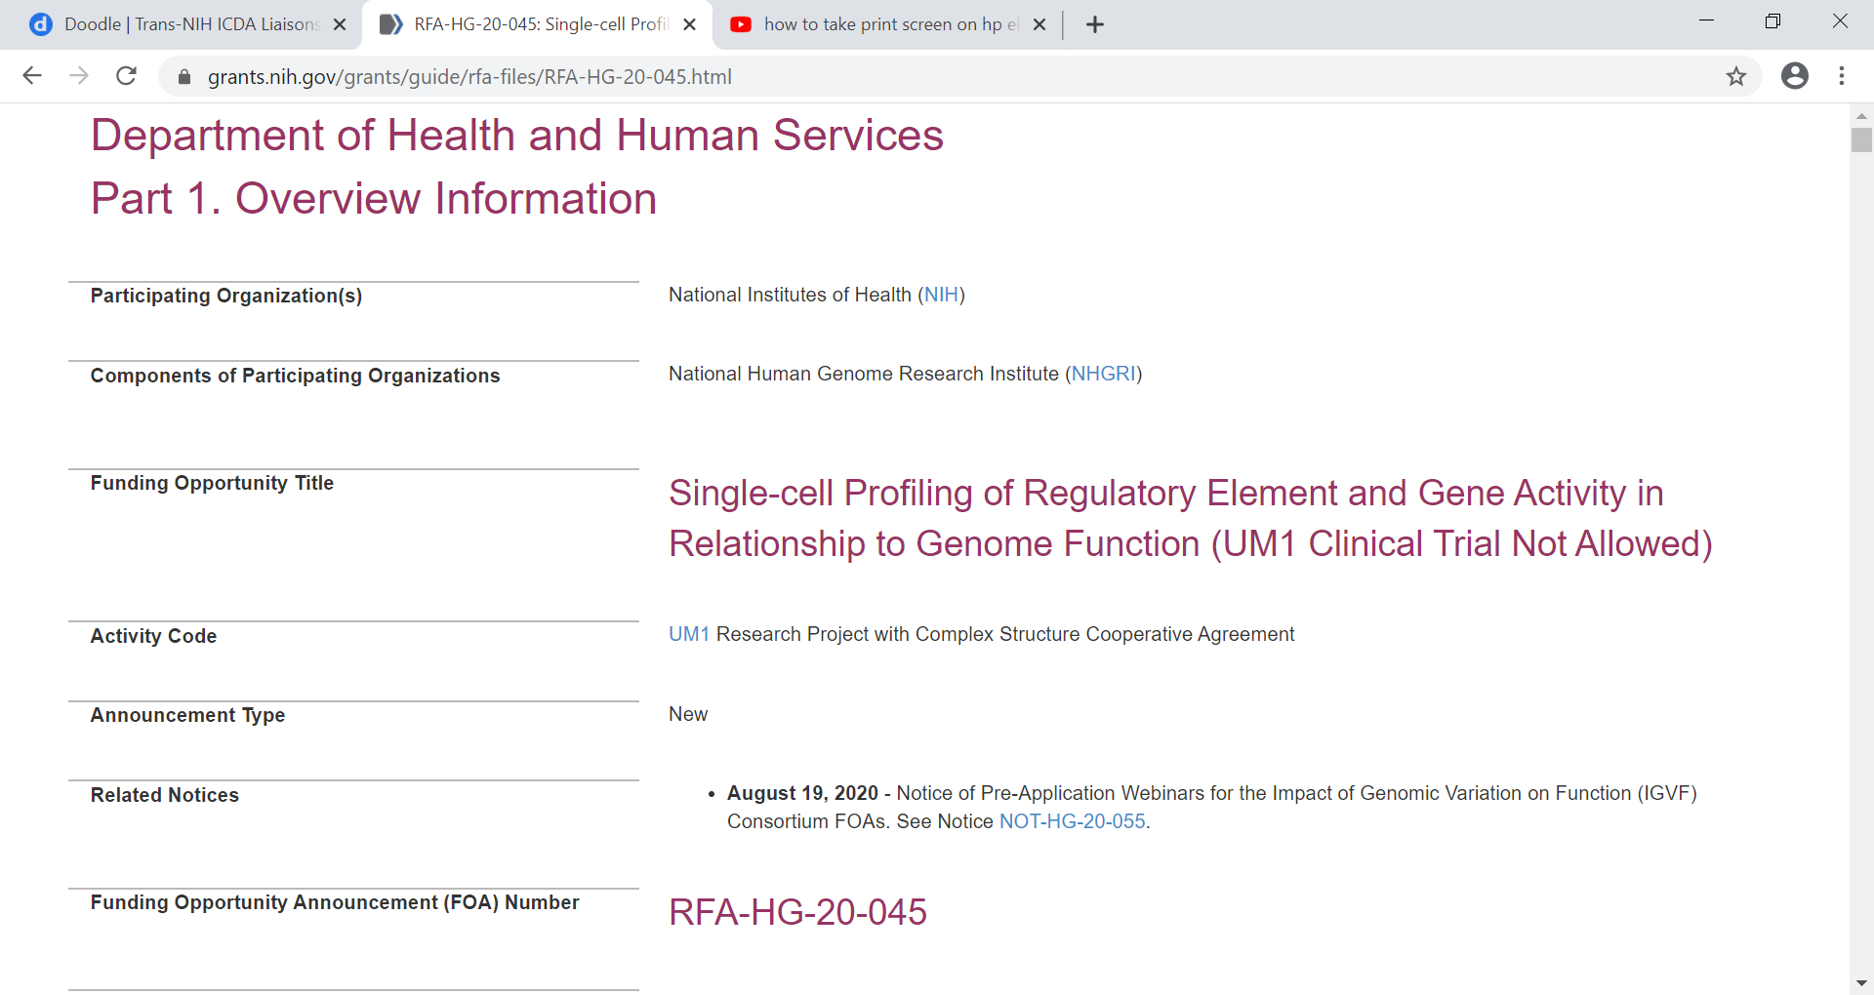
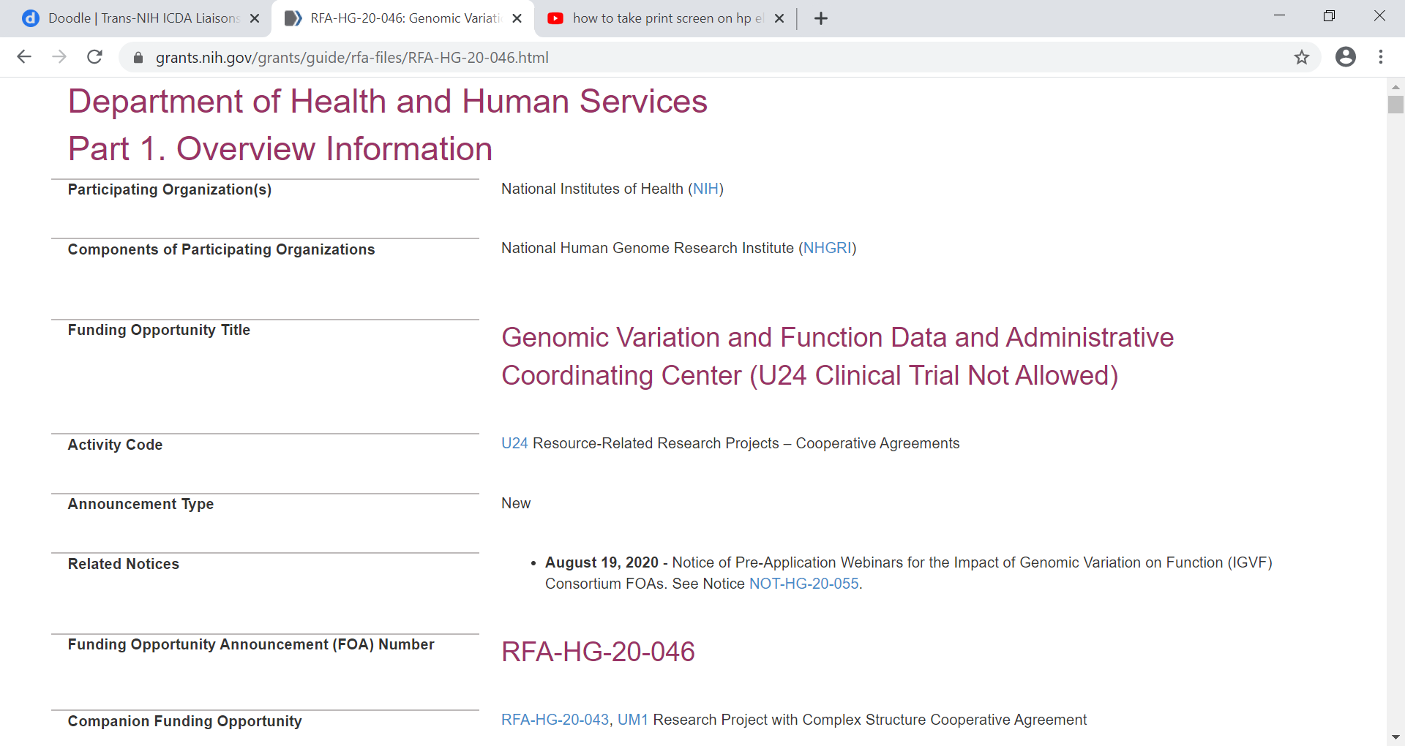
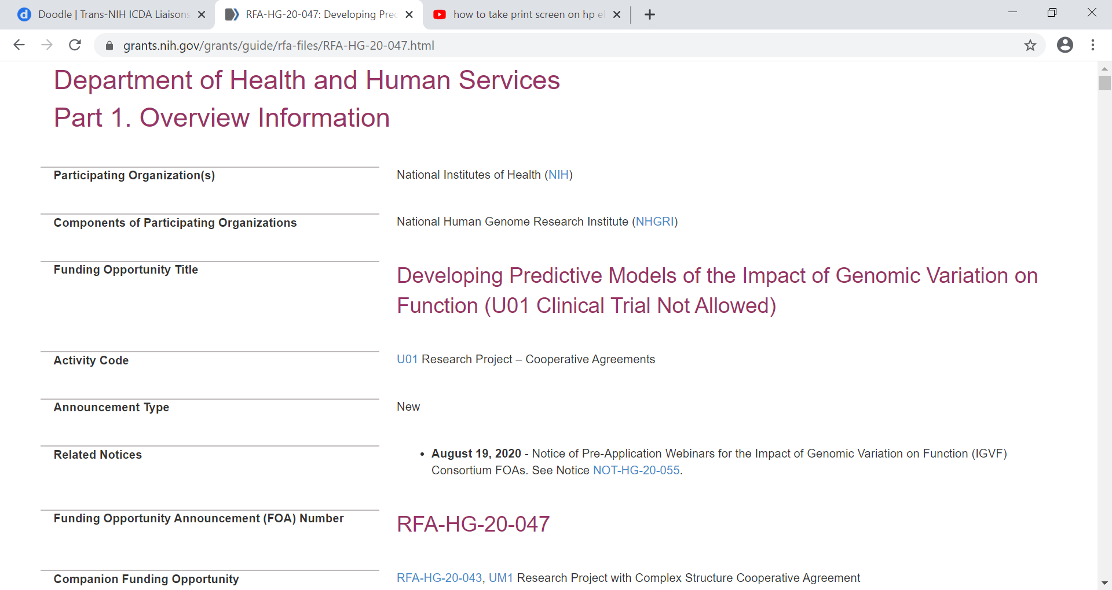
Impact of Genomic Variation on Function (IGVF) Program
  Five new funding opportunities:
  Applications due November 4, 2020
Document 21
Notes:
NHGRI is launching a new initiative in functional genomics called the Impact of Genomic Variation on Function (or IGVF) Program. This program aims to develop a framework for systematically understanding the effects of genomic variation on genome function and how these effects shape phenotypes. The IGVF Program will consist of five interrelated components that will use emerging experimental and computational approaches to build a catalog of the impact of genomic variants on genome function and phenotypes.
* Five new funding opportunities are now published in the following areas: * systematic characterization of genomic variation on genome function and phenotype; * defining genomic influence on gene network regulation; * single-cell profiling of regulatory element and gene activity in relationship to genome function; * genomic variation and functional data and administrative coordinating center, and * developing predictive models of the impact of genomic variation on genome function.
NHGRI especially encourages applicants who are new investigators, experienced investigators new to genomics, investigators that have not previously participated in a NHGRI consortium or program, and investigators from demographic groups or institutions that are considered underrepresented in genomics. * Applications for all five funding opportunities are due November 4, 2020.
34

Slide 35
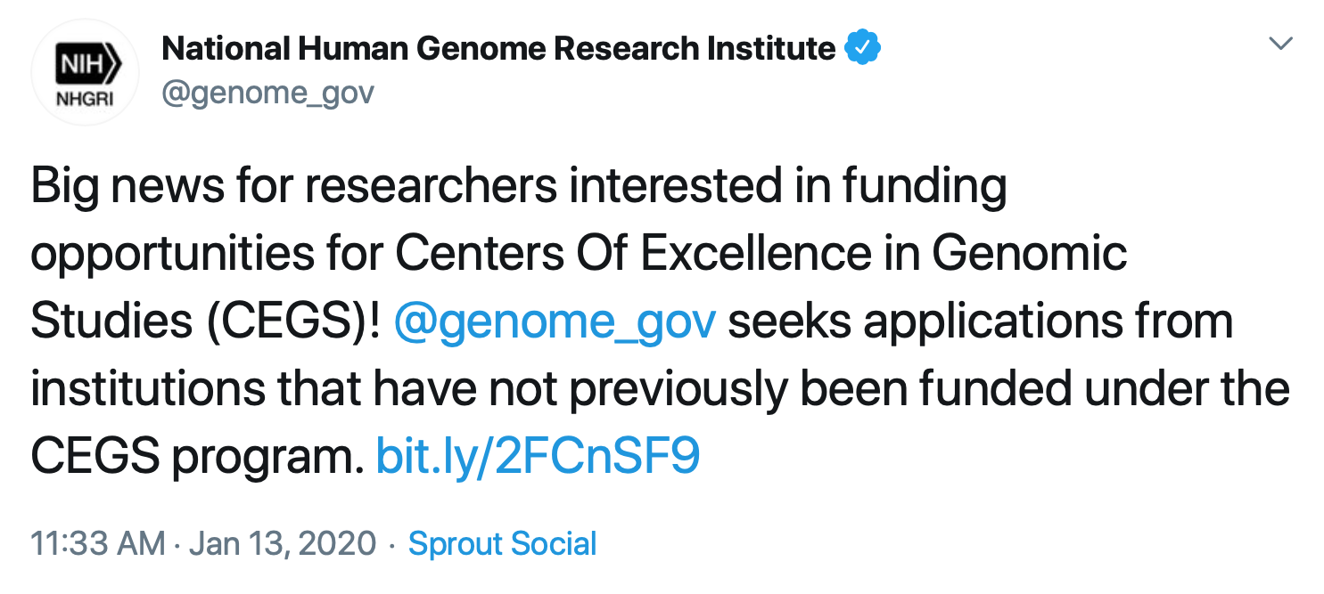
Centers of Excellence in Genomic Science (CEGS)
Emerging Centers of Excellence
  1st Notice of Change for Fiscal Year 2020
  Opportunity for institutions that are not previous CEGS grantees
  2nd Notice of Change for Fiscal Year 2021
  Additional Receipt Date
  Emphasize interest in institutions that are not previous CEGS grantees
New receipt date for Emerging Centers:
November 20, 2020
Standard CEGS receipt dates unaffected:
May 20, 2021
Document 22
Notes:
The Centers of Excellence in Genomic Science (or CEGS) program supports interdisciplinary research teams for developing highly innovative approaches in genomics research.
* The Fiscal Year 2020 NHGRI appropriation included $10 million for a new competitively awarded, center-based grant program for Emerging Centers of Excellence (or eCEGS). In response, NHGRI issued a first Notice of Change for Fiscal Year 2020 to amend the original announcement for the CEGS program and to allow an opportunity for institutions that are not previous CEGS grantees to apply for CEGS funding (which would be executed as part of the ‘program balance’ criterion when making funding decisions).
* NHGRI has now issued a second Notice of Change for Fiscal Year 2021 to fund another round of eCEGS. Specifically, we added an additional receipt date in November 2020, and again emphasized our interest in applications from institutions that are not previous CEGS grantees.
The CEGS program will continue to encourage submission of outstanding and innovative applications from all eligible institutions; we have applications under review for the regular CEGS program, and the next receipt date in May 2021 will not change.
35

Slide 36
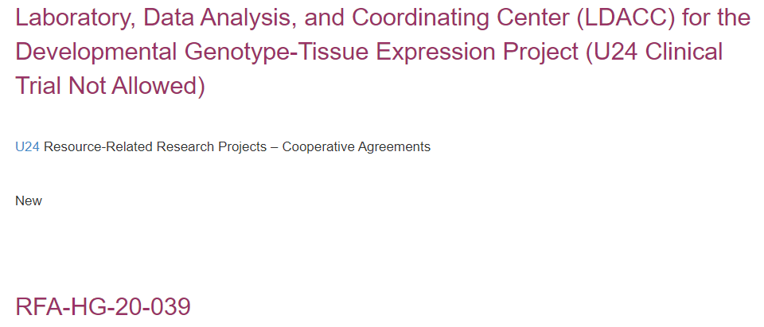
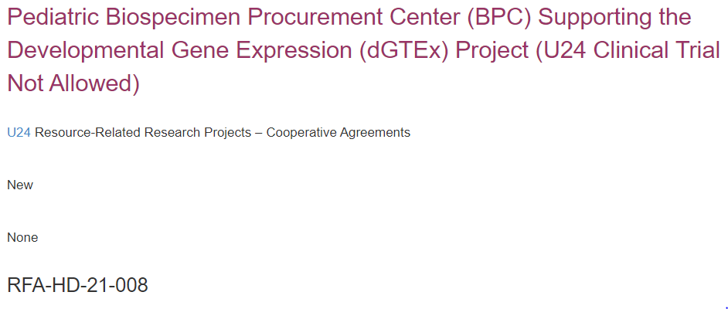
Developmental Genotype-Tissue Expression (dGTEx)
Create atlas of gene expression and biobank
Analyze differences in gene expression
Develop ELSI research projects
    Applications due on November 13, 2020
    Applications due on December 3, 2020
Document 23
Notes:
The Developmental Genotype-Tissue Expression (or dGTEx) project is a new initiative that will be co-led by NHGRI and the National Institute of Child Health and Human Development. The goal of dGTEx is to catalog and analyze transcriptional profiles from a wide variety of tissues obtained from neonates, children, and adolescents in a post-mortem setting. * The aims of the project are to create an atlas of gene expression and biobank on bulk tissues and single cells, to analyze differences in gene expression across developmental stages, and to develop ELSI research projects. Two companion dGTEx Request for Applications were recently released.
* The Laboratory, Data Analysis, and Coordinating Center will perform two major functions: (1) serve as a molecular laboratory and perform basic analyses of genotyping and expression data at the tissue and single-cell levels for public release; and (2) serve as a coordinating center to help monitor study progress and laboratory performance.
* The Biospecimen Procurement Center will procure tissues from pediatric donors and provide high-quality tissue samples for genomic analyses.
* Applications are due on November 13 and December 3, respectively, for these two funding opportunities.
36

Slide 37

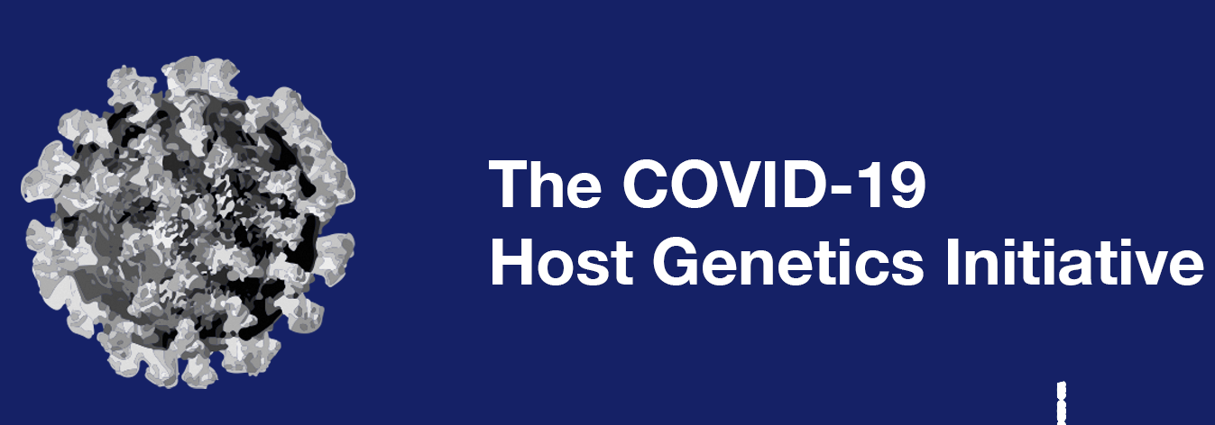
NHGRI Analysis, Visualization, and Informatics
Lab-space (AnVIL)
    Massive Genome Informatics in the Cloud (MaGIC) Jamboree
    Workshops ASHG 2020 Meeting:
      GWAS analyses with Galaxy in AnVIL
      Find and analyze cloud data with Gen3, Dockstore, & Terra
    Designated repository for COVID-19 HGI data
Document 24
Notes:
In September 2018, NHGRI established the Analysis, Visualization, and Informatics Lab-space (or AnVIL). AnVIL is a cloud-based infrastructure and software platform that provides an analysis and computing environment for unrestricted- and controlled-access genomic and phenotypic datasets.
* This past June, the AnVIL training team hosted the Massive Genome Informatics in the Cloud (or MaGIC) Jamboree for NHGRI’s Genome Sequencing Program researchers. The event included an introduction focused on how to use the AnVIL platform and tools to analyze the Genome Sequencing Program data.
* There will be opportunities to learn more about AnVIL through workshops at the virtual 2020 American Society of Human Genetics (or ASHG) Meeting next month. Specifically, the AnVIL team will be leading workshops focused on how to * perform GWAS analyses with Galaxy in AnVIL, and how to * find and analyze cloud data with the Gen3, Dockstore, and Terra platforms.
* Finally, AnVIL is a designated repository for the COVID-19 Host Genetics Initiative (or HGI) data from U.S. contributors. The purpose of HGI is to share and analyze data to learn the genetic determinants of COVID-19 susceptibility, severity, and outcomes.
​

Slide 38

    Recent GWAS Summary Statistics Standards and Sharing Workshop
    Attendees: cohort representatives, summary statistics users, tools developers, resource providers, journal editors, and funders
    Recommendations:
      Improve platform functionality
      Standardize summary statistics reporting
      Link summary statistics data to relevant datasets/resources
Document 25
Notes:
The Genome-Wide Association Studies (or GWAS) Catalog is a collaborative project between the European Bioinformatics Institute (or EBI) and NHGRI. The catalog provides a searchable and freely available database of SNP-trait associations for scientists, clinicians, and other users worldwide.
* Staff associated with the GWAS Catalog organized a community workshop entitled “GWAS Summary Statistics Standards and Sharing Workshop,” which was held virtually in early June. This workshop addressed the standards, infrastructure, and incentives required to promote and enable sharing of GWAS summary statistics.
* The workshop brought together attendees that represented diverse groups of stakeholders, including cohort representatives, summary statistics users, tools developers, resource providers, journal editors, and funders.
* Recommendations from the workshop included: * improving the functionality of the GWAS Catalog platform for submitting and curating summary statistics from GWAS studies; * standardizing the reporting of summary statistics and related study data in a manner that is Findable, Accessible, Interoperable, and Reproducible (or FAIR); * and linking GWAS summary statistics data to other relevant datasets/resources, such as dbGaP, EGA, and AnVIL. The recommendations from the workshop will be shared in a white paper that outlines the future of GWAS data sharing.
38

Slide 39
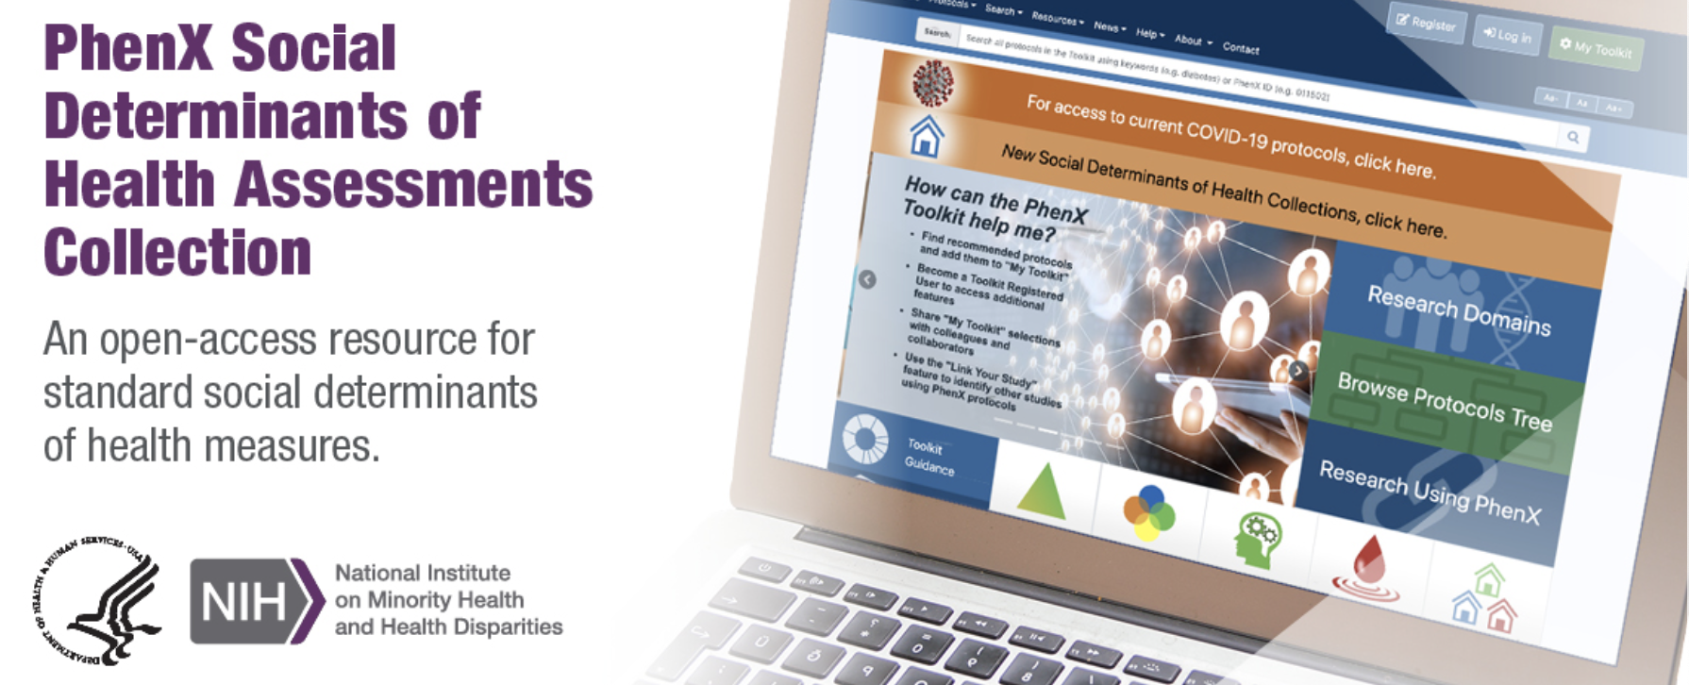


Phenotypes and Exposures (PhenX) Toolkit
Social Determinants of Health Assessments Collection (SDOH)
Rapid Acceleration of Diagnostics – Underserved Populations (RADx-UP)
Document 26
Notes:
The Phenotypes and Exposures (or PhenX) Toolkit is a catalog of consensus protocols for measuring phenotypes and exposures in biomedical research.
With significant leadership and funding support from the National Institute on Minority Health and Health Disparities, a new Social Determinants of Health Assessments Collection (or SDOH) was added to the PhenX Toolkit. This collection contains 19 protocols to help measure factors that shape behaviors and health outcomes. Examples of the SDOH protocols include concentrated poverty, access to health services and technology, spirituality, and areas where junk food outlets outnumber healthy food options (also known as “food swamps”). This collection is expected to provide a common currency for studying social determinants of health and can be used to examine health inequities.
* The SDOH collection has been highlighted in a number of COVID-19-related funding notices, including that foro the Rapid Acceleration of Diagnostics – Underserved Populations (or RADx-UP) program, which seeks to understand factors that have led to disproportionate burden of the COVID-19 pandemic on underserved and/or vulnerable populations.
39

Slide 40

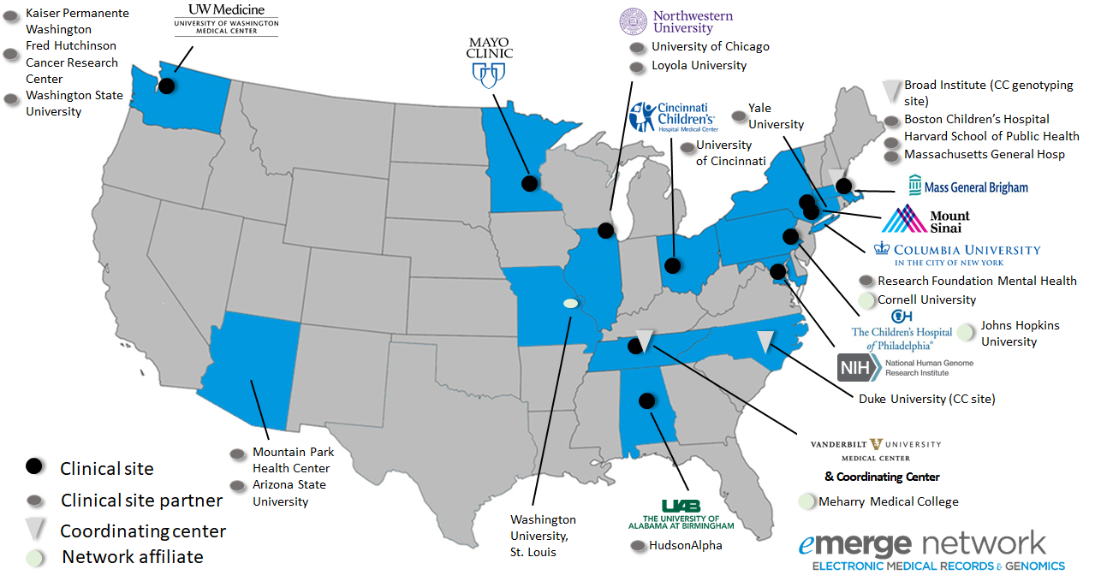





eMERGE Genomic Risk Assessment and Management Network (2020-2024)
Validate PRS in diverse populations
Combine with family history, clinical covariates
Return results using EMR
Assess uptake of risk-reduction recommendations
Document 27
Notes:
The Electronic Medical Records and Genomics (or eMERGE) Network conducts groundbreaking research on how to effectively use electronic health records and large biorepositories to enable the integration of genomic information into clinical care.
* This July, the eMERGE Genomic Risk Assessment and Management Network was launched. This five-year phase of eMERGE will include 10 clinical sites and a study coordinating center. The Network also includes 15 clinical site partners and many affiliates, as shown on this map. The Network aims to expand best practices and knowledge in effective implementation of genomic medicine by understanding how genomics contributes to an individuals’ risk of developing disease.
* The eMERGE Genomic Risk Assessment and Management Network will * apply and validate polygenic risk scores (or PRS) in diverse populations, * combine PRS results with family history and clinical covariates to develop genomic risk assessments, * return results using the electronic medical record (or EMR) to 25,000 diverse participants, * and assess uptake of risk-reduction recommendations and impact on related clinical outcomes to better understand genomic risk in the broader U.S. population.

Slide 41

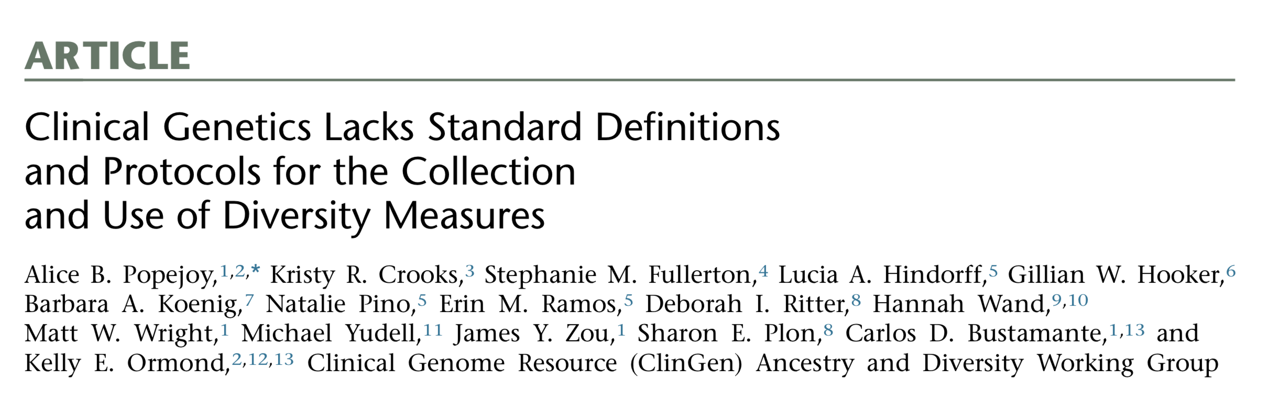
Clinical Genome Resource (ClinGen)
Ancestry and Diversity Working Group Efforts
Document 28
Notes:
The Clinical Genome Resource (or ClinGen) evaluates and disseminates the clinical relevance of genes and genomic variants for use in precision medicine and research.
ClinGen’s Ancestry and Diversity Working Group collaborated with the Clinical Sequencing Evidence-generating Research (or CSER) program to investigate clinical geneticists’ understanding and use of the terms “race,” “ethnicity,” and “ancestry” in their work. This study was recently published in the American Journal of Human Genetics. The findings highlight a lack of standard definitions and protocols for the collection and use of diversity measures in clinical genetics and support the need for standardizing and harmonizing the collection of these measures to understand their importance in genomic medicine and precision medicine.
41

Slide 42
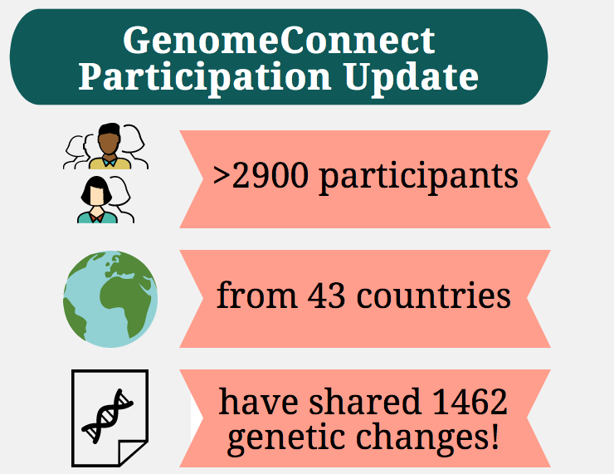


Clinical Genome Resource (ClinGen)
GenomeConnect Patient Registry
Document 28
Notes:
GenomeConnect is ClinGen’s online patient registry where individuals can securely share their genetic and health information for use by researchers and healthcare providers. GenomeConnect also gives participants the ability to share their genomic variant data with ClinVar, to connect with others who have similar genomic variants, to learn about additional research opportunities, and to receive updates about their genomic test results.
As of April 2020, 2,998 participants from 43 countries have consented to participate in the registry and nearly 1,500 genomic variant interpretations from de-identified GenomeConnect participant data have been shared with ClinVar.
* Given GenomeConnect’s success in engaging patients in genomic data sharing, the GenomeConnect team wanted to make those same opportunities available to patients participating in other registries who are not currently sharing data. To that end, GenomeConnect has launched the Patient Data Sharing Program. Thus far, the nine registries shown here are participating in this expanded program.
42

Slide 43
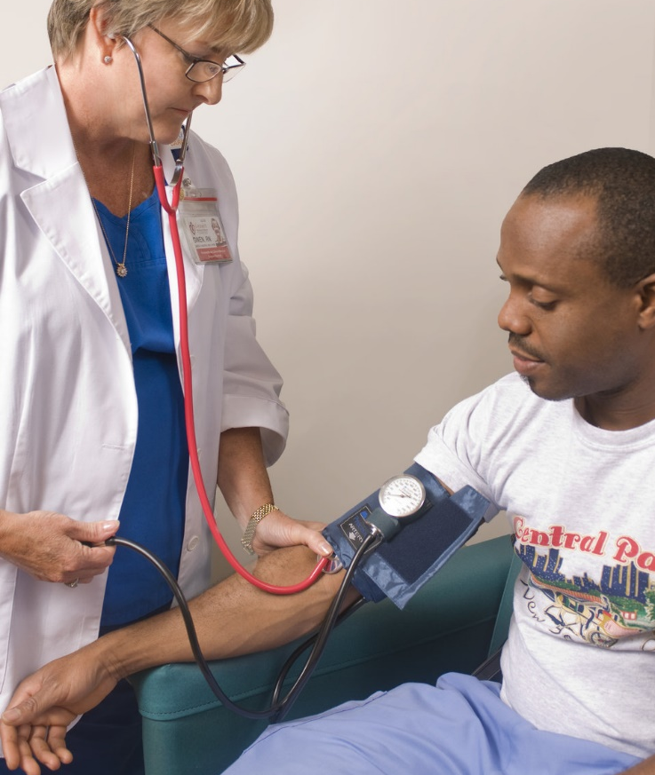

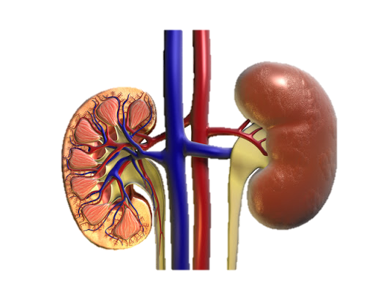
Implementing Genomics in Practice (IGNITE)
      4 clinical sites activated
      First patient randomized in July
      >100 participants enrolled
Document 29
Notes:
The Implementing Genomics in Practice (or IGNITE) Network consists of five clinical groups and a coordinating center, which are together conducting pragmatic clinical trials to study the implementation of genomic medicine in diverse settings.
* Despite the unprecedented times related to the COVID-19 pandemic, the network recently launched the trial Genetic testing to Understand Renal Disease Disparities across the U.S. (or GUARDD-US). * The trial is studying whether knowledge that a participant is positive for a high-risk genomic variant in APOL1, a gene associated with chronic kidney disease, results in a change in blood pressure management. The study aims to enroll over 5,000 African American participants, as high-risk APOL1 genotypes are disproportionately present in this population.
* Four clinical sites have been activated, with several more planned for activation over the next few months. * The first patient was randomized into the trial in early July, and * over 100 participants have been enrolled so far.
Though COVID-19 delayed site activation and enrollment by a few months, the IGNITE Network is working to safely and effectively recruit participants into the study.
43

Slide 44
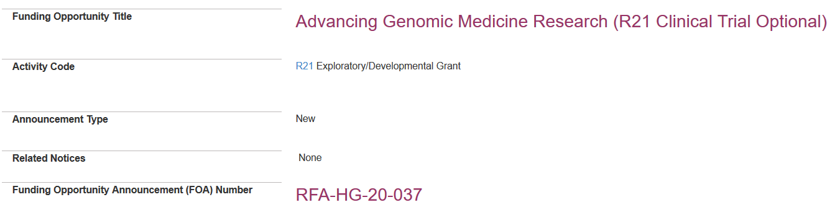
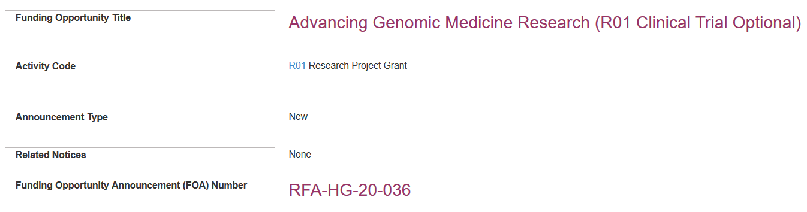
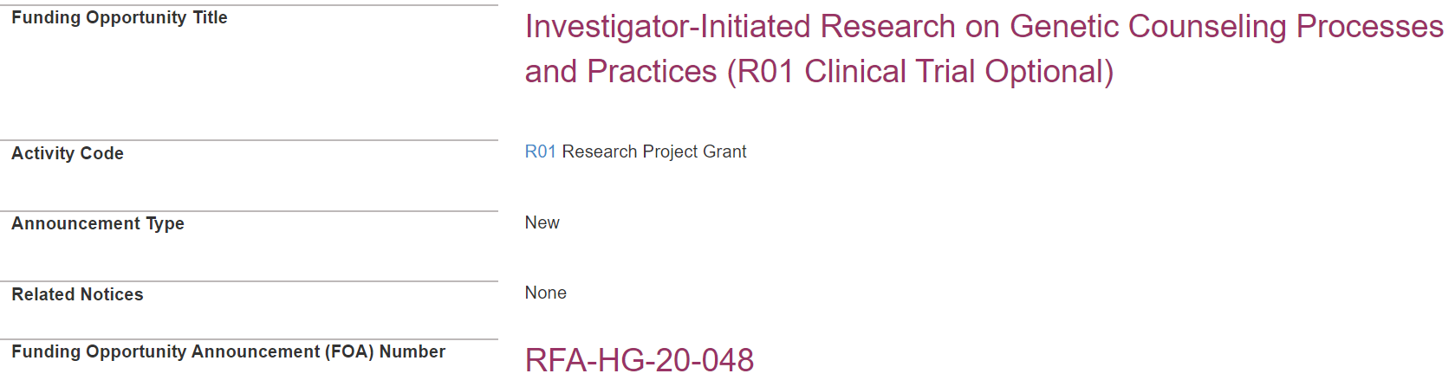
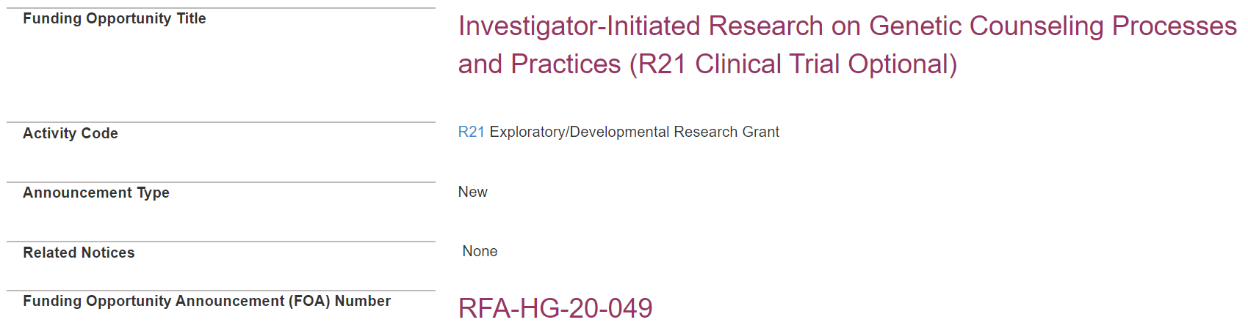
Advancing Genomic Medicine Research and
Genetic Counseling Research
    New R01 and R21 funding opportunities
    Stimulate innovation and advance understanding of when, where, and how to implement genomic information and technologies in clinical care
    Assess strategies to optimize the counseling process in the context of limited resources
Document 30
Notes:
This past June and July, * new R01 and R21 funding opportunities in genomic medicine and genetic counseling were published.
* The Advancing Genomic Medicine Research opportunities are soliciting applications that stimulate innovation and advance understanding of when, where, and how best to implement genomic information and technologies in clinical care. The first application due date was this past August, with the next due date in March 2021 and the last in March 2023.
* The Investigator-Initiated Research on Genetic Counseling Processes and Practices opportunities are soliciting applications to assess strategies to optimize the counseling process in the context of limited resources. The first application due date is in October, with a second date in July 2021.
Proposed projects for all funding opportunities should be broadly applicable to genomic medicine as a field, and strongly encouraged to include ancestrally diverse and underrepresented participants and populations.
44

Slide 45
ELSI Research Program
    Program Announcements
    Large multi-disciplinary studies: PAR-20-254 – R01
    Small projects: PAR-20-255 – R21
    Very small projects: PAR-20-257 – R03
    Due Dates 2021-2023:
    Oct. 19
    Feb. 17
    Jun. 17
Document 31
Notes:
The Ethical, Legal, and Social Implications (or ELSI) Research Program supports research that anticipates, explores, and addresses implications of genomics for individuals, families, and communities.
NHGRI, along with nine other NIH Institutes and Centers and the NIH Office of Behavioral and Social Sciences Research, recently updated three ELSI Program Announcements (or PARs) inviting a wide range of applications for studying the ethical, legal, and social implications of human genomics research.
* For large multi-disciplinary studies that are building on preliminary data and require funding beyond two years, applicants should consider the ELSI R01 PAR. * For small projects that are exploratory in nature or designed to generate pilot data, applicants should consider the ELSI R21 PAR. * For very small projects, such as those involving single investigators, focused conceptual or analytical studies, or secondary data analyses, applicants should consider the ELSI R03 PAR.
* Of note, the three annual application due dates are different from the standard NIH due dates. For all three PARs, the application due dates are in October, February, and June from 2021 through 2023.

Slide 46
Training and Career Development
    Fiscal Year 2020 T32 Training Awards
Principal Investigator | Institution | Starting Year | Scientific Area
Michael Boehnke | U. Michigan at Ann Arbor | 1995 | Genomic Science
Evan Eichler | U. Washington | 1995 | Genomic Science
Michael Brent, Barak Cohen | Washington University | 1997 | Genomic Science
Maja Bucan, Junhyong Kim | U. Pennsylvania | 1999 | Genomic Science
John Storey, John Akey | Princeton University | 2004 | Genomic Science
Dan Rokhsar Michael Eisen | U. California Berkeley | 2004 | Genomic Science
Brent Graveley Charles Lee | U. Connecticut | 2020 | Genomic Science
Document 32
Notes:
NHGRI offers training and career development support through a variety of mechanisms, including individual fellowship and career development awards; institutional awards; and diversity and re-entry supplements. Our programs offer opportunities at the undergraduate, postbaccalaureate, graduate, postdoctoral, and faculty levels. The program continues to grow with new T32 awards.
The T32 programs funded by NHGRI date back to 1995. In Fiscal Year 2020, six T32 programs successfully renewed, shown in the first six rows of this table. The last row reflects a seventh T32 that represents a new program at the University of Connecticut, which will support pre-doctoral scientists and will focus on computational genomics.
These seven training grants will complement the 21 other T32 programs currently funded by NHGRI.

Slide 47

2020 Genomic Innovator Awards
Early Stage Investigators
Jessica Chong | Billy Tsz Cheong Lau
Katrina Claw | Jie Liu
Lee Cong | Craig Lowe
Yarui Diao | Christine Lu
Jesse Engreitz | Wouter Meuleman
Audrey Hendricks | Casey Overby Taylor
    Applications due October 30, 2020
Document 33
Notes:
The Genomic Innovator Awards support creative, early career genomics researchers who have played key roles in consortia or similar large team-science efforts. The program provides flexible funding that allows these investigators to pursue highly innovative research in all areas of genomics relevant to NHGRI’s mission.
* NHGRI recently announced the second set of Genomic Innovator Awards to the 12 promising investigators listed here. These grants will support a range of different research projects, including the development of a variety of innovative tools and computational methods for genomics research, an investigation of genomic variation in American Indian and Alaska Native people in genes important for drug response, and studies related to the implementation of genomic testing in clinical settings.
* The next receipt date for this program is October 30.

Slide 48
Director’s Report Outline
General NHGRI Updates
General NIH Updates
General Genomics Updates
NHGRI Extramural Research Program
NIH Common Fund/Trans-NIH
NHGRI Communications, Policy, and Education
NHGRI Intramural Research Program
Notes:
Moving on to the NIH Common Fund and other trans-NIH efforts.
48

Slide 49

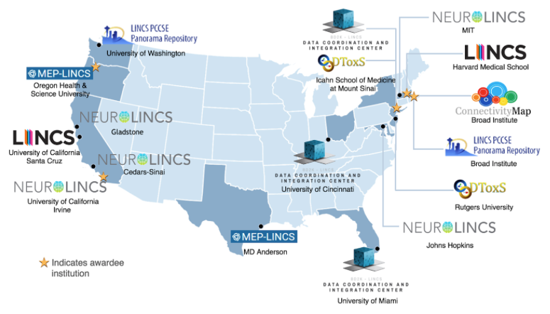
Library of Integrated Network-based
Cellular Signatures (LINCS)
    LINCS Final Symposium: November 19-20, 2020
Highlight achievements
Focus on how community can access LINCS data and tools
Document 34
Notes:
The Library of Integrated Network-based Cellular Signatures (or LINCS) is a Common Fund program intended to create a network-based understanding of biology by cataloging changes in gene expression and other cellular processes. LINCS uses computational tools to integrate this diverse information for the development of new biomarkers and therapeutics.
* The LINCS Consortium will be holding its final symposium virtually on November 19-20. The symposium will highlight achievements of the LINCS program and individual centers over the past ten years, with presentations focusing on how perturbation-based experiments are providing new insights into cell biology and drug discovery. The second half of the symposium will focus on ways the scientific community can access LINCS data and tools.
49

Slide 50
Harnessing Data Science for Health Discovery and Innovation in Africa (DS-I Africa)
Funding Opportunity Announcements | FOA Number | Due Date
DS-I Africa Open Data Science Platform and Coordinating Center (U2C) | RFA-RM-20-018 | December 3, 2020
DS-I Africa Research Hubs (U54) | RFA-RM-20-015 | December 8, 2020
DS-I Africa Research Training Program (U2R) | RFA-RM-20-016 | November 24, 2020
DS-I Africa Ethical, Legal, and Social Implications Research (U01) | RFA-RM-20-017 | December 1, 2020
Document 35
Notes:
The NIH Common Fund recently released four new Funding Opportunity Announcements (or FOAs) for the Harnessing Data Science for Health Discovery and Innovation in Africa (DS-I Africa) program.
This new Common Fund program is designed as a five-year, African-led initiative and is intended to build on previous large-scale NIH collaborations on the continent, including the Human Heredity and Health in Africa (or H3Africa) program. DS-I Africa will leverage existing data and technologies to develop solutions for the continent’s most pressing clinical and public health problems.
The FOAs call for applications in four areas: an open data science platform and coordinating center; research hubs; research training programs; and ethical, legal, and social implications research. Applications are due in late November and early December.
50

Slide 51
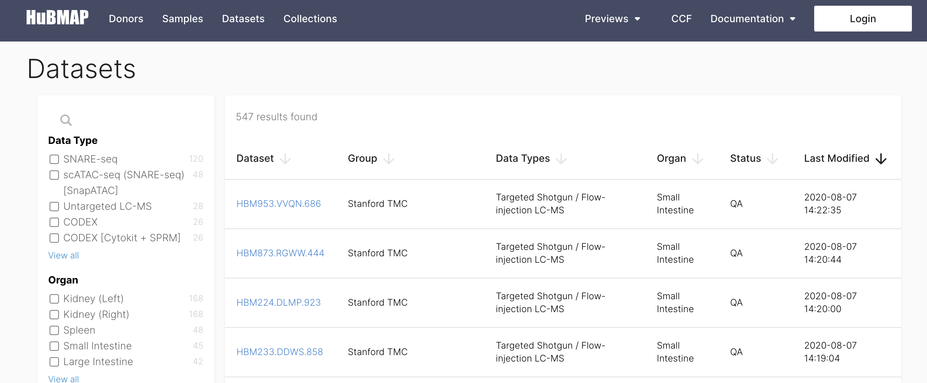
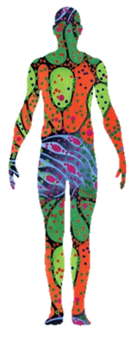
Human Biomolecular Atlas Program (HuBMAP)
    HuBMAP’s first data release in September
    Data generated with healthy tissues from seven organs
    Functional Proteomics Virtual Workshop
    New awards in October
Document 36
Notes:
The Human Biomolecular Atlas Program (or HuBMAP) is a NIH Common Fund program that aims to catalyze development of an open, global framework for comprehensively mapping the human body at cellular resolution. HuBMAP insights will lead to better understanding of the significance of inter-individual variability, changes across the lifespan, tissue engineering, and the emergence of disease at the biomolecular level.
* HuBMAP’s first data release occurred earlier this month. * These data were generated with healthy tissues from seven organs: heart, kidney, large intestine, lymph node, small intestine, spleen, and thymus. This release features a uniform data-analysis pipeline applied on single-cell transcriptomics and epigenetic data along with antibody-based images. The release also includes comprehensive metadata that covers all aspects of labelling and provenance, including de-identified donor information, details of tissue processing and protocols, data levels, and processing pipelines. Future releases are planned for every six months.
* HuBMAP held a Functional Proteomics Virtual Workshop last week. The workshop focused on two key questions: how to integrate analysis of proteomics and transcriptomics data and how to link single-cell proteomics datasets together.
* New awards will start in October 2020, which will almost double the number of HuBMAP groups and expand the number of organs being studied significantly.
51

Slide 52

Faculty Institutional Recruitment for Sustainable Transformation (FIRST) Program
    Create cultures of inclusive excellence at NIH-funded institutions
    Notice of Intent to Publish two FOAs:
      Cohort hiring of diverse group of research faculty
      Coordination and Evaluation Center
    Estimated publication date: Sept. 9, 2020
    Estimated application due date: Nov. 9, 2020
Great minds
think differently…
Document 37
Notes:
Last January, the NIH Council of Councils approved a new $241 million initiative called the Faculty Institutional Recruitment for Sustainable Transformation (or FIRST) program. * The overall objective of FIRST is to create cultures of inclusive excellence at NIH-funded institutions by implementing a set of well-integrated, evidence-based strategies, and then evaluating their impact on prespecified metrics of institutional culture, inclusion, and diversity.
* Last month, NIH released a Notice of Intent to Publish two Funding Opportunity Announcements (or FOAs) for the FIRST Program. * One funding mechanism will provide opportunities for institutions to develop and implement faculty cohort models for the simultaneous hiring of a diverse group of research faculty. * The second funding mechanism will support a Coordination and Evaluation Center to facilitate consortium-wide activities, lead the development of evaluation strategies, and assess the impact and outcomes of the FIRST program.
* The estimated publication date is September 9, and the estimated application due date is November 9. NHGRI strongly encourages investigators in the genomics research community to apply.

Slide 53







Genomic data being generated
Targets for the next year:
  >200K with genotype arrays
  ~100K with whole-genome sequencing
Data Curation:
  Data and Research Center
  Data available in 2021
Return of Information:
  FDA approval of Investigational Device Exemption
  Hereditary disease risk and pharmacogenomics
Document 38
Notes:
The All of Us Research Program is building one of the largest biomedical resources that utilizes volunteer participation within the United States to represent its population diversity. Its aim is to gather data from one million or more people living in the United States to accelerate research and improve the health of the nation.
* In partnership with Baylor College of Medicine’s Human Genome Sequencing Center, the Center for Inherited Disease Research, the Broad Institute, the Northwest Genomics Center at University of Washington, Partners Healthcare, and Color Genomics, the All of Us Research Program has started generating genomic data. * The program plans to perform genotyping on over 200K samples and whole-genome sequencing on approximately 100K samples within the next year. * Data curation is being performed at the Data and Research Center using the Broad Institute’s Terra platform, with the first data becoming available in 2021. * Finally, the FDA approved the All of Us Investigational Device Exemption in July for return of select information on heredity disease risk and pharmacogenomics.

Slide 54
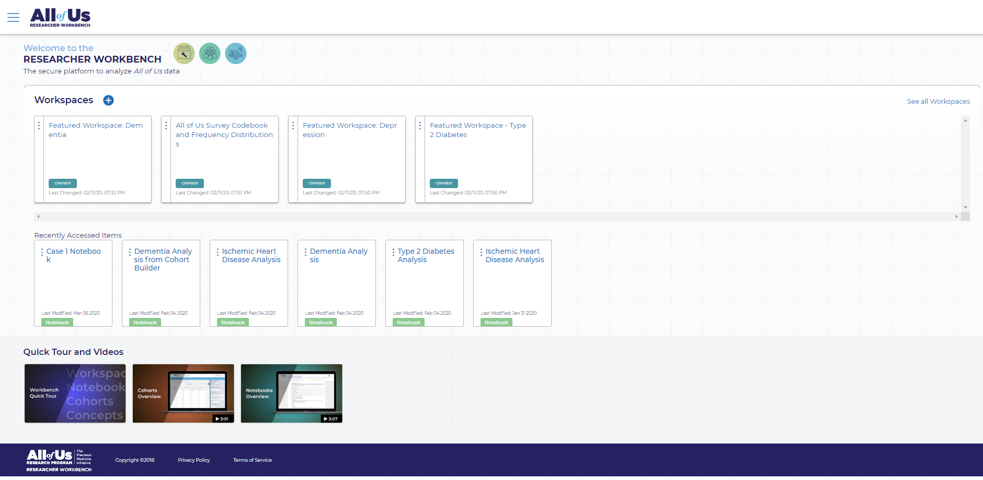
Data: physical measurements, survey data, and some EHR data - much more to come (e.g., genomics, digital health technology)
Tools: Cohort Builder, Dataset Builder, Concept Sets
-more to come
Help Resources: FAQs, sample notebooks and workspaces, documentation, Help Desk
Document 38
Notes:
This past May, All of Us opened the Researcher Workbench for beta testing, marking an important step in their effort to engage the research community and accelerate new discoveries. The initial data release features physical measurements and data from surveys and electronic health records. New data will be added about twice a year, and over time, this will include data from genomic analyses, wearables, and more.
The beta test site is designed for researchers who can code in R or Python. The workbench includes a set of tools to help build participant cohorts, including datasets with customized sets of medical concepts. A help desk and other resources are available to enable researchers to explore and interact in the Researcher Workbench environment.
Currently, access is available to researchers with eRA Commons accounts whose institutions have signed a data use agreement with the program. You are encouraged to explore the Researcher Workbench and learn how the All of Us resource can contribute to your research. Beta testers are also encouraged to provide feedback to All of Us on how well the data, tools, and policies are working.

Slide 55
Director’s Report Outline
General NHGRI Updates
General NIH Updates
General Genomics Updates
NHGRI Extramural Research Program
NIH Common Fund/Trans-NIH
NHGRI Communications, Policy, and Education
NHGRI Intramural Research Program
Notes:
Moving on to NHGRI activities in the areas of communications, policy, and education.
55

Slide 56
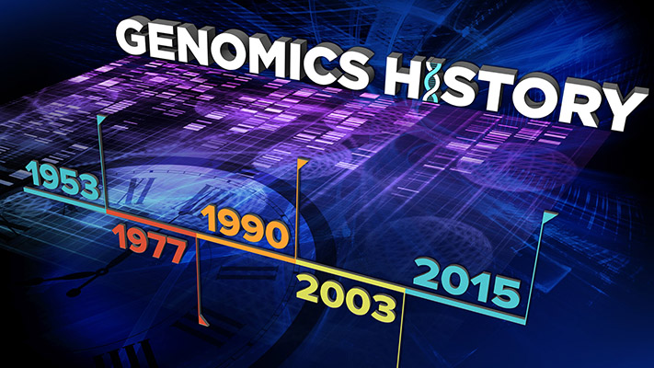
NHGRI Postdoctoral Fellowship in History of Genomics
Document 39
Notes:
NHGRI’s History of Genomics Program recently announced the establishment of a special postdoctoral fellowship opportunity to conduct scholarly pursuits related to the history of the field of genomics. This work will be conducted in partnership with the institute’s Intramural Research Program (specifically, within the Engagement Methods Unit of the Social and Behavioral Research Branch). The selected fellow will produce scholarly writings related to the history of genomics and pursue original research studies, with special emphasis on engagement with diverse and underserved groups.

Slide 57
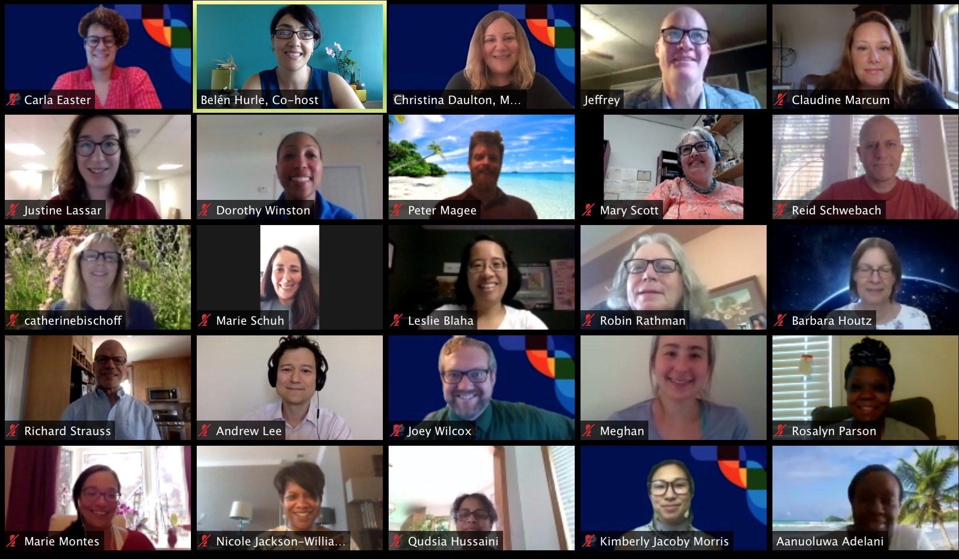
2020 Short Course in Genomics
Document 40
Notes:
Every summer, NHGRI’s Education and Community Involvement Branch hosts its annual Short Course in Genomics for middle school, high school, community college, and Tribal College science educators. In a typical year, about 30 educators travel to NIH to hear lectures and receive teaching resources from NHGRI and NIH researchers, clinicians, and staff. Topics include genetic diseases, DNA sequencing technologies, bioinformatics, gene editing, microbiome studies, and ethical issues in biomedical research.
This year’s course was held in a virtual format for the first time. The institute’s Communications and Public Liaison Branch pre-recorded key course lectures, and students were provided articles, hands-on materials, and other resources in advance of the course. More than two dozen educators participated in this summer’s Short Course, all conducted via Zoom.

Slide 58




Summer Virtual Engagement
Notes:
Also during this summer, the Education and Community Involvement Branch worked with the Prince Georges County Maryland Youth Career Connect Program and the District of Columbia’s Career Academics Network to support career preparedness and science inquiry programming for high school students. The students developed their professional skills and telework etiquette, while simultaneously gaining exposure to a variety of genomic careers and applications of genomic technologies.
* Branch staff also converted CRISPR and DNA sequencing hands-on activities into virtual engagement experiences for middle and high school students. These new materials were used by two STEM virtual summer camps offered by the local Every Girl Can Learning Institute and the Department of Biological Science at the University of Texas at Dallas.

Slide 59
Director’s Report Outline
General NHGRI Updates
General NIH Updates
General Genomics Updates
NHGRI Extramural Research Program
NIH Common Fund/Trans-NIH
NHGRI Communications, Policy, and Education
NHGRI Intramural Research Program
Notes:
59
And finally, moving on to NHGRI’s Intramural Research Program.

Slide 60



NHGRI Researchers Generate First Gapless
Sequence of Human X Chromosome
Mutations that prevent caspase cleavage of RIPK1 cause autoinflammatory disease
News release
Press coverage
YouTube
Social Media
Document 41
Notes:
In July, the Telomere-to-Telomere Consortium, co-led by NHGRI Intramural Senior Investigator Adam Phillippy and NHGRI grantee Karen Miga (of the University of California at Santa Cruz), published a groundbreaking paper in the journal Nature, which reported the generation of the first gapless, end-to-end assembly of a human chromosome sequence (specifically, for the X chromosome). The de novo human chromosome sequence assembly surpasses the continuity of the best-available human reference genome sequence. The researchers were able to achieve this feat by using high-coverage, ultra-long-read nanopore DNA sequencing of a complete hydatidiform mole genome, combined with complementary technologies for quality improvement and validation.
* To note this important milestone, NHGRI’s Communications and Public Liaison Branch developed multiple products for various platforms. An interview with Adam garnered thousands of views on YouTube and social media platforms. The branch also drove a successful media coverage campaign, with a news release and press coverage that was extensively picked up.

Slide 61


New President-Elect, American Society of Human Genetics
Charles Rotimi, Ph.D.
Document 42
Notes:
Charles Rotimi, another Intramural Senior Investigator, has been elected the 2022 President of the American Society of Human Genetics. Charles is an NIH Distinguished Investigator, Director of the NIH Center for Research on Genomics and Global Health, and Chief of NHGRI’s Metabolic, Cardiovascular, and Inflammatory Disease Genomics Branch. Congratulations to Charles for this honor.
61

Slide 62

NHGRI Director on Twitter
Document 43
Notes:
Before closing, let me remind you that I can be followed on Twitter at @NHGRI_Director, where I communicate regularly about NHGRI and genomics to various stakeholders.

Slide 63


Document 44
Notes:
And for those of you who only want to hear from me once a month, you are welcome to sign up to receive my monthly email update (called The Genomics Landscape) on the NHGRI website (genome.gov) by subscribing under “Email Updates.”
63

Slide 64


Thanks!
Special Thanks!
Notes:
Finally, a personal thanks to the many NHGRI staff members who contributed the slides and associated materials that I just reviewed in my Director’s Report. As always, a group effort is essential for getting such a large amount of information conveyed efficiently at each Council meeting.
An additional thanks to the NHGRI communications group and web team for making my Director’s Report into an electronic resource.
And * a special thanks to the usual ‘ringleader’ for helping me prepare my Director’s Report, Kris Wetterstrand (shown here on the top row, middle position). This screen capture is from one of the Zoom-based video recordings produced for celebrating the 30th anniversary of the Human Genome Project launch. Members of the NHGRI History of Genomics Program and Communications and Public Liaison Branch can be seen here preparing to video Marco Marra of the University of British Columbia (in the upper right corner).
64

Slide 65
Notes:
65

