Slide 1



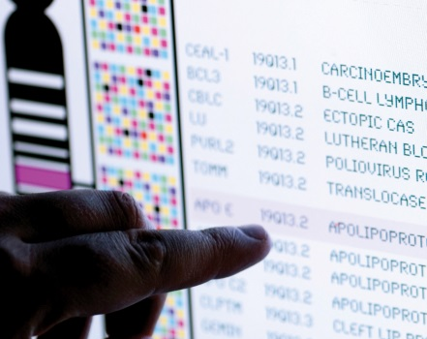
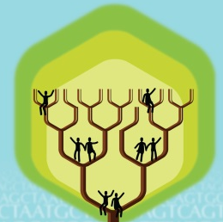
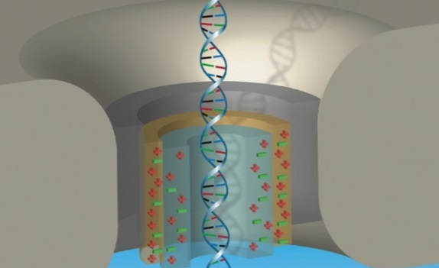


DIRECTOR’S REPORT
Eric Green, M.D., Ph.D.
Director, NHGRI
May 2022
Document #
Notes:
I would again like to welcome all of you to this Open Session of the National Advisory Council for Human Genome Research meeting. As you can see, we still find ourselves in a pandemic-related situation in which I must give my Director’s Report while sitting alone in my conference room – and consistent with the past two-plus years, we will just have to make the best of it.
As with the rest of the Open Session, my Director’s Report presentation is being videotaped, and that recording will be made available as a permanent archive on NHGRI’s website (genome.gov).
1

Slide 2
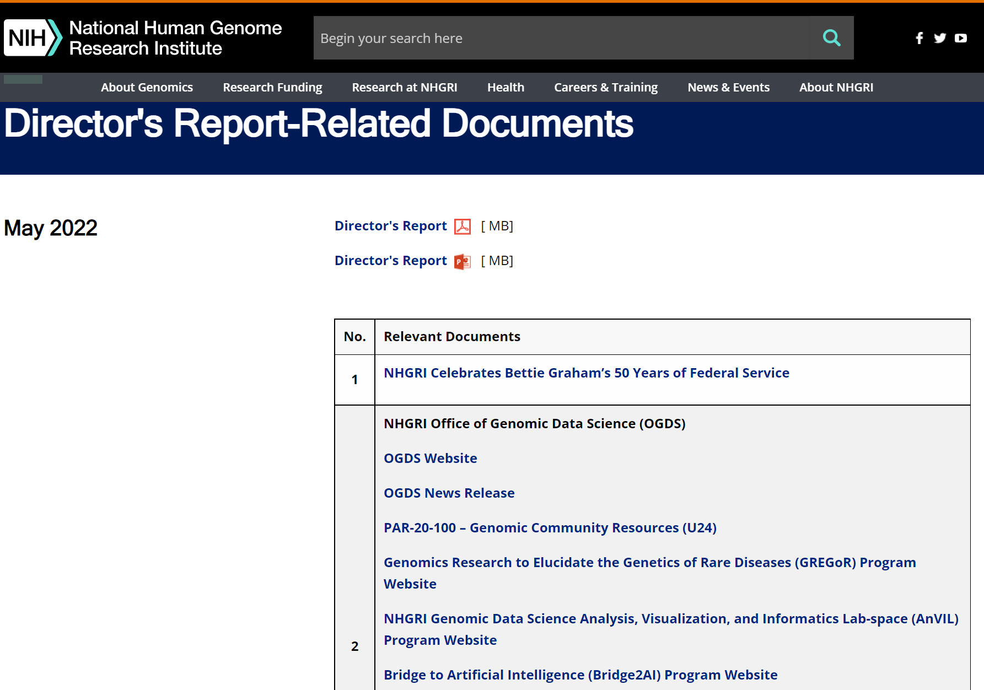
genome.gov/DirectorsReport
Document #
Notes:
For those who are new to our Council meetings, I want to make you aware of the ‘electronic resource’ that is developed for my Director’s Report. Analogous to the supplemental materials of a published paper, this resource can be accessed at the URL shown here.
The slides that I will show during my Director’s Report are also available electronically at this site – * both in PDF and PowerPoint formats.
* When there are documents or relevant websites associated with a particular slide, you will find a ‘Document #’ indicated on the bottom right of that slide; that ‘Document #’ references materials that can be accessed and/or downloaded from the webpage shown here. This dedicated webpage and all linked documents will be archived on genome.gov as part of the historic record of this Council meeting.
2

Slide 3
Open Session Presentations
  Presentations:
    The Future of Nursing Research: Innovation, Collaboration, and Impact
    Shannon Zenk
    Chief Officer for Scientific Workforce Diversity Update
    Marie Bernard
Notes:
There will be a number of other presentations during the Open Session of this Council meeting. My Director’s Report is tailored around those presentations, and I will not discuss in detail the topics that others will cover.
* Following my Director’s Report, Shannon Zenk, Director of NIH’s National Institute of Nursing Research, will speak about “The Future of Nursing Research: Innovation, Collaboration, and Impact.”
* Next, Marie Bernard, NIH’s Chief Officer for Scientific Workforce Diversity, will give a “Chief Officer for Scientific Workforce Diversity Update.”
3

Slide 4
Open Session Presentations
  Concept Clearances:
    Diversity Genome Research Centers
  Ebony Maddon
    Analysis, Visualization, and Informatics Lab-Space (AnVIL)
  Chris Wellington and Ken Wiley
  Workshop Report:
    Future Directions in Genomics and Health Equity
    Judy Cho
Notes:
After those presentations, there will then be two concept clearances presented by NHGRI Extramural Program Directors.
* First, Ebony Maddon will present a concept clearance on “Diversity Genome Research Centers.”
* Second, Chris Wellington and Ken Wiley will present a concept clearance on the “Analysis, Visualization, and Informatics Lab-Space (AnVIL)” program.
* Lastly, Judy Cho, Director of the Charles Bronfman Institute for Personalized Medicine at the Icahn School of Medicine at Mount Sinai, will give a workshop report about “Future Directions in Genomics and Health Equity.”
4

Slide 5
Director’s Report Outline
General NHGRI Updates
General NIH Updates
General Genomics Updates
NHGRI Extramural Research Program
NIH Common Fund/Trans-NIH
NHGRI Communications, Policy, and Education
NHGRI Intramural Research Program
Notes:
For the rest of my Director’s Report, I will cover the 7 areas listed here, which reliably provide a useful framework for reviewing the relevant topics.
5

Slide 6
Director’s Report Outline
General NHGRI Updates
General NIH Updates
General Genomics Updates
NHGRI Extramural Research Program
NIH Common Fund/Trans-NIH
NHGRI Communications, Policy, and Education
NHGRI Intramural Research Program
Notes:
6
And I will start with some general NHGRI updates.

Slide 7
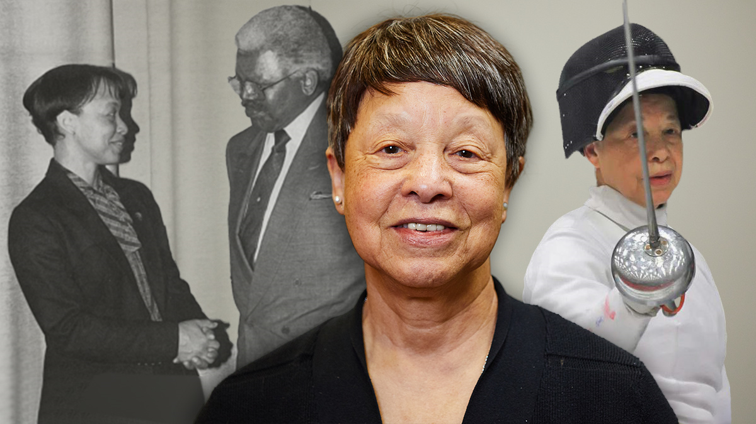
NHGRI Celebrates Bettie Graham’s
50 Years of Federal Service
Document 1
Notes:
Last month, one of NHGRI’s founding staff members and current leaders, Bettie Graham (who serves as Director of the institute’s Division of Extramural Operations), reached a truly remarkable milestone: 50 years of service in the federal government. Bettie has been a member of the NHGRI Extramural Research Program since its inception, becoming deeply woven into the fabric of all aspects of NHGRI’s extramural operations.
Bettie was the third employee to join the then-named National Center for Human Genome Research in 1989. Her experience and wisdom about all things related to NIH are deeply respected by her colleagues, both inside and outside of NHGRI. She has a wealth of knowledge, especially about the intricacies of NIH program management. If that is not impressive enough, Bettie is a decorated fencer, having won multiple medals on the veteran world epee team and taking home a national epee individual bronze medal in 2016. Bettie Graham is a truly dedicated, remarkably competent, and overwhelmingly generous individual.

Slide 8
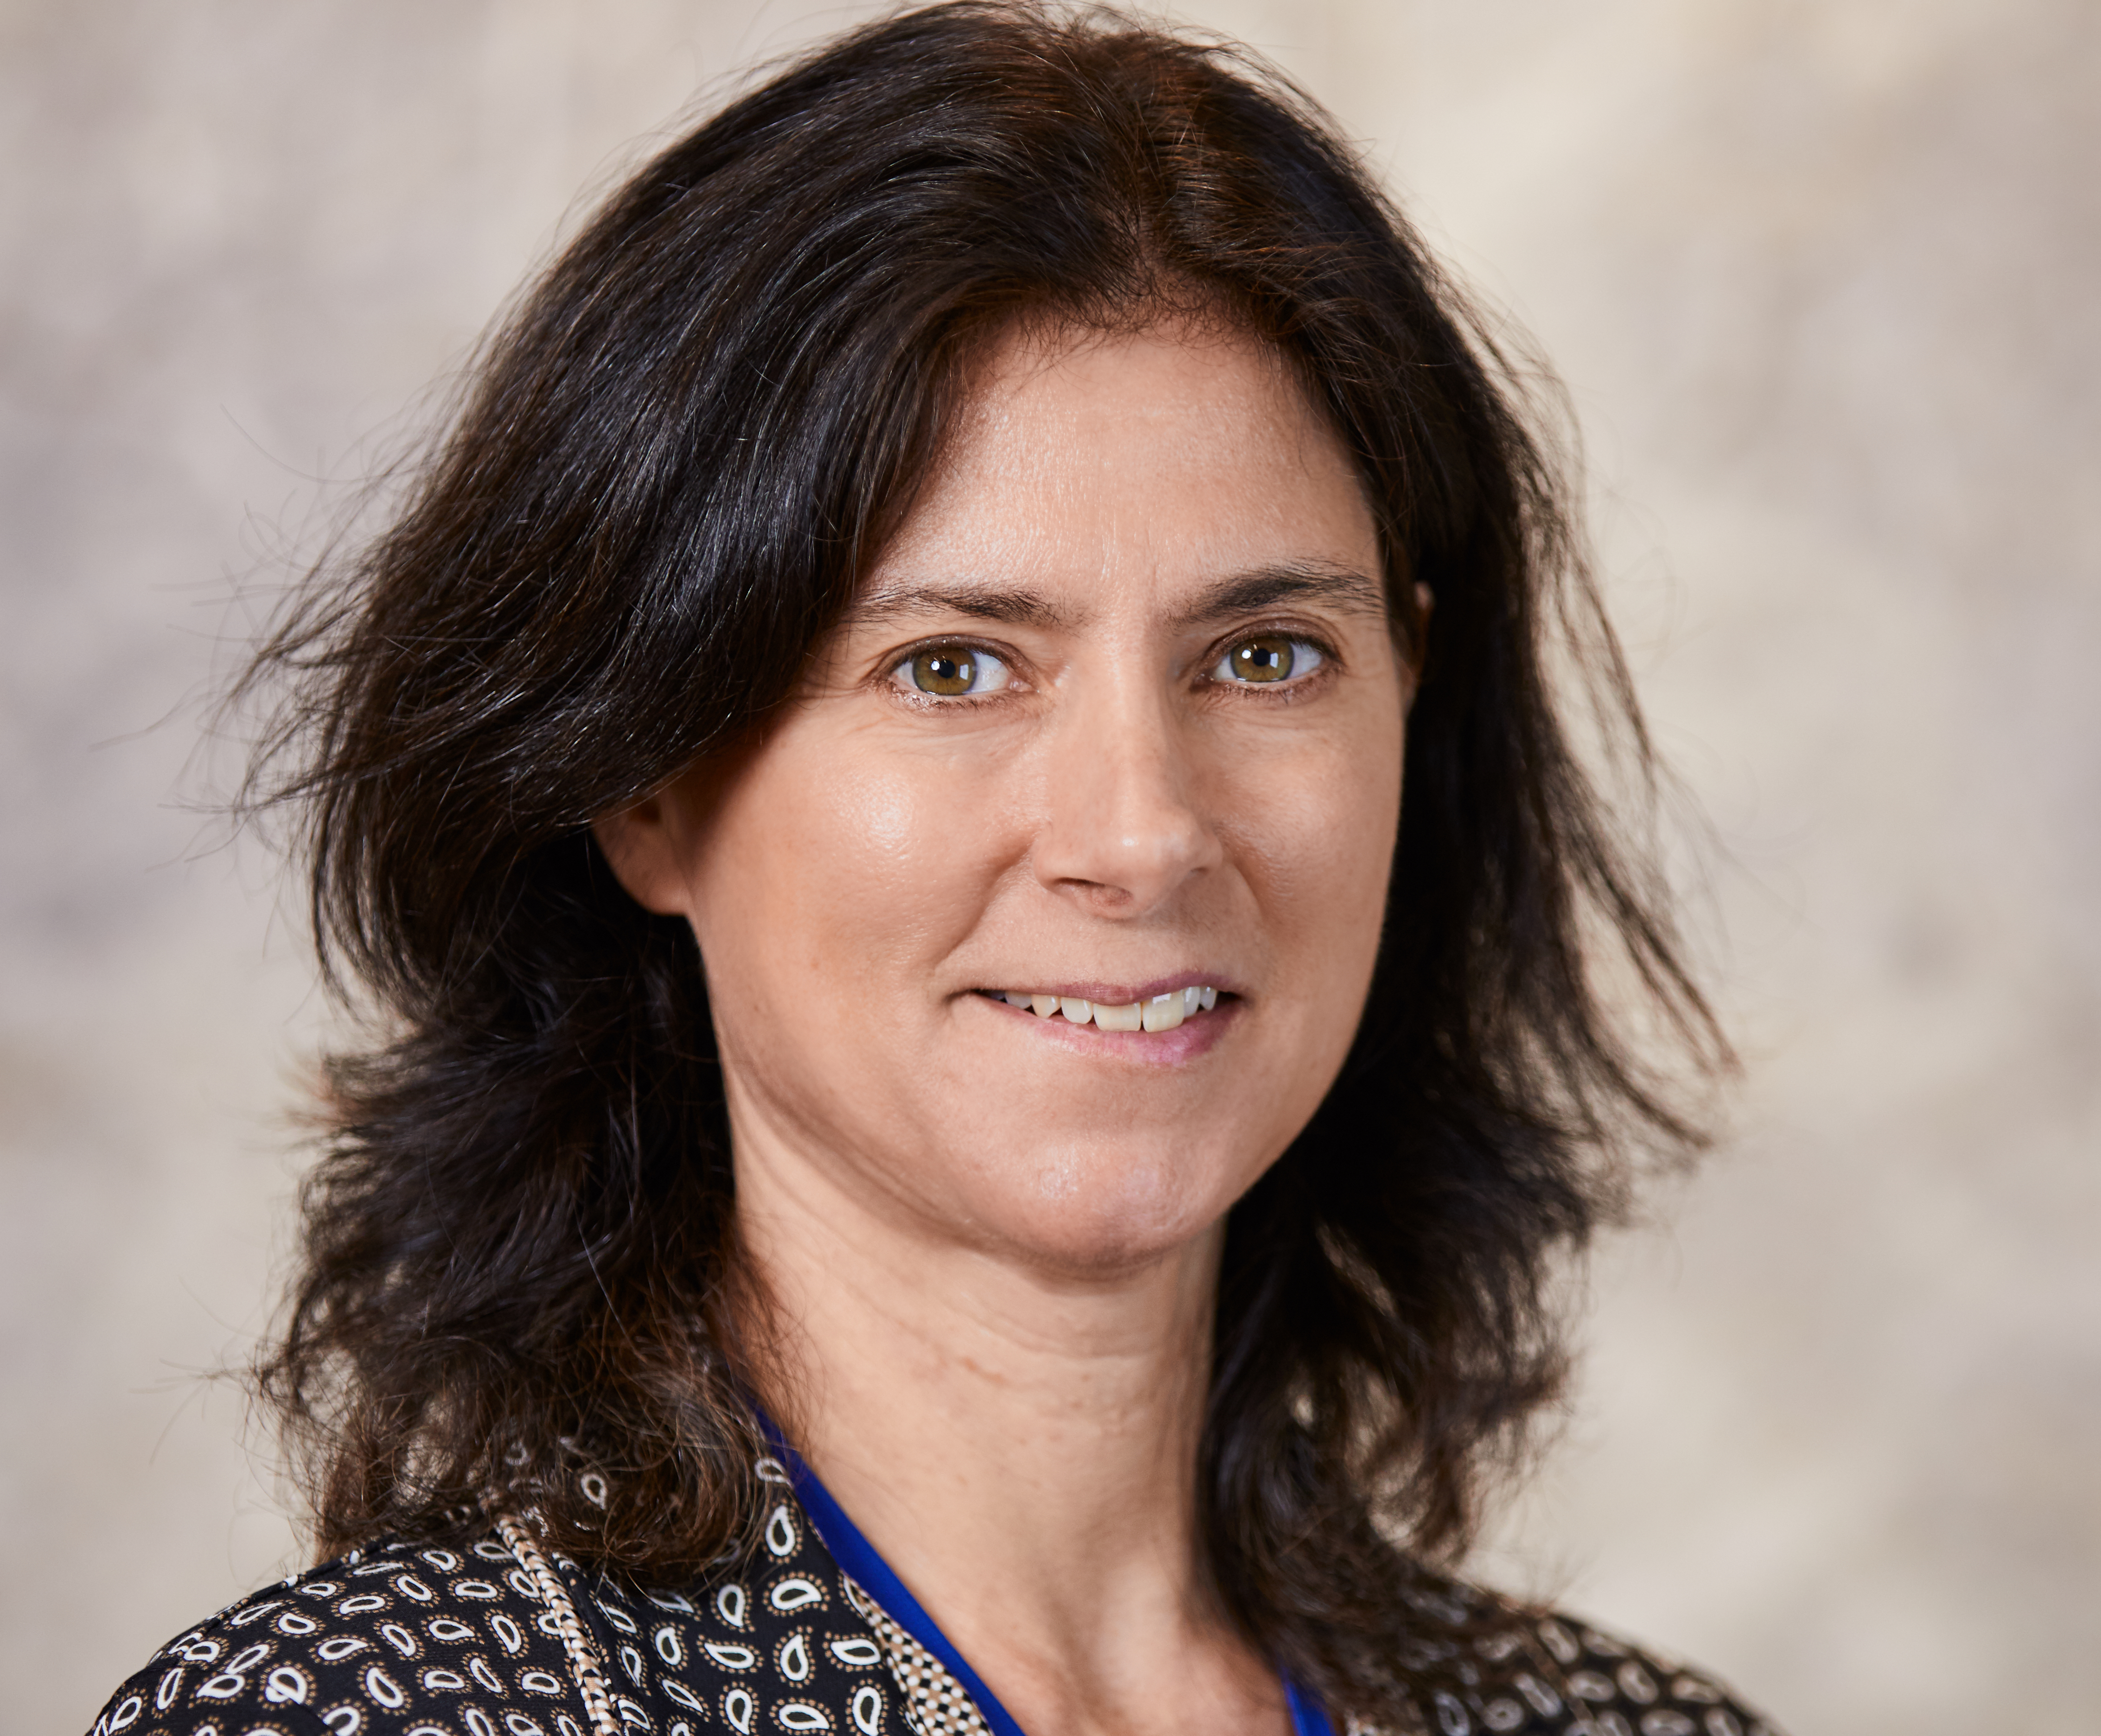
Departure of Extramural Program Director
Tina Gatlin, Ph.D.
Notes:
Tina Gatlin, who until this past March was an Extramural Program Director in NHGRI’s Division of Genome Sciences, is now a Program Director in the National Institute of Biomedical Imaging and Bioengineering’s Division of Interdisciplinary Training. In her over decade-long career at NHGRI, Tina managed a portfolio of grants focused on training, genome sciences, and proteomics. She also served as one of the working group coordinators for the NIH Common Fund Protein Capture Reagents program.
Over the last several years, Tina was the lead Training Program Director for efforts focused on genome sciences. In that role, she developed and fostered several NHGRI initiatives centered around promoting career opportunities for trainees and advancing a diverse biomedical workforce.
We are grateful to Tina for her contributions to NHGRI and the Common Fund, and we wish her much success as she continues her work in training and career development.

Slide 9

New Extramural Program Director
Alexander Arguello, Ph.D.
Notes:
In March, Alexander (or Xander) Arguello joined NHGRI as an Extramural Program Director in the Division of Genome Sciences. He oversees an investigator-initiated portfolio in genomic variation, population genetics, and statistical genetics. He is also part of the NHGRI program leadership teams for the Human Genome Reference Program and the Developmental Genotype-Tissue Expression (or dGTEx) initiative.
Xander came to NHGRI from the National Institute of Mental Health, where he was part of the program leadership team for the PsychENCODE Consortium and oversaw a portfolio of awards in functional genomics as well as statistical and computational methods development. Prior to coming to NIH, Xander was a Senior Scientific Editor at Nature Neuroscience.

Slide 10

NHGRI Office of Genomic Data Science (OGDS)
Chris Wellington, B.S.
Computational Genomics and Data Science Program Director
Document 2
Notes:
Late last year, NHGRI established the Office of Genomic Data Science (or OGDS) within the Office of the Director. More recently, we established the initial staffing of this new office.
First, Chris Wellington has joined the office as a Computational Genomics and Data Science Program Director and the new co-lead for the NHGRI Genomic Data Science Analysis, Visualization, and Informatics Lab-space (or AnVIL) program. Chris will continue to serve as the point of contact for the Genomic Community Resources U24 Funding Opportunity Announcement and as a Program Director for the Genomics Research to Elucidate the Genetics of Rare Diseases (or GREGoR) Consortium.

Slide 11
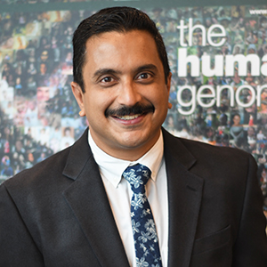
NHGRI Office of Genomic Data Science (OGDS)
Shurjo Sen, Ph.D.
Computational Genomics and Data Science Program Director
Document 2
Notes:
Shurjo Sen also joined the office as a Computational Genomics and Data Science Program Director and serves as a coordinator for the NIH Common Fund Bridge to Artificial Intelligence (or Bridge2AI) Program. Shurjo focuses on artificial intelligence in genomics, workforce development, diversity, equity, and inclusion activities. He also supports training and outreach for the AnVIL program and is leading the Educational Hub for Enhancing Diversity in Computational Genomics and Data Science.

Slide 12
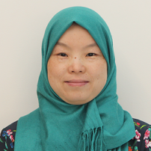
NHGRI Office of Genomic Data Science (OGDS)
Asiyah Yu Lin, M.D., Ph.D.
Data and Technology
Advancement (DATA) Scholar
Document 2
Notes:
Asiyah Yu Lin is now serving as the NIH Data and Technology Advancement (or DATA) Scholar in the office. In this role, she supports the NIH Cloud Platform Interoperability Effort (or NCPI) and focuses on development, implementation, and adoption of ontologies, data models, and standards.

Slide 13

NHGRI Office of Genomic Data Science (OGDS)
Elena Ghanaim, M.A.
Policy Advisor for Data Science and Sharing
Document 2
Notes:
Lastly, Elena Ghanaim serves as the Policy Advisor for Data Science and Sharing within the office. In this role, Elena leads NHGRI’s scientific data sharing policy development, oversight, and implementation. She also works with NIH staff, extramural grantees, and international partners on data sharing and privacy policy issues.

Slide 14
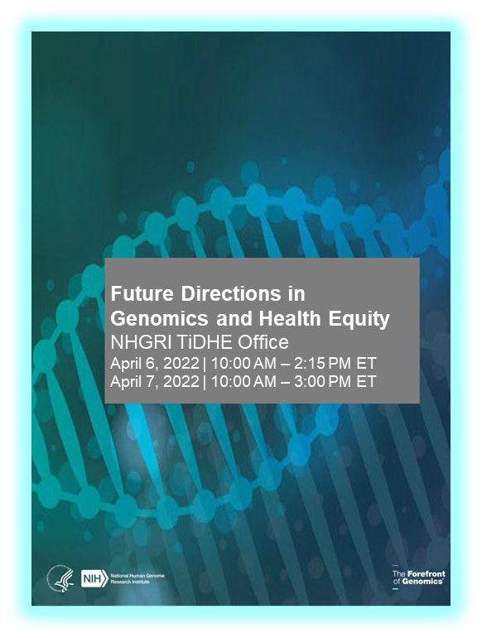
    Future Directions in Genomics and Health Equity Research Workshop
    Identify research gaps and opportunities that help address health disparities and improve health equity in genomics
    Over 300 participants
Document 3
Notes:
The NHGRI Training, Diversity, and Health Equity (or TiDHE) Office hosted a virtual workshop last month entitled “Future Directions in Genomics and Health Equity Research.”
* The workshop’s goal was to identify research gaps and opportunities that could help address health disparities and improve health equity in genomics. * Over 300 participants attended the workshop, which included a series of presentations, panels, and breakout groups on topics such as moving from health disparities to health equity in genomics, current research in genomics and health equity, and structural factors needed to support genomics and health equity research.
The workshop report and video recording is available on NHGRI’s website, genome.gov, and you will hear more about this workshop from Judy Cho later in this Council meeting.

Slide 15
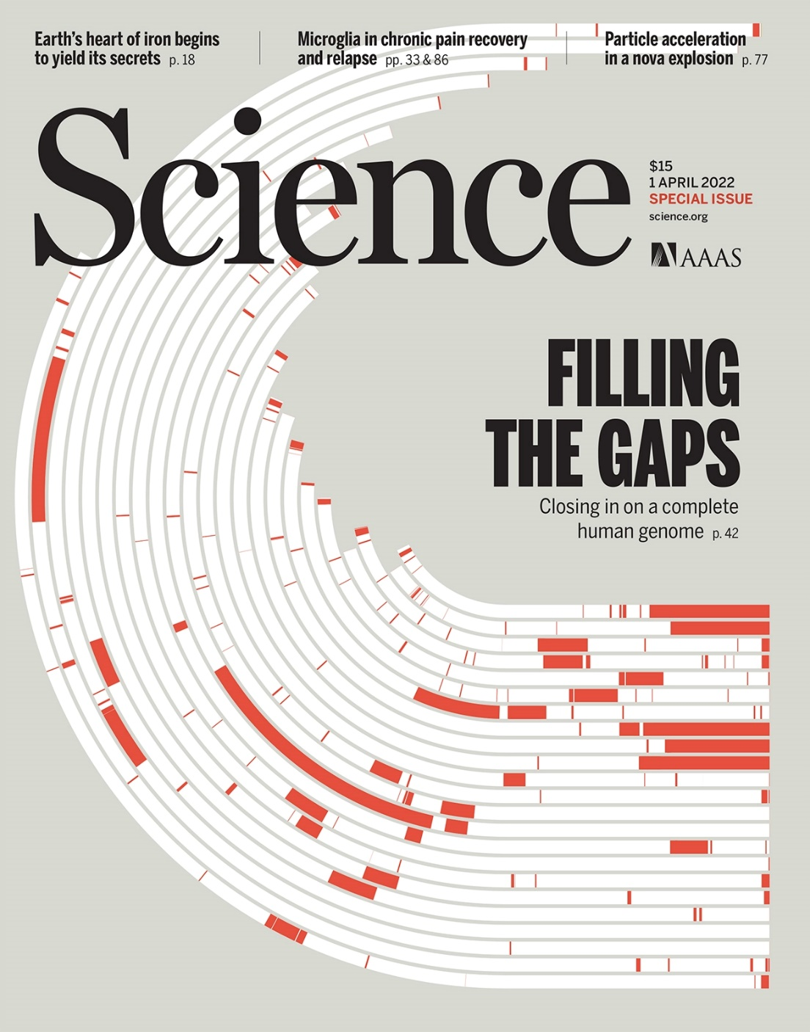
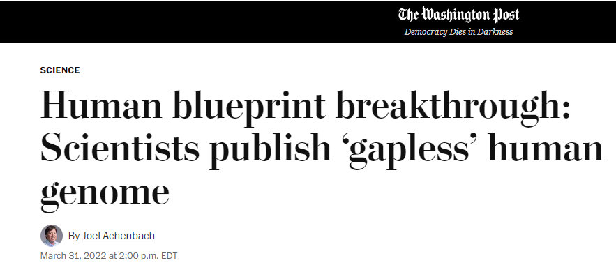
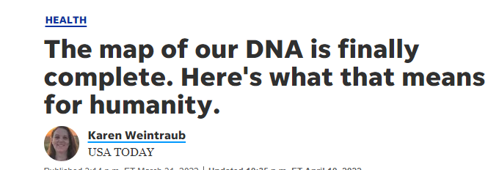
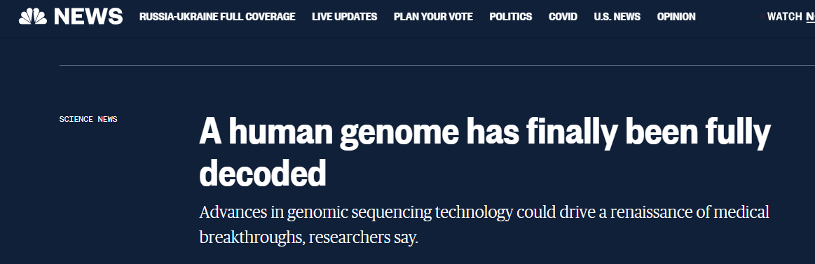
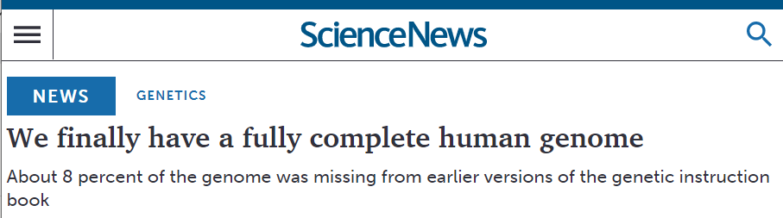
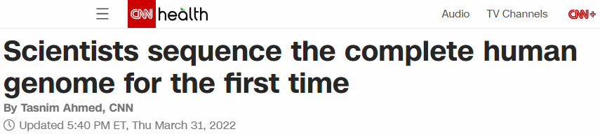
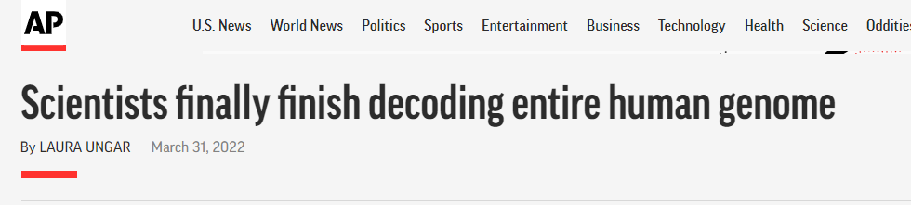
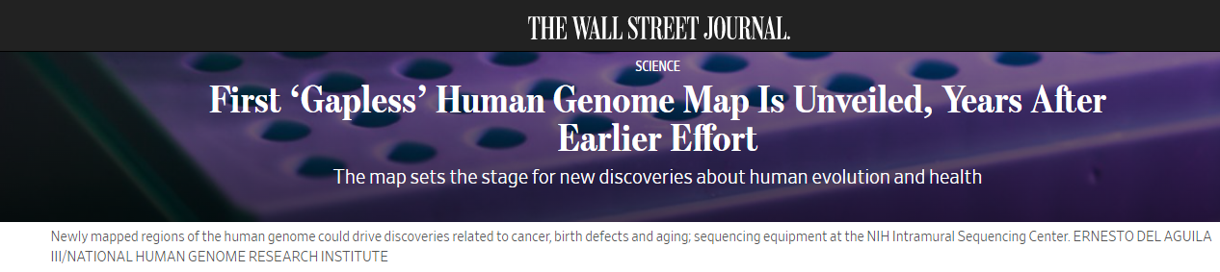

    Telomere-to-Telomere (T2T) Consortium
Document 4
Notes:
In April, the Telomere-to-Telomere (or T2T) Consortium published the first complete, gapless sequence of a human genome, roughly two decades after the Human Genome Project produced the first draft human genome sequence. This remarkable scientific achievement reflected a joint effort that involved the leadership of investigators supported by NHGRI’s Extramural Research Program and Intramural Research Program.
The NHGRI Office of Communications took the lead in communicating this historic achievement to the press and public. The announcement was the culmination of nearly a year of planning between NHGRI communications staff and dozens of T2T Consortium researchers, university and institution communications offices, and members of the press and public.
* The success of these efforts are nicely represented by various outcomes. For example, between March 31 and April 8, NHGRI and T2T received mentions in 1,074 news articles that collectively have a circulation of 998 million unique visitors per month. NHGRI’s web site, genome.gov, received more than 13,000 page views of the news release, over 7,800 page views of the T2T landing page, and over 5,600 page views of a web profile of NHGRI intramural investigator Adam Phillippy, who is one of the co-chairs of the T2T Consortium.
15

Slide 16
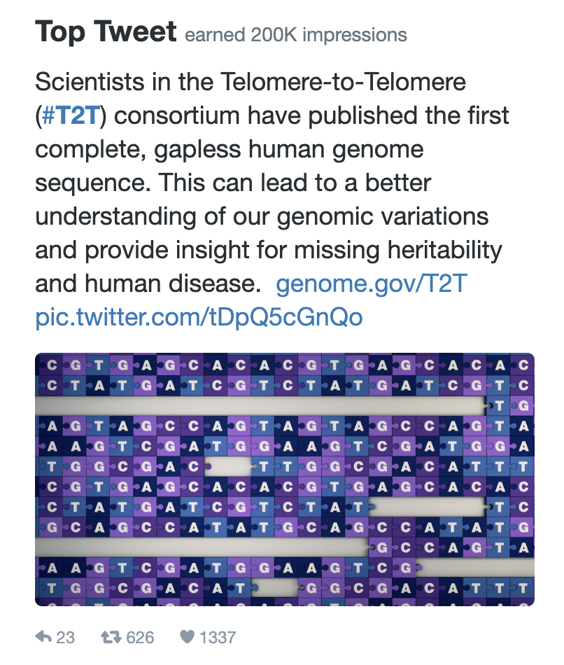
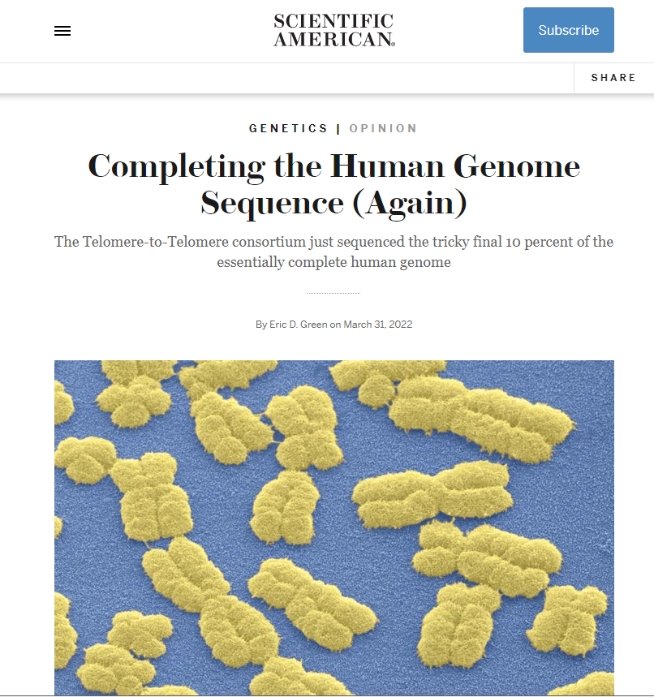
    Telomere-to-Telomere (T2T) Consortium
Document 4
Notes:
NHGRI’s Twitter account @Genome_gov received * over 80 million appearances on people’s Twitter feeds, more than 3 million views for our NHGRI account over the past 30 days (which is a record high), and over 50,000 views for a special T2T animation.
* In addition, I wrote a commentary that was published in Scientific American about “Completing the Human Genome Sequence (Again),” which was featured on the Scientific American homepage and received a shoutout from Scientific American Editor-in-Chief Laura Helmuth as a “fascinating and fun what-it-all-means piece on today's big T2T announcement.”
16

Slide 17
Director’s Report Outline
General NHGRI Updates
General NIH Updates
General Genomics Updates
NHGRI Extramural Research Program
NIH Common Fund/Trans-NIH
NHGRI Communications, Policy, and Education
NHGRI Intramural Research Program
Notes:
Moving on to general NIH updates.
17

Slide 18
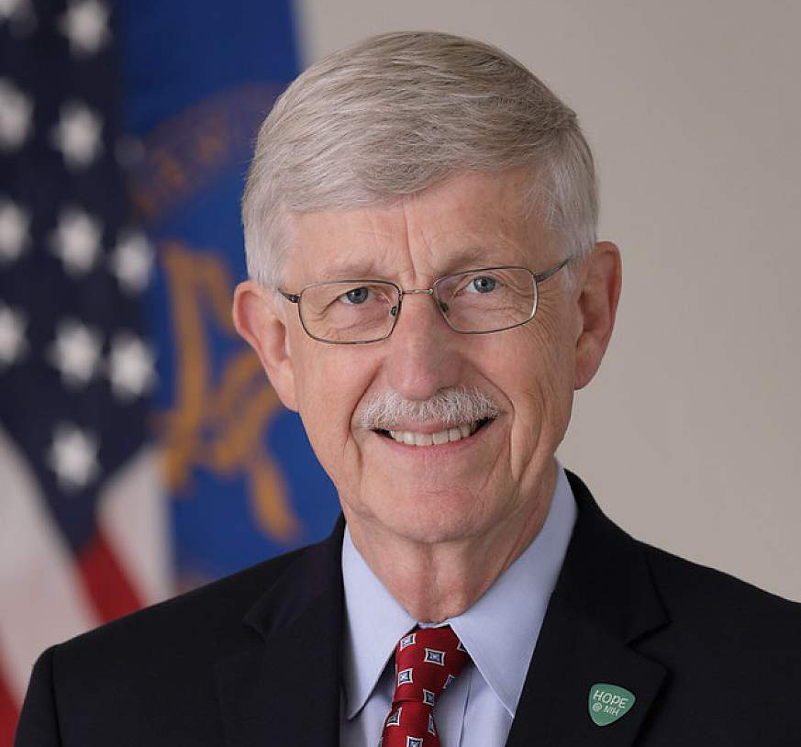
Acting Science Advisor to President Biden
Francis Collins, M.D., Ph.D.
Document 5
Notes:
At the February Council meeting, I reported that Francis Collins had returned to NHGRI on a full-time basis as a Senior Investigator in our Intramural Research Program. His full-time status with us did not even last three months!
In February, Francis agreed to serve as the Acting Science Advisor to President Biden and Acting Co-Chair of the President’s Council of Advisors on Science and Technology. As he did throughout his almost 12 years as NIH Director, Francis will continue to direct his NHGRI-based research laboratory while providing continued service to our country in yet another crucial scientific leadership role.

Slide 19
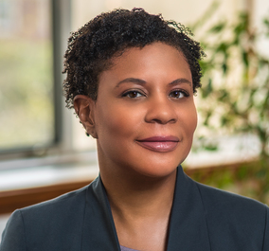
Acting Director,
Office of Science and Technology Policy
Alondra Nelson, Ph.D.
Document 6
Notes:
Alondra Nelson has been named Acting Director of the White House Office of Science and Technology Policy (or OSTP), with plans for her to serve in this capacity until a permanent director is nominated and confirmed. Under her leadership, OSTP’s six policy divisions will advance critical Administration priorities in science and technology. Alondra was also named Deputy Assistant to the President.
A renowned scholar of science, technology, medicine, and social inequality, she had already been serving as Deputy Director of the newly created OSTP Science and Society Division.

Slide 20
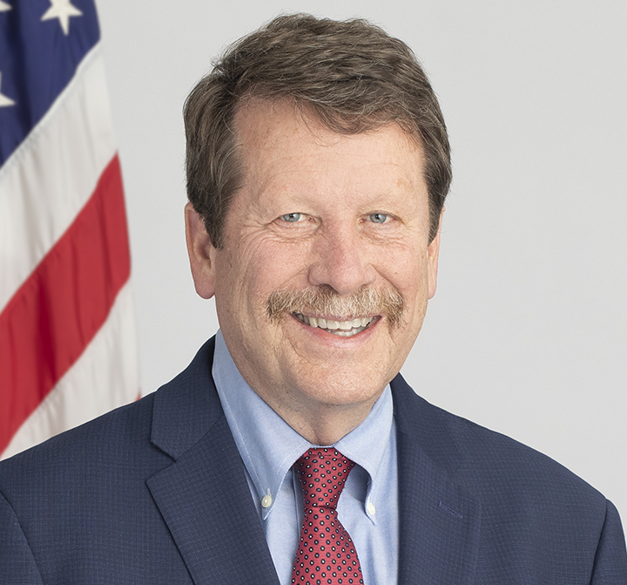

New Commissioner, Food and Drug Administration
Robert Califf, M.D.
Document 7
Notes:
In February, Robert Califf was sworn in as Commissioner of the U.S. Food and Drug Administration (or FDA). Previously, Rob served in this capacity from February 2016 to January 2017. Prior to rejoining the FDA, he was Head of Medical Strategy and Senior Advisor at Alphabet Inc. and Professor of Medicine and Vice Chancellor for Clinical and Translational Research at Duke University.

Slide 21
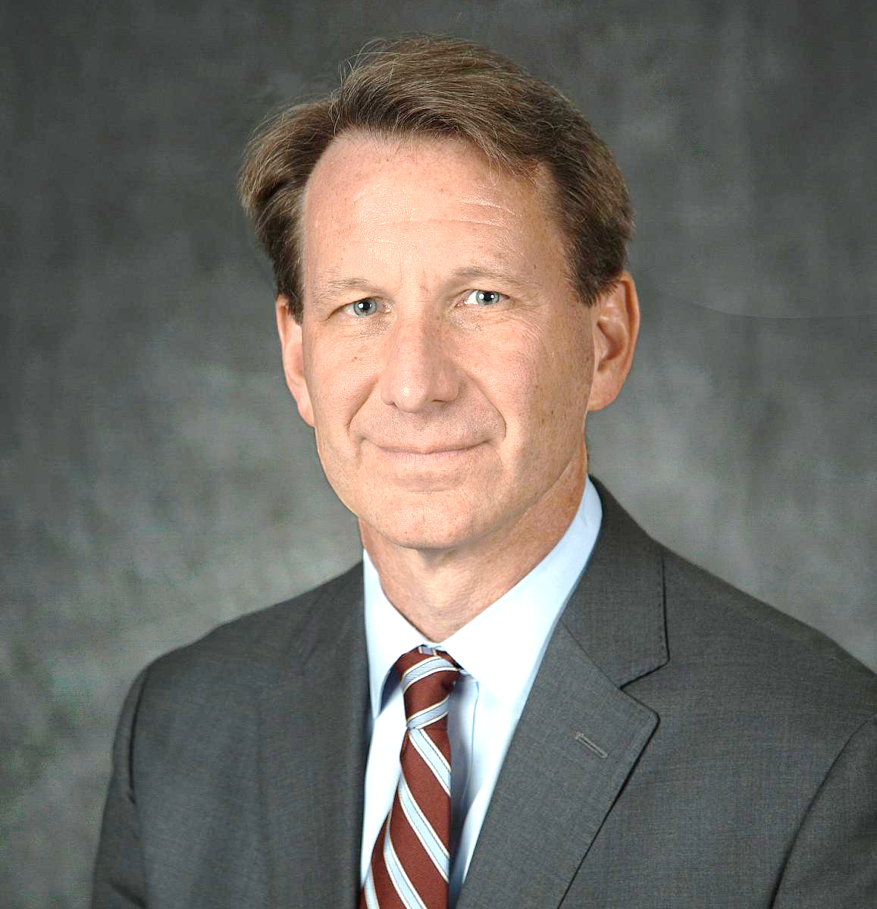
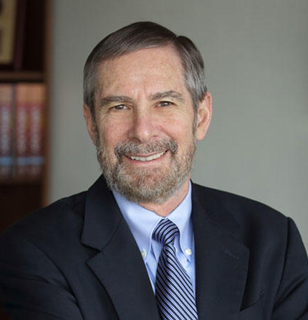

Ned Sharpless Steps Down as
Director, National Cancer Institute
Norman Sharpless, M.D.
Douglas Lowy, M.D.
Document 8
Notes:
In April, Norman (or Ned) Sharpless stepped down as the 15th Director of the National Cancer Institute (or NCI), a position he had held since 2017. Ned also served as Acting Commissioner of the FDA for seven months in 2019 before returning to the NCI directorship. At NIH, he championed health equity; developed important programs in data science; and advocated forcefully for policies to ensure continued support for investigator-initiated research and diversity in the cancer research workforce.
* NCI Principal Deputy Director Doug Lowy will now (once again) serve as Acting Director until a new NCI Director is appointed.

Slide 22


New CEO, Foundation for the NIH
Julie Gerberding, M.D., M.P.H.
Document 9
Notes:
Today, Julie Gerberding assumes the position of Chief Executive Officer of the Foundation for NIH (or FNIH). FNIH raises funds and creates and manages alliances with public and private institutions in support of NIH’s mission.
Julie previously served as Chief Patient Officer and Executive Vice President for Population Health and Sustainability at Merck. Prior to that, she headed Merck’s Vaccines Division. Earlier, she was the first woman to serve as CDC Director. Her distinguished career has earned her global recognition – for example, she has been included in Forbes magazine’s 100 Most Powerful Women in the World and Time magazine’s 100 Most Influential People in the World.

Slide 23
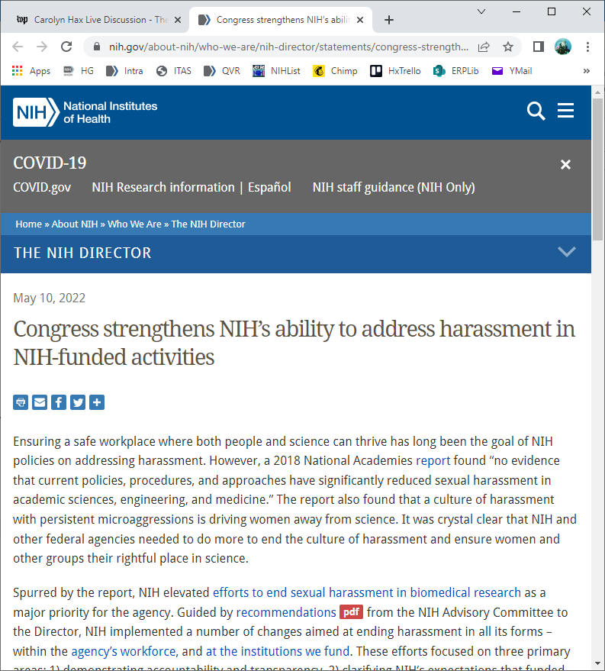
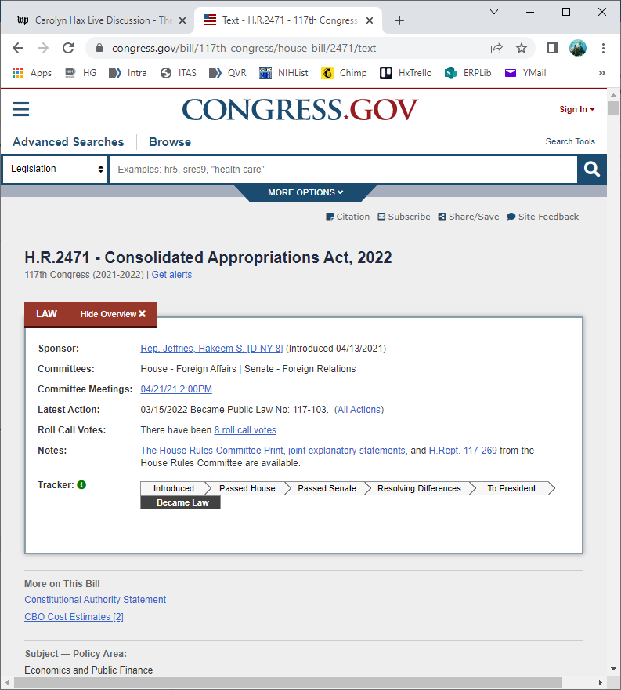
NIH Implements Harassment
Reporting Requirements for Grantees
Document 10
Notes:
On the policy front, NIH is implementing a general provision in the 2022 Consolidated Appropriations Act that makes reporting to NIH by NIH-funded institutions mandatory “when individuals identified as a principal investigator or as key personnel in an NIH notice of award are removed from their position or are otherwise disciplined due to concerns about harassment, bullying, retaliation, or hostile working conditions.”
Previously, NIH lacked clear authority to require funded institutions to report to NIH whether personnel changes to an NIH grant are related to harassment. Passage of this bill into law ensures NIH is made aware when the reason for the personnel changes is harassment, and it therefore strengthens NIH’s ability to take the necessary action to ensure safe work environments wherever NIH-funded activities are conducted. This is an important milestone in support of NIH’s commitment to do what we can to end harassment and improve civility in biomedical research.

Slide 24
Fiscal Year 2022 Appropriations
 | FY2022 Enacted Labor-HHS Appropriation | Change from FY2021
NIH | $45 B* | $2.25 B (5.3%)
NHGRI | $639.0 M | $23.3 M (3.8%)
Fiscal Year 2023 Appropriations
 | FY2023 President’s Budget | Change from FY2022
NIH | $49 B** | $4 B (8.9%)
* Includes $1 billion for ARPA-H
** Includes $5 billion for ARPA-H
Document 11
Notes:
At the time of the February Council meeting, the government was operating under a continuing resolution. On March 15, President Biden signed a Fiscal Year 2022 omnibus appropriations bill into law. * The bill included a 5.3% budget increase for NIH along with an increase of no less than 3.4% for each NIH Institute and Center. * NHGRI received a 3.8% increase, bringing our total budget to $639 million in Fiscal Year 2022. The bill also appropriated $1 billion for Advanced Research Projects Agency for Health (or ARPA-H).
President Biden’s Fiscal Year 2023 budget request was unveiled on March 28, reflecting the White House’s priorities and serving as an opening gambit for the appropriations process for next fiscal year. The budget does not have granularity at the level of individual NIH Institutes and Centers * but does propose a topline NIH budget of $49 billion. While this would reflect a nearly 9% increase for NIH overall, such an increase would include additional funding for ARPA-H.
News outlets report that House and Senate appropriators are meeting to begin discussions on the Fiscal Year 2023 budget limit.
24

Slide 25
    Advanced Research Projects Agency for Health (ARPA-H)
To benefit the health of all Americans by catalyzing health breakthroughs that cannot readily be accomplished through traditional research or commercial activity
Summer 2021
OSTP and NIH publish commentary in Science
March 2022
FY22 omnibus with $1B available for 3 years
April 2022
ARPA-H transferred to NIH
Launch engagement activities to gather community feedback
ARPA-H Director will report to HHS Secretary
$5B in FY23 President's budget request
Director to be Presidentially appointed
Document 11
Notes:
Very much related to the Fiscal Year 2022 budget is the recently authorized Advanced Research Projects Agency for Health (or ARPA-H), which aims to conduct high-impact biomedical and health research with a mission “to benefit the health of all Americans by catalyzing health breakthroughs that cannot readily be accomplished through traditional research or commercial activity.”
* Last summer, the Office of Science and Technology Policy (or OSTP) and NIH published a commentary in Science outlining a vision for ARPA-H, held information sessions and numerous meetings with different organizations, and convened 16 listening sessions to get community feedback (including from patient advocacy groups, industry, and scientific professional organizations).
As I mentioned in the last slide, the Fiscal Year 2022 omnibus provided $1 billion that will be available over three years to launch ARPA-H. The ARPA-H Director will be appointed by the President.
And then most recently, the decision was made to transfer ARPA-H to NIH and have its Director reporting to the HHS Secretary. And finally, the President requested $5 billion in his Fiscal Year 2023 budget to continue building ARPA-H.
25

Slide 26
Director’s Report Outline
General NHGRI Updates
General NIH Updates
General Genomics Updates
NHGRI Extramural Research Program
NIH Common Fund/Trans-NIH
NHGRI Communications, Policy, and Education
NHGRI Intramural Research Program
Notes:
Moving on to general genomics updates.
26

Slide 27
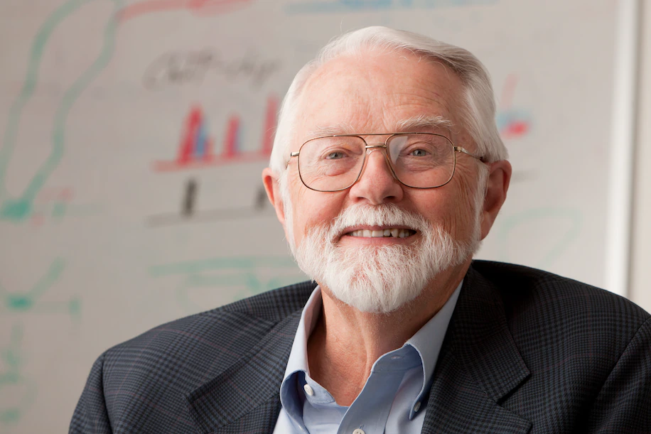
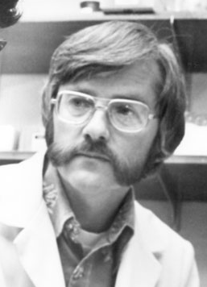
Mourning the Loss of Arthur Riggs
Document 12
Notes:
In March, Arthur Riggs, a medical researcher whose experiments with recombinant DNA led to the development of synthetic insulin, passed away. He was 82 years old. His research across the field of medical science has profoundly improved the health and treatment of millions of individuals with diabetes and cancer and helped to launch the genetic engineering revolution and the biotechnology industry.
27

Slide 28

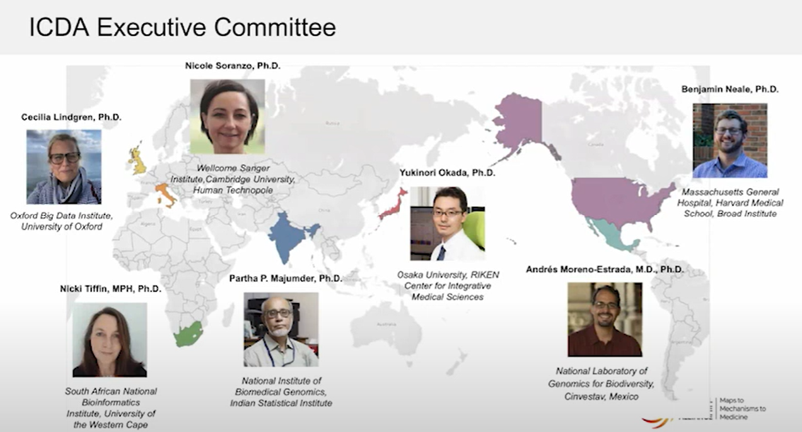
International Common Disease Alliance
(ICDA)
2nd ICDA Virtual Scientific Plenary Meeting in March
New Executive Committee
Virtual Community Town Halls in April
Document 13
Notes:
The International Common Disease Alliance (or ICDA) is a scientific consortium that aims to define barriers to progress in tackling the Maps-to-Mechanisms-to-Medicines challenge, identify opportunities for new projects, and facilitate international collaborations.
* In March, ICDA held its 2nd Virtual Scientific Plenary Meeting, which consisted of presentations and discussions focused on current challenges and successes in advancing genetic maps, international genomic resources, analytical methods, and cellular models for Maps-to-Mechanisms-to-Medicines.
* The new ICDA Executive Committee was announced as part of the Plenary Meeting, which now consists of the individuals shown here. * As one of their first activities, the Executive Committee hosted a series of virtual Community Town Halls in April.
Video recordings of the Plenary Meeting and Community Town Halls can be found on the ICDA YouTube channel.

Slide 29

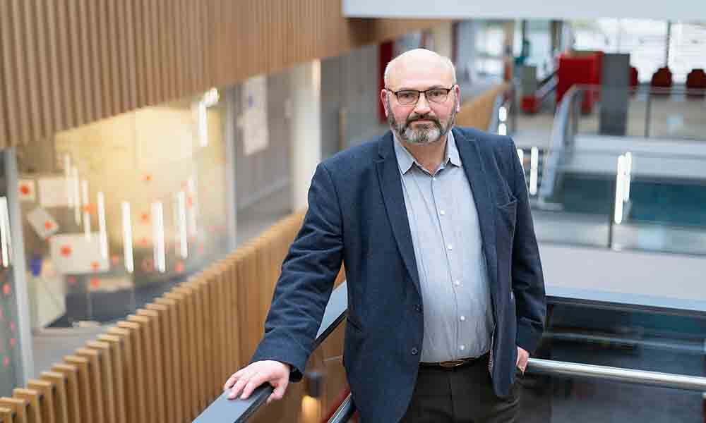

Global Biodata Coalition (GBC)
Guy Cochrane, D.Phil.
Document 14
Notes:
The Global Biodata Coalition (or GBC) was established as a coalition of life sciences and biomedical research funders that aims to optimize the funding and management of biodata resources worldwide. The GBC has two priority aims: (1) to better coordinate and share approaches for efficient management and growth of the biodata infrastructure; and (2) to stabilize and ensure sustainable financial support for the global biodata infrastructure.
* Last month, GBC appointed Guy Cochrane as its founding Executive Director. Guy has over two decades of experience working with and leading biodata resources and is an authority on large-scale international genome sequence data sharing.
29

Slide 30

Elected to National Academy of Sciences
Howard Cedar
Job Dekker
Michael Elowitz
Mark Johnston
Erik Jorgensen
Rasmus Nielsen
Julie Segre
Jay Shendure
Len Zon
Document 15
Notes:
The National Academy of Sciences recently announced their newly elected members. Of particular relevance to NHGRI and the genomics community are the individuals listed here. Note two former members of this Advisory Council among this group: Mark Johnston and Jay Shendure. In addition, NHGRI is particularly proud to see Julie Segre on this list; Julie is a Senior Investigator and Branch Chief in the Institute’s Intramural Research Program.
30

Slide 31
Director’s Report Outline
General NHGRI Updates
General NIH Updates
General Genomics Updates
NHGRI Extramural Research Program
NIH Common Fund/Trans-NIH
NHGRI Communications, Policy, and Education
NHGRI Intramural Research Program
Notes:
Moving on to the NHGRI Extramural Research Program.
31

Slide 32

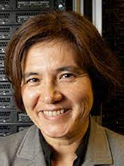
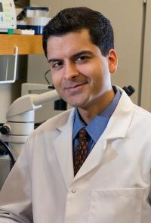

    Centers for Excellence in Genomic Science (CEGS)
New Awards:
David Haussler - University of California, Santa Cruz
Center for Live Cell Genomics
Lucila Ohno Machado - University of California, San Diego
Center for Admixture Science and Technology
Samie Jaffrey - Weill Medical College of Cornell University
Center for Genomic Information Encoded by RNA Nucleotide Modifications
PAR-22-107 Next due date: June 22, 2022
Document 16
Notes:
The Centers for Excellence in Genomic Science (or CEGS) program supports interdisciplinary research teams for developing highly innovative approaches in genomics research.
NHGRI recently made three new awards at institutions that had not previously been part of the CEGS program, all using designated “emerging CEGS” (or “eCEGS”) funds. These awards went to the * Center for Live Cell Genomics at University of California, Santa Cruz; * the Center for Admixture Science and Technology at the University of California, San Diego; and * the Center for Genomic Information Encoded by RNA Nucleotide Modification at Weill Medical College of Cornell University.
* This past March, NHGRI reissued the Funding Opportunity Announcement for the CEGS program for an additional three years. The next due date is June 22, 2022.
32

Slide 33

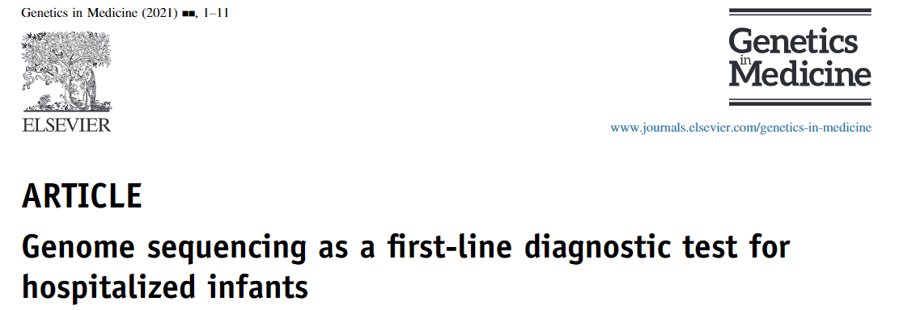
Clinical Sequencing Evidence-Generating
Research Program
    Utility of genome sequencing in infant cohort
    Of 367 infants that received genome sequencing, 30% received a genetic diagnosis
    57% of detected genomic variants not detected by other genetic tests
    Participants from ethnically and racially diverse backgrounds as well as rural, medically underserved areas
Document 17
Notes:
The Clinical Sequencing Evidence-Generating Research (or CSER) program aims to generate evidence related to the clinical utility of genome sequencing, with a major emphasis on participant diversity and engagement.
In November 2021, CSER investigators from the HudsonAlpha SouthSeq clinical site published an paper about the utility of genome sequencing as a first-line diagnostic test for critically ill infants. While genome sequencing is becoming more common as a diagnostic test for pediatric patients, it is less often used for the medical management of infants.
* The SouthSeq study focused on evaluating the utility of genome sequencing in one of the largest cohorts of infants in neonatal intensive care units, which included 74% racial or ethnic minority or rural participants. * The investigators described the results for 367 infants tested by genome sequencing; of these, 30% received a genetic diagnosis. * Additionally, 57% of the detected genomic variants were not detected by other genetic tests. * This study extends previous work by recruiting participants from ethnically and racially diverse backgrounds as well as rural, medically underserved areas.
33

Slide 34

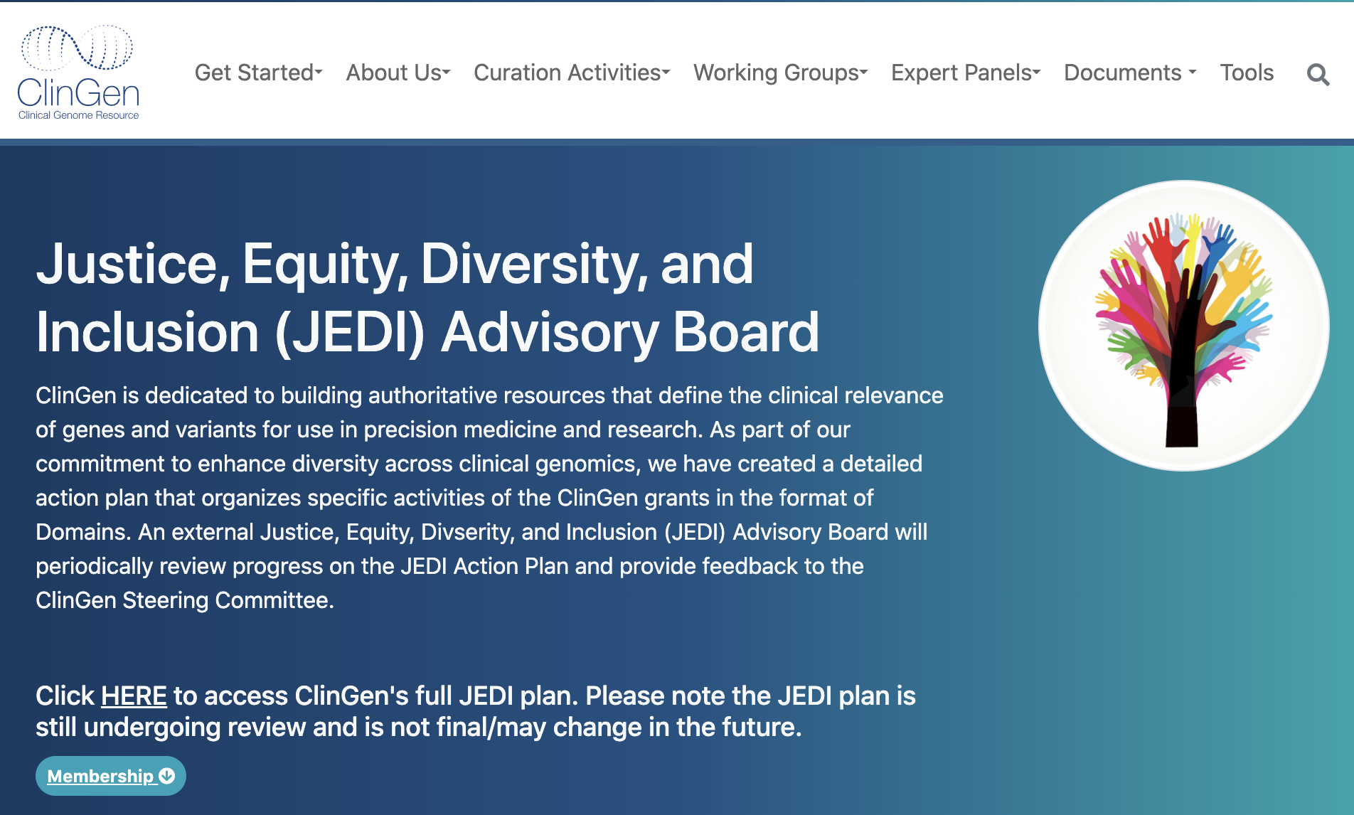
    Clinical Genome Resource (ClinGen)
    Justice, Equity, Diversity, and Inclusion Action Plan
Contribute data, tools, and resources to the genomic knowledgebase to enhance equity in patient care
Develop recommendations for the use of population descriptors in genetics and genomics
Foster diversity, equity, and inclusion in the ClinGen workforce
Document 18
Notes:
The Clinical Genome Resource (or ClinGen) evaluates and disseminates the clinical relevance of genes and genomic variants for use in precision medicine and research. ClinGen is committed to promoting justice, equity, diversity, and inclusion in all aspects of its ecosystem, from the tools it generates to the workforce it develops.
To emphasize its commitment to these values, the ClinGen Ancestry and Diversity Working Group, with input from the ClinGen Steering Committee and other members of the ClinGen Consortium, led the development of a Justice, Equity, Diversity, and Inclusion Action Plan. This plan provides a roadmap of measurable and actionable goals for ClinGen to pursue in three key domains
* First, contribute data, tools, and resources to the genomic knowledgebase that will enhance equity in patient care across global populations; * second, develop recommendations for the use of population descriptors in genetics and genomics; and * third, foster diversity, equity, and inclusion in the ClinGen workforce.
ClinGen also assembled a Justice, Equity, Diversity, and Inclusion Advisory Board to review the content of the generated plan, identify gaps, and provide advice as ClinGen embarks on implementing these goals. As such, the plan is undergoing review and may be refined in the future. The plan and Advisory Board roster can be viewed on the ClinGen website.
34

Slide 35


Global Genomic Medicine Collaborative (GGMC)
Vision: Realizing the full potential of genomic medicine worldwide to improve individual and population health
Mission: To identify barriers and solutions, lead and develop programs, and global leverage expertise to bring genomic medicine to low-resource settings worldwide
International Hundred K+ Cohorts Consortium (IHCC)
Global Genomic Medicine Consortium (G2MC)
Potential additional programs
2021 Annual Report
Document 19
Notes:
The Global Genomic Medicine Collaborative (or GGMC) was established in 2016 to create a community of global leaders dedicated to advancing genomic medicine implementation. The organization was started within the U.S. National Academies of Medicine and supported by NIH.
GGMC aims to realize the full potential of genomic medicine worldwide for improving individual and population health, with a mission to identify barriers and solutions, lead and develop programs, and leverage global expertise to bring genomic medicine to low-resource settings worldwide through educational programs, policy development, and implementation science.
GGMC expanded in 2018 to include more observational components, knitting together large cohort studies such as the All of Us Research Program, UK Biobank, and over 70 global cohorts in * the International 100K+ Cohort Consortium (or IHCC). Recently, the GGMC Board of Directors decided to establish GGMC as an organization housing additional programs with a common thread of genomic medicine implementation. It provides financial management and operational support for a variety of programs. * Also, its genomic medicine implementation arm was recast as the Global Genomic Medicine Consortium (or G2MC). * Other potential programs may be added at a later date. * More information about all of this is available in the organization’s 2021 Annual Report.
35

Slide 36

Technology Development Program
Funding Opportunities:
    Technology Development for Single-Molecule
    Protein Sequencing
      RFA-HG-21-001 (R01, also linked R21 RFA and R43/R44 PAR)
      Next due date: June 15, 2022
    Advancing Genomic Technology Development for
    Research and Clinical Application
      NOT-HG-21-018, Notice of Special Interest (NOSI)
      R01, R21, R41/R42, & R43/R44
      Standard receipt dates
Document 20
Notes:
NHGRI’s Technology Development Program continues to enable the development of new and improved technologies, fostering genomic discovery.
* NHGRI, in collaboration with the National Cancer Institute and the National Institute of Allergy and Infectious Diseases, has three open funding opportunities designed to accelerate innovation and early development in the rapidly emerging field of single-molecule protein sequencing. The next application due date for these activities is June 15, 2022.
* NHGRI also supports technology development more broadly through parent funding announcements and through targeted announcements, such as the Advancing Genomic Technology Development Notice of Special Interest (or NOSI). This genomic technology NOSI uses standard receipt dates.
36

Slide 37
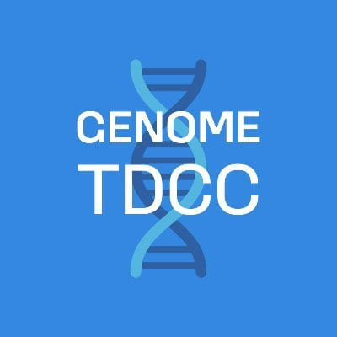
Technology Development Program
    Outreach events organized by the Technology Development Coordinating Center (TDCC) at the Jackson Laboratory
    Understanding Cells in Context:
    Spatial Transcriptomics
      May 23, 2022
    Understanding Recent Advances in
    Genome Technology Development
      July 7, 2022
Both events are free, virtual, and open to the public
Document 20
Notes:
The recently funded Technology Development Coordinating Center (or TDCC) at the Jackson Laboratory has organized two virtual outreach events.
* On May 23, NHGRI and the TDCC are hosting a Technology Area Forum entitled “Understanding Cells in Context: Spatial Transcriptomics.” The event will highlight the strengths and limitations of current DNA-sequencing- and imaging-based methods that are used in spatial gene-expression profiling.
* On July 7, the TDCC will be hosting a virtual symposium on “Understanding Recent Advances in Genome Technology Development.” Biomedical researchers, learners, and clinical providers will have the opportunity to gain a fundamental understanding of how new genomic technologies are utilized and hear about emerging opportunities and challenges in the field.
* Both virtual events are free, virtual, and open to the public, but registration is required.
37

Slide 38
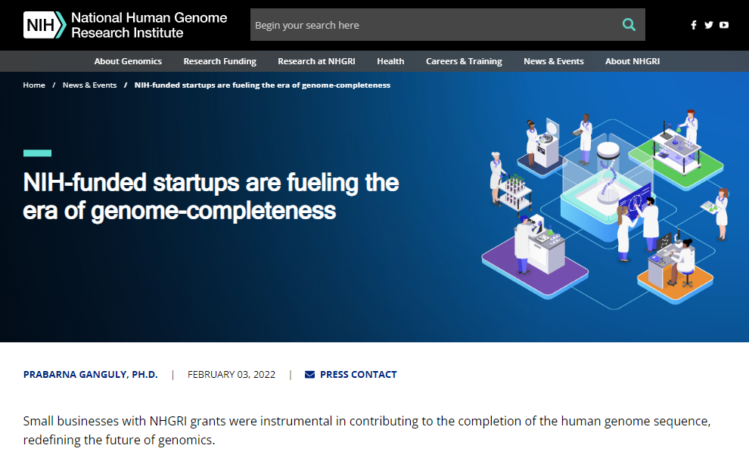
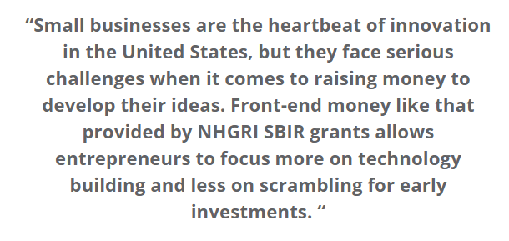
    Small Business Program
    Grantee Success Stories
    Features NHGRI-funded
    companies Circulomics,
    Arima Genomics, and
    Dovetail Genomics
Document 21
Notes:
NHGRI’s Small Business Program awards grants to support the work of genomics companies related to commercialization as well as for technology transfer of academic innovations.
NHGRI often showcases our small business grantees through products created by our Office of Communications. For example, genome-sequencing techniques and technologies developed by Circulomics, Arima Genomics, and Dovetail Genomics were instrumental in contributing to the recent generation of a truly complete human genome sequence. A recent feature article on our website genome.gov tells the story of how their work is fueling such important advances in genomics.
38

Slide 39
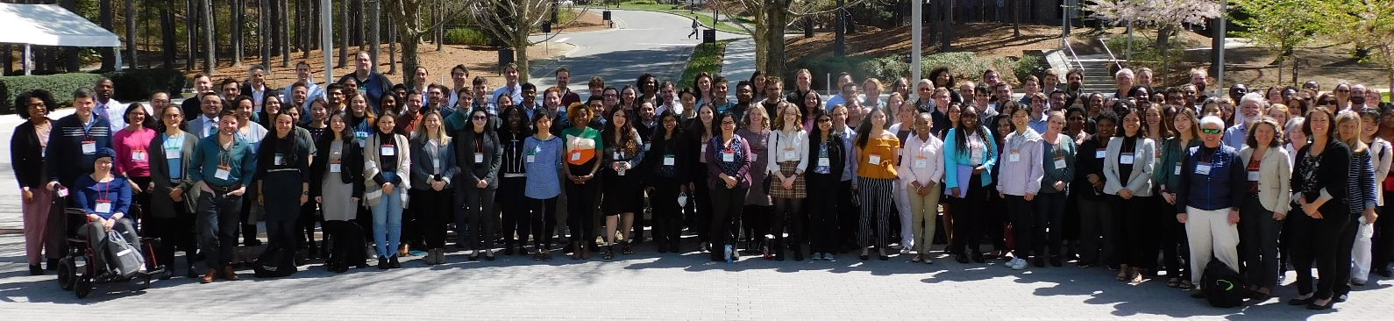
    Training and Career Development Program
    7th Annual Training and Career Development Program Meeting
    Hosted by Duke University
    227 in-person attendees and 157 virtual attendees
Document 22
Notes:
NHGRI aims to prepare a talented and diverse genomics workforce by providing both institutional and individual funding through a variety of mechanisms, including individual fellowship and career development awards, institutional awards, and diversity supplements. Programs are offered at the undergraduate, postbaccalaureate, graduate, postdoctoral, and faculty levels.
The 7th Annual Training and Career Development Program Meeting was recently held at Duke University. The meeting gathered over 200 in-person attendees and over 150 virtual attendees.
NHGRI-supported trainees presented their research and met other trainees and researchers from across the NHGRI training programs. The trainees included those from the Centers of Excellence in Ethical, Legal, and Social Implications Research Program, the Diversity Action Plan programs, the T32 training programs, and individual awardees of fellowships and career development grants. The trainees presented posters, gave lightning talks, and attended scientific lectures presented by their peers. Other highlights included keynote talks, network lunches, and various concurrent sessions.
39

Slide 40
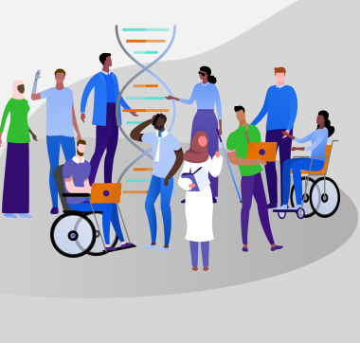
Diversity, Equity, Inclusion, and Accessibility (DEIA) in the Genomics Workforce Award
Genomics Workforce DEIA Award
Extramural investigators:
  Early-Stage Investigator (ESI)
  Established Investigator(s)
Nominees must have NHGRI grant funding
Due date: September 1, 2022
Document 23
Notes:
NHGRI has developed a new awards program to recognize extramural investigators who are making sustained and substantial contributions to enhancing diversity, equity, inclusion, and accessibility (or DEIA) in the genomics workforce.
* The Genomics Workforce DEIA Award will recognize * an extramural early-stage investigator and an established investigator (or group of investigators) annually that exemplify their commitment to enhancing the diversity of the genomics workforce.
* To be considered for the award, a nominee must have NHGRI grant funding, and * the due date for nominations is September 1, 2022.
The program is being administered by the Training, Diversity, and Health Equity (or TiDHE) Office, which aims to promote workforce diversity, develop and support training programs, and provide leadership to reduce health disparities and foster health equity.
40

Slide 41

    Genomics Workforce Diversity Funding Opportunities
    RFA-HG-22-004: Genome Research Experiences to Attract Talented Undergraduates into the Genomics Field to Enhance Diversity (GREAT) Receipt date: July 1, 2022
    RFA-RM-22-008: NIH Institutional Recruitment for Sustainable Transformation (FIRST) Program: FIRST Cohort Receipt date: July 12, 2022
    PAR-20-153: NIH Science Education Partnership Award (SEPA) Receipt date: July 13, 2022
Document 24
Notes:
The NHGRI Extramural Training Program currently has three Funding Opportunities focused on genomics workforce diversity.
* The Genome Research Experiences to Attract Talented Undergraduates into the Genomics Field to Enhance Diversity (or GREAT) program supports educational activities encouraging undergraduates from diverse backgrounds, including those from groups underrepresented in the biomedical workforce, to pursue training and careers in the scientific, medical, ethical, social, and/or legal areas of genomics research. Applications for this program are due July 1.
* The Faculty Institutional Recruitment for Sustainable Transformation (or FIRST) Program, a Common Fund initiative, is accepting applications to facilitate institutions in building a self-reinforcing community of scientists through recruitment of a critical mass of early-career faculty who have a demonstrated commitment to inclusive excellence. Applications for this program are due July 12.
* The NIH Science Education Partnership Award (or SEPA) program supports pre-kindergarten to grade 12 and informal science education activities that enhance the diversity of the biomedical, behavioral, and clinical research workforce and that foster a better understanding of NIH-funded biomedical, behavioral, and clinical research and its public health implications. Applications for this program are due July 13.
41

Slide 42
Director’s Report Outline
General NHGRI Updates
General NIH Updates
General Genomics Updates
NHGRI Extramural Research Program
NIH Common Fund/Trans-NIH
NHGRI Communications, Policy, and Education
NHGRI Intramural Research Program
Notes:
Moving on to the NIH Common Fund and other trans-NIH efforts.
42

Slide 43
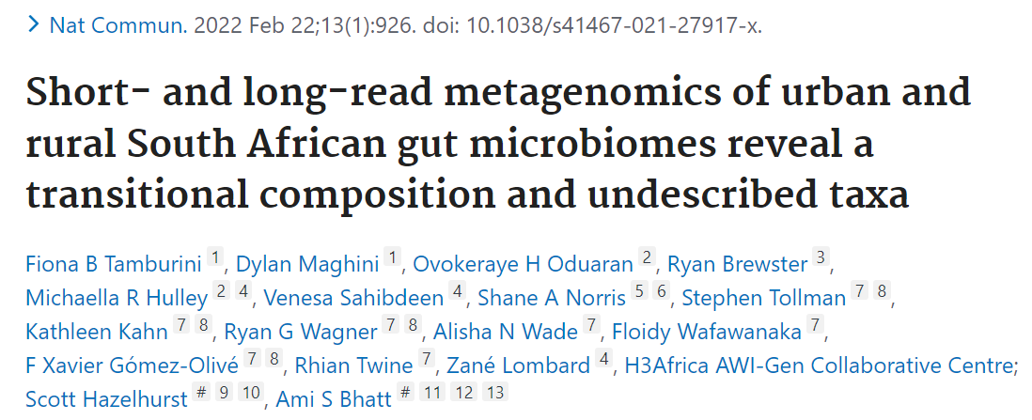
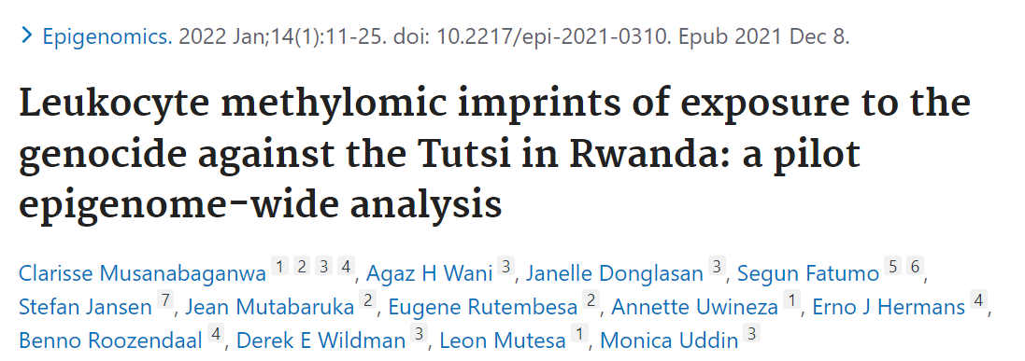
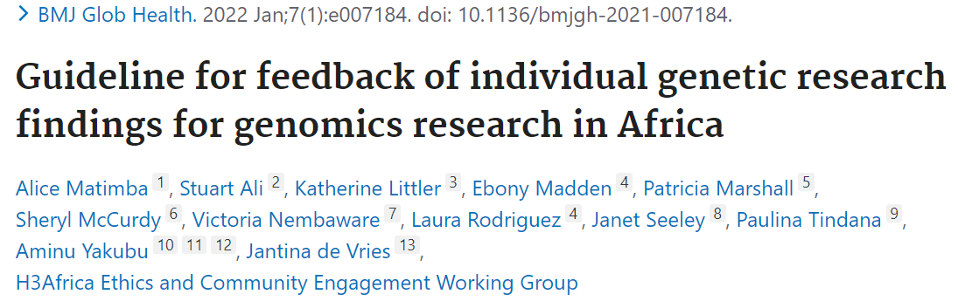

    Human Heredity & Health in Africa (H3Africa)
    600+ publications to date
    Uptake of Consortium recommendations into policies
    Final Consortium meeting in Nigeria
Document 25
Notes:
The central goal of the NIH Common Fund’s Human Heredity and Health in Africa (or H3Africa) program is to develop a sustainable and collaborative African genomics research enterprise.
* Now in its tenth and final year, H3Africa has published over 600 papers, with many additional manuscripts in the works. Recent papers, highlighted on this slide, reveal a previously undescribed gut microbiome taxa, describe methylation patterns in adults who were in utero during the Rwandan genocide, and propose guidelines for feedback of individual genomic findings in African research settings.
* In addition to publications, H3Africa investigators have played major roles in the update of Consortium recommendations into policies for genomics research in African countries. As one example, groups funded as part of the H3Africa Ethical, Legal, and Social Implications Research Projects have collaborated with their local governments and contributed to national guidelines on human genomics research and community engagement in Uganda and Botswana.
* The final Consortium meeting will occur at the end of this month in Nigeria. Investigators and fellows will highlight the impact of H3Africa on their careers, on research infrastructure in Africa, and on advances in genomics research.
43

Slide 44

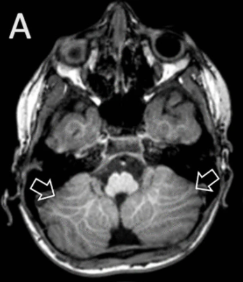
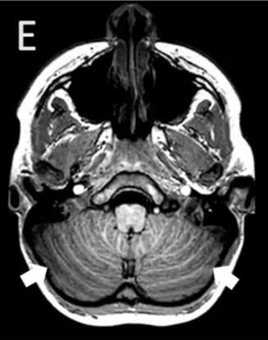
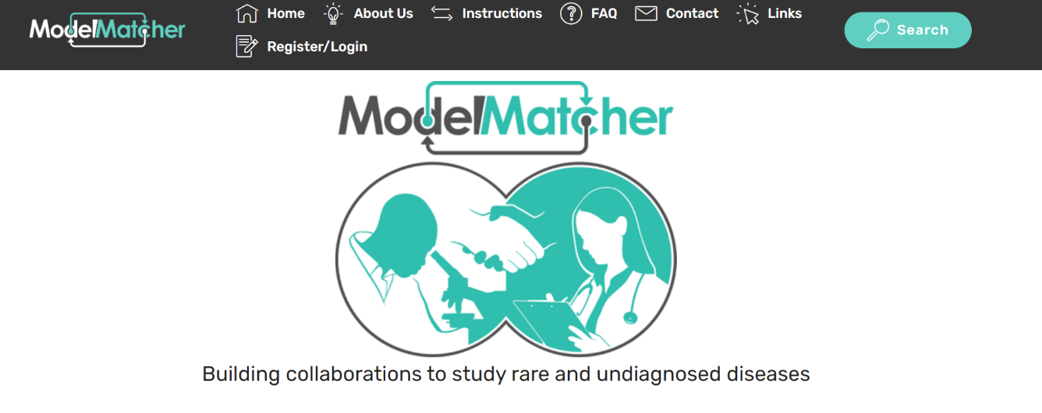
Undiagnosed Diseases Network (UDN)
Image from: https://www.modelmatcher.net/
Neuroimaging features of the NAV2-related neurodevelopmental disorder (Fig. A) vs. age-matched control subject (Fig. E)
Online investigator matchmaking tool
Cross-disciplinary collaboration in rare disease research
    First human case of Neuron Navigator 2 (NAV2) gene mutation
    Functional analyses to identify crucial role of NAV2 in central nervous system development
Document 26
Notes:
The Undiagnosed Diseases Network (or UDN) is an NIH Common Fund program that aims to improve the level of diagnosis for rare and undiagnosed conditions through a team-based approach.
* UDN investigators from the Baylor Model Organism Screening Center published an article describing ModelMatcher, an online investigator matchmaking tool designed to encourage cross-disciplinary collaboration in rare disease research. As of January 2022, users have access to a database containing 5,383 model-organism genes that correspond to over 6,000 human genes.
* The same UDN Baylor investigators contributed to an article describing a novel human neurodevelopmental phenotype associated with a mutation in the Neuron Navigator 2 (or NAV2) gene. While mouse studies showed NAV2 protein is critical in the development of the central nervous system, particularly the cerebellum, little was known about the role of the NAV2 protein in humans. By screening exome-sequence data from individuals affected with sporadic cerebellar dysplasia, investigators identified the first human with biallelic loss-of-function variants in NAV2. Through animal-model analyses, investigators were able to identify a potentially conserved role for NAV2 protein in central nervous system development across multiple species.
44

Slide 45
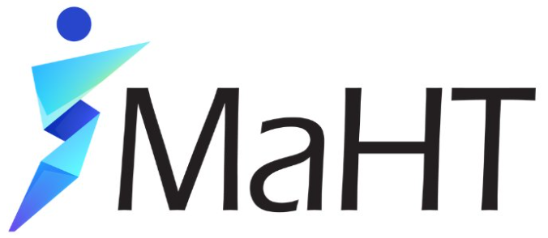
    Somatic Mosaicism Across Human Tissues (SMaHT)
Somatic Variant Discovery
1. Tissue Procurement
2. Genome Characterization
Validated Data
Data Analysis and Organization
SMaHT Network
4. Data Analysis
5. Organization
3. Technology & Tool Development
Validated Data
Variant Catalog
SMaHT Workbench
Application deadline: July 8, 2022
Document 27
Notes:
The NIH Common Fund has initiated a new program of interest to NHGRI, the Somatic Mosaicism Across Human Tissues (or SMaHT) program. The SMaHT Network aims to transform our understanding of how somatic mosaicism in human cells influences human biology and health.
* Five Funding Opportunities have been released for the various components of the SMaHT Network, shown here in colored boxes. The components include: a Tissue Procurement Center and Genome Characterization Centers, Technology and Tool Development Projects, a Data Analysis Center, and an Organizational Center. The various components will generate and analyze validated data and produce a genomic variant catalog as well as a workbench to facilitate use of these data by the broader research community.
* The application deadline for all five components is July 8, 2022.
45

Slide 46

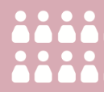
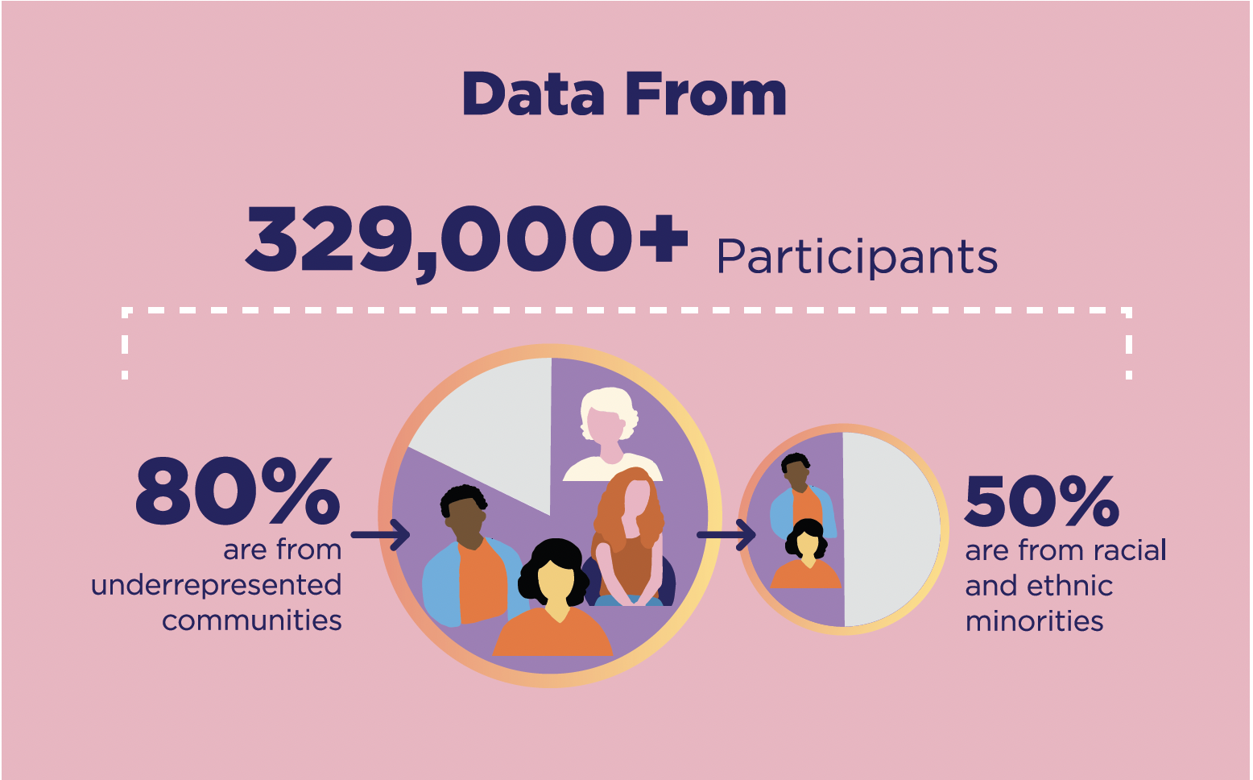
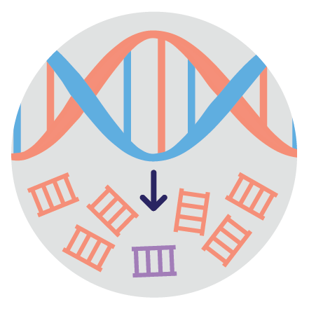

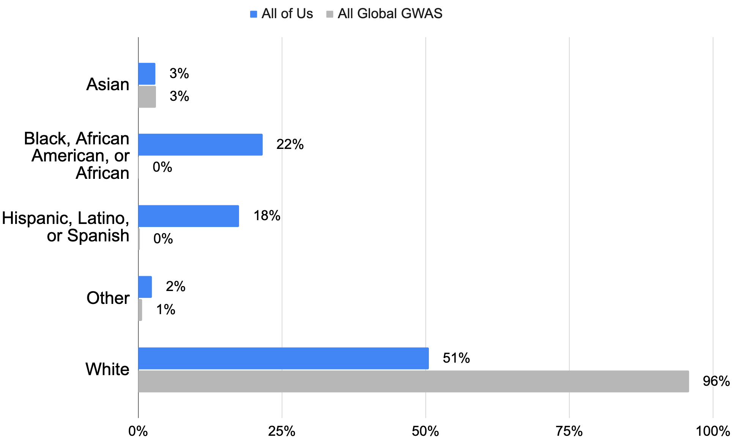



80%
Underrepresented in Biomedical Research
50%
Diverse by Race/Ethnicity
329,000+
Participants
98,600+
Whole Genome Sequences
165,000+
Genotyping
Arrays
329,000+
Surveys
11,600+
Fitbit Records
<1%
593,500,000+
Unique Variants
Represented and searchable through public genomic data browser
Genomics
Analysis Tools
Hail and PLINK
in addition to R, Python,
and Jupyter Notebooks
<1%
100M of these occur >2 times in AoU and are not in gnomAD
214,200+
Electronic Health Records
267,600+
Physical Measurements
All Global GWAS values from www.gwasdiversitymonitor.com.
Values current as of February 17, 2022
Document 28
Notes:
The mission of the All of Us Research Program is to accelerate health research and medical breakthroughs, enabling individualized prevention, treatment, and care for all of us. The program will partner with one million or more people across the United States to build the most diverse biomedical data resource of its kind, thereby helping researchers gain better insights into the biological, environmental, and behavioral factors that influence health.
The All of Us Research Program released its first genomic dataset in March. * This data release – which features whole-genome sequences from nearly 100,000 participants as well as genotyping array data, genomic variant data, and a suite of genomics analysis tools – is available via the All of Us Researcher Workbench cloud-based platform. * The Researcher Workbench also includes information from participants’ survey responses, Fitbit devices, electronic health records, and physical measurements. * A key feature of the All of Us Research Program is its focus on diverse participants, with about 50% of the data coming from individuals who identify with racial or ethnic groups that have historically been underrepresented in research. This contrasts with the vast majority of existing global genome-wide association study data, which are primarily derived from individuals of European ancestry.
We encourage interested researchers to register for access to the All of Us Researcher Workbench in order to start using this data and tools for their own research.
46

Slide 47
Director’s Report Outline
General NHGRI Updates
General NIH Updates
General Genomics Updates
NHGRI Extramural Research Program
NIH Common Fund/Trans-NIH
NHGRI Communications, Policy, and Education
NHGRI Intramural Research Program
Notes:
Moving on to NHGRI activities in the areas of communications, policy, and education.
47

Slide 48

NHGRI History of Genomics Program
Roundtable Meetings
Does genetic and genomic screening keep open the door to eugenics? May 25, 2022
The promise and perils of social and behavioral genomics December 2022
Document 29
Notes:
In December 2021, the NHGRI History of Genomics Program hosted a symposium that addressed the history of eugenics and scientific racism and their complex legacies in the modern health sciences.
The symposium illustrated the need for more informed public discussions about the connection between existing and emerging genetic and genomic technologies and the historical and present-day uses of genetics and genomics in social and behavioral research. It also raised issues about how NHGRI, as a key funder of genomics research, communicate about the state of the science and its limitations.
The NHGRI History of Genomics Program will next host two roundtable meetings to further explore these two themes.
* A meeting on May 25 will address the question: does genetic and genomic screening keep open the door to eugenics? At this meeting, panelists will discuss historical and present-day eugenics and scientific racism in the context of existing and developing genetic and genomic screening technologies.
* Then in December, a second meeting will address the promise and perils of social and behavioral genomics, at which the discussion will focus on the historical uses of genetics and genomics in social and behavioral research, including the historical connections of research into the genetics of social mobility and educational attainment with antisemitism, eugenics, and scientific racism.
48

Slide 49


Talking Glossary of Genomic and Genetic Terms
Audio recordings from 37 NHGRI experts
222 terms – 142 with new illustrations and 15 with new animations
Document 30
Notes:
On National DNA Day this year (that is, April 25), the NHGRI Office of Communications released a fully revamped version of its incredibly popular Talking Glossary, which included a new name: the Talking Glossary of Genomic and Genetic Terms.
* This new and improved educational resource now features audio recordings from 37 NHGRI experts.
* To date, the new Talking Glossary has 222 terms, of which 142 have new accompanying illustrations and 15 have new associated animations. There are plans for additional terms, illustrations, and animations in the coming months.
We encourage you to check out the new Talking Glossary and spread the word about its availability.

Slide 50



    Conversations with trailblazing science communicators
Document 31
Notes:
The seventh and final event in the Genomics and the Media virtual lecture series will feature Magdalena Skipper, Editor in Chief of Nature on June 30.
* This last lecture will cap off the highly successful series, which featured the trailblazers in science communication shown here and demonstrated the various approaches for communicating about genomics as well as the unique challenges and opportunities that different communication media can bring.

Slide 51


Ask Dr. Genome
Document 32
Notes:
Ask Dr. Genome is a monthly series of live Twitter Q&As with myself and invited genomic experts. The series offers a way to engage with members of the public (namely students, educators, and science-curious Twitter followers) who want to know more about a particular genomics topic. Anyone can tweet us a question about the designated genomics topic, and we retweet an answer from my account.
* In March, I was joined by Josh Denny, CEO of the All of Us Research Program, to answer questions about precision medicine and the generation of diverse genomic datasets.
* In April, I was joined by Karen Miga, who answered questions about the Telomere-to-Telomere Consortium's efforts to generate a truly complete human genome sequence.

Slide 52




Communications Award Nominations
Document 33
Notes:
And speaking of NHGRI’s social media efforts… the NHGRI Office of Communication was recently nominated for a Golden Post Award for best Twitter presence. The Golden Post Awards recognize outstanding use of social media by government agencies in the United States. Out of more than 400 entries, NHGRI was named one of the top five finalists.
* In addition, the NHGRI Office of Communication was also nominated for a Shorty Award, which honors the best of social media and digital, specifically for its work on the History of Eugenics and Scientific Racism Symposium in December.

Slide 53



    National DNA Day 2022
Document 34
Notes:
As I mentioned earlier, April 25 was National DNA Day, and every year, NHGRI hosts several programs and offers educational resources to mark the occasion. This year, DNA Day was celebrated virtually throughout the month of April.
* NHGRI hosted two H3Africa DNA Day presentations featuring the H3Africa researchers shown here. Then, * on April 25, NHGRI hosted Carter Clinton, postdoctoral scholar in the Departments of Anthropology and Biology at Pennsylvania State University, for the Louise M. Slaughter National DNA Day Lecture. Carter shared his research investigating New York African Burial Ground population soil samples to better understand health disparities in living African Americans and discussed the urgency for diversity in genomic databases.

Slide 54


Inter-Society Coordinating Committee for
Practitioner Education in Genomics (ISCC-PEG)
ISCC-PEG 11th Annual Meeting
Document 35
Notes:
The Inter-Society Coordinating Committee for Practitioner Education in Genomics (or ISCC-PEG) focuses on integrating genomic literacy into clinical practice.
The group does this by making presentations at professional meetings, creating pharmacogenomic continuing education modules, and publishing a direct-to-consumer genetic testing FAQ resource.
The ISCC-PEG also sponsors scholars who work directly with ISCC-PEG mentors on projects. * Recently, a scholar created an “GENETEST-101” app to assist non-genetics healthcare providers navigate the genetic testing process.
* ISCC-PEG’s 11th Annual Meeting was held in February and featured a keynote presentation by NHGRI Acting Deputy Director Vence Bonham. The meeting also included reports from two new project groups, a Nursing Genomics Group and a LGBTQI+ Issues in Genomics Group.
54

Slide 55
Director’s Report Outline
General NHGRI Updates
General NIH Updates
General Genomics Updates
NHGRI Extramural Research Program
NIH Common Fund/Trans-NIH
NHGRI Communications, Policy, and Education
NHGRI Intramural Research Program
Notes:
55
And finally, moving on to NHGRI’s Intramural Research Program.

Slide 56


EURORDIS Lifetime Achievement Award
William Gahl, M.D., Ph.D.
Document 36
Notes:
NHGRI intramural researcher Bill Gahl received the EURORDIS (or Rare Diseases Europe) Lifetime Achievement award. This award recognizes Bill’s lifelong dedication in addressing the needs of people living with a rare and undiagnosed diseases. It also honors him for the creation of the Undiagnosed Diseases Program within NIH.
Congratulations, Bill!

Slide 57


Election into American Society for
Clinical Investigation
Neil Hanchard, D.Phil.
Document 37
Notes:
NHGRI intramural investigator Neil Hanchard has been elected into the American Society for Clinical Investigation.
Congratulations, Neil!

Slide 58


Samuel J. Heyman Service to America Medal Finalist
Diana Bianchi, M.D.
Document 38
Notes:
Diana Bianchi (who is both an NHGRI intramural investigator and Director of the National Institute of Child Health and Human Development) is a finalist for the Samuel J. Heyman Service to America Medals, known as the “Sammies.” She is a COVID-19 Response finalist for initiating critical research to understand the medical implications of the COVID-19 virus on underserved populations.
Congratulations, Diana!

Slide 59

    Intramural Research Program Blue Ribbon Panel
    2022 – 2023 Panel Members:
      Gail Jarvik, M.D., Ph.D. (co-chair)
      Lynn Jorde, Ph.D. (co-chair)
      Greg Barsh, M.D., Ph.D.
      Lon Cardon, Ph.D.
      Chanita Hughes-Halbert, Ph.D.
      Guillermina (Gigi) Lozano, Ph.D.
      Carole Ober, Ph.D.
      Neil Risch, Ph.D.
Notes:
Each NIH institute/center’s Intramural Research Program (or IRP) is required to undergo a Blue Ribbon Panel review every 10 years. These reviews aim to provide high-level feedback and general input about the current state and future opportunities of the various NIH IRPs, which complements the more detailed, investigator-by-investigator reviews that take place every four years by the institute/center’s Board of Scientific Counselors.
NHGRI has conducted two Blue Ribbon Panel reviews of our Intramural Research Program to date. The most recent one was held in 2011-2012, when Dan Kastner took the helm as Scientific Director. With the recent appointment of Charles Rotimi as the new Scientific Director, it is an appropriate time to have a Blue Ribbon Panel review of the NHGRI IRP again.
* As such, I have assembled the following panel of eight external experts and put them under the leadership of two outstanding co-chairs who are members of this Advisory Council: Gail Jarvik and Lynn Jorde. The Panel will conduct their review from May 2022 to May 2023. The co-chairs will present their final report to this Advisory Council at its May 2023 meeting.
I, and the broader NHGRI leadership, look forward to the feedback and advice from the Panel about our IRP (which currently has an annual budget of ~$125 million), with particular input about the coming decade.

Slide 60




‘One-Stop-Shop’ to Stay Connected
genome.gov/stayconnected
Document 39
Notes:
Before I end my Director’s Report, I want to again remind you about a * user-friendly, one-stop-shop for staying connected with me and NHGRI. By visiting this web page through this convenient URL and then scrolling down, * you get a menu of 9 major resources associated with the Institute.
This includes links for the genome.gov website, The Genomics Landscape monthly newsletter, and my Twitter feed. There are also convenient links to the 2020 NHGRI Strategic Vision, the NHGRI brochure, our Talking Glossary of Genomic and Genetic Terms, our Building a Diverse Genomics Workforce Action Agenda, the GenomeTV channel of YouTube, and the NHGRI History Program’s set of oral histories. And if those sites are not what you are looking for, * scrolling down further reveals recordings of some selected talks of mine as well as some of my recent * podcasts and op-eds.
I hope people find this one-stop-shop helpful when trying to stay connected with me and NHGRI.
60

Slide 61


Thanks!
Special Thanks!
Notes:
Finally, a personal thanks to the many NHGRI staff members who contributed the slides and associated materials that I just reviewed in my Director’s Report. As always, a group effort is essential for getting such a large amount of information conveyed efficiently at each Council meeting.
An additional thanks to the NHGRI Office of Communications staff for creating the electronic resource associated with my Director’s Report.
And * a special thanks to the usual ‘ringleader’ for helping me prepare my Director’s Report, Kris Wetterstrand. Kris declined providing a photo of her this time, but rather offered up * this photo of the entrance to my Director’s Suite, where a masked cardboard Eric has been standing by for the last few weeks as we welcomed staff back to the physical workspace.
61

Slide 62
Notes:
62

