Slide 1



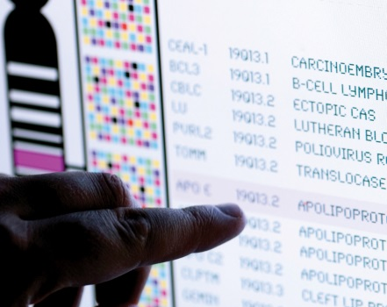
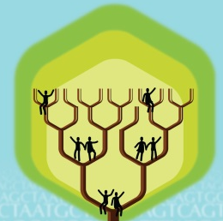
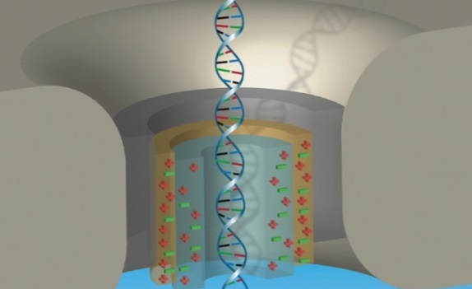


DIRECTOR’S REPORT
Eric Green, M.D., Ph.D.
Director, NHGRI
May 2024
Notes:
I would again like to welcome all of you to this Open Session of the National Advisory Council for Human Genome Research meeting, including those who are here with me in person and those who are joining remotely.
As with the rest of the Open Session, my Director’s Report presentation is being recorded, and that recording will be made available as a permanent archive on NHGRI’s website (genome.gov).

Slide 2
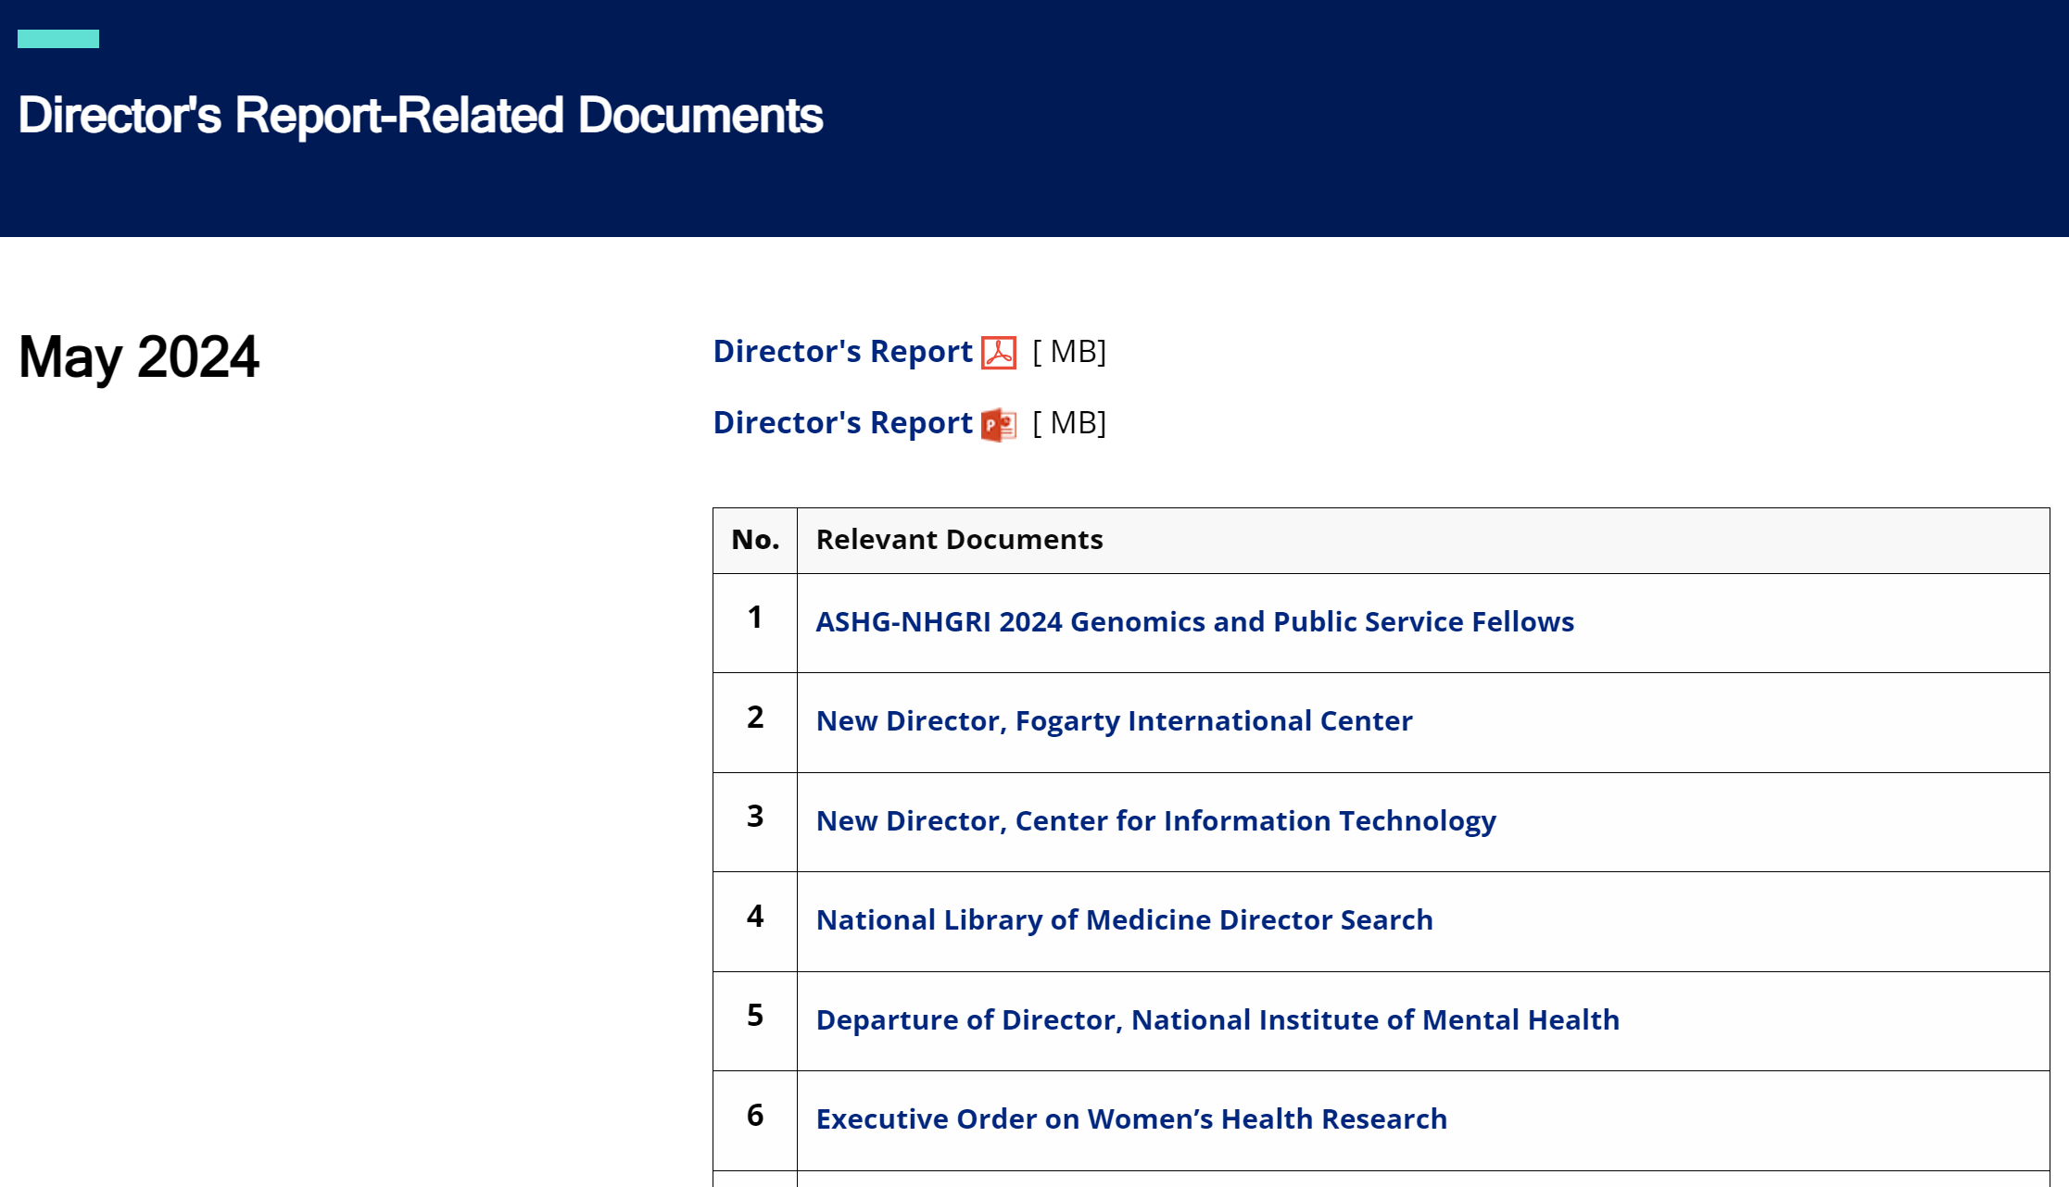

genome.gov/DirectorsReport
Document #
Notes:
As a reminder, and for those who are new to our Council meetings, I want to make you aware of the ‘electronic resource’ that has been developed for my Director’s Report. This resource, which is analogous to the supplemental materials of a published paper, can be accessed at the URL shown here.
The slides that I will show during my Director’s Report are also available electronically at this site – * in both PDF and PowerPoint formats.
* When there are documents or relevant websites associated with a particular slide, you will find a “Document #” indicated on the bottom right of that slide; that “Document #” references materials that can be accessed and/or downloaded from the webpage shown here. This dedicated webpage and all linked documents will be archived on genome.gov as part of the historical record of this Council meeting.

Slide 3
Open Session Agenda
  Presentation:
    The NIAID Mission: Infectious Diseases and Beyond
  Jeanne Marrazzo
  Concept Clearances:
      Supporting Talented Early Career Researchers in Genomics
      Lisa Chadwick
    Genome Research Experiences to Attract Talented Undergraduates into Genomic Fields to Enhance Diversity (GREAT)
    Ebony Madden
    NHGRI Predoctoral to Postdoctoral Transition Award for a Diverse Genomics Workforce
    Lucia Hindorff
Notes:
There will be several other presentations during the Open Session of this Council meeting. Given these later presentations, I will not discuss in detail the topics that others will cover.
* Following my Director’s Report, Jeanne Marrazzo, Director of the National Institute of Allergy and Infectious Diseases (or NIAID), will give a presentation on The NIAID Mission: Infectious Diseases and Beyond.
* Then, there will be three concept clearances presented by extramural program directors.
* First, Lisa Chadwick will present a concept clearance on Supporting Talented Early Career Researchers in Genomics.
* Then, Ebony Madden will present a concept clearance on Genome Research Experiences to Attract Talented Undergraduates into Genomic Fields to Enhance Diversity (GREAT).
* Finally, Lucia Hindorff will present a concept clearance on the NHGRI Predoctoral to Postdoctoral Transition Award for a Diverse Genomics Workforce.

Slide 4
Open Session Agenda
  Presentations:
    Bettie J. Graham Leadership Awards for Enhancing Diversity, Equity, Inclusion, and Accessibility in the Genomics Workforce
    Lucia Hindorff & Eric Green
    Impact of Genomic Variation on Function (IGVF) Consortium Update Karen Mohlke & Jesse Engreitz
    Genomics Research to Elucidate the Genetics of Rare Disease (GREGoR) Consortium Update
    Jennifer Posey
Notes:
Following the concept clearances, we will have three more presentations.
* First, Lucia Hindorff and I will present the Bettie J. Graham Leadership Awards for Enhancing Diversity, Equity, Inclusion, and Accessibility in the Genomics Workforce.
* Then, Karen Mohlke and Jesse Engreitz will talk about the Impact of Genomic Variation on Function (IGVF) Consortium Update.
* Finally, Jennifer Posey will discuss the Genomics Research to Elucidate the Genetics of Rare Disease (or GREGoR) Consortium Update.

Slide 5
Open Session Agenda
    Reports:
    Workshop Report: Advances in the Genetic Architecture of Complex Human Traits
    Alexander Arguello & Nancy Cox
    Overview of the NHGRI Small Business Program
    Renee Rider & Ian Nova
  Presentation:
  Revisions for Fellowship Applications and Simplified Review Framework for Research Applications
    Sarah Wheelan
Notes:
Following those presentations, we will have two reports.
* First, Alexander Arguello and Nancy Cox will give a report from the Advances in the Genetic Architecture of Complex Human Traits workshop.
* And then Renee Rider and Ian Nova will give us an Overview of the NHGRI Small Business Program.
* Finally, we will have a presentation from Sarah Wheelan about some upcoming Revisions for Fellowship Applications and Simplified Review Framework for Research Applications.

Slide 6
Director’s Report Outline
General NHGRI Updates
General NIH Updates
General Genomics Updates
NHGRI Extramural Research Program
NIH Common Fund/Trans-NIH
NHGRI Communications, Policy, and Education
NHGRI Intramural Research Program
Notes:
For the rest of my Director’s Report, I will cover the seven areas listed here, which reliably provide a useful framework for reviewing the relevant topics.

Slide 7
Director’s Report Outline
General NHGRI Updates
General NIH Updates
General Genomics Updates
NHGRI Extramural Research Program
NIH Common Fund/Trans-NIH
NHGRI Communications, Policy, and Education
NHGRI Intramural Research Program
Notes:
And I will start with some general NHGRI updates.

Slide 8
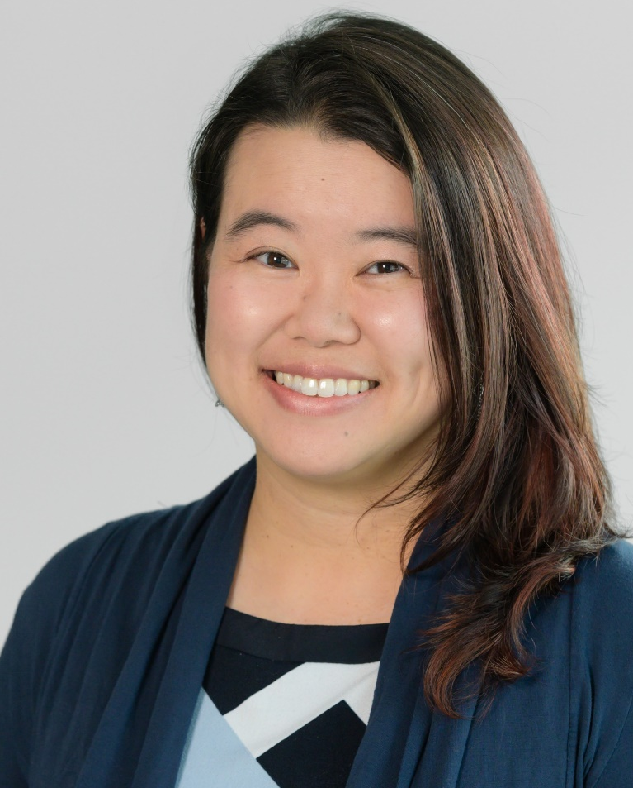
New Deputy Director,
Division of Extramural Operations
Issel Anne Lim, Ph.D.
Notes:
In March, Issel Anne Lim joined NHGRI as the new Deputy Director of the Division of Extramural Operations. This division develops and implements extramural policy at NHGRI, including those for application referral, scientific review, grants management, and research integrity.
Prior to joining NHGRI, Issel built and supervised the Policy, Legislation, Communications, and Engagement Team at the NIH Office of AIDS Research. There, she oversaw operational planning, reports to Congress, and online resources covering NIH’s HIV research portfolio. Previously, she led projects on strategic planning, portfolio analysis, data visualization, and program evaluation at the National Institute of Child Health and Human Development. She also pursued short-term assignments – first, as a program official working on intellectual and developmental disability policies; second, in the extramural research program at the National Institute of Allergy and Infectious Disease; third, within the receipt and referral component of the Center for Scientific Review; and fourth, in the NIH Office of Extramural Research working on implementing rigor and reproducibility policy.

Slide 9
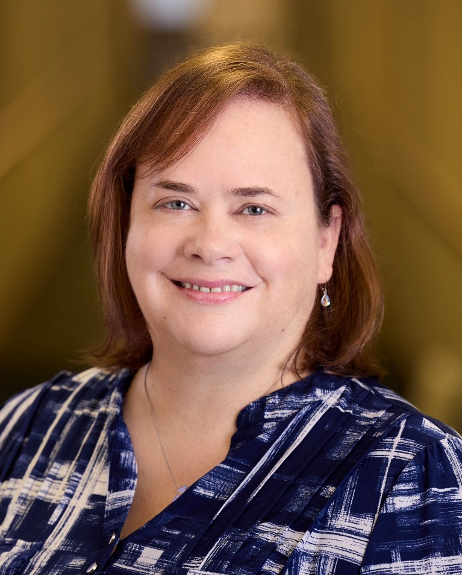
New Extramural Program Director,
Divisions of Extramural Operations & Genome Science
Kris Wetterstrand, M.S.
Notes:
In March, Kris Wetterstrand took on new roles at NHGRI, returning to the Extramural Research Program as program operations lead within the Division of Extramural Operations. There, she will foster the development and implementation of extramural policy (especially in the areas of program operations and data release. She is also a program director in the Division of Genome Sciences, where she will manage the comparative genomics grant portfolio.
Prior to this, Kris worked for me in the Office of the Director for 13 years. Some of her notable accomplishments included major roles in two strategic planning efforts, content development for the exhibition Genome: Unlocking Life’s Code, serving as lead editor of my monthly newsletter, The Genomics Landscape, and helping to start the NHGRI History of Genomics Program.

Slide 10

New Extramural Program Director,
Division of Genomic Medicine
Nephi Walton, M.D., M.S.
Notes:
In April, Nephi Walton joined NHGRI as a program director in the Division of Genomic Medicine. He brings expertise in clinical informatics as it relates to genomic medicine. Prior to joining NHGRI, he was the Associate Medical Director of Intermountain Precision Genomics at Intermountain Healthcare.
After receiving his M.D. from the University of Utah, Nephi trained in Pediatrics and Genetics. He has over 20 years of experience in medical genetics, biomedical informatics, machine learning, and precision medicine, and has been involved in efforts at two of the largest population genome-sequencing programs in the United States.

Slide 11
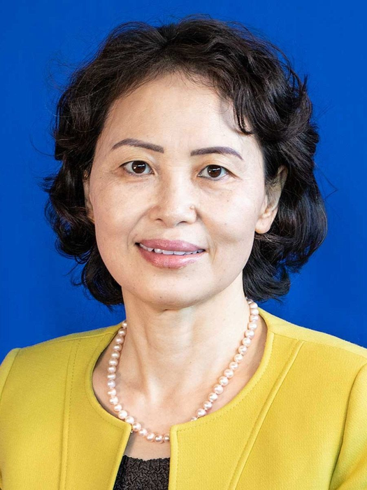
New Extramural Program Director,
Office of Genomic Data Science
Jean Gao, Ph.D.
Notes:
In March, Jean Gao joined NHGRI as a program director in the Office of Genomic Data Science. Before joining NHGRI, she was a program director for four years in the Division of Biological Infrastructure at the National Science Foundation, serving as the lead program director managing grant portfolios related to bioinformatics and computational biology. She also co-initiated and managed several new, foundation-wide programs, including the Mid-Career Advancement Program, the Dark Dimensions for the RNA Regulome Ideas Lab, and the Pathways to Enable Open-Source Ecosystems Program.
Jean was previously Professor of Computer Science and Engineering in the Department at the University of Texas at Arlington for 22 years. Her research focused on developing efficient algorithms to solve large-scale data analysis problems in basic medicine and in clinical settings, while making theoretical and fundamental contributions to machine learning, data mining, statistical pattern recognition, and computer vision.

Slide 12



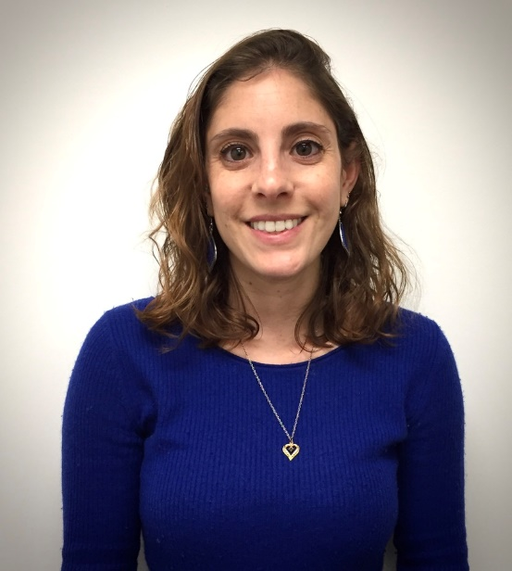
ASHG-NHGRI 2024 Genomics and
Public Service Fellows
Genetics Education &
Engagement Fellow
Genetics & Public Policy
Fellow
Genomics Communications
Fellow
Camerun Washington, M.S., C.G.C.
Greenwood Genetic Center
Elizabeth Roy, M.P.H.
University of Pittsburgh
Jacqueline Cohen, M.P.H.
University of Pittsburgh
Document 1
Notes:
As you may recall, last fall I announced the new ASHG-NHGRI Genomics and Public Service Fellowship program, an expansion of the joint fellowships that the American Society of Human Genetics (or ASHG) and NHGRI have had for many years. Today, both ASHG and NHGRI are very excited to formally announce the inaugural class of this new, expanded fellowship program.
There are 10 new fellows who will begin this July. * The new graduate-level fellows are: Camerun Washington as our Genetics Education & Engagement Fellow, Elizabeth Roy as our Genetics & Public Policy Fellow, and Jacqueline Cohen as our Genomics Communications Fellow.
12

Slide 13
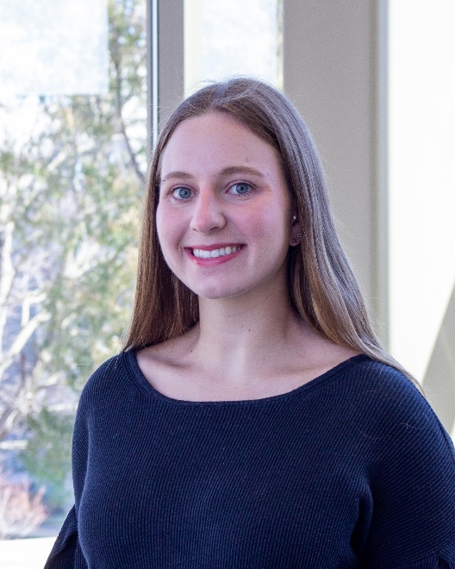

ASHG-NHGRI 2024 Genomics and
Public Service Fellows
Post-Baccalaureate Genomics Analyst Fellows – ASHG-based
Maya Montgomery
Duke University
Alison Wilcox
St. Olaf College
Document 1
Notes:
There will also be seven Post-Baccalaureate Genomics Analyst Fellows. The two shown here will be based at the ASHG office: Maya Montgomery and Alison Wilcox.
13

Slide 14

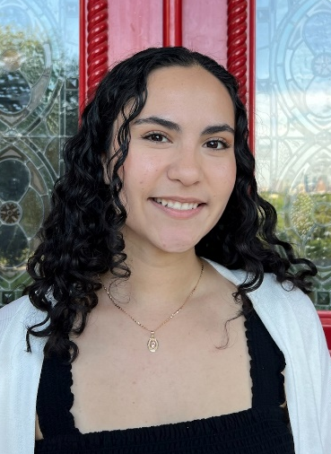


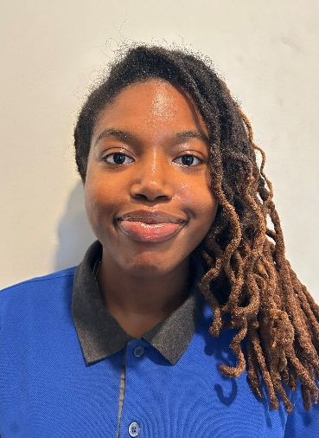
ASHG-NHGRI 2024 Genomics and
Public Service Fellows
Post-Baccalaureate Genomics Analyst Fellows – NHGRI-based
Malia Jennings
Fisk University
Mike Lopez
New Mexico
State University
Sofia Martin
St. Edward’s
University
Jessica Reinach
University of
Michigan
Gabrielle Villard
Southern California
Univ. of Health Sciences
Document 1
Notes:
And then the five Post-Baccalaureate Genomics Analyst Fellows shown here will be based at NHGRI within our Extramural Research Program: Malia Jennings, Mike Lopez, Sofia Martin, Jessica Reinach, and Gabrielle Villard.
Those of us at both ASHG and NHGRI are very excited to have this first group of 10 fellows arrive on July 1, and we have many things planned to ensure a very positive experience during their two-year fellowship with us.
14

Slide 15
Director’s Report Outline
General NHGRI Updates
General NIH Updates
General Genomics Updates
NHGRI Extramural Research Program
NIH Common Fund/Trans-NIH
NHGRI Communications, Policy, and Education
NHGRI Intramural Research Program
Notes:
Moving on to general NIH updates.

Slide 16
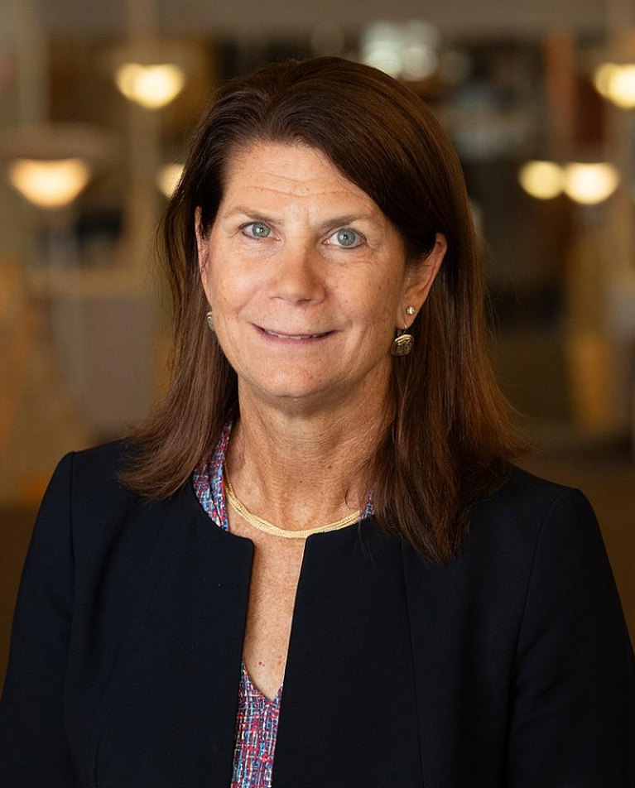

New Director, Fogarty International Center
Kathleen Neuzil, M.D.
Document 2
Notes:
Kathleen Neuzil was recently appointed the 13th director of NIH’s Fogarty International Center and NIH Associate Director for International Research. She is the first woman to hold this directorship since the center’s founding in 1968. She brings decades of global health experience with an impressive portfolio that includes clinical and epidemiological studies. Her many years as a vaccine policy advisor to the Centers for Disease Control and Prevention and the World Health Organization makes her well-suited to lead the Fogarty International Center.

Slide 17


New Director, Center for Information Technology
Sean Mooney, Ph.D.
Document 3
Notes:
Sean Mooney is now in place as the Director of NIH’s Center for Information Technology. In addition to this leadership role, Sean will also head a research program hosted by NHGRI’s Intramural Research Program, specifically within the new Center for Genomics and Data Science Research.

Slide 18

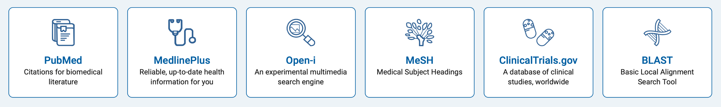
    National Library of Medicine Director Search
    Search launched May 1
    Search committee co-chairs: Eric Green & Nora Volkow
    Applications due July 1
Document 4
Notes:
On May 1, NIH officially launched the search for a new Director of the National Library of Medicine (or NLM). NLM aims to be the NIH epicenter of information and data science and is home to databases like PubMed and ClinicalTrials.gov. This is a unique opportunity for an exceptional leader to provide the executive direction and scientific leadership that will continue pushing NLM forward to become a world-class hub for research, analytics, and training in health-related data science.
I am co-chairing this search committee along with Nora Volkow, Director of the National Institute on Drug Abuse. We are eager to get suggestions of candidates to contact, so please email me directly with any ideas. Note that applications are due by July 1.

Slide 19
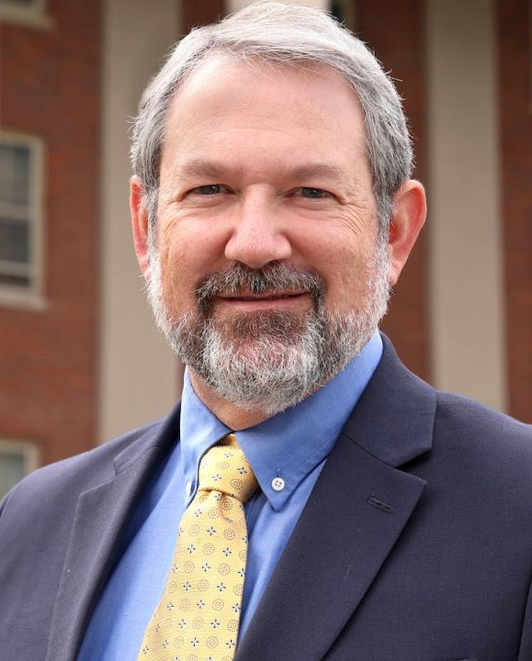
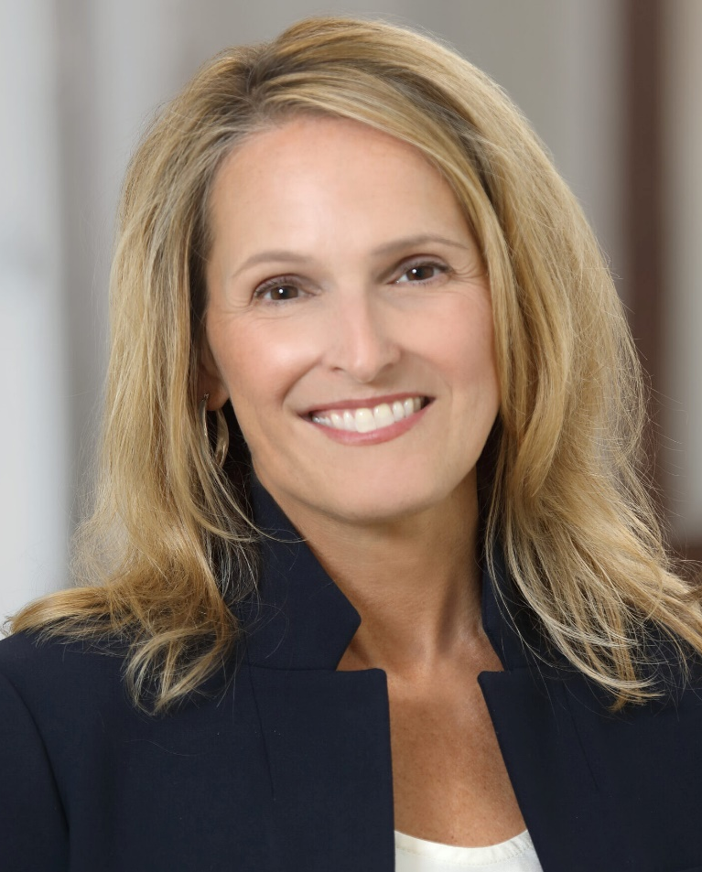

Departure of Director,
National Institute of Mental Health
Joshua Gordon,
M.D., Ph.D.
Shelli Avenevoli,
Ph.D.
Document 5
Notes:
Josh Gordon recently announced that he will soon be departing from his role as the Director of the National Institute of Mental Health (or NIMH) to return to Columbia University. During his time as NIMH Director, Josh has overseen a major growth in NIMH’s basic, translational, and clinical research that aims to transform the understanding and treatment of mental illnesses.
* Following his departure and while a search for a new director is conducted, Shelli Avenevoli, currently serving as the NIMH Deputy Director, will serve as the Acting NIMH Director.

Slide 20
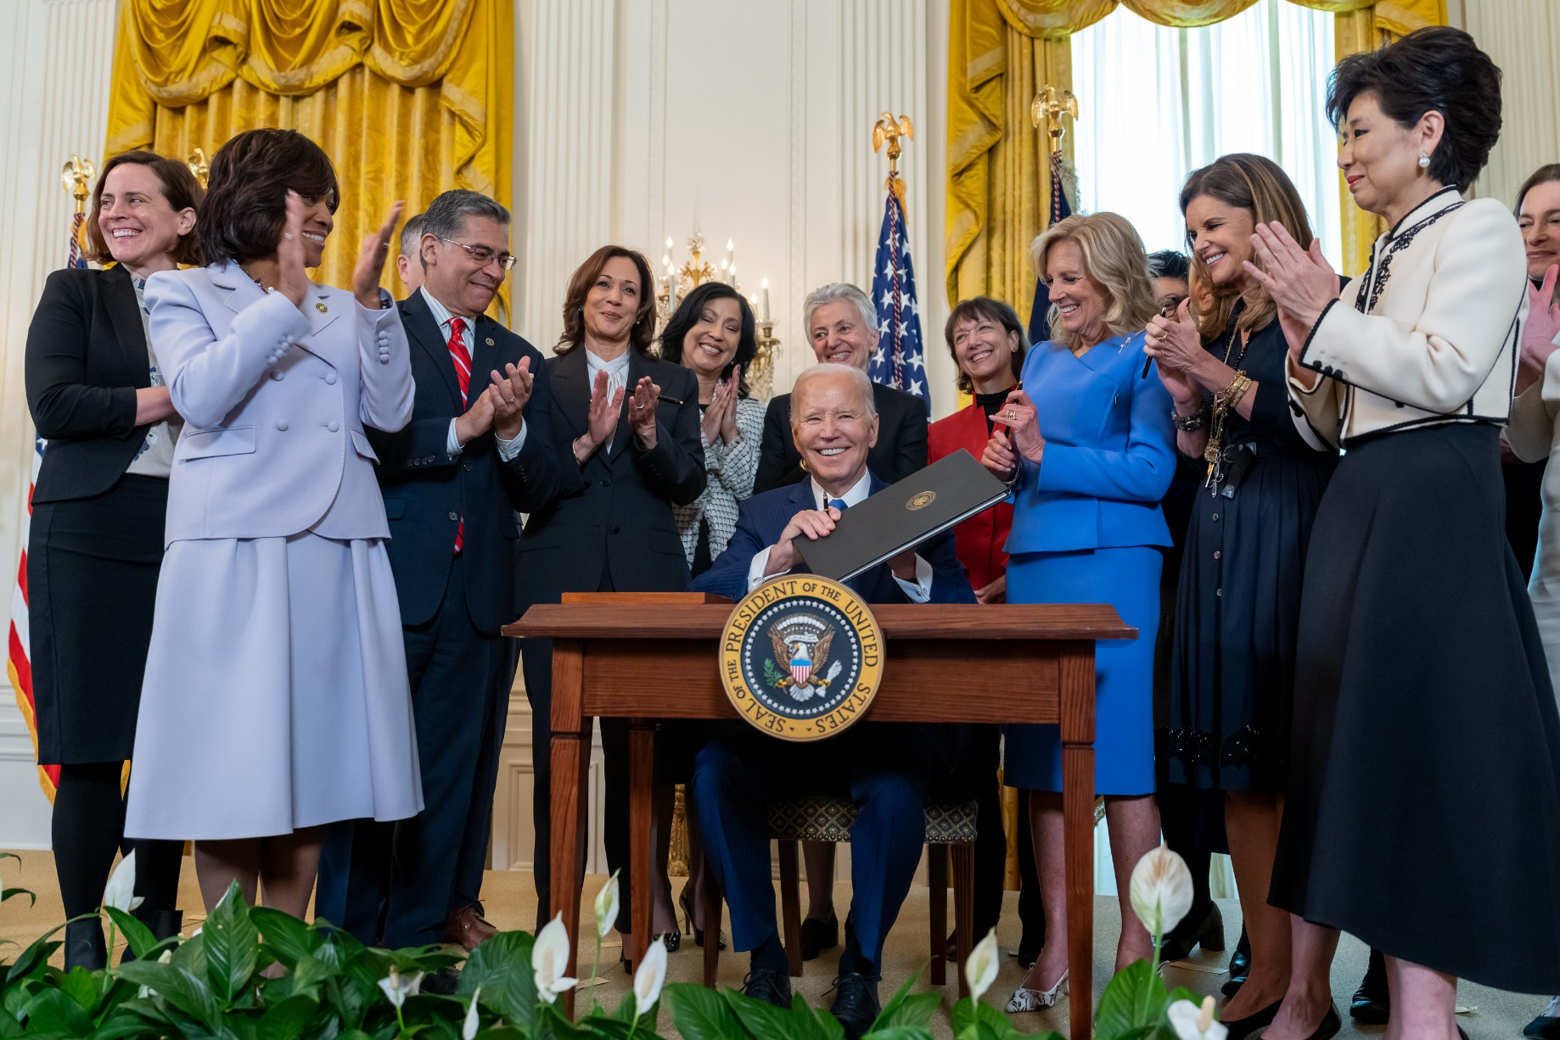
Executive Order on Women’s Health Research
Document 6
Notes:
In March, President Biden signed a new executive order to build upon the establishment of the White House Initiative on Women’s Health Research. The executive order prioritizes investments in women’s health research, integrating women’s health across the federal research portfolio, galvanizing new research on women’s midlife health, and assessing the unmet needs to support women’s health research.

Slide 21

FDA Finalizes Rule for LDT Oversight and Regulation
    Medical devices to include LDTs
    Same oversight as other diagnostic products manufactured by industry
    Four-year phaseout of general enforcement discretion
    Implementation of targeted enforcement discretion of certain LDTs
    Some tests will be considered legacies and will not undergo the full FDA regulatory process
    LDTs offered prior to May 6, 2024, with no further modifications
Document 7
Notes:
In April, the U.S. Food and Drug Administration (or FDA) posted a finalized rule to regulate Laboratory Developed Tests (or LDTs). * The proposed rule changes the definition of medical devices to include LDTs, subjecting them to the same oversight as other diagnostic products manufactured by industry.
* The rule includes a four-year phaseout of general enforcement discretion and implementation of targeted enforcement discretion of certain LDTs, meaning they would not need to undergo premarket and quality system review.
* It is important to note that some tests will be considered legacies and will not need to undergo the full FDA regulatory process. This includes LDTs offered prior to May 6, 2024, with no further modifications, such as updates for improved genomic variant calling and LDTs manufactured and performed by a lab integrated in a healthcare system when an FDA authorized test is not available.
21
21

Slide 22

NIH’s Role in Sustaining the U.S. Economy
$1 NIH funded research = $2.46 economic activity
Document 8
Notes:
In March, United for Medical Research released a report entitled NIH’s Role in Sustaining the U.S. Economy. The report noted a substantial return on investment from NIH research. Specifically, they calculated that every dollar invested in NIH produces $2.46 in economic activity within the United States, with the economic benefits helping every state in the country. The report also demonstrated NIH’s role as a catalyst for innovation and economic growth and noted the negative impacts on U.S. leadership in biomedical research and innovation that would result from a failure to robustly fund biomedical research. So, in light of this report, now would be a good time to pivot to the current budget situation for NIH…
22

Slide 23
Fiscal Year 2024 Appropriations
Portion | FY 2024 Enacted Appropriation | FY 2023 Enacted Appropriation | FY 24-23 Difference $ | FY 24-23 Difference %
NIH (excluding ARPA-H) | $47.08 B | $47.68 B | -$380 M | -0.8%
NHGRI | $663.2 M | $663.2 M | $0 | 0%
Notes:
Following six months of operating under a Continuing Resolution, a federal budget for Fiscal Year 2024 was enacted in March, providing about * $47 billion to NIH and * $663 million to NHGRI. Not accounting for inflation, and excluding ARPA-H, the budget provides a topline * 0.8% cut from the Fiscal Year 2023 enacted level for NIH and a technically flat budget for NHGRI.
23
23

Slide 24
Fiscal Year 2025 Appropriations
Portion | FY 2025 President's Budget | FY 2024 Enacted L-HHS Appropriation | FY 2024 President's Budget | FY24 Enacted – FY24 President's Budget Difference $ | FY24 Enacted – FY24 President's Budget Difference %
NIH (excluding ARPA-H) | $50.1 B | $47.08 B | $48.68 B | -$1.4 B | -3%
NHGRI | $664 M | $663.2 M | $663 M | +$200,000 | +0.03%
Notes:
Meanwhile, the Biden administration also released the Fiscal Year 2025 President’s Budget, which is meant to lay out the Biden administration’s priorities for the next fiscal year. The Fiscal Year 2025 President’s budget * includes $50.1 billion for NIH and $664 million for NHGRI.
For comparison, also shown is the Fiscal Year 2024 enacted budget. This was $1.4 billion less that what was originally proposed by the President for Fiscal Year 2024, so essentially this is a proposed * flat budget for NHGRI and a * proposed 3% overall cut for NIH.
24
24

Slide 25
Director’s Report Outline
General NHGRI Updates
General NIH Updates
General Genomics Updates
NHGRI Extramural Research Program
NIH Common Fund/Trans-NIH
NHGRI Communications, Policy, and Education
NHGRI Intramural Research Program
Notes:
Moving on to general genomics updates.
25

Slide 26
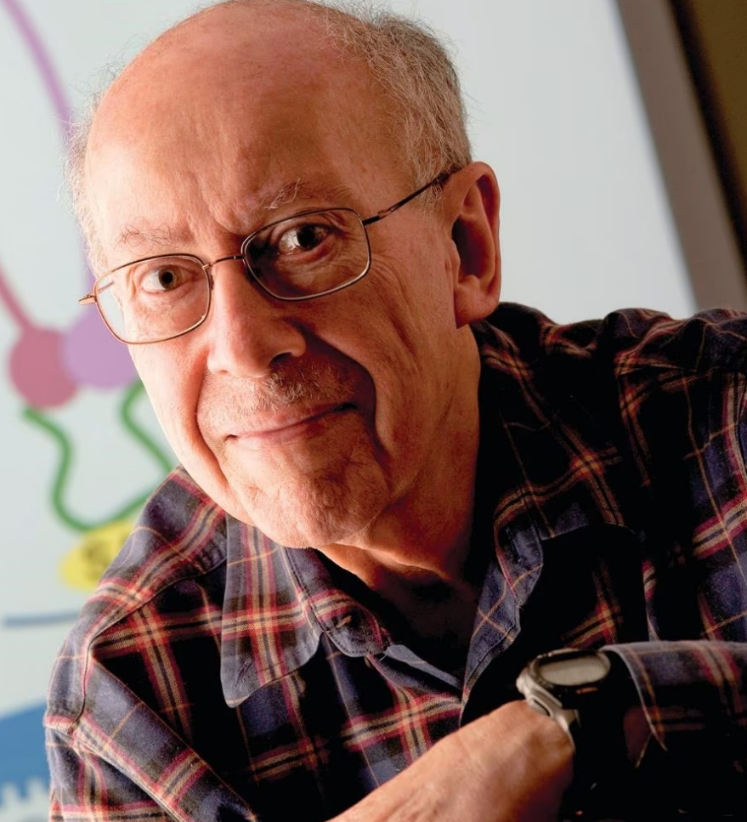
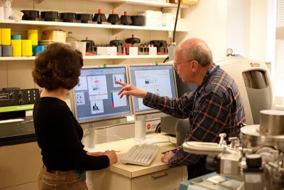
Mourning the Loss of Gary Felsenfeld
Document 9
Notes:
A good friend (and relative) of NHGRI, Gary Felsenfeld, passed away earlier this month. Gary was a highly accomplished researcher who made major contributions to our understanding of the relationship between chromatin structure and gene expression. Before retiring, he was for many years a Section Chief in the Laboratory of Molecular Biology at the National Institute of Diabetes and Digestive and Kidney Diseases. He truly enjoyed working at NIH, which provided him the opportunity to work in the lab every day, train postdoctoral fellows, and remain constantly invested in the science. After retirement, he enjoyed photography and spending time with his family, including NHGRI Program Director, Adam Felsenfeld.

Slide 27

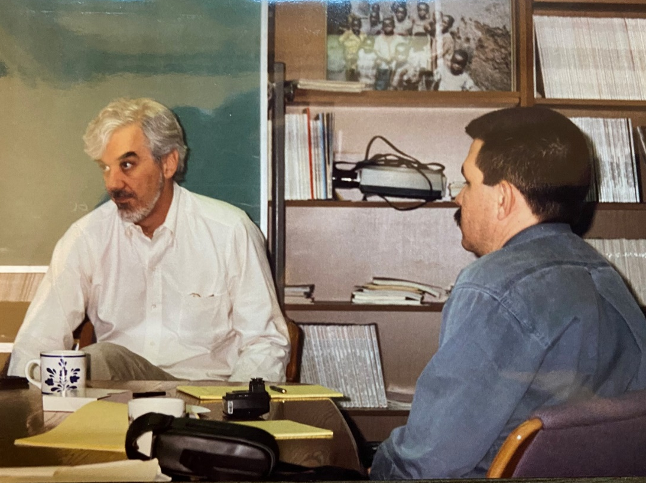
Mourning the Loss of Richard Cooper
Document 10
Notes:
Richard Cooper passed away in April. Richard was known for his extensive contributions in the study of hypertension and other cardiac diseases in individuals of African ancestry. Before retiring, Richard served as the Chair of the Department of Public Health Sciences at Loyola University Chicago’s Stritch School of Medicine. He received an NIH MERIT award for his research of the African diaspora and previously served on this Advisory Council from 2008 to 2011.

Slide 28
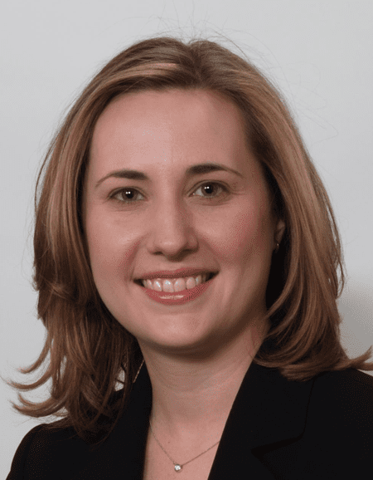

New Chief Executive Officer,
American Society of Human Genetics
Amanda Perl
Document 11
Notes:
Amanda Perl has been appointed the new Chief Executive Officer of the American Society of Human Genetics (or ASHG). In this role, Amanda will oversee the day-to-day operations of ASHG and help to execute the updated strategic plan to meet the organization’s vision of providing the best member value, service, professionalism, innovation, and advocacy for the genetics and genomics community. With her expertise in issues that are affecting member-based organizations, experience in association management, and previous leadership role as Executive Director of the American Thyroid Association, she is well-poised to take the helm of ASHG.

Slide 29
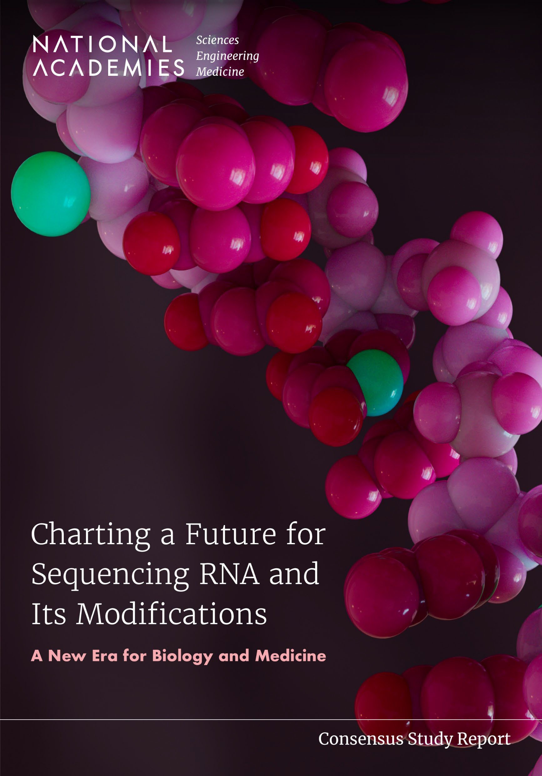
NASEM Report: Charting a Future for
Sequencing RNA and Its Modifications
    Reviews the impact of RNA base modifications
    Highlights critical gaps in existing RNA sequencing technologies
    Provides recommendations for standards, technologies, and regulatory agency tasks
    Sets 5, 10, and 15-year priorities and milestones
Document 12
Notes:
In February, the National Academies of Sciences, Engineering, and Medicine (or NASEM) released their highly anticipated report entitled Charting a Future for Sequencing RNA and Its Modifications. This report details the findings from a two-year consensus study and was sponsored by the Warren Alpert Foundation, the National Institute of Environmental Health Sciences, and NHGRI.
The report focuses on the technology and infrastructure needed for the direct end-to-end sequencing of RNA and the chemical modifications of RNA bases, referred to as the epitranscriptome. * The report reviews the currently known impacts of RNA base modifications on biology, health, and biotechnology. * The report also highlights critical gaps in existing RNA sequencing technologies.
* Looking towards the future, the report provides recommendations for standards, technologies, and regulatory agency tasks, while also * setting 5, 10, and 15-year priorities and milestones to achieve these goals.

Slide 30

Elected to National Academy of Sciences
David J. Glass
Todd R. Golub
Thomas A. Kunkel
Nipam H. Patel
Steven A. Rosenberg
Jenny Tung
Joana Wysocka
Document 13
Notes:
The National Academy of Sciences recently announced their newly elected members. Of particular relevance to NHGRI and the genomics community are the people listed here – congratulations to these friends and colleagues!
30

Slide 31
Director’s Report Outline
General NHGRI Updates
General NIH Updates
General Genomics Updates
NHGRI Extramural Research Program
NIH Common Fund/Trans-NIH
NHGRI Communications, Policy, and Education
NHGRI Intramural Research Program
Notes:
Moving on to the NHGRI Extramural Research Program.

Slide 32
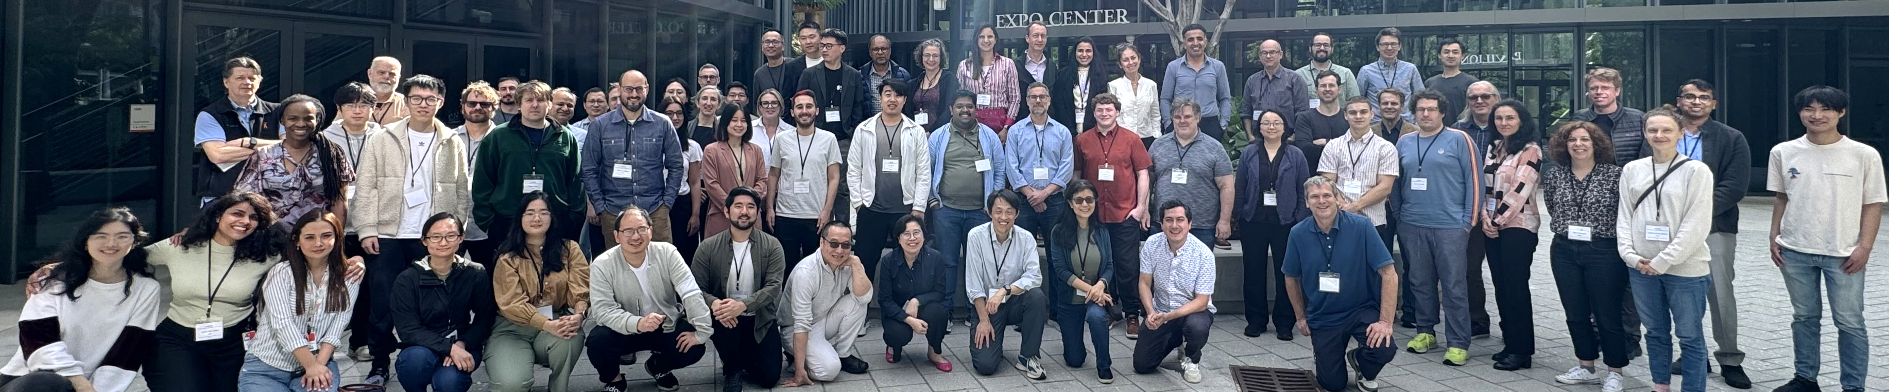
    Molecular Phenotypes of Null Alleles in Cells (MorPhiC) Phase 1
Consortium Meeting in February 2024
Focus on experimental design, data pipelines, individual scientific results, and progress updates
Hackathon led by early career investigators
Document 14
Notes:
In August 2022, NHGRI launched the Molecular Phenotypes of Null Alleles in Cells (or MorPhiC) Consortium, which aims to develop an extensive catalog of molecular and cellular phenotypes for null alleles of every human gene. The program is still in its first phase, laying the foundation for the program and generating early data.
MorPhiC had its first full consortium meeting this past February. The two-day meeting highlighted experimental design, data pipelines, individual scientific results, and progress updates. The program also included a hackathon led by early career investigators from the consortium data analysis centers. Hackathon participants explored multiple analysis approaches using initial datasets generated by the MorPhiC Consortium. The External Scientific Consultants panel attended the meeting and also provided valuable feedback.

Slide 33
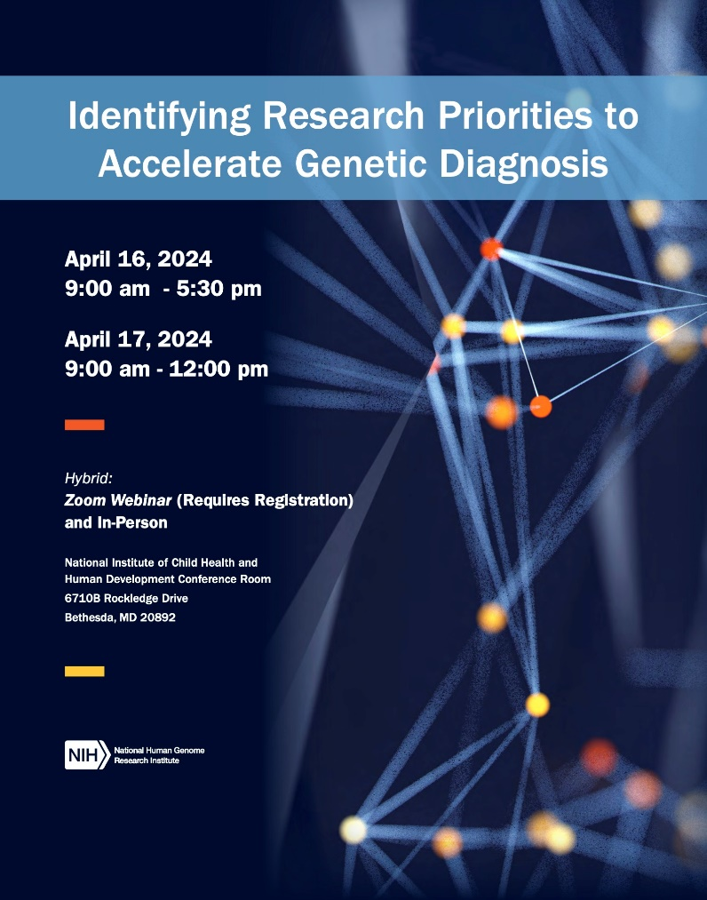
    Identifying Research Priorities to Accelerate
    Genetic Diagnosis Meeting
    Challenges, gaps, and opportunities:
      Advance understanding of the genetic causes of Mendelian conditions
      Increase rate of identifying genetic causes of rare genetic diseases
    Workshop recording and report will be available soon
Document 15
Notes:
In April, NHGRI hosted a strategic planning meeting on Identifying Research Priorities to Accelerate Genetic Diagnoses. The presentations and discussions focused on major challenges, gaps, and opportunities to advance our understanding of the genetic causes of Mendelian conditions and to increase the rate of identifying the genetic causes of rare genetic diseases. Topic areas included emerging technologies, data sharing, linking genomic variants to function, and computational tools.
The workshop hosted about 25 in-person participants in addition to remote viewers. The workshop recording and report will be available soon on genome.gov.

Slide 34

Community Input on Genomic Variant Interpretation
    Testing and assessing function of individual genomic variants
    Testing and assessing function of genomic variants in context
    Technology development needs
    Predictive modeling
    Resource building
Notes:
From February to April, NHGRI sought input from the scientific community about future research directions towards understanding the effects of genomic variants on genome function.
External scientists with a range of scientific backgrounds provided written feedback and participated in virtual panel discussions on the following topics: testing and assessing the function of individual genomic variants; testing genomic variants in context to assess function; needs for technology development; predictive modeling; and resource building.
The community feedback will be used to identify gaps, opportunities, and challenges for which NHGRI can support research, both in the short term to improve our understanding of how human genomic variants affect traits and diseases and in the long term to apply these scientific discoveries in medicine. A written report of the feedback received during community input was just posted on genome.gov.

Slide 35

    Educational Hub & Sites for Enhancing Diversity in Computational Genomics and Data Science
The Hub will leverage cloud platforms to increase access to educational and research opportunities
Partner Sites will develop educational content that makes uses cloud- computing resources
Applications are due on June 10
Document 16
Notes:
Last year, NHGRI launched the Educational Hub for Enhancing Diversity in Computational Genomics and Data Science (or “The Hub” for short).
* The Hub will leverage cloud platforms, increasing access to educational and research opportunities in computational genomics and data science. Efforts will be geared towards undergraduate and masters’ degree students enrolled at institutions serving students from diverse backgrounds, including those that have been historically underrepresented in genomics research.
* NHGRI is soliciting applications from faculty members at the Hub’s Partner Sites to develop educational content that uses cloud-computing resources. Together, the Hub and the Partner Sites will create a community of institutions working collectively to broaden the future workforce for computational genomics and data science.
* Applications for the funding opportunity for the Partner Sites are due on June 10.

Slide 36


    NHGRI Analysis, Visualization, and Informatics
    Lab-space (AnVIL)
    AnVIL collaborating with the NIH Cloud Platform Interoperability Program (NCPI) on four projects:
Document 17
Notes:
The NHGRI Analysis, Visualization, and Informatics Lab-space (or AnVIL) is a secure, cloud-based platform where researchers can store, combine, share, and analyze unrestricted- and controlled-access datasets, particularly those generated with NHGRI funding or support. Although cloud computing presents opportunities for analyzing large genomic datasets, it is often difficult to analyze data across different platforms. The NIH Cloud Platform Interoperability Program (or NCPI) was created to address this challenge by fostering interoperability between NIH-supported cloud platforms in an effort to create a trans-NIH, cloud-based, federated data ecosystem.
* With funding support from the NIH Office of Data Science Strategy, AnVIL is collaborating with NCPI on four projects: NHLBI’s BioData Catalyst, NCI’s Cancer Research Data Commons, NCBI’s dbGaP, and the Common Fund’s Gabriella Miller Kids First Pediatric Research Program.
These projects are seeking to enable the integration of data across NIH-funded platforms with scientific driver projects. By better connecting NIH’s cloud-based platforms, these projects aim to expand research potential by maximizing the value of NIH-supported datasets.

Slide 37


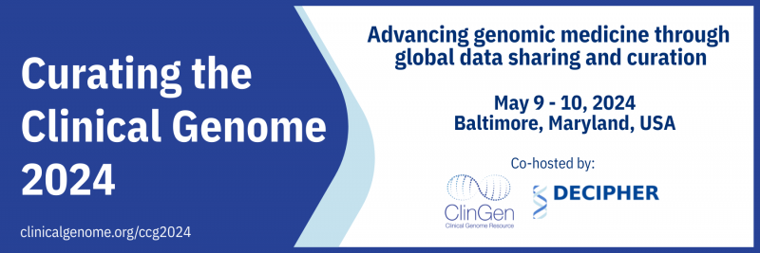
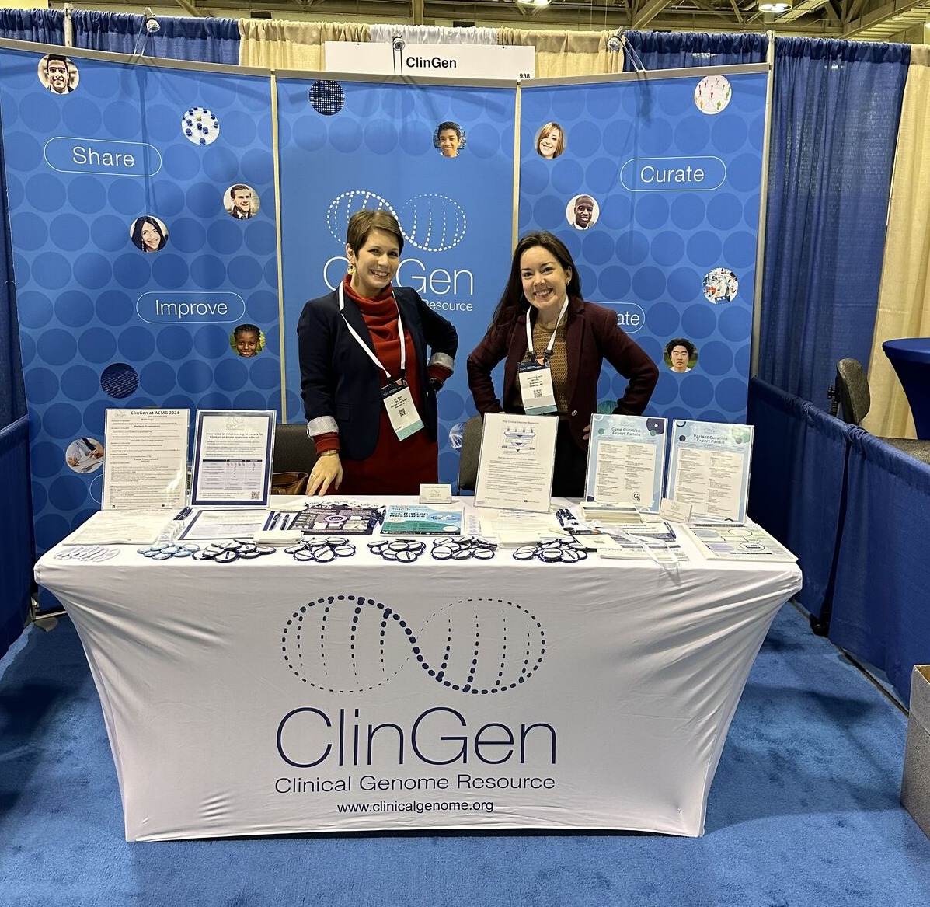
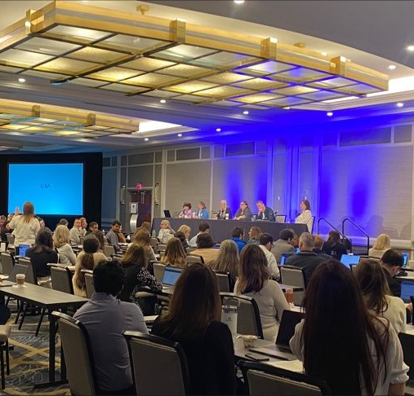
    Clinical Genome Resource (ClinGen)
    10th Anniversary
American College of
Medical Genetics and Genomics
(ACMG)
Curating the Clinical Genome (CCG)
Document 18
Notes:
The Clinical Genome Resource (or ClinGen) evaluates and disseminates the clinical relevance of genes and genomic variants for use in precision medicine and research.
ClinGen is celebrating its 10th anniversary this year. For this anniversary, they held celebratory events at the American College of Medical Genetics and Genomics meeting and, more recently, at the Curating the Clinical Genome meeting. The celebrations were an opportunity to acknowledge ClinGen’s decade of remarkable progress and to thank the nearly 2,500 ClinGen contributors for their dedication to ClinGen's curation efforts.

Slide 38
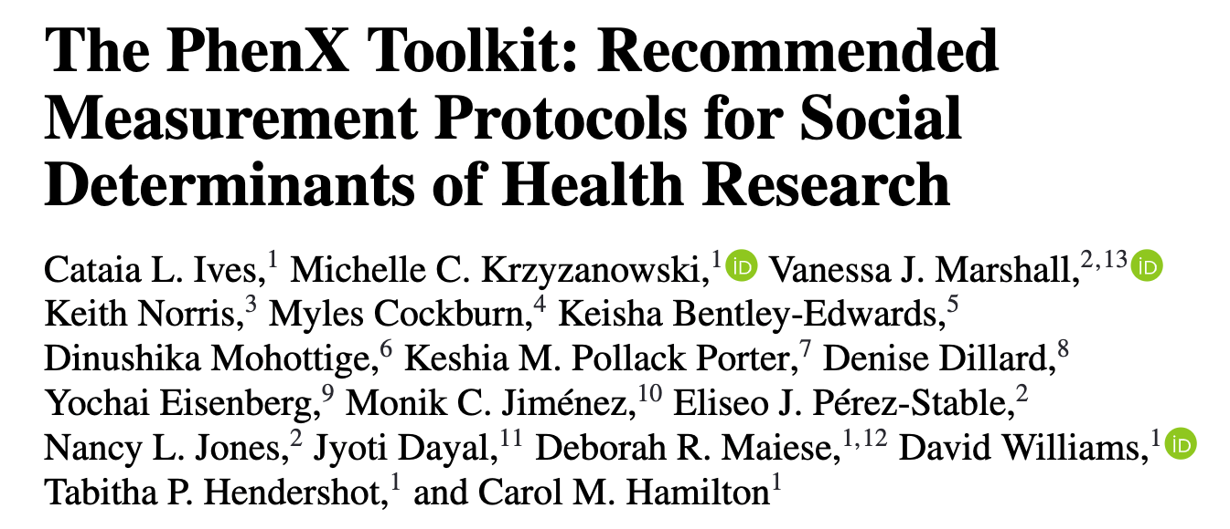

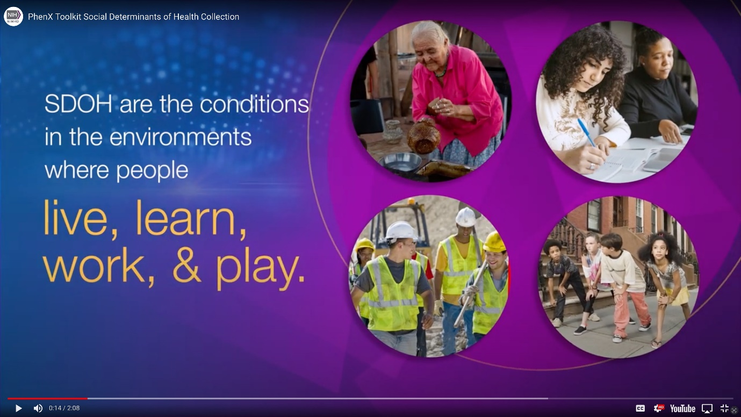
PhenX Toolkit: Social Determinants of Health (SDOH)
15 new protocols added to the PhenX SDOH collections
Examples of new individual measures: Discrimination in Healthcare & Internet Access
Examples of new structural measures: Water Access, Sanitation, & Minimum Wage
Document 19
Notes:
In March, PhenX published a paper outlining the process of selecting and implementing social determinants of health measurement protocols in the PhenX toolkit. In 2022, the National Institute on Minority Health and Health Disparities provided funding to broaden the PhenX’s social determinants of health collection and convened a second expert working group to address new topic areas.
* This effort resulted in 15 new protocols being added to the social determinants of health collections, covering both individual-level and structural-level social determinants of health. * Examples of new individual-level measures include discrimination in healthcare and internet access. * New structural-level measures, which are at the societal or community level, include water access, sanitation, and minimum wage.
These protocols provide a valuable resource for researchers hoping to appropriately measure social determinants of health in their studies and to better understand the impact of social determinants of health on biological and behavioral mechanisms, phenotypes, and exposures. Ultimately, as more researchers incorporate social determinants of health and use these standard protocols, it will be more straightforward to replicate studies and promote collaborative research through data sharing and cross-study analysis.
* The National Institute on Minority Health and Health Disparities created a short YouTube video that provides additional information on the PhenX social determinants of health collection.

Slide 39
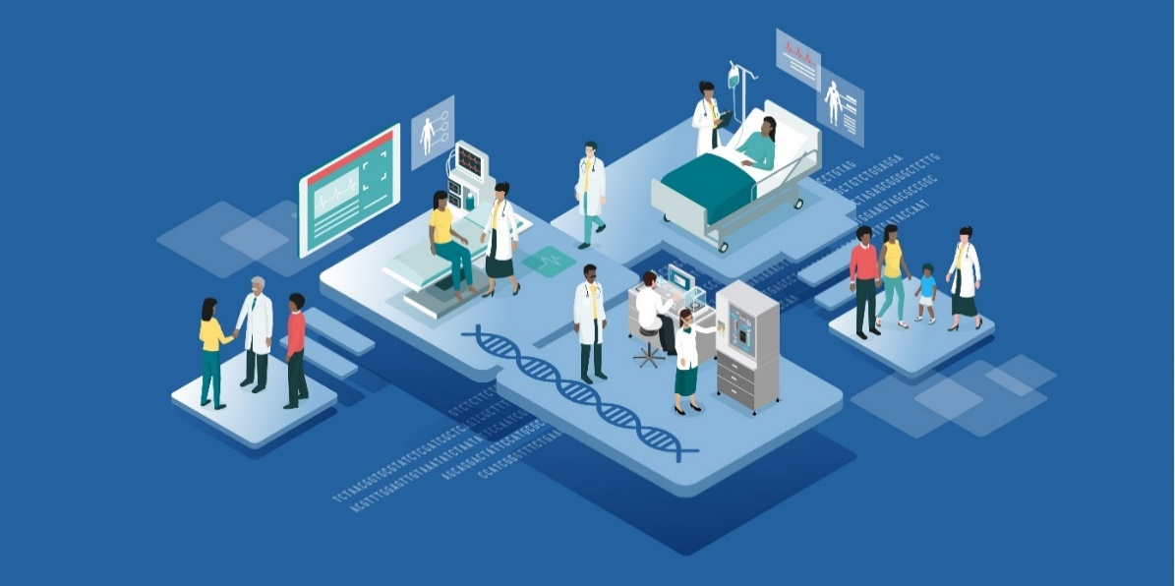
    Defining a Clinical Data Ecosystem for Genomic Health Workshop
    Define a data ecosystem, outlining paths of genomic data from laboratory to electronic health records to patient/clinician and across health systems
    Determine informatics standards to be adopted, systems to be built, and policies to be developed
    Identify research directions for optimizing genomic data integration and utilization in delivery of healthcare
Document 20
Notes:
In April, NHGRI convened a workshop aimed at defining the optimal clinical data ecosystem for genomic health. The transformative potential of genomics in healthcare is immense, yet there are significant challenges to enabling the longitudinal use of genome sequencing in clinical care. Our healthcare infrastructure currently falls short of supporting the promise of precision medicine. Genomic data, which is crucial for personalized medicine, remains confined within laboratory walls and is largely inaccessible for direct clinical application. This workshop was dedicated to identifying ways to overcome these barriers.
The objectives of the workshop were to * define a data ecosystem, outlining paths of genomic data from laboratory to electronic health records to each patient/clinician and across health systems; * determine informatics standards to be adopted, systems to be built, and policies to be developed; and * Identify research directions for optimizing genomic data integration and utilization in delivery of healthcare. The workshop recording and summary will be made available on genome.gov.

Slide 40


    Ethical, Legal, and Social Implications (ELSI) Research Program
    ELSIcon2024: The 6th ELSI Congress
Reimagining the Benefits of Genomic Science
    SAVE THE DATE
    June 10-12, 2024
    New York City
Register now!
Document 21
Notes:
The Ethical, Legal, and Social Implications (or ELSI) Research program supports research that anticipates, explores, and addresses implications of genetics and genomics for individuals, families, and communities.
The 6th ELSI Congress will be held June 10-12 in New York City, featuring both in-person and virtual components. The theme for the 2024 Congress is Reimagining the Benefits of Genomic Science. ELSIcon invites researchers, practitioners, trainees, and other scholars to share their latest ELSI research. Registration for the event is now open.

Slide 41
NOT-HG-24-027: Building Partnerships and Broadening Perspectives to Advance Ethical, Legal and Social Implications (ELSI) Research (BBAER)
    Ethical, Legal, and Social Implications (ELSI) Research Program
1) Transdisciplinary ELSI Research
2) Research Teams with Community Experts
3) ELSI Research Capacity Building
4) ELSI Workforce Development
Eligible applicants: Domestic organizations in the U.S. receiving <$30M per year in total NIH funding for last 3 years
Document 21
Notes:
NHGRI intends to release a new funding opportunity entitled Building Partnerships and Broadening Perspectives to Advance Ethical, Legal, and Social Implications Research (or BBAER). The BBAER program has four goals. First, to support transdisciplinary ELSI research. Second, to enhance ELSI research teams by including community experts as team members. Third, to build capacity for ELSI research within organizations that have not been traditionally funded by NHGRI. Fourth, to expand the ELSI research workforce.
Eligible applicants include domestic organizations in the U.S. receiving less than $30 million per year in total NIH funding for the last 3 years.
A notice of intent to publish was released in March to allow potential applicants sufficient time to develop meaningful collaborations and responsive projects. NHGRI is planning to disseminate further through other avenues to increase awareness of this new opportunity.

Slide 42
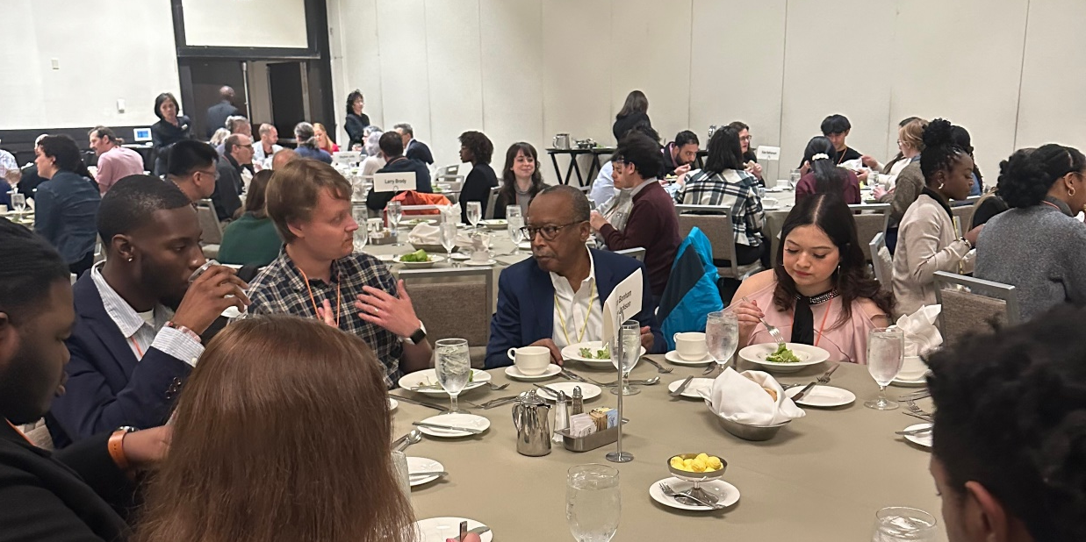
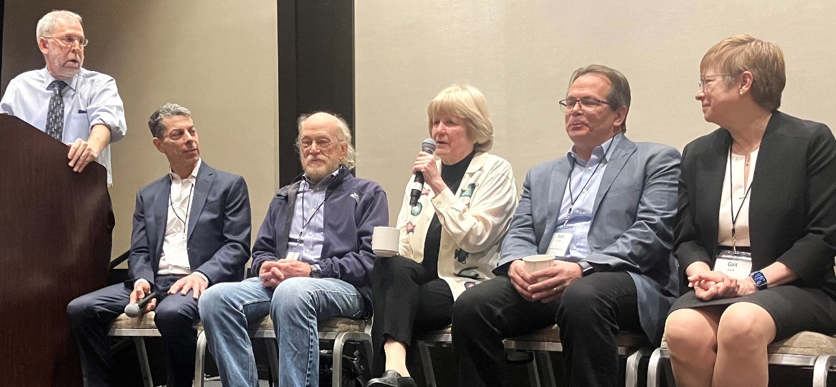
    9th Annual NHGRI Research Training and
    Career Development Meeting
    Held on April 7-9 in Seattle
    Hosted by Duke University
    >400 in-person attendees
Document 22
Notes:
The NHGRI Training Program aims to prepare a talented and diverse genomic workforce by providing both institutional and individual funding through a variety of mechanisms, including individual fellowship and career development awards, institutional training awards, and diversity supplements. Programs are offered at the undergraduate, postbaccalaureate, graduate, postdoctoral, and faculty levels.
The 9th Annual Research Training and Career Development Meeting was held in Seattle in April and was hosted by Duke University. The meeting brought over 400 in-person attendees. The trainees presented posters, gave lightning talks, and attended scientific lectures presented by their peers. Other highlights included a keynote talk by Wylie Burke, a plenary panel discussion with some outstanding local genomic talent that I convened, and networking lunches with PIs and NHGRI staff.

Slide 43
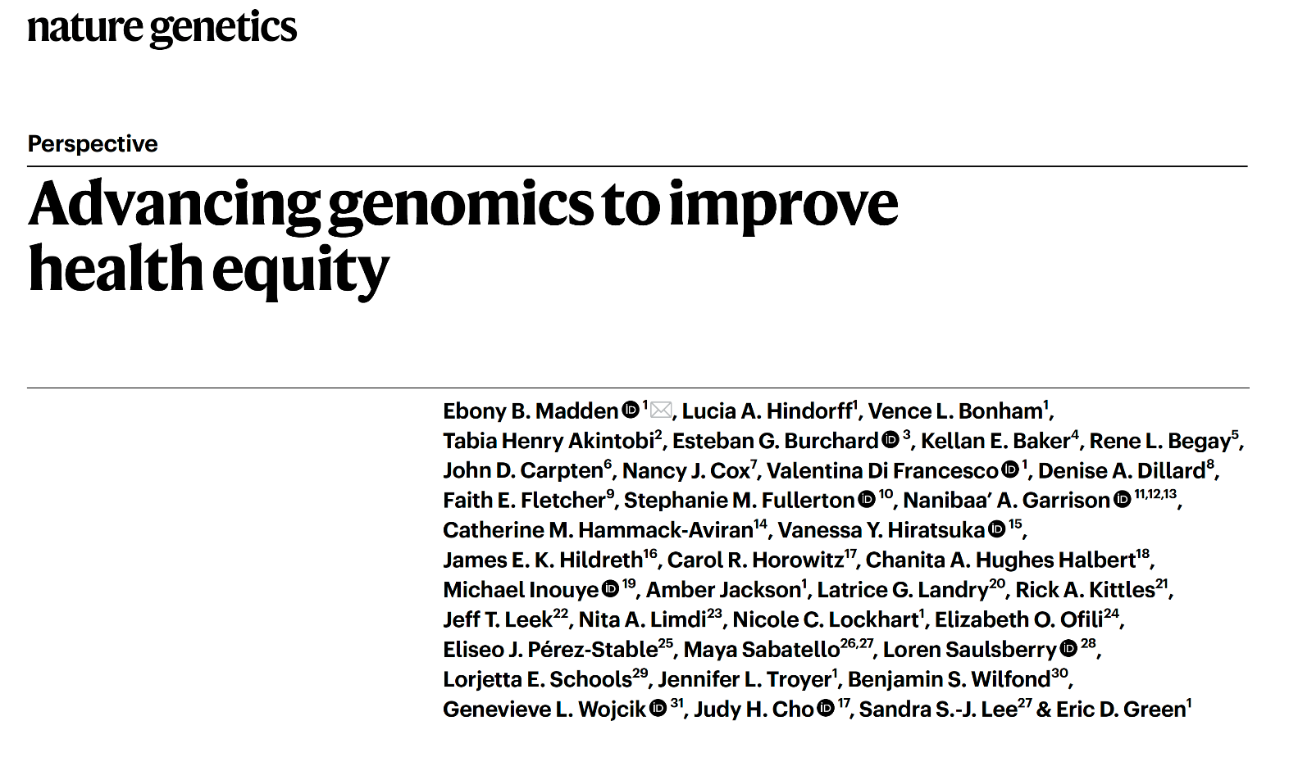
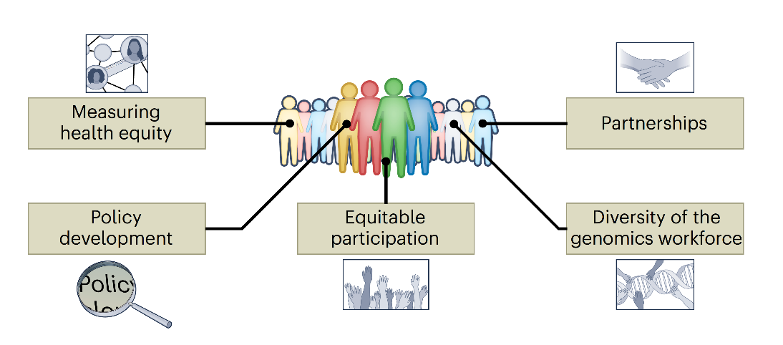
Publication of Genomics and Health Equity Paper
Document 23
Notes:
In 2022, NHGRI worked with others at NIH to convene a workshop entitled Future Directions in Genomics and Health Equity, a meeting that examined health equity within the context of human genomics. A paper reporting the recommendations of that workshop was recently published in Nature Genetics. The paper also provides an informative literature review and discusses the importance of developing metrics to measure progress in health equity, policy development, equitable participation, establishing partnerships, and improving workforce diversity.

Slide 44

    Population Descriptors for Legacy Genomic Data: Challenges and Future Directions Workshop
May 28 - 29, 2024 (Virtual)
  Leaders of genomic data science resources, researchers who use legacy data, & other partners
  Workshop objectives:
    Summarize current approaches to the use of population descriptors in/for legacy data
    Define and address challenges with harmonization, interoperability, and analysis
    Develop recommendations that can be widely adopted
    Identify opportunities for research and collaboration
  Register now!
Document 24
Notes:
In 2023, multiple NIH institutes, centers, and offices sponsored a National Academies of Sciences, Engineering, and Medicine study to review and assess existing methodologies, benefits, and challenges in using population descriptors in genomics research. This culminated in the report entitled Using Population Descriptors in Genetics and Genomics Research: A New Framework for an Evolving Field. To further explore this report with regards to legacy genomic data, NHGRI is partnering with other NIH institutes and centers to host a two-day virtual workshop on May 28 and 29.
* This workshop will convene leaders of genomic data science resources, researchers who use legacy data, and other partners to make recommendations regarding the application of population descriptors to existing data.
* The workshop objectives are to summarize current approaches to the use of population descriptors in/for legacy data, define and address challenges with harmonization, interoperability, and analysis, develop recommendations that can be widely adopted, and identify opportunities for future research and collaboration.
* All are encouraged to register and participate in this event.

Slide 45
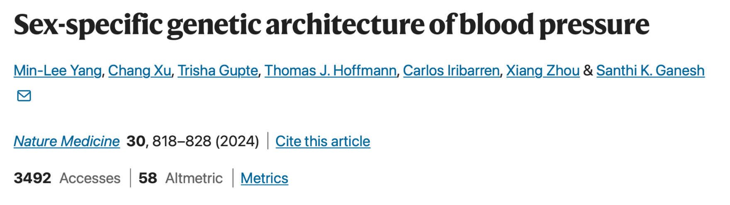
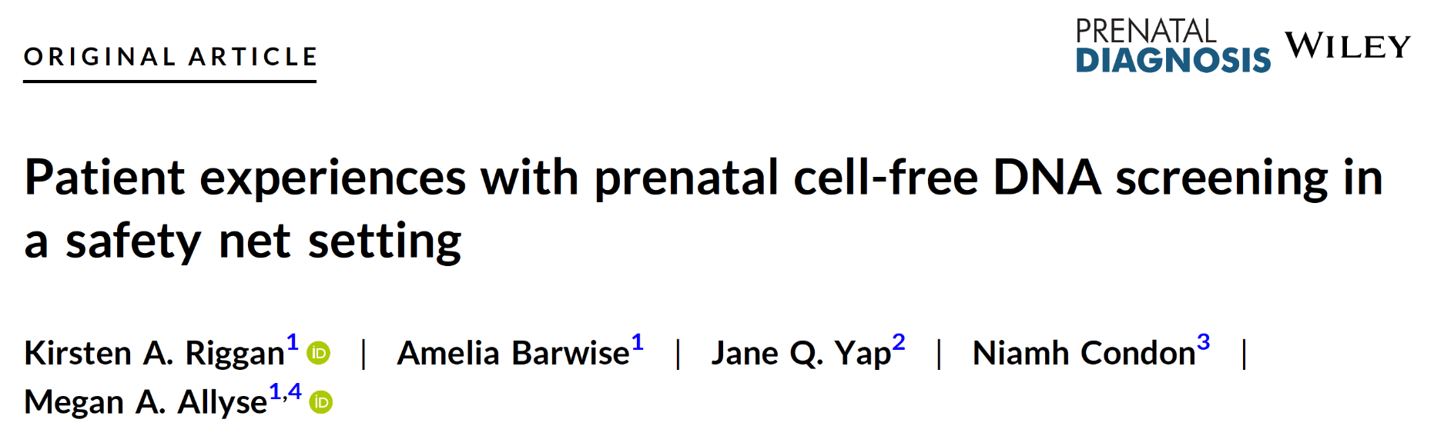
    Extramural Investigator-Initiated Highlights
Document 25
Notes:
I would like to briefly highlight two recent publications supported by NHGRI’s extramural investigator-initiated research portfolio.
* This publication from Yang and colleagues provides insight into the genetic basis of differences in blood pressure traits between males and females. They identified several sex-specific genetic loci enriched for hormone-related transcription factors as well as regions showing female-specific association with blood pressure and pulse pressure.
* This publication from Riggan and colleagues describes the experiences of self-identified Black and Hispanic women in Florida’s new program that offers prenatal cell-free DNA screening to patients receiving state health insurance. Although the researchers noticed interest in the screening by patients, the patients reported a lack of pre-screening counseling as well as a limited understanding of the benefits of such prenatal genetic screening.

Slide 46
Director’s Report Outline
General NHGRI Updates
General NIH Updates
General Genomics Updates
NHGRI Extramural Research Program
NIH Common Fund/Trans-NIH
NHGRI Communications, Policy, and Education
NHGRI Intramural Research Program
Notes:
Moving on to the NIH Common Fund and other trans-NIH efforts.

Slide 47
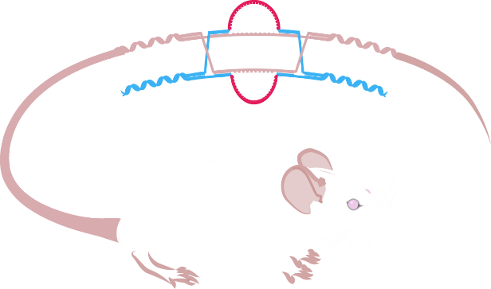

Knockout Mouse Phenotyping Project (KOMP2)
Resource impact demonstrated by >7,000 publications
International Mouse Phenotyping Consortium (IMPC) Spring Meeting – April 2024
IMPC Virtual Workshop – May 2024
Document 26
Notes:
The Knockout Mouse Phenotyping Project (or KOMP2) is a trans-NIH research program focused on generating a comprehensive resource of null mutant mice and their phenotype information. KOMP2 is a founding member of the International Mouse Phenotyping Consortium (or IMPC) that comprises 21 centers in 15 countries. To date, KOMP2 investigators have developed and phenotyped around 5,500 strains of knockout mice, contributing to the more than 10,000 strains created by the IMPC.
* The impact of the resource is demonstrated by a growing body of publications using KOMP2 and IMPC resources. Averaging nearly 700 articles per year over the last decade, there are now over 7,000 publications that can be explored on the resource website.
*The International Mouse Phenotyping Consortium Spring Meeting was held in April. With an overarching theme of exploration beyond the genome, meeting topics focused on advances in understanding noncoding sequences, epigenetic influences, and disease therapies.
* An IMPC Virtual Workshop will occur later this month, which will introduce attendees to methods for extracting data from the IMPC resource.

Slide 48
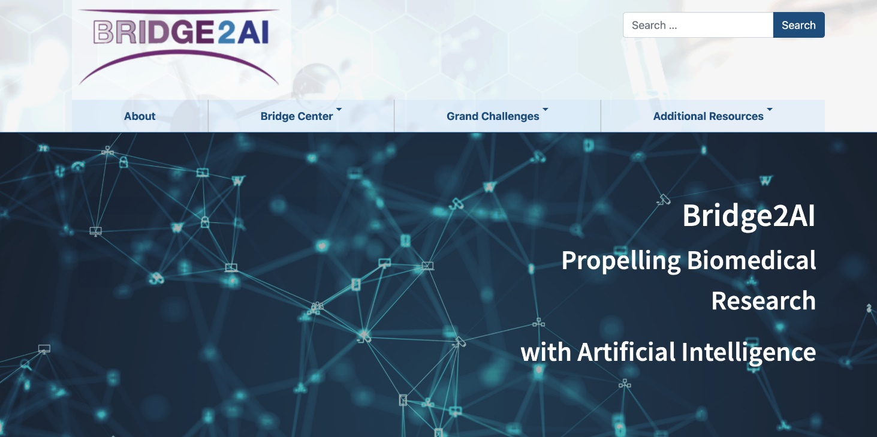
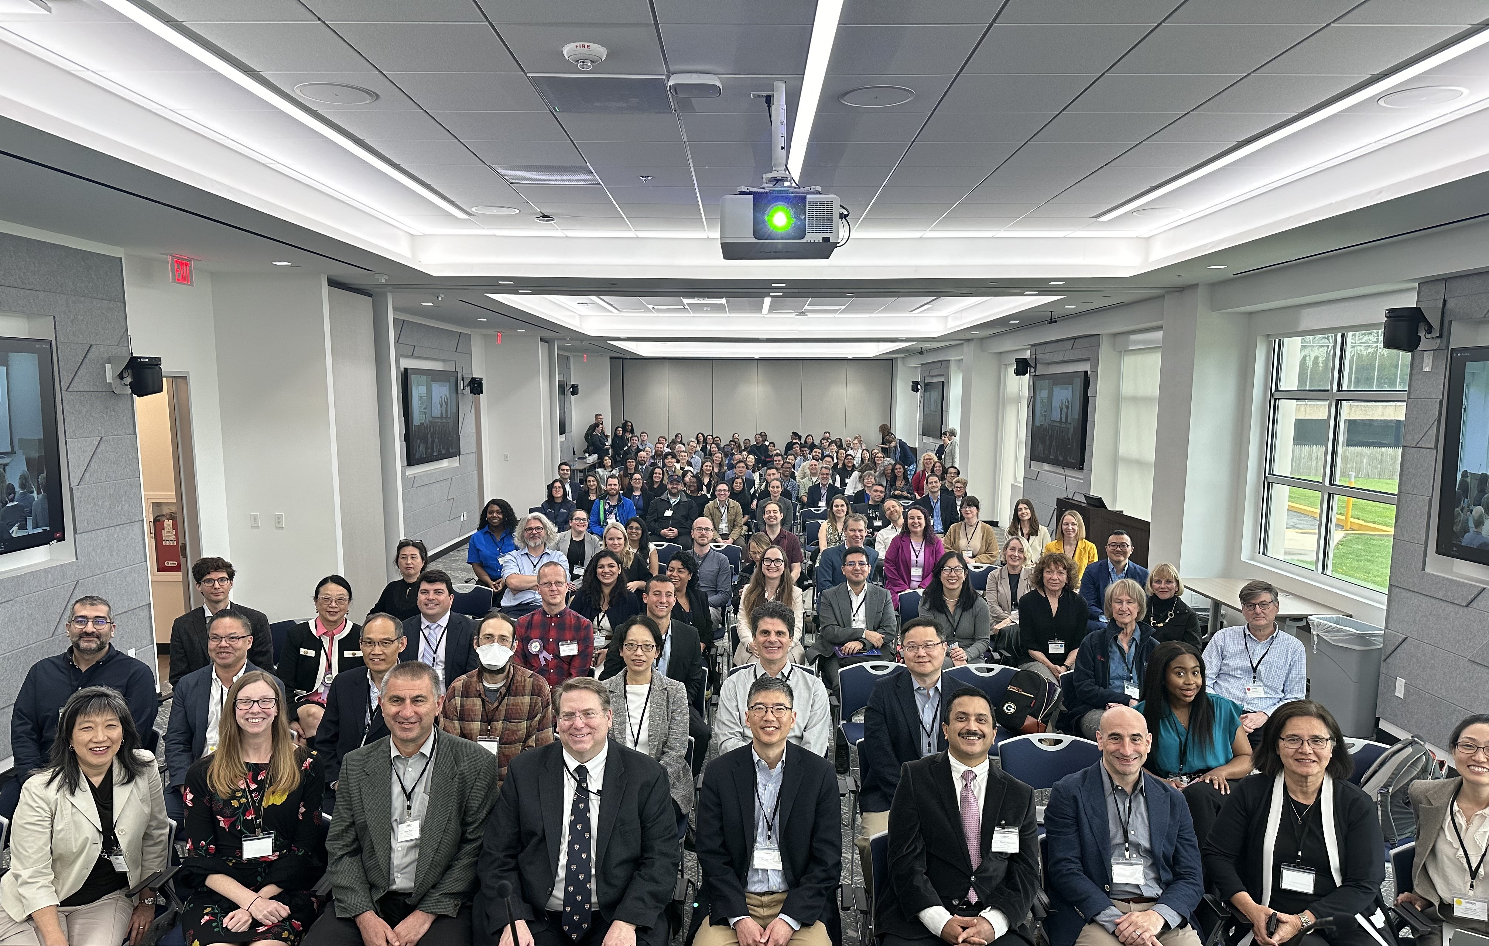
    Bridge to Artificial Intelligence (Bridge2AI)
Goals:
Generate AI-ready datasets
Create ethical AI best practices
Train a future biomedical AI workforce
All-Hands Conference and
AI-Ready Data Open House
April 2024
Document 27
Notes:
Bridge to Artificial Intelligence (or Bridge2AI) is an NIH Common Fund program that will set the stage for widespread use of artificial intelligence (or AI) in healthcare research. The goals of the program are to generate hypothesis-agnostic AI-ready datasets, create ethical AI best practices, and train a future biomedical AI workforce.
Bridge2AI’s grand challenges include AI analyses of human voice recordings as a biomarker for health; analyses of ICU data to build predictive models for adverse health events; the creation of functional genomic maps of human cells for interpretable genotype-phenotype learning; and using Type 2 diabetes as a model to show how a person’s health is restored after disease. I serve as one of the Co-Chairs of the program, and NHGRI is playing a prominent role in its oversight, including administering awards for the program’s Bridge Center, which will integrate and disseminate the data, knowledge, and practices from across the program.
One of the goals of Bridge2AI is to share AI-ready datasets as quickly as possible with the broader scientific community. The program had their first ever open house last month. This event was significant because datasets from the grand challenges were made available for use. The event also featured hands-on collaborative sessions to evaluate the utility of these resources for scientists in the wider community.

Slide 49

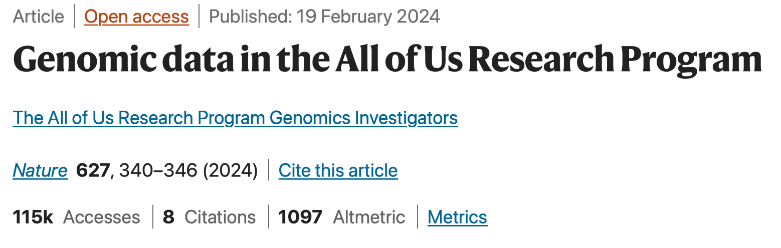
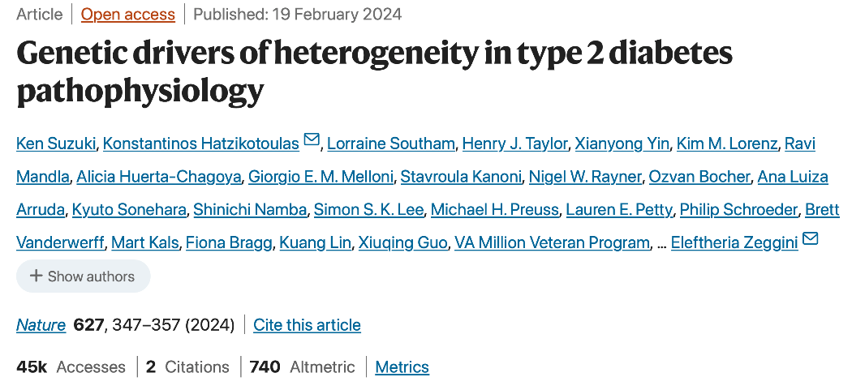
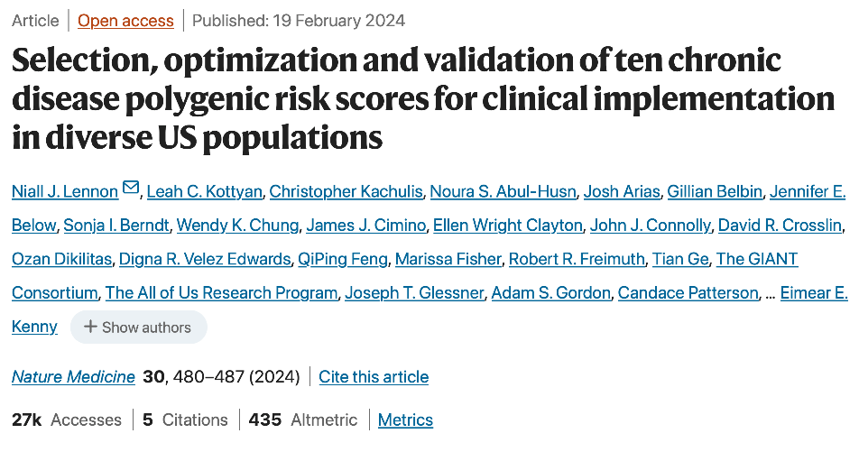
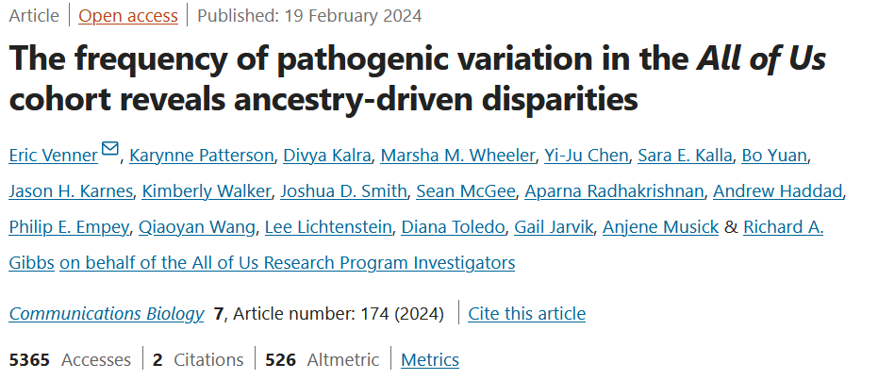
Document 28
Notes:
The NIH All of Us Research Program is seeking to build a national research cohort of over one million or more participants, reflecting the diversity of the United States. The program is creating a partnership with participants in order to advance precision medicine and to change healthcare for the benefit of all.
This past February, the program published several papers in the Nature portfolio of journals. * In this flagship publication, the All of Us Research Program investigators describe the generation and release of nearly 250,000 genome sequences, 77% of which are from historically underrepresented communities in the United States. The accompanying analysis revealed the identification of nearly 275 million previously unreported genomic variants. These data can be accessed through the All of Us Researcher Workbench. This paper received significant attention within the scientific community, sparking important conversations on the presentation of genetic ancestry data alongside social identity labels and the proper use of data-visualization techniques.
* Additional recently published papers described the integration of multi-ancestry GWAS data with single-cell epigenomics to identify genetic drivers of heterogeneity in patients with type 2 diabetes, * disparities in the frequency of pathogenic genomic variants across ancestry groups in the All of Us cohort, and * the use of All of Us data to optimize polygenic risk scores for diverse populations. This last publication represents a collaborative effort between the NHGRI eMERGE consortium and All of Us.

Slide 50
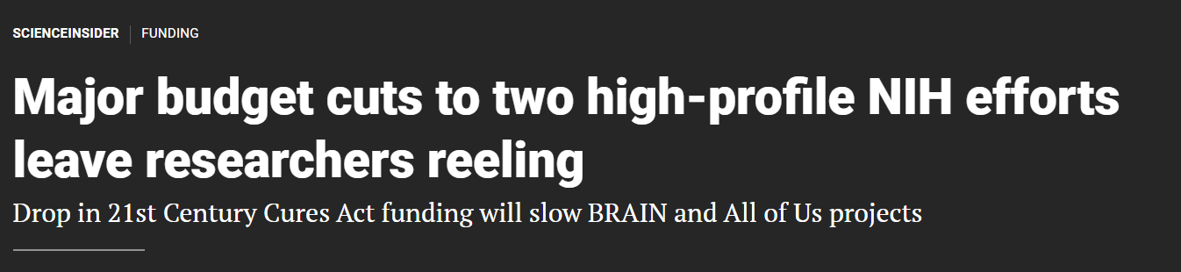
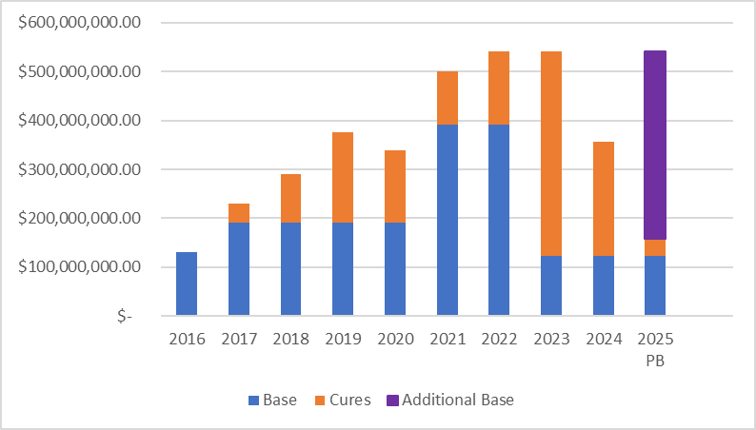
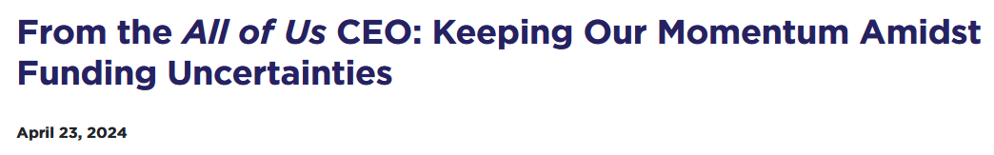

-$184M
(-34%)
Josh Denny
All of Us Research Program
Chief Executive Officer
Document 28
Notes:
However, all news is not good news for the All of Us Research Program. For complicated reasons, the program received a significant funding cut in their Fiscal Year 2024 appropriation. This graph shows the funding level for All of Us each year, with blue representing funds from its base allocation and orange representing funds from the 21st Century Cures Act. All of Us funding was $541 million in Fiscal Year 2023. Due to the drop in Cures Act funds, the program is only receiving $357 million in Fiscal Year 2024, * representing an immediately overall decrease of $184 million (or 34%). Looking forward, there could be even more significant reductions in Cures Acts funds in Fiscal Years 2025 and 2026, after which that funding stream is set to expire – unless something is done to fix this downward trajectory. However, the President’s Fiscal Year 2025 budget (shown on the far right) proposes an increase in non-Cures Act funds, depicted by the purple bar. However, this restoration of funding is not guaranteed.
* Last month, Josh Denny, the All of Us CEO, provided an update about these funding uncertainties. There will be reductions to most program awards this year, with a resulting decrease in enrollment rates, a delay in launching pediatric enrollment, and a slowing of new data generation. However, the program will continue to build on its accomplishments to date, which includes having over 790,000 participants enrolled, having over 10,000 researchers signed up for data access, and having hundreds of papers published using All of Us data.

Slide 51
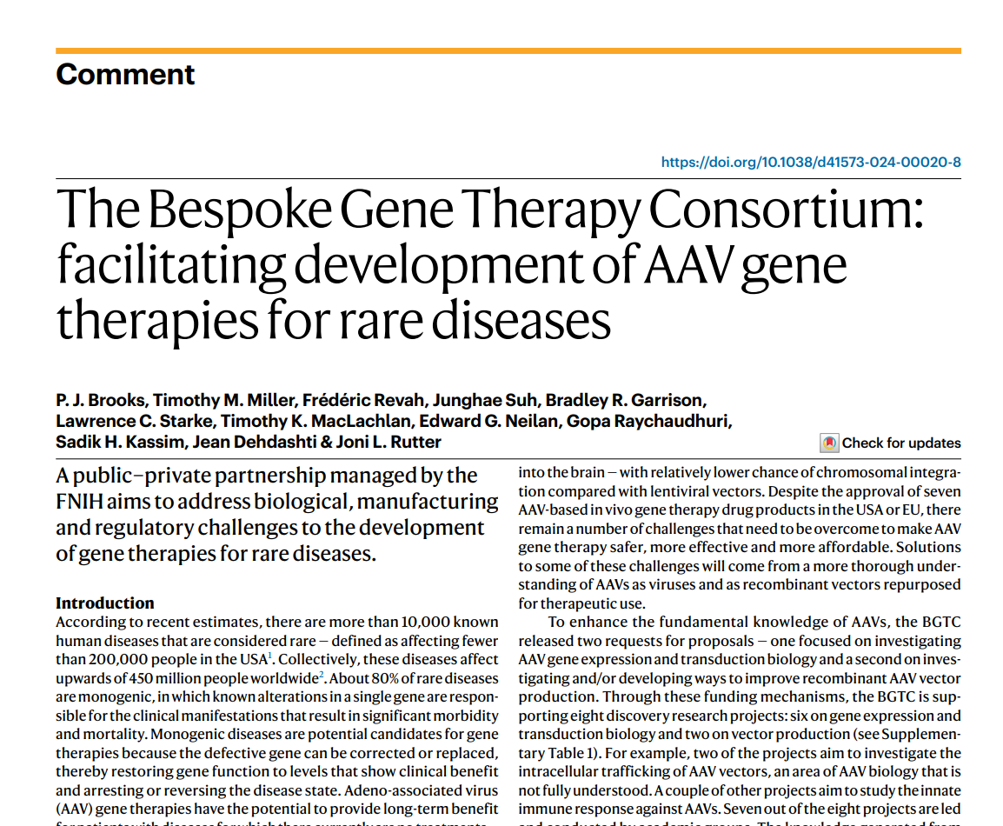
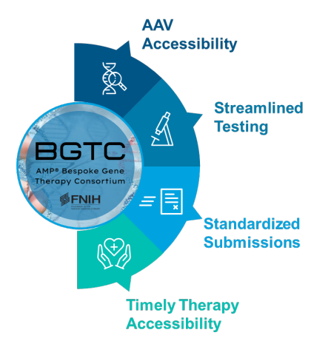
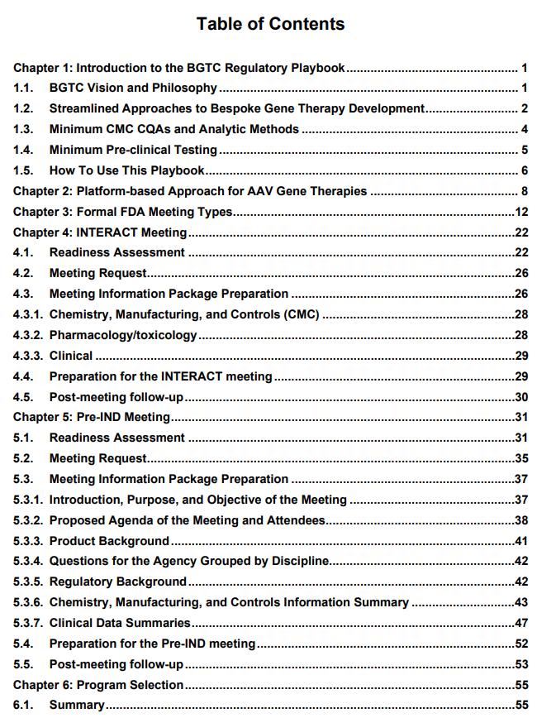
    Bespoke Gene Therapy Consortium (BGTC)
Disease Type | Disease Name | Affected Gene | Lead Institution Conducting Clinical Trial
Ocular | Congenital Hereditary Endothelial Dystrophy | SLC4A11 | University of California Los Angeles
 | Retinal Degeneration | NPHP5 | University of Pennsylvania
 | Retinitis pigmentosa 45 | CNGB1 | Columbia University
Neurological | Multiple Sulfatase Deficiency | SUMF1 | Children’s Hospital of Philadelphia
 | Charcot-Marie-Tooth Disease Type 4J | FIG4 | Elpida Therapeutics & University of Texas Southwestern
 | Spastic Paraplegia 50 | AP4M1 | Elpida Therapeutics & University of Texas Southwestern
Systemic | Propionic Acidemia | PCCB | National Human Genome Research Institute
 | Mucopolysaccharidosis IVA (Morquio A Syndrome) | GALNS | Nemours Children’s Health
Document 29
Notes:
The Bespoke Gene Therapy Consortium (or BGTC) brings together partners from the public, private, and non-profit sectors to foster development of gene therapies intended to treat rare genetic diseases, which affect populations too small for viable commercial development. BGTC aims to advance the understanding of basic adeno-associated virus (or AAV) life cycle biology, to help optimize vector generation and delivery, and to standardize and streamline regulatory requirements for approval of gene therapies.
* Last summer, BGTC finalized the selection of eight rare diseases for its clinical trial portfolio, shown here. One of the clinical trials is led by NHGRI’s intramural investigator Chuck Venditti. * BGTC also recently published its first paper, a commentary in Nature Reviews Drug Discovery, which provides a high-level overview of BGTC objectives. * Lastly, the first version of the BGTC Regulatory Playbook is now online and contains a wealth of useful information. The playbook was created as a “one-stop-shop guide” for clinical and drug development researchers who are working to bring AAV gene therapies to rare disease patients. It addresses the critical steps before the submission of Investigational New Drug applications for the first human studies and includes overviews of regulatory best practices as well as case studies of existing AAV gene therapies.

Slide 52
NIH Common Fund Program to Support
Clinical Research in Primary Care Settings
Establish clinical research network focused on primary care
All institute/center mission areas but also disease agnostic
Integrate innovative research with routine clinical care in real-world settings
Create foundation for engagement with underrepresented communities
May/June 2024
Listening Sessions
Public Workshop
2024
Expand existing studies
2025
Launch new studies across the network
Document 30
Notes:
The U.S. populations that are disproportionately affected by illness are traditionally underrepresented in research and often medically underserved. To help address this, NIH is developing a program to expand research to where people seek care, integrating clinical research into primary care settings.
* A priority of the new NIH Director, NIH plans to establish a clinical research network focused on primary care across the mission areas of all institutes and centers, but one that is also disease agnostic. * The progream will integrate innovative research with routine clinical care in real-world settings. * It will also create a foundation for sustained engagement with communities often underrepresented in clinical research.
* For this program, the NIH Common Fund will contribute $5 million in Fiscal Year 2024 and $25 million in Fiscal Year 2025, and then assess feasibility and additional budget requirements. In Fiscal Years 2026 and 2027, the program hopes to receive additional support from the NIH institutes and centers to ramp up its total support to $50-100 million.
* The NIH Office of the Director is currently gathering community feedback on how best to build the network through listening sessions and a public workshop. NIH anticipates a quick launch this fiscal year to expand existing studies to increase engagement, and then expand the program further next year and beyond.
52

Slide 53
Director’s Report Outline
General NHGRI Updates
General NIH Updates
General Genomics Updates
NHGRI Extramural Research Program
NIH Common Fund/Trans-NIH
NHGRI Communications, Policy, and Education
NHGRI Intramural Research Program
Notes:
Moving on to NHGRI activities in the areas of communications, policy, and education.

Slide 54
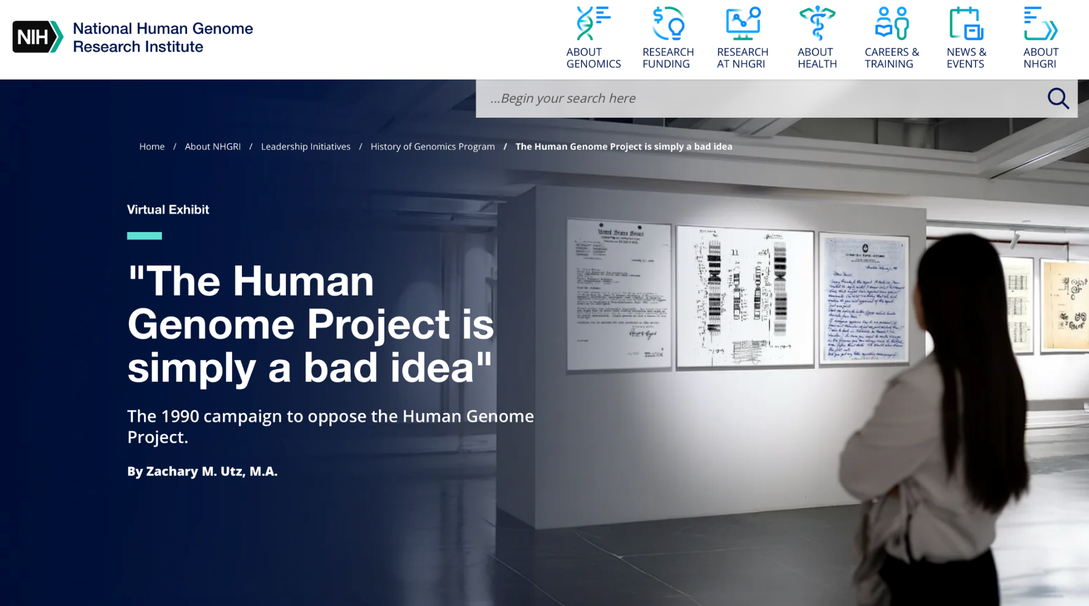
NHGRI History of Genomics Program
Archival Spotlight
Document 31
Notes:
For this Council meeting’s archival spotlight from NHGRI’s History of Genomics Program, we are announcing a new feature – virtual exhibits that will be posted on genome.gov. Utilizing specifically curated and summarized materials from NHGRI’s extensive historical archives, these virtual exhibits will tell complex and impactful stories from the larger history of NHGRI and genomics in a fashion that is geared towards a general audience.
The first exhibit to be posted is entitled The Human Genome Project is simply a bad idea, which tells the story of a 1990 letter-writing campaign to stop funding the yet-to-begin Human Genome Project. The exhibit contains a curated collection of letters sent to then acting NIH Director William Raub in early 1990, which lay out a variety of arguments against the Human Genome Project. The nearly 50 letters were kept by Elke Jordan, the Deputy Director of the National Center for Human Genomics Research at the time.
By reviewing the materials in this easy-to-access exhibit, one can learn about the nuanced arguments opposing the Human Genome Project. We hope that this exhibit will provide meaningful historical context for how a project the size and scope of the Human Genome Project presented legitimate concerns for some researchers at the time.
54

Slide 55
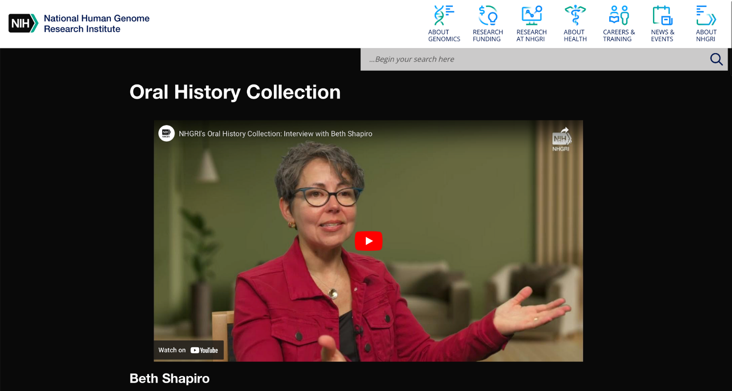
NHGRI History of Genomics Program
Oral History Update
Beth Shapiro, Ph.D.
Chief Scientific Officer, Colossal Biosciences
Document 31
Notes:
Beth Shapiro is a leading expert in ancient DNA and de-extinction, in addition to being a MacArthur Fellowship recipient in 2009. Beth was recently appointed Chief Scientific Officer of the company Colossal Biosciences, which aims to bring back the woolly mammoth and other animals from extinction. Recently, NHGRI’s History of Genomics Program conducted an oral history with Beth, which is now available to watch on NHGRI’s YouTube channel, GenomeTV.
55

Slide 56


NHGRI History of Genomics Program
Virtual Symposium
July 17-18, 2024
Exploring the many dimensions of sex and gender in the genomics era: Clarifying complexities in light of social and genomic advances and their histories
Document 31
Notes:
On July 17-18, the NHGRI History of Genomics Program, the NIH Sexual and Gender Minority Office, and the NIH Office of Research on Women's Health will host a two-day virtual symposium entitled Exploring the many dimensions of sex and gender in the genomics era, an event that aims to clarify the complexity of sex and gender in light of social and genomic advances and their histories.
The symposium will bring together experts from the biological and social sciences to clarify and contextualize, though not resolve, complexities around sex, gender, and genomics by considering them in their scientific, ethical, and historical contexts. These interdisciplinary conversations will aid scientists, policymakers, and the public in understanding the many dimensions of sex and sex categories and their relationships with gender.
The symposium aims to facilitate rigorous discussions about the many dimensions of sex and gender; how to consider these distinct constructs in genetics, genomics, and medicine; and how these insights can translate more broadly into research practices and clinical care in the genomics era.
56

Slide 57


Louise M. Slaughter National DNA Day Lecture
Document 32
Notes:
April 25 is National DNA Day. Every year, NHGRI hosts several programs and offers educational resources to mark the occasion. Over the course of the past three months and in celebration of DNA Day, NHGRI’s Education and Community Involvement Branch led hands-on activities engaging with over 1,000 middle, high school, and community college students across Washington, D.C., Maryland, Virginia, and West Virginia.
National DNA Day was also celebrated on the NIH campus on April 26 with the annual Louise M. Slaughter National DNA Day Lecture, named after Congresswoman Louise Slaughter, who was a champion of the Genetic Information Non-Discrimination Act. This year’s lecture was given by Joe Palca, science communicator and former National Public Radio correspondent. He shared his views on genomics and public health literacy. Nearly 300 people tuned in to view the livestream and 50 people joined in person.

Slide 58




National DNA Day: “The Ladder” Dedication
Document 32
Notes:
For another component of National DNA Day, NHGRI intramural investigator and Director of the Eunice Kennedy Shriver National Institute of Child Health and Human Development, Diana Bianchi, welcomed a special guest, artist Mary Ellen Scherl, to unveil a genomics-relevant sculpture that she donated to NIH. The sculpture is called "The Ladder" and blends biblical imagery and modern science, drawing parallels between Jacob's ladder and the double-helical structure of DNA.
The sculpture is now located immediately in front of the NIH Clinical Center. The dedication event featured remarks from NIH Director Monica Bertagnolli, NIH Clinical Center CEO, James Gilman, Dianna Bianchi, and myself. In addition, Mary Ellen spoke about her personal connections with genetics and how, as an adoptee, she used modern tools of genetics to find her biological family.

Slide 59

Inter-Society Coordinating Committee for Practitioner Education in Genomics (ISCC-PEG)
13th Annual Meeting
Document 33
Notes:
The Inter-Society Coordinating Committee for Practitioner Education in Genomics (or ISCC-PEG) held its 13th Annual Meeting in April. This committee aims to improve genomic literacy of healthcare providers and enhance the effective practice of clinical genomic medicine by facilitating interactions among key stakeholders in genomics education. Highlights of the meeting included hearing presentations by the third class of ISCC-PEG Scholars about their ongoing genetics education projects, a keynote talk by Teri Manolio, and formation of eight subgroups that worked to design strategies to integrate genomic literacy into clinical practice.

Slide 60
Director’s Report Outline
General NHGRI Updates
General NIH Updates
General Genomics Updates
NHGRI Extramural Research Program
NIH Common Fund/Trans-NIH
NHGRI Communications, Policy, and Education
NHGRI Intramural Research Program
Notes:
And finally, moving on to NHGRI’s Intramural Research Program.

Slide 61


2024 Edward Novitski Prize
Elaine Ostrander, Ph.D.
Document 34
Notes:
Intramural Branch Chief Elaine Ostrander is the recipient of this year’s Genetics Society of America Edward Novitski Prize. This award recognizes creativity and intellectual ingenuity in the solution of problems in genetics research. Elaine is recognized for her work on using the domestic dog to study fundamental biological problems and to identify genomic variants relevant to human health and disease. Her dedication to creative methods for understanding canine genetics and translating research organisms to humans is extensive and impressive.

Slide 62


2023 George M. Kober Medal
Dan Kastner, M.D., Ph.D.
Document 35
Notes:
Former NHGRI Scientific Director Dan Kastner is the recipient of the 2024 George M. Kober Medal from the Association of American Physicians. This award is one of the most prestigious honors given to physician-scientists in the United States, recognizing outstanding leaders in medicine who make significant contributions through their scientific discoveries and mentorship. Dan has been using genetics and genomic tools to study rare inflammatory disorders for nearly four decades. He and his research group have evaluated over 2,000 patients with recurrent fever syndrome and other autoinflammatory disorders.

Slide 63


2023 Arthur S. Flemming Award
Charles Rotimi, Ph.D.
Document 36
Notes:
NHGRI Scientific Director Charles Rotimi will be honored as a recipient of the 2023 Arthur S. Fleming Award. This year, the award will be given to 12 public servants from federal agencies, recognizing them for performing outstanding service in the fields of applied science, basic science, leadership and management, social science, clinical trials, and translational research. The winners of this award serve as outstanding role models for our public administration and public policy staff, in addition to all aspiring public servants. The award recognizes Charles for his vision in engaging U.S. and global communities in genomics and genomic medicine.

Slide 64


Washingtonian Magazine: Disease Detectives
Document 37
Notes:
In March, Washingtonian Magazine featured an article highlighting the trans-NIH Undiagnosed Diseases Program (or UDP), which is part of the Undiagnosed Diseases Network. The UDP is led by Bill Gahl and focuses on individuals whose conditions have eluded medical diagnoses. Patients selected for the UDP undergo diagnostic tests and expert consultations by a multidisciplinary medical team at the NIH Clinical Center. Bill's team specializes in genetic conditions and uses state-of-the-art genomic techniques to offer patients the hope of a diagnosis and the possibility of therapeutic strategies.

Slide 65






    NHGRI Intramural Research Highlights
Lipodystrophy in methylmalonic acidemia associated with elevated FGF21 and abnormal methylmalonylation
The variation and evolution of complete human centromeres
Vitamin B12 status and folic acid supplementation influence mitochondrial heteroplasmy levels in mice
Document 38
Notes:
The NHGRI Intramural Research Program has once again been very productive since the last Council meeting. A few of their many research highlights include:
* Irini Manoli in Charles Venditti's group recently discovered a distinct phenotype of abnormal fat distribution in individuals with the rare metabolic disorder, methylmalonic acidemia (or MMA). The study further examined adipose tissue physiology in a mouse model of MMA and found that treatment of these mice with a lipid-lowering drug can improve survival, reverse brown fat mitochondrial dysfunction, and induce the beiging of adipose tissues.
* Adam Phillippy, Sergey Koren, and Sergey Nurk, along with a team of collaborators, provided insights into the evolution and variation of centromeres. The researchers generated a complete set of centromere sequences from a second human genome. The researchers also found notable variation in the number of certain types of DNA repeats. Ironically, this same paper was independently selected by extramural staff to be one of the Investigator-Initiated Highlights (that I featured earlier); this paper thus nicely illustrates a wonderful example of an intramural-extramural collaboration involving NHGRI-funded investigators.
* Finally, Larry Brody’s group used new mitochondrial genome sequencing methods to study how diet, specifically the amount of vitamin B12 and folate, affects mutation rates. The researchers found that vitamin B12 deficiency increased the number of mutations in the mitochondrial genomes of the mice, and that this was especially true for older mice.

Slide 66





‘One-Stop-Shop’ to Stay Connected
genome.gov/stayconnected
Document 39
Notes:
Before I end my Director’s Report, I want to again remind you about a * regularly updated, user-friendly, one-stop-shop for staying connected with me and NHGRI. By visiting this web page through this convenient URL and then scrolling down, * you get a menu of these major resources associated with the Institute.
This includes links for the genome.gov website, my biography, my The Genomics Landscape monthly newsletter, and my three social media feeds. Also on this page, there are convenient links to the 2020 NHGRI Strategic Vision, our Building a Diverse Genomics Workforce Action Agenda, the NHGRI brochure, NHGRI’s YouTube channel (GenomeTV), the NHGRI History of Genomics Program’s set of oral histories, and our Talking Glossary of Genomic and Genetic Terms. And if those sites are not what you are looking for, * scrolling down further reveals recordings of some selected talks of mine as well as some of my * recent podcasts and * published features.
I hope people find this one-stop-shop helpful when trying to stay connected with me and NHGRI.

Slide 67







Thanks!
Special Thanks!
Notes:
Finally, a personal thanks to the many NHGRI staff members who contributed the slides and associated materials that I just reviewed in my Director’s Report. As always, a group effort is essential for getting such a large amount of information conveyed efficiently at each Council meeting.
I would like to especially thank the various folks who review the Director’s Report at various stages as well as NHGRI’s Office of Communications for creating the electronic resource associated with my Director’s Report.
And * a special thanks to the ‘ringleaders’ for helping me prepare my Director’s Report, Vanessa Campos and Kris Wetterstrand. * They are pictured here in eclipse gear in honor of the eclipse that occurred last month.

