Slide 1



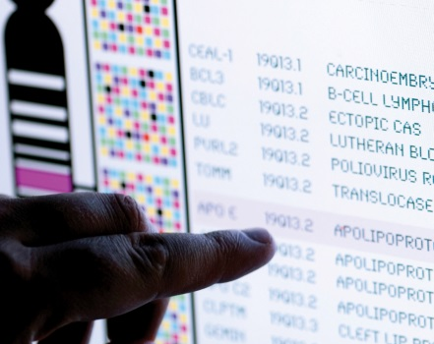
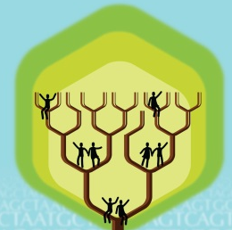
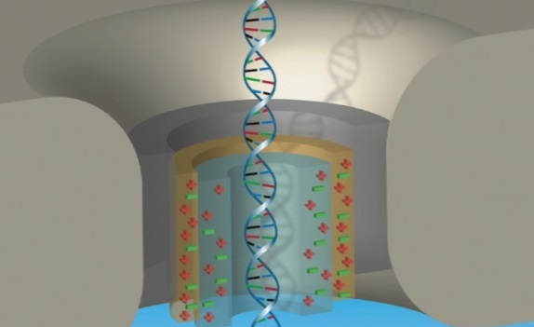


DIRECTOR’S REPORT
Eric Green, M.D., Ph.D.
Director, NHGRI
May 2023
Notes:
I would again like to welcome all of you to this Open Session of the National Advisory Council for Human Genome Research meeting, including those who are here with me in person and those who are joining remotely.
As with the rest of the Open Session, my Director’s Report presentation is being videorecorded, and that recording will be made available as a permanent archive on NHGRI’s website (genome.gov)

Slide 2
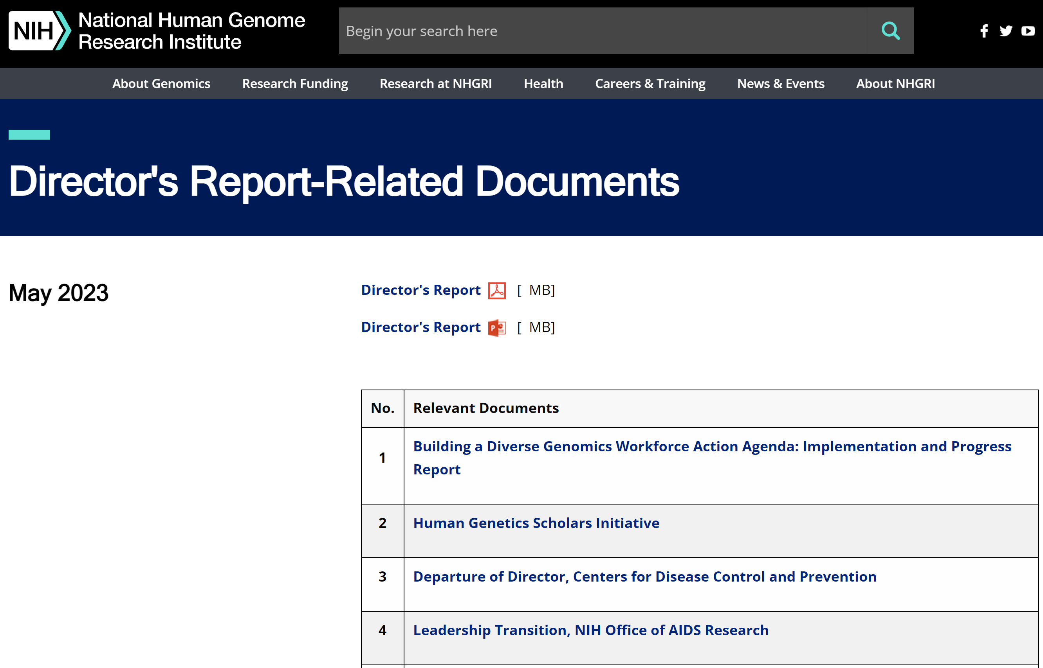

genome.gov/DirectorsReport
Document #
Notes:
For those who are new to our Council meetings, I want to make you aware of the ‘electronic resource’ that has been developed for my Director’s Report. Analogous to the supplemental materials of a published paper, this resource can be accessed at the URL shown here.
The slides that I will show during my Director’s Report are also available electronically at this site – * both in PDF and PowerPoint formats.
* When there are documents or relevant websites associated with a particular slide, you will find a “Document #” indicated on the bottom right of that slide; that “Document #” references materials that can be accessed and/or downloaded from the webpage shown here. This dedicated webpage and all linked documents will be archived on genome.gov as part of the historical record of this Council meeting.

Slide 3
Open Session Agenda
  Presentations:
    NHGRI Intramural Research Program Report
    Charles Rotimi
    NHGRI Intramural Research Program Blue Ribbon Panel Report
    Gail Jarvik & Lynn Jorde
    NASEM Report on the Use of Race, Ethnicity, and Ancestry as Population Descriptors
    Aravinda Chakravarti & Charmaine Royal
Notes:
There will be a number of other presentations during the Open Session of this Council meeting. My Director’s Report is tailored around those presentations, and I will not discuss in detail the topics that others will cover.
* Following my Director’s Report, Charles Rotimi, NHGRI’s Scientific Director, will provide an update about the NHGRI Intramural Research Program.
* And then after lunch, council members Gail Jarvik and Lynn Jorde will present the NHGRI Intramural Research Program Blue Ribbon Panel Report.
* This will be followed by a presentation about the recently released NASEM Report on the Use of Race, Ethnicity, and Ancestry as Population Descriptors in genetics and genomics research by Aravinda Chakravarti and Charmaine Royal.

Slide 4
Open Session Agenda
  Presentation:
    Update on the H3Africa Program
  Jennifer Troyer
  Concept Clearances:
    Genomic-Enabled Learning Health Systems
  Robb Rowley
    Developing Novel Theory and Methods for Understanding the Genetic Architecture of Complex Traits
  Alexander Arguello
Notes:
The final presentation will be an Update on the H3Africa Program by Extramural Program Director, Jennifer Troyer.
Lastly, we will have * two concept clearances by Extramural Program Directors.
* First, Robb Rowley will present a concept clearance on Genomic-Enabled Learning Health Systems.
* Second, Xander Arguello will present a concept clearance on Developing Novel Theory and Methods for Understanding the Genetic Architecture of Complex Traits.

Slide 5
Director’s Report Outline
General NHGRI Updates
General NIH Updates
General Genomics Updates
NHGRI Extramural Research Program
NIH Common Fund/Trans-NIH
NHGRI Communications, Policy, and Education
NHGRI Intramural Research Program
Notes:
For the rest of my Director’s Report, I will cover the seven areas listed here, which reliably provide a useful framework for reviewing the relevant topics.

Slide 6
Director’s Report Outline
General NHGRI Updates
General NIH Updates
General Genomics Updates
NHGRI Extramural Research Program
NIH Common Fund/Trans-NIH
NHGRI Communications, Policy, and Education
NHGRI Intramural Research Program
Notes:
And I will start with some general NHGRI updates.

Slide 7
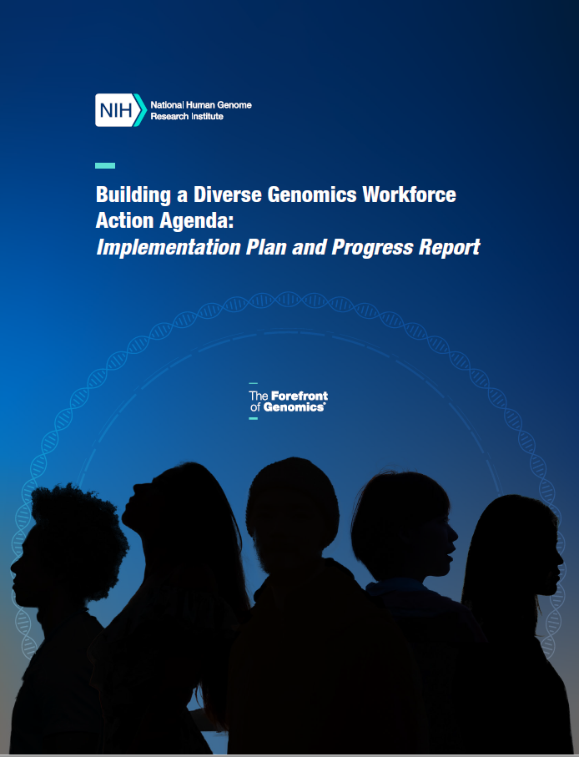
    Building a Diverse Genomics Workforce Action Agenda: Implementation and Progress Report
    Details programs, projects, initiatives, and engagements that have been enacted since release of Action Agenda in 2021
    Diversifying the genomics workforce cannot be achieved without support from the scientific community
Document 1
Notes:
NHGRI just released the Building a Diverse Genomics Workforce Action Agenda: Implementation and Progress Report. The purpose of this report is to articulate NHGRI’s progress in our recent programmatic efforts to diversify the genomics workforce.
* The plan details the programs, projects, initiatives, and engagements that have been enacted since the release of the Action Agenda in 2021. The strategies articulated include a large number of partners and continued engagement with colleges, universities, professional societies, and industry.
* Diversifying the genomics workforce cannot be achieved without continued support from the scientific community, and so we invite you to read the progress report (which is available on our website, genome.gov).

Slide 8
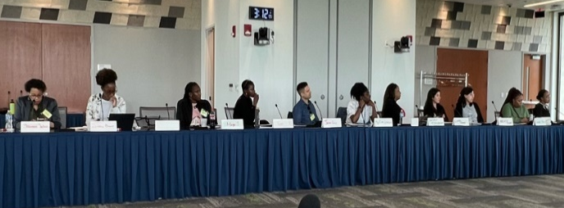
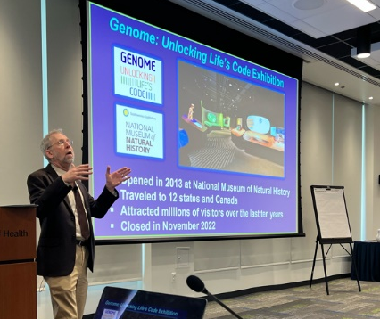
Human Genetics Scholars Initiative
>20 predoctoral, postdoctoral, and early-career scholars visited NHGRI
Discussed research funding and career development opportunities
NHGRI has supported this initiative since 2019
Document 2
Notes:
The Human Genetics Scholars Initiative is a program developed with the American Society of Human Genetics (or ASHG), NHGRI, and other partners to help advance diversity and inclusion in genetics and genomics. This program identifies and mentors a select group of diverse early-career individuals, helping them achieve professional success.
* In April, more than 20 predoctoral, postdoctoral, and early-career Human Genetics Scholars visited NHGRI in person.
* During their visit, they had the opportunity to interact with me, extramural program directors, and intramural researchers to discuss research funding and career-development opportunities. For example, I gave an update about NHGRI’s new initiatives and upcoming events; I also discussed future directions for the institute.
* NHGRI has supported this initiative since 2019. We plan to make this an annual in-person event and look forward to hosting future scholars.

Slide 9
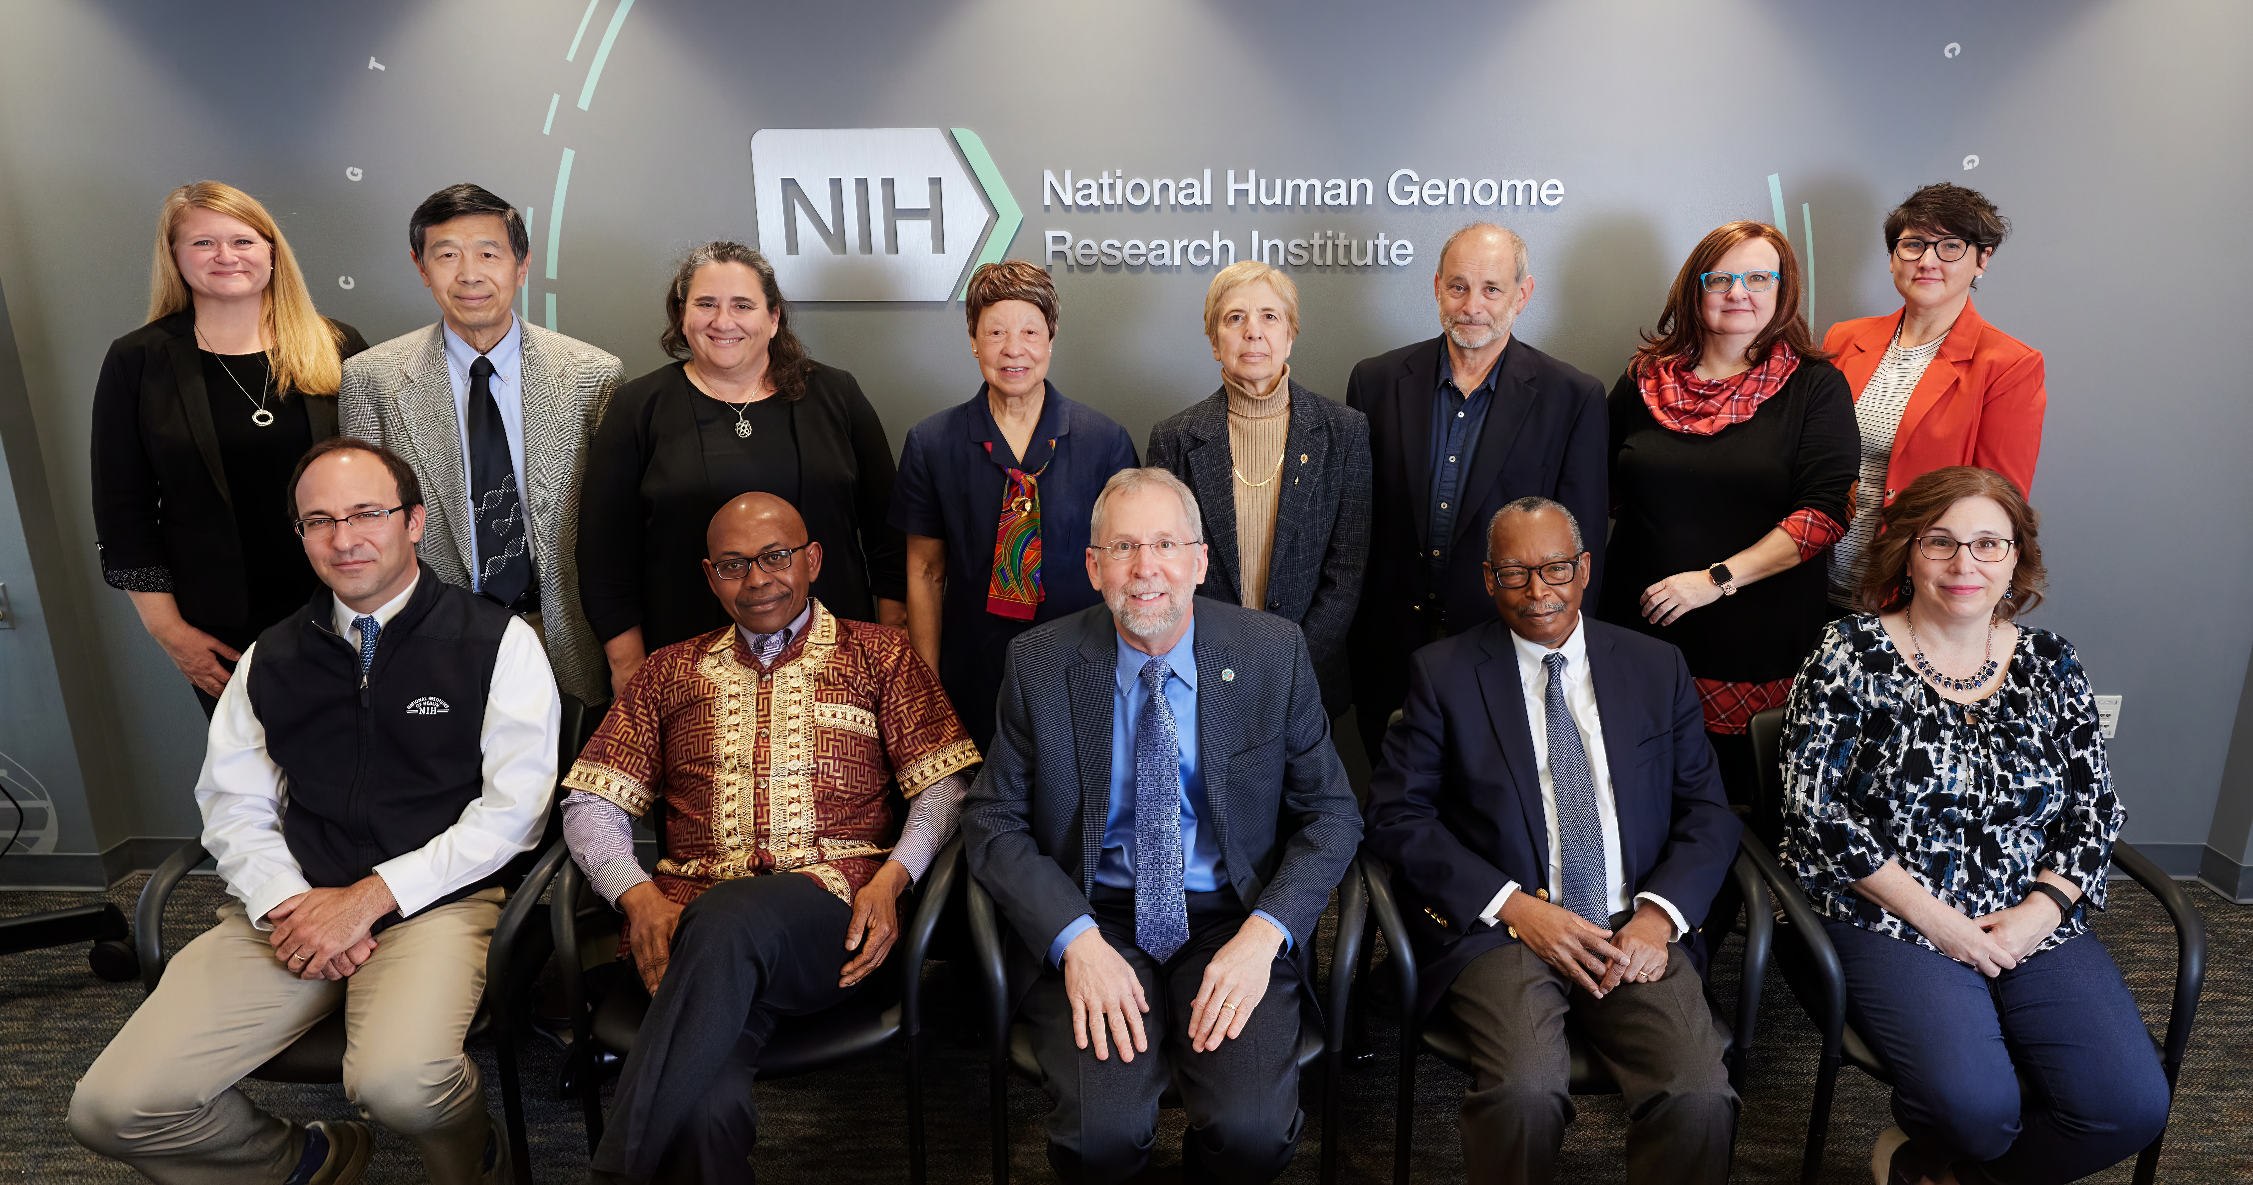
NHGRI Leadership: Director's Working Group
Notes:
Among the many things delayed by the COVID-19 pandemic has been the ability to get group photographs (in fact, we are overdue in getting an updated Council photograph!).
I am immensely proud of my leadership team at NHGRI, which is called the Director's Working Group. This distinguished ensemble meets on a roughly weekly basis and helps me in every possible way to lead NHGRI, with virtually all important decisions made with their involvement.
Not surprisingly, the composition of the Director's Working Group changed a bit during the pandemic, but getting every member of the group in the same room at the same time took the better part of a year! But we finally did it and were able to capture this wonderful group photograph, which I wanted to share with you. Besides being incredibly distinguished looking, these people are individually and collectively amazing leaders who I am deeply indebted to for their commitment to genomics, their dedication to NHGRI, and their friendship.

Slide 10
Director’s Report Outline
General NHGRI Updates
General NIH Updates
General Genomics Updates
NHGRI Extramural Research Program
NIH Common Fund/Trans-NIH
NHGRI Communications, Policy, and Education
NHGRI Intramural Research Program
Notes:
Moving on to general NIH updates.

Slide 11
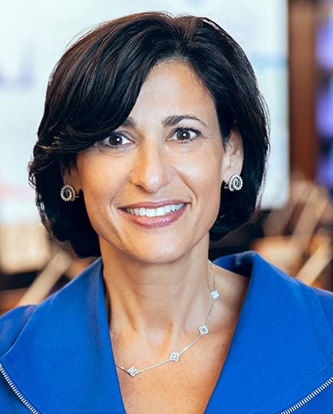

Departure of Director, Centers for Disease
Control and Prevention
Rochelle Walensky, M.D., M.P.H.
Document 3
Notes:
Rochelle Walensky will step down as Director of the Centers for Disease Control and Prevention (or CDC) on June 30. Rochelle took the helm of the CDC in January 2021 and helped to guide President Joe Biden’s response to the COVID-19 pandemic from his first day in office. During her tenure as Director, she launched a reorganization of the CDC to modernize the agency and improve its reputation. She also declared racism a serious public health threat and led the agency in its efforts to contain a multinational monkey-pox outbreak.

Slide 12
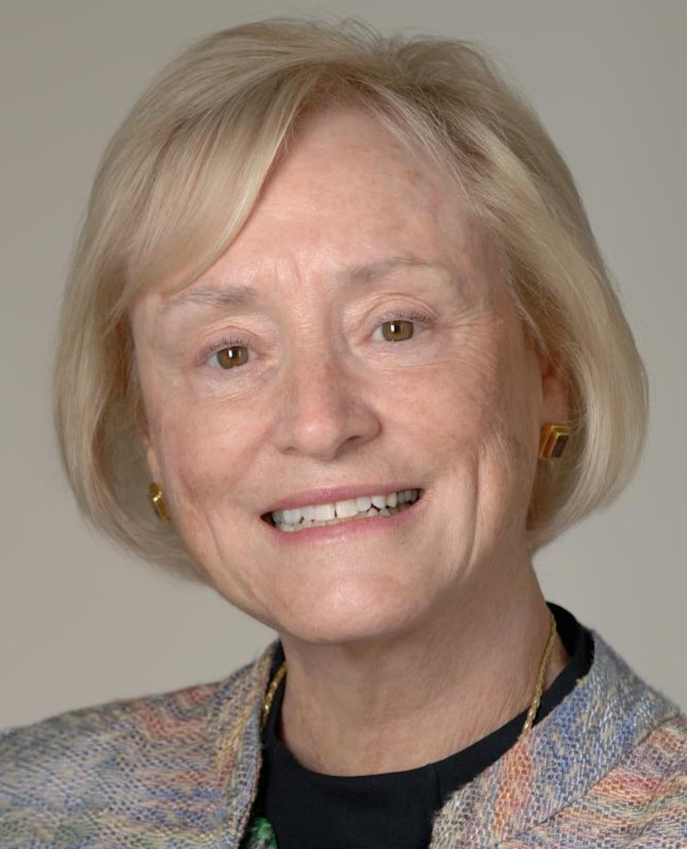


Leadership Transition, NIH Office of AIDS Research
Maureen Goodenow, Ph.D.
Bill Kapogiannis, M.D.
Document 4
Notes:
Maureen Goodenow has transitioned from her former role as NIH Associate Director for AIDS Research and Director of the NIH Office of AIDS Research to a new role as Senior Advisor in the NIH Office of the Director. Maureen will continue to serve as Chief of the Molecular HIV and Host Interactions Section in the National Institute of Allergy and Infectious Diseases. She was the first woman to serve in this position since its establishment in 1988.
* Bill Kapogiannis will serve as Acting NIH Associate Director of AIDS Research and Acting Director of the NIH Office of AIDS Research while a search for a new director is conducted.

Slide 13
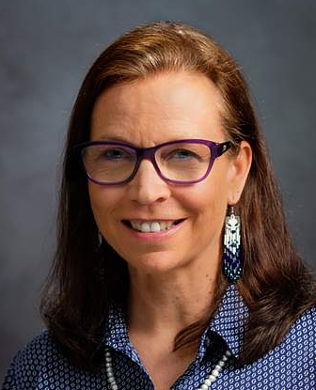

New Director, NIH Tribal Health Research Office
Karina Walters, Ph.D., M.S.W.
Document 5
Notes:
Karina Walters, an enrolled member of the Choctaw Nation of Oklahoma, has been selected as the Director of the NIH Tribal Health Research Office. She succeeds David Wilson, who is now on assignment to the White House Council on Native American Affairs. Karina is a social epidemiology and health prevention scholar with more than 28 years of American Indian/Alaska Native health research experience; she has conducted social epidemiological research on the environmental, historical, social, and cultural determinants of health and health equity in American Indian/Alaska Native communities.

Slide 14

Departure of Senior Advisor, NIH Office of the Director
Carrie Wolinetz, Ph.D.
Document 6
Notes:
Earlier this month, Carrie Wolinetz departed from her role as Senior Advisor in the NIH Office of the Director. She joined NIH in February 2015 as the NIH Associate Director for Science Policy, where she oversaw policy issues related to clinical trials, human participant protections, biosecurity and biosafety, and data sharing and management policies. In April 2021, Carrie accepted a detail to the White House Office of Science and Technology Policy (or OSTP), where she served as Deputy Director for Health and Life Sciences. She is now at a Washington, D.C.-based government relations firm.

Slide 15

NIH-Wide Strategic Plan for Diversity, Equity,
Inclusion, and Accessibility (DEIA)
Fiscal Years 2023-2027
NIH's role as a people-centered organization
Encourages enhancing DEIA in operations, workforce, and research
Crosscutting themes promoting transparency, communication, and engagement; fostering sustainable change; and harnessing data
Roadmap for NIH-supported institutions
Document 7
Notes:
In March, NIH released its NIH-Wide Strategic plan for Diversity, Equity, Inclusion, and Accessibility (or DEIA).
* The five-year DEIA Strategic Plan covers Fiscal Years 2023-2027 and articulates NIH’s mission to integrate DEIA across all activities in pursuit of the agency’s mission.
* The plan prioritizes NIH’s role as a people-centered organization and encourages the NIH community to enhance DEIA in its operations, workforce, and research.
* The plan includes crosscutting themes for promoting transparency, communication, and engagement; fostering sustainable change; and harnessing data.
* The plan applies to the internal and external NIH workforce and can serve as a roadmap for NIH-supported institutions as they advance their DEIA efforts.

Slide 16
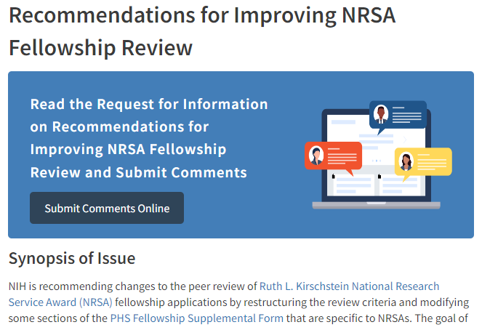
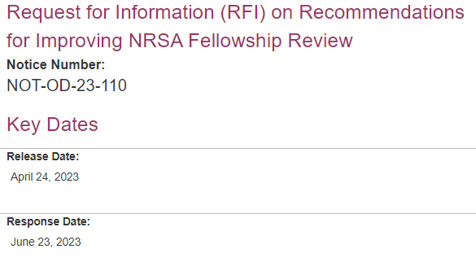
Recommendations for Improving National Research Service Award (NRSA) Fellowship Review
RFI open through June 23, 2023
Document 8
Notes:
NIH is seeking input on their proposed changes to the National Research Service Award (or NRSA) fellowship review. There have been persistent concerns that NRSA fellowship reviews disadvantage some highly qualified, promising applicants.
As a result, a Center for Scientific Review (or CSR) Advisory Council Working Group was convened and recommended that both the review criteria and the fellowship application be revised. The goal of seeking additional input about these initial recommendations is to further improve the review of NRSA fellowships and to identify highly promising research scientists of the future, all while ensuring fairness and equity for all applicants.
* Those interested in submitting feedback must do so through the formal Request for Information (or RFI) by June 23.

Slide 17
Fiscal Year 2024 Appropriations
 | FY2022 ($) | FY2023 ($) | FY2024 PB ($) | Increase ($) | Increase (%)
NIH | $46.178 billion * | $49.178 billion * | $51.098 billion * | $1.92 billion | 3.9%
NHGRI | $636 million | $661 million | $661 million | $0 | 0%
* Includes appropriations for both NIH and ARPA-H
Document 9
Notes:
In March, President Biden released his budget request outlining the administration's proposal for federal spending in Fiscal Year 2024, which begins on October 1. The President’s budget is an indicator of the Administration’s priorities, and its release marks the opening of the budget negotiation season.
Most NIH institutes (including NHGRI) did not receive an increase in the President’s budget. Rather, NHGRI is proposed to be flat compared to the current fiscal year, with the additional funds proposed for NIH going mostly to programs such as ARPA-H. It remains to be seen what the House and Senate will propose and agree upon, so stay tuned.

Slide 18
Director’s Report Outline
General NHGRI Updates
General NIH Updates
General Genomics Updates
NHGRI Extramural Research Program
NIH Common Fund/Trans-NIH
NHGRI Communications, Policy, and Education
NHGRI Intramural Research Program
Notes:
Moving on to general genomics updates.

Slide 19

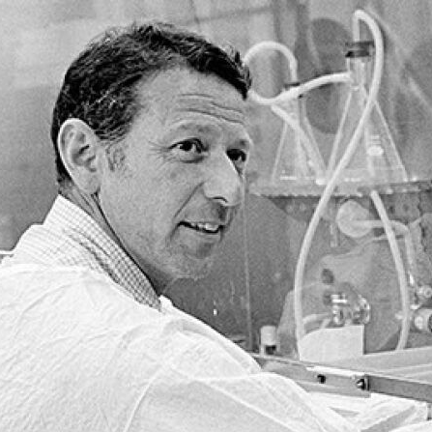
Mourning the Loss of Paul Berg
Document 10
Notes:
Paul Berg, a Stanford University Emeritus Professor of Biochemistry, died in February. Paul shared, with Walter Gilbert and Frederick Sanger, the 1980 Nobel Prize in chemistry “for his fundamental studies of the biochemistry of nucleic acids, with particular regard to recombinant-DNA.” He created the first recombinant DNA molecule which marked the dawn of genetic engineering and the molecular biology revolution.

Slide 20


Mourning the Loss of Casey Brown
Document 11
Notes:
Casey Brown, Associate Professor of Genetics at the University of Pennsylvania Perelman School of Medicine, passed away in March. He was a brilliant scientist whose innovative work centered on approaches to understanding how human genomic variation influences gene expression. He was a pivotal member of the Genotype-Tissue Expression (or GTEx) Consortium and was a gifted, deeply informed, and highly charismatic teacher who was beloved by students and trainees.

Slide 21
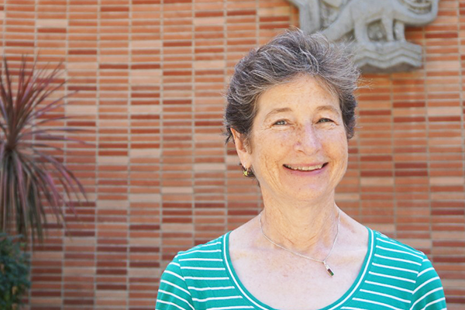
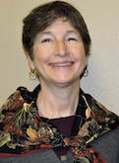
Mourning the Loss of Janet Sinsheimer
Document 12
Notes:
Janet Sinsheimer also passed away in March. Janet had a long and prominent career at UCLA, where she was a Professor of Human Genetics, Biomathematics, and Biostatistics. Her research focused on developing mathematical models of evolution and genetics. However, her passion remained teaching. She was very involved in NHGRI’s T32 program and served as a doctoral advisor for 13 students.

Slide 22

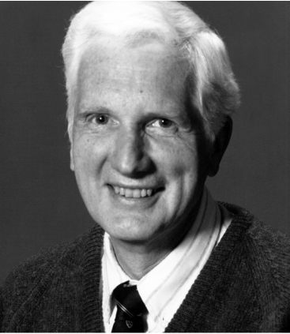
Mourning the Loss of Charles Scriver
Document 13
Notes:
Charles Scriver, Alva Professor Emeritus of Human Genetics at McGill University, passed away in April. He was a pioneer in the field of medical genetics. His research focused on a subset of rare genetic disorders called inborn errors of metabolism, and his efforts spearheaded Quebec’s innovative newborn screening program for congenital diseases. He was a tireless teacher and his work improved the lives of countless children and their families around the world.

Slide 23
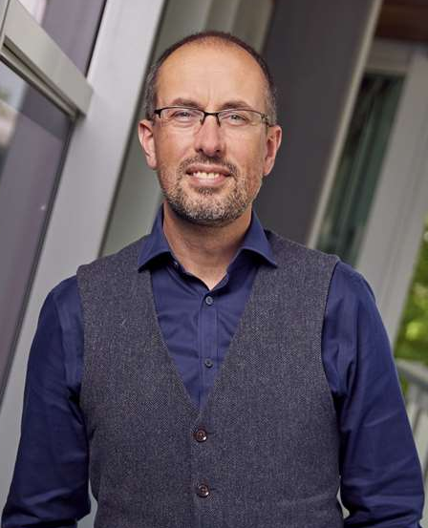

New Director, Wellcome Sanger Institute
Matt Hurles, Ph.D.
Document 14
Notes:
Matt Hurles, a long-time NHGRI collaborator, has been appointed as the new Wellcome Sanger Institute Director. Matt has served as Head of the Human Genetics Program at the Sanger Institute since 2017. His work focuses on deciphering the genetic causes of severe developmental disorders and understanding how DNA mutates through the generations. He was elected a Fellow of the UK Academy of Medical Sciences in 2017 anda Fellow of the Royal Society in 2019.

Slide 24

Elected to National Academy of Sciences
Spyros Artavanis-Tsakonas
Claire Fraser
Jo Handelsman
Daphne Koller
Leonid Kruglyak
Xihong Lin
John O’Shea
Anna Marie Pyle
Richard Roberts
Yosef Shiloh
Alice Ting
Anne Yoder
Phil Zamore
Kenneth Zaret
Document 15
Notes:
The National Academy of Sciences recently announced their newly elected members. Of particular relevance to NHGRI and the genomics community are the people listed here – congratulations to these friends and colleagues!
24

Slide 25
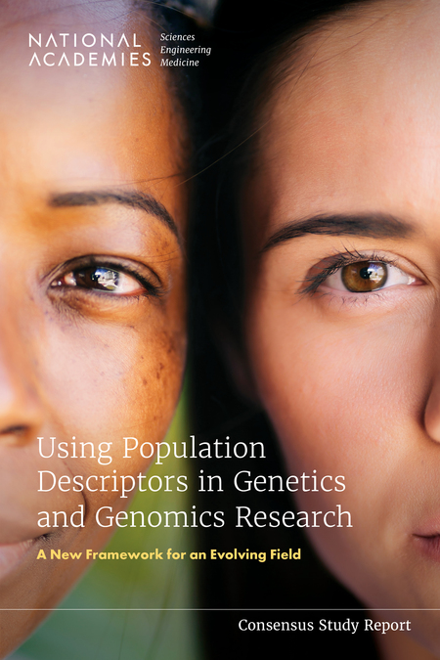
NASEM Population Descriptors Report
14 NIH institutes, centers, and offices were co-sponsors
NHGRI served as task co-leader with All of Us Research Program
Past and current uses of population descriptors
Proposes guiding principles and a new framework for the field
Aravinda Chakravarti and Charmaine Royal will present later
Document 16
Notes:
In March, the National Academies of Sciences, Engineering, and Medicine (or NASEM) released the report Using Population Descriptors in Genetics and Genomics Research: A New Framework for an Evolving Field. This report is a product of a study conducted by an interdisciplinary committee of expert volunteers that NASEM assembled and charged with reviewing and assessing the existing methodologies, benefits, and challenges in using race, ethnicity, ancestry, and other population descriptors in genetics and genomics research.
* NHGRI was one of 14 NIH institutes, centers, and offices who were co-sponsors of this study, and NHGRI served as task co-leader along with the All of Us Research Program.
* The report details past and current uses of population descriptors and proposes guiding principles and a new framework for the field.
* Later today, Aravinda Chakravarti and Charmaine Royal, the study’s co-chairs, will be here to discuss the report's findings and recommendations.

Slide 26
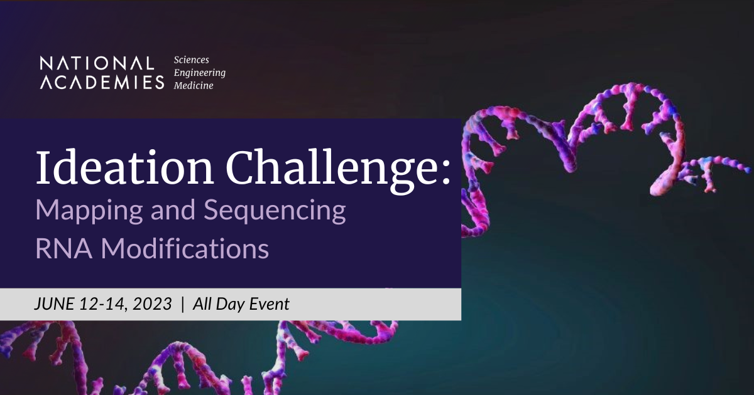
NASEM Study: Toward Sequencing and
Mapping RNA Modifications
    Public workshop held in March
    Facilitate additional community brainstorming and problem- solving
Document 17
Notes:
In another NASEM effort, a distinguished committee has been convened to conduct a two-year consensus study to determine what scientific and technological breakthroughs, workforce, and infrastructure are needed to directly sequence RNA and its modifications. The study is sponsored by the Warren Alpert Foundation, the National Institute of Environmental Health Sciences, and NHGRI.
* The committee hosted a public workshop in March as part of their information-gathering process. The next major opportunity for input from the community will be through an Ideation Challenge that will be held June 12-14, where interdisciplinary teams will participate in structured brainstorming and problem-solving activities in order to identify and solve the key challenges in this area.

Slide 27
Director’s Report Outline
General NHGRI Updates
General NIH Updates
General Genomics Updates
NHGRI Extramural Research Program
NIH Common Fund/Trans-NIH
NHGRI Communications, Policy, and Education
NHGRI Intramural Research Program
Notes:
Moving on to the NHGRI Extramural Research Program.

Slide 28

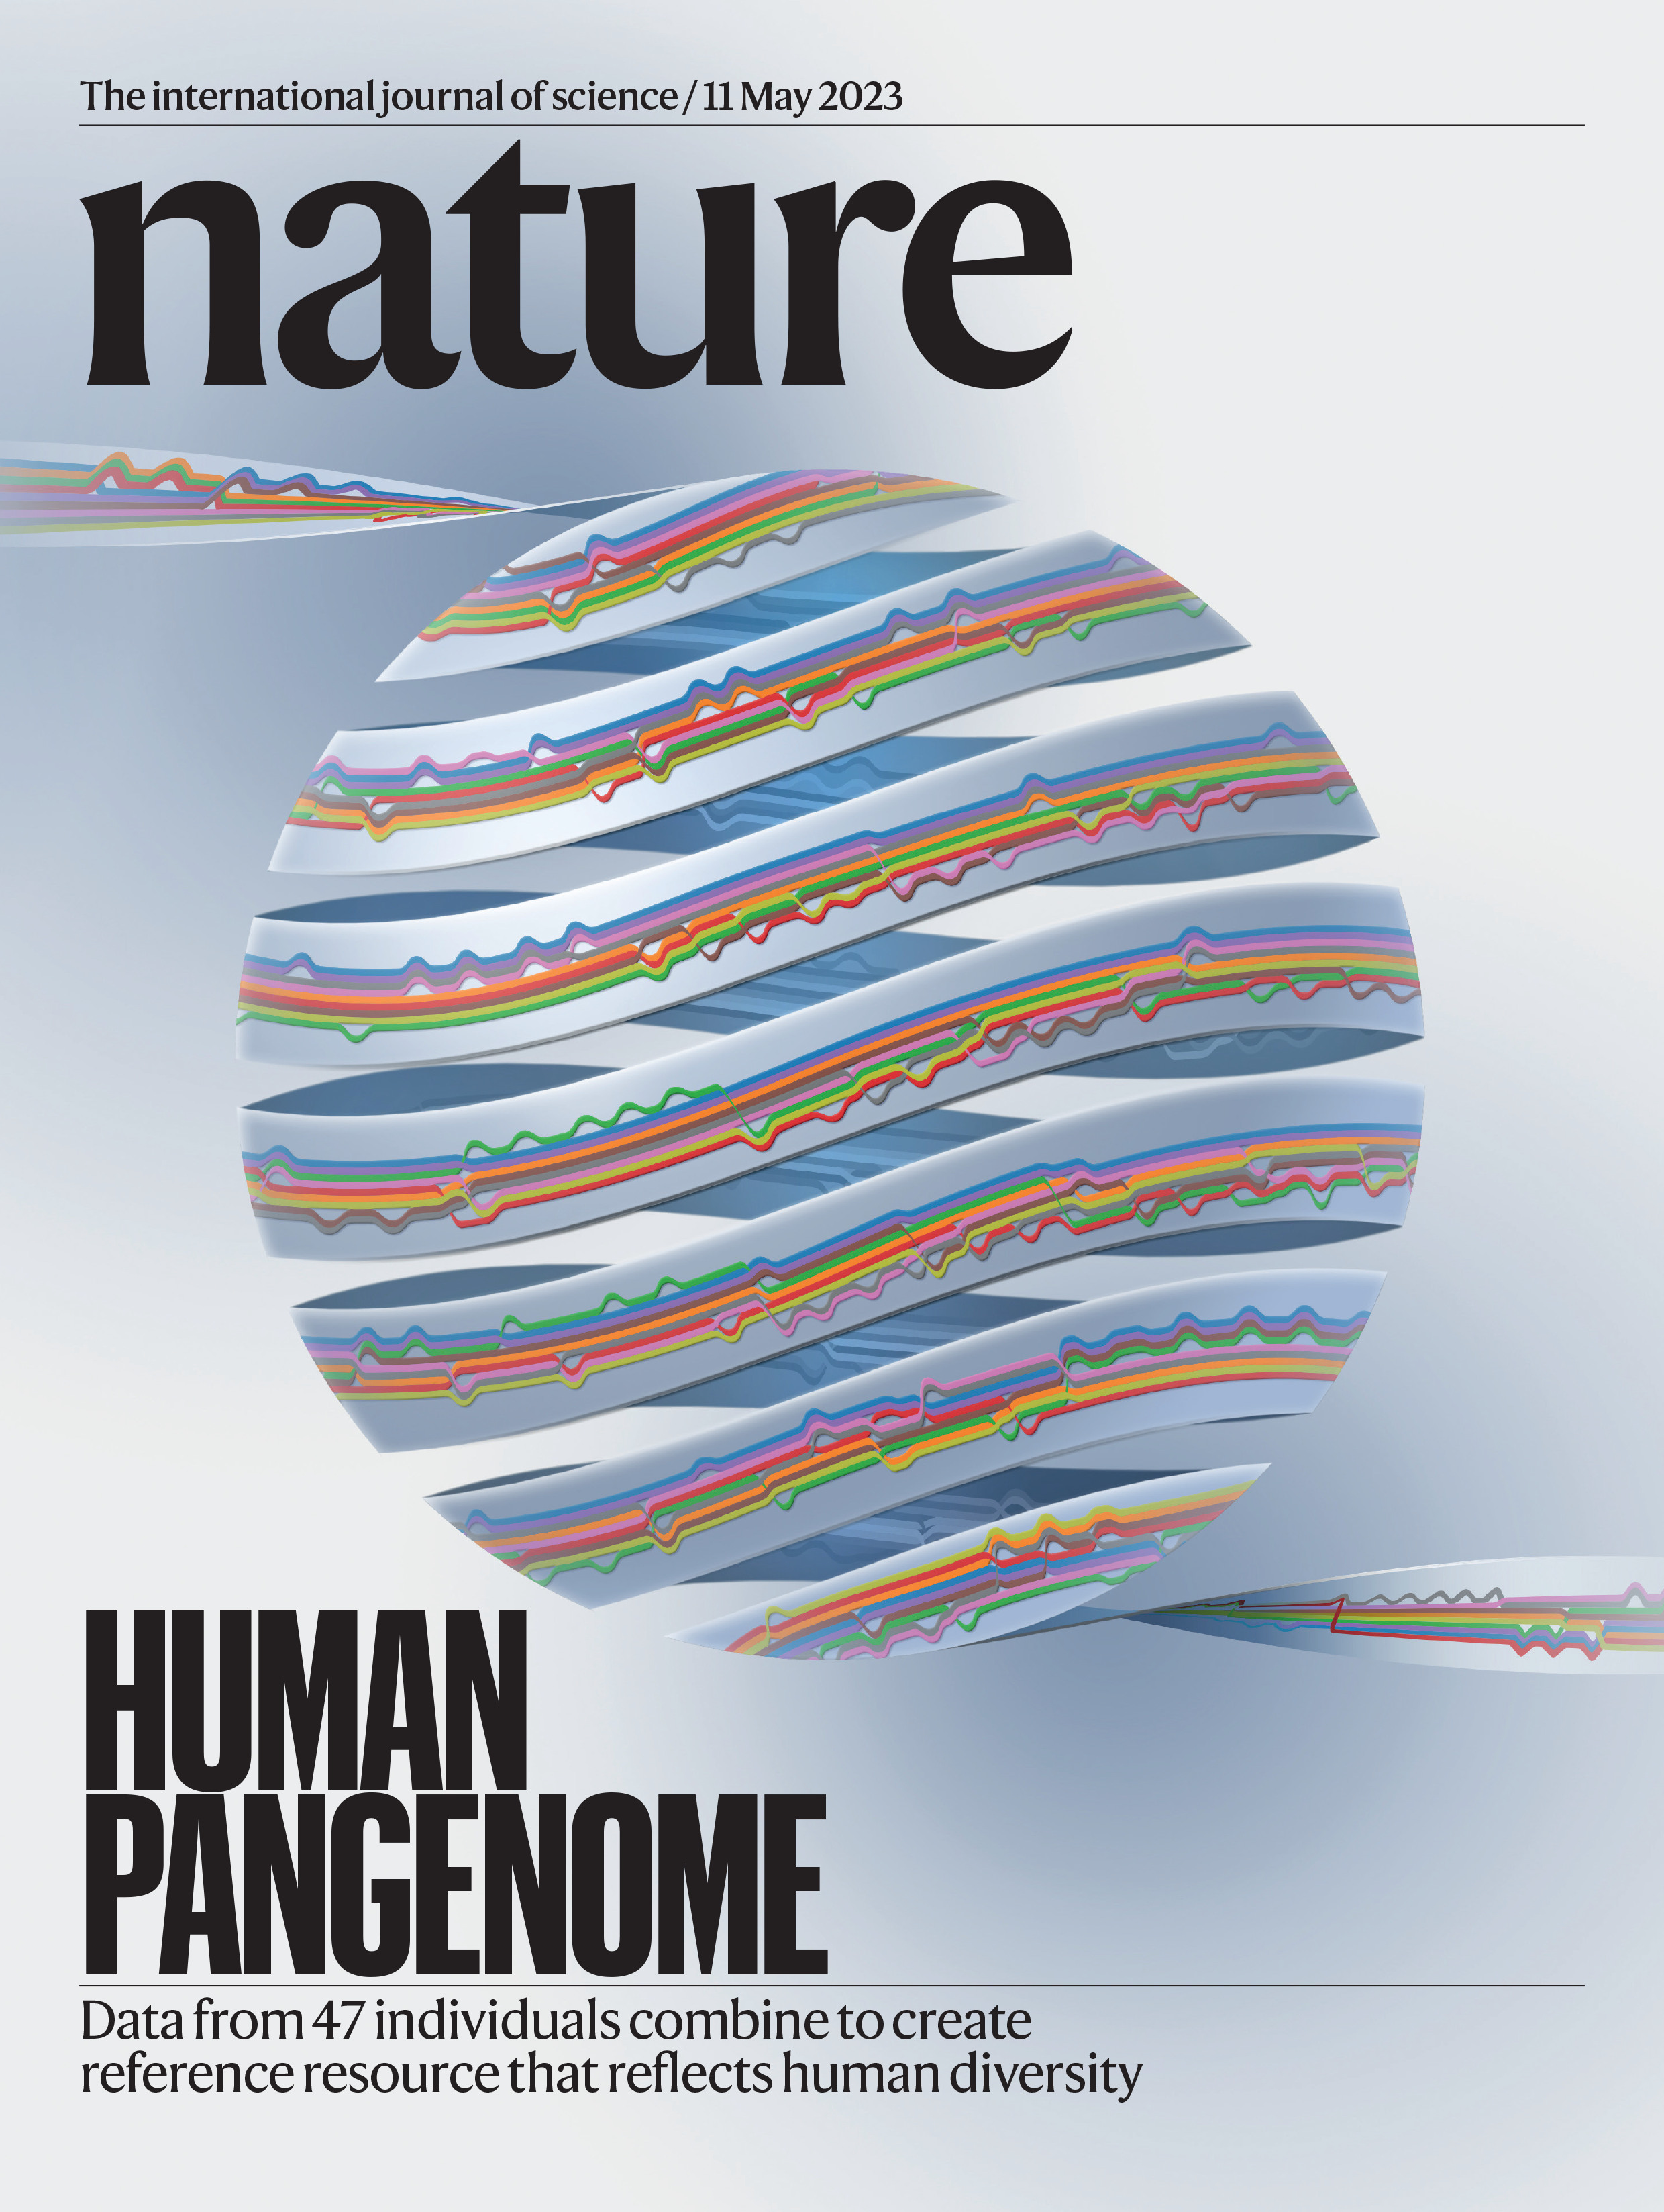
    Human Genome Reference Program (HGRP)
    Collection of high-quality reference human genome sequences
    Includes sequences from 47 people
    Four papers recently published
Document 18
Notes:
The Human Genome Reference Program (or HGRP) represents NHGRI’s continued commitment to advancing and maintaining the human genome reference sequence.
* A draft of the highly anticipated human pangenome reference was released this month. The human pangenome reference captures significantly more population diversity than previous references. Currently, it includes the genome sequences of 47 people. So, with each person carrying paired chromosomes, the human pangenome reference currently contains 94 distinct sequences. Researchers in the Human Pangenome Reference Consortium are aiming to generate 700 reference sequences by 2024.
* The human pangenome paper is one of several recently published in Nature by Consortium researchers. The companion papers report the study of the evolution of acrocentric chromosome short arms and segmental duplications, the analysis of inversion polymorphisms, and a tool for constructing and analyzing pangenome graphs.
The Nature cover (on the right) depicts the pangenome wrapping around the globe and uses a “sequence tube map” rendering of a pangenome relating 10 haplotypes within the highly variable HLA-A locus on human chromosome 6. The map was created by Adam Novak at the University of California, Santa Cruz, and the graphic was created by NHGRI's Darryl Leja.

Slide 29
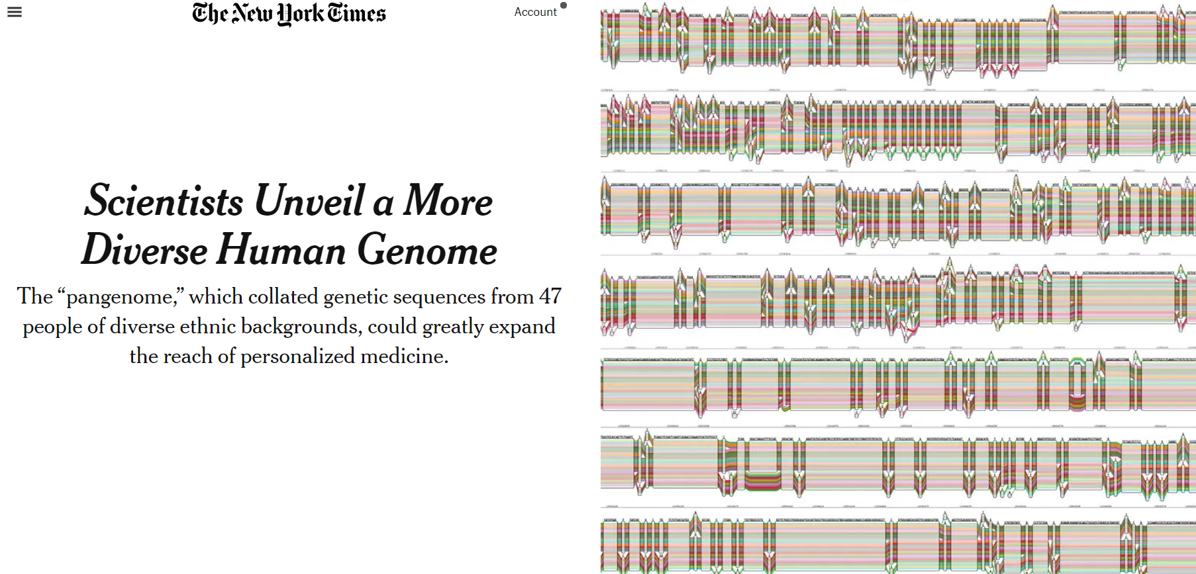
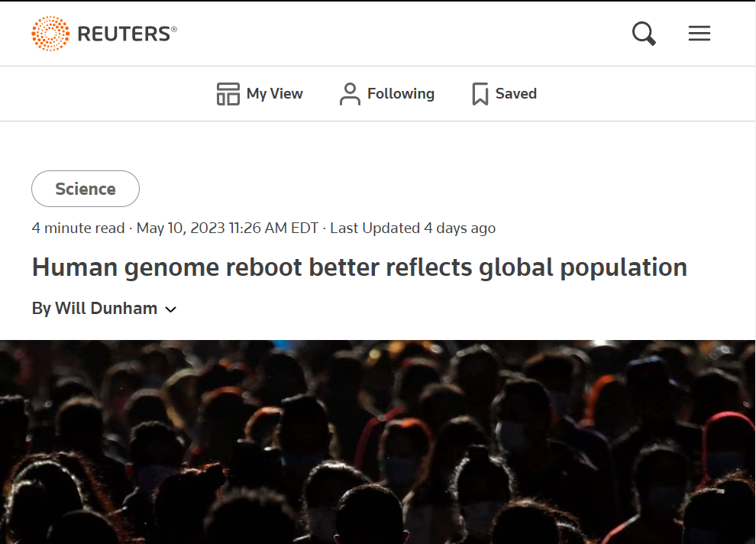
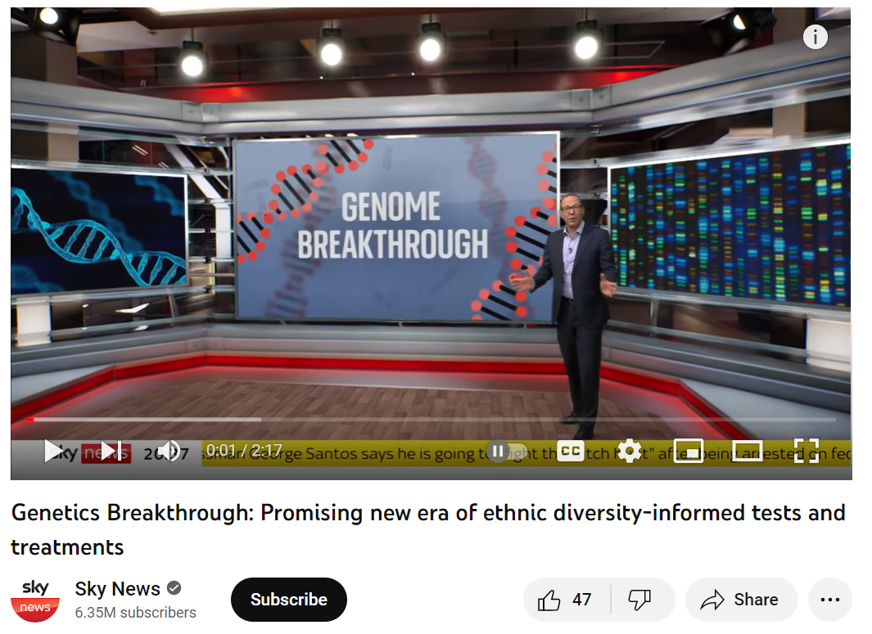
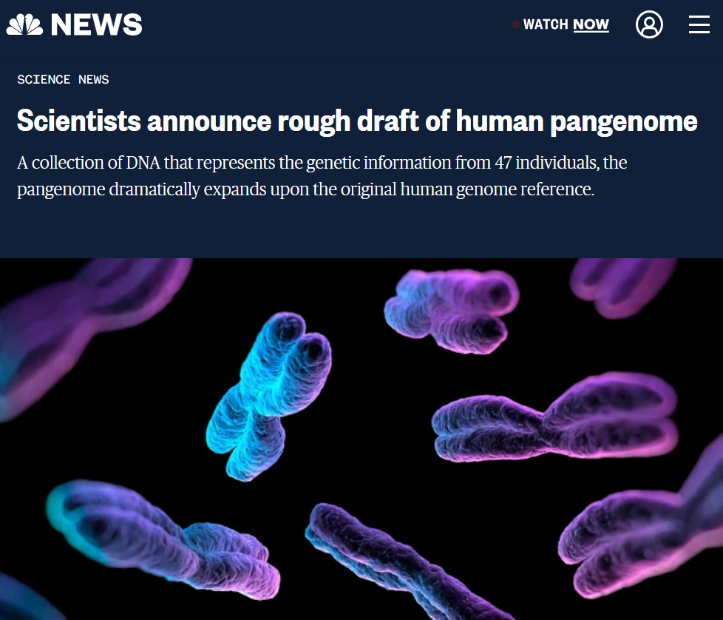
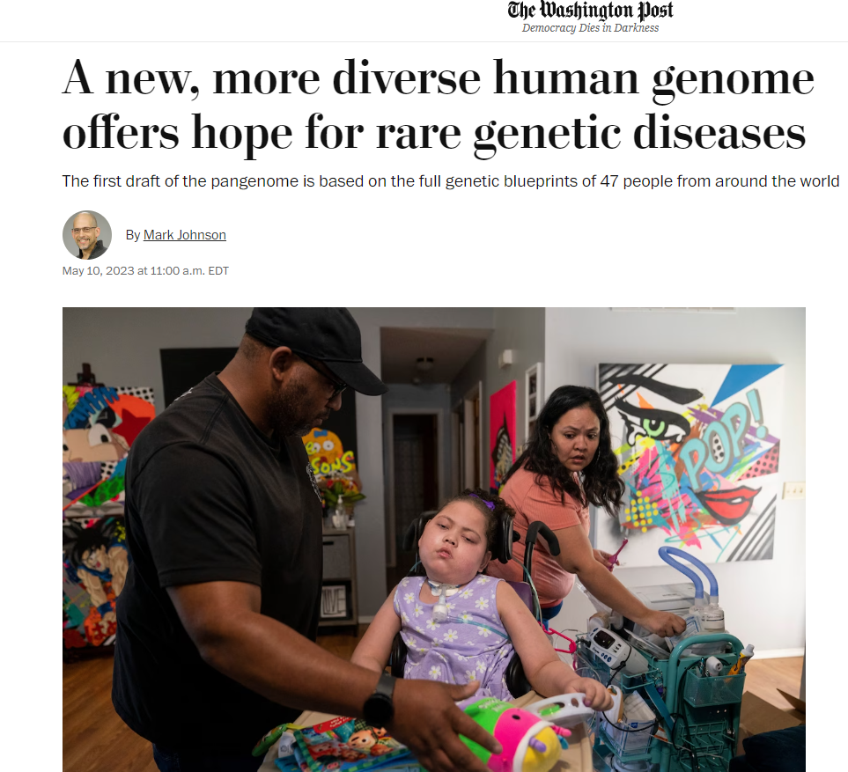
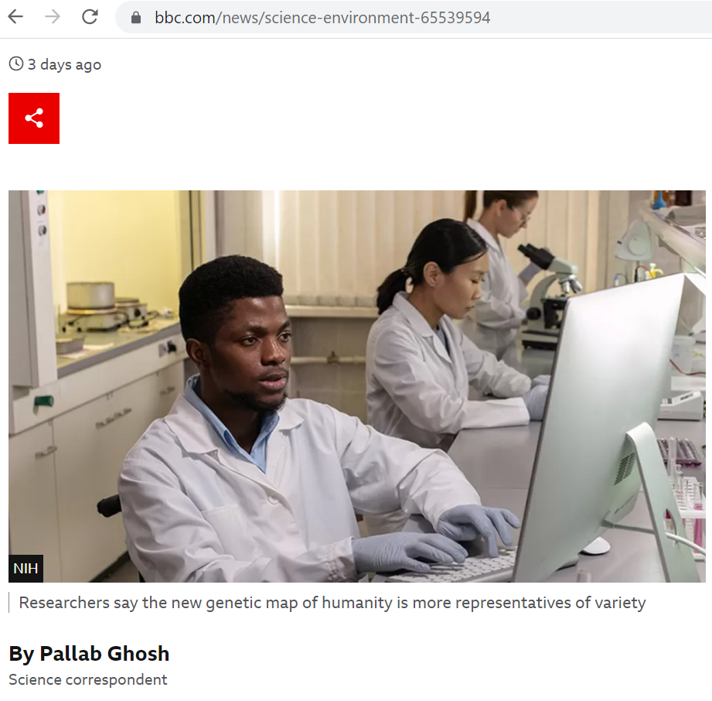
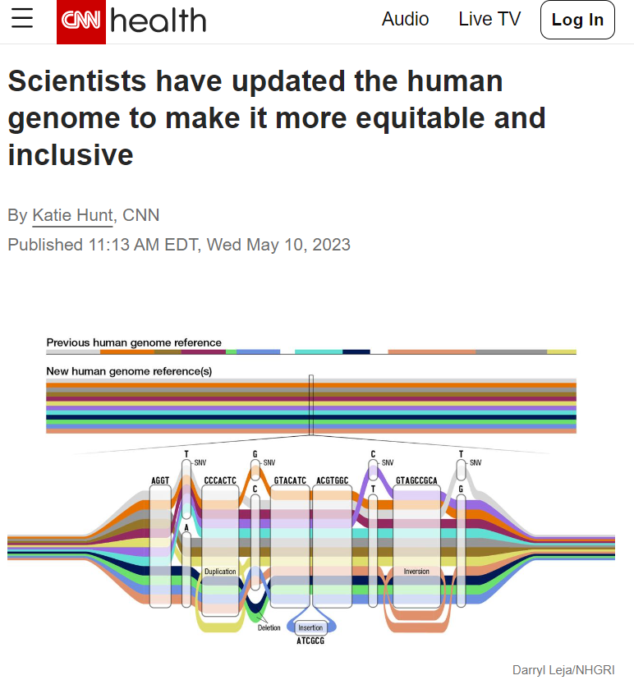
    Human Genome Reference Program (HGRP)
Document 18
Notes:
News coverage about the new human pangenome reference began in earnest on May 10, one day after a press event with nearly 80 journalists – one of the highest-attended briefings that the journal Nature has hosted.
This coverage was reflected by more than 600,000 news mentions and had a total reach of more than 1.2 billion, according to online circulation numbers of the word “pangenome.” Top outlets – such as * the New York Times, * the Washington Post, * CNN, * the BBC, * NBC News, * Reuters, and on and on! – covered the announcement, spreading our message of the importance of diversity in genomics.
* I even got to participate in a few live radio and TV interviews, including this one for Sky News.

Slide 30
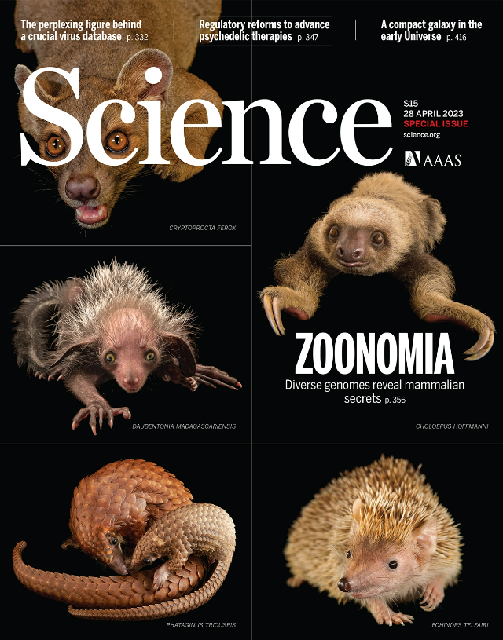
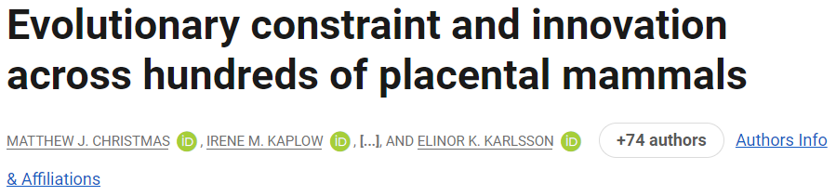
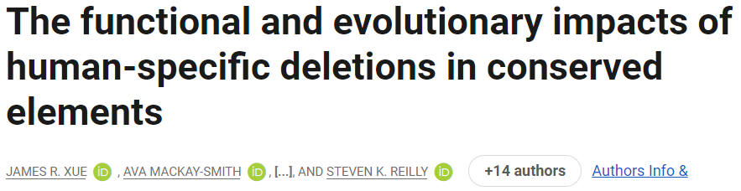
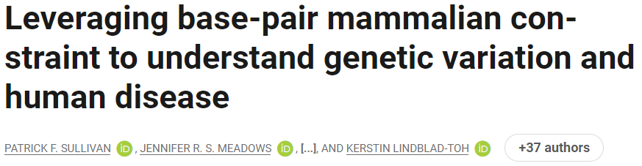
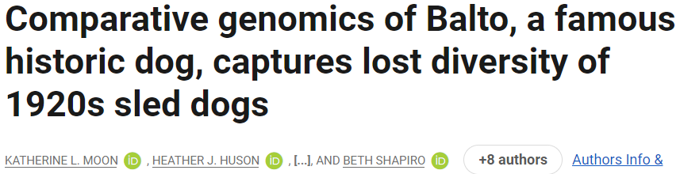
    Zoonomia Project
    Special issue in Science
    >150 researchers using comparative genomics to understand >240 species
    NHGRI-funded genome sequencing and analysis projects
Document 19
Notes:
One effort stemming from NHGRI’s investigator-initiated portfolio is the Zoonomia Project. * This project, which aims to catalog the differences across mammalian genomes, recently published 11 papers in a special issue of the journal Science.
* The Zoonomia Project is an international collaboration involving over 150 researchers that is using comparative genomics to study the genomes of over 240 mammalian species. * NHGRI has been a major funder of the Zoonomia Project, contributing ~$2.8 million over four years in an R01 award that has supported genome sequencing and analysis.
* In the special issue of Science, Zoonomia researchers report a number of findings, including specific regions of the mammalian genome that have remained largely unchanged through millions of years of evolution. * NHGRI K99/R00 awardee Stephen Reilly and his group reported how loss of some of these conserved regions may play an important role in uniquely human traits. * Other researchers summarized how Zoonomia has helped us understand the biological links across species, which can lead to the development of diagnostics and treatments for humans. * Finally, Beth Shapiro and colleagues used comparative genomics to provide insights into the selective pressures that shaped Balto, a heroic member of the sled dog teams that helped deliver life saving diphtheria medicine to Nome, Alaska in the 1920's.

Slide 31


    Centers of Excellence in Genomic Science (CEGS)
Jef Boeke , Ph.D.
​
  PAR-23-098 CEGS Reissued
  Next Receipt Dates: June 23, 2023; June 21, 2024
Document 20
Notes:
The Centers of Excellence in Genomic Science (or CEGS) program supports interdisciplinary research teams working together to develop highly innovative approaches in genomics research.
Since my last update about this program, one center was successfully renewed, the Center for Synthetic Regulatory Genomics led by Jef Boeke. The Center will expand their technologies for generating synthetic DNA molecules that are 50,000 to 100,000 base pairs long (termed “BIG DNA”). They will also develop methods for studying those BIG DNA molecules in stem cells and humanized mouse models in order to improve our understanding of gene regulation, genomic variation, and human disease.
* The CEGS funding opportunity has been reissued, with the next receipt date on June 23, 2023 followed by a receipt date on June 21, 2024.

Slide 32





    Molecular Phenotypes of Null Alleles in Cells (MorPhiC)
Data Production Reseach & Development Centers
  PI: Paul Robson
  PI: Danwei Huangfu
  PI: Mazhar Adli
  PI: Luke Gilbert
Data Resource & Administrative Coordinating Center
Data Analysis & Validation Centers
May 2023 Council
  PI: Stephan Schürer
In-person meeting took place in January/February 2023
Document 21
Notes:
Last year, NHGRI launched the Molecular Phenotypes of Null Alleles in Cells (or MorPhiC) Consortium, which aims to develop an extensive catalog of molecular and cellular phenotypes for null alleles of every human gene. In its first phase, the program will optimize available methods to knock out 1,000 genes; evaluate the utility of various cell lines and organoids; explore multiple molecular and cellular assays; develop analyses to understand the use of, and requirements for, the data; and disseminate the results to the research community.
* The MorPhiC Consortium is made up of four Data Production Research and Development Centers at the Jackson Laboratory, Memorial Sloan Kettering, Northwestern University, and the University of California, San Francisco. * There is also one Data Resource and Administrative Coordinating Center at the University of Miami. * Applications are being discussed during this May Council meeting for the final component of the program, the Data Analysis and Validation Centers, which will undertake data analysis and modeling to evaluate and help ensure the use of MorPhiC data.
* The Consortium’s first in-person meeting took place earlier this year.

Slide 33
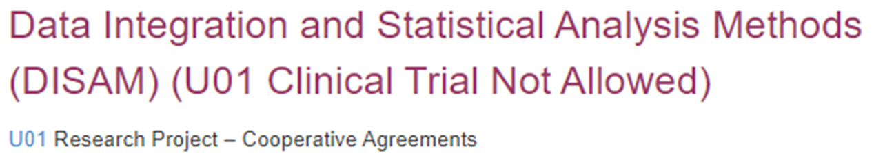
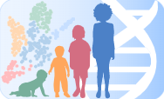

    Developmental Genotype-Tissue Expression (dGTEx)
New Funding Opportunity Announcement:
  RFA-HG-23-005 Data Integration and Statistical Analysis Methods
  Develop methods for analyses of data from human and non-human primate dGTEx efforts
  Applications due Nov. 20, 2023
Document 22
Notes:
In the Fall 2021, NHGRI, together with the Eunice Kennedy Shriver National Institute of Child Health and Human Development, the National Institute of Neurological Disorders and Stroke, the National Institute of Mental Health, and the Office of Research Infrastructure Programs, launched the Developmental Genotype-Tissue Expression Consortium (or dGTEx), which aims to establish a resource database and associated tissue bank to study gene-expression patterns in multiple reference tissues during human and non-human primate development.
* NHGRI, along with our partners, recently published a new funding opportunity for data integration and statistical analysis methods. Applicants are expected to propose the development of innovative and generalizable statistical and computational methods for dGTEx data analyses. There is also strong encouragement to develop methods that assess the influence of genomic variation on development, compare gene expression and regulation across tissues and time points, or leverage comparative genomics to understand developmental and evolutionary processes and integrate with existing tissue and cell atlas efforts.
Applications are due on November 20.

Slide 34
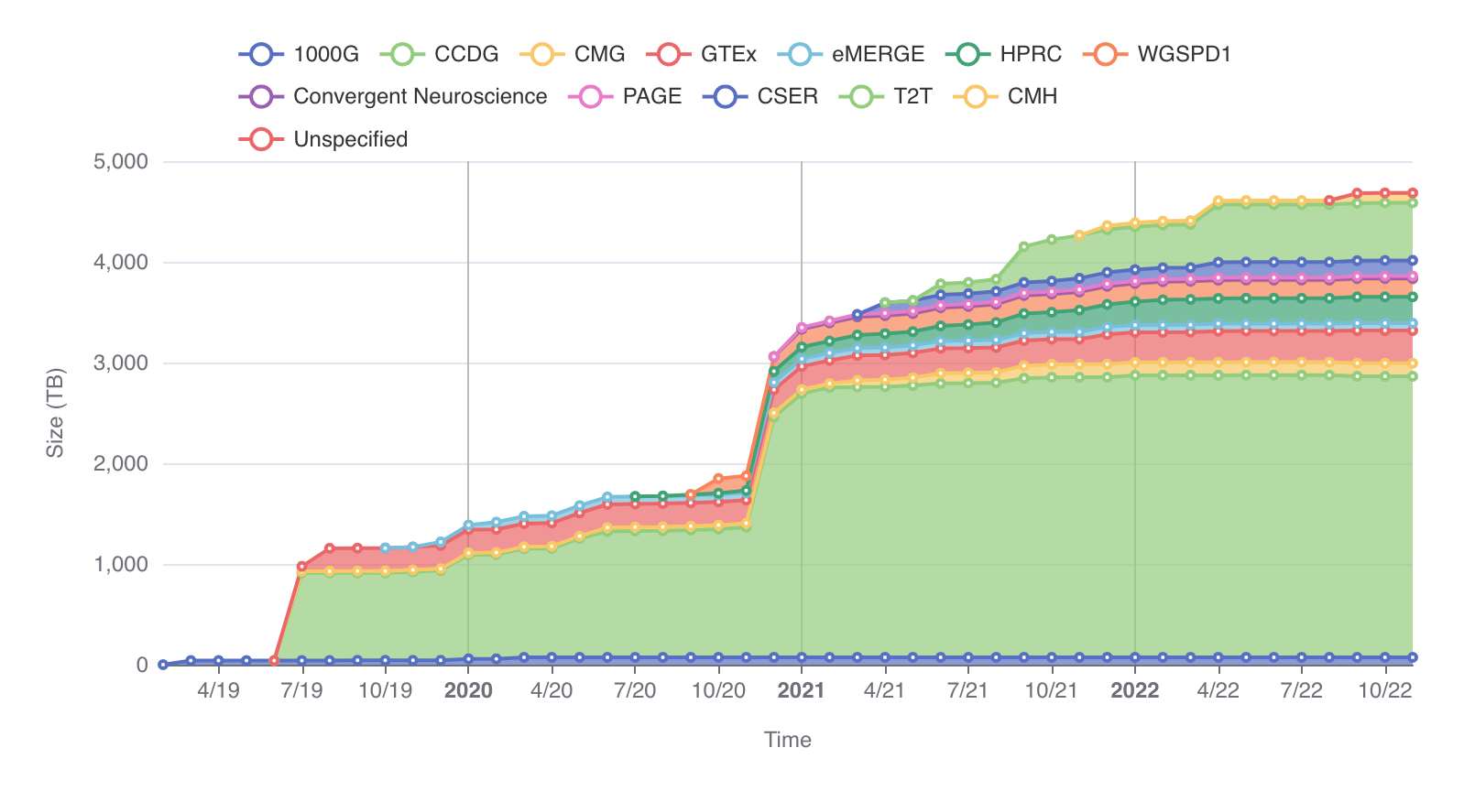
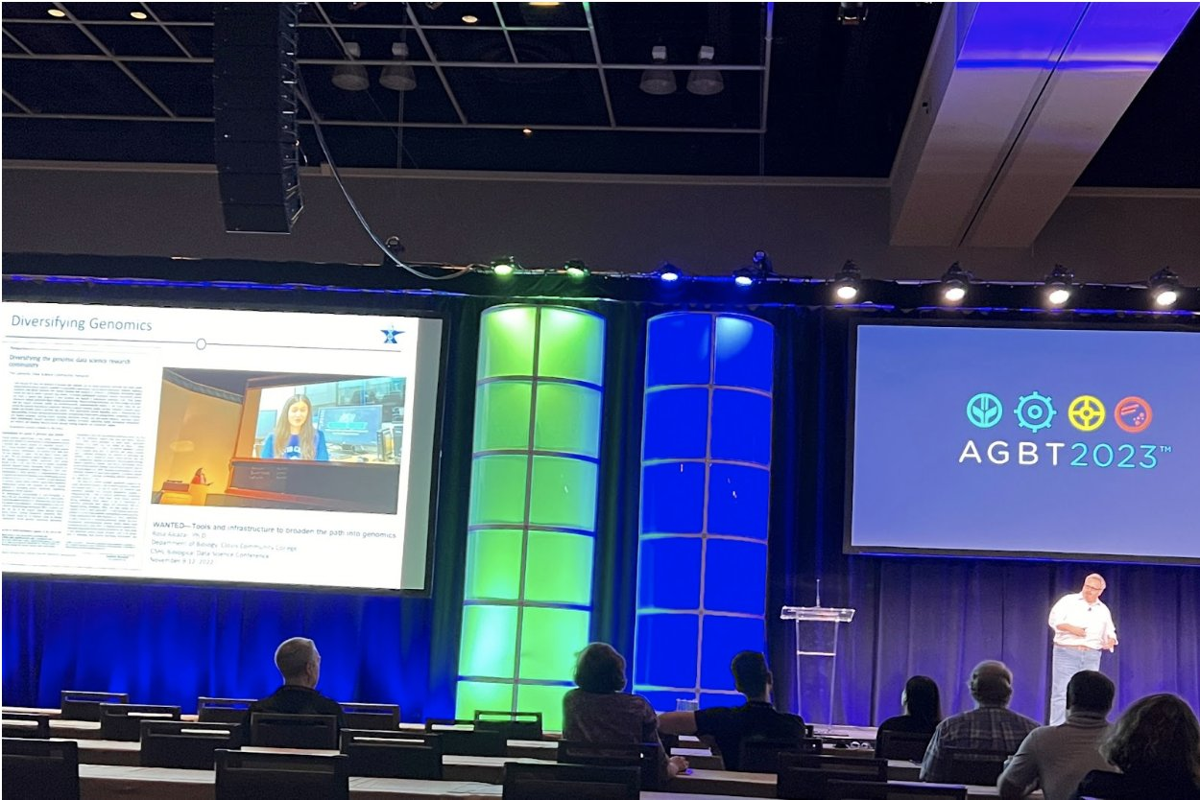
NHGRI Analysis, Visualization, and Informatics Lab-space (AnVIL)
Over 600,000 genomes and five petabytes of data
AnVIL presented at AGBT Meeting in February 2023
Document 23
Notes:
The NHGRI Genomic Data Science Analysis, Visualization, and Informatics Lab-space (or AnVIL) is a federated cloud-based infrastructure and software platform that provides an analysis and computing environment for genomics research. AnVIL distributes genomic and phenotypic data through both unrestricted and controlled access. * These datasets include over 600,000 genome sequences and more than five petabytes of total data, most of which are from NHGRI-funded programs and initiatives.
The AnVIL group has been working to expand outreach efforts to broaden awareness and educate new users. * One such effort was a presentation at the Advances in Genome Biology and Technology (or AGBT) Meeting in February, which focused on making genomic data science accessible to researchers from diverse backgrounds through AnVIL.

Slide 35
    Computational Genomics and
    Data Science (CGDS) Program
    Genomic Community Resources
    NHGRI Genomic Community Resources PAR-23-124
      Due dates in 2023: May 25 and September 25
    Trans-NIH Notice of Intent to Publish
      Established Data Repositories and Knowledgebases
        NOT-OD-23-099
      Early-stage Data Repositories and Knowledgebases
        NOT-OD-23-093
      Earliest estimated application due date: Fall 2023
Document 24
Notes:
Genomics relies on resources that make data, materials, and tools widely accessible. These resources are essential for researchers to facilitate their understanding of the genome and to explore its role in health and disease.
* Recognizing this, NHGRI continues to invest in Genomic Community Resources by renewing its funding opportunity announcement, which will support the development and distribution of resources that are valuable for both basic and clinical genomics research. Examples of resources include collections of analysis tools and software platforms, community data standards and ontologies, collections of samples or biological materials, and comprehensive genomic data generation. * The first round of applications for the renewed funding opportunity is due on May 25, and the next round is due in September.
* NIH has also released notices of intent to publish two trans-NIH funding opportunity announcements to support data resources. * The first will support early stage data repositories and knowledgebases, * while the second will support established data repositories and knowledgebases. * The earliest estimated application due date for both is in the Fall 2023.

Slide 36
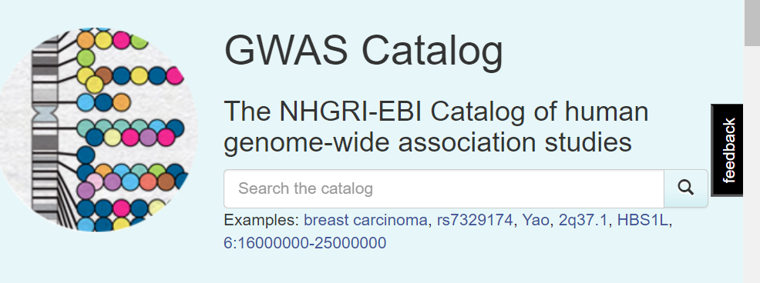

    Genome-Wide Association Studies (GWAS) Catalog
    15th Anniversary
    >515,000 curated associations from >6300 publications
    >60,000 user-submitted summary statistics
    >5,800 citations of the GWAS Catalog and associated papers
Credit: Jackie MacArthur
Document 25
Notes:
The NHGRI-EBI Genome-Wide Association Studies (or GWAS) Catalog is an online resource providing curated results from GWAS papers and user-provided summary statistics. On April 28, the GWAS Catalog celebrated its 15th anniversary. The Catalog started in 2008 with a single study on age-related macular degeneration.
* Now, 15 years later, the GWAS Catalog contains over 515,000 curated associations from over 6,300 publications.
* There have been over 60,000 user-submitted summary statistics, * as well as over 5,800 citations of the GWAS Catalog and associated papers written by catalog investigators. The number of studies and associations has increased over the years, suggesting that the initial investment in GWAS continues to yield dividends, even as more advanced genome-sequencing technologiesbecome widespread.
* Also, shown on the right is a cake baked in honor of the iconic GWAS Catalog diagram. We wish the GWAS Catalog a very happy anniversary!

Slide 37
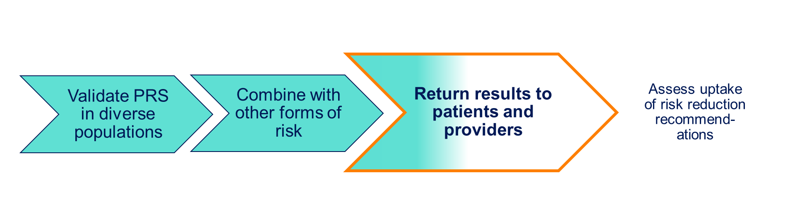
Genome-informed risk assessment (GIRA)
  PRS
  Monogenic risk
  Family health history
  Clinical covariates
eMERGE has returned 753 results & 156 high- risk results
Document 26
Notes:
In July 2020, the Electronic Medical Records and Genomics (or eMERGE) Network, comprising 10 clinical sites and a coordinating center, launched a nationwide study to evaluate the impact of genome-informed risk assessments (or GIRAs) on participant and clinician behaviors and decision-making.
* To create a GIRA, the Network validated polygenic risk scores in diverse populations and combined the scores with other forms of risk – monogenic risk, family health history, and clinical covariates – to return the risk of developing 11 common, complex diseases.
* The eMERGE Network has begun returning results to patients and providers at five sites, returning 753 results to date. Of those, 156 are high-risk results, which are provided with specific recommendations for clinical action.
* After this, the network will assess the uptake of these recommendations by patients and providers.

Slide 38
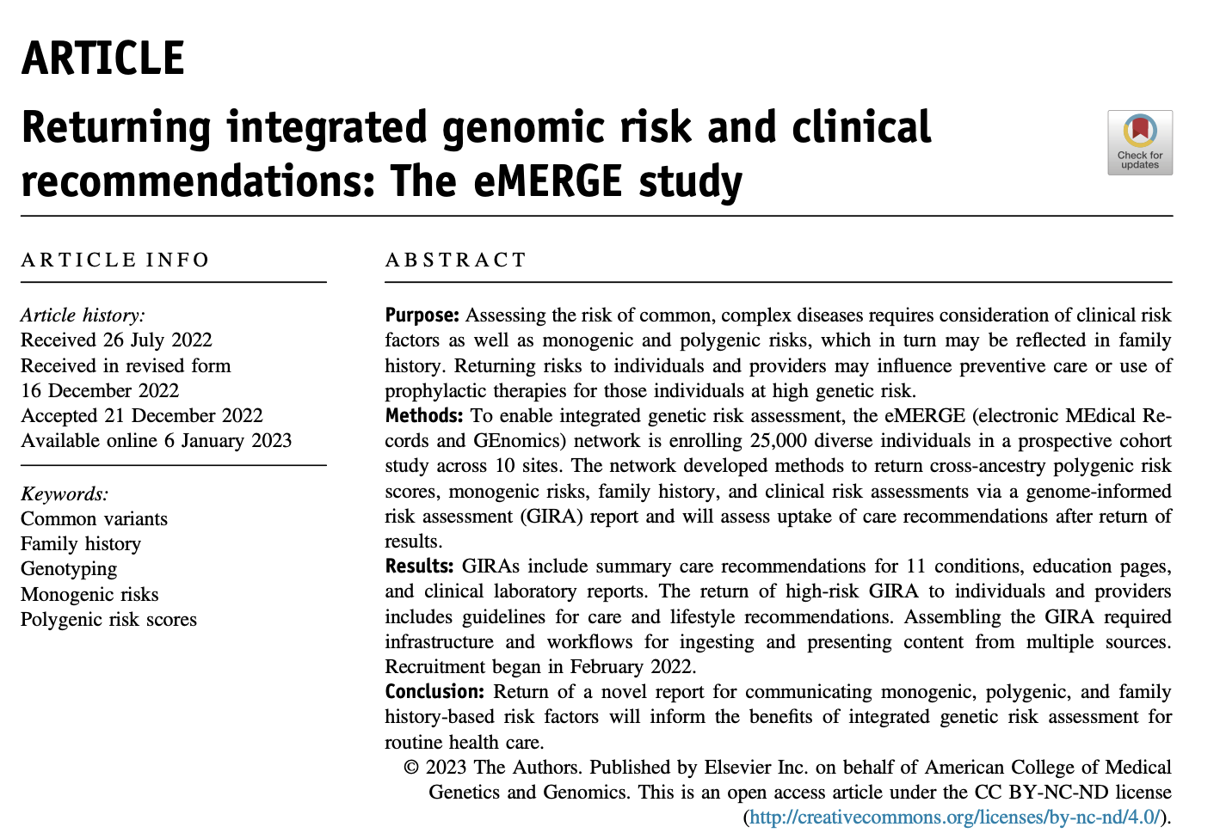
Marker paper published January 2023
Document 26
Notes:
The eMERGE Network published a marker paper in January of this year entitled Returning integrated genomic risk and clinical recommendations: the eMERGE study in the journal Genetics in Medicine. The paper describes the design of the ongoing eMERGE study. The Network aims to return roughly 1,500 results this year.

Slide 39


Clinical Sequencing Evidence-Generating
Research Program (CSER)
    CSER at ACMG 2023: 10 oral presentations & 9 posters
      Differences in genes implicated in disease comparing prenatal to pediatric patients (Sparks et al.)
      Development and validation of new CSER-wide outcome measure to assess the impact of genomic sequencing on children and adults (Smith et al.)
      Prenatal exome sequencing in an underrepresented population (Norton et al.)
Document 27
Notes:
The Clinical Sequencing Evidence-Generating Research (or CSER) program aims to generate evidence supporting the clinical utility of genome sequencing, with a major emphasis on utility in diverse patient populations and healthcare settings. As the CSER program concludes its work this spring, investigators have been busy presenting and publishing their work.
* The 2023 American College of Medical Genetics and Genomics (or ACMG) Annual Meeting featured 10 oral presentations and 9 posters by CSER researchers. The topics included fetal exome sequencing, clinical genome sequencing tools, and ethical considerations of reproductive genetics.
This slide highlights three of the oral presentations given by CSER investigators. * Teresa Sparks reported on differences in genes implicated in disease, comparing prenatal to pediatric patients. * Hadley Smith reported on development and validation of a new CSER-wide outcome measure to assess the impact of genome sequencing on children and adults. * Mary Norton reported findings on prenatal clinical exome sequencing in a study where 64% participants were from an underrepresented population.

Slide 40
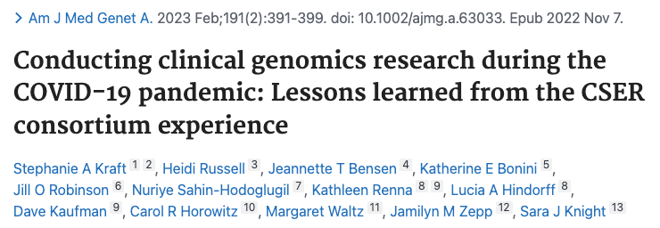
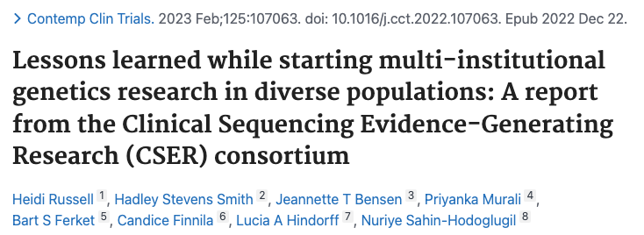
Clinical Sequencing Evidence-Generating
Research Program (CSER)
    Lessons Learned and Challenges
      Research during the COVID-19 pandemic
      Designing and implementing research in underrepresented populations
Document 27
Notes:
CSER investigators also recently published two papers related to lessons learned by the Consortium.
* The first paper examined the challenges that CSER investigators faced during the COVID-19 pandemic. The authors interviewed representatives at each CSER research site and identified factors that affected each site's experiences with the COVID-19 pandemic.
* The second paper focused on identifying pragmatic challenges related to designing and implementing research that involves underrepresented populations.

Slide 41
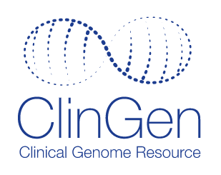
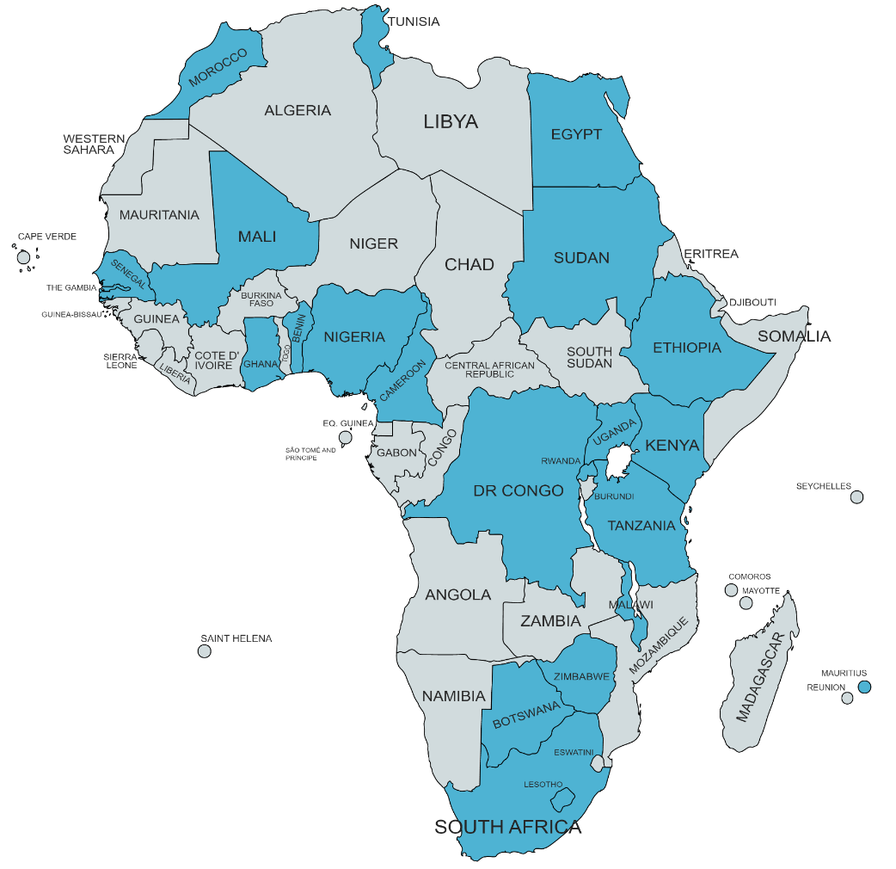
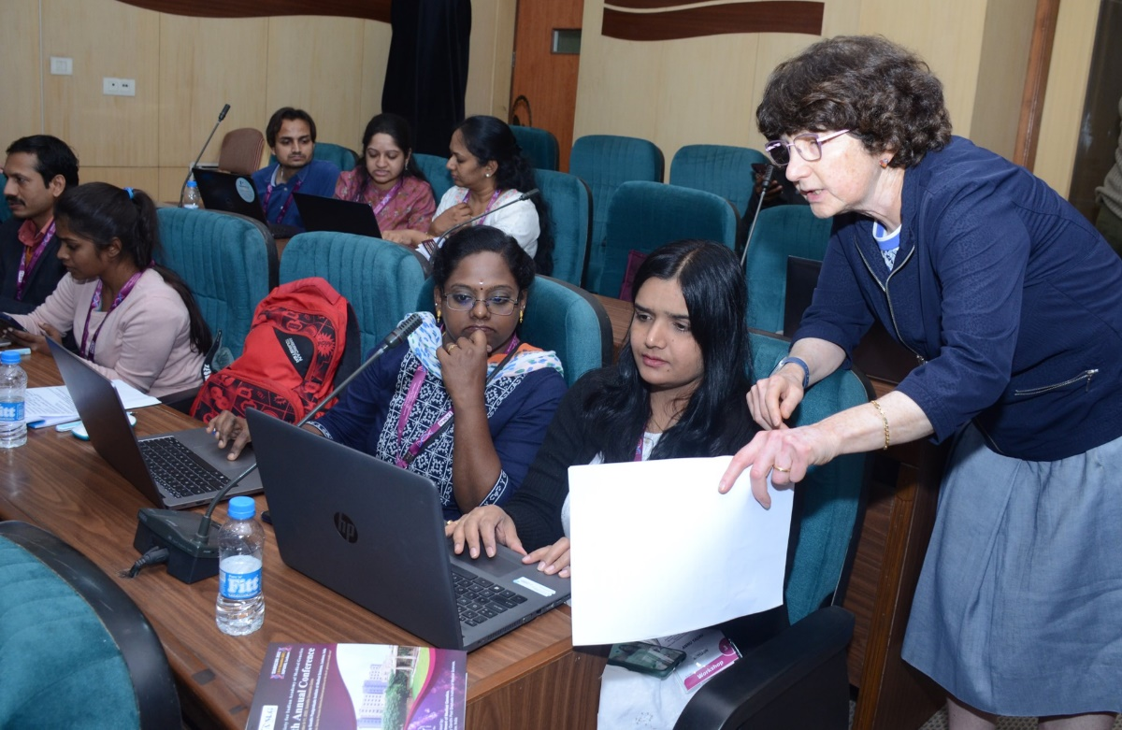
    Clinical Genome Resource (ClinGen)
    International Collaborations
H3Africa Workshop Participation
Variant Curation Interface Workshop, India 2022
Document 28
Notes:
The Clinical Genome Resource (or ClinGen) evaluates and disseminates information about the clinical relevance of genes and genomic variants for use in precision medicine and research. As a global resource with members from 59 countries, ClinGen aims to provide training on its resources and to encourage worldwide participation in ClinGen curation efforts.
* For example, an ongoing partnership with the Human Heredity and Health in Africa (or H3Africa) program’s Rare Diseases Working Group has yielded three workshops to develop accessible educational content for African investigators. The most recent workshop, held in March, focused on variant classification using ClinGen’s Variant Curation Interface. Previous workshops were held in 2021 and 2022. Shaded in blue on the map are the 23 African countries that have participated in at least one of the workshops, with seven participating in all three. In total, the workshops have attracted over 450 participants, some of whom have become active members of ClinGen expert panels and working groups.
* The image on the right shows ClinGen PI and former Council member, Sharon Plon, leading a training session during the Annual Conference of the Society for Indian Academy of Medical Genetics in December 2022. During this hands-on session, participants learned about ClinGen variant curation guidelines and how to perform variant classification.

Slide 42

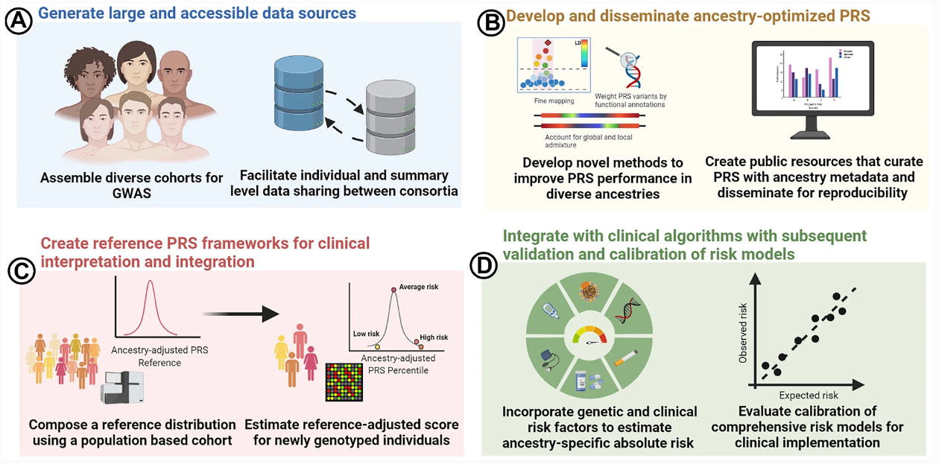

Polygenic RIsk MEthods in Diverse Populations (PRIMED) Consortium
PRIMED publications (~32)
Methods Review Working Group
Joint meeting with eMERGE
➡ Methods Development Working Group
Document 29
Notes:
The Polygenic Risk Methods in Diverse Populations (or PRIMED) Consortium is developing methods and refining polygenic risk scores (or PRS) to improve the prediction of disease risk in diverse ancestry populations.
* PRIMED has at least 32 publications in print or in press. * Displayed on the right is a figure from a PRIMED paper that highlights the goals and impact that PRIMED efforts will have in optimizing PRS for assessing coronary heart disease risk in diverse populations. The figure illustrates the steps in the PRS development process, specifically: (A) generating large and accessible data sources by assembling and sharing GWAS data from diverse cohorts; (B) developing novel methods for ancestry-optimized PRS and creating public resources for curation; (C) creating reference PRS frameworks using population-based cohorts and estimating reference-adjusted scores; and (D) integrating with clinical algorithms to incorporate genetic and clinical risk factors and calibrate risk models for clinical translation.
* The PRIMED Consortium’s Methods Review Working Group has also transitioned to a newly formed Methods Development Working Group, which will lead state-of-the-art PRS development approaches in diverse populations. * Finally, the PRIMED Consortium and the eMERGE Network held a joint meeting recently to identify areas of mutual interest and collaboration for the advancement of PRS development and clinical implementation.

Slide 43

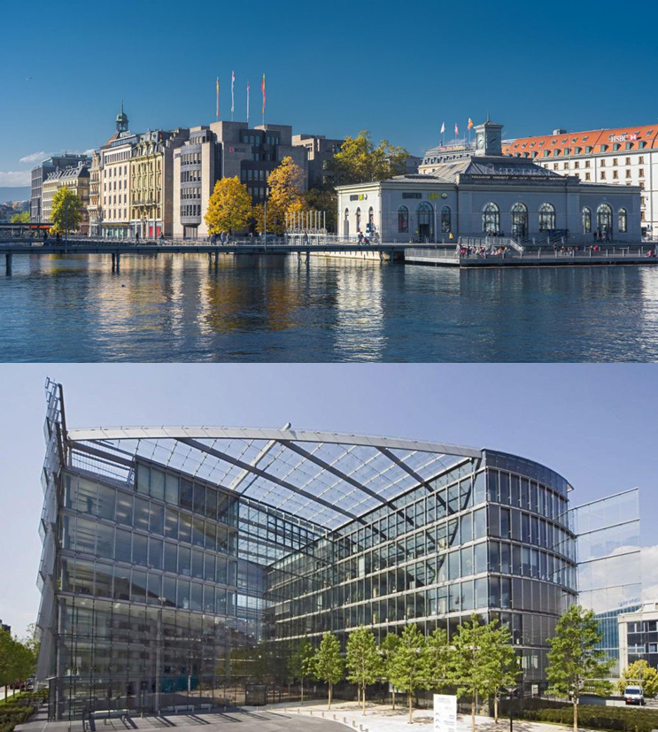
Global Genomic Medicine Consortium (G2MC)
7th International Conference
Campus Biotech in Geneva
Genomic Medicine for Everyone
Themes:
                Implementation of Genomic Medicine
    Collaboration
    Diversity, Equity, & Inclusion (DEI) in Genomics
Registration now open
Document 30
Notes:
The Global Genomic Medicine Consortium (or G2MC), established by NHGRI and the National Academies of Sciences, Engineering, and Medicine in 2014, will hold its 7th International Conference on October 2023, in Geneva, Switzerland. * It will be a hybrid meeting convened at Campus Biotech, which is known as “a Swiss center of excellence in biotechnology and life sciences research.”
* The title of this year’s conference is “Genomic Medicine for Everyone: Accelerating Implementation of Genomic Medicine for Global Equity and Access.”
* There are three themes for the conference: implementation of genomic medicine; collaboration; and diversity, equity, and inclusion (DEI) in genomics. These themes are based on the WHO Science Council’s report calling for accelerating access to genomics for global health.
* Registration for the conference is now open.

Slide 44

Advancing Genomic Medicine Research (AGMR)
Topics funded:
Undiagnosed diseases
EHR integrated tools
Evidence for clinical & economic value
Newborn screening
Promoting access for underserved populations
Notice of Intent to Publish a Notice of Funding Opportunity for Advancing Genomic Medicine Research (R01/ R21 Clinical Trial Optional)
Notice Numbers: NOT-HG-23-034, NOT-HG-23-035
Document 31
Notes:
NHGRI's Advancing Genomic Medicine Research (or AGMR) funding opportunity is now in its third year, encouraging applications that “stimulate innovation and advance understanding of when, where, and how best to implement the use of genomic information and technologies in clinical care” and that are broadly applicable to genomic medicine and significant beyond a single disease.
* The research topics funded to date include implementing genomic medicine for undiagnosed and rare disease patients; integrating clinical decision support and other tools into electronic health record (or EHR) systems; building the evidence base for clinical and economic value of genomic testing; screening of newborns for genetic diseases; and promoting access for and understanding barriers to genomic medicine in underserved populations.
* A Notice of Intent to Publish (or NOIP) has been released for the renewed funding opportunity, which is expected to be published this summer and will have an accompanying Notice of Special Interest (or NOSI) for soliciting applications from small businesses through the parent R43/R44.

Slide 45
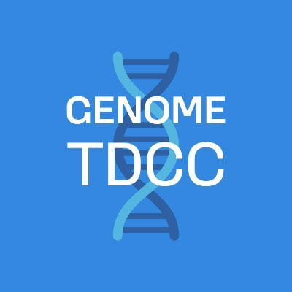
Technology Development Program
    Virtual Outreach Series
    Direct RNA Sequencing & Base Modifications
    Single-Molecule Protein Sequencing
    Advances in Single-Cell Analysis
    Genome-Scale Regulatory Mechanisms
All events are free, virtual, and open to the public
Registration is required
Document 32
Notes:
The Technology Development Coordinating Center (or TDCC) facilitates opportunities for grantee collaborations, leads efforts to promote standards in genomic technologies, develops resources to share with the research community, and disseminates information about program advances.
The TDCC has organized a virtual outreach series, sharing insights from industry leaders and genomic technology developers and users. The objective of this outreach series is to provide postsecondary students, postdoctoral fellows, and biomedical researchers with a fundamental understanding of how these new genomic technologies are utilized as well as to showcase the opportunities and challenges associated with their optimization and use.
* The sessions will be held over the next two weeks and will focus on emerging technologies and methods, such as direct RNA sequencing, base modification analyses, single-molecule protein sequencing, advances in single-cell genomic analyses, and methods for studying genome-wide regulatory mechanisms.
* Each of these virtual events is free and open to the public, but registration is required.

Slide 46

Small Business Program
    Transition Grant Opportunity
    Funding for early-career academic scientists
    interested in transitioning to entrepreneurship
    while supporting technology transfer
    Unique fast-track mechanism:
    Phase I STTR → Phase II SBIR
    Mentorship required and entrepreneurship training provided
    Partnership with NCI, NIBIB, and NIDA
    Applications due August 21, 2023
Document 33
Notes:
NHGRI’s Small Business Program continues to support commercialization and technology transfer by U.S. companies working across the genomics landscape.
A unique funding opportunity is available for early-career academic scientists through NHGRI’s Small Business Program. * The Small Business Transition Grant is designed for individuals interested in transitioning to entrepreneurship. The mechanism also supports the transfer of technology from academic laboratories to small businesses. * This program uses a fast-track mechanism where participants start with a Small Business Technology Transfer (or STTR) award in Phase I before transitioning to a Small Business Innovation Research (or SBIR) award in Phase II.
* Mentorship is required and entrepreneurship training is provided. * The program was released in partnership with the three other institutes listed here. * Applications are due on August 21.

Slide 47

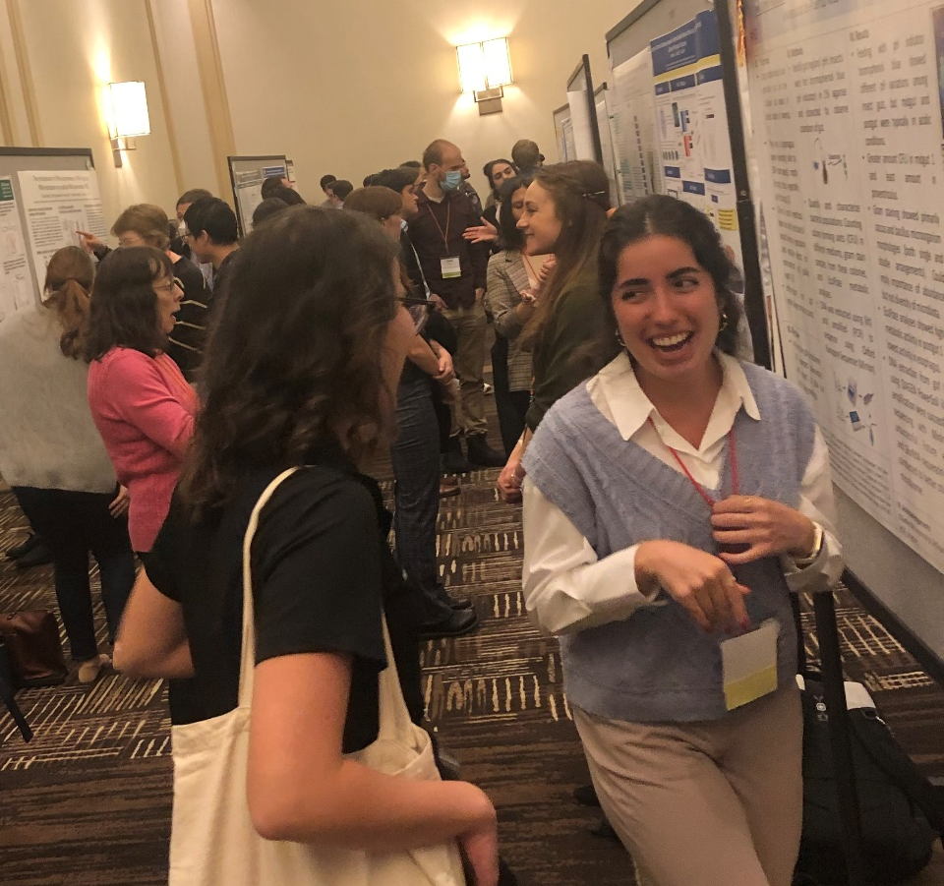
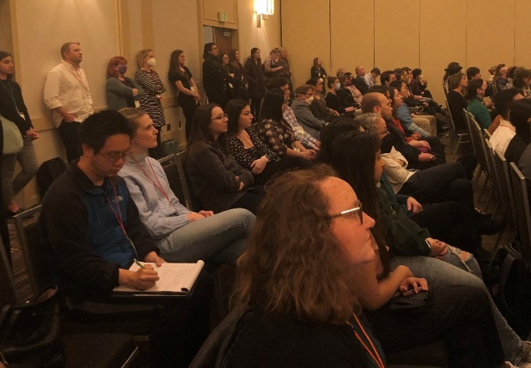

    Training and Career Development Program
    8th Annual Training Meeting
    Hosted by Duke University and held in Salt Lake City
    300 in-person attendees and 50 virtual attendees
Document 34
Notes:
The Training and Career Development Program aims to prepare a talented and diverse genomics workforce by providing both institutional and individual funding through a variety of mechanisms, including individual fellowship and career development awards, institutional awards, and diversity supplements. Programs are offered at the undergraduate, postbaccalaureate, graduate, postdoctoral, and faculty levels.
The 8th Annual Training and Career Development Meeting, hosted by Duke University, was held this April in Salt Lake City. The meeting brought together roughly 300 in-person attendees and 50 virtual attendees.

Slide 48

    Genomics Workforce Diversity Programs
    Notices of Funding Opportunities
    PAR-23-123: Entry-Level Modules (ELM) for Training the Genomics Research Workforce
    Receipt date: June 1
    PAR-23-137: NIH Science Education Partnership Award (SEPA)
    Receipt date: July 14
Document 35
Notes:
The Training and Career Development Program would also like to highlight two Notices of Funding Opportunities (NOFO) focused on enhancing workforce diversity.
* The Entry-Level Modules (or ELM) for Training the Genomics Research Workforce support the development of modules of genomics-related curricula for those in the entry-level research workforce. Entry-level is defined as positions that do not require a bachelor’s degree or higher. Applications are due June 1.
* The NIH Science Education Partnership Award (or SEPA) program supports informal science education activities designed for the pre-kindergarten to grade 12 levels. These activities aim to enhance the diversity of the biomedical, behavioral, and clinical research workforce as well as to foster a better understanding of NIH-funded research and its public health implications. Applications are due July 14.

Slide 49



    Extramural Investigator-Initiated Highlights
Document 36
Notes:
Here are some notable highlights from NHGRI’s extramural investigator-initiated research portfolio.
* First, Dajiang Liu and colleagues developed a tool called TESLA, which integrates GWAS summary statistics, whole-genome sequencing data, and multi-ancestry eQTL data. They applied TESLA to tobacco use phenotypes and identified 273 new gene associations. They also performed in silico analysand found several drugs that may be repurposed to treat nicotine addiction.
* Second, Paul Khavari and colleagues developed a framework integrating gene expression, chromatin accessibility, transcription factor footprinting, and DNA looping data to identify over 800 cell-type-specific, recurrent DNA motif combinations (called DMC). They found that neoplastic cancer cells were activating DMC processes that healthy cells did not.
* Finally, Kayte Spector-Bagdady (an investigator funded by a NHGRI Mentored Research Scientist Development Award) and colleagues surveyed genetic researchers on their use of shared data resources and identified key factors that facilitate the efficient utilization of these resources. These factors include accessibility, harmonization, and administrative support.

Slide 50
Director’s Report Outline
General NHGRI Updates
General NIH Updates
General Genomics Updates
NHGRI Extramural Research Program
NIH Common Fund/Trans-NIH
NHGRI Communications, Policy, and Education
NHGRI Intramural Research Program
Notes:
Moving on to the NIH Common Fund and other trans-NIH efforts.

Slide 51







Undiagnosed Diseases Network
    Solving Medical Mysteries Through Team Science
Applications: 6354
Accepted: 2535
Data Sharing
Manuscripts published: 210
Variant interpretations submitted to ClinVar: 647
Records shared across Matchmaker Exchange: 1991
Clinical Evaluations: 2159
Sequencing:
2180
Model Organisms: 301
Metabolomics:
312
Diagnosed: 679
Document 37
Notes:
The Undiagnosed Diseases Network (or UDN) is a NIH Common Fund program that aims to improve the level of diagnosis for rare and undiagnosed conditions through a team based-approach.​ Over the past decade, the UDN has * received over 6,300 applications, * accepted over 2,500 participants, and * provided clinical evaluations, genome sequencing, model organism genomic variant screening, and metabolic analyses. * The Network has successfully assigned diagnoses to over 670 participants, and that number continues to grow.
* Since its inception, the UDN has made great strides in discovering novel disease genes, gene variants, and syndromes and in connecting these to disease pathways. From this work, the UDN has published over 200 manuscripts, submitted over 600 genomic variant interpretations to ClinVar, and shared just under 2,000 records in Matchmaker Exchange

Slide 52
Undiagnosed Diseases Network
Transition from NIH Common Fund support to Trans-NIH support
    Led by NINDS and supported by 16 NIH institutes and centers:​
    NCATS, NCCIH, NCI, NEI, NHGRI, NHLBI, NIA, NIAID, NIAMS, NICHD, NIDCD, NIDCR, NIDDK, NIEHS, NIGMS, NLM
    Vision: evolve into a larger, self-sustained network to provide expert diagnostic services for undiagnosed patients and to foster scientific discovery
  Data Management Coordinating Center​ (Fiscal Year 2023-2027)
    Awarded to Harvard Medical School (PI: Kohane)
  Diagnostic Centers of Excellence
Document 37
Notes:
With 10 years of NIH Common Fund support ending in June 2023, the UDN has transitioned to a trans-NIH program led by the National Institute of Neurological Disorders and Stroke and supported by the 16 NIH institutes and centers listed here.
* The vision for the next phase of the UDN is to evolve into a larger, self-sustained network to provide expert diagnostic services for undiagnosed patients and to foster scientific discovery.
* The Data Management Coordinating Center was awarded to Harvard Medical School to provide infrastructure, data management, and clinical research support for the next five years. Clinical Sites will join the Network as Diagnostic Centers of Excellence, allowing them access to resources to assist patients with undiagnosed diseases.

Slide 53


    Bridge to Artificial Intelligence (Bridge2AI)
    Four Centers:
      Functional genomics
      Voice as a biomarker of disease
      AI/ML in acute care
      Human health restoration after disease
    Bridge Center for cross-program coordination and dissemination
    First Bridge2AI in-person consortium meeting in April
Document 38
Notes:
Bridge to Artificial Intelligence (or Bridge2AI) is a NIH Common Fund program that will set the stage for widespread use of artificial intelligence (or AI) in healthcare research. The goals of the program are to generate flagship AI-ready datasets centered around biomedical grand challenge questions, to emphasize best practices for ethical uses of AI, and to promote the work of diverse research groups that span the perceived boundary separating AI and healthcare research.
* This program now includes four centers that will generate hypothesis-agnostic datasets for functional genomics, voice as a biomarker of disease, AI and machine learning in acute care, and human health restoration after disease.
* The program also includes the Bridge Center for cross-program coordination, which is responsible for the integration and dissemination of the activities, knowledge, and practices from all the other components of the program.
* In April, the consortium had its first in-person meeting, at which I participated in a fireside chat along with the four other co-chairs of the program – including the directors of the National Institute of Biomedical Imaging and Bioengineering, the National Library of Medicine, the National Eye Institute, and the National Center for Complementary and Integrative Health.

Slide 54



Somatic Mosaicism Across Human Tissues (SMaHT)
Tissue Procurement Center
Data Analysis Center
Organizational Center
Genome Characterization Centers
Baylor College of Medicine
Broad Institute
New York Genome Center
Seattle Children’s Hospital
Washington University
Tools and Technology Development Awards
Document 39
Notes:
The Somatic Mosaicism Across Human Tissues (or SMaHT) network is a new NIH Common Fund program aiming to build a greater understanding of somatic mosaicism, which reflects the unique post-conception changes in our DNA that can vary from cell to cell. Key aims of this network include developing a catalog of somatic genomic variants, creating innovative DNA sequencing and analysis tools, and forming a data workbench that integrates with other datasets.
* Last month, the NIH Common Fund announced the first awards for the SMaHT program in response to five funding opportunities. The Tissue Procurement Center was awarded to the National Disease Research Interchange, the Data Analysis Center was awarded to Harvard Medical School, and the Organizational Center was awarded to Washington University.
* There are five awards for Genome Characterization Centers, specifically at Baylor College of Medicine, the Broad Institute, the New York Genome Center, Seattle Children’s Hospital, and Washington University.
* Furthermore, 12 institutions received the Tool and Technology Development awards.

Slide 55


Release of nearly 250,000 whole-genome sequences
45% of data from people who identify as a member of a group underrepresented in medical research
Document 40
Notes:
The NIH All of Us Research Program is seeking to build a national research cohort of over one million or more participants, reflecting the diversity of the United States. The program is creating a partnership with participants in order to advance precision medicine and to change healthcare for the benefit of all.
* Last month, the program expanded the data available in the All of Us Researcher Workbench, including the release of nearly 250,000 whole-genome sequences with participant consent for broad research use. * 45% of the data are from people who identify as a member of a racial or ethnic group who has been historically underrepresented in biomedical research. * Researchers can now access information from over 400,000 individuals, including data from survey responses, physical measurements, and electronic health records. The data release also includes long-read genome sequences from over 1,000 individuals.
We are excited about this update and encourage members of the genomics research community to visit the All of Us Researcher Workbench and to start exploring and analyzing these data. Access to the Researcher Workbench is available to researchers from eligible organizations after they complete training.

Slide 56

    NIH Cloud Platform Interoperability (NCPI)
    Establish a trans-NIH, cloud-based, federated data ecosystem
    NCPI Administrative Coordinating Center
    Solicitations for interoperability projects
Document 41
Notes:
The goal of the NIH Cloud Platform Interoperability (or NCPI) effort is to establish and implement guidelines and technical standards to create a trans-NIH, cloud-based, federated data ecosystem in order to facilitate end-user analyses across participating cloud platforms. NCPI was launched in late 2019 and is a collaboration of the NHGRI Analysis Visualization and Informatics Lab-space (or AnVIL) program and other cloud-based programs and resources supported by the National Cancer Institute; the National Heart, Lung, and Blood Institute; the NIH Common Fund; and the National Library of Medicine.
* This past January, the NIH Office of Data Science Strategy awarded funds to the Research Triangle Institute to establish an Administrative Coordinating Center for NCPI. This center will provide technical, administrative, and coordination support for the NCPI program.
* In March, the Administrative Coordinating Center released a solicitation for interoperability projects to test or implement tools and approaches, with the aim of facilitating researcher-driven analyses of datasets across the NCPI platforms and repositories. The applications are due today, May 15, 2023.

Slide 57
Director’s Report Outline
General NHGRI Updates
General NIH Updates
General Genomics Updates
NHGRI Extramural Research Program
NIH Common Fund/Trans-NIH
NHGRI Communications, Policy, and Education
NHGRI Intramural Research Program
Notes:
Moving on to NHGRI activities in the areas of communications, policy, and education.

Slide 58







2023 Genomics Anniversaries
Document 42
Notes:
On April 25, National DNA Day, NHGRI hosted a symposium to celebrate two special milestones: the 20th anniversary of the completion of the Human Genome Project and the 70th anniversary of the discovery of DNA's double-helical structure. Organized by our Education and Community Involvement Branch and our Office of Communications, the event brought in close to 100 in-person attendees and just over 700 virtual attendees.
I had the privilege of leading a panel discussion with several of my fellow NIH institute and center directors, exploring how genomic advances have directly influenced research at their respective institutes and centers. Other highlights of the day included a discussion about the benefits and challenges of using population descriptors in genetics and genomics research, a presentation highlighting an international celebration of DNA Day in Ghana, and a panel showcasing the diverse career opportunities in genomics. The day concluded with Francis Collins presenting the annual Louise M. Slaughter National DNA Day Lecture.
* I especially enjoyed a surprise segment in which I challenged my predecessor, that Collins guy, to a series of activities to determine who is the Greatest of All Time (or G.O.A.T.) NHGRI Director. That spirited competition consisted of a pre-recorded video followed by a live segment at the symposium itself. Together, the complete G.O.A.T. competition takes about 17 minutes to watch, with the GenomeTV/YouTube video available at the link provided via Document 42. But to really really entice you to watch the Green-Collins frivolity, I will show you a brief teaser...

Slide 59


New NHGRI Videos on GenomeTV/YouTube
Purifying Strawberry DNA
Sequencing a Genome
Document 44
Notes:
And speaking of frivolity... the NHGRI Office of Communications recently released two GenomeTV/YouTube videos that are both fun and educational for everyone.
* In the first video, our social media specialist, Jenny Montooth, and I show you step-by-step instructions for extracting DNA from strawberries using materials available in your kitchen. This is an updated version of the original instructional video that I made with Carla Easter 12 years ago (a video that has garnered nearly 500,000 views on YouTube!).
* In the second video, NHGRI researchers from Adam Phillippy’s group and the NIH Intramural Sequencing Center show how to extract human DNA, sequence it, and interpret the data – with some fun DNA hijinks along the way.

Slide 60

Human Genome Project 'G5' Virtual Reunion
Document 45
Notes:
The story of the 13-year Human Genome Project is a tale of great individual and group accomplishments and, in many ways, incredible audacity. The Project actually consisted of many smaller narratives – some scientific, some political, and some sociological. To capture some of this history and as part of the 20th anniversary celebration, NHGRI recently recorded a virtual discussion involving the major leaders that pushed the Human Genome Project across the finish line in 2003. That group was dubbed the ‘G5’ and included the leaders of the five genome-sequencing centers that produced the largest amount of sequence data.
For this incredibly fun virtual reunion, I was joined by Jane Rogers, then at the Wellcome Trust Sanger Institute (previously known as the Sanger Centre); Michael Morgan, then a leader at the Wellcome Trust; Ari Patrinos, representing the efforts of the Department of Energy’s Joint Genome Institute; Eric Lander of the Broad Institute/Whitehead Institute for Biomedical Research; Richard Gibbs of Baylor College of Medicine’s Human Genome Sequencing Center; Bob Waterston, then at Washington University School of Medicine’s Genome Sequencing Center; and Francis Collins, then the NHGRI Director.
While the full reunion video is not yet available, a teaser reel has been released that you can now watch. Meanwhile, we will get the word out when we release the full video on our GenomeTV/YouTube channel.

Slide 61

Genome: Unlocking Life’s Code Exhibition
Pieces Now on Display at NIH
    Opened in 2013, traveled to 12 U.S. states and Canada
    Attracted millions of visitors over the last 10 years
    Five pieces of the exhibition now on display at NIH
Document 46
Notes:
As you may recall, 10 years ago as part of the then 10th anniversary celebration of the Human Genome Project's completion, NHGRI and the Smithsonian National Museum of Natural History (or NMNH) created the Genome: Unlocking Life’s Code exhibition.
The exhibition examined the complexities of genomes (particularly the human genome), chronicled the remarkable breakthroughs that have taken place since the completion of the Human Genome Project, and highlighted both the benefits and challenges that genomics brings to modern society. After a year-plus stay at NMNH, the exhibition travelled to 12 U.S. states and Canada. It returned to Washington, D.C, in October 2021 for a final stay in the museum of its origin. It attracted millions of visitors over the last 10 years.
Upon closing of the exhibition in November 2022, NHGRI was provided the opportunity to take custody of pieces of our choice from the exhibition. * Five pieces of the Genome: Unlocking Life’s Code exhibition are now on display on NIH’s Bethesda campus. Four of the pieces can be found in Building 31, and one is on display in the medical library in the NIH Clinical Center.

Slide 62



Genomics Featured in National History Day
Notes:
Seemingly out of nowhere and perhaps related to the 20th anniversary of the completion of the Human Genome Project, genomics has become a ‘hot topic’ for students participating in National History Day activities. For the first time ever, I was contacted by not one but two student groups, seeking Zoom interviews with me and other genomics leaders as part of National History Day projects specifically focused on the Human Genome Project.
* Here are the three delightful and spirited high school students from Boulder, Colorado, who interviewed me by Zoom; I then arranged for them to interview Rick Myers, Richard Gibbs, and Karen Miga.
* More locally, I was contacted by three similarly delightful and spirited middle schoolers from Howard County, Maryland, who then interviewed me, Vence Bonham, and Sarah Bates by Zoom. Their extensive research allowed them to make * this highly informative presentation on the Human Genome Project. They proceeded to get the top honor at the state-regional level and then competed at the Maryland state level (this photo is from nine days ago, when Sarah Bates and I visited them at the state competition). By the way, * note the ties that these gentleman wore for the state competition – they bought them in bulk and gave me one as a token of their appreciation (which I am proudly wearing today!)
62

Slide 63




NHGRI History of Genomics Program
Archive Highlight
Document 47
Notes:
The NHGRI History of Genomics Program’s digital archive is set to enter an exciting new phase in the coming months. The group has been working on some new tools and resources that will allow greater access to some of the unique historical assets in the institute’s archival collections. In anticipation of these developments, we wanted to show you a few items from this archive.
* The first item is Francis Collins’s handwritten notes for the June 2000 press conference with Craig Venter announcing the completion of the draft human genome sequence. This is just one document from nearly 100 boxes of digitized materials from Francis’s collection, which he accumulated during his tenure as NHGRI Director.
The other three items are documents from Elke Jordan, accumulated during her tenure as NHGRI Deputy Director from 1988 to 2002. * The first is a draft sketch from 1988 of a possible budget and timeline for the “Human Genome Initiative” or as it would soon be called, the Human Genome Project. * Next is the seating chart from the very first meeting of the Program Advisory Committee on the Human Genomem in January 1989. * Last is the official meeting report from the February 1996 “Bermuda meeting" in which the principles of data sharing and open access to genome sequencing data were laid out and adopted.
63

Slide 64

Inter-Society Committee for
Practitioner Education in Coordinating Genomics (ISCC-PEG)
ISCC-PEG 12th Annual Meeting
Document 48
Notes:
Meeting in-person for the first time since 2020, the Inter-Society Coordinating Committee for Practitioner Education in Genomics (or ISCC-PEG) held its 12th Annual Meeting in February. At the meeting, I gave a talk highlighting recent NHGRI achievements. After my talk, Josh Denny, Chief Executive Officer of the NIH All of Us Research Program, provided an update about that program, including the release of participants’ genomic health-related results. Then, presentations were given by the second class of ISCC-PEG scholars, describing their ongoing genomics education projects.
ISCC-PEG members continue to develop resources to integrate genomic literacy into clinical practice. Ten different project groups held active working sessions, including both in-person and virtual participants. These discussions included updates on the direct-to-consumer genetic testing resource for healthcare professionals, as well as the soon-to-be-released materials answering common questions that nurses may have about becoming a genomics nurse and integrating genomics into practice.
Videos of presentations and slide decks from the meeting are available on the ISCC-PEG website.
64

Slide 65

New Chief, Education and Community
Involvement Branch
Beth Tuck, M.A.
Notes:
Beth Tuck was recently selected to be the new Chief of the Education and Community Involvement Branch within NHGRI’s Division of Genomics and Society.
Beth is currently the Executive Director and Director of Science Education at Genspace, the world’s first community biology lab, in Brooklyn, New York. As Executive Director, she has overseen the organization’s staff, programs, strategy, fundraising, and finance; she has also served as a key liaison and spokesperson for Genspace.
Beth will actually becoming home to NHGRI since she was previously a genomics education specialist within the Education and Community Involvement Branch. Her earlier work at NHGRI focused on enhancing genomic literacy, education, and community engagement at the K-12 and college levels; this work included designing curricular resources, engaging students and teachers in hands-on genomics activities, supporting teacher professional development, and training scientists in public engagement skills. Beth initially arrived at NHGRI as the very first participant in the ASHG-NHGRI Genetics Education & Engagement Fellowship.
Beth will begin her new appointment at NHGRI in the early summer.

Slide 66
Director’s Report Outline
General NHGRI Updates
General NIH Updates
General Genomics Updates
NHGRI Extramural Research Program
NIH Common Fund/Trans-NIH
NHGRI Communications, Policy, and Education
NHGRI Intramural Research Program
Notes:
And finally, moving on to NHGRI’s Intramural Research Program.

Slide 67


Samuel J. Heyman Service to America Medal Finalists
Document 49
Notes:
Adam Phillippy, Arang Rhie, and Sergey Koren of NHGRI's intramural Genome Informatics Section in the Computational and Statistical Genomics Branch are finalists for the Samuel J. Heyman Service to America Medals, also known as the “Sammies.” The Sammies honor the remarkable and inspiring accomplishments of federal employees. This group was nominated for their work in the Telomere-to-Telomere (or T2T) Consortium, which successfully generated the first complete assembly of a human genome sequence.
Congratulations, Adam, Arang, and Sergey!

Slide 68


American Society of Human Genetics
2022 Presidential Address
Document 50
Notes:
NHGRI Scientific Director, Charles Rotimi (who will be here to make a presentation following my Director's Report), was featured on the cover of the March issue of the American Journal of Human Genetics. This eye-catching cover pointed to the issue’s publication of Charles’s 2022 American Society of Human Genetics presidential address, entitled “One Human Race: Billions of Genomes.” The address emphasized that “as we learn to read and interpret information coded in the living and evolving genomic history book of billions of individuals from around the world, we are gaining insights into fundamental questions about our evolutionary history, health, and complex issues surrounding individual and group identity, including the notion of human racial groups.”

Slide 69






    NHGRI Intramural Research Highlights
The impact of Mmu17 non-Hsa21 orthologous genes in the Ts65Dn mouse model of Down syndrome: the “gold standard” refuted
The dogs of Chernobyl: Demographic insights into populations inhabiting the nuclear exclusion zone
Telomere-to-telomere assembly of diploid chromosomes with Verkko
Document 51
Notes:
The NHGRI Intramural Research Program has once again been very productive since the last Council meeting. A few of their many research highlights include the following.
* Diana Bianchi and her group studied an enhanced mouse model of Down syndrome that more precisely captures the features of the condition. The researchers found that the new model shows milder cognitive traits. These results have important implications for human clinical trials that aim to improve cognition in these patients.
* Elaine Ostrander and her group led a study that characterized the genetic ancestry of free-roaming dogs currently living in and around the Chernobyl Nuclear Power Plant. The researchers sampled over 300 dogs and found large, complex og families living in the area. This study establishes the importance of genetic studies in understanding the effects of exposure to long-term, low-dose ionizing radiation.
* Sergey Koren, along with other researchers at NHGRI, designed and tested a software system called Verkko that automates analysis methods used by the Telomere-to-Telomere Consortium to assemble gapless genome sequences. This software can assemble whole-chromosome sequences in a matter of days and promises to lead to more gapless genome sequences from humans and other species.

Slide 70




‘One-Stop-Shop’ to Stay Connected
genome.gov/stayconnected
Document 52
Notes:
Before I end my Director’s Report, I want to again remind you about a * user-friendly, one-stop-shop for staying connected with me and NHGRI. By visiting this web page through this convenient URL and then scrolling down, * you get a menu of nine major resources associated with the institute.
This includes links for the genome.gov website, my The Genomics Landscape monthly newsletter, and my Twitter feed. Also on this page, there are convenient links to the 2020 NHGRI Strategic Vision, the NHGRI brochure, our Talking Glossary of Genomic and Genetic Terms, our Building a Diverse Genomics Workforce Action Agenda, the GenomeTV/YouTube channel, and the NHGRI History of Genomics Program’s set of oral histories. And if those sites are not what you are looking for, * scrolling down further reveals recordings of some selected talks of mine as well as some of my recent podcasts and op-eds.
I hope people find this one-stop-shop helpful when trying to stay connected with me and NHGRI.

Slide 71


Thanks!
Special Thanks!
Notes:
Finally, a personal thanks to the many NHGRI staff members who contributed the slides and associated materials that I just reviewed in my Director’s Report. As always, a group effort is essential for getting such a large amount of information conveyed efficiently at each Council meeting.
An additional thanks to the NHGRI Office of Communications staff for creating the electronic resource associated with my Director’s Report.
And * a special thanks to the usual ‘ringleader’ for helping me prepare my Director’s Report, Kris Wetterstrand. * Kris is pictured here with the International Human Genome Sequencing Consortium in this 'throwback' photograph, included to commemorate the 20th anniversary of the Human Genome Project’s completion. This photograph was taken in May 2002 at the Cold Spring Harbor Laboratory.

