Slide 1



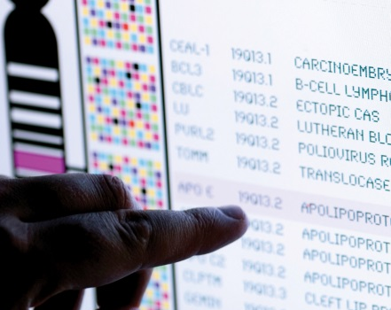
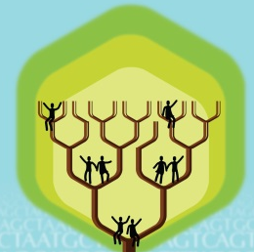
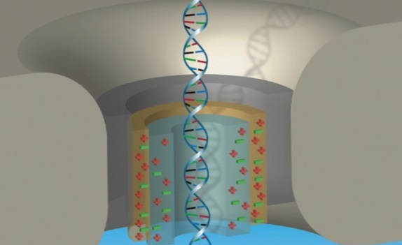


DIRECTOR’S REPORT
Eric Green, M.D., Ph.D.
Director, NHGRI
May 2021
Document #
Notes:
I would like to again welcome all of you to this Open Session of the National Advisory Council for Human Genome Research meeting. As you can see, the current situation with the COVID-19 pandemic has once again led me to give my Director’s Report while sitting all alone in my conference room. In addition (and to accommodate a shorter Council meeting), my Director’s Report is a bit briefer than the norm. Nonetheless, it contains an informative collection of updates that we wanted to share with you.
As with the rest of the Open Session, my Director’s Report presentation is being videotaped, and that recording will be made available as a permanent archive on NHGRI’s website (genome.gov).
1

Slide 2
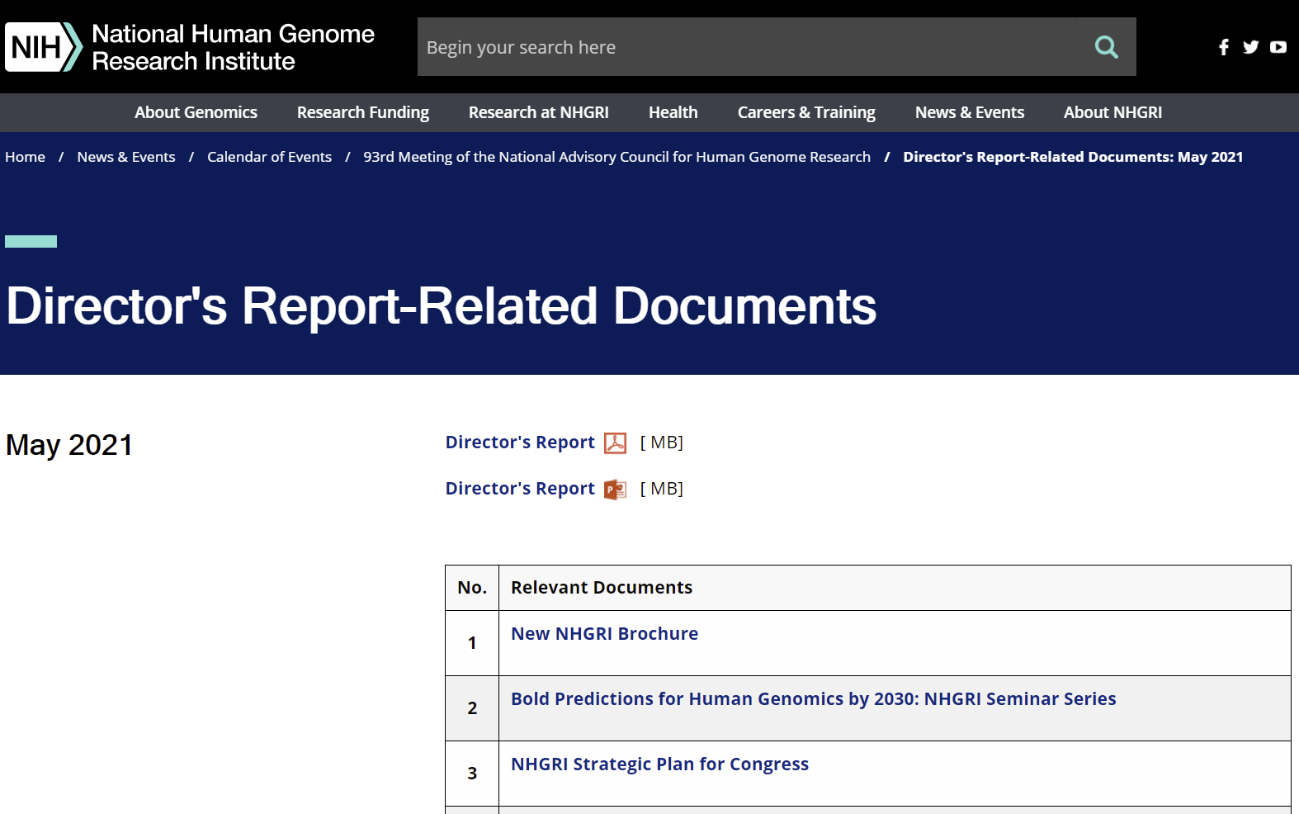
genome.gov/DirectorsReport
Document #
Notes:
For those who are new to our Council meetings, I want to make you aware of the ‘electronic resource’ that is developed for my Director’s Report. Analogous to the supplemental materials of a published paper, this resource can be accessed at the URL shown here.
The slides that I will show during my Director’s Report are also available electronically at this site – * both in PDF and PowerPoint formats.
* When there are documents or relevant websites associated with a particular slide, you will find a ‘Document #’ indicated on the bottom right of that slide; that ‘Document #’ references materials that can be accessed and/or downloaded from the webpage shown here. This dedicated webpage and all linked documents will be archived on genome.gov as part of the historic record of this Council meeting.
2

Slide 3
Open Session Presentations
  Presentations:
    Genomics & Society Working Group of NACHGR Annual Report
    Steven Joffe
    Genomic Medicine Working Group of NACHGR Annual Report
    Teri Manolio
Notes:
There will be a number of other presentations during the Open Session of this Council meeting. My Director’s Report is tailored around those presentations, and I will not discuss in detail the topics that others will cover.
Following my Director’s Report, there will be two presentations. * First, Steven Joffe, Founders Professor of Medical Ethics and Health Policy at the University of Pennsylvania Perelman School of Medicine, will give the annual report from this Council’s Genomics & Society Working Group.
* Next, Teri Manolio, Director of NHGRI’s Division of Genomic Medicine, will give the annual report from this Council’s Genomic Medicine Working Group.
3

Slide 4
Open Session Presentations
  Concept Clearances:
    Supporting Talented Early Career Researchers in Genomics
    Lisa Chadwick
    Centers of Excellence in Genomic Science (CEGS) Program
    Adam Felsenfeld
    The Knockout Mouse Phenotyping Program
    Colin Fletcher
    Curriculum Development in Genomics, Genetics, or Genomic Informatics for Medical Students
    Heather Colley
Notes:
There will then be four concept clearances presented by NHGRI extramural program directors.
* First, Lisa Chadwick will present a concept clearance on “Supporting Talented Early Career Researchers in Genomics.”
* Second, Adam Felsenfeld will present a concept clearance on the “Centers of Excellence in Genomic Science (CEGS) Program.”
* Third, Colin Fletcher will present a concept clearance on “The Knockout Mouse Phenotyping Program.”
* And finally, Heather Colley will present a concept clearance on “Curriculum Development in Genomics, Genetics, or Genomic Informatics for Medical Students.”
4

Slide 5
Director’s Report Outline
General NHGRI Updates
General NIH Updates
General Genomics Updates
NHGRI Extramural Research Program
NIH Common Fund/Trans-NIH
NHGRI Communications, Policy, and Education
NHGRI Intramural Research Program
Notes:
For the rest of my Director’s Report, I will cover the 7 areas listed here, which reliably provide a nice framework for reviewing the relevant topics.
5

Slide 6
Director’s Report Outline
General NHGRI Updates
General NIH Updates
General Genomics Updates
NHGRI Extramural Research Program
NIH Common Fund/Trans-NIH
NHGRI Communications, Policy, and Education
NHGRI Intramural Research Program
Notes:
6
And I will start with some general NHGRI updates.

Slide 7
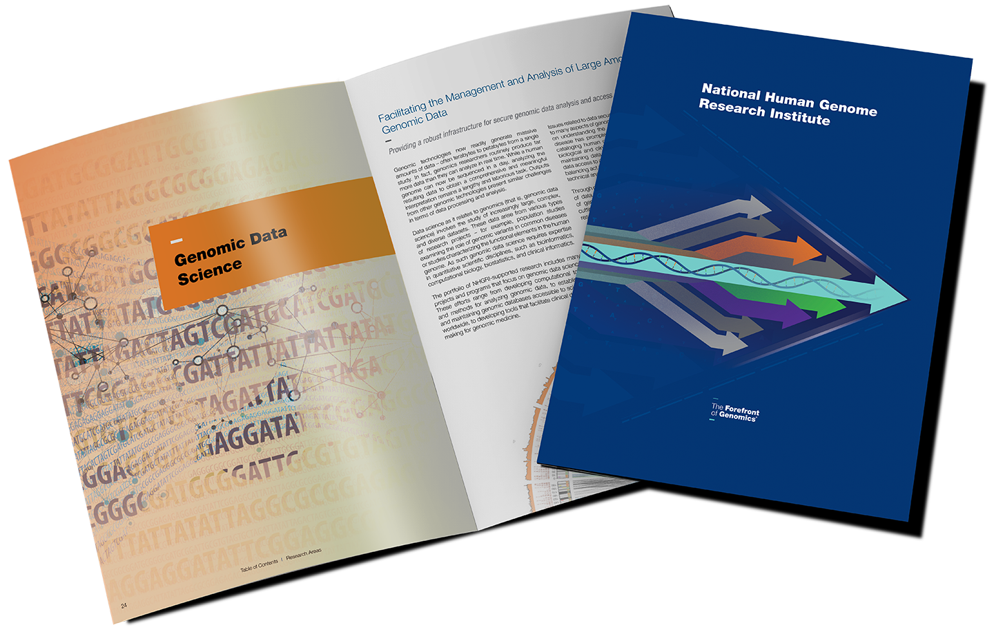
New NHGRI Brochure
    NHGRI’s history, organization, values, and major research areas
    PDF and ‘flipbook’ versions available at genome.gov/brochure
    Printed copies will be available on request
Document 1
Notes:
I am delighted to announce that today NHGRI is releasing a new and updated brochure about the Institute. Resulting from an immense amount of effort of numerous staff members, this ~35-page brochure nicely showcases the key elements of NHGRI.
Designed for a broad audience, * the brochure features information about NHGRI’s history, organization, and values. The brochure also highlights key Institute programs from our major research areas.
* PDF and ‘flipbook’ versions of the new NHGRI brochure are available immediately on NHGRI’s website (genome.gov) at the URL shown on this slide, and * printed copies will be available on request in the near future.

Slide 8
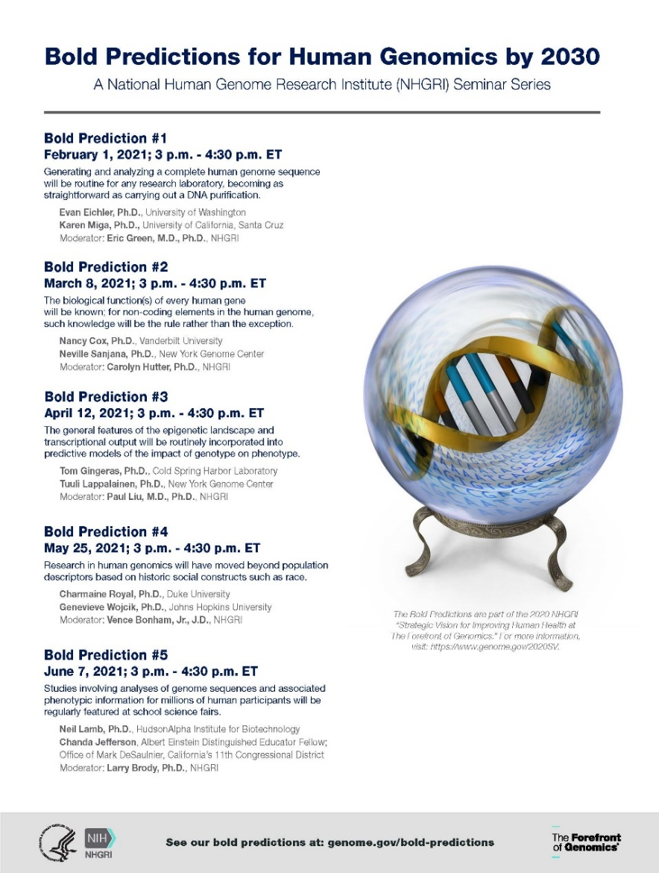
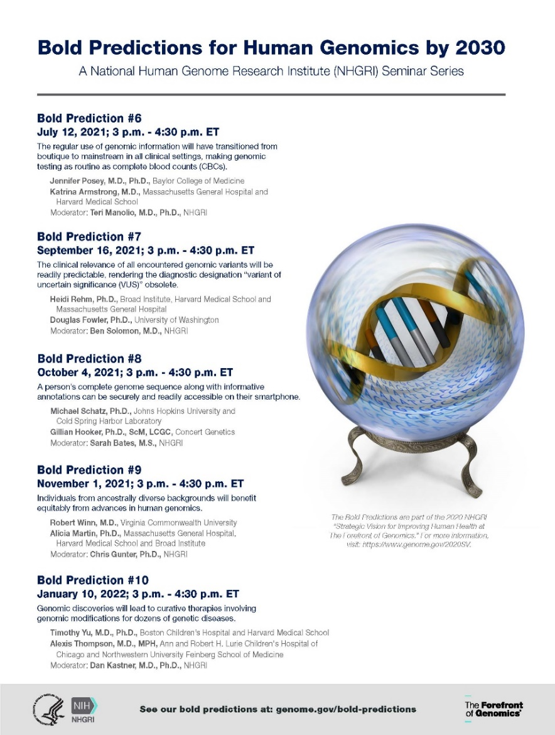
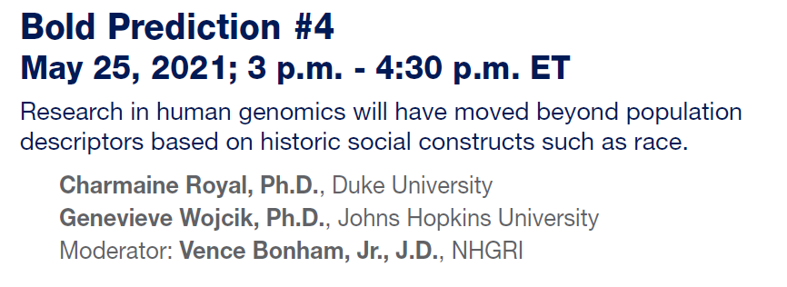
    Bold Predictions for Human Genomics by 2030
    NHGRI Seminar Series
Document 2
Notes:
At the February Council meeting, * I provided information about our new “Bold Predictions for Human Genomics by 2030” seminar series. At that time, I announced the first 5 sessions. * Now, I am pleased to share that the schedule for sessions 6-10 has been finalized.
As a reminder, for each seminar in the series, two speakers are invited to use a specific bold prediction as an aspirational theme for their talks, highlighting their own research in the context of that theme and speculating about the next decade in their research area. The sessions are open to the public and are recorded for later viewing on our GenomeTV channel of YouTube.
* The next session will be held on May 25 at 3:00 pm ET focusing on Bold Prediction #4: Research in human genomics will have moved beyond population descriptors based on historic social constructs such as race. This session will feature talks by Charmaine Royal of Duke University and Genevieve Wojcik of Johns Hopkins University. The session will be moderated by NHGRI’s Vence Bonham.
8

Slide 9
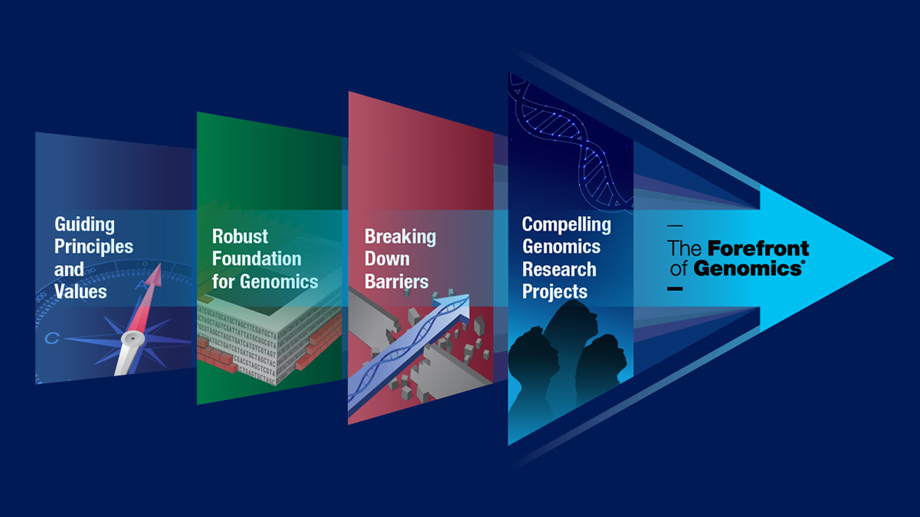
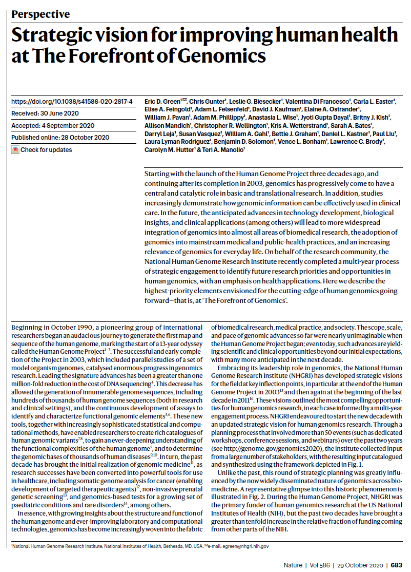
    NHGRI Strategic Plan for Congress
    NIH Institutes/Centers required to submit a plan every 5 years
    Companion document to go with 2020 NHGRI Strategic Vision
    Develop a framework for crafting next plan in 5 years
Document 3
Notes:
Under the 21st Century Cures Act, * all NIH institutes and centers are required to submit a strategic plan to Congress every five years in order to keep members updated on the work going on at NIH.
The Policy and Program Analysis Branch is currently drafting NHGRI’s required strategic plan for Congress. * This will be crafted as a companion document that will go along with our 2020 NHGRI Strategic Vision recently published in Nature. Relying heavily on the 2020 NHGRI Strategic Vision, the Institute’s strategic plan for Congress will highlight the Institute’s scientific objectives and priorities as well as underscore how NHGRI is serving as an efficient and effective steward of public resources.
* Through these efforts, we will also develop a framework for crafting the next strategic plan for Congress in 5 years, when there will not be a recently published strategic vision paper to submit at the same time.

Slide 10


NHGRI Staff Volunteer in Support of
Unaccompanied Children’s Program
Notes:
A number of NHGRI staff members have volunteered to support the Administration for Children and Families (or ACF), which is part of the Department of Health and Human Services, through the Unaccompanied Children’s Program at our southern border. As of today, 10 NHGRI staff members have volunteered their time and energy to this effort, and 1 NHGRI Commissioned Officer has been deployed on a long-term assignment.
NIH has well over 200 volunteers, who are being deployed to locations across the United States for 2-8 weeks at a time. Each volunteer first travels to a Personnel Mobilization Center in Dallas, Texas initially, and is later sent to another location (such as San Diego, California; San Antonio and Fort Bliss, Texas; Erie, Pennsylvania; and Miami, Florida, with new sites being added across the country as the program continues). Volunteers are providing logistical support, clinical support, and general oversight of the children until they can be placed with their families in the United States. It is a tough assignment, as you can imagine, but it can also be extremely rewarding. I am very impressed, although not surprised, to see such a giving spirit from the NHGRI staff.
10

Slide 11
Director’s Report Outline
General NHGRI Updates
General NIH Updates
General Genomics Updates
NHGRI Extramural Research Program
NIH Common Fund/Trans-NIH
NHGRI Communications, Policy, and Education
NHGRI Intramural Research Program
Notes:
Moving on to general NIH updates.
11

Slide 12
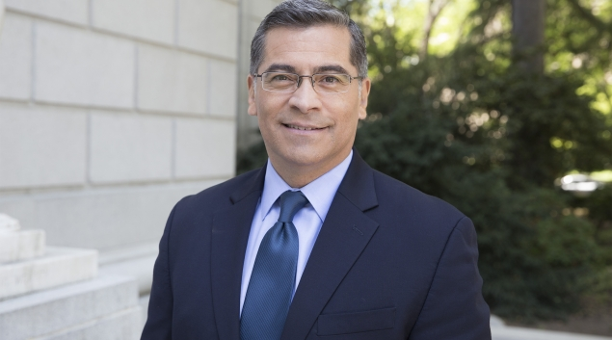
New Secretary, Department of Health
and Human Services
Xavier Becerra, J.D.
Document 4
Notes:
Xavier Becerra was recently sworn in as the 25th Secretary of the Department of Health and Human Services and the first Latino to hold the office in the history of the United States. As Secretary, he will focus on ensuring that all Americans have health security and access to healthcare. Previously, Secretary Becerra served 12 terms in Congress as a member of the U.S. House of Representatives and later served as Attorney General of the state of California.
Of note, while a member of the U.S. House of Representatives, he also served on the Smithsonian Board of Regents at the time when NHGRI forged its partnership with the Smithsonian’s National Museum of Natural History to create the exhibition Genome: Unlocking Life’s Code. The Board had to formally approve that partnership, and so I personally interacted with the then-Congressman at that time. I can tell you that he was very excited about genomics in general and the new genomics exhibition in particular, being extremely committed to supporting efforts for educating the general public about important new areas of science and medicine.
12

Slide 13



Departure of Director, National Center for
Advancing Translational Sciences
Chris Austin, M.D.
Joni Rutter, Ph.D.
Document 5
Notes:
Last month, Chris Austin departed as Director of the National Center for Advancing Translational Sciences (or NCATS). As Founding Director of NCATS, Chris led the Center’s efforts to transform translation from an empirical process into a predictive science. Prior to the establishment of NCATS, Chris was Senior Advisor and Director of the NIH Center for Translational Therapeutics, which was hosted by NHGRI.
In his new position, Chris will become CEO-partner at Flagship Pioneering, a life science platforms company in Cambridge, Massachusetts.
* Joni Rutter will serve as Acting Director of NCATS while a national search is conducted for a new NCATS Director.
13

Slide 14

NIH UNITE Initiative
U — Understanding stakeholder experiences through listening and learning
N — New research on health disparities, minority health, and health equity
I — Improving the NIH culture and structure for equity, inclusion, and excellence
T — Transparency, communication, and accountability with our internal and
external stakeholders
E — Extramural research ecosystem: changing policy, culture, and structure to promote workforce diversity
Document 6
Notes:
In March, NIH Director Francis Collins announced expansive new efforts for all of NIH to support equity, diversity, and inclusion in science. Organized as a multi-faceted initiative called UNITE, these efforts aim to address structural racism in biomedical research with the goal of ending racial inequities. The primary goals of the UNITE initiative are:
* U — Understanding stakeholder experiences through listening and learning.
* N — New research on health disparities, minority health, and health equity.
* I — Improving the NIH culture and structure for equity, inclusion, and excellence
* T — Transparency, communication, and accountability with our internal and external stakeholders.
* E — Extramural research ecosystem: changing policy, culture, and structure to promote workforce diversity.
NIH is committed to instituting new ways to support diversity, equity, and inclusion, as well as identifying and dismantling any policies and practices that may harm our workforce and our science. You can expect to be hearing more about the UNITE initiative, as well as the programs and policies that emanate from it, in the coming months.
14

Slide 15

NIH COVID-19 Information Resources
    NOT-OD-21-106: Continuation of Temporary Extension of Eligibility for the NIH K99/R00 Pathway to Independence Award During the COVID- 19 Pandemic
    RFA-OD-21-009: RADx-UP - Social, Ethical, and Behavioral Implications Research on Disparities in COVID-19 Testing among Underserved and Vulnerable Populations
Document 7
Notes:
I would like to remind you that there are several government websites available that provide relevant information about COVID-19, such as those at NIH and at the Centers for Disease Control and Prevention. For NIH grantees and applicants, a COVID-19 resource is available on the NIH Grants and Funding website. In addition, NIH regularly issues news releases regarding COVID-19-related research findings, and NIH Director Francis Collins’s blog regularly provides an excellent source of updated information.
* A recent notice announced the continuation of the temporary extension of eligibility for the NIH K99/R00 Pathway to Independence Award during the COVID-19 pandemic.
* And a recently released funding opportunity aims to support “Social, Ethical, and Behavioral Implications Research on Disparities in COVID-19 Testing among Underserved and Vulnerable Populations.”
*Also, Mike Lauer, NIH Deputy Director for Extramural Research, recently posted COVID-19 extramural survey results on his blog “Open Mike.”
15

Slide 16
Fiscal Year 2022 Appropriations
 | Fiscal Year 2021 Enacted | Fiscal Year 2022 President’s Budget Outline | $ Increase | % Increase
HHS | $108.6 B | $133.7 B | $25.1 B | 23.1%
NIH | $41.7 B | $51.0 B | $9.0 B * | 21.6%
NHGRI | $606.3 M | TBD | TBD | TBD
* ARPA-H would receive $6.5 billion of the $9 billion increase for NIH
Document 8
Notes:
The May Council meeting is typically the time when I can provide an appropriations update that features the first versions of the House and Senate appropriations bills. This year, the President’s budget outline was unveiled in mid-April (rather than the more-typical February release date). This is the opening gambit for the appropriations process that reflects the White House priorities, with the featured numbers not yet having granularity at the level of individual NIH institutes and centers. A more detailed President’s budget is expected to be released on May 27, and this updated budget should include institute- and center-specific numbers.
What we know so far from the President’s budget outline is that the White House is proposing some notable increases. The Department of Health and Human Services is proposed to be funded at $133.7 billion, reflecting a 23% increase over the Fiscal Year 2021 enacted numbers. The ask for NIH is $51 billion, reflecting a $9 billion increase. Of that $9 billion increase, $6.5 billion is proposed for a new Advanced Research Projects Agency-Health (or ARPA-H), which would be modeled after the Defense Advanced Research Projects Agency (or DARPA) and would aim to drive transformational innovation in health research. That would leave $2.5 billion as the increase for the rest of NIH.
Of course, this all reflects the President’s proposal, and there will be many twists and turns in the appropriations process before we end up with a final Fiscal Year 2022 appropriation, so stay tuned (and put on your seat belts).
16
16

Slide 17
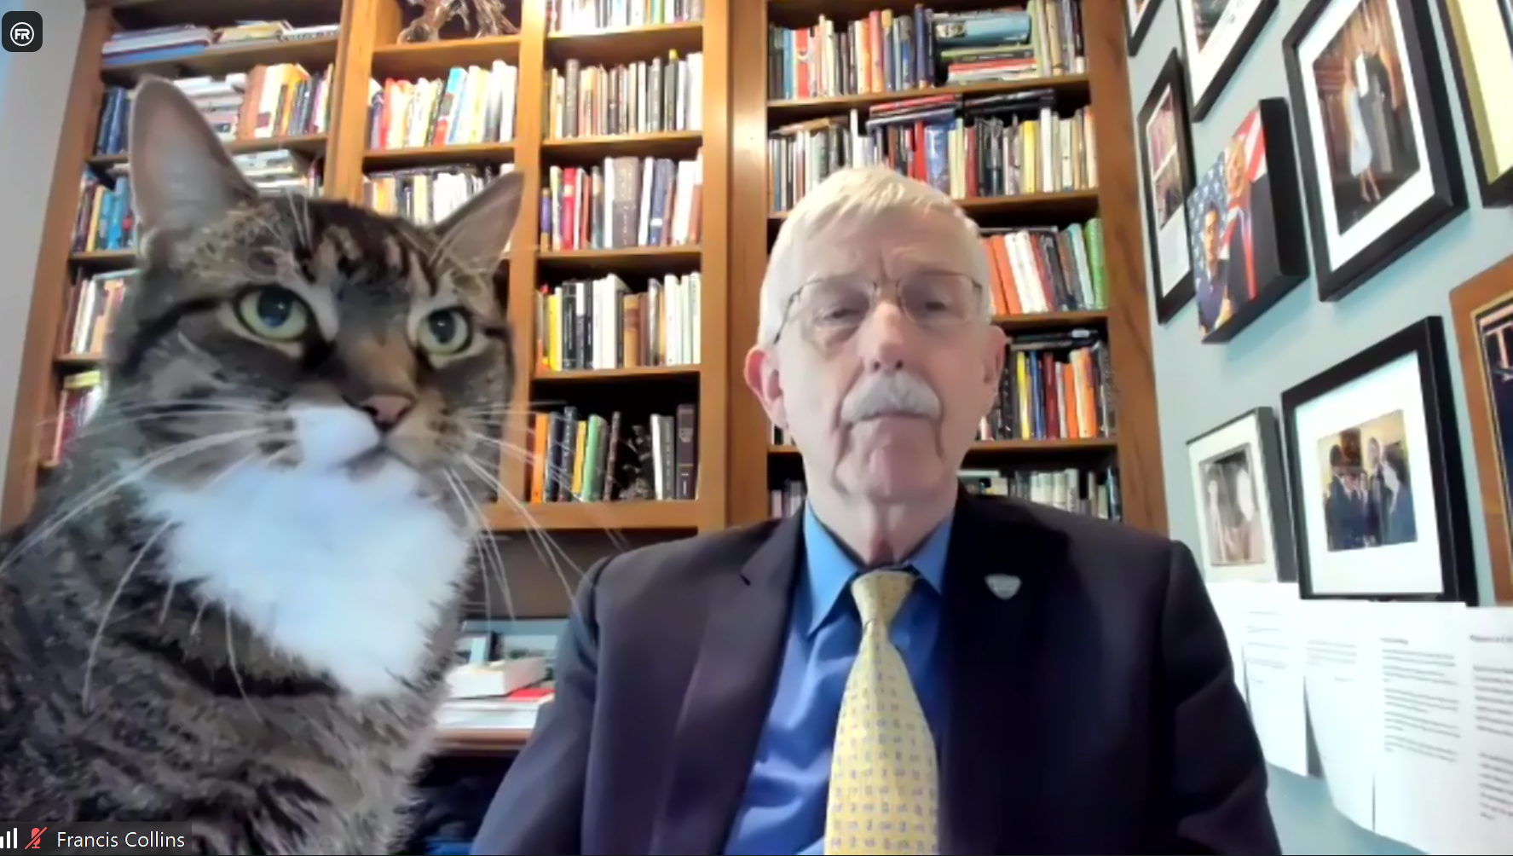
NIH Feline-in-Chief and Head NIH Zoom Bomber
Notes:
And finally, in late-breaking news, NIH Director Francis Collins recently announced his selection of * Zoe the Cat as the NIH Feline-in-Chief and Head NIH Zoom Bomber. In her new role, Zoe will be the ‘top cat’ for all things requiring feline input, including leading major research programs in the genetics of “its all about me” and the gastrointestinal consequences of fur balls. In addition, she will regularly break up the important work of the NIH Director by bombing his Zoom meetings and making people laugh during (what can sometimes be) rather boring Zoom gatherings. Finally, she will be launching a YouTube channel for cats of NIH staff members called “The Feline Bombers,” which will showcase the best cat Zoom bombing episodes that occurred during NIH meetings throughout the COVID-19 pandemic.
Zoe’s appointment will become official once she receives all government ethics and security clearances as well as takes all of the required online training, which might take so long that it actually happens in the next of her 9 lives. We will keep you updated about this important appointment as we learn more.
17
17

Slide 18
Director’s Report Outline
General NHGRI Updates
General NIH Updates
General Genomics Updates
NHGRI Extramural Research Program
NIH Common Fund/Trans-NIH
NHGRI Communications, Policy, and Education
NHGRI Intramural Research Program
Notes:
Moving on to general genomics updates.
18

Slide 19
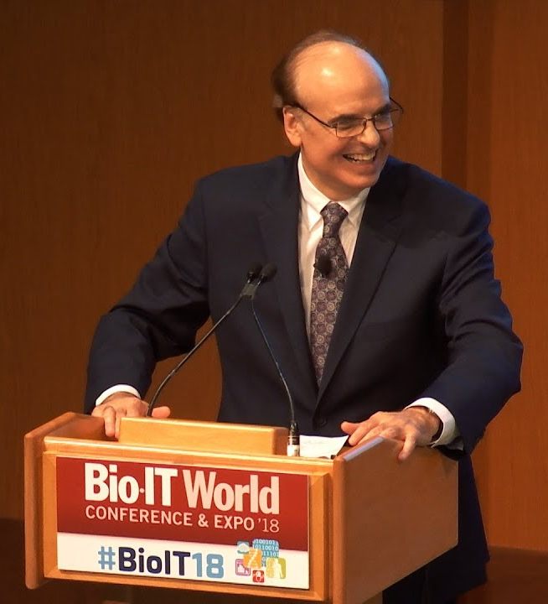
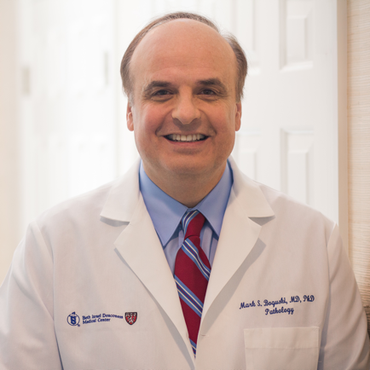
Mourning the Loss of Mark Boguski
Document 9
Notes:
Mark Boguski passed away on March 18, 2021 at the age of 66. Mark was a pioneer in bioinformatics and genomics. He was one of the original Medical Staff Fellows at the National Library of Medicine’s National Center for Biotechnology Information (or NCBI). During his career, he served on the faculties of Harvard Medical School, Beth Israel Deaconess Medical Center, Johns Hopkins University School of Medicine, and Fred Hutchinson Cancer Research Center. He also served as the Founding Director of the Paul Allen Institute for Brain Science and as Vice President of the Novartis Institute for Biomedical Research.
19

Slide 20

Elected to National Academy of Sciences
Katherine High
Kenneth Lange
David Liu
Olufunmilayo Olopade
NATIONAL
ACADEMY
OF SCIENCES
Document 10
Notes:
The National Academy of Sciences recently announced their newly elected members. Of particular relevance to the genomics community and to NHGRI are the individuals listed here.
20

Slide 21

Elected to American Academy of Arts & Sciences
Charles Rotimi
Sarah Tishkoff
Document 11
Notes:
Similarly, an impressive duo of genetics and genomics researchers (and NHGRI colleagues) were recently elected to the American Academy of Arts & Sciences. We extend our heartfelt congratulations to these colleagues.
21

Slide 22


2021 ACMG David L. Rimoin Lifetime Achievement
Award in Medical Genetics
Ada Hamosh, M.D., M.P.H, FACMG
Document 12
Notes:
Ada Hamosh, the Frank V. Sutland Professor of Pediatric Genetics and Clinical Director of the McKusick-Nathans Institute of Genetic Medicine at Johns Hopkins University School of Medicine, has received the 2021 ACMG Foundation for Genetic and Genomic Medicine’s David L. Rimoin Lifetime Achievement Award in Medical Genetics.
Ada was recognized with this award because of her commitment to teaching and mentoring, her energy and dedication while helping patients and their families, and her leadership in the creation of online resources – most notably as the Scientific Director of Online Mendelian Inheritance in Man (or OMIM) and co-creator of PhenoDB and GeneMatcher.
22

Slide 23
Director’s Report Outline
General NHGRI Updates
General NIH Updates
General Genomics Updates
NHGRI Extramural Research Program
NIH Common Fund/Trans-NIH
NHGRI Communications, Policy, and Education
NHGRI Intramural Research Program
Notes:
Moving on to the NHGRI Extramural Research Program.
23

Slide 24



    Genome Sequencing Program
    Final GSP datasets in AnVIL
    Joint GSP-TOPMed Workshop
    Data sharing
    Data analysis
Document 13
Notes:
NHGRI’s Genome Sequencing Program (or GSP) is composed of the Centers for Mendelian Genomics, Centers for Common Disease Genomics, and GSP Analysis Centers. The program aims to use genome sequencing to identify genes and genomic variants underlying human diseases. The program is wrapping up this year, and the centers that make up the GSP are working on their final products and finalizing data submissions in NHGRI’s Genomic Data Science Analysis, Visualization, and Informatics Lab-Space (or AnVIL).
All of the GSP components are working on final papers, resources, and analyses, which will be completed within the next 6-12 months.
* One recent highlight was the GSP Analysis Centers’ 5th annual joint workshop with the National Heart Lung and Blood Institute’s Trans-Omics in Precision Medicine (or TOPMed) program, which took place this past March. This workshop featured talks that described current GSP and TOPMed data sharing and availability in addition to talks addressing key aspects of genomic data analysis. 150-plus attendees participated in the workshop.

Slide 25
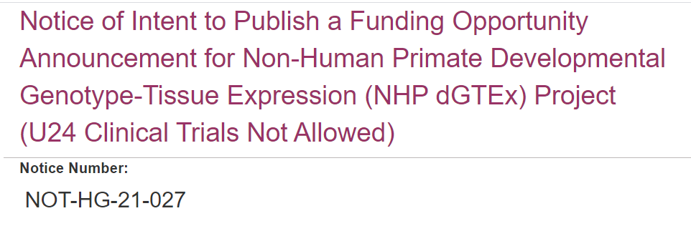
    Comparative Genomics
    Study gene-expression patterns in non-human primates and compare to humans
    Expected due date: Summer 2021
Document 14
Notes:
Comparative genomics involves using computational analysis tools to compare the genome sequences of different species. The study of a wide range of organisms continues to be instrumental for attaining a comprehensive view of vertebrate genome structure and function. * As a complement to the developmental Genotype-Tissue Expression project in humans (or dGTEx), NHGRI released a Notice of Intent to Publish a Funding Opportunity Announcement (or FOA) for a new Non-Human Primate dGTEX project.
* The major goal of this initiative is to study gene-expression patterns in multiple reference tissues across developmental stages in non-human primates and compare them to human gene-expression patterns. This opportunity is expected to be published in the coming months with an * expected due date in the Summer 2021. The notice, shown here, contains more details about the planned FOA to allow potential applicants sufficient time to develop meaningful collaborations and responsive projects.

Slide 26

Technology Development Program
Technology Development Program
Funding Opportunities:
Notice of Special Interest: Advancing Genomic Technology Development for Research and Clinical Application
NOT-HG-21-018
Transformative Nucleic Acid Sequencing Technology Innovation and Early Development
RFA-HG-21-007 (R01, also linked R21 and R43/44)
First due date: June 25, 2021
Document 15
Notes:
NHGRI’s Technology Development Program continues to expand and evolve, enabling new and improved technologies to foster genomic discoveries. I would like to highlight two funding opportunities.
* First, there is the Notice of Special Interest in Advancing Genomic Technology Development for Research and Clinical Application, which applies to the parent R01, R21, and omnibus small business announcements. This notice encourages a broad expanse of technology development research to enable new lines of scientific inquiry and clinical applications in human genomics. This notice uses standard due dates, with the next due date being this summer.
* Second, there is the Transformative Nucleic Acid Sequencing Technology Innovation and Early Development Requests for Applications (or RFAs), which include R01, R21, and small business announcements. These opportunities solicit applications to develop early stages of novel technologies that will enable greater than an order-of-magnitude improvement in one of two areas: DNA sequencing and direct sequencing of the diversity of entire RNA molecules. The first due date for these RFAs is June 25.

Slide 27

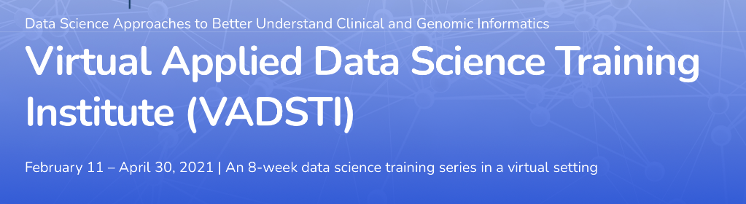
NHGRI Analysis, Visualization, and
Informatics Lab-space (AnVIL)
Genomic Data Science Community Network
      Partnerships from diverse spectrum of institutions
      Develop curricula for undergraduate students
Virtual Applied Data Science Training Institute
  Free eight-week training series
  AnVIL-led session on cloud computing
Document 16
Notes:
The NHGRI Genomic Data Science Analysis, Visualization, and Informatics Lab-space (or AnVIL) is a cloud-based infrastructure and software platform that provides an analysis and computing environment for unrestricted and controlled access of genomic and phenotypic datasets. Now in its third year, AnVIL has expanded its outreach efforts with a focus on training opportunities at both resource-rich institutions and those institutions not traditionally engaged in genomics research.
* In March, the AnVIL Outreach Team helped to organize the first meeting of the Genomic Data Science Community Data Network. This meeting brought together over 40 researchers. * The focus of the Network is to build partnerships from a diverse spectrum of institutions and develop meaningful curricula for undergraduate students.
* The AnVIL team has also partnered with the NIH Office of Data Science Strategy and Howard University’s Virtual Applied Data Science Training Institute (or VADSTI) to develop a free eight-week virtual training series. VADSTI aims to attract and engage underrepresented students and researchers interested in data science applications to biomedical, clinical, and genomics research, with a focus on diseases common to minority populations. The training sessions covered foundational analytic skills needed for research using big data, and included an AnVIL-led session on how to use cloud computing to make biomedical data science discoveries.

Slide 28
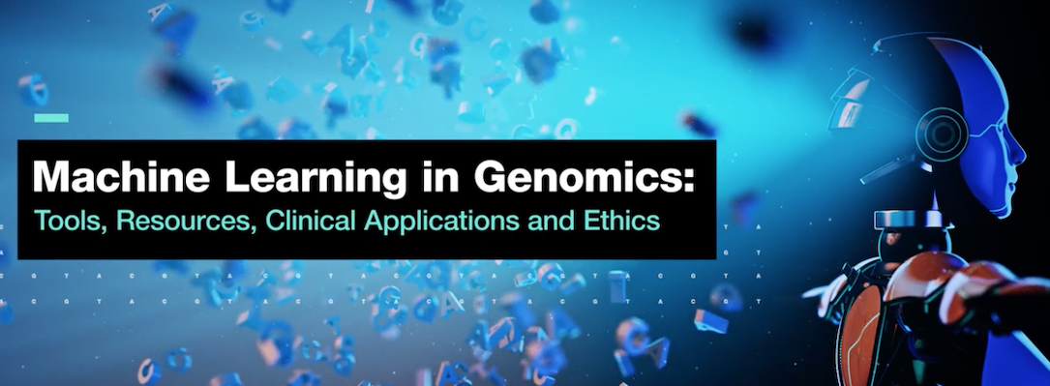
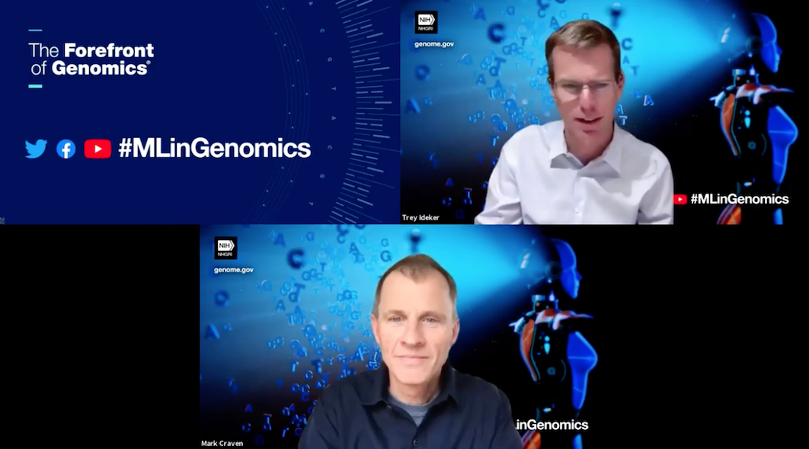
NHGRI Genomic Data Science Working Group
    Define key areas in genomics for machine learning analysis and NHGRI’s role in machine learning research for both genomic medicine and genomic sciences
    Nearly 1,800 participants
    Video recordings and presentations available on workshop webpage
Document 17
Notes:
The NHGRI Genomic Data Science Working Group of this Council hosted a virtual Machine Learning in Genomics Workshop last month. The goal was to define key areas in genomics for machine learning analysis and NHGRI’s unique role in machine learning research for both genomic medicine and genome sciences.
The event kicked off with two keynote presentations and moved on to four focused sessions exploring algorithm development; ethical, legal, and social implications; data and resource needs; and clinical applications for machine learning in genomics.
* The event generated tremendous interest, with nearly 1,800 participants from over 50 countries on Day 1 and about 1,500 participants in Day 2.
* Video recordings and presentations are now available on the workshop webpage.

Slide 29

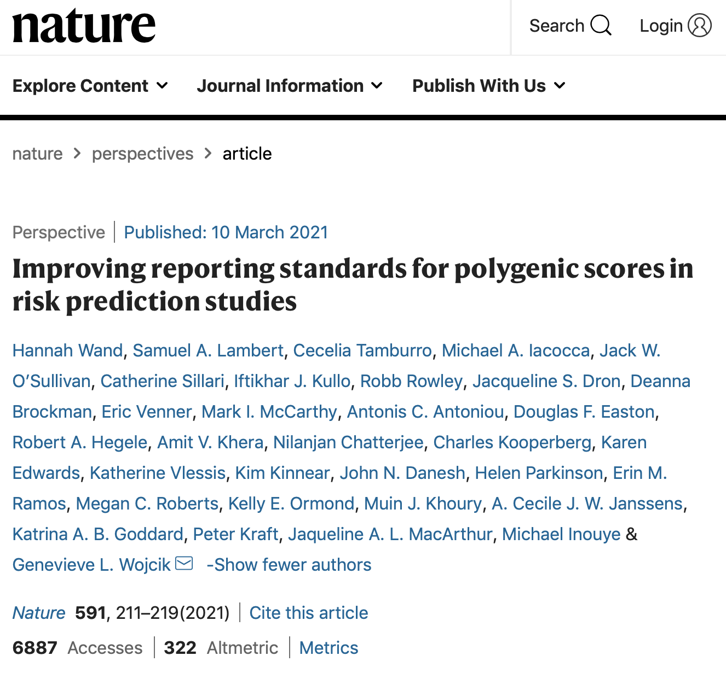
Clinical Genome Resource (ClinGen)
Complex Disease Working Group publishes reporting standards for polygenic scores
Includes guidance for:
  Score development
  Describing study populations
  Score evaluation
  Clinical applications
Document 18
Notes:
The Clinical Genome Resource (or ClinGen) evaluates and disseminates the clinical relevance of genes and genomic variants for use in precision medicine and research.
ClinGen’s Complex Disease Working Group collaborated with the Polygenic Score Catalog, an open database of polygenic scores and sister catalog to the NHGRI-EBI GWAS Catalog, to develop and publish a framework for generating and reporting on polygenic scores.
* The framework includes guidance for score development, including describing study populations, score evaluation, and score translation for clinical applications.
* Two of NHGRI’s outstanding program analysts were co-leads and co-authors of this paper, as highlighted here.
29

Slide 30

Curating the Clinical Genome (CCG)
ClinGen and DECIPHER Host Annual Conference
Topics included:
  Polygenic risk scores across populations
  Estimating penetrance
  Non-invasive prenatal testing
  Precision oncology
  Sharing data and associated clinical phenotypes
Document 18
Notes:
The ClinGen and DECIPHER consortia hosted the 5th Curating the Clinical Genome conference earlier this month, which brought together the clinical genomics and biodata communities to discuss best practices for the clinical use of genomic data, including interpretation and clinical utility as well as the consensus generation of curated knowledge.
* Topics included polygenic risk scores across populations, approaches to estimating penetrance, non-invasive prenatal testing, precision oncology, and sharing data and associated clinical phenotypes.
30

Slide 31

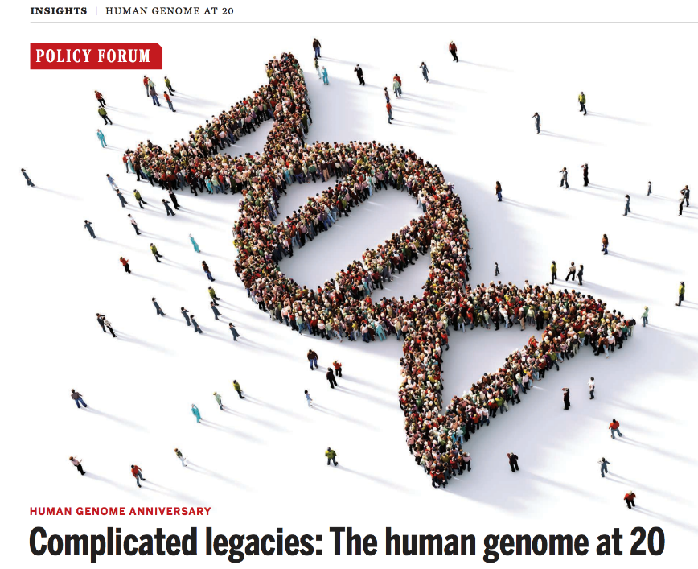
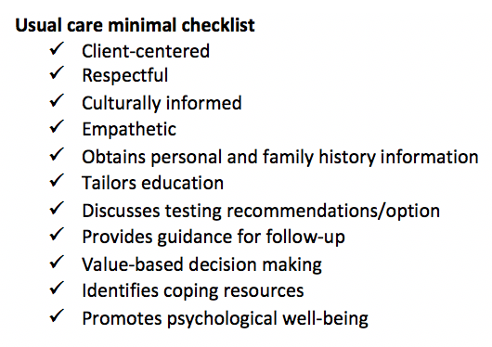
Clinical Sequencing Evidence-Generating
Research Program
    Phillips et al.: affordability and value are key to precision medicine implementation
    Biesecker et al.: definition of “usual care” in genetic counseling
    ACMG 2021: challenges and strategies for reporting findings in young patients
Document 19
Notes:
The Clinical Sequencing Evidence-Generating Research (or CSER) program aims to generate evidence related to the clinical utility of genome sequencing, with a major emphasis on participant diversity and engagement.
* The recent issue of Science commemorating the 20th anniversary of the draft sequence of the human genome included an article from CSER investigator Kathryn Phillips. Key points in the article are that precision medicine implementation requires consideration of both affordability and value and that research on how to best define these terms will continue to be needed.
* In February, CSER investigators led by Barbara Biesecker published an article addressing the need to define the term “usual care” in clinical genetic counseling research. Reviewing CSER protocols, published literature on randomized genetic counseling trials, and professional practice guidelines, the researchers proposed a working definition merging elements from existing professional resources, which is summarized in the minimal checklist shown here.
* At the American College of Medical Genetics and Genomics conference in April, CSER investigators presented 13 posters and 7 presentations. One highlight was a concurrent session at which several CSER talks addressed challenges in reporting secondary findings in young patients.

Slide 32


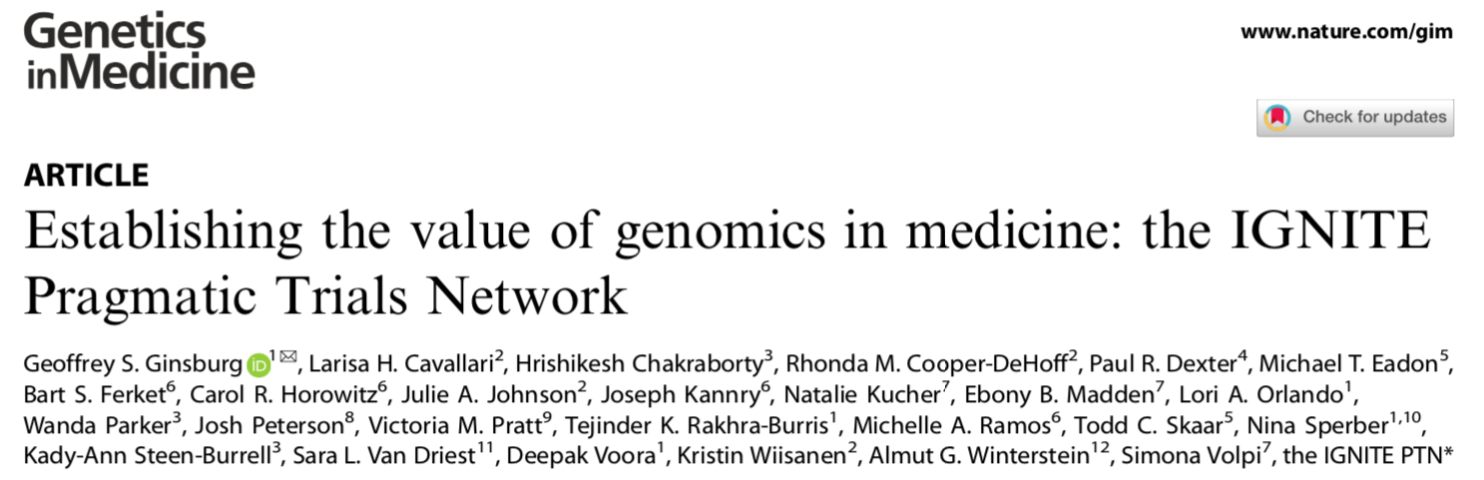
Implementing Genomics in Practice (IGNITE)
    GUARDD-US assesses knowledge of APOL1 variants on blood pressure management
      Over 1,850 of 5,435 participants enrolled
    ADOPT PGx investigates genotype-guided therapy on acute pain, chronic pain, and depression
      Over 50 of 4,500 participants enrolled
Document 20
Notes:
The Implementing Genomics in Practice (or IGNITE) Network is conducting pragmatic clinical trials to study the implementation of genomic medicine in diverse settings.
* The first trial, called the Genetic testing to Understand Renal Disease Disparities across the U.S. (or GUARDD US), will investigate whether knowledge that a participant is positive for a high-risk variant in APOL1, a gene associated with chronic kidney disease, results in a change in blood pressure management. As of May 5, GUARDD had enrolled over 1,850 of the planned 5,435 African American participants that the study aims to engage (as variants are found almost exclusively in African American populations).
* A Depression and Opioid Pragmatic Trial in Pharmacogenetics (or ADOPT PGx) comprises three coordinated trials studying whether pharmacogenomic testing and genotype-guided therapy improve acute pain, chronic pain, and depressive symptoms in participants who metabolize the relevant medicines at different rates than normal. The study team successfully enrolled the first participant in February 2021 and, as of May 5, over 50 participants (of a planned 4,500 total) had been enrolled.
*In March, the journal Genetics in Medicine published the IGNITE Pragmatic Clinical Trials Network marker paper, outlining how the Network will generate and share evidence about genomic medicine interventions.
32

Slide 33
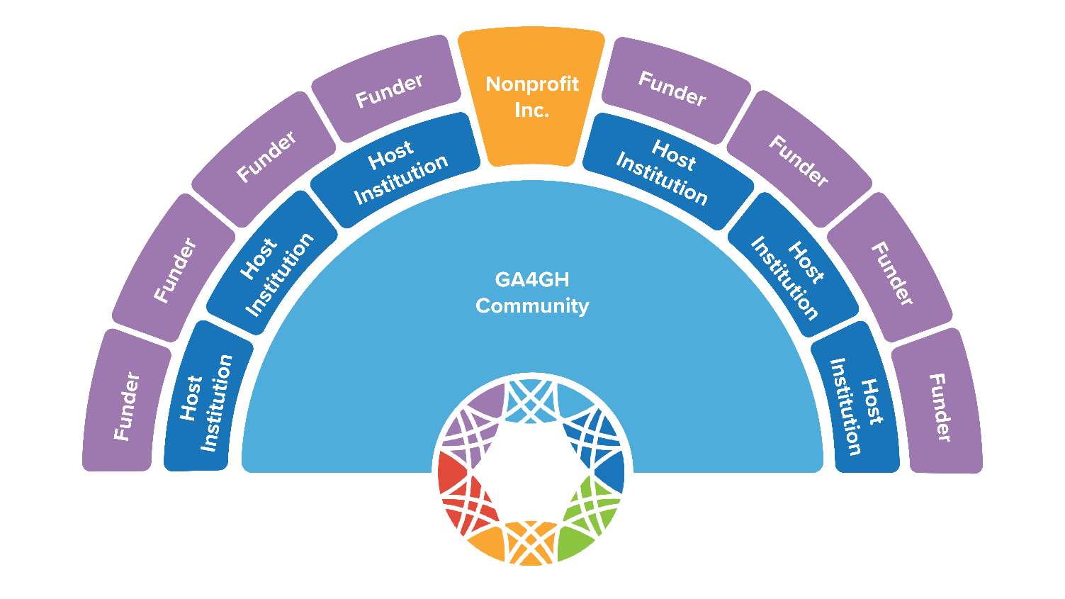
    Genomics in Healthcare: GA4GH in 2025
    Incorporated as not-for-profit “GA4GH, Inc.”
    U24 Community Resource (NHGRI, NCI, NHLBI, All of Us, ODSS)
    NIH Cloud Commons adopting GA4GH standards
Document 21
Notes:
The Global Alliance for Genomics and Health (or GA4GH) is an international standards body that aims to accelerate the responsible sharing of clinical and genomic data. The GA4GH marker paper, “Genomics in Healthcare: GA4GH looks to 2025,” has been submitted as part of a collection of papers to Cell Genomics.
* In December 2020, GA4GH was incorporated as a Canadian not-for-profit organization. The legal entity “GA4GH, Inc.” will act as the keystone of the Alliance, working alongside contributors, funders, and host institutions for long-term sustainability. The CEO is Peter Goodhand of the Ontario Institute for Cancer Research. Ewan Birney of the European Bioinformatics Institute leads the Executive Committee.
* In February 2021, NHGRI co-funded a GA4GH U24 community resource grant to Heidi Rehm at the Broad Institute (along with our NIH partners, specifically NCI, NHLBI, the All of Us Research Program, and the NIH Office of Data Science Strategy).
* Finally, the NIH Cloud Commons is now adopting GA4GH standards for its researcher authentication steps.

Slide 34
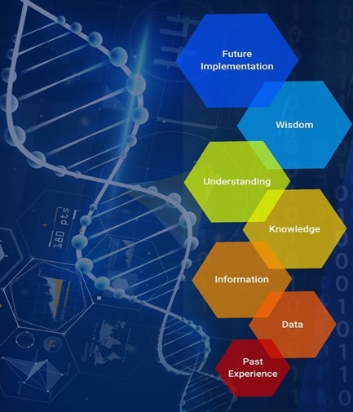
    Genomic Medicine Meeting XIII
    Developing a Clinical Genomic Informatics Research Agenda
To develop a research strategy for using genomic-based clinical informatics tools and resources to improve the detection, treatment, and reporting of genetic disorders in clinical settings
Key recommendations included:
Incorporate an implementation component within the overall clinical informatics research framework
Advance research to better understand the interface between human cognition and information technology
Develop methods to identify and mitigate inherent and pervasive biases
Document 22
Notes:
This past February, the Genomic Medicine Working Group of this Council planned and virtually hosted the 13th Genomic Medicine meeting (or GM XIII) entitled “Developing a Clinical Genomic Informatics Research Agenda.” The meeting’s goal was to develop a research strategy for using genomic-based clinical informatics tools and resources to improve the detection, treatment, and reporting of genetic disorders in clinical settings.
Six sessions were held, during which experts from government agencies, the private sector, and academia discussed topics related to genomic medicine and clinical informatics.
* Key recommendations from the meeting included: * incorporate an implementation component within the overall clinical informatics research framework; * advance research to better understand the interface between human cognition and information technology to improve patient care; * and develop research methods to identify and mitigate inherent and pervasive biases in data, information systems, access, knowledge, and clinical algorithms.
The outcomes and themes from this meeting will be used to develop a manuscript for publication and to explore potential funding directions and opportunities. Video recordings, presentations, and additional information from the GMXIII meeting can be found on the meeting’s website.

Slide 35
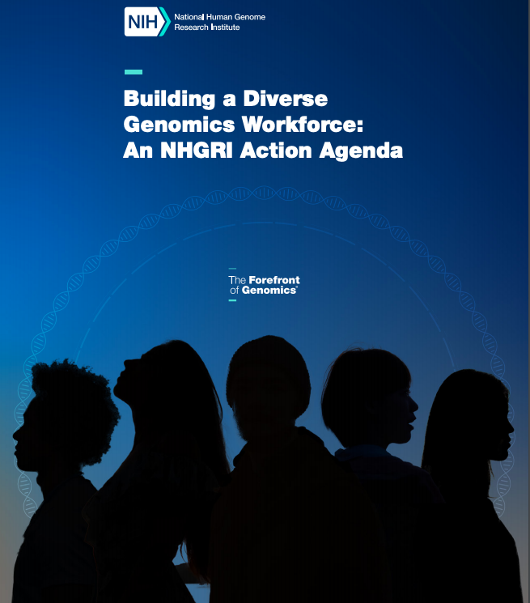
Training and Career Development
    Enhancing the Diversity of the Genomics Workforce
New FOAs:
PAR-21-143
F99/K00 – NHGRI Predoctoral to Postdoctoral Transition Award to Promote Diversity
PAR-21-214
K18 – Short-term Mentored Research Career Enhancement Award to Promote Diversity
FOAs Under Development:
R01 – Grants for New Investigators to Promote Diversity in Genomics Research
R25 – Genome Research Experiences to Attract Talented Undergraduates into the Genomics Field to Promote Diversity (GREAT)
Document 23
Notes:
To enhance the diversity of the genomics workforce and to strive towards the goals of our new Action Agenda, NHGRI is developing new initiatives to increase the participation of diverse students and faculty members in genomics research.
* The Institute recently released the F99/K00 Funding Opportunity Announcement (or FOA) to support graduate students from diverse backgrounds in their transition to postdoctoral positions and the K18 Funding Opportunity Announcement to support the training of faculty members from diverse backgrounds in genomics.
* Currently, two Funding Opportunity Announcements are also under development. The R01 Funding Opportunity Announcement will allow faculty members to develop independent research, while the GREAT program Funding Opportunity Announcement will provide research experiences to undergraduate students with the aim of attracting such individuals to graduate programs in genomics.
Applications for these programs will be funded in Fiscal Year 2022.

Slide 36
Director’s Report Outline
General NHGRI Updates
General NIH Updates
General Genomics Updates
NHGRI Extramural Research Program
NIH Common Fund/Trans-NIH
NHGRI Communications, Policy, and Education
NHGRI Intramural Research Program
Notes:
Moving on to the NIH Common Fund and other trans-NIH efforts.
36

Slide 37

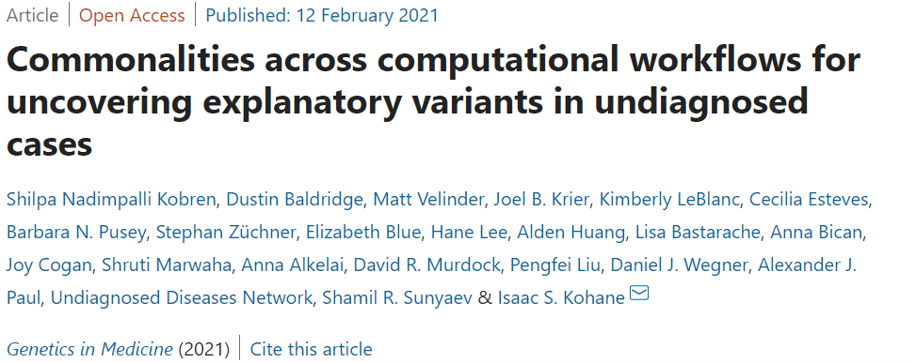
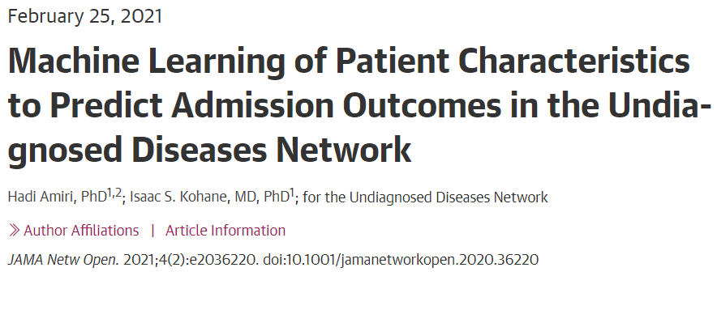
Undiagnosed Diseases Network (UDN)
Investigated commonalities across genome-sequencing processing workflows
Advances in structural variant detection, noncoding variant interpretation, and integration of additional biomedical data promising for solving undiagnosed cases
Developed and evaluated machine learning model to prioritize evaluation of patients with undiagnosed diseases by retrospective and prospective validation
Predictive model may reduce the processing time for accepted applications by two thirds
Document 24
Notes:
In February 2021, the Undiagnosed Diseases Network published two bioinformatics papers. * The first paper by Kobren et al. investigated the commonalities in the genome-sequencing processing workflows across the 11 UDN Clinical Sites. It concluded that advances in structural variant detection, noncoding variant interpretation, and integration of additional biomedical data may be especially promising for solving cases that have long eluded a clear diagnosis.
* The second study by Amiri et al. developed and evaluated a machine learning model to prioritize evaluation of patients with undiagnosed diseases by retrospective and prospective validation. They found that this predictive model may reduce the processing time for accepted patients by two thirds – from 3.3 months to 1.1 months – by ordering UDN applications based on the likelihood of acceptance.
These bioinformatic efforts contribute towards the overarching UDN model of solving undiagnosed cases and improving the diagnostic journey for patients with undiagnosed diseases.
37

Slide 38
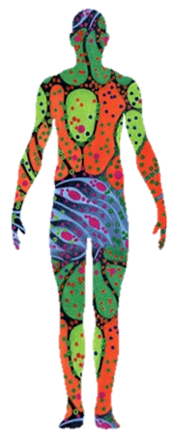
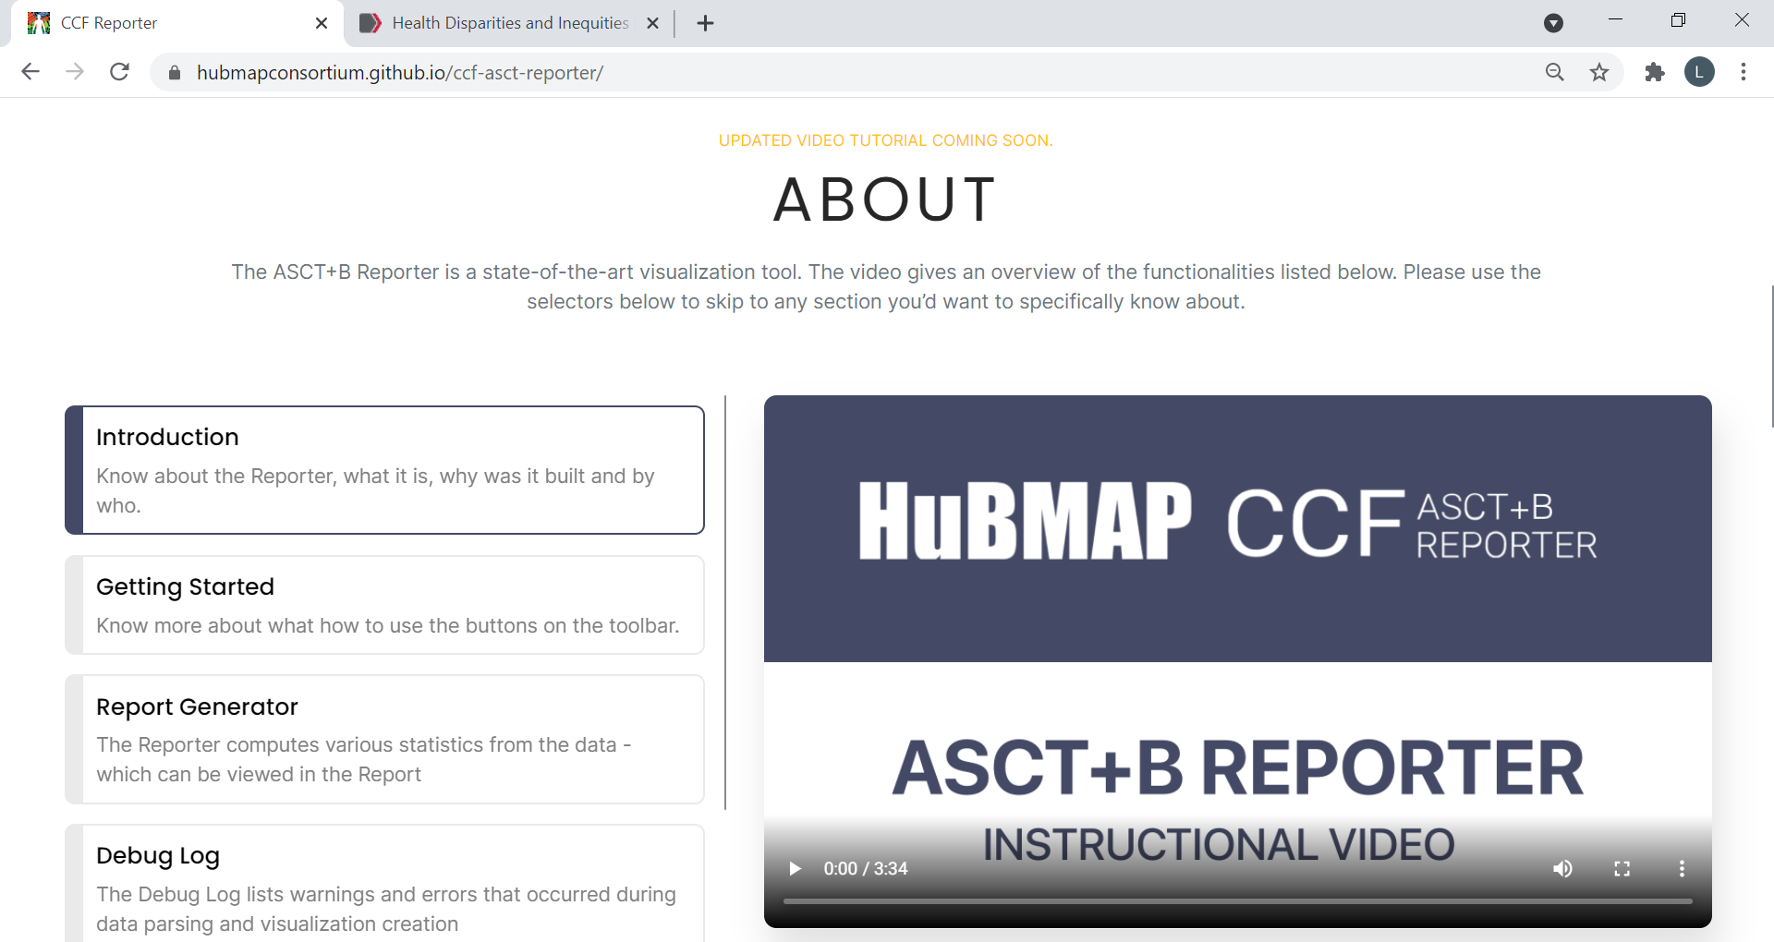
Human Biomolecular Atlas Program (HuBMAP)
    Community effort to relate anatomical structures and cell types to ontologies
    Opportunities for trainees and early career investigators:
      Student Genome Internship Program for Undergraduates
      Jump Start Program for Junior Investigators
Document 25
Notes:
The NIH Common Fund Human Biomolecular Atlas Program (or HuBMAP) aims to catalyze development of an open global framework for comprehensively mapping the human body at cellular resolution and to determine how the relationships between cells can affect the health of an individual.
* HuBMAP recently launched a community effort to identify organ-specific anatomical structures and major cell types and relate them to existing ontologies. HuBMAP is inviting the community to contribute to this effort.
* HuBMAP has also launched two opportunities for undergraduates and early career investigators. The Student Genome Internship Program for Undergraduates provides the opportunity for undergraduate students from populations underrepresented in the biomedical sciences to participate in research, mentorship, and training activities within the HuBMAP consortium. The program received over 50 applications, and HuBMAP labs will host eight students from institutions across the country for this virtual summer internship. The Jump Start for Junior Investigators program provides junior investigators within HuBMAP an opportunity to undertake scientific projects to help advance their career and develop their independence in the workplace. The first cohort for this program includes investigators from Purdue, Yale, and Vanderbilt. HuBMAP intends to continue both programs in the future.

Slide 39


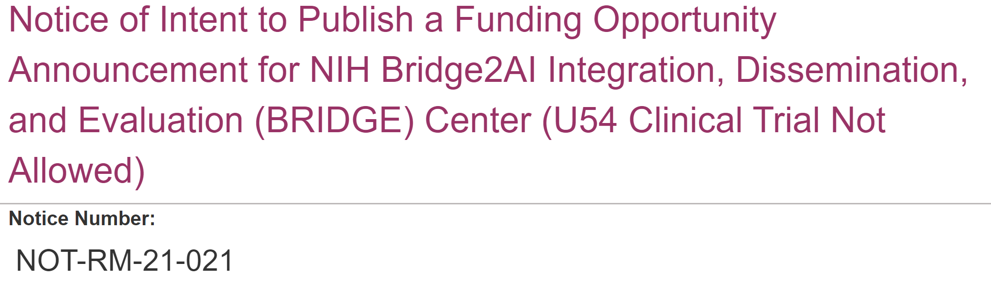
    Bridge to Artificial Intelligence (Bridge2AI)
New NIH Common Fund Program
Document 26
Notes:
The NIH Common Fund recently launched the Bridge to Artificial Intelligence (or Bridge2AI) Program. The Bridge2AI Program will propel biomedical research forward by setting the stage for widespread adoption of artificial intelligence (or AI) that tackles complex biomedical challenges beyond human intuition. A key step in this process is generating new “flagship” datasets and best practices that adhere to the FAIR (Findable, Accessible, Interoperable, and Reproducible) principles and critically integrate ethical considerations in preparing data for computation. I serve as one of four co-chairs for this Common Fund Program.
Two Bridge2AI Notices of Intent to Publish were released last month. * The first relates to a planned Funding Opportunity Announcement for Data Generation Projects of the program. * The second relates to a planned Funding Opportunity Announcement for an Integration, Dissemination, and Evaluation Center. The anticipated application due date for both opportunities is this coming August. Potential applicants are encouraged to visit the Bridge2AI website for updates and additional information.

Slide 40
Director’s Report Outline
General NHGRI Updates
General NIH Updates
General Genomics Updates
NHGRI Extramural Research Program
NIH Common Fund/Trans-NIH
NHGRI Communications, Policy, and Education
NHGRI Intramural Research Program
Notes:
Moving on to NHGRI activities in the areas of communications, policy, and education.
40

Slide 41
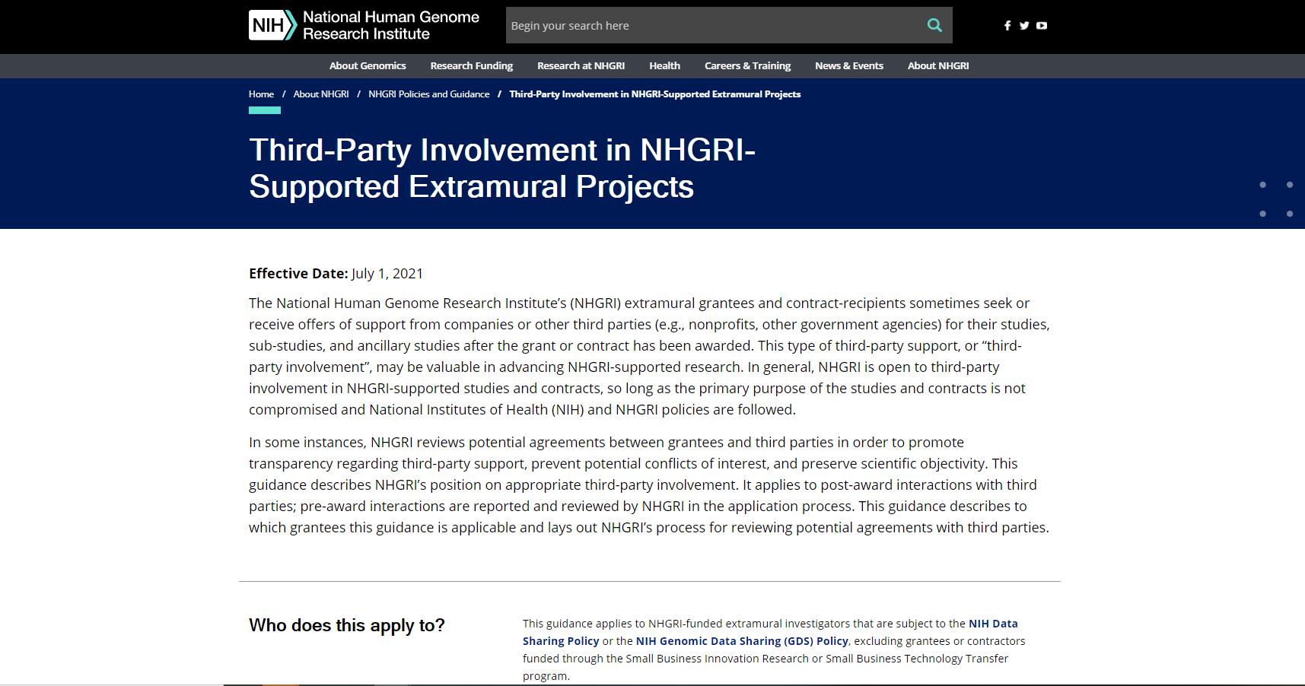
    NHGRI Guidance for Third-Party Involvement in Extramural Research
Document 27
Notes:
NHGRI extramural grantees and contract recipients sometimes seek or receive offers of support from companies or other third parties (for example, nonprofit organizations or other government agencies) for their studies, sub-studies, and ancillary studies after the grant or contract has been awarded. This type of third-party support (or “third-party involvement”) may be valuable for advancing NHGRI-supported research. In general, NHGRI is open to third-party involvement in NHGRI-supported studies and contracts, so long as the primary purpose of the studies and contracts is not compromised and all NIH and NHGRI policies are followed.
To that end, NHGRI has developed a guidance for Third-Party Involvement in NHGRI-Supported Extramural Projects, which outlines the type of third-party involvement NHGRI generally finds appropriate. Effective July 1, grantees and contractors who are considering whether to enter into such an agreement should consult this guidance prior to doing so. If the grantee, contractor, or project governance body is unsure whether the third-party’s involvement in their research adheres to this guidance, they should contact their respective program director(s) and submit information about the proposed third-party involvement to NHGRI. The Institute will review the proposed agreement and then provide a recommendation on how to proceed.

Slide 42

    NHGRI Data Sharing Expectations:
    Sharing Quality Metadata and Phenotypic Data
    NHGRI-funded and -supported researchers are expected to:
    Share metadata and phenotypic data associated with the study
    Use standardized data-collection protocols and survey instruments for capturing data, as appropriate
    Use standardized notation for metadata to enable the harmonization of datasets for secondary research analyses
Document 28
Notes:
Providing sufficient and well-structured metadata is a key component of abiding by the FAIR principles for scientific data management and sharing. FAIR datasets maximize investments in biomedical research.
In February, * NHGRI published a notice announcing that the Institute will expect investigators generating data that will be shared according to NIH data-sharing policies to be diligent about also sharing the associated metadata. Also, in these situations, NHGRI expects comprehensive phenotypic data associated to be shared as well. * NHGRI also expects investigators to use standard data-collection protocols and survey instruments for capturing data, as appropriate; as well as * to use standardized notation for metadata (i.e., controlled vocabularies or ontologies) to enable the harmonization of datasets for secondary research analyses. These expectations will go into effect on June 5.

Slide 43


NHGRI Communications Video Wins Journalism Award
  NHGRI science writer Prabarna Ganguly wins DCSWA Newsbrief Award for “The Human Pangenome” video
Credit: Massive Science/NHGRI
Document 29
Notes:
I am pleased to report that the DC Science Writers Association recently awarded NHGRI science writer, Prabarna Ganguly, the Newsbrief Award in short journalism in the multimedia category for her work in script writing and producing the NHGRI communications video, "The Human Pangenome."
The video creatively describes the important work being done by NHGRI through the Telomere-to-Telomere Consortium and the Human Genome Reference Program. In the association's press release, a judge astutely noted that "Explaining DNA is never easy, so I was impressed by their mastery of blending animation and strong writing to effectively tell a story.“
Congratulations to Prabarna and the entire communications team for their tremendous work in producing this video.

Slide 44


    Conversations with trailblazing science communicators
Document 30
Notes:
Throughout 2021 and 2022, NHGRI will host a Genomics and the Media virtual lecture series featuring trailblazers in science communication. Each distinguished speaker is an expert in communicating genomics across different media, including radio, podcasting, writing, speaking, publishing, and everything in-between. The series aims to demonstrate the various approaches for communicating about genomics as well as the unique challenges and opportunities that each medium can bring. The first event will feature Apoorva Mandavilli from the New York Times on May 20.
To register and learn more, please visit the series website.

Slide 45
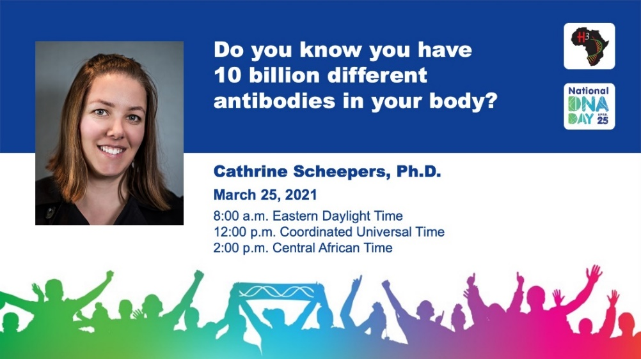
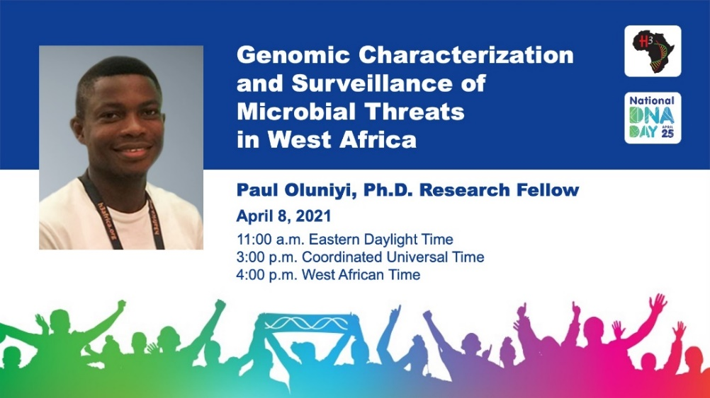

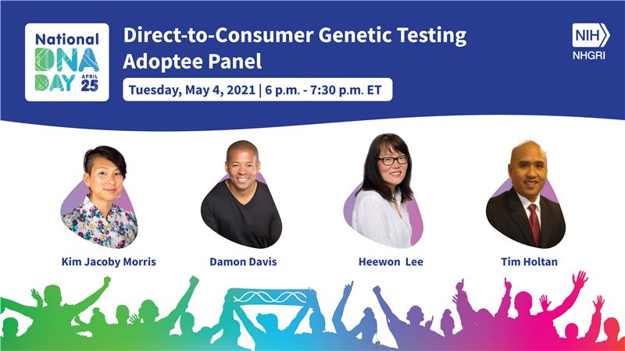
National DNA Day 2021
Document 31
Notes:
April 25 is National DNA Day, and every year, NHGRI hosts several programs and offers educational resources to mark the occasion. This year, DNA Day was celebrated virtually.
* NHGRI hosted two H3Africa DNA Day presentations featuring the two H3Africa researchers shown here.
* On April 23, NHGRI hosted Rebecca Johnson, Chief Scientist at the Smithsonian National Museum of Natural History, for the Louise M. Slaughter National DNA Day Lecture. Dr. Johnson shared her ‘DNA-driven’ science journey, which includes establishing the first accredited wildlife forensic laboratory in the southern hemisphere and working on conservation genomics of some of Australia’s most iconic wildlife species.
* Finally, on May 4, NHGRI’s Kim Jacoby Morris moderated a panel discussion with community leaders entitled "Genetic Ancestry Testing, Identity, and the Adoptee Perspective."

Slide 46

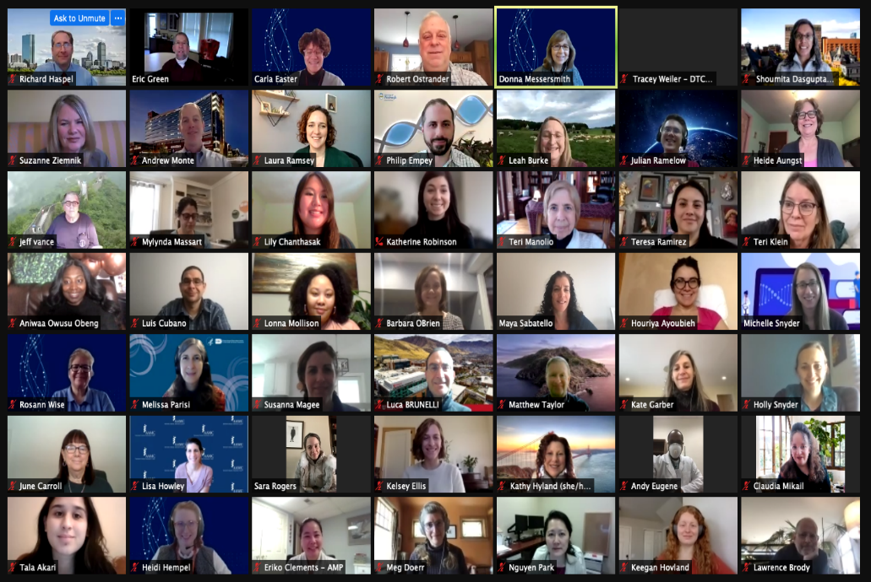
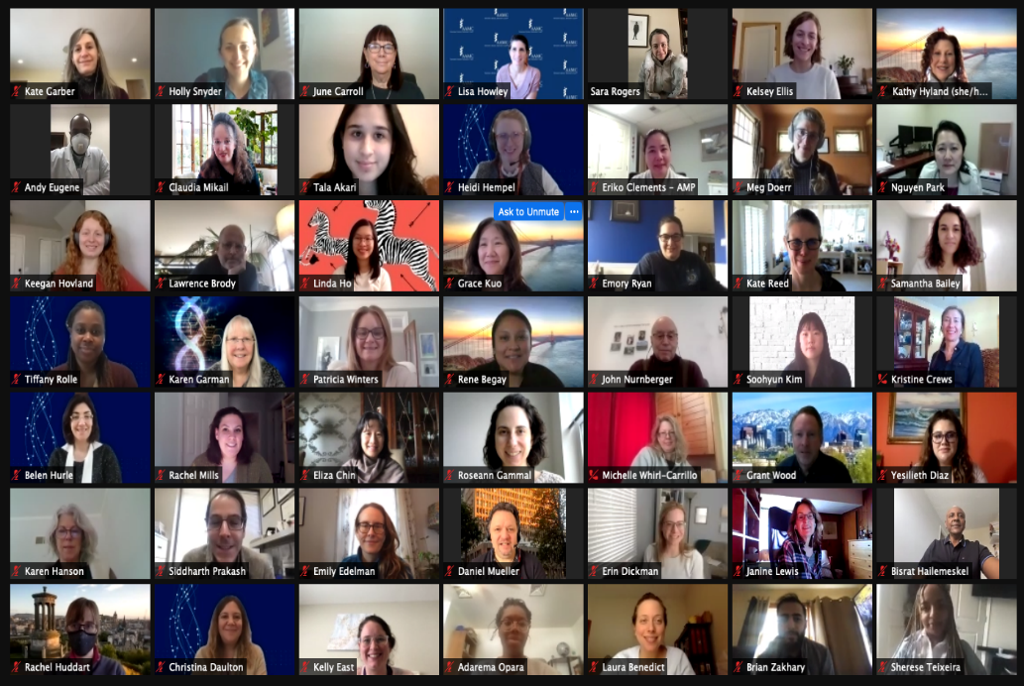
Inter-Society Coordinating Committee for
Practitioner Education in Genomics
10th “In-Person” Meeting
Document 32
Notes:
The Inter-Society Coordinating Committee for Practitioner Education in Genomics (or ISCC-PEG) aims to improve practitioner genomic literacy and enhance the practice of genomic medicine through the sharing of educational resources and joint identification of educational needs. ISCC-PEG membership now includes over 200 representatives from societies, professional organizations, NIH institutes, industry, as well as individuals with expertise in medical education. 57 new members joined this year, including 4 new ISCC-PEG Scholars who will be mentored by ISCC-PEG members.
This year’s ISCC-PEG Annual Meeting was held virtually in February. Almost twice as many members registered for this year’s meeting compared to last year’s gathering.

Slide 47
Director’s Report Outline
General NHGRI Updates
General NIH Updates
General Genomics Updates
NHGRI Extramural Research Program
NIH Common Fund/Trans-NIH
NHGRI Communications, Policy, and Education
NHGRI Intramural Research Program
Notes:
47
And finally, moving on to NHGRI’s Intramural Research Program.

Slide 48
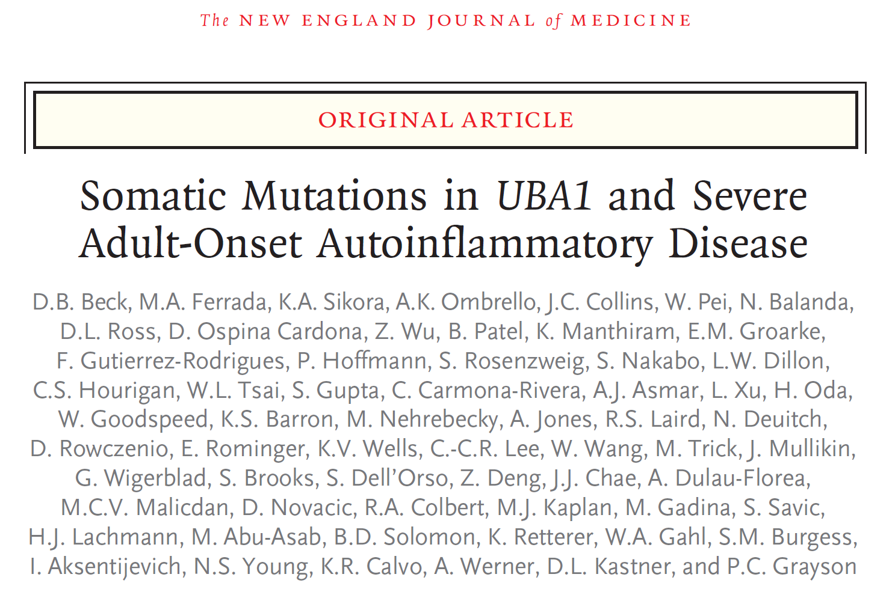
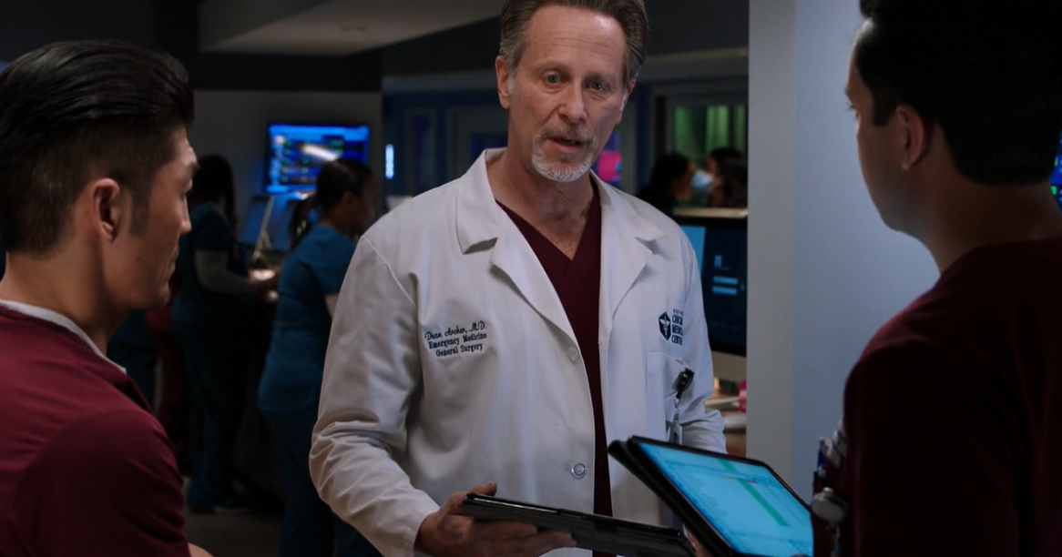
Genome Sequencing on Prime-Time TV
NEJM 2020
Notes:
As we come to the end of my Director’s Report, here is a little fun.
A spring episode of the TV show “Chicago Med” featured the genetic disease VEXAS, a syndrome that was very recently discovered and reported by Dan Kastner’s research group within the NHGRI Intramural Research Program. One of the story lines in the episode of Chicago Med includes a patient who presents to the emergency room with red ears and a fever. One of the senior physicians suggests that it could be this newly described disease called VEXAS, which was met by skepticism from the younger members of the medical team. But later, when genome-sequencing results came back, the skeptics declared “you’re right - genetic sequencing found that mutation” and confirmed that the patient did indeed have VEXAS.
Congratulations to Dan Kastner and his research group for not only publishing their landmark 2020 New England Journal of Medicine paper reporting the new syndrome called VEXAS, but also for the rapid uptake of their discovery by Hollywood.
The episode (which was Chicago Med’s episode 9 of season 6 ) aired on March 17.

Slide 49
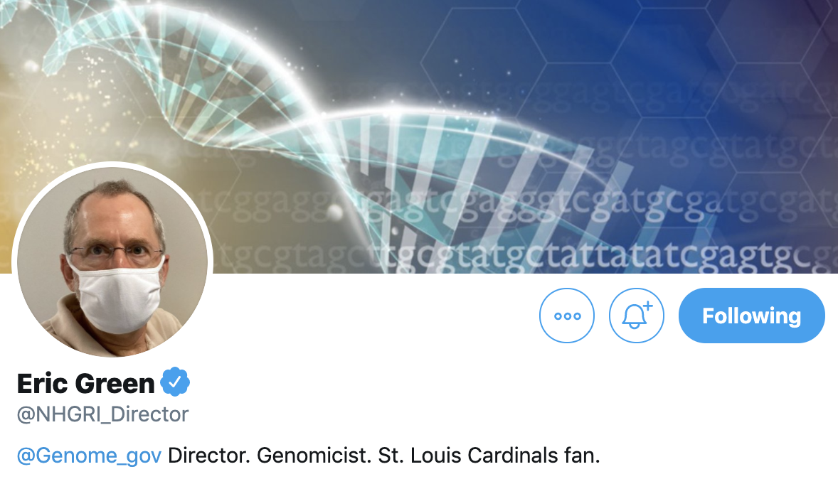
NHGRI Director on Twitter
Document 33
Notes:
Before closing, let me remind you that I can be followed on Twitter at @NHGRI_Director, where I communicate regularly about NHGRI and genomics to various stakeholders.

Slide 50

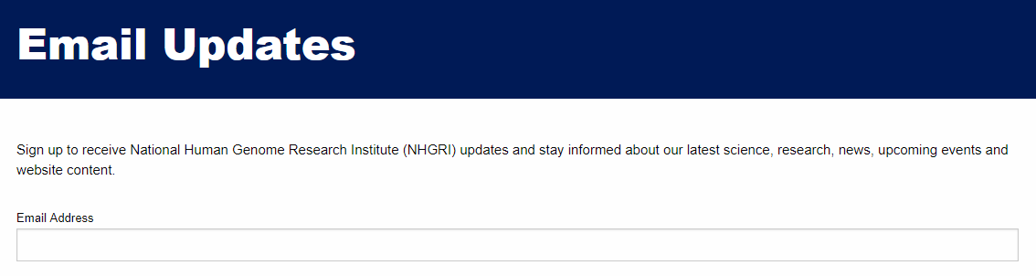
Document 34
Notes:
And for those of you who only want to hear from me once a month, you are welcome to sign up to receive my monthly email update (called The Genomics Landscape) on the NHGRI website (genome.gov) by subscribing under “Email Updates.”
50

Slide 51

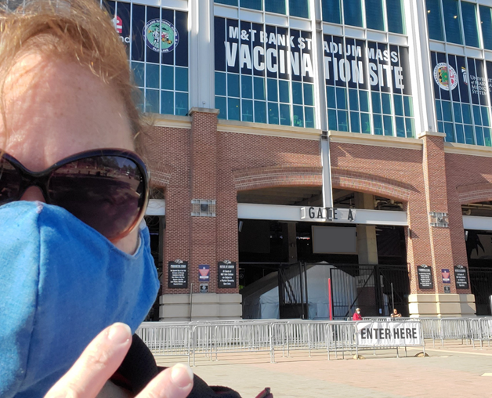
Thanks!
Special Thanks!
Notes:
Finally, a personal thanks to the many NHGRI staff members who contributed the slides and associated materials that I just reviewed in my Director’s Report. As always, a group effort is essential for getting such a large amount of information conveyed efficiently at each Council meeting.
An additional thanks to the NHGRI communications group and web team for making my Director’s Report into an electronic resource.
And * a special thanks to the usual ‘ringleader’ for helping me prepare my Director’s Report, Kris Wetterstrand (shown here after receiving her second dose of the COVID-19 vaccine).
51

Slide 52
Notes:
52

