Slide 1



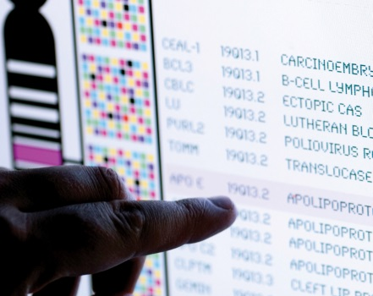
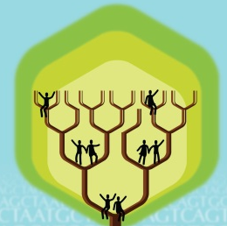
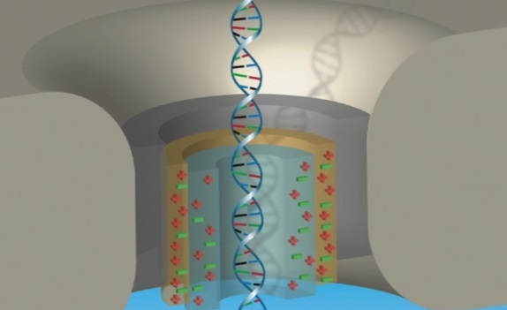


DIRECTOR’S REPORT
Eric Green, M.D., Ph.D.
Director, NHGRI
February 2023
Notes:
I would again like to welcome all of you to this Open Session of the National Advisory Council for Human Genome Research meeting, including my NHGRI colleagues who are here with me in this conference room and those watching me remotely.
As with the rest of the Open Session, my Director’s Report presentation is being videorecorded, and that recording will be made available as a permanent archive on NHGRI’s website (genome.gov)

Slide 2
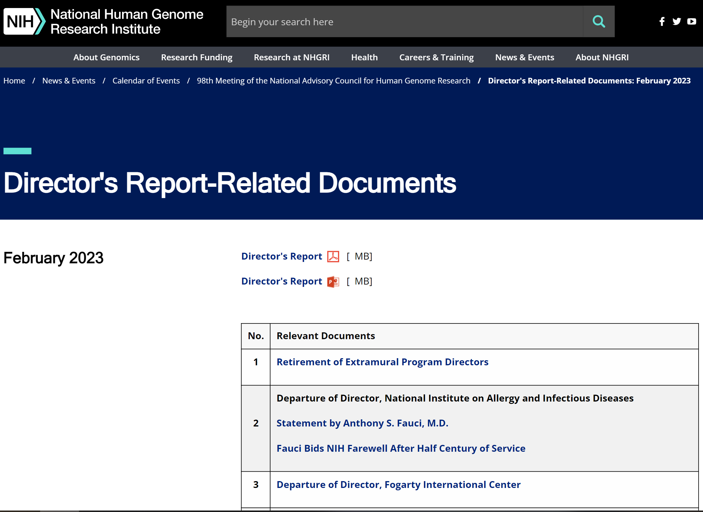

genome.gov/DirectorsReport
Document #
Notes:
For those who are new to our Council meetings, I want to make you aware of the ‘electronic resource’ that has been developed for my Director’s Report. Analogous to the supplemental materials of a published paper, this resource can be accessed at the URL shown here.
The slides that I will show during my Director’s Report are also available electronically at this site – * both in PDF and PowerPoint formats.
* When there are documents or relevant websites associated with a particular slide, you will find a “Document #” indicated on the bottom right of that slide; that “Document #” references materials that can be accessed and/or downloaded from the webpage shown here. This dedicated webpage and all linked documents will be archived on genome.gov as part of the historical record of this Council meeting.

Slide 3
Open Session Agenda
  Presentations:
    Building a Diverse Genomics Workforce Action Agenda: Implementation Plan and Progress Report
    Vence Bonham
    Outstanding Awards for Diversity, Equity, Inclusion, and Accessibility (DEIA) in the Genomics Workforce
    Lorjetta Schools
Notes:
There will be a number of other presentations during the Open Session of this Council meeting. My Director’s Report is tailored around those presentations, and I will not discuss in detail the topics that others will cover.
* Following my Director’s Report, Vence Bonham, NHGRI’s Acting Deputy Director, will speak about “Building a Diverse Genomics Workforce Action Agenda: Implementation Plan and Progress Report.”
* And then after lunch, Lorjetta Schools, Program Specialist in NHGRI’s Training, Diversity, and Health Equity Office, will present the Outstanding Awards for Diversity, Equity, Inclusion, and Accessibility (or DEIA) in the Genomics Workforce. This will be followed by a moderated discussion that I will lead with the awardees.

Slide 4
Open Session Agenda
  Concept Clearances:
    ELSI Program Announcements for R01, R03, and R21 Applications
  Dave Kaufman
    Center for ELSI Resources and Analysis
  Nicole Lockhart
    Diversity Action Plan
  Lucia Hindorff
    Advancing Genomic Medicine Research
  Christine Chang
    Human Genome Reference Program
  Adam Felsenfeld
Notes:
After those presentations, there will be five concept clearances presented by NHGRI extramural program staff.
* First, Dave Kaufman will present a concept clearance on the “ELSI Program Announcements for R01, R03, and R21 Applications.”
* Second, Nicole Lockhart will present a concept clearance on the “Center for ELSI Resources and Analysis.”
* Third, Lucia Hindorff will present a concept clearance on the “Diversity Action Plan.”
* Fourth, Christine Chang will present a concept clearance on “Advancing Genomic Medicine Research.”
* Lastly, Adam Felsenfeld will present a concept clearance on the “Human Genome Reference Program.”

Slide 5
Open Session Agenda
  Reports:
    Genomic Medicine Working Group of Council: Update of Meetings, Activities, and Accomplishments
    Teri Manolio
    Genomic Data Science Working Group of Council Update
    Mark Craven
    Community Engagement in Genomics Working Group of Council Update
    Maya Sabatello & Greta Goto
Notes:
Finally, there will be three reports presented from working groups of this Council.
* First, Teri Manolio will present “Genomic Medicine Working Group of Council: Update of Meetings, Activities, and Accomplishments.”
* Second, Mark Craven will present the “Genomic Data Science Working Group of Council Update.”
* Lastly, Maya Sabatello and Greta Goto will present the “Community Engagement in Genomics Working Group of Council Update.”

Slide 6
Director’s Report Outline
General NHGRI Updates
General NIH Updates
General Genomics Updates
NHGRI Extramural Research Program
NIH Common Fund/Trans-NIH
NHGRI Communications, Policy, and Education
NHGRI Intramural Research Program
Notes:
For the rest of my Director’s Report, I will cover the seven areas listed here, which reliably provide a useful framework for reviewing the relevant topics.

Slide 7
Director’s Report Outline
General NHGRI Updates
General NIH Updates
General Genomics Updates
NHGRI Extramural Research Program
NIH Common Fund/Trans-NIH
NHGRI Communications, Policy, and Education
NHGRI Intramural Research Program
Notes:
And I will start with some general NHGRI updates.

Slide 8
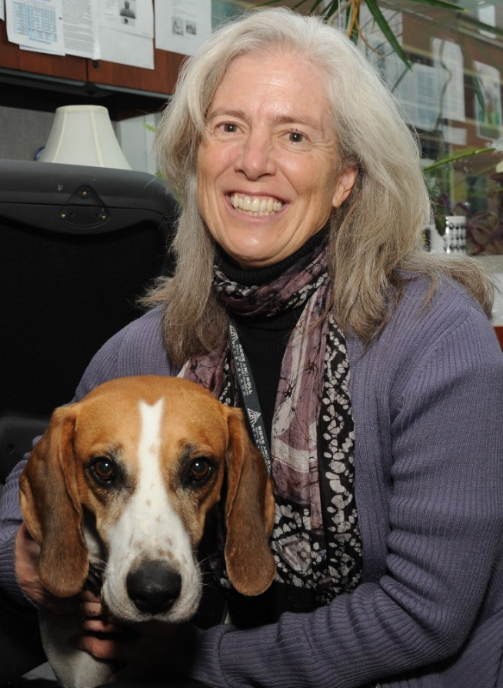
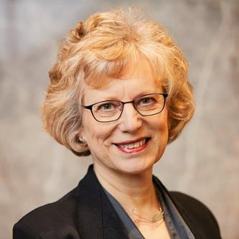
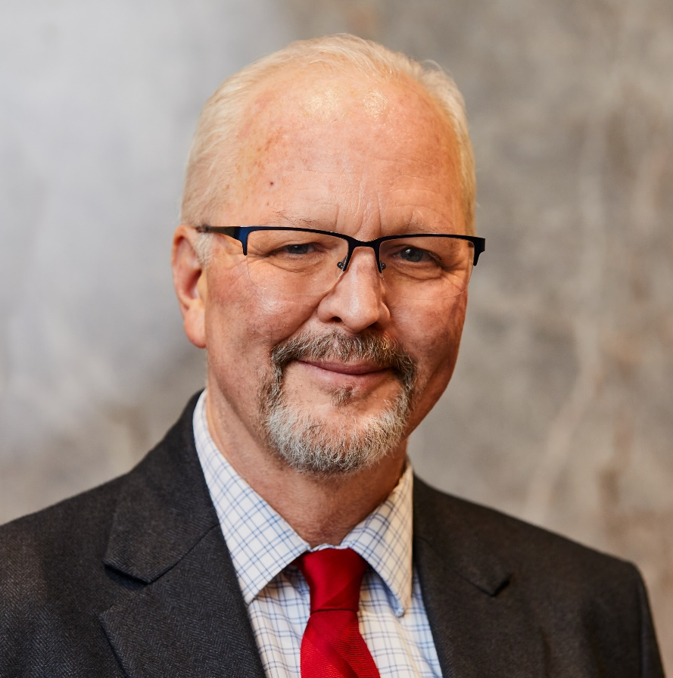
Retirement of Extramural Program Directors
Joy Boyer
Elise Feingold, Ph.D.
Mike Smith, Ph.D.
Document 1
Notes:
After nearly 30 years in NHGRI’s ELSI Research Program, Joy Boyer retired in December. Joy was the rock of the ELSI Research Program and a pioneer who helped shape this innovative area of science. She was a role model to our Extramural Research Program, with a style and wisdom that was widely admired. As ELSI’s longest serving program director, Joy influenced and helped grow the field of ELSI research. As Joy prepared to retire, we heard from current and former trainees, along with investigators at various stages in their career, about the positive impact that Joy had on their work and career trajectories.
* After an over 30-year career at NIH, Elise Feingold retired in December. Elise joined NHGRI in 1992 when it was still the National Center for Human Genome Research. She made numerous contributions that effectively guided the evolution and growth of NHGRI’s Extramural Research Program. Most notably, Elise was one of the critical program leaders for the ENCODE project. More recently, she served as the Scientific Advisor for Strategic Implementation in the Division of Genome Sciences. Elise’s professionalism, strategic vision, and humor have always been appreciated by NIH staff, grantees, and applicants. Elise’s retirement did not take her too far, as she actually rejoined us as a part-time contractor last month.
* Mike Smith also retired at the end of last year following a distinguished career at NIH. Before joining NHGRI, Mike spent 20 years at the National Cancer Institute, developing genomic technologies and researching conditions such as kidney failure, HIV/AIDS, and diabetes. For the past 10 years, Mike served as a program director at NHGRI, focusing on technology development and coordination of the small business program. Throughout his time at NHGRI, Mike has been known for his enthusiasm for science, his considered approach to program management, and his dedication to working with extramural grantees.

Slide 9
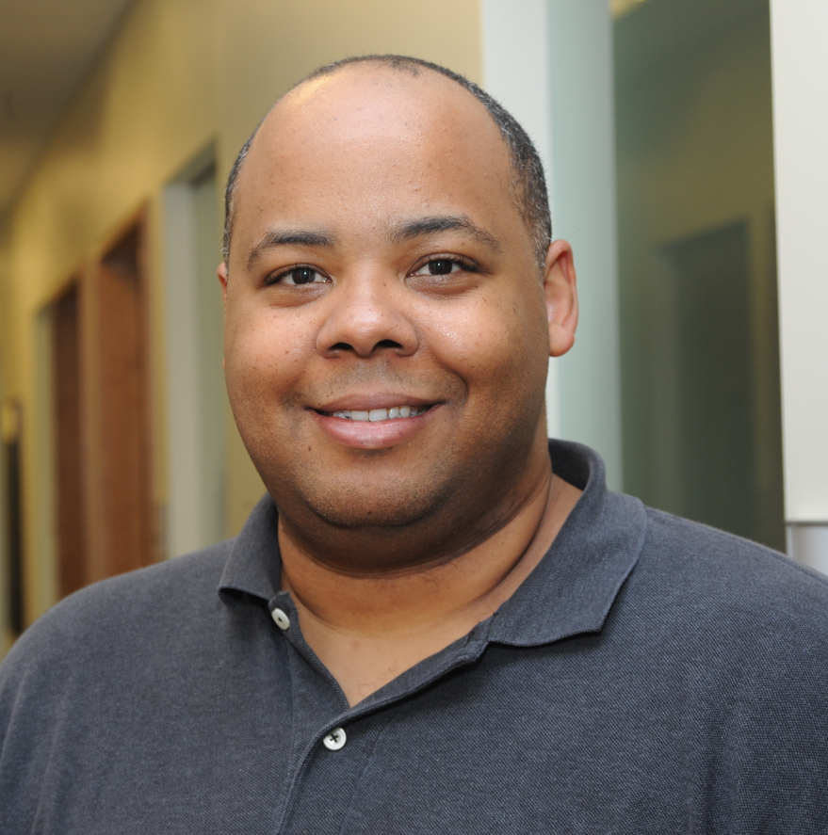
Departure of Extramural Program Director
Ken Wiley, Ph.D.
Notes:
Ken Wiley, a Program Director in the Division of Genomic Medicine, has accepted a new position at the National Center for Advancing Translational Sciences. During his nearly 9 years at NHGRI, Ken has led our clinical informatics efforts and managed an extensive portfolio of projects related to pharmacogenomics, epigenomics, and clinical informatics.
We wish Ken the best in his new role at the National Center for Advancing Translational Sciences. .

Slide 10
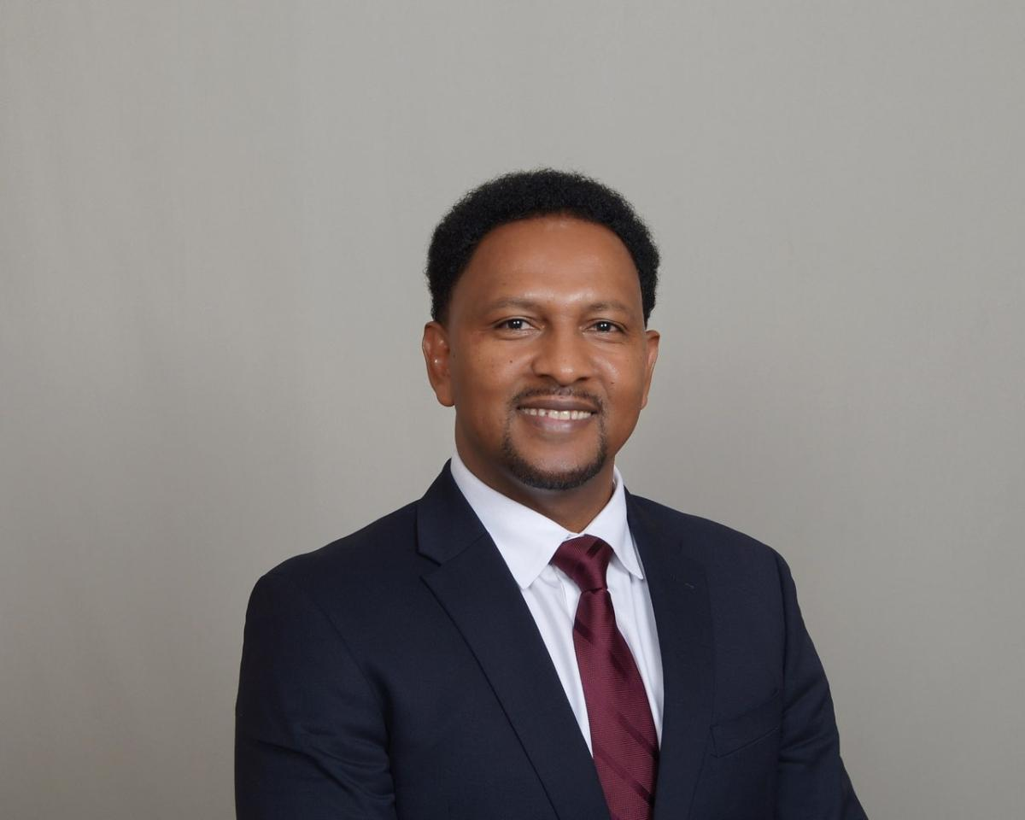
New Extramural Program Director
Temesgen Fufa, Ph.D.
Notes:
Temesgen Fufa joined NHGRI’s Division of Genome Science as a program director last fall. Until recently, Temesgen served as a staff scientist in the National Eye Institute, where he worked on stem cell differentiation, functional genomics, and multi-omics to elucidate the mechanisms of developmental diseases.
One of his primary responsibilities at NHGRI is serving as the Division of Genome Science’s representative on the extramural training team. He is also part of the NIH program leadership team for the Multi-omics for Heath and Disease program that will launch this coming summer, and he holds a portfolio of awards focused on technology development for protein sequencing.
Of note, Temesgen completed his postdoctoral research at NHGRI in the intramural laboratory of Bill Pavan. It is great to have him back at the Institute as an extramural Program Director.

Slide 11
Director’s Report Outline
General NHGRI Updates
General NIH Updates
General Genomics Updates
NHGRI Extramural Research Program
NIH Common Fund/Trans-NIH
NHGRI Communications, Policy, and Education
NHGRI Intramural Research Program
Notes:
Moving on to general NIH updates.

Slide 12
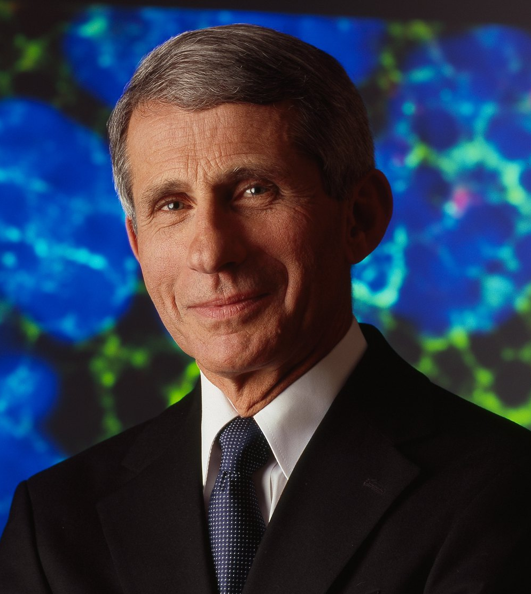
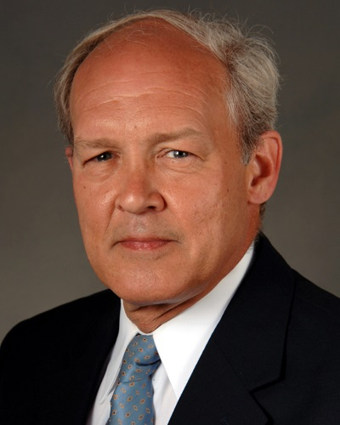

Departure of Director, National Institute on
Allergy and Infectious Diseases
Anthony Fauci, M.D.
Hugh Auchincloss, M.D.
Document 2
Notes:
In truly seismic NIH news (well, actually world news), Tony Fauci retired from federal service at the end of last year. Tony was truly an icon at NIH, having worked here for 50 years and having served as Director of the National Institute of Allergy and Infectious Diseases (or NIAID) for 38 years. He advised seven U.S. Presidents regarding infectious disease threats, including HIV/AIDS and COVID-19.
* Hugh Auchincloss, currently NIAID’s Principal Deputy Director, is now serving as NIAID’s Acting Director while a search for the next Director is conducted.

Slide 13
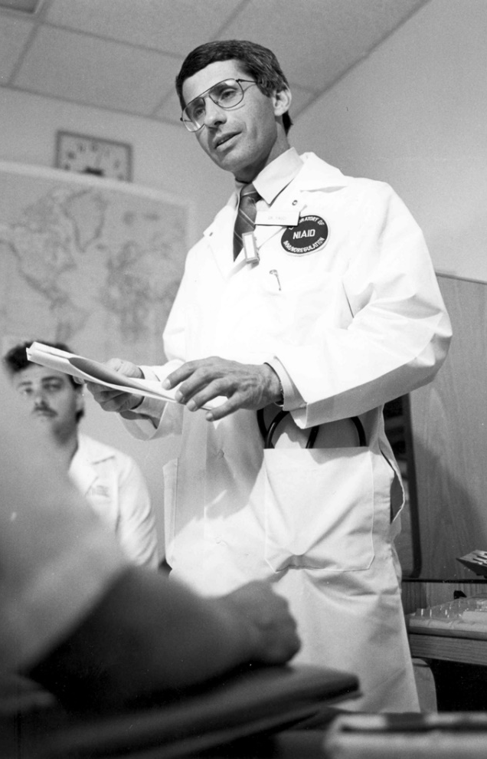

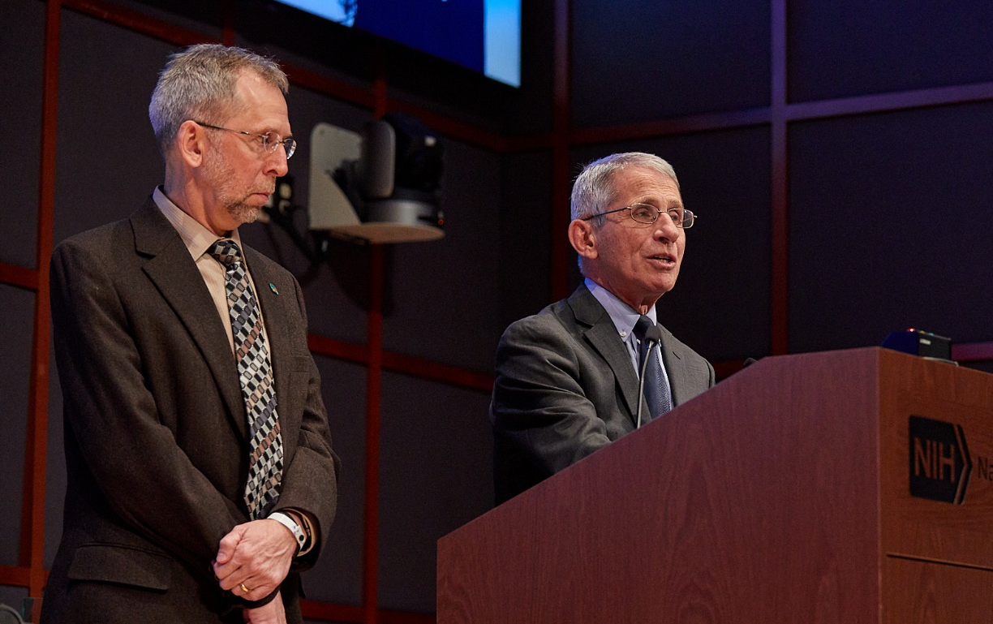
Departure of Director, National Institute on
Allergy and Infectious Diseases
Document 2
Notes:
Okay – wait a second. I cannot let the departure of Tony Fauci from NIH be represented by a single slide!
* Tony is almost himself an institution, representing the best of scientists engaged in public service. He has had an impact on all of us through our recent experiences with COVID-19. * In my opinion, the NIH will not be the same without him.
* That said, I consider it an honor and a privilege to have served as a fellow Institute Director with Tony for 13 years and 1 month (of his 38 years as an Institute Director himself), cherishing every moment of his mentorship and friendship.
I am pleased to report that Tony plans to continue advancing science and public health in his ongoing and future endeavors (and from what I can tell, he has not slowed down one bit).

Slide 14
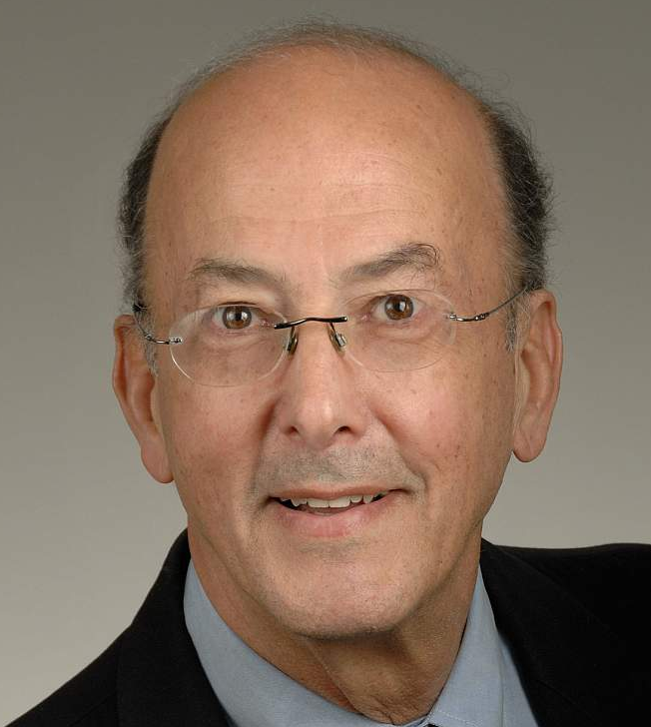
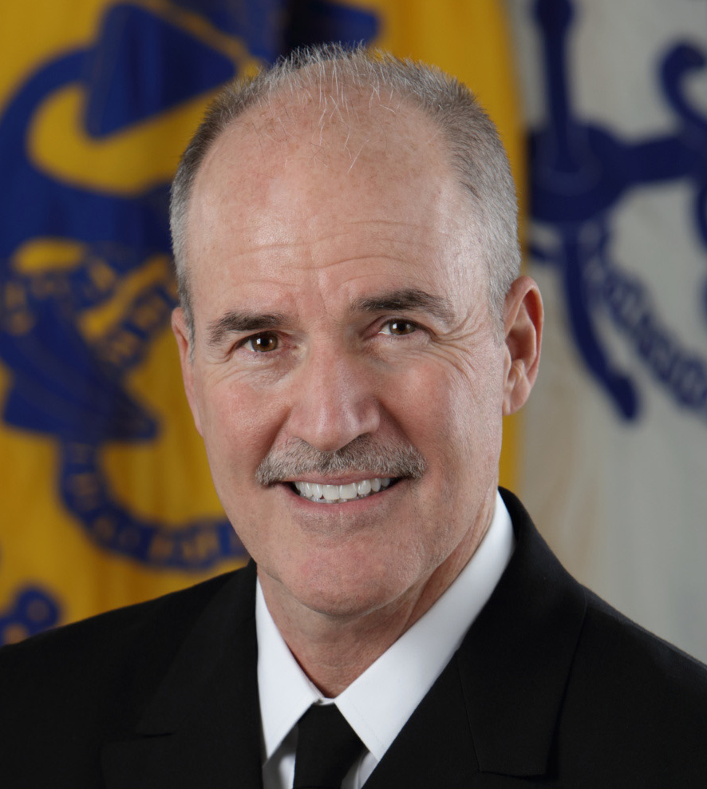

Departure of Director, Fogarty International Center
Roger Glass, M.D., Ph.D.
Peter Kilmarx, M.D.
Document 3
Notes:
Roger Glass will retire tomorrow from federal service, stepping away from his positions as Director of the Fogarty International Center and NIH Associate Director for International Research, having held both positions since March 2006. As the longest-serving Director of the Fogarty International Center, Roger broadened NIH’s global health footprint, partnering with all NIH Institutes and Centers to advance global health research in support of the NIH mission.
* Fogarty’s Deputy Director, Peter Kilmarx, will serve as the Acting Director while a search for the next Director is conducted.

Slide 15
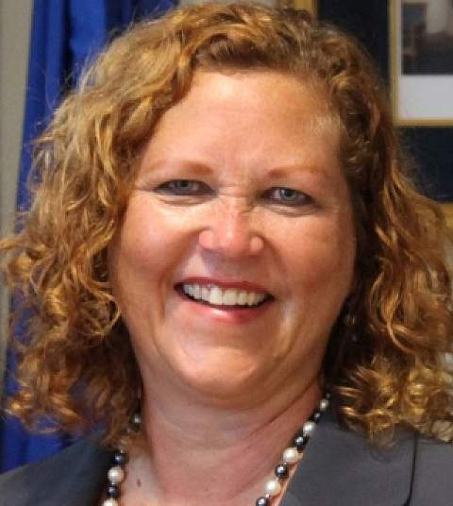
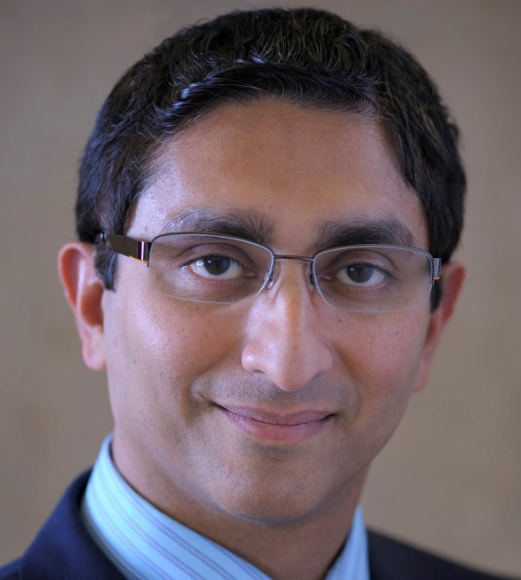
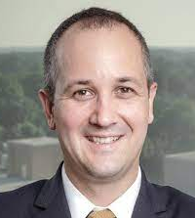

Departure of Director, Center for
Information Technology
Andrea Norris, M.B.A.
Ivor D’Souza, M.S.
Dennis Papula, M.S.
Document 4
Notes:
In December, Andrea Norris retired from her positions as Director of the NIH Center for Information Technology (or CIT) and NIH’s Chief Information Officer. For more than a decade, she led a $1.6-billion technology portfolio that supports the research of NIH’s 27 Institutes and Centers as well as researchers at more than 2,500 universities and medical centers across the country that receive NIH funding.
* Ivor D’Souza has been selected to serve as the Acting Director of CIT, while Dennis Papula has been selected to serve as the Acting Director of the NIH Office of the Chief Information Officer. NIH is launching searches for both of these positions.

Slide 16


Departure of Associate Director
for Clinical Research
John Gallin, M.D.
Document 5
Notes:
John Gallin will retire from federal service in March. He currently serves as the NIH Associate Director for Clinical Research and Chief Scientific Officer of the NIH Clinical Center. John’s career at NIH spans more than 50 years, during which he has played an instrumental role in developing the research portfolio for the NIH Clinical Center. Among John’s many contributions, his most significant one was serving as the 10th Director of the NIH Clinical Center, a position he held from 1994 to 2017 (making him the longest-serving Clinical Center Director).

Slide 17
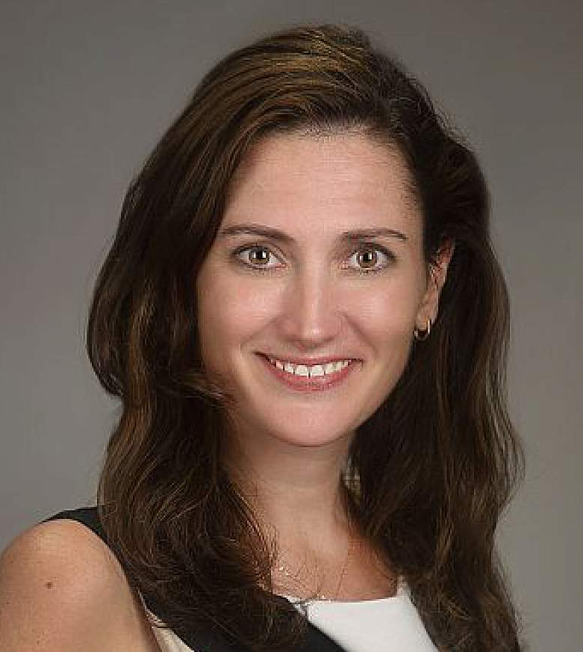
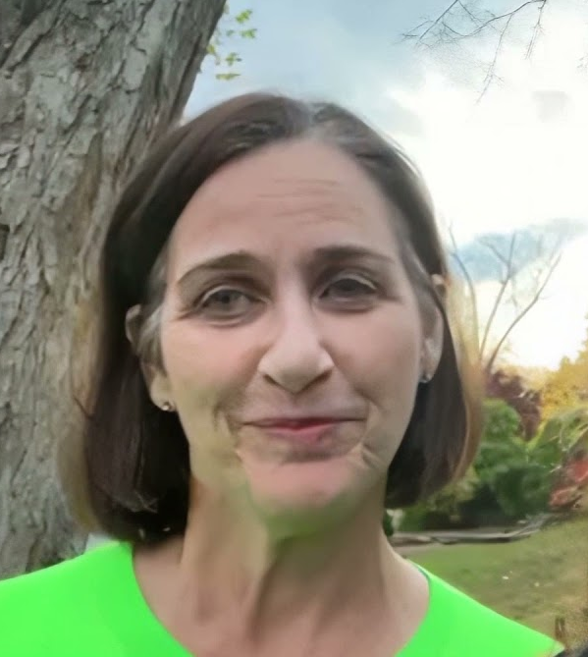
Departure of Associate Director
for Legislative Policy and Analysis
Adrienne Hallett, M.A.
Lauren Higgins
Document 6
Notes:
Later this month, Adrienne Hallett will depart from her role as NIH Associate Director for Legislative Policy and Analysis. Adrienne joined NIH in May 2015 and has led NIH’s engagement with both chambers of Congress for the past eight years, during which NIH’s appropriations have grown by more than 40%. Upon departing from NIH, she will become the Vice President of Global Policy and Strategic Initiatives at Cambrian BioPharma, Inc.
* Lauren Higgins, the current Deputy Director under Adrienne, will serve as the Acting Associate Director until a permanent replacement is identified.

Slide 18
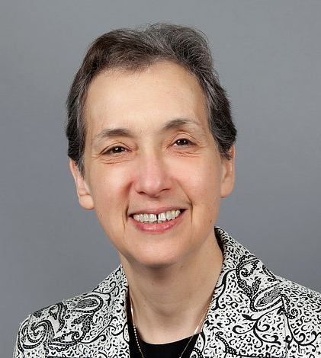

New Deputy Director for Intramural Research
Nina Schor, M.D., Ph.D.
Document 7
Notes:
In November, Nina Schor was appointed the NIH Deputy Director for Intramural Research. She has been serving in that role in an acting capacity since August, following the departure of Michael Gottesman from that position. The NIH Deputy Director for Intramural Research leads the broader NIH Intramural Research Program, which involves researchers and clinicians from 24 of NIH’s 27 Institutes and Centers.

Slide 19
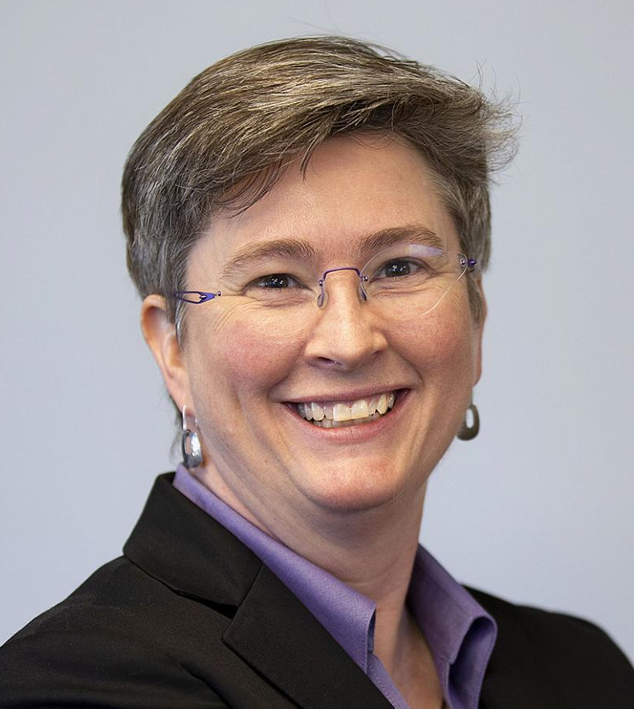

New Director, National Center for
Advancing Translational Sciences
Joni Rutter, Ph.D.
Document 8
Notes:
In November, Joni Rutter became the Director of the National Center for Advancing Translational Sciences (or NCATS). She has served as NCATS’s Acting Director since April 2021. In this role, Joni will oversee a diverse portfolio of research activities focused on improving the translational process of turning scientific discoveries into health interventions.

Slide 20
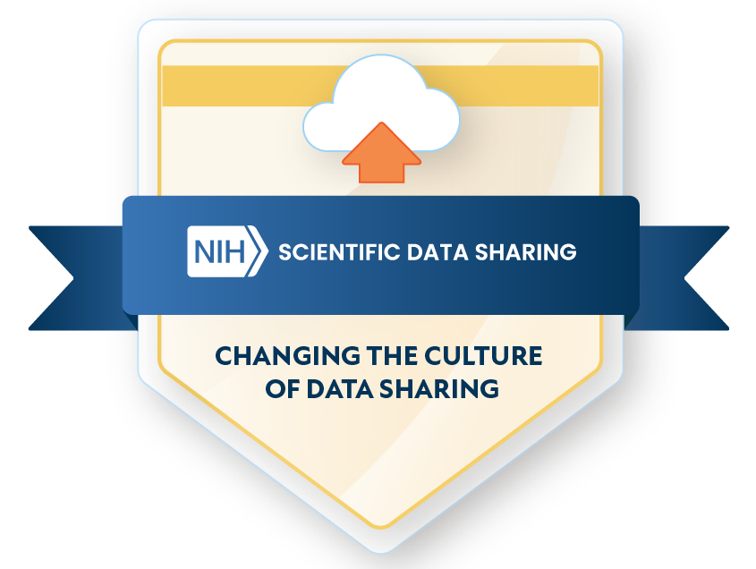
    NIH Data Management and Sharing Policy
Effective January 25, 2023
NHGRI’s preparation for implementation of the policy:
  Guidance on where to share scientific data
  NHGRI sample DMS Plans
Document 9
Notes:
The new NIH Data Management and Sharing (or DMS) Policy went into effect in late January. Under this policy, investigators applying to NIH for funding must submit a DMS Plan outlining how the resulting scientific data and any accompanying metadata generated by the funded project will be managed and eventually shared with the research community. Once funded, award recipients are expected to comply with the DMS Plan approved by the funding Institute or Center as a “Term and Condition” of the award. A designated NIH website for this new policy (which is sharing.nih.gov) has a wealth of useful information and guidance to assist them with plan preparation.
* NHGRI has also been active in preparation for implementing the new Policy and in providing NHGRI-specific guidance to applicants. Specifically, * we have updated our data-sharing policy webpage (on genome.gov) with guidance on where to share scientific data generated with NHGRI funding. * Additionally, we (along with several other NIH Institutes and Centers) have generated sample DMS Plans to help investigators get started.
Given the generally strong commitment of genomics researchers to genomic data sharing, we are confident that our research community is well-poised to craft thoughtful and comprehensive DMS Plans.

Slide 21
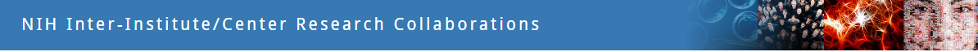
    NIH Institute/Center Research Collaborations
Report for Fiscal Years 2019-2021
IC | FY2019 | FY2020 | FY2021
NHGRI | 36% | 33% | 33%
All NIH | 17% | 18% | 18%
Document 10
Notes:
Research collaborations among Institutes and Centers are crucial for achieving many of NIH’s goals. A new report from the NIH Division of Program Coordination, Planning, and Strategic Initiatives revealed that NHGRI is the second highest Institute or Center (among 27) with respect to inter-Institute/Center research collaborations for Fiscal Years 2019 to 2021. Specifically, 33 to 36% of NHGRI’s budget in those Fiscal Years was involved in such collaborative efforts. Note that the overall average is 17-18%, which really illustrates the incredible degree to which our Institute pursues collaboration efforts across the NIH – something that I am certain will continue to be the case going forward.

Slide 22


    Office of Science and Technology Policy Guidance
Ensuring Free, Immediate, and Equitable Access
to Federally Funded Research
    Memorandum to federal departments and agencies:
      Agencies must make publications that describe taxpayer-funded work freely available to the public by the end of 2025
      Agencies required to develop plans to improve transparency
Document 11
Notes:
In August 2022, the White House Office of Science and Technology Policy (or OSTP) issued a memorandum to federal departments and agencies stating that by December 31, 2025, publications and their supporting data resulting from federally funded research must be made publicly accessible without an embargo upon their free and public release. The OSTP guidance will end the current optional embargo, which allows scientific publishers to put taxpayer-funded research behind a subscription-based paywall.
* Additionally, the policy requires that agencies develop plans to improve transparency, including clearly disclosing authorship, funding, affiliations, and the status of federally funded research. This policy change was catalyzed in part by the COVID-19 pandemic, during which publishers agreed to make COVID-19-relevant papers open access. This represented a shift in practice during the public health crisis. In 2020, OSTP estimated that federal funds supported 7 to 9% of the 2.9 million papers published worldwide that year. This guidance is expected to have a substantial impact on the scientific publishing landscape.

Slide 23
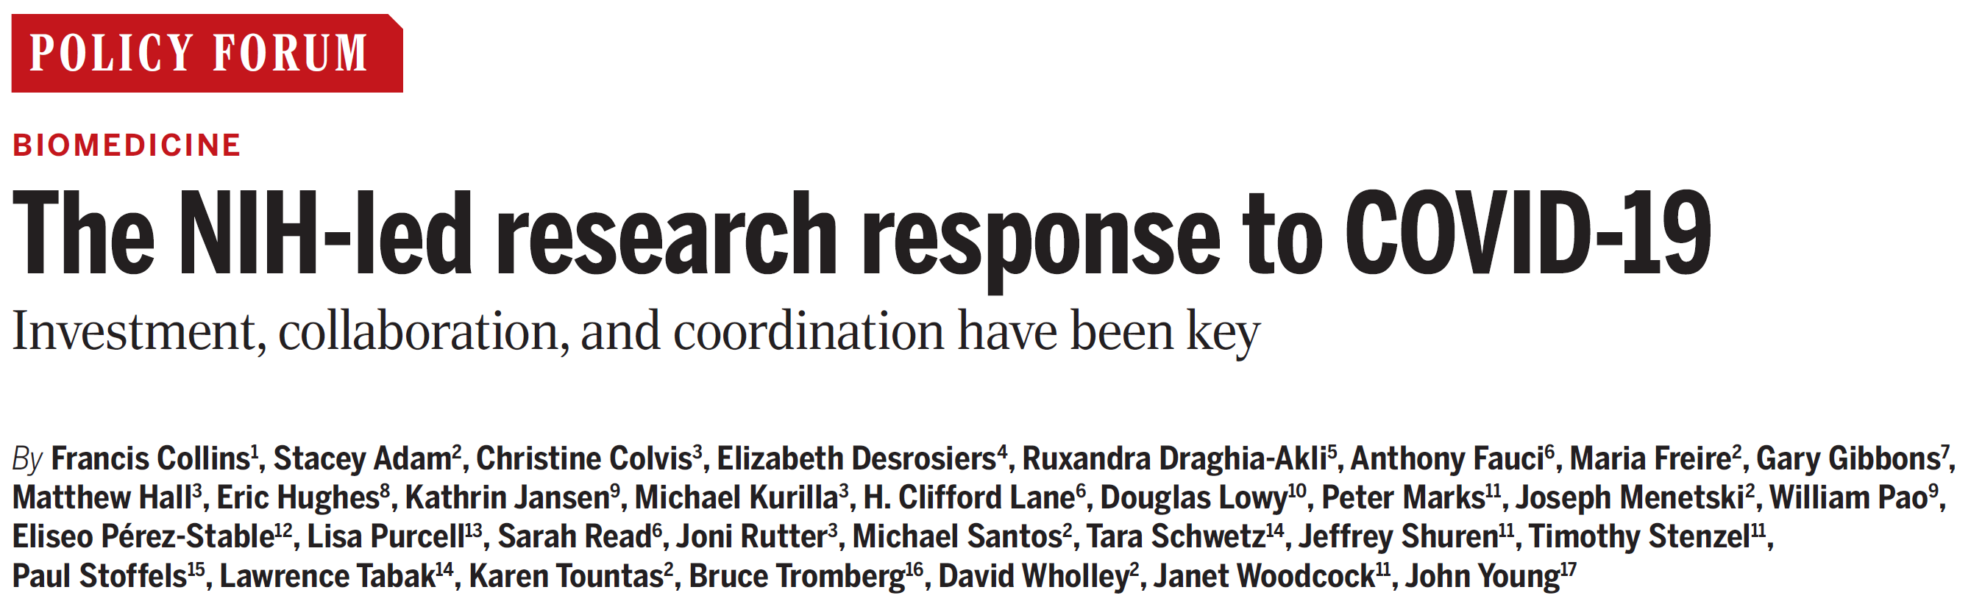
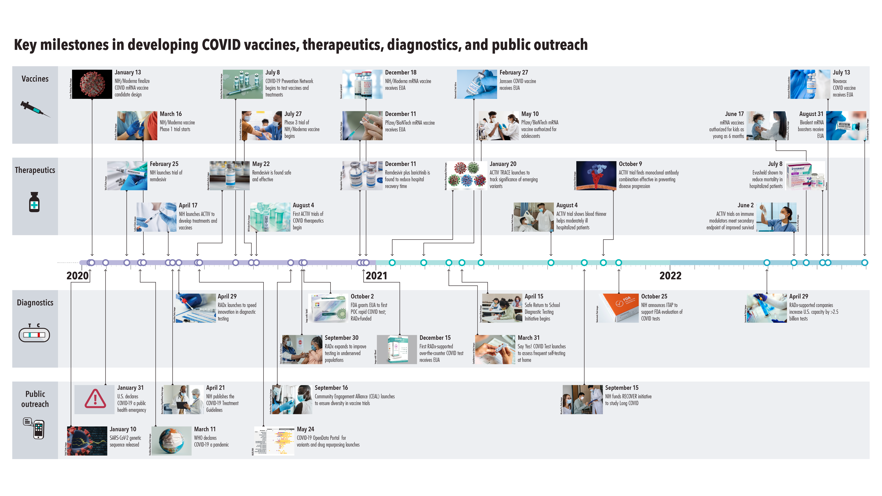
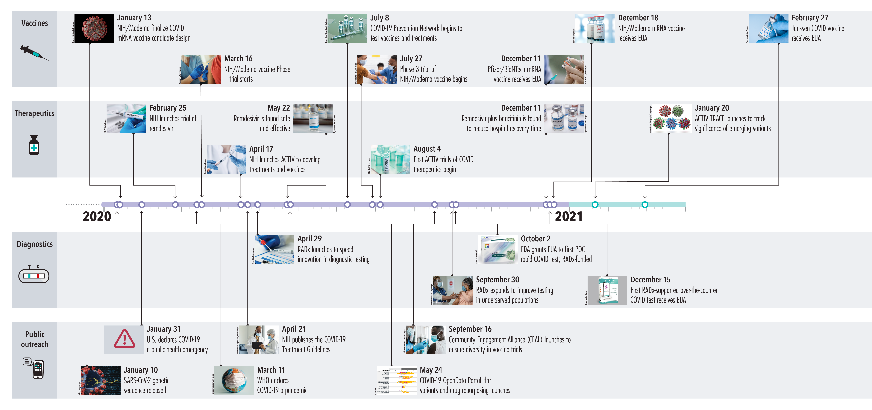
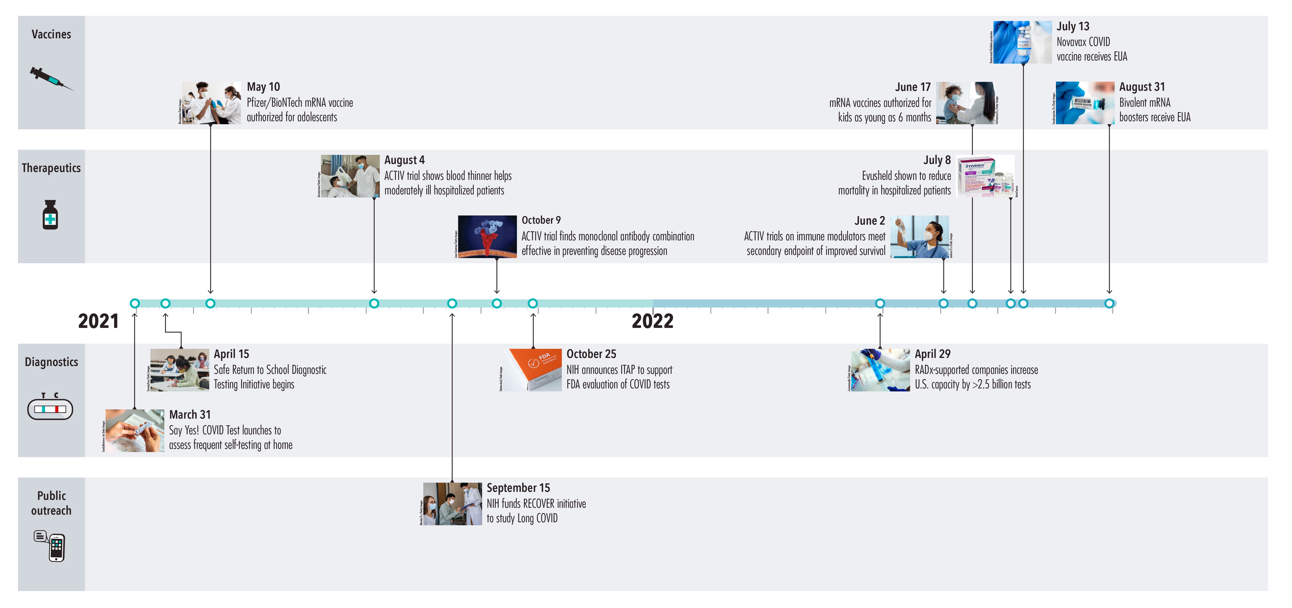
Science Policy Forum on NIH-led COVID-19 Response
Document 12
Notes:
Perhaps of general interest to many of you, two weeks ago, the journal Science published a policy forum that details the NIH-led research response to the COVID-19 pandemic. The paper emphasizes that by building on decades of basic and applied research and convening all sectors in highly collaborative ways, NIH and its partners were able to quickly develop vaccines, therapeutics, and diagnostics in response to the COVID-19 pandemic. Additionally, the paper details the crucial lessons learned that will inform the public health research response to future pandemics.
* The paper also included a very informative timeline that showcases the key milestones in developing COVID vaccines, therapeutics, diagnostics, and public outreach.

Slide 24
Fiscal Year 2023 Appropriations
 | FY 2022 ($) | FY 2023 ($) | Increase ($) | Increase (%)
NIH | $45.0 billion | $47.5 billion | $2.5 billion | 5.6
NHGRI | $639 million | $663 million | $24 million | 3.8
Document 13
Notes:
On December 29, President Biden signed a massive Fiscal Year 2023 omnibus appropriations bill into law.
The bill included a * 5.6% budget increase for NIH. NHGRI received a * 3.8% increase, which brought our total funding to $663 million in Fiscal Year 2023.
This 3.8% increase was higher than the initial proposals that came from the House and Senate, which is always appreciated.

Slide 25
Director’s Report Outline
General NHGRI Updates
General NIH Updates
General Genomics Updates
NHGRI Extramural Research Program
NIH Common Fund/Trans-NIH
NHGRI Communications, Policy, and Education
NHGRI Intramural Research Program
Notes:
Moving on to general genomics updates.

Slide 26
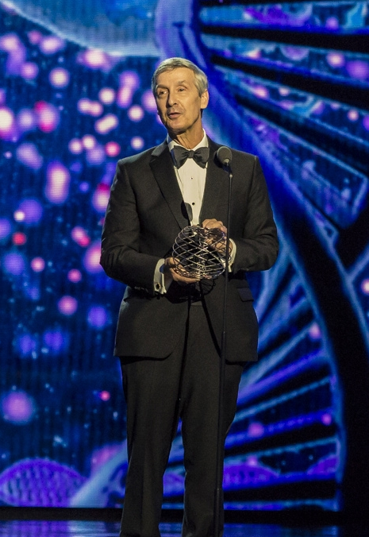

Mourning the Loss of David Allis
Document 14
Notes:
David Allis, a molecular biologist whose research greatly advanced our scientific understanding of how proteins interact with genes, passed away in January. He was 71. David’s discoveries reshaped knowledge of the genetic “on-off” and “volume” switches in gene expression. He was a professor and researcher at Rockefeller University from 2003 until last year.

Slide 27
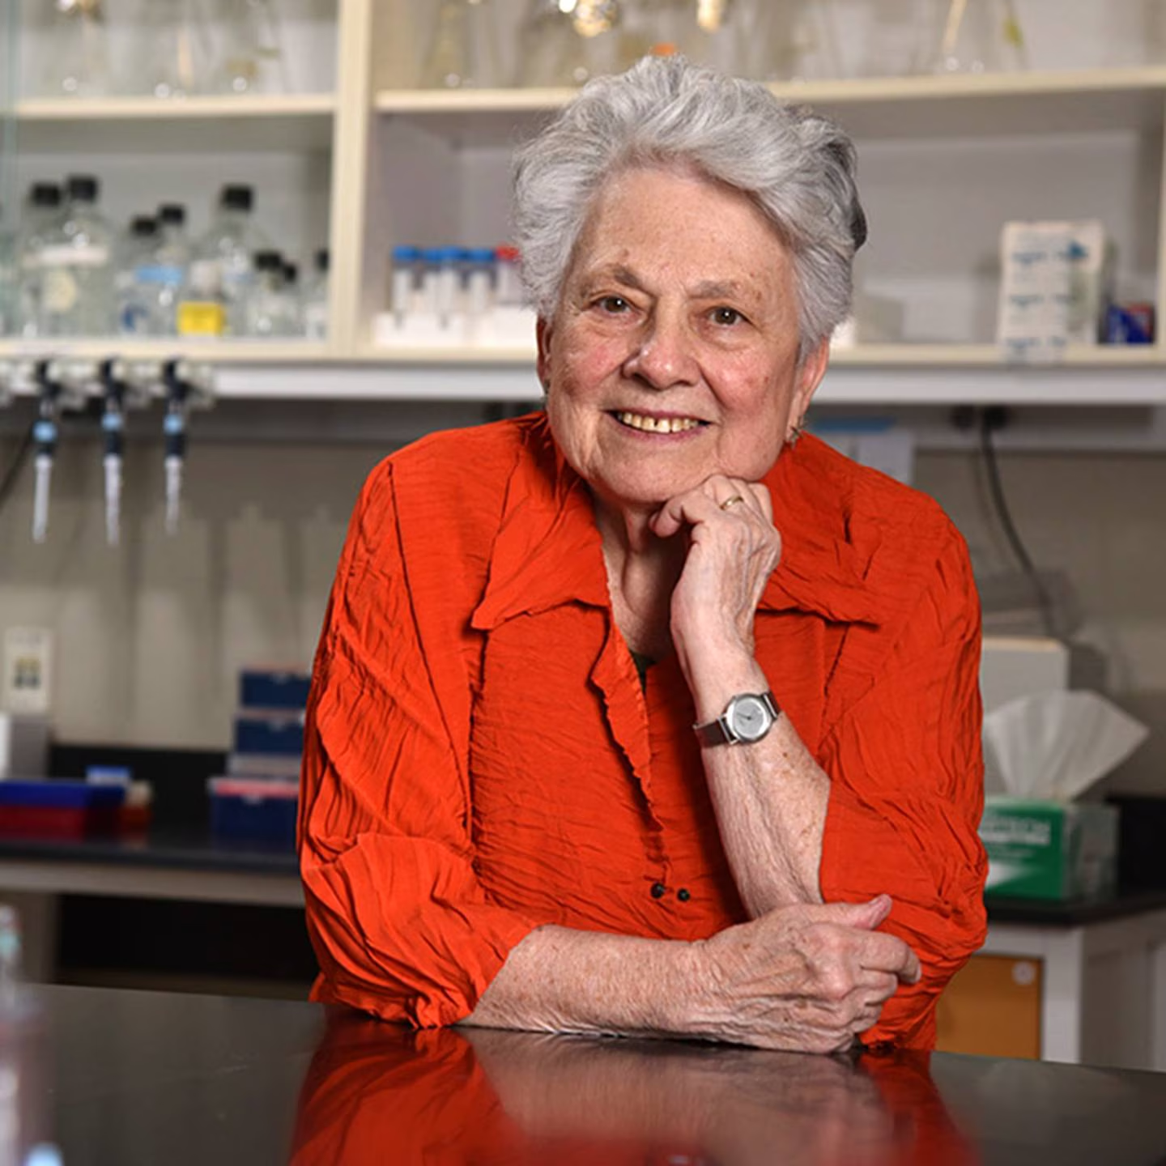
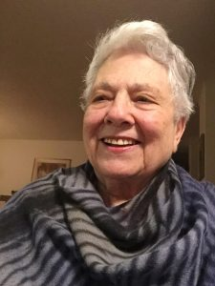
Mourning the Loss of Barbara Migeon
Document 15
Notes:
Barbara Migeon, a genetics pioneer who spent over 60 years working at Johns Hopkins University, passed away in January. She was 91. Barbara’s research focused on X inactivation, the process by which one of the two X chromosomes is turned off in female mammals. She was the 6th female to become a Professor at Johns Hopkins University, receiving that promotion in 1978.

Slide 28


New Chief Scientist, World Health Organization
Jeremy Farrar,
OBE, FMedSci, FRS
Document 16
Notes:
A good friend of NHGRI’s, Jeremy Farrar, has been selected to be the next Chief Scientist of the World Health Organization (or WHO). Jeremy is highly accomplished physician scientist, who has served as Director of the Wellcome Trust since 2013. A strong advocate for all-things genomics, Jeremy will join WHO in the second quarter of 2023.

Slide 29
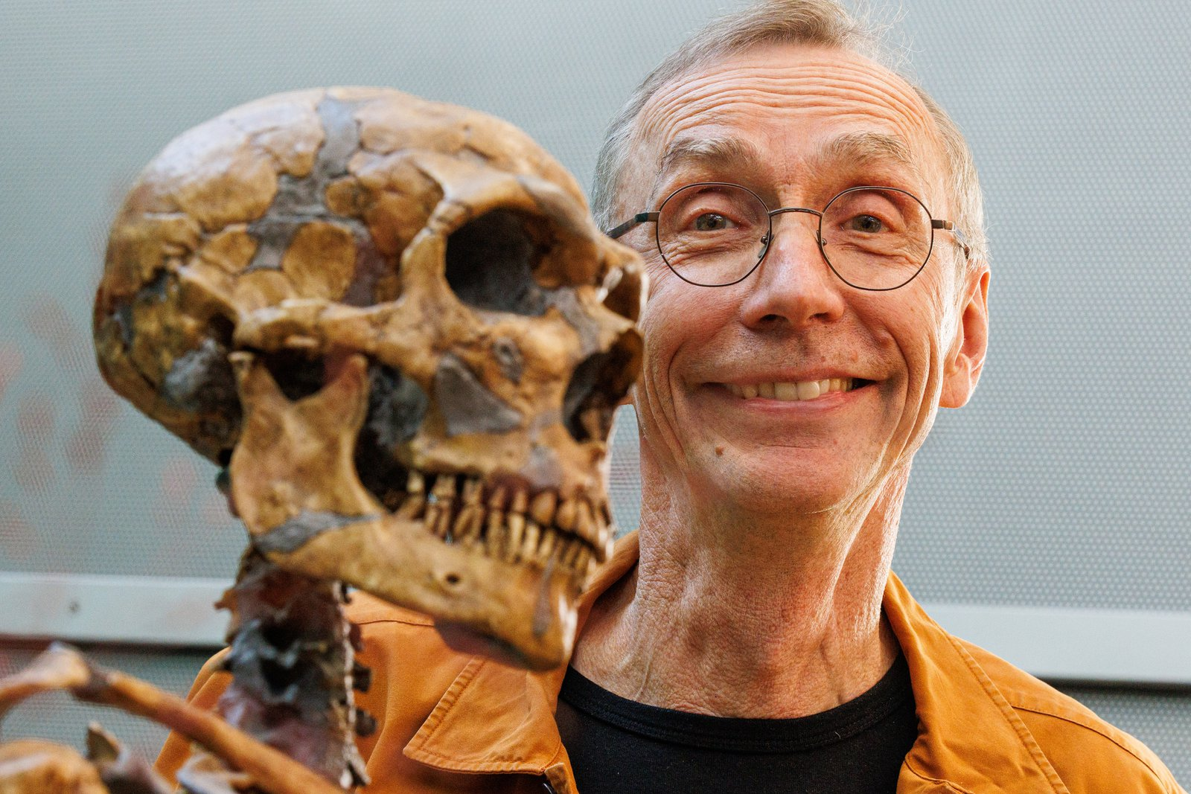
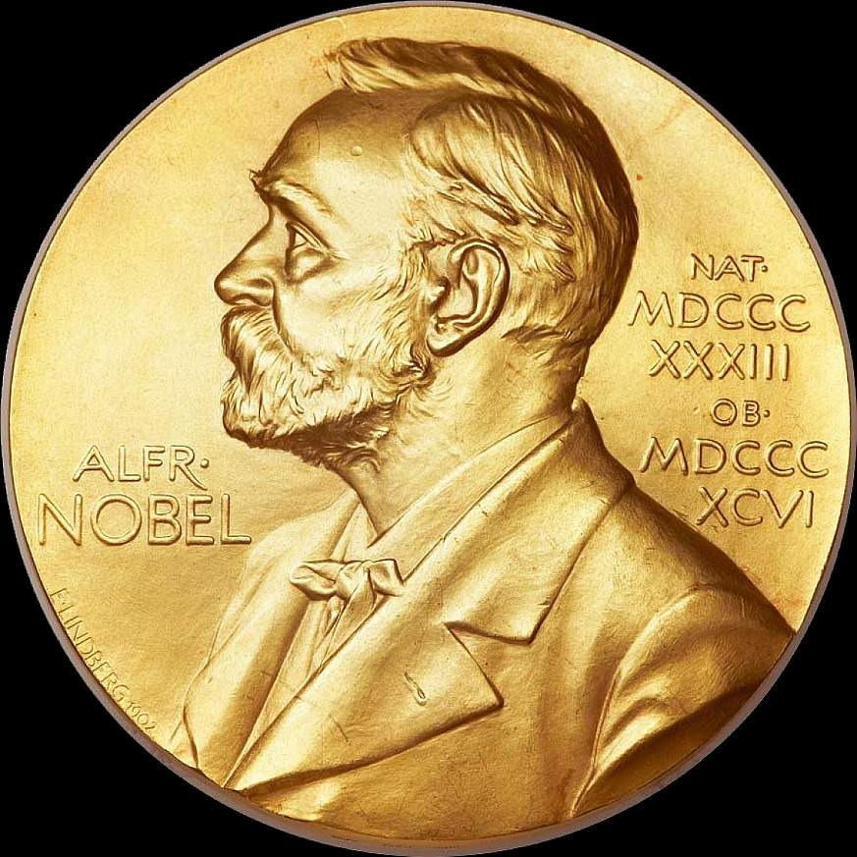
2022 Nobel Prize in Physiology or Medicine
Svante Pääbo, Ph.D.
Document 17
Notes:
The Nobel Assembly awarded the 2022 Nobel Prize in Physiology or Medicine to Svante Pääbo for his discoveries about the genomes of extinct hominins and human evolution. Svante revolutionized the use of cutting-edge genomic technologies to create the field of ancient DNA research. He is currently Director of the Max Planck Institute for Evolutionary Anthropology. Nobel prizes are awarded to "those who … have conferred the greatest benefit to humankind."
29

Slide 30
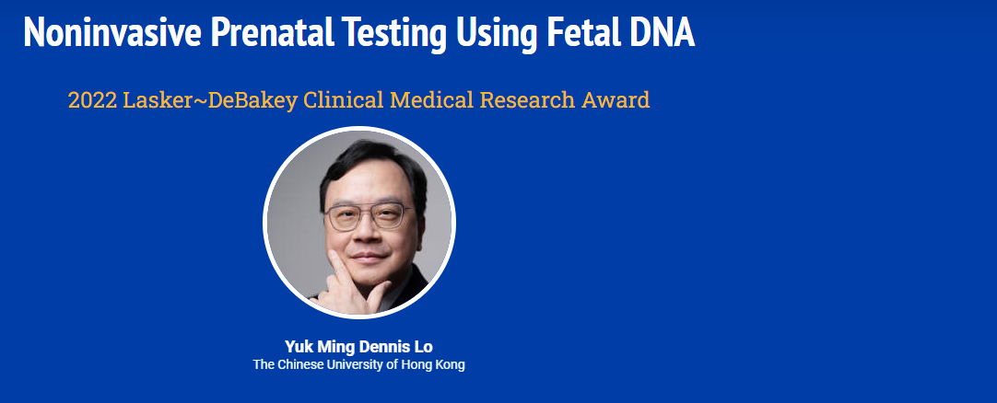

2022 Lasker~DeBakey Clinical
Medical Research Award
Document 18
Notes:
The 2022 Lasker~DeBakey Clinical Medical Research Award was given to physician scientist Yuk Ming Dennis Lo of the Chinese University of Hong Kong for his work in advancing the analysis of fetal DNA in maternal blood. This seminal research led to the now-routine use of noninvasive prenatal genetic testing for aneuploidies. The Lasker~DeBakey award is given to honor outstanding work that contributes to the understanding, diagnosis, prevention, treatment, and cure of diseases.
30

Slide 31

Elected to National Academy of Medicine
Steven Joffe
Eugene Koonin
Katherine Pollard
John Quackenbush
Norman Sharpless
Bruce Tromberg
Marylyn Ritchie
Sarah Tishkoff
Document 19
Notes:
The National Academy of Medicine recently announced the election of new members. Of particular relevance to the genomics community, to NIH, and/or to NHGRI are the individuals listed here.

Slide 32

Elected to AAAS
Linda Birnbaum
Atul Butte
Cynthia Dunbar
Paul Liu
Alan Love
Robert Tjian
Elias Zerhouni
Document 20
Notes:
Similarly, an impressive set of genetics and genomics researchers (including NHGRI colleagues) were recently elected to be Fellows of the American Association for the Advancement of Science, with their names listed here.

Slide 33
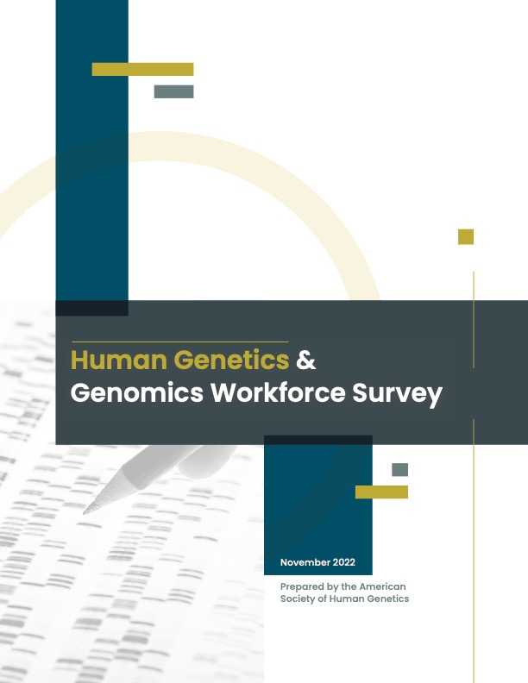
Human Genetics & Genomics
Workforce Survey Report
Report from American Society of Human Genetics (ASHG) – with support from NHGRI
Report lays important groundwork for future assessment and action
Key respondent findings: 67.7% identified as White; 73.3% as U.S. Citizens; women made up majority of respondents
NHGRI hosted webinar with report partners to explore key findings and define next steps
Document 21
Notes:
In November, the American Society of Human Genetics (or ASHG) released the human genetics and genomics workforce survey report, which was developed with NHGRI funds and created in partnership with the American College of Medical Genetics and Genomics and the National Society of Genetic Counselors. The report summarizes the first-of-its-kind in-depth look at the workforce demographics of the genetics and genomics field. * The report lays important groundwork for future assessment and action.
* Over 4,000 members of genetics and genomic societies participated in the survey. 67.7% of respondents identified their race, ethnicity, or ancestry as White, and 73.3% identified as U.S. citizens. Note that women made up the majority of respondents (specifically, 74.7%). Genetic counseling, research, and academics were the top primary areas of work for employed respondents.
* NHGRI hosted a webinar with report partners in December to explore the key findings from the report and define next steps. More than 150 people attended the webinar in real time. If you missed the discussion, the webinar was recorded and can be viewed on NHGRI’s website (genome.gov).

Slide 34
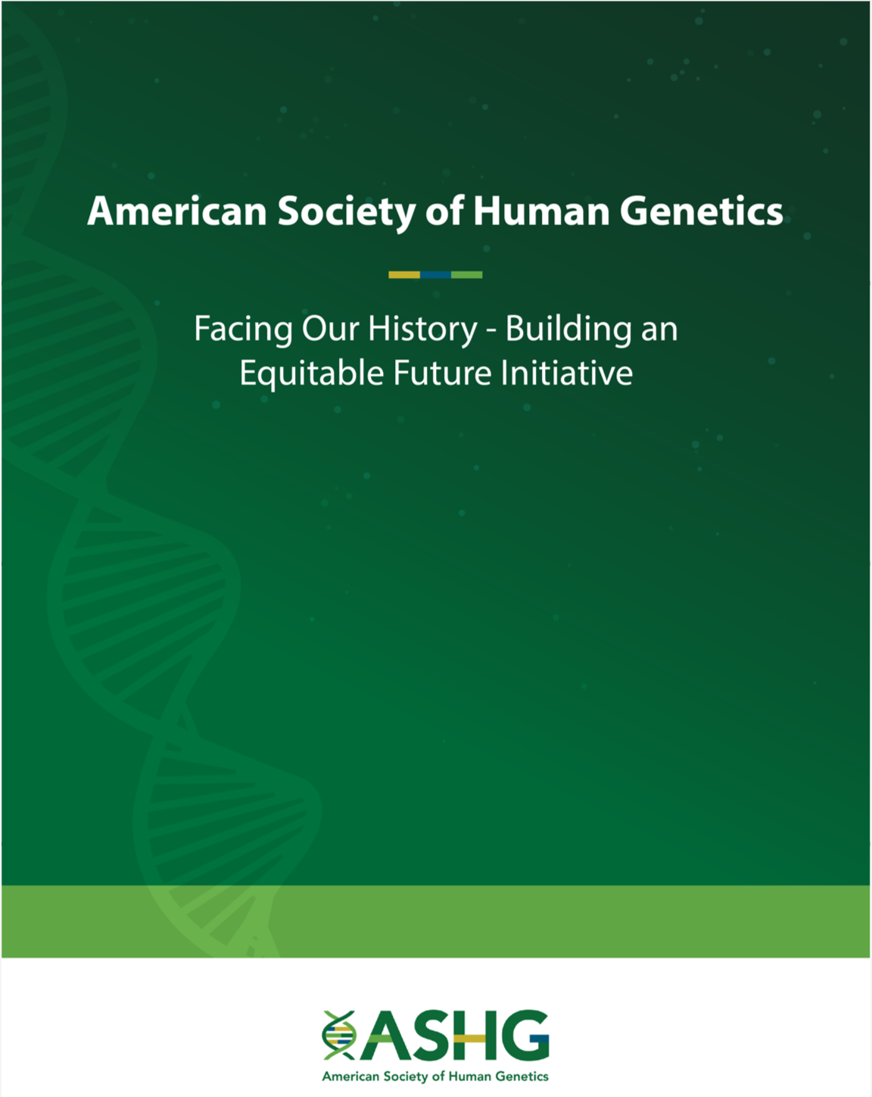
American Society of Human Genetics
Facing Our History – Building an Equitable Future Initiative
Document 22
Notes:
On January 24, the American Society of Human Genetics (or ASHG), the largest and among the most distinguished professional societies in human genetics, publicly apologized for the strong support of scientific racism and eugenics by past senior leadership, including several past Presidents. An essential element of that apology was the acknowledgement by ASHG that it should have done much more to combat the misuse of genetic findings for eugenic and racist ends. Importantly, ASHG announced that it will remove the names of people from the titles of its professional awards, pending further review of whether those individuals had any past associations with eugenics and scientific racism.
This public apology was one of a series of immediate actions taken by ASHG in response to their 27-page “Facing Our History- Building an Equitable Future Initiative” report. This report and an accompanying ASHG statement is now online and carries with it a renewed commitment to build equity and inclusion within ASHG’s membership and among its leadership, to rebuild trust with the scientific community and the public, and to ensure that the grave errors of the past are not repeated.

Slide 35
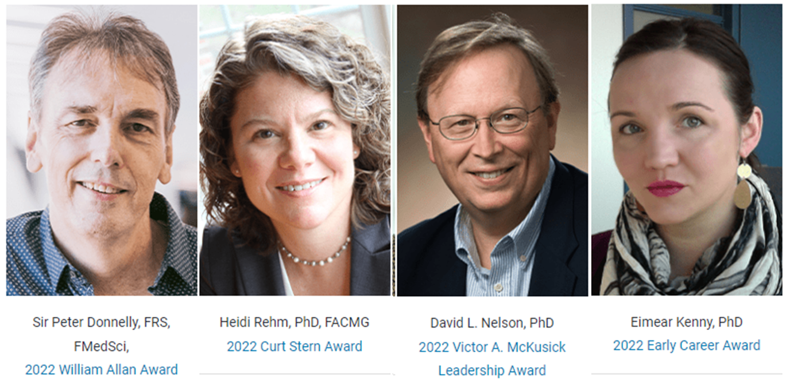

2022 American Society of Human Genetics Awards
Document 23
Notes:
And now for some honors… ASHG gave awards to four members of the genomics community at its 2022 Annual Meeting.
Peter Donnelly received the William Allan Award, which recognizes a scientist for substantial and far-reaching scientific contributions to human genetics.
Heidi Rehm received the Curt Stern Award, which recognizes genetics and genomics researchers who have made significant scientific contributions during the past decade.
David Nelson received the Victor A. McKusick Award, which recognizes an individual who has exhibited exemplary leadership and vision in advancing ASHG’s mission through the promotion and successful assimilation of genetics and genomics knowledge into the broader scientific community.
Eimear Kenny received the Early-Career Award, which recognizes the contributions of genetics and genomics scientists in their first 10 years as an independent investigator.
35

Slide 36
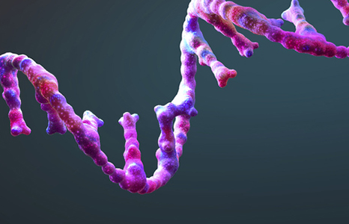

NASEM Study
Toward Sequencing and Mapping of RNA Modifications
    Consensus study on direct sequencing of RNA modifications
    Sponsored by: Warren Alpert Foundation, NIEHS, & NHGRI
    Upcoming Workshop: March 14-15, 2023
Document 24
Notes:
The National Academies of Sciences, Engineering, and Medicine (or NASEM) have convened an ad hoc committee to conduct a two-year consensus study to assess the scientific and technological breakthroughs, workforce, and infrastructure needs to directly sequence RNA and all of its modifications (e.g., the epitranscriptome) and to understand the roles RNA modifications play in biological processes and disease. The study is sponsored by the Warren Alpert Foundation, the National Institute of Environmental Health Sciences, and NHGRI.
* As part of this study, the committee will hold a public workshop on March 14 and 15, 2023.

Slide 37
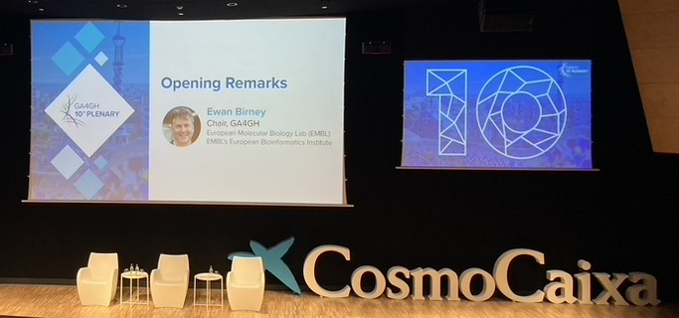
    Global Alliance for Genomics and Health (GA4GH)
    10th plenary meeting in September 2022
    11 NIH-supported GA4GH Driver Projects (out of 24 projects)
    Call for new GA4GH Driver Projects and Strategic Partnerships
    GA4GH Assigned Expert program extends global reach
Document 25
Notes:
The Global Alliance for Genomics and Health (or GA4GH) is dedicated to the responsible sharing of genomic and clinical data by developing technical standards and policy frameworks and facilitating their uptake in diverse research and healthcare settings.
* GA4GH held the 10th plenary meeting in September 2022 in Barcelona, Spain. At that meeting, five new board directors were introduced, extending international representation in Africa, Asia, and Latin America.
* GA4GH Driver Projects are genomic data initiatives that help guide GA4GH standards development and pilot their implementation in real-world projects. Currently, NIH supports or contributes to 11 of the 24 GA4GH Driver Projects.
* GA4GH has opened a call for new Driver Projects and seeks to build larger Strategic Partnerships.
* The GA4GH Assigned Expert program is a pilot to engage technical experts from a broad range of projects around the world. NIH has funded the first dedicated GA4GH engineer in this program through the NIH Common Fund DSI-Africa program led by Nicky Mulder at the University of Cape Town, South Africa.

Slide 38

    Global Biodata Coalition
    First set of Global Core Biodata Resources (GCBRs) selected
    GCBRs of fundamental importance to life sciences around the world, and the long-term preservation of biological data
    Of the 37 resources selected, 16 are funded by NHGRI
Document 26
Notes:
The Global Biodata Coalition (or GBC) is a forum for research funders to coordinate and share approaches for the efficient management and growth of biodata resources worldwide. The GBC aims to stabilize and ensure sustainable financial support for the global biodata infrastructure.
* After a rigorous two-round selection process involving international reviewers, the GBC announced the first set of Global Core Biodata Resources (or GCBRs) in December.
* GCBRs are biodata resources of fundamental importance to life sciences around the world and the long-term preservation of biological data.
* Of the 37 resources selected, 16 are funded by NHGRI.

Slide 39

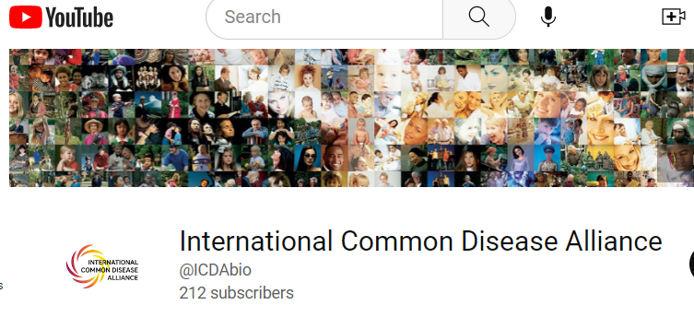
    International Common Disease Alliance
ICDA Scientific Plenary Meeting in December 2022
Meeting focused on proposals for moving from Maps to Mechanism to Medicine
Document 27
Notes:
The International Common Disease Alliance (or ICDA) is a scientific consortium that aims to define barriers to progress in tackling its signature Maps-to-Mechanisms-to-Medicines challenge, identify opportunities for new projects, and facilitate international collaborations.
* ICDA held its third Scientific Plenary Meeting this past December. This meeting featured talks by leaders from academia and industry and highlighted innovative proposals conceived by the core ICDA working groups. Each of these proposals is focused on moving from Maps to Mechanism to Medicine at scale, meaning that they are designed to move the needle on our understanding of how genetic variation affects biological systems and contributes risk to human disease, with the ultimate goal of informing medical practice.
* To learn more about ICDA and about the proposals featured at the Scientific Plenary Meeting, visit the ICDA website and view the recordings that have been uploaded to YouTube.

Slide 40

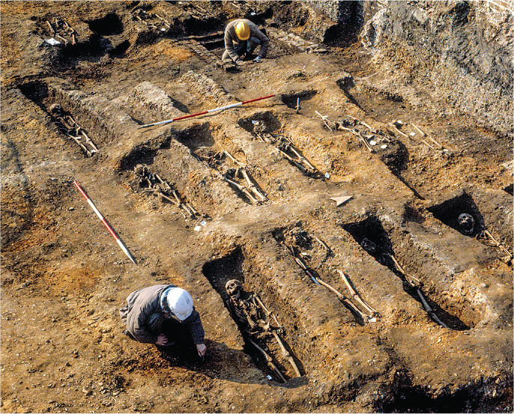

Science’s 2022 Breakthrough of the Year
& Runners Up
Black Death’s legacy detected in the genes of Europeans
Ancient ecosystem reconstructed from
2-million-year-old DNA
Document 28
Notes:
Now for some end-of-2022 accolades…
Although the Science Breakthrough of the Year went to the James Webb Space Telescope, there were two runners up of particular interest to the genomics community. They were “Black Death’s legacy detected in the genes of Europeans” and “Ancient ecosystem reconstructed from 2-million-year-old DNA” – both super-cool advances.

Slide 41

Nature’s 10 People
Who Helped Shape Science in 2022
Document 29
Notes:
Late last year, Nature named 10 people who helped shape science in 2022. One of those was Alondra Nelson, who is Deputy Director for Science and Society in the U.S. Office of Science and Technology Policy. Alondra was also previously a member of the Genomics and Society Working Group of this Council.
41

Slide 42
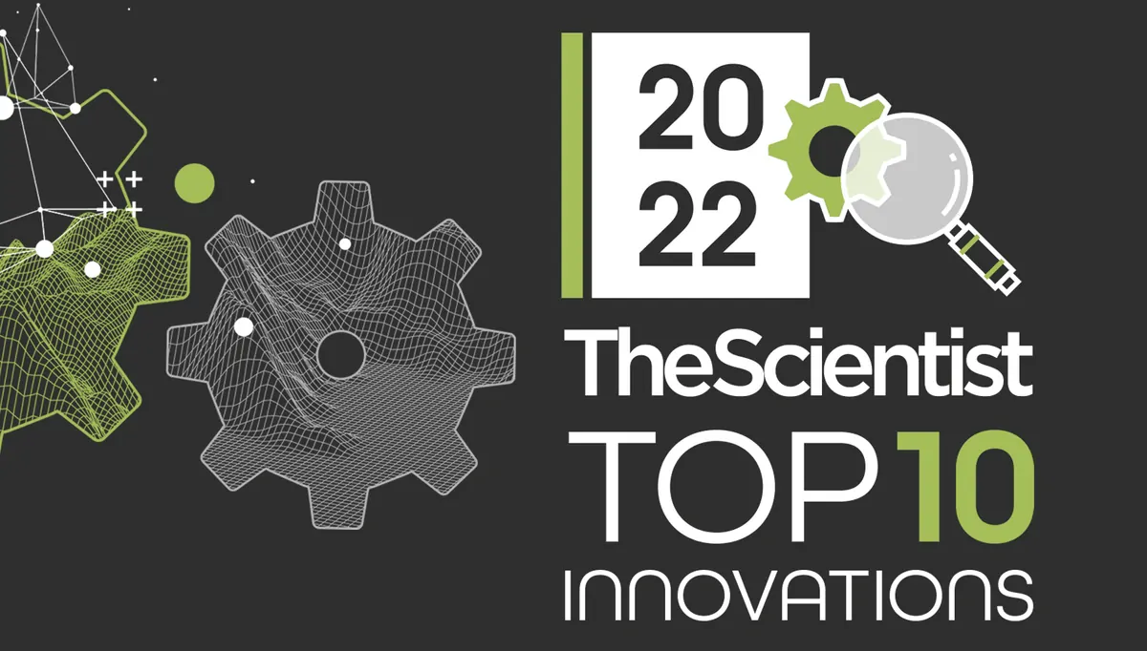
The Scientist’s Top Innovations of 2022
Machine to sequence the genome for $100
Instruments for single-cell analysis
Non-invasive prenatal testing
3D view of gene expression
Document 30
Notes:
Meanwhile, The Scientist’s Top 10 Innovations of 2022 included a machine to sequence the genome for $100, instruments for single-cell analysis, tools for non-invasive prenatal testing, and a 3D view of gene expression.

Slide 43
Director’s Report Outline
General NHGRI Updates
General NIH Updates
General Genomics Updates
NHGRI Extramural Research Program
NIH Common Fund/Trans-NIH
NHGRI Communications, Policy, and Education
NHGRI Intramural Research Program
Notes:
Moving on to the NHGRI Extramural Research Program.

Slide 44
Human Genome Reference Program (HGRP)
Annual HPRC meeting (October 2022)
  Sample selection and collection
  Embedded ELSI research
  Changes in DNA sequence-production costs
HGRP planning meeting (October 2022)
Document 31
Notes:
The Human Genome Reference Program (or HGRP) represents NHGRI’s continued commitment to refining and maintaining the reference human genome sequence.
The program, which is in its fourth year, aims to generate at least 350 high-quality reference human genome sequences and incorporate these data into a pangenome reference for the research community. Data generated with multiple DNA-sequencing platforms, reflecting phased diploid genome sequences from 150 individuals, have been released and are available for download from multiple repositories.
* The annual HPRC meeting was held in October 2022 and featured updates on sample selection and collection, embedded ethical, legal, and social implications research, and changes in DNA sequence-production costs. The meeting also covered pangenome reference representations, outreach, and international collaborations.
* NHGRI hosted a separate planning meeting the day after the main meeting to consider next steps for the HPRC program. A concept stemming from this meeting will be presented this afternoon.

Slide 45

Genomics Research Enhances Genetics of
Rare Disease (GREGoR) Consortium
First in-person GREGoR Consortium Meeting
  November 2022
    Over 140 participants
Key themes of networking and collaboration
    Identifying challenges to solving Mendelian disorders
    Internal and external collaboration
Document 32
Notes:
The Genomics Research Enhances Genetics of Rare Disease (or GREGoR) Consortium aims to significantly increase the proportion of identified genetic causes of Mendelian diseases through enhanced data sharing, collaboration, and a strong focus on the application of new technologies, DNA-sequencing strategies, and analytical approaches.
​
* In November 2022, the GREGoR Consortium held its first in-person meeting with over 140 participants.
* The meeting’s key themes were networking and collaboration. Poster sessions, panel discussions, and lunch groups helped to foster connections among Consortium members. The meeting included a session on the major challenges to solving the genetic causes of Mendelian disorders as well as a session on collaborations with projects that could be performed across the GREGoR research centers (and with other related consortia).

Slide 46
    Impact of Genomic Variation on Function (IGVF)
First Annual Consortium Meeting
Meeting focus:
Coordinating activities
Engaging trainees
Fostering interactions
Defining future goals
September 2022
Document 33
Notes:
The Impact of Genomic Variation on Function Consortium (or IGVF) aims to develop a framework for systematically understanding the effects of genomic variation on genome function and how these effects shape phenotypes in health and disease.
This past September, IGVF members associated with the 26 awards gathered for the first annual Consortium meeting. The meeting focused on coordinating activities across the IGVF awards, engaging trainees and promoting career development, fostering interactions with other consortia, and defining future goals and timelines. There were awardee and working group presentations, poster sessions, lightning talks, and a panel with guest speakers from various consortia.

Slide 47
    Impact of Genomic Variation on Function (IGVF)
IGVF Affiliate Membership
Affiliate role
  Contribute to data sharing and analysis
  Engage in Consortium
  Broaden participation
Current affiliate members
  17 members
  U.S. and Europe
Affiliate Sites in Continental U.S.
Document 33
Notes:
Researchers who are not funded by the IGVF Consortium can apply to join the program as affiliate members. Affiliate members can benefit from the highly interactive research environment and consortium discussions. These members will make valuable contributions to the generation, sharing, and analysis of data; engage in Consortium activities; and broaden participation from the scientific community.
* IGVF currently has 17 affiliate members, each contributing their unique expertise to the Consortium. They span 17 different institutions with 15 sites located across the United States, as shown here, as well as two sites in Europe.
See the NHGRI IGVF website for a full list of affiliate members as well as information on how to apply for affiliate membership. The deadline to apply for affiliate membership is rolling.

Slide 48
Molecular Foundations for Biotechnology (MFB)
Partnerships to Transform Emerging Industries
RNA Tools/Biotechnology
    NSF23-554: Partnership between NSF & NHGRI
    Soliciting synergistic proposals:
      Study RNA function in complex biological systems
      Harness RNA research to advance biotechnology
      Integrate across disciplines
    Letters of intent due: March 16, 2023
    Full proposal due: May 11, 2023
Document 34
Notes:
The National Science Foundation’s Molecular Foundations for Biotechnology (or MFB) program aims to develop fundamentally new approaches in molecular sciences to drive novel directions in biotechnology.
* NSF and NHGRI jointly released the 2023 MFB solicitation, which is a partnership that focuses on RNA tools and biotechnology.
* The program is soliciting synergistic proposals that pursue creative, technological approaches to study RNA function in complex biological systems and harness RNA research to advance biotechnology. The goal is to catalyze collaborations that integrate across biological, chemical, computational, mathematical, and physical science disciplines.
* Letters of intent are due March 16, with the full proposal due May 11.

Slide 49
    Analysis, Visualization, and Informatics Lab-space (AnVIL)
    Data Use Oversight System (DUOS) Pilot
    DUOS expedites controlled data access
    By mid-2023, DUOS will be used by the NHGRI Data Access Committee to process all data access requests
Document 35
Notes:
The NHGRI Analysis, Visualization, and Informatics Lab-space (or AnVIL) is a federated cloud-based infrastructure and software platform that provides an analysis and computing environment for unrestricted and controlled access of genomic and phenotypic datasets. ​
* ​AnVIL has been piloting the Data Use Oversight System, called “DUOS.” DUOS is a semi-automated service that expedites controlled data access for researchers, simplifying oversight of the data access request process by a Data Access Committee (or DAC). ​​DUOS implements the GA4GH Data Use Ontology (or DUO) standard and other features to streamline receiving and managing data access requests. It facilitates browsing of datasets that can be used for a particular research purpose. DUOS also supports DACs in their review and oversight by aligning proposed projects with data use limitations of requested datasets.
​* By mid-2023, DUOS will be used by the NHGRI DAC to process all data-access requests for datasets stored in AnVIL. Further innovation supporting the use of DUOS by the NHGRI DAC – and potentially expanding to the DACs of other NIH Institutes – will be key deliverables of the AnVIL.​

Slide 50
    iDASH Genomic Privacy Challenge 2022
    Privacy algorithms rapidly becoming practical in real-world use
    Compute time decreasing faster than Moore’s Law
    iDASH challenge winners building useful genomics applications
Document 36
Notes:
The 9th iDASH Genomic Privacy Challenge was held in November 2022 with competition tasks including secure genotype-phenotype prediction, analysis of single-cell transcriptomics, and secure record linkage with patient data.
* Privacy algorithms used in the challenge are rapidly becoming practical in real-world use.
* The speed of homomorphic encryption (or compute time) is decreasing faster than Moore’s Law.
* Previous iDASH Challenge winners are building useful applications for genomics and health. Fast genome imputation that is fully encrypted is now available in the OpenImpute server at the University of Texas Health Science Center. Another team of previous iDASH contributors has just won Phase 1 of the UK-US privacy prize challenge in the healthcare competition.

Slide 51

Clinical Sequencing Evidence-generating
Research Program (CSER)
    10 presentations
    P3EGS: Rates of positive diagnoses and inconclusive findings were similar between URM and non-URM children
    KidsCanSeq: Combined exome sequencing and panel testing may improve utility in pediatric cancer
35
Courtesy of Anne Slavotinek (unpublished)
Document 37
Notes:
The Clinical Sequencing Evidence-Generating Research (or CSER) program aims to generate evidence of the clinical utility of genome sequencing, with a major emphasis on diverse patient populations. As CSER heads to completion this spring, its investigators have been busy presenting and publishing their work.
* The 2022 ASHG Annual Meeting featured 10 CSER presentations. * A platform talk from the UCSF Program in Prenatal and Pediatric Genome Sequencing Study (or P3EGS) showed that among 529 pediatric and 316 prenatal patients whose parents self-reported as underrepresented minority (or URM) status and received exome sequencing, rates of both positive diagnoses and inconclusive findings were similar between URM and non-URM children (for both pediatric and prenatal exome sequencing). These findings support the application of exome sequencing in patients from diverse populations.
* Another platform presentation from the Baylor KidsCanSeq study evaluated yield and utility of adding exome sequencing to a pediatric cancer panel test. Among reported results from 581 childhood cancer patients, less than half of the pathogenic and likely pathogenic variants were reported on both the exome sequence and panel. Exome sequencing showed a large number of results not covered by the panel, while variants unique to the panel were all found to be actionable. This finding suggests that careful optimization of combined exome sequencing and panel testing may improve utility in pediatric cancer.

Slide 52
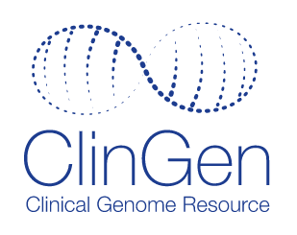





    Clinical Genome Resource (ClinGen)
    Efforts Toward Sustainability
Increased Curation Output
Other NIH Funding
NCI
NEI
NICHD
NINDS
Non-NIH Funding
Document 38
Notes:
The Clinical Genome Resource (or ClinGen) evaluates and disseminates the clinical relevance of genes and genomic variants for use in precision medicine and research.
* The number of ClinGen Gene and Variant Curation Expert Panels has more than doubled since 2019, from 50 Expert Panels to over 100. This has led to a sharp increase in the completed gene and variant curations that are freely available in the ClinGen resource, with total curations around 6,000 unique genes and variants.
* This exciting growth has been supported, in part, by the NIH Institutes listed here, which have funded 15 Curation Expert Panels in disease areas relevant to their mission.
* Additionally, ClinGen-funded grantee institutions have developed partnerships with non-profit and industry groups. These partners have provided funds to support biocurators on a variety of expert panels. Each partner has agreed to ClinGen’s Partnership Policy, which emphasizes principles such as data sharing, transparency, and no expectation of endorsement by ClinGen or NIH. The growing funding support from our sister NIH Institutes, non-profit organizations, and industry contributes to ClinGen’s ability to sustain this important resource into the future.

Slide 53
Phenotypes and Exposures (PhenX) Toolkit
PhenX Toolkit renewed
(Fiscal Years 2022-2026)
  Carol Hamilton, RTI International
  Funded as Trans-NIH Biomedical Knowledgebase
  Co-funding from NHLBI, NIMHD, NINDS, and OBSSR
Document 39
Notes:
The Phenotypes and Exposures Toolkit (or PhenX) is a catalog of consensus protocols for measuring phenotypes and exposures in biomedical research. Usage of PhenX consensus protocols facilitates combining studies to increase statistical power, comparing studies to validate results, and increasing the impact of individual studies.
* The PhenX Toolkit grant was recently renewed, with Carol Hamilton from RTI International as the Principal Investigator. PhenX is now supported under the NIH-wide Trans-NIH Biomedical Knowledgebase Program funding announcement, which supports curation, annotation, and linkage of core datasets. NHGRI will provide funding for 5 years with co-funding from the indicated four other Institutes and Center.
In this next phase, PhenX aims to increase use by leveraging biomedical standards to increase scientific impact and awareness of the resource. The active participation from our partners will facilitate wider dissemination and use of the Toolkit among the NIH-funded research community.

Slide 54
Phenotypes and Exposures (PhenX) Toolkit
Expanded Social Determinants of Health Collection
15 new protocols
Protocols include:
    Internet access
    Minimum wage
    Healthcare discrimination
Document 39
Notes:
This December, PhenX expanded its Social Determinants of Health collection. The expansion was achieved with significant leadership and funding from the National Institute on Minority Health and Health Disparities, along with input from a trans-NIH working group. The new Social Determinants of Health protocols measure social factors at the individual and community level that influence health outcomes. The expanded collection includes 15 new protocols for measures such as internet access, minimum wage, and healthcase discrimination.
The Social Determinants of Health collection is a popular resource, ranked as the seventh most downloaded collection of protocols on the PhenX website. We expect the expanded collection to further enhance the science of minority health and health disparities while advancing a culture of scientific collaboration.

Slide 55
Polygenic Risk MEthods in Diverse populations Consortium (PRIMED)
Working Groups:
Data Sharing
Genotype Harmonization
Methods Review
Phenotype Harmonization
Social and Ethical Implications of Polygenic Risk
Establishment of PRIMED External Scientific Panel)
Document 40
Notes:
The Polygenic Risk Methods in Diverse Populations (or PRIMED) Consortium is developing methods and refining polygenic risk scores to improve the prediction of health and disease in diverse ancestry populations. To assist in their efforts, the PRIMED Consortium has received approvals from various dbGaP Data Access Committees for over 300 data access requests. Combining these data from other publicly accessible repositories will provide PRIMED investigators with participant data from the blue shaded areas shown on the map for their analyses.
* The PRIMED Consortium established five working groups. The Data Sharing Working Group focuses on developing policies and processes for sharing data. The Genotype Harmonization Working Group is formulating a quality control and a harmonization plan. The Methods Review Working Group assesses methods. The Phenotype Harmonization Working Group defines phenotype data standards while working closely with the Social and Ethical Implications of Polygenic Risk Working Group, which identifies, investigates, and responds to ethical, social, and related considerations.
* Finally, the PRIMED Consortium recently established its External Scientific Panel, a non-governing entity comprising multidisciplinary experts, that will assist the NIH in assessing the PRIMED Consortium’s activities.

Slide 56
Small Business Program
    ~$16.5 million in Fiscal Year 2022
    19 Phase I Proof of Principle awards
    11 Phase II Pre-Commercialization awards
Document 41
Notes:
NHGRI’s Small Business program continues to support innovative research and enable commercialization in genomics and genomic medicine through funding Small Business Innovation Research (or SBIR) and Small Business Technology Transfer (or STTR) grants.
* In total, the Institute funded $16.5 million in small business grants in Fiscal Year 2022.
* These recent SBIR and STTR grants include 19 Phase I Proof of Principle and 11 Phase II Pre-Commercialization awards.
* Of note, the five companies shown here have been awarded new Phase II grants: Curio Bioscience for commercialization of a reagent kit for spatial transcriptomic analysis; Primordial Genetics for their work on a novel and efficient enzymatic process for synthesis of DNA oligonucleotides; Armonica Technologies for development of single molecule nucleic acid sequencing technology; Datirium for their scientific data analysis platform; and Electronic Biosciences for their nanoscale tools for inosine sequencing.

Slide 57
    Extramural Training Program
    Outreach at the 2022 Annual Biomedical Research Conference for Minority Students (ABRCMS)
    Publication of the conference report on the 2022 NHGRI Research Training and Career Development Annual Meeting
Document 42
Notes:
NHGRI’s Extramural Training Program aims to prepare a talented and diverse genomics workforce by providing both institutional and individual funding through a variety of mechanisms, including individual fellowship, and career development awards, institutional awards and diversity supplements. Programs are offered at the undergraduate, postbaccalaureate, graduate, postdoctoral, and faculty levels.
The Extramural Training Program has two updates on outreach activities to attract more diverse individuals to the workforce.
* First, Program staff participated in outreach at the 2022 Annual Biomedical Research Conference for Minority Students (or ABRCMS) in November 2022. There are similar plans for participating in this and other outreach events in 2023.
* Also, Duke University Principal Investigator Susanne Haga published a conference report on the 2022 NHGRI Research and Career Development Annual Meeting. Published in Personalized Medicine, the report highlights specific programs and events that were offered to the trainees during the three-day meeting, raising its visibility to the biomedical research community.

Slide 58
Director’s Report Outline
General NHGRI Updates
General NIH Updates
General Genomics Updates
NHGRI Extramural Research Program
NIH Common Fund/Trans-NIH
NHGRI Communications, Policy, and Education
NHGRI Intramural Research Program
Notes:
Moving on to the NIH Common Fund and other trans-NIH efforts.

Slide 59
Knockout Mouse Phenotyping Project (KOMP2)
Awards funded for a final five-year project period
Annual meeting held December 2022
Document 43
Notes:
The Knockout Mouse Phenotyping Program (or KOMP2) is a trans-NIH research program focused on generating a comprehensive resource of null mutant mice and their phenotype information. To date, KOMP2 investigators have developed and phenotyped approximately 5,500 strains of knockout mice, contributing to the more than 10,000 strains created by the International Mouse Phenotyping Consortium (or IMPC).
* KOMP2 launched the final phase of its program last year with co-funding from 18 NIH Institutes, Centers, and Offices. Awards totaling $42 million over a five-year period were made to three production centers at the University of California, Davis, The Jackson Laboratory, and Baylor College of Medicine, as well as to a Data Coordination Center at EBI-Hinxton. The final phase of the program will generate an additional 1,200 mutant mouse lines using CRISPR/Cas9 technology, perform a series of phenotyping assays, and make mice strains and data readily available to the research community.
* KOMP2 hosted its annual meeting in December 2022. Over 240 attendees convened to discuss consortium-wide efforts, accomplishments, and goals. The meeting featured several guest speakers, including NHGRI Council member Len Pennacchio.

Slide 60
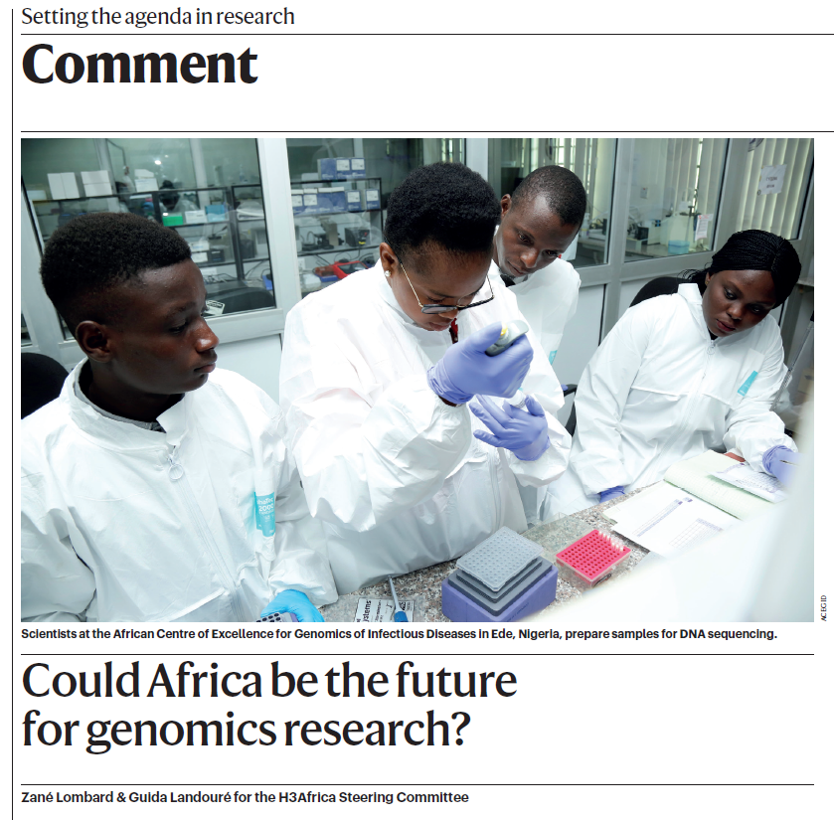
Human Heredity & Health in Africa (H3Africa)
Document 44
Notes:
The central goal of the Human Heredity and Health in Africa (or H3Africa) program has been to develop a sustainable and collaborative African genomics research enterprise. H3Africa has now completed its tenth and final year of NIH Common Fund support.
Two weeks ago, a paper describing the accomplishments of the H3Africa program and its influence on genomics in Africa was published in Nature. Aside from the incredible achievements of H3Africa that were included, the paper importantly makes the case for future genomics funding in Africa.

Slide 61
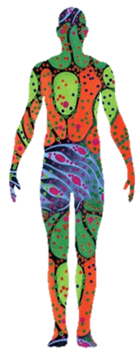
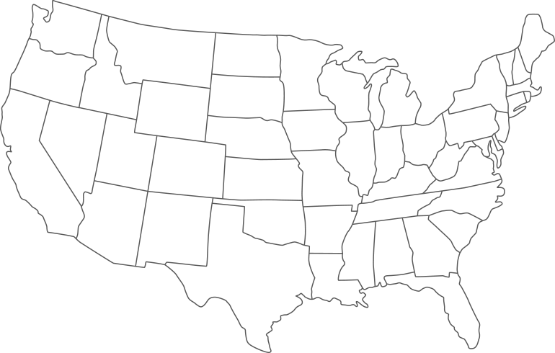








Human Biomolecular Atlas Program (HuBMAP)
      Now in Production Phase (Fiscal Years 2022-2026)
        6 HuBMAP Integration, Visualization, and Engagement Groups
        10 Tissue Mapping Centers
        4 Demonstration Projects
Document 45
Notes:
The NIH Common Fund Human Biomolecular Atlas Program (or HuBMAP) aims to develop an open, global framework for creating comprehensive mappings of the human body at a cellular resolution, which will help determine how the relationships between cells affect the health of a person.
HuBMAP has now entered its production phase, which will run during Fiscal Years 2022 to 2026 and will focus on building out reference datasets for more organs and modalities, integrating across different molecular and spatial resolutions, improving access to the generated data, enhancing diverse perspectives in research efforts, and establishing collaborative efforts with other programs.
20 new awards were made in the production phase with locations across 10 states. These include * 6 HuBMAP Integration, Visualization, and Engagement groups that will build the tools for integrating and visualizing data; * 10 Tissue Mapping Centers that will generate the data for creating 2D and 3D maps for multiple organs; and * 4 Demonstration Projects that will focus on analysis that show how the broader research community can benefit from HuBMAP data and resources.

Slide 62
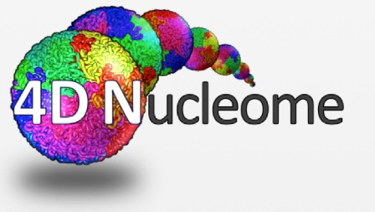
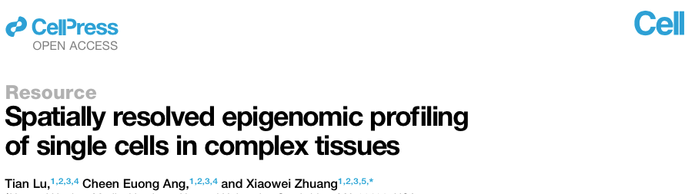
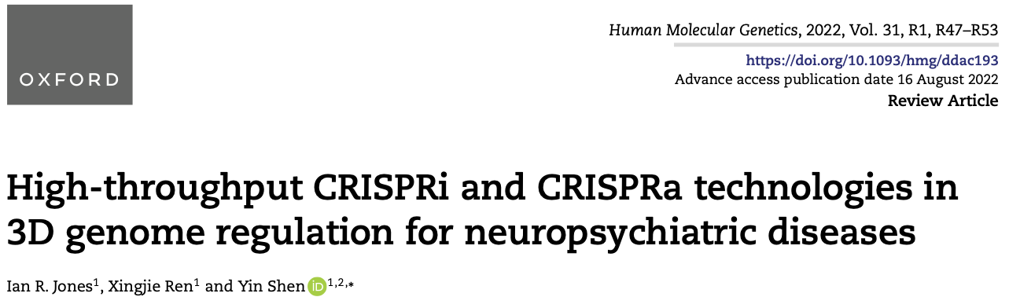
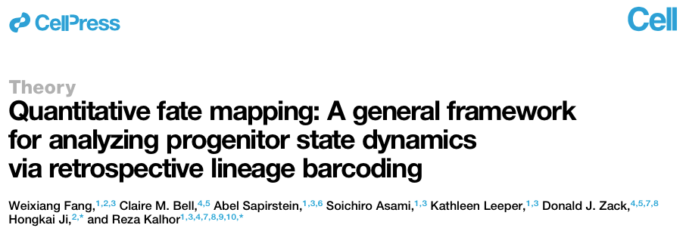

4D Nucleome (4DN)
Document 46
Notes:
The 4D Nucleome (or 4DN) is an NIH Common Fund program that aims to study the organization of the nucleus in both space and time. Phase 2 launched in 2020, with a focus on understanding the role of nuclear architecture in disease and biological processes such as gene expression.
I would like to highlight four recent publications from the 4DN program:
* The first involves development of a novel method that captures spatially resolved single-cell epigenomic data. This method can be used to identify enhancer-promoter pairs and enhancer hubs.
* The second is a review that highlights current challenges and opportunities in using epigenome editing screens to examine the role of nuclear architecture in disease.
* The third reports progress in quantitative cell-fate mapping, specifically using an approach that connects cell lineage to cell fate and dynamics long after embryonic development.
* The fourth is a perspective from the NIH program team that summarizes how the 4DN program started, accomplishments of phase 1, and plans for phase 2.
In addition to reading 4DN publications, I also encourage you to tune in to the webinars on the 4DN YouTube channel.

Slide 63

    Faculty Institutional Recruitment for Sustainable Transformation (FIRST)
    2022 Awardees
Institution | Principal Investigators
Northwestern University in Chicago | Melissa Simon, Eric Perreault, Clyde Yancy
University of California, San Diego | JoAnn Trejo, María Elena Martinez
University of Maryland Baltimore | James Kaper, William LaCourse
The University of New Mexico | Jane Ellen Smith, Irene Salinas
University of South Carolina in Columbia | Angela D. Liese, Coretta Jenerette
Document 47
Notes:
The NIH Faculty Institutional Recruitment for Sustainable Transformation (or FIRST) Program aims to enhance and maintain cultures of inclusive excellence in the biomedical research community through recruitment of early career faculty. Led by the NIH Common Fund and managed in collaboration with several NIH Institutes and Centers, five new sites were funded in response to the most recent funding opportunity.
The new awardees are: Northwestern University in Chicago, University of California, San Diego, University of Maryland in Baltimore, University of New Mexico, and University of South Carolina in Columbia. The second-round awardees will join the existing awarded sites in recruitment of a critical mass of early career faculty who have a demonstrated commitment to inclusive excellence. The program also seeks to advance faculty development, retention, progression, and eventual promotion, as well as to develop inclusive environments that are sustainable.

Slide 64


Return of health-related genetic results to participants
New Funding Opportunity Announcements
  RFA-PM-23-001
  RFA-PM-23-002
    Due date: March 1, 2023
Document 48
Notes:
The All of Us Research Program is seeking to build a national research cohort of one million or more participants, reflecting the diversity of the United States. The program is creating a partnership with participants in order to advance precision medicine and to change healthcare for the benefit of all.
* All of Us is now returning health-related genetic results to more than 150,000 study participants nationwide. This includes a Hereditary Disease Risk report with information on genomic variants in the 59 medically actionable genes identified by the American College of Medical Genetics as well as a report focused on pharmacogenomics. Participants have the option to speak to a genetic counselor to discuss and interpret the results of their genetic tests.
* We are also excited to announce that NHGRI is partnering with All of Us and other NIH Institutes and Centers on two new funding opportunity announcements listed here. These solicitations are aimed at enhancing the use of All of Us data in the Researcher Workbench and developing new tools and applications to analyze these data. The application due date for both announcements is March 1.

Slide 65


























    Bespoke Gene Therapy Consortium (BGTC)
Candidate Diseases:
Congenital Hereditary Endothelial Dystrophy
MPS VI Corneal Disease
Leber Congenital Amaurosis 16
Retinitis Pigmentosa - CNGB1
Retinal Degeneration - NPHP5
Charcot Marie Tooth Disease, Type 4J
Multiple Sulfatase Deficiency
Spastic Paraplegia, Type 47
Spastic Paraplegia, Type 50
Barth Syndrome
PGM1-Congenital Disorder of Glycosylation
Propionic Acidemia
Fibrodysplasia Ossificans Progressiva
Mucopolysaccharidosis IVA
(Morquio A Syndrome)
Government
Industry
Non-Profit
NCATS NHLBI
NEI NHGRI
NICHD
NIAMS NIMH
NIDCR NINDS
NIDCD
Document 49
Notes:
The Bespoke Gene Therapy Consortium (or BGTC) launched in October of 2021 with an aim to improve understanding of the basic biology of vectors involved in gene delivery and simplify regulatory requirements for gene therapies for ultra-rare diseases. The program is coordinated by the Foundation for the National Institutes of Health as part of its Accelerating Medicines Partnership, with involvement of 12 government, 13 industry, and 10 non-profit partners as well as over $81 million in committed resources (the names and logos of which are shown on the left).
Now in year one of a planned six year-initiative, BGTC has selected 14 candidate diseases that will be focused on and will be announcing the final 5 to 6 diseases later this summer. These diseases will be the targets for gene-therapy efforts, including manufacturing and preclinical testing.

Slide 66
Director’s Report Outline
General NHGRI Updates
General NIH Updates
General Genomics Updates
NHGRI Extramural Research Program
NIH Common Fund/Trans-NIH
NHGRI Communications, Policy, and Education
NHGRI Intramural Research Program
Notes:
Moving on to NHGRI activities in the areas of communications, policy, and education.

Slide 67


Talking Glossary of Genomic and Genetic Terms
    ~18.4 million page views
Document 50
Notes:
The recently upgraded NHGRI Talking Glossary of Genomic and Genetic Terms features nearly 250 terms explained in an easy-to-understand way by leading scientists and professionals in addition to providing graphics and animations for viewing and downloading.
Based on data from April 2021 to January 2023, the resource has received over 18.4 million page views by viewers in 190 countries.
* As a testament to the growing visibility of this resource, the journal Clinical Chemistry used the Glossary’s nanopore DNA sequencing graphic on the cover of its December 2022 issue.

Slide 68


NHGRI History of Genomics Program
Recent Events
Document 51
Notes:
In the past two years, the NHGRI History of Genomics Program has hosted public forums to stimulate dialogue about genomics and the related potential for stigmatization and misinformation.
The most recent of these events took place in January with a virtual roundtable discussion entitled “The Promise and Perils of Social and Behavioral Genomics.” The event attracted 900 attendees that engaged with expert panelists who addressed how the history of scientific racism and eugenics in genetics and genomics may limit the scientific community’s capacity to respond decisively to the misuse and misappropriation of scientific data.
Also this past October, the Program hosted a two-day virtual symposium entitled “Irreducible Subjects: Disability and Genomics in the Past, Present and Future.” Nearly 1,000 attendees registered for this event. Participants addressed historical and present-day constructions of disability and ableism, with a focus on the history and lived experiences of people with disabilities in the context of genetics and genomics.
Recordings of both events can be found on our website (genome.gov).

Slide 69


NHGRI History of Genomics Program
Archive Highlight
Document 52
Notes:
Since 2023 will mark the 20th anniversary of the completion of the Human Genome Project and the 70th anniversary of the discovery of DNA's double-helical structure, this Director’s Report 'archive highlight’ features items related to these anniversaries.
On the left is a letter from President George W. Bush sending his congratulations for the successful completion of the Human Genome Project, marking a new era of medical progress. He also commemorated what was then the 50th anniversary of the discovery of DNA's double-helical structure.
In the center is a logo used in April 2003, illustrating the journey from the discovery of DNA's double-helical structure in 1953 to the completion of the Human Genome Project in 2003.
Lastly, on the right is an excerpt from the Senate concurrent resolution that designated April 2003 as "Human Genome Month" and April 25 as National "DNA Day." This resolution, which was in large part due to the work of the late Representative Louise M. Slaughter, was a means to commemorate the successful completion of the Human Genome Project in 2003 and the discovery of DNA's iconic structure, the double helix, in 1953.

Slide 70





Genomics Anniversaries in 2023
Document 53
Notes:
As I just mentioned, 2023 is going to be an energetic, spirited, and celebratory year! Put on your seat belts because NHGRI will be leading efforts to engage the genomics community in celebrating three anniversaries this year – the 20th anniversary of the completion of the Human Genome Project, the 70th anniversary of the discovery of DNA's double-helical structure, and the 20th anniversary of National DNA Day.
To commemorate these anniversaries, NHGRI will hold a symposium on National DNA Day, April 25, highlighting relevant and interesting topics in genomics and concluding with the annual Louise M. Slaughter National DNA Day Lecture. The symposium agenda and guest lecturer will be announced soon. Follow us on social media and check the National DNA Day webpage for the most up-to-date information.
And wait – there will be more! Because the September meeting of this Advisory Council will be… yes, wait for it… the 100th such gathering of this amazing group. Yes, we will also celebrate that anniversary as well when we all gather for the September Council meeting. * Yes, you can expect cake, balloons, and maybe even some genome songs – it will be quite the celebration!

Slide 71

    Communications on Artificial Intelligence in Genomics
    Feature story on AI and ML research at NHGRI
    Video with Benjamin Solomon, Susan Persky, and Oleg Shchelochkov
    Twitter Q&A with Spencer Hong (Ph.D. Candidate)
Document 54
Notes:
The NHGRI Office of Communications released materials for audiences to learn about the different ways that artificial intelligence and machine learning are being used at NHGRI and in genomics research. This included a feature story and accompanying video about three NHGRI Intramural investigators who use these technologies to characterize genomic disorders and to communicate genomic risk.
NHGRI also held a live Twitter Q&A with Spencer Hong from Northwestern University. Spencer uses machine learning to analyze materials in NHGRI’s history archive, which contains over two million pages of documents pertaining to the history of genomics and NHGRI. Machine learning tools help to analyze these documents much faster than humans can.

Slide 72







    Communications on the NHGRI Dog Genome Project
Document 55
Notes:
Another exciting area of NHGRI research recently received significant press attention. * By analyzing DNA samples from over 200 dog breeds along with nearly 50,000 pet-owner surveys, researchers in Elaine Ostrander’s laboratory have pinpointed some of the genes associated with the behaviors of specific dog breeds. Their study, published in Cell in December, suggested that behavior, not just appearance, has helped qualify these dogs for their various roles with humans.
* This paper garnered significant attention by the popular press, including the New York Times, Daily Beast, and Scientific American. * The real highlight of that media coverage was a feature about dog genomics on 60 Minutes, which included a major interview with Elaine Ostrander by Anderson Cooper.

Slide 73


Inter-Society Coordinating Committee for Practitioner Education in Genomics (ISCC-PEG)
2022-2024 Scholars
    Ava Willoughby
    Molly Felix
Document 56
Notes:
NHGRI’s Inter-Society Coordinating Committee for Practitioner Education in Genomics (or ISCC-PEG) facilitates student interactions with healthcare and education professionals working in genomics. Three years ago, ISCC-PEG created a Scholars Program, which provides trainees with exposure to the broader genomics community and one-on-one interactions with experts in the field. Over a two-year term, scholars work on genetics/genomics-related education projects under the mentorship of an ISCC-PEG member.
The first class, whose term ran from December 2020 to November 2022, presented their work this October. The program then selected two new scholars in December. Both are in genetic counseling programs: Ava Willoughby at Ohio State University and Molly Felix at Virginia Commonwealth University.

Slide 74
Director’s Report Outline
General NHGRI Updates
General NIH Updates
General Genomics Updates
NHGRI Extramural Research Program
NIH Common Fund/Trans-NIH
NHGRI Communications, Policy, and Education
NHGRI Intramural Research Program
Notes:
And finally, moving on to NHGRI’s Intramural Research Program.

Slide 75



    Retirement of Intramural Investigators
    Joan Bailey-
    Wilson, Ph.D.
    David Bodine, Ph.D.
    Jim Mullikin, Ph.D.
Document 57
Notes:
As with our Extramural Research Program, the retirement bug is also hitting NHGRI’s Intramural Research Program!
* Joan Bailey-Wilson recently retired after 27 years at the Institute. Joan led a highly successful program that used statistical genetics to determine the genetic underpinnings of multiple types of cancers. She served as a Co-Branch Chief at NHGRI for many years, was passionate about helping trainees flourish under her mentorship and launch their careers, and published over 240 papers throughout her time as an active researcher.
* Another long-time Branch Chief, David Bodine, also recently retired from NHGRI. Dave first joined NIH as a postdoctoral fellow at the National Heart, Lung, and Blood Institute, joining NHGRI at the start of our Intramural Research Program in 1993. His work advanced the fields of genomics and hematology, for example by identifying genetic factors involved in blood disorders like Diamond-Blackfan anemia. In addition to his scientific achievements, Dave holds the record for most Mentor of the Year awards at NHGRI.
* Finally, Jim Mullikin retired from NHGRI after 25 years at the Institute. Jim worked on the Human Genome Project at the Sanger Center before bringing his expertise in genome-sequencing technologies to NHGRI in 2003. In 2009, Jim became Director of the NIH Intramural Sequencing Center. Under Jim's guidance, NISC evolved with modern technologies and aided countless genomics projects at NIH. A few notable examples of Jim's collaborative scientific work include his involvement with the International HapMap Project, the ENCODE Consortium, and the Neanderthal Genome Project.

Slide 76

New Chief, NHGRI Metabolic Medicine Branch
Charles Venditti, M.D., Ph.D.
Document 58
Notes:
Chuck Venditti was recently appointed the new Chief of NHGRI’s Metabolic Medicine Branch. A talented medical geneticist, Chuck has been at NHGRI for nearly 20 years, starting as a member of the Physician-Scientist Development Program and later transitioning to an Investigator position in 2008.

Slide 77






    NHGRI Intramural Research Highlights
Educational considerations based on medical student use of polygenic risk information and apparent race in a simulated consultation
Genotype first: Clinical genomics research through a reverse phenotyping approach
A family of unusual immunoglobulin superfamily genes in an invertebrate histocompatibility complex
Document 59
Notes:
The NHGRI Intramural Research Program has once again been very productive since the last Council meeting. A few of their many research highlights include:
* Susan Persky and her group used virtual reality simulations to investigate how clinicians might use polygenic risk scores in medical care. They found that medical students who received additional genomic information made different clinical recommendations to the virtual patient depending on the patient's race.
* Les Biesecker and his group assessed 13 NIH studies that use a genotype-first approach to patient care, which involves selecting patients with specific genomic variants and studying their traits and symptoms. The researchers found that this approach uncovered new relationships between genes and clinical conditions, broadened the traits and symptoms associated with known disorders, and offered insights into newly described disorders.
* Andy Baxevanis and his collaborators identified a set of genes used for colony formation in a saltwater invertebrate. These invertebrate genes are similar to genes involved in human immunity (specifically the histocompatibility complex), lending new insights into the evolution of the immune system.

Slide 78




















    Where’s Eric?
Notes:
And finally, I will leave you with a recommendation about how to improve morale among trainees at your research institution. Our Intramural Training Office noted that, ever since the pandemic started, our trainees were not getting out of their laboratories as often and interacting with other trainees across the Institute (especially those located in other buildings on the NIH campus).
* So, recently the Office staff held a week-long event during which my cardboard self (looking like Waldo) was placed at a different location around the NIH campus each day; a photo of ‘Eric as Waldo’ at that location was emailed to all trainees each day. If they could correctly identify the location and come there in person to mingle with other trainees, then they received a baked treat AND had the chance to take photos with Cardboard Eric. As you can see, this was a smashing success. I am convinced that the few hundred dollars used by our communications group to make that Cardboard Eric was some of the most morale-enhancing money we have ever spent!

Slide 79




    Where’s Eric?
    Where’s
    Laura?
    Where’s
    Stephen?
    Where’s
    Gail?
    Where’s
    Hal?
Notes:
So, my recommendation is that each of you do the same thing at your Institution. I can readily imagine the trainees flocking in droves to be photographed with * Cardboard Laura, * Cardboard Stephen, * Cardboard Gail, and especially * Cardboard Hal! Please let my communications folks know if you need advice about making such cardboard replicas of yourself.

Slide 80




‘One-Stop-Shop’ to Stay Connected
genome.gov/stayconnected
Document 60
Notes:
Before I end my Director’s Report, I want to again remind you about a * user-friendly, one-stop-shop for staying connected with me and NHGRI. By visiting this web page through this convenient URL and then scrolling down, * you get a menu of nine major resources associated with the Institute.
This includes links for the genome.gov website, The Genomics Landscape monthly newsletter, and my Twitter feed. Also on this page, there are convenient links to the 2020 NHGRI Strategic Vision, the NHGRI brochure, our Talking Glossary of Genomic and Genetic Terms, our Building a Diverse Genomics Workforce Action Agenda, the GenomeTV channel of YouTube, and the NHGRI History Program’s set of oral histories. And if those sites are not what you are looking for, * scrolling down further reveals recordings of some selected talks of mine as well as some of my recent * podcasts and op-eds.
I hope people find this one-stop-shop helpful when trying to stay connected with me and NHGRI.

Slide 81


Thanks!
Special Thanks!
Notes:
Finally, a personal thanks to the many NHGRI staff members who contributed the slides and associated materials that I just reviewed in my Director’s Report. As always, a group effort is essential for getting such a large amount of information conveyed efficiently at each Council meeting.
An additional thanks to the NHGRI Office of Communications staff for creating the electronic resource associated with my Director’s Report.
And * a special thanks to the usual ‘ringleader’ for helping me prepare my Director’s Report, Kris Wetterstrand. Kris is pictured here (* center, back), with the Office of the Director staff and a couple of suspicious-looking Cardboard Eric’s. Those Cardboard Eric’s sure do get around.

