Slide 1



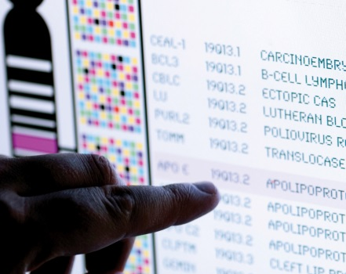
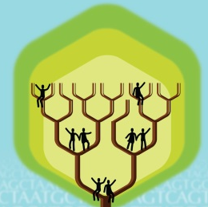
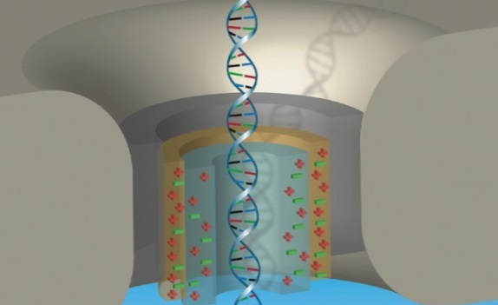


DIRECTOR’S REPORT
Eric Green, M.D., Ph.D.
Director, NHGRI
February 2021
Document #
Notes:
I would like to again welcome all of you to this Open Session of the National Advisory Council for Human Genome Research meeting. As you can see, the current situation with the COVID-19 pandemic has once again led me to give Director’s Report while sitting alone in my conference room. In addition (and to accommodate a shorter Council meeting), my Director’s Report is a bit shorter than the norm. Nonetheless, it contains an informative collection of updates that we wanted to share with you.
As with the rest of the Open Session, my Director’s Report presentation is being videotaped, and that recording will be made available as a permanent archive on NHGRI’s website (genome.gov).
1

Slide 2
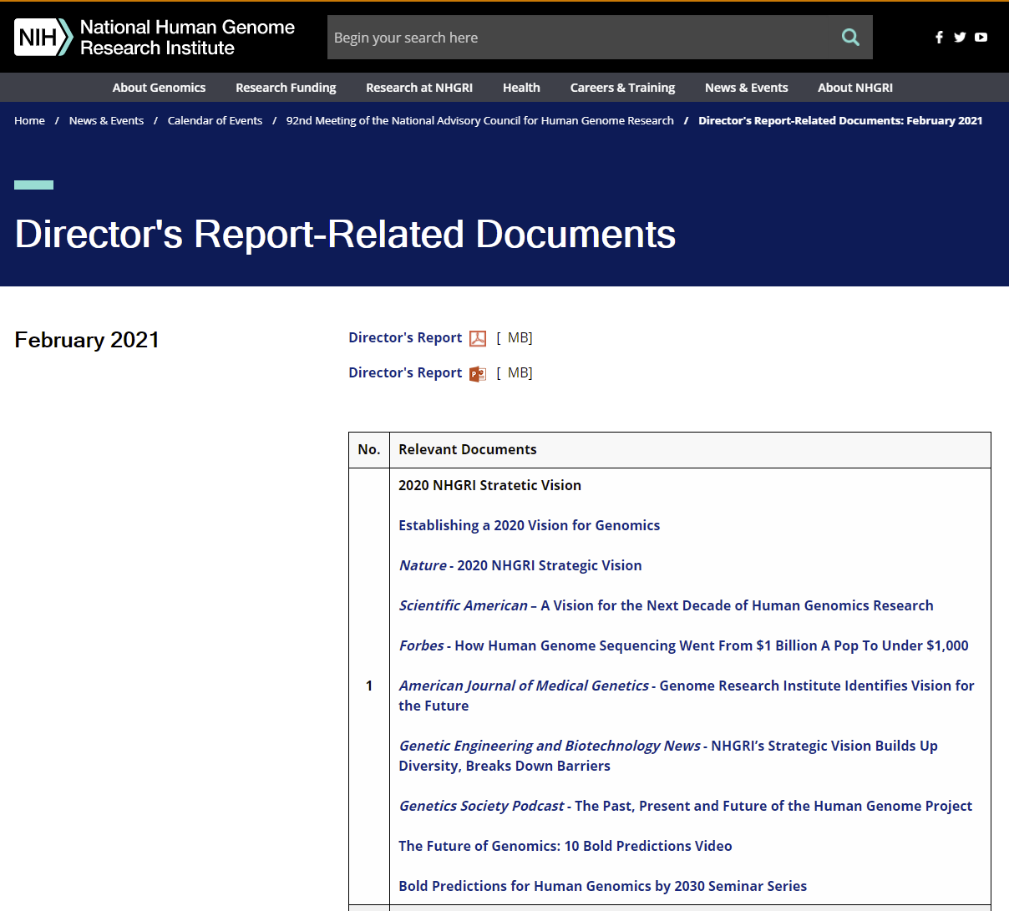
genome.gov/DirectorsReport
Document #
Notes:
For those who are new to our Council meetings, I want to make you aware of the ‘electronic resource’ that is developed for my Director’s Report. Analogous to the supplemental materials of a published paper, this resource can be accessed at the URL shown here.
The slides that I will show during my Director’s Report are also available electronically at this site – * both in PDF and PowerPoint formats.
* When there are documents or relevant websites associated with a particular slide, you will find a ‘Document #’ indicated on the bottom right of that slide; that ‘Document #’ references materials that can be accessed and/or downloaded from the webpage shown here. This dedicated webpage and all linked documents will be archived on genome.gov as part of the historic record of this Council meeting.
2

Slide 3
Open Session Presentations
  Presentations:
    Final NIH Policy on Data Management and Sharing
    Carrie Wolinetz
    Building a Diverse Genomics Workforce: An NHGRI Action Agenda
    Vence Bonham
Notes:
There will be a number of other presentations during the Open Session of this Council meeting. My Director’s Report is tailored around those presentations, and I will not discuss in detail the topics that others will cover.
Following my Director’s Report, there will be two presentations. * First, Carrie Wolinetz, NIH Associate Director for Science Policy, will give a presentation on the “Final NIH Policy on Data Management and Sharing.”
* Next, Vence Bonham, Senior Advisor to the NHGRI Director on Genomics and Health Disparities, will give a presentation on “Building a Diverse Genomics Workforce: An NHGRI Action Agenda.” Vence’s talk will provide an important context and background for the two presentations that will then follow.
3

Slide 4
Open Session Presentations
  Concept Clearances:
    Genome Research Experiences to Attract Talented Undergraduates into the Genomics Field to Promote Diversity (GREAT Program)
    Tina Gatlin
    Grants for New Investigators to Promote Diversity in Genomics Research
    Jyoti Dayal
Notes:
Those two presentations will be concept clearances directly related to the NHGRI’s new action agenda for enhancing the diversity of the genomics workforce.
* First, Tina Gatlin will present “Genome Research Experiences to Attract Talented Undergraduates into the Genomics Field to Promote Diversity (the GREAT Program).”
* Second, Jyoti Dayal will present “Grants for New Investigators to Promote Diversity in Genomics Research.“
4

Slide 5
Open Session Presentations
  Concept Clearances:
    Non-Human Primate dGTEx
    Jennifer Troyer
    Computational Genomics and Data Science
    Daniel Gilchrist
    Molecular Phenotypes of Null Alleles in Cells Pilot Project
    Adam Felsenfeld
Notes:
There will then be three more concept clearances presented by NHGRI extramural program directors.
* Jennifer Troyer will present a concept clearance on “Non-Human Primate dGTEx.”
* Daniel Gilchrist will present a concept clearance on “Computational Genomics and Data Science.”
* And finally, Adam Felsenfeld will present a concept clearance on “Molecular Phenotypes of Null Alleles in Cells Pilot Project.”
5

Slide 6
Open Session Presentations
  Presentation:
    Phenotypes and Exposures (PhenX) Toolkit
    Erin Ramos
Notes:
Finally, * Erin Ramos, Deputy Director of the Division of Genomic Medicine, will give a presentation on the “Phenotypes and Exposures (PhenX) Toolkit.”
6

Slide 7
Director’s Report Outline
General NHGRI Updates
General NIH Updates
General Genomics Updates
NHGRI Extramural Research Program
NIH Common Fund/Trans-NIH
NHGRI Communications, Policy, and Education
NHGRI Intramural Research Program
Notes:
For the rest of my Director’s Report, I will cover the 7 areas listed here, which reliably provide a nice framework for reviewing the relevant topics.
7

Slide 8
Director’s Report Outline
General NHGRI Updates
General NIH Updates
General Genomics Updates
NHGRI Extramural Research Program
NIH Common Fund/Trans-NIH
NHGRI Communications, Policy, and Education
NHGRI Intramural Research Program
Notes:
8
And I will start with some general NHGRI updates.

Slide 9
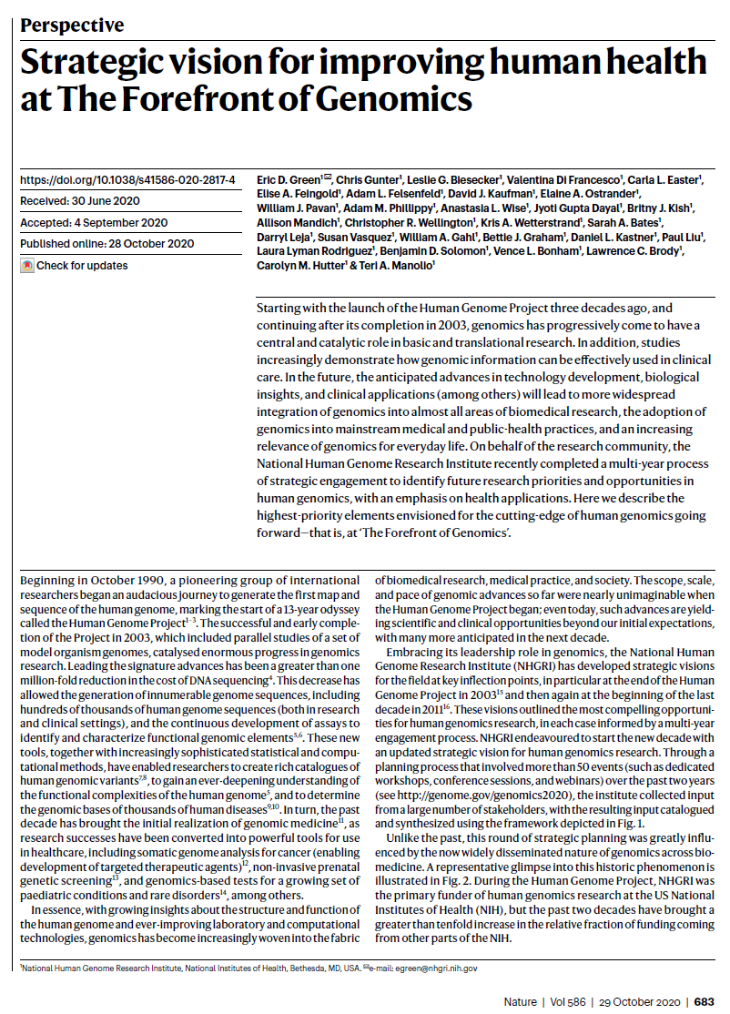
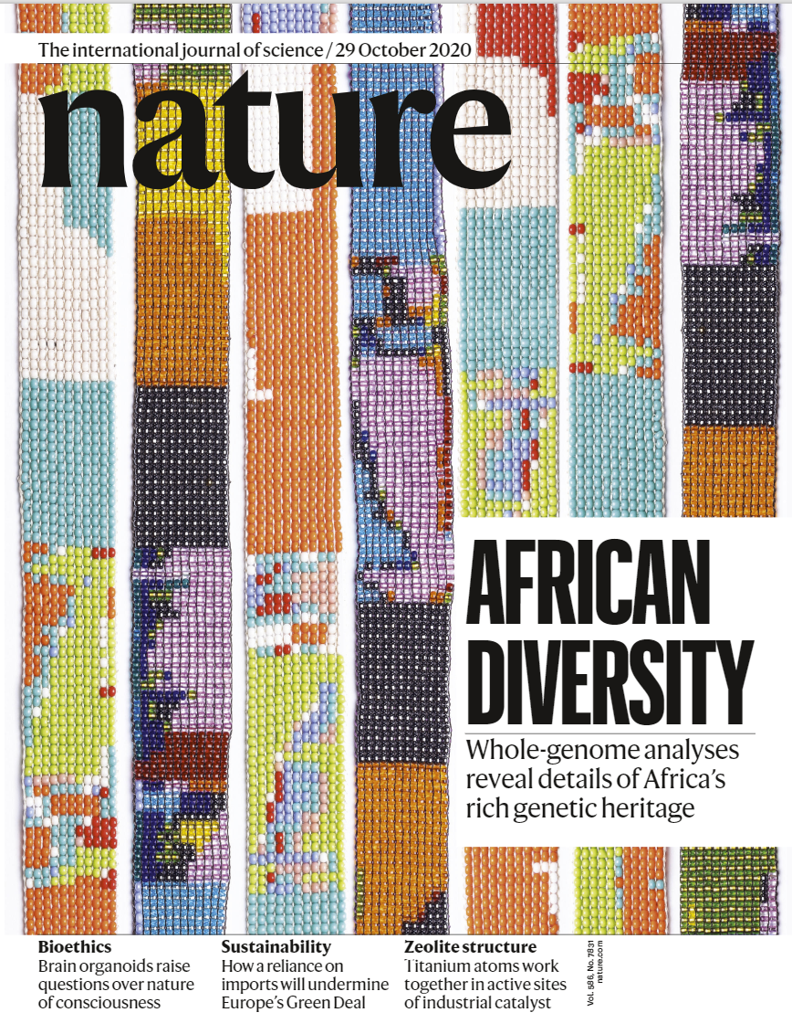

2020 NHGRI Strategic Vision
Nature (2020)
Document 1
Notes:
Certainly, the biggest NHGRI news since the last Council meeting was the publication of the 2020 NHGRI Strategic Vision on October 28, 2020. This 10-page Nature paper reflects the final product and culmination of the extensive strategic planning process that took place over the previous two-plus years.
I would personally like to thank all current and former Council members for their input and valuable advice throughout the entire strategic planning process, including many important suggestions for the final crafting of this paper. On behalf of NHGRI, I am also deeply grateful to the many hundreds of others who participated in various events and provided input through various means. It is that wide and far engagement that makes these strategic planning processes so critical to the development of NHGRI strategic visions.
9

Slide 10
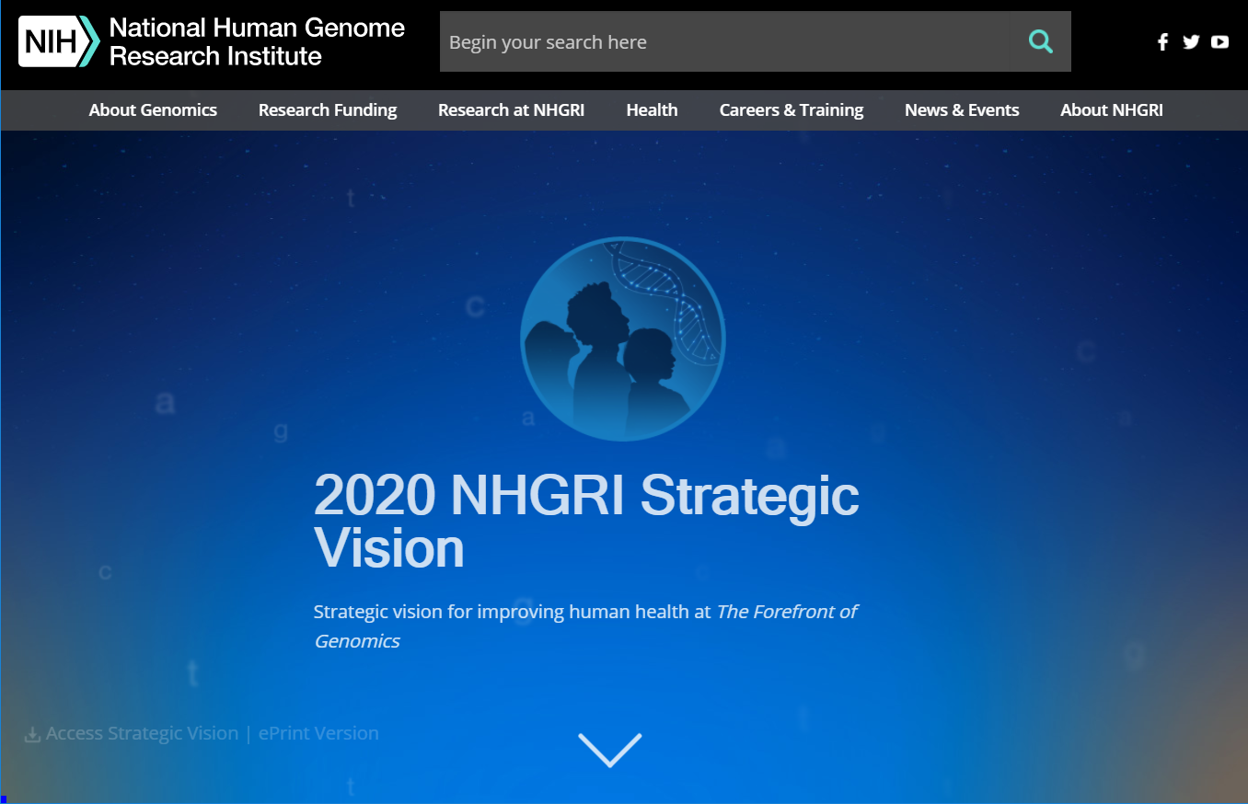
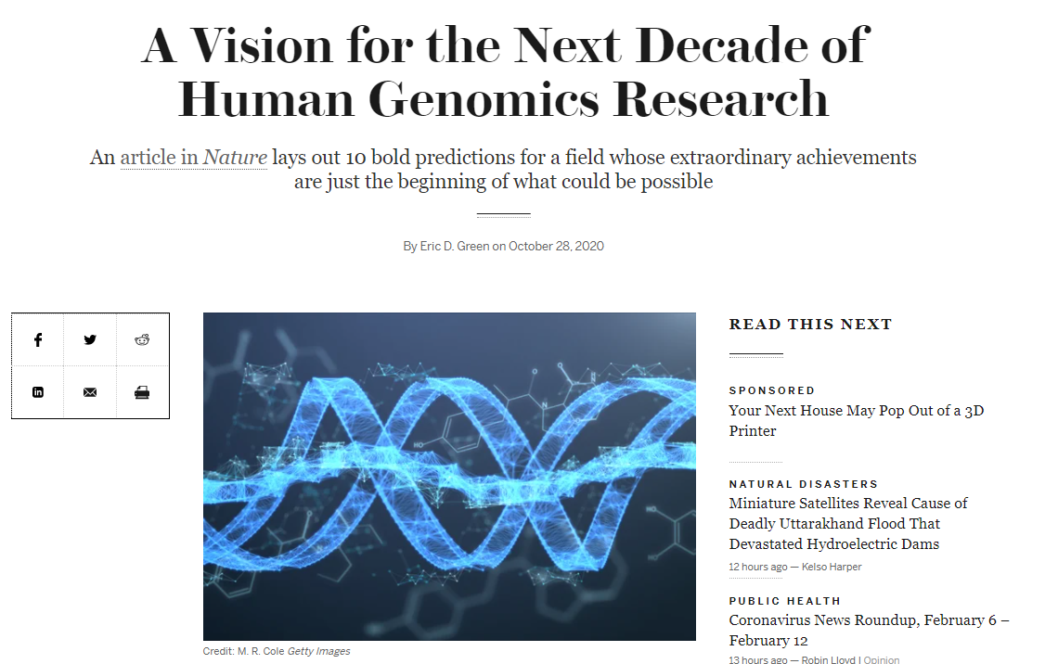
2020 NHGRI Strategic Vision
Outreach and Media Coverage
Document 1
Notes:
I thought you would be interested to hear a bit about the outreach and media coverage associated with the publication of the 2020 NHGRI Strategic Vision.
* Webpages on the NHGRI website (genome.gov) were developed to host the content of the Strategic Vision in a dynamic and compelling way. This site contains an immense amount of additional materials related to the entire strategic planning process itself.
* Accompanying the publication of the Strategic Vision in Nature was a forward-looking commentary that I authored, which was published online in Scientific American.
Needless to say, the NHGRI Communications and Public Liaison Branch led a robust outreach and media campaign related to the publication of the 2020 NHGRI Strategic Vision. That effort yielded nearly 48 million impressions. For example, interviews that I participated in yielded stories by a number of different media outlets, including Chemical and Engineering News, Genome Web, Forbes, Genetic Engineering and Biotechnology News, and WIRED. I also was interviewed for a Genetics Unzipped podcast.
10

Slide 11
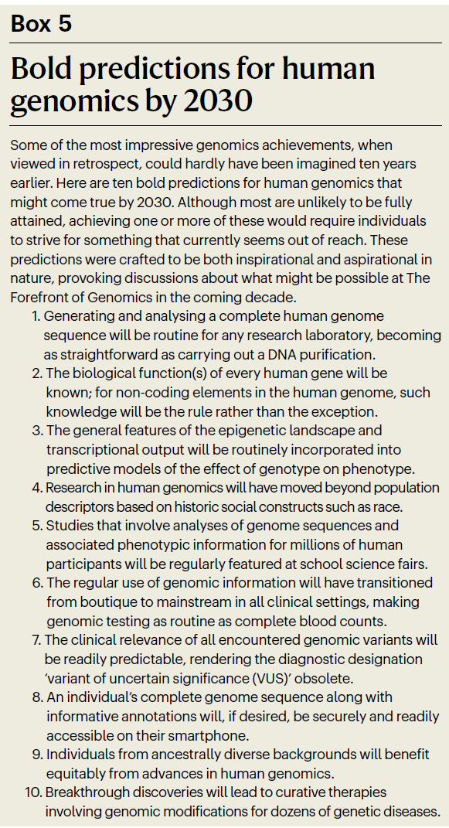
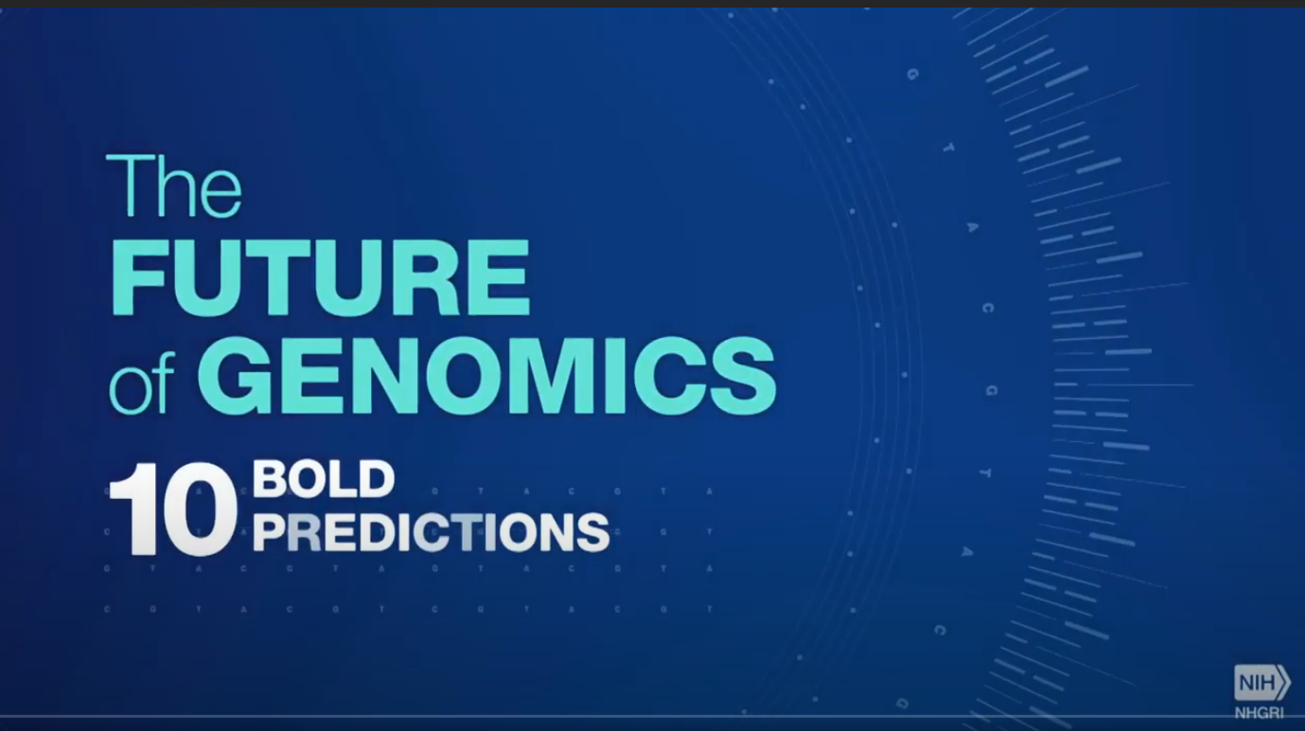
2020 NHGRI Strategic Vision
Document 1
Notes:
I can tell you that the media became particularly excited about covering the last major component of the 2020 NHGRI Strategic Vision: the 10 “bold predictions for human genomics by 2030.” I was repeatedly asked in interviews about these predictions more than any other aspect of the Strategic Vision or the strategic planning process.
That focused attention on the bold predictions was actually anticipated by our communications staff. * So, when they were developing ideas for a promotional video that would accompany publication of the new Strategic Vision, they decided that the video itself should actually feature the 10 bold predictions.
While it will make my Director’s Report 3.5 minutes longer, I thought you might enjoy seeing this terrific NHGRI-produced video, which (as you will hear) was narrated by the accomplished author and NHGRI friend, Sid Mukherjee.
11

Slide 12
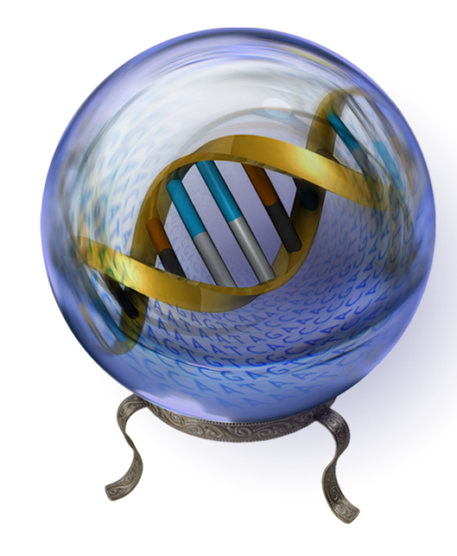
    Bold Predictions for Human Genomics by 2030
    NHGRI Seminar Series
    Bold Prediction #1: February 1
    Evan Eichler, University of Washington
    Karen Miga, UC, Santa Cruz
    Bold Prediction #2: March 8
    Nancy Cox, Vanderbilt University
    Neville Sanjana, NY Genome Center
Document 1
Notes:
To keep up the momentum related to strategic planning, NHGRI sought to organize a seminar series for the coming year specifically linked to the new Strategic Vision. Because of the popularity of the 10 bold predictions, we decided to have monthly seminars, each featuring 1 of the 10 bold predictions.
* The first seminar was held on February 1 and focused on Bold Prediction #1 (“Generating and analyzing a complete human genome sequence will be routine for any research laboratory, becoming as straightforward as carrying out a DNA purification”). Evan Eichler of the University of Washington and Karen Miga of the University of California, Santa Cruz used this prediction as an aspirational theme for their talks, highlighting their own research in the context of that theme and speculating about the next decade in their research area. This session attracted over 550 live attendees.
* The next seminar will be held on March 8 and will feature Bold Prediction #2 (“The biological function(s) of every human gene will be known; for non-coding elements in the human genome, such knowledge will be the rule rather than the exception”). The two speakers will be Nancy Cox of Vanderbilt University and Neville Sanjana of the New York Genome Center.
All seminars are being held virtually, are open to the public, and are being recorded for posting on our GenomeTV of YouTube. For future seminar dates and speakers, visit the series webpage.
12

Slide 13
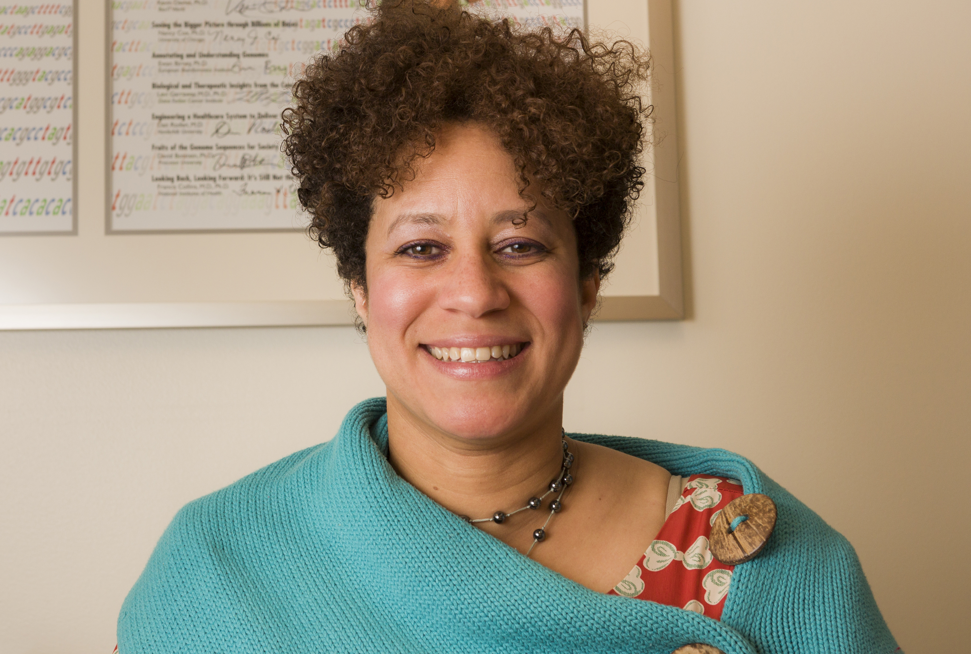
Departure of Chief,
Education and Community Involvement Branch
Carla Easter, Ph.D.
Notes:
Carla Easter, Chief of NHGRI’s Education and Community Involvement Branch, will be leaving NHGRI this April to join the Smithsonian’s National Museum of Natural History. Carla will become the first Broh-Kahn Weil Director of Education and lead the Department of Education, Outreach, and Visitor Experience at the museum.
Carla was recruited to NHGRI over 15 years ago as an Education Specialist and rose to become Chief of the Education and Community Involvement Branch; her work in leading that branch has been nothing short of spectacular, including a major expansion of the Institute’s educational programs and significant increases in the visibility and impact of the branch. On one hand, we are truly going to miss Carla at NHGRI, but on the other hand, we could not be more excited for her as she moves on to this truly exciting opportunity.
13

Slide 14

New Extramural Program Director
Joannella Morales, Ph.D.
Notes:
In January, Joannella Morales joined NHGRI as an extramural program director in the Division of Genomic Medicine. Joannella will work as part of Clinical Genome Resource (or ClinGen) team, manage investigator-initiated grants, and develop initiatives focused on the “omics of disease.” She is interested in the role of human genomic variation in health and disease and in leveraging genomic findings to improve medical care.
Prior to joining NHGRI, Joannella served as a Project Manager at the European Bioinformatics Institute, where she developed standardized tools for clinical annotation and genomic variant reporting. She was also a Senior Curator for the NHGRI-EBI GWAS Catalog. She holds a Ph.D. in Molecular and Human Genetics from Baylor College of Medicine and Bachelor’s in Biology degree from the University of Puerto Rico.

Slide 15
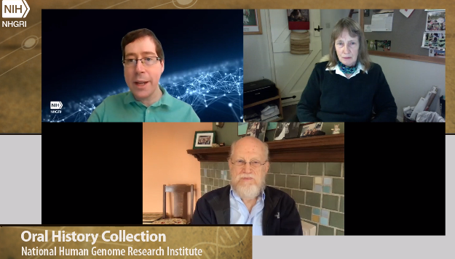

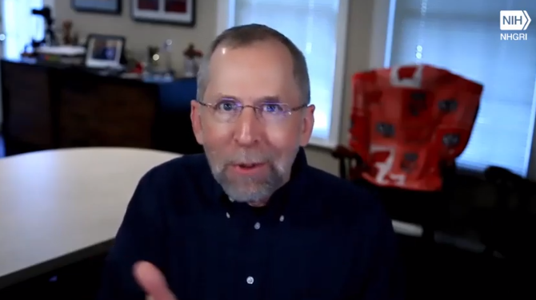
20th Anniversary of Publications Reporting
Draft Human Genome Sequence
Document 2
Notes:
On February 12, 2001, scientists, government officials, members of the press, and leaders of the Human Genome Project crowded into a conference room in downtown Washington, D.C., to publicly unveil the major scientific highlights derived from the first examination of the draft sequence of the human genome. A few days later (on February 15, 2001), Nature and Science published the major papers describing those findings.
NHGRI marked the 20th anniversary of these historic publications through a story in my monthly newsletter (The Genomics Landscape), an update to the NHGRI Human Genome Project Timeline of Events webpage, and a joint video interview with Bob Waterston, Former Director of the Washington University Genome Sequencing Center, and Jane Rogers, Former Head of Sequencing at the Wellcome Trust Sanger Institute. I also recorded my thoughts about this important anniversary in a short video interview. All of these efforts are representative of the ongoing work of the NHGRI History of Genomics Program in chronicling and featuring major events in the field of genomics.
15

Slide 16
Director’s Report Outline
General NHGRI Updates
General NIH Updates
General Genomics Updates
NHGRI Extramural Research Program
NIH Common Fund/Trans-NIH
NHGRI Communications, Policy, and Education
NHGRI Intramural Research Program
Notes:
Moving on to general NIH updates.
16

Slide 17




Members of White House Science Team
FRANCIS S. COLLINS, M.D., PH.D.
DIRECTOR OF THE NATIONAL
INSTITUTES OF HEALTH
ERIC S. LANDER, PH.D.
OSTP DIRECTOR AND PRESIDENTIAL
SCIENCE ADVISOR
ALONDRA NELSON, PH.D.
OSTP DEPUTY DIRECTOR FOR
SCIENCE AND SOCIETY
Document 3
Notes:
In case you happened to have missed it, the United States is now being led by a new administration. The Executive Branch, in which NIH resides, is of course now led by President Joe Biden.
I am delighted to remind you that the Biden administration will feature three individuals with strong ties to NHGRI within the White House Science Team.
* Francis Collins will continue in his role as NIH Director.
* Eric Lander (well-known to NHGRI and to the entire genomics community) will serve as President Biden’s Science Advisor and Director of the White House Office of Science and Technology Policy (or OSTP). President Biden is elevating the role of science within the White House, including by designating the Presidential Science Advisor as a member of the cabinet for the first time in history.
* Alondra Nelson (who has been a member of the Genomics and Society Working Group of this Council) will serve as OSTP Deputy Director for Science and Society.
17

Slide 18
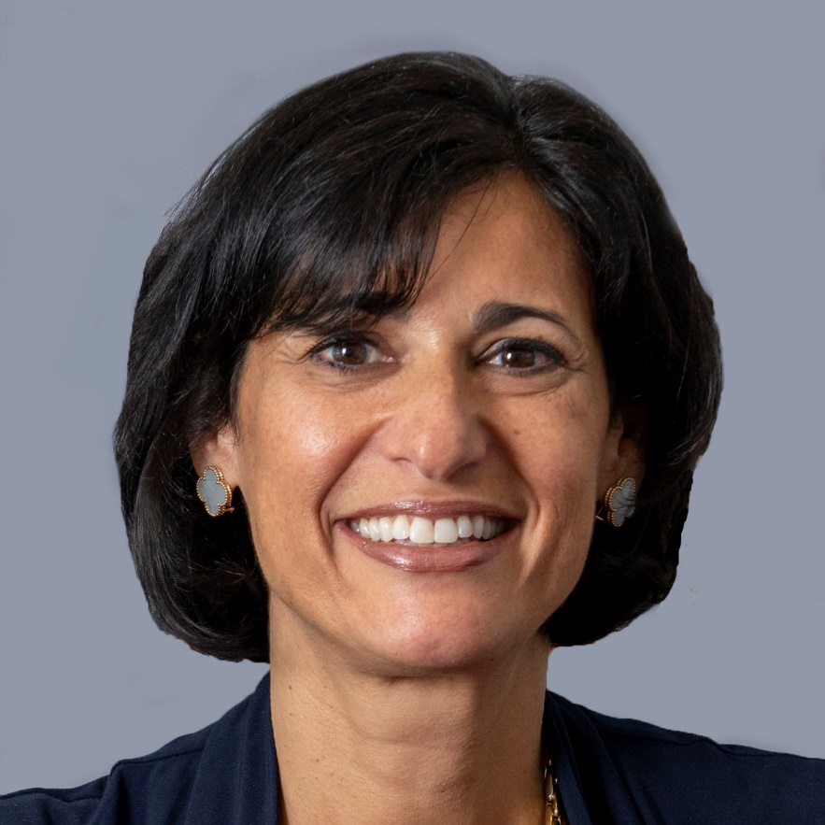



Leadership Changes at Centers for Disease Control (CDC) and Food and Drug Administration (FDA)
New Director, CDC
Rochelle Walensky M.D., M.P.H.
Acting Commissioner, FDA
Janet Woodcock, M.D.
Document 3
Notes:
There have also been leadership changes at NIH’s sibling agencies.
* In January, Rochelle Walensky began her position as the 19th Director of the U.S. Centers for Disease Control and Prevention (or CDC). She comes to the CDC from Massachusetts General Hospital, where she served as Chief of the Division of Infectious Diseases, and Harvard Medical School, where she served as Professor of Medicine.
* Also last month, Janet Woodcock was named Acting Commissioner of the U.S. Food and Drug Administration (or FDA). As Acting Commissioner, Dr. Woodcock oversees the full breadth of FDA’s portfolio and execution of the Federal Food, Drug, and Cosmetic Act and other applicable laws.
18

Slide 19
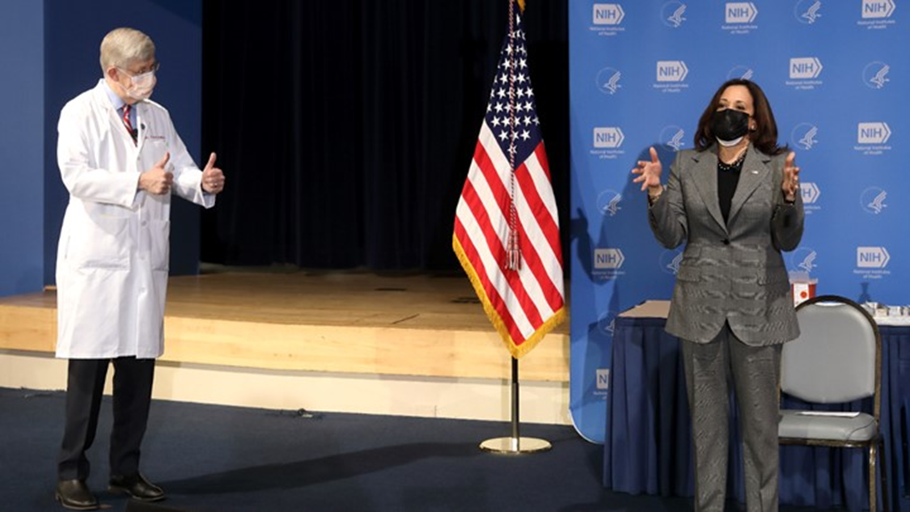
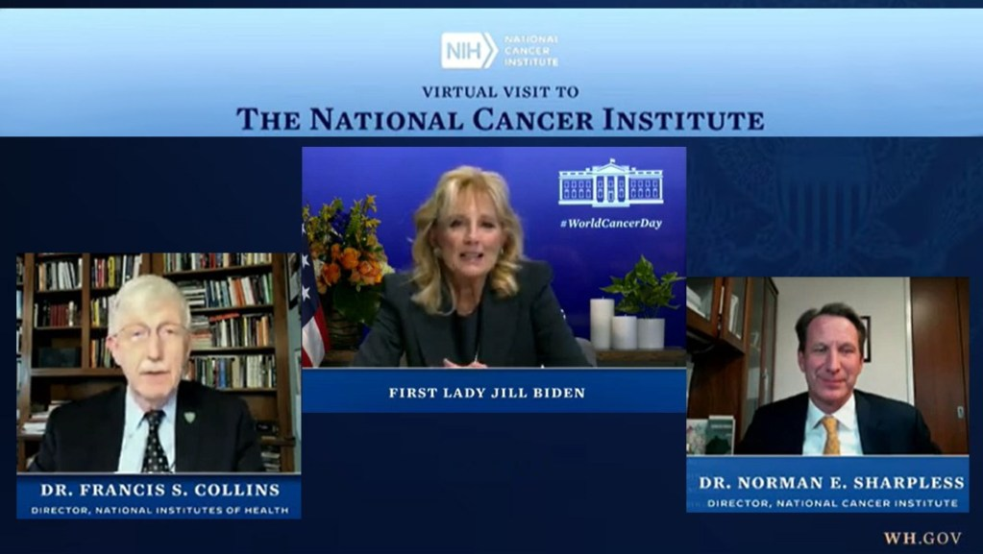
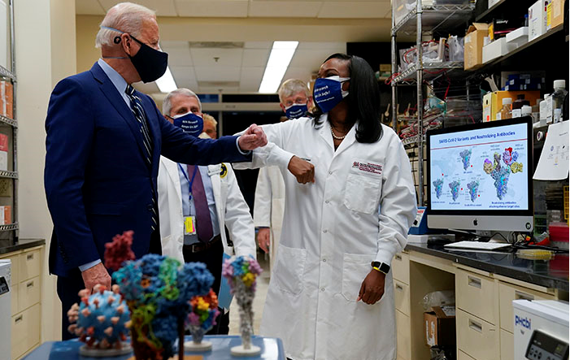
VIPs Visit NIH
President
Joe Biden
First Lady
Dr. Jill Biden
Vice President Kamala Harris
Document 3
Notes:
Meanwhile, the Biden administration has immediately demonstrated their genuine interest in NIH and our mission, with several prominent VIPs visiting NIH (in person or virtually) within a few weeks of the inauguration.
* On January 26, Vice President Kamala Harris and Second Gentleman Doug Emhoff came to the NIH to talk with researchers and to receive second doses of the Moderna COVID-19 vaccine at the NIH Clinical Center.
* On February 3, First Lady Dr. Jill Biden paid a virtual visit to NIH on the eve of World Cancer Day to discuss recent advances in fighting cancer.
* On February 11, President Joe Biden came to the NIH, where he toured the Vaccine Research Center, learned about recent NIH progress against COVID-19, and gave a speech about the current situation with the COVID-19 pandemic.
19

Slide 20
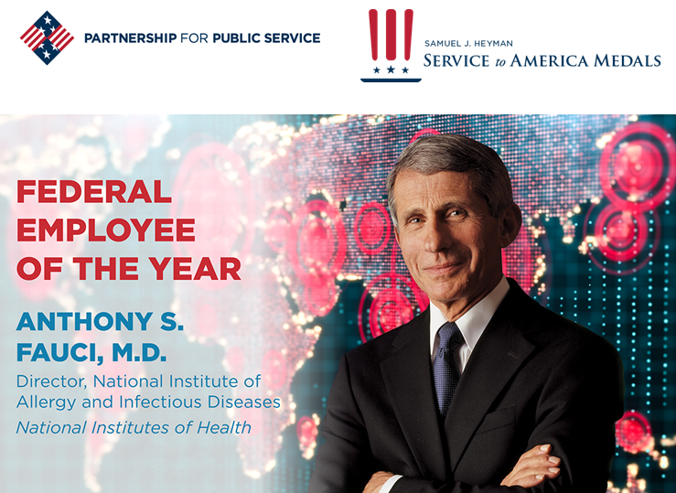
2020 Federal Employee of the Year
Document 4
Notes:
Tony Fauci, Director of the National Institute of Allergy and Infectious Diseases, was appropriately named the Federal Employee of the Year as part of the 2020 Samuel J. Heyman Service to America Medals program, also known as the "Sammies.“
Tony was recognized for having served as the government’s premier expert and spokesperson on infectious diseases during six presidencies, including taking a prominent role in seeking to protect the public from the highly contagious and deadly new coronavirus that has swept through the country and the world over the past year.
20

Slide 21
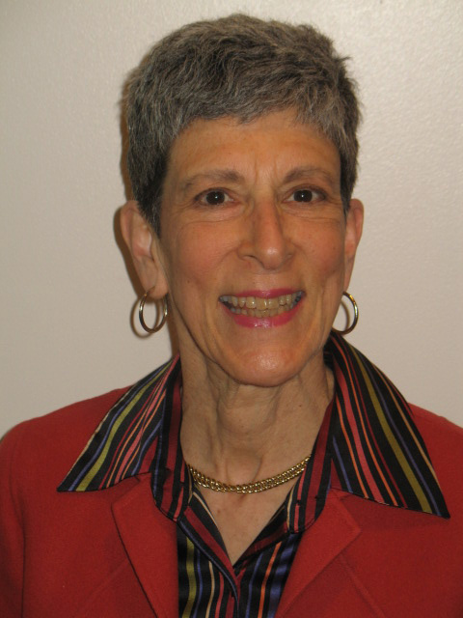

Judith Greenberg Retires as Deputy Director,
National Institute of General Medical Sciences
Judith Greenberg,
M.D., Ph.D.
Document 5
Notes:
In October of 2020, Judith Greenberg, Deputy Director of the National Institute of General Medical Sciences, retired after 45 years of service to NIH. Of relevance to NHGRI, Judith was Chief of the NIGMS Genetics Division from which the NIH efforts in the Human Genome Project originated.
21

Slide 22
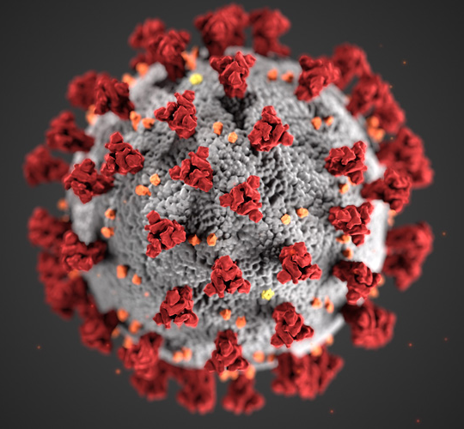
NIH COVID-19 Information Resources
Document 6
Notes:
I would like to remind you that there are several government websites available that provide relevant information about COVID-19, such as those at NIH and at the Centers for Disease Control and Prevention. For NIH grantees and applicants, a COVID-19 resource is available on the NIH Grants and Funding website.
In addition, NIH regularly issues news releases regarding COVID-19-related research findings, and NIH Director Francis Collins’s blog regularly provides another good source of updated information.
22

Slide 23
Fiscal Year 2021 Appropriations
 | Fiscal Year 2020 Labor-HHS Appropriation | Fiscal Year 2021 Labor-HHS Appropriation | $ Increase | % Increase
NIH | $41.68 B | $42.93 B | $1.25 B | 2.99%
NHGRI | $606.35 M | $615.78 M | $9.43 M | 1.56%
Document 7
Notes:
After several continuing resolutions, Congress passed a Fiscal Year 2021 budget by wide, bipartisan margins in late December. This budget reflects $1.4 trillion in government funding to secure federal agency operations through September 2021 and a $900 billion COVID-relief supplement. President Trump signed the measure into law on December 27.
* Within the Fiscal Year 2021 Labor-HHS spending package, NIH received an increase of $1.25 billion (or approximately 3% above the Fiscal Year 2020 enacted levels). The bill language specifies that “no NIH institute or center shall receive less than a 1.5% increase.” As so, * NHGRI received an increase of $9.43 million (or 1.56% above the Fiscal Year 2020 enacted levels).
Of note, within the COVID-relief supplement, NIH secured an extra $1.25 billion to provide research and clinical trials related to long-term studies of COVID-19 and another $100 million for the Rapid Acceleration of Diagnostics (or RADx) initiative.
23

Slide 24
Director’s Report Outline
General NHGRI Updates
General NIH Updates
General Genomics Updates
NHGRI Extramural Research Program
NIH Common Fund/Trans-NIH
NHGRI Communications, Policy, and Education
NHGRI Intramural Research Program
Notes:
Moving on to general genomics updates.
24

Slide 25
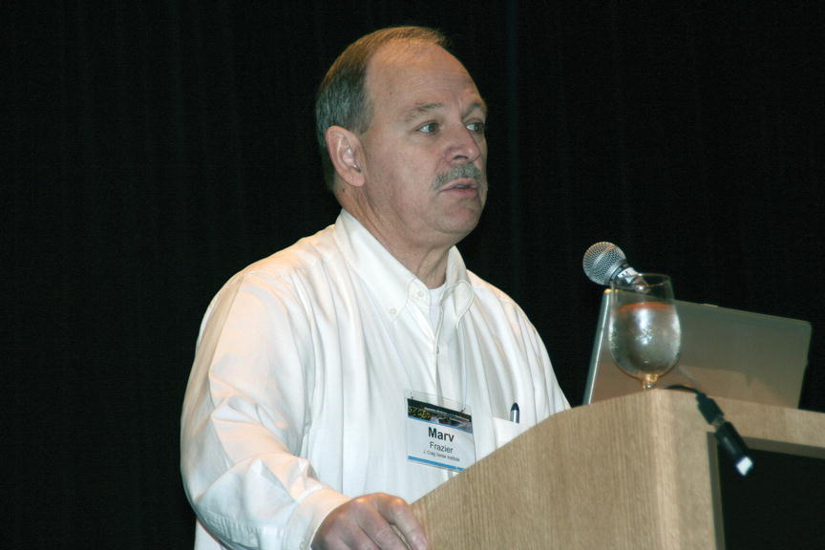
Mourning the Loss of Marvin Frazier
Notes:
Marvin Frazier, former Life Sciences Division Director at the US Department of Energy during the Human Genome Project, passed away in November. Marv worked extensively with NHGRI staff and grantees throughout the Human Genome Project and contributed greatly to the highly collaborative spirit among the Project’s funders.
Following the Human Genome Project, he played an integral role in developing the US Department of Energy’s Genomes to Life program. During his career, he also was the Vice President of Research of the J. Craig Venter Institute.
25

Slide 26


Mourning the Loss of Gertjan van Ommen
Document 8
Notes:
In November, Gertjan van Ommen, former head of the Department of Human Genetics of Leiden University Medical Center, passed away. During his remarkable career, Gertjan served as Editor-in-Chief of the European Journal of Human Genetics, President of the Human Genome Organization, and President of both the Dutch and European Societies of Human Genetics. He was a strong advocate for sharing and using genetic information and a leading figure in the 1+ Million Genomes Initiative. Gertjan had a great interest in the ethical, legal, and societal aspects of genome science as well as in public and professional communication.
26

Slide 27
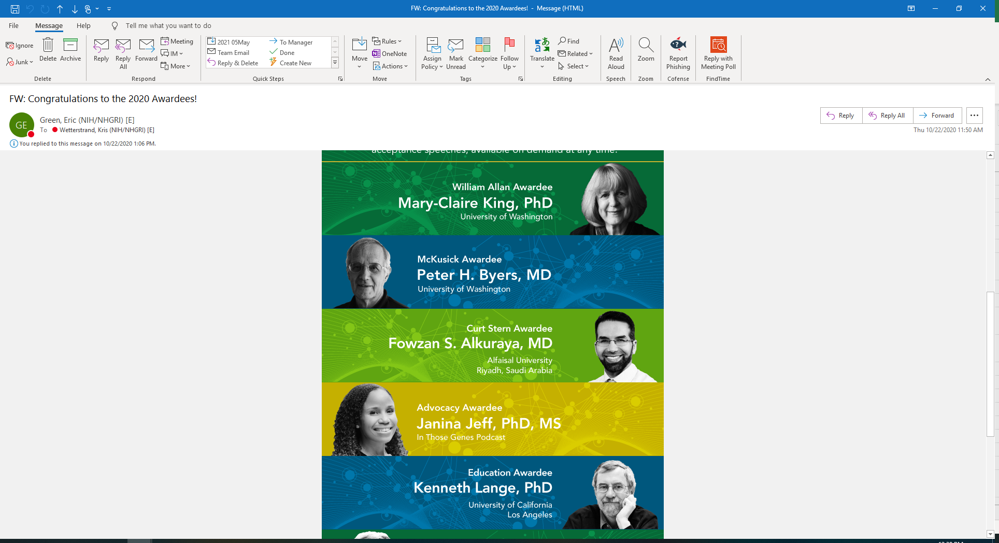

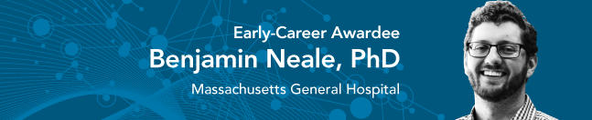
2020 American Society of Human Genetics Awards
Document 9
Notes:
The American Society of Human Genetics gave awards to three members of the genomics community at its 2020 Annual Meeting.
* Mary-Claire King received the William Allan Award, which recognizes a scientist for substantial and far-reaching scientific contributions to human genetics.
* Kenneth Lange received the Arno Motulsky-Barton Childs Award for Excellence in Human Genetics Education, which recognizes those who have made significant contributions of exceptional quality and great importance to human genetics education.
* Benjamin Neale received the Early-Career Award, which recognizes contributions of genetics and genomics scientists in the first 10 years as an independent investigator.
27

Slide 28

Elected to National Academy of Medicine
Judy Cho
Wendy Chung
Levi Garraway
Joel Hirschhorn
David Liu
Consuelo Hopkins Wilkins
Alondra Nelson
Aviv Regev
Pardis Sabeti
Louis Staudt
Hannah Valantine
Document 10
Notes:
The National Academy of Medicine recently announced the election of new members. Of particular relevance to the genomics community, to NIH, and to NHGRI are the individuals listed here.
28

Slide 29

Elected to AAAS
Lisa Brooks
R. Alta Charo
Dana Crawford
Ronald Davis
Pui-Yan Kwok
Matthew Meyerson
William Murphy
Len Pennacchio
Document 11
Notes:
Similarly, an impressive set of genetics and genomics researchers (and NHGRI colleagues) were recently elected to be Fellows of the American Association for the Advancement of Science, with their names listed here.
Lisa Brooks, retired extramural program director, is among those elected an AAAS Fellow for her distinguished contributions to human genomic sciences in shepherding the Human HapMap Project and the 1000 Genomes Project to successful completion.
29

Slide 30
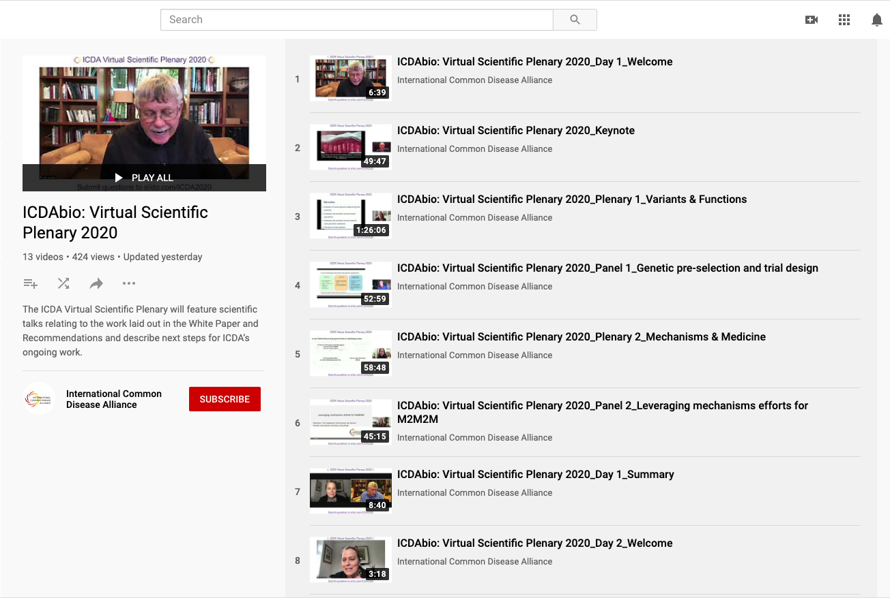
International Common Disease Alliance (ICDA)
Document 12
Notes:
The International Common Disease Alliance (or ICDA) was launched in 2019 with the goal to improve prevention, diagnosis, and treatment of common diseases by accelerating discovery from genetic maps to biological mechanisms to physiology and medicine.
* In December, the ICDA held a two-day Virtual Scientific Plenary meeting, which featured scientific talks and panel discussions. The meeting served to highlight the ICDA White Paper and Recommendations and to describe next steps for the organization. Over 700 people attended the virtual meeting, and all presentations and discussions are available on the ICDA YouTube channel.
30

Slide 31
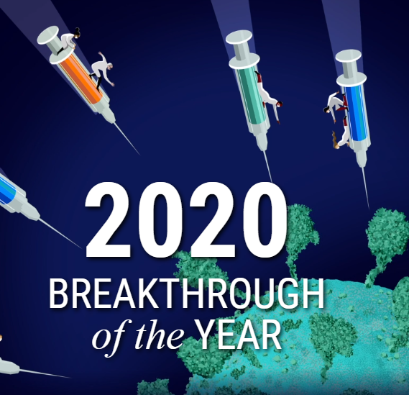
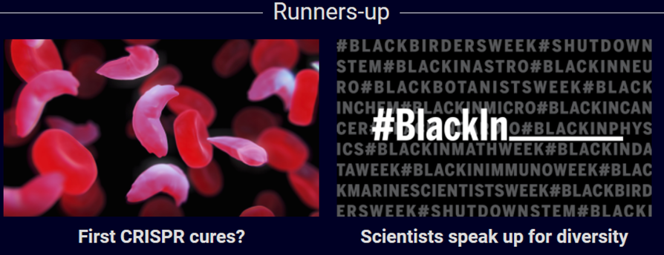
Science 2020 Breakthrough of the Year Runners Up
Document 13
Notes:
Although the Science Breakthrough of the Year went to the development of the first vaccines to protect against COVID-19, there were two runners up of particular interest to the genomics community. They were therapeutic applications of gene editing and scientists speaking up for diversity.
31

Slide 32

The Scientist Top Technical Advances of 2020
DNA assembly and amplification
Single cell gene expression
Spatial gene expression
Digital genome engineering
Document 14
Notes:
Meanwhile, The Scientist Top 10 Innovations of 2020 included an automated platform for on-demand DNA assembly and amplification, a single-cell gene expression system, a spatial gene expression system, and a digital genome engineering platform.
32

Slide 33
Director’s Report Outline
General NHGRI Updates
General NIH Updates
General Genomics Updates
NHGRI Extramural Research Program
NIH Common Fund/Trans-NIH
NHGRI Communications, Policy, and Education
NHGRI Intramural Research Program
Notes:
Moving on to the NHGRI Extramural Research Program.
33

Slide 34


Human Genome Reference Program
Generate ≥350 high-quality reference genome sequences
Year 1 data released
HGRP and T2T joint meeting (September 2020)
Human pangenome video
Document 15
Notes:
The Human Genome Reference Program (or HGRP) represents NHGRI’s continued commitment to refining and maintaining the human reference genome sequence. * The multi-component program, which is currently in its second year, aims to generate at least 350 high-quality human reference genome sequences, a subset of which will be finished, telomere-to-telomere sequences. To represent as much human haplotype variation as possible, the high-quality genome sequences will be from ancestrally diverse populations. These will be incorporated into a pangenome reference for the community. * Year 1 data from multiple genome-sequencing platforms for the first 30 high-quality genomes have been released and are available for download in multiple repositories.
* Last September, HGRP held its kickoff meeting, which was held in collaboration with the Telomere-to-Telomere (or T2T) Consortium and featured topics such as data production and technology, samples and representation, and graph genome representations.
* To explain the concept of a pangenome, NHGRI collaborated with the media company Massive Science to produce a video entitled “The Human Pangenome” (which I will discuss a bit later in my Director's Report).

Slide 35
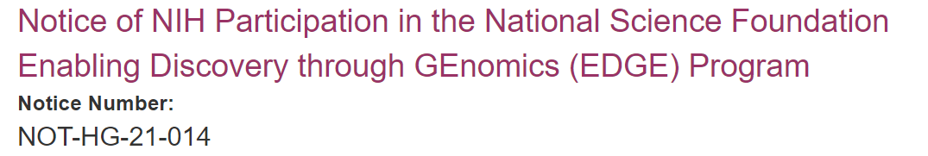
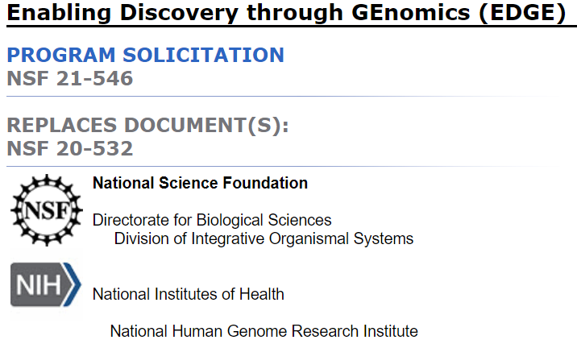
    Comparative Genomics
    Enabling Discovery Through GEnomics (EDGE)
      Functional Genomic Tools Track
      Complex Multigenic Traits Track
    Applications due: March 16, 2021
Document 16
Notes:
NHGRI regards comparative genomics as an important research area that can help us to maximize our understanding of genome function, something that is part of sustaining and providing a robust foundation for the field of genomics. We also see comparative genomics as an appropriate area for partnerships and collaborations with other communities and agencies.
​As part of our Comparative Genomics Program, NHGRI has signed on to the National Science Foundation-led “Enabling Discovery through GEnomics” (or EDGE) Program. This multi-agency initiative supports research to advance the understanding of comparative and functional genomics. EDGE has two tracks:
* The Functional Genomic Tools Track supports the development of innovative tools, technologies, resources, and infrastructure to advance biological research focused on the identification of the causal mechanisms connecting genes and phenotypes.
* The Complex Multigenic Traits Track supports functional genomic research that addresses the mechanistic basis of complex traits in diverse organisms within the environmental, developmental, social, and/or genomic context in which they function.
* Applications are due on March 16. Those interested in applying should reach out to program staff listed on the National Science Foundation solicitation page. ​
35

Slide 36
Technology Development Program
Funding Opportunities
Notice of Special Interest (NOSI): Advancing Genomic Technology Development for Research and Clinical Applications
NOT-HG-21-018
Standard due dates start February 5, 2021
Novel Synthetic Nucleic Acid Technology Development
RFA-HG-20-014 (R01, also linked R21 and R43/44)
Applications due March 9, 2021
Notice of Intent to Publish: Transformative Nucleic Acid Sequencing Technology Innovation and Early Development
NOT-HG-21-016
Document 17
Notes:
NHGRI’s Technology Development Program continues to expand and evolve, enabling new and improved technologies to foster genomic discoveries. New funding and program announcements include:
* The Notice of Special Interest in Advancing Genomic Technology Development for Research and Clinical Applications, which applies to the parent R01, R21, and omnibus small business announcements. This notice encourages a broad expanse of technology development research to enable new lines of scientific inquiry and clinical applications in human genomics.
* The newest initiative, the Novel Synthetic Nucleic Acid Technology Development Request for Applications, has an upcoming due date of March 9. NHGRI seeks to fund research in novel enzymatic, biological, chemical, and physical approaches along with instrumentation for synthetic nucleic acids.
* The Notice of Intent to Publish the Transformative Nucleic Acid Sequencing Technology Innovation and Early Development funding opportunity emphasizes NHGRI’s investment in innovation and early development for nucleic acid sequencing. These RFAs will be published soon.
36

Slide 37
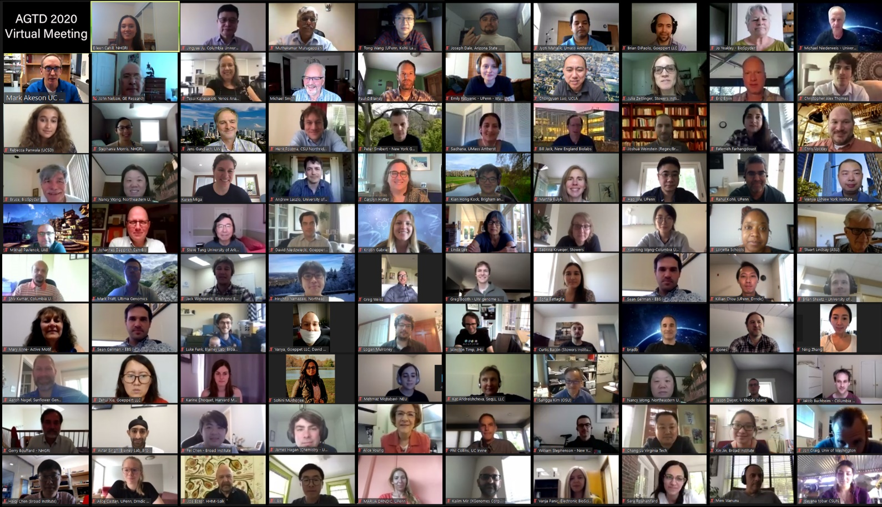
Technology Development Program
Advanced Genomic Technology Development Meetings
  New colloquia (Fall 2020)
  Virtual annual meeting
  May 25-27, 2021
  Northeastern University
Document 17
Notes:
The Technology Development Program hosted a colloquia series this past Fall for the first time, during which grantees of varying career stages presented their research. These talks included reporting on progress of funded technology development efforts along with new, related COVID-19 research projects.
The Advanced Genomic Technology Development Meeting will be hosted virtually again this year by Northeastern University in late May. This meeting serves as a yearly opportunity for novel nucleic acid sequencing and genomic technology development grantees to communicate, collaborate, and interact.
37

Slide 38
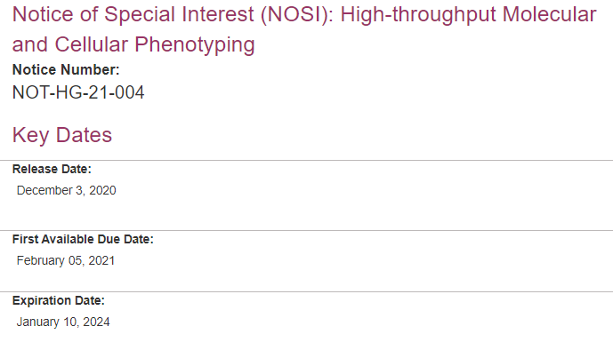
High-Throughput Molecular and Cellular
Phenotyping Opportunity
Document 18
Notes:
NHGRI has issued a Notice of Special Interest (or NOSI) to encourage applications focused on developing novel methods to perform high-throughput molecular and cellular phenotyping to interpret the functional consequences of DNA variation. The objective of this NOSI is to stimulate the development of novel high-throughput phenotyping assays of high utility, generalizability, and thoroughness, so as to expand their utility and the range of molecular and cellular phenotypes that can be examined. The first receipt dates were earlier this month, with R01 and R21 applications being accepted using standard receipt dates through January, 2024.
38

Slide 39

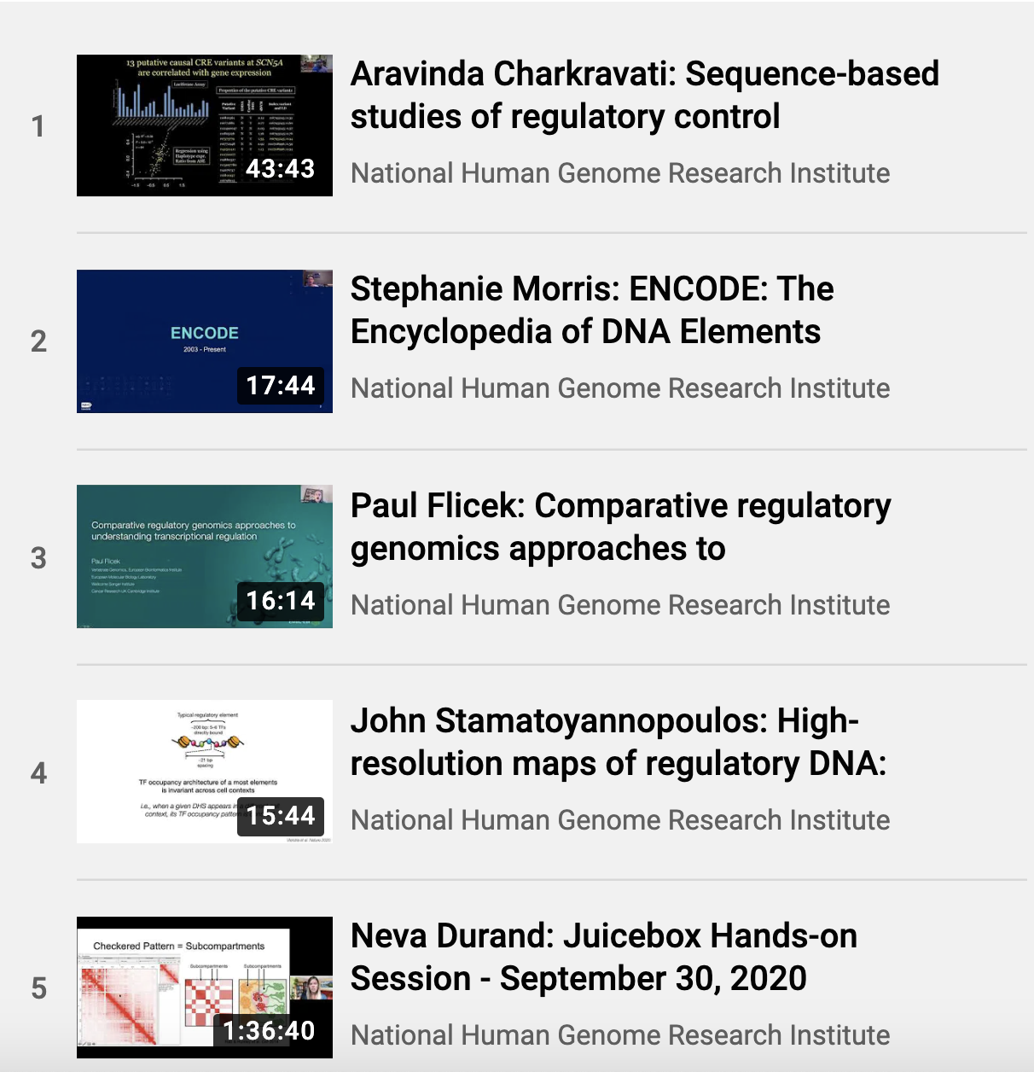

ENCyclopedia of DNA Elements
Meeting materials available on the ENCODE portal
Document 19
Notes:
The goal of the Encyclopedia of DNA Elements (or ENCODE) project is to create catalogs of all functional elements in the human and mouse genomes and to make those catalogs freely available as a resource to the biomedical research community. In Fall 2020, the ENCODE Consortium held a virtual Research Applications and Users Meeting, which had participation from over 500 attendees from the United States and Europe. The goals were to expose new users to ENCODE data and to provide skills to use these data. The meeting featured keynote speakers, talks from ENCODE Consortium members, and interactive instructional workshops on ENCODE resources.
Recorded meeting materials can be found on the ENCODE portal. The ENCODE portal also hosts information and materials from all previous meetings and workshops, along with data, analyses, protocols, and standards.
39

Slide 40

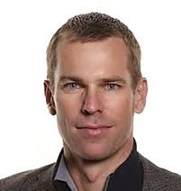





Computational Genomics and Data Science Program
    Machine Learning in Genomics Workshop
    Genomic Data Science Working Group
    April 13-14, 2021
Algorithm development
Data and resource needs
ELSI
Clinical applications
Document 20
Notes:
The Computational Genomics and Data Science Program supports advances in cross-cutting areas of research related to computational genomics and data science, from generalizable tools and methods; solutions to data storage, management, and distribution; and interoperability of genomics research approaches.
Coming up in April, the NHGRI Genomic Data Science Working Group of this Council will host a virtual Machine Learning in Genomics Workshop. This workshop is being co-chaired by working group and council members Trey Ideker and Mark Craven.
The goals of the workshop are to define key areas in genomics for machine learning and define NHGRI’s unique role in machine learning research for both genomic sciences and genomic medicine. This event is open to anyone interested in the cutting-edge intersection of artificial intelligence and genomics research. * The workshop will kick off with two keynote presentations and then dive into panels exploring topics that include: * algorithm development; * ethical, legal, and social implications; * data and resource needs; and * clinical applications for machine learning in genomics.
Workshop registration is available on the NHGRI webpage.
40

Slide 41

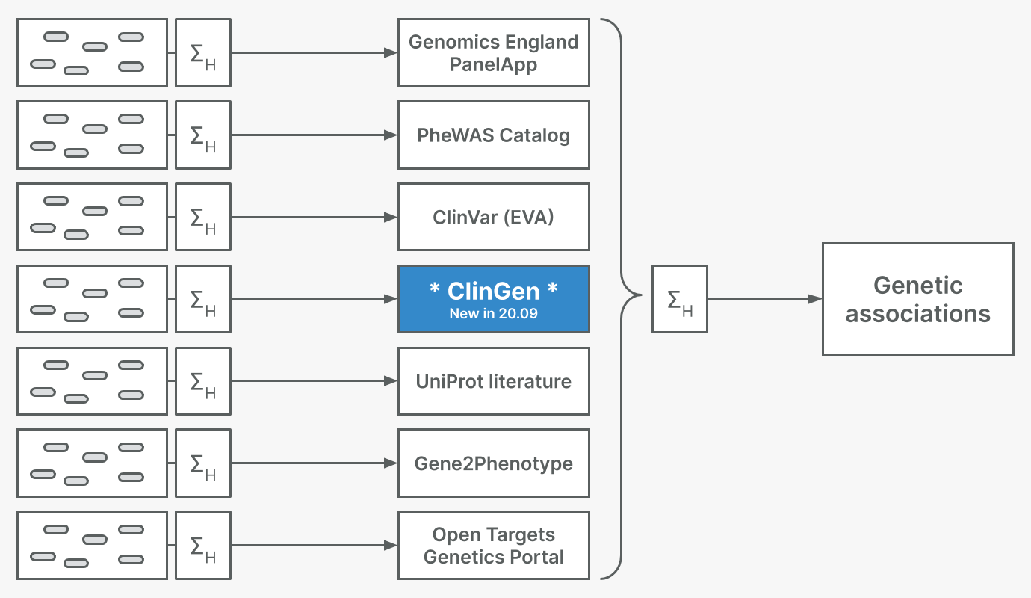


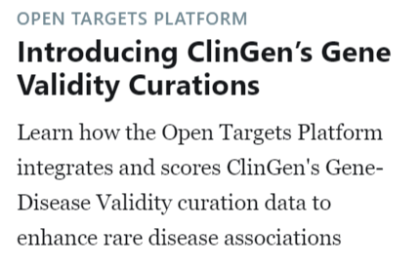
Clinical Genome Resource (ClinGen)
ClinGen Validity Curations Integrated into Open Targets Platform
Document 21
Notes:
The Clinical Genome Resource (or ClinGen) evaluates and disseminates information about the clinical relevance of genes and genomic variants for use in precision medicine and research.
The latest release of the Open Targets Platform includes ClinGen as a source of evidence for genetic associations. The Open Targets Platform is a multi-year, public-private partnership that brings together multiple data types and aims to assist users in identifying and prioritizing potential drug targets associated with disease. The Open Targets Platform supports workflows starting from a target or disease, and then shows available evidence for target-disease associations. ClinGen is the latest addition to its list of expert-curated evidence sources for rare disease genetics that also includes UniProt, the Genomics England PanelApp, and Gene2Phenotype.
The integration of ClinGen has added 1,055 unique target-disease associations, which has helped the Open Targets Platform build new target-disease associations and strengthen existing ones.
41

Slide 42


Clinical Sequencing Evidence-generating
Research (CSER) Program
Errors (18)*
Lab Protocol (9)
(13)
(4)
(5)
(5)
Evidence Codes Applied Differently
(33)
(19)
(4)
ClinGen Guidance** (5)
(1)
    “Variant bake-off 2.0” of ACMG secondary findings genes
    Concordance rate of 84%
    CSER sites adapted to COVID-19 challenges through telemedicine
Document 22
Notes:
The Clinical Sequencing Evidence-Generating Research (or CSER) program aims to generate evidence related to the clinical utility of genome sequencing, with a major emphasis on participant diversity and engagement.
In November, CSER and eMERGE investigators published an analysis of current sources of discordance across laboratories in genomic variant classification. * Referred to informally as the “variant bake-off 2.0”, 158 variants in ACMG secondary findings genes were annotated and independently classified by three laboratories. * Following additional review and discussion, the concordance rate was 84%, compared to 54% before review and 71% following the first variant bake-off. The most common reason for discordance was evidence codes being applied differently; less common sources of discordance included differing use of internal ClinGen guidance and data entry errors introduced by activities specific to this project.
* This year, CSER sites have adapted to the COVID-19 public health emergency and related challenges by relying on telemedicine to continue providing care and remain in contact with providers. While sites were able to eventually continue their studies, some experienced a pause in recruitment. For example, the NYCKidSeq study was paused for approximately five months, but completed return-of-results visits at a two-fold higher rate compared to before the COVID-19 pandemic. The site is also readjusting their recruitment strategy in order to make up for lost time.
42

Slide 43


International 100K+ Cohort Consortium (IHCC)
    Exploring the Role of Genetically Determined BMI in Infancy, Childhood, and Early Adulthood on Colorectal Cancer Development in Later Life
    High-throughput Metabolomic Biomarker Measures in Diverse Ancestries
    Opioid Cohort Consortium (OPICO) to Investigate the Effects of Regular Opioid Use on Mortality and on Cancer Development
    Global Mental Health Impact of the COVID-19 Pandemic
    Strengthening biospecimen collection for Global Longitudinal Population Studies in the COVID-19 era
    Novel coronavirus host susceptibility study in South Africa (COVIGen-SA)
Document 23
Notes:
The International 100K+ Cohort Consortium (or IHCC) was established in 2018 at the request of the leaders of the Heads of International Research Organizations through a collaboration between the Global Genomic Medicine Collaborative (or G2MC) and the Global Alliance for Genomics and Health (or GA4GH).
* Teri Manolio, Peter Goodhand, and Geoff Ginsburg recently published a paper providing details about the IHCC in Lancet Digital Health. The paper outlines the goals, efforts, and benefits of the IHCC and invites leaders of large human cohorts to join the IHCC.
* The IHCC funded six pilot projects (listed here) in 2020 to conduct tests of data harmonization and data sharing across cohorts as well as to test scientific hypotheses among a large number of participants with diverse ancestry as well as physical and social environment in different geographical locations.
43

Slide 44





Ethical, Legal, and Social Implications (ELSI)
Research Program
Launch of ELSIhub
    Curated by the Center for ELSI Resources and Analysis (CERA)
    ELSI publications database
    Scholar directory
    Research tools database
    Policy resources
    ELSI funding opportunities
Document 24
Notes:
The Ethical, Legal, and Social Implications (or ELSI) Research Program supports research that anticipates, explores, and addresses implications of genomics for individuals, families, and communities.
In November, the Center for ELSI Resources and Analysis (or CERA) launched ELSIhub. Co-led by Stanford University and Columbia University in partnership with the Hastings Center and the Personal Genetics Education Project, ELSIhub serves as a platform for the production, sharing, and use of ELSI research. * The site includes an ELSI publications database, scholar directory, research tools database for empirical ELSI research, a collection of genomics and bioethics policy resources, and a catalog of available ELSI funding opportunities.
44

Slide 45
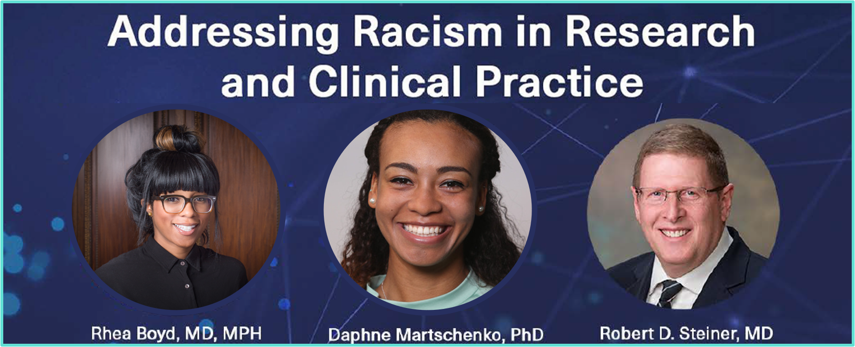
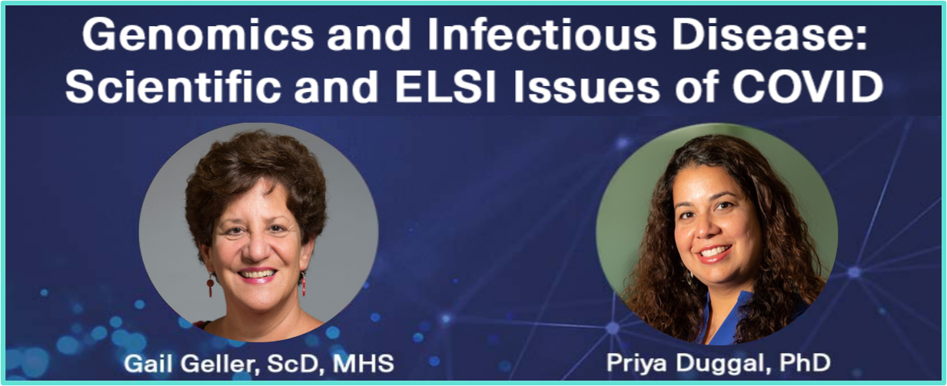


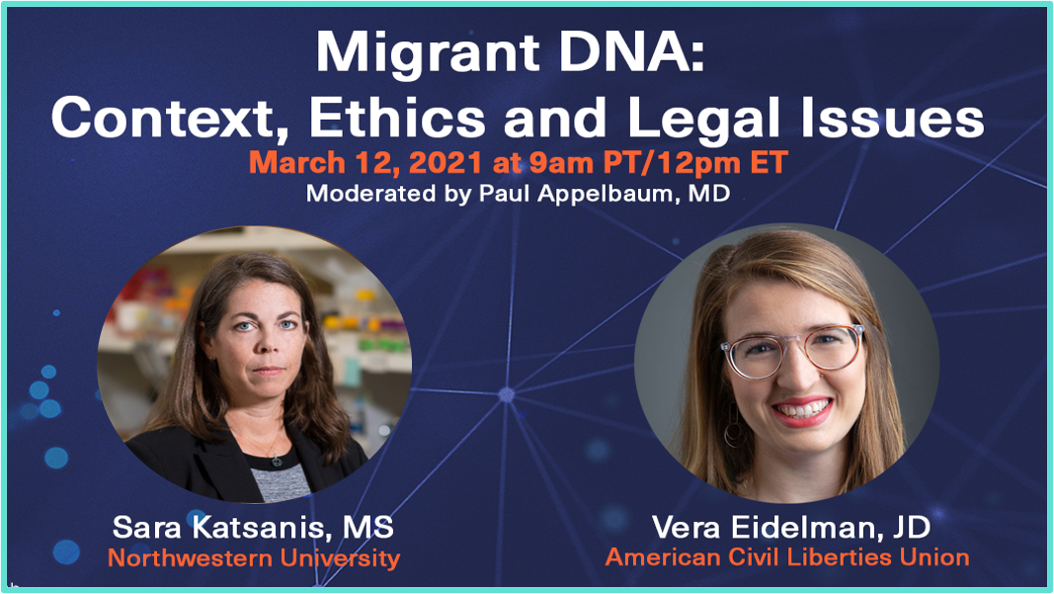
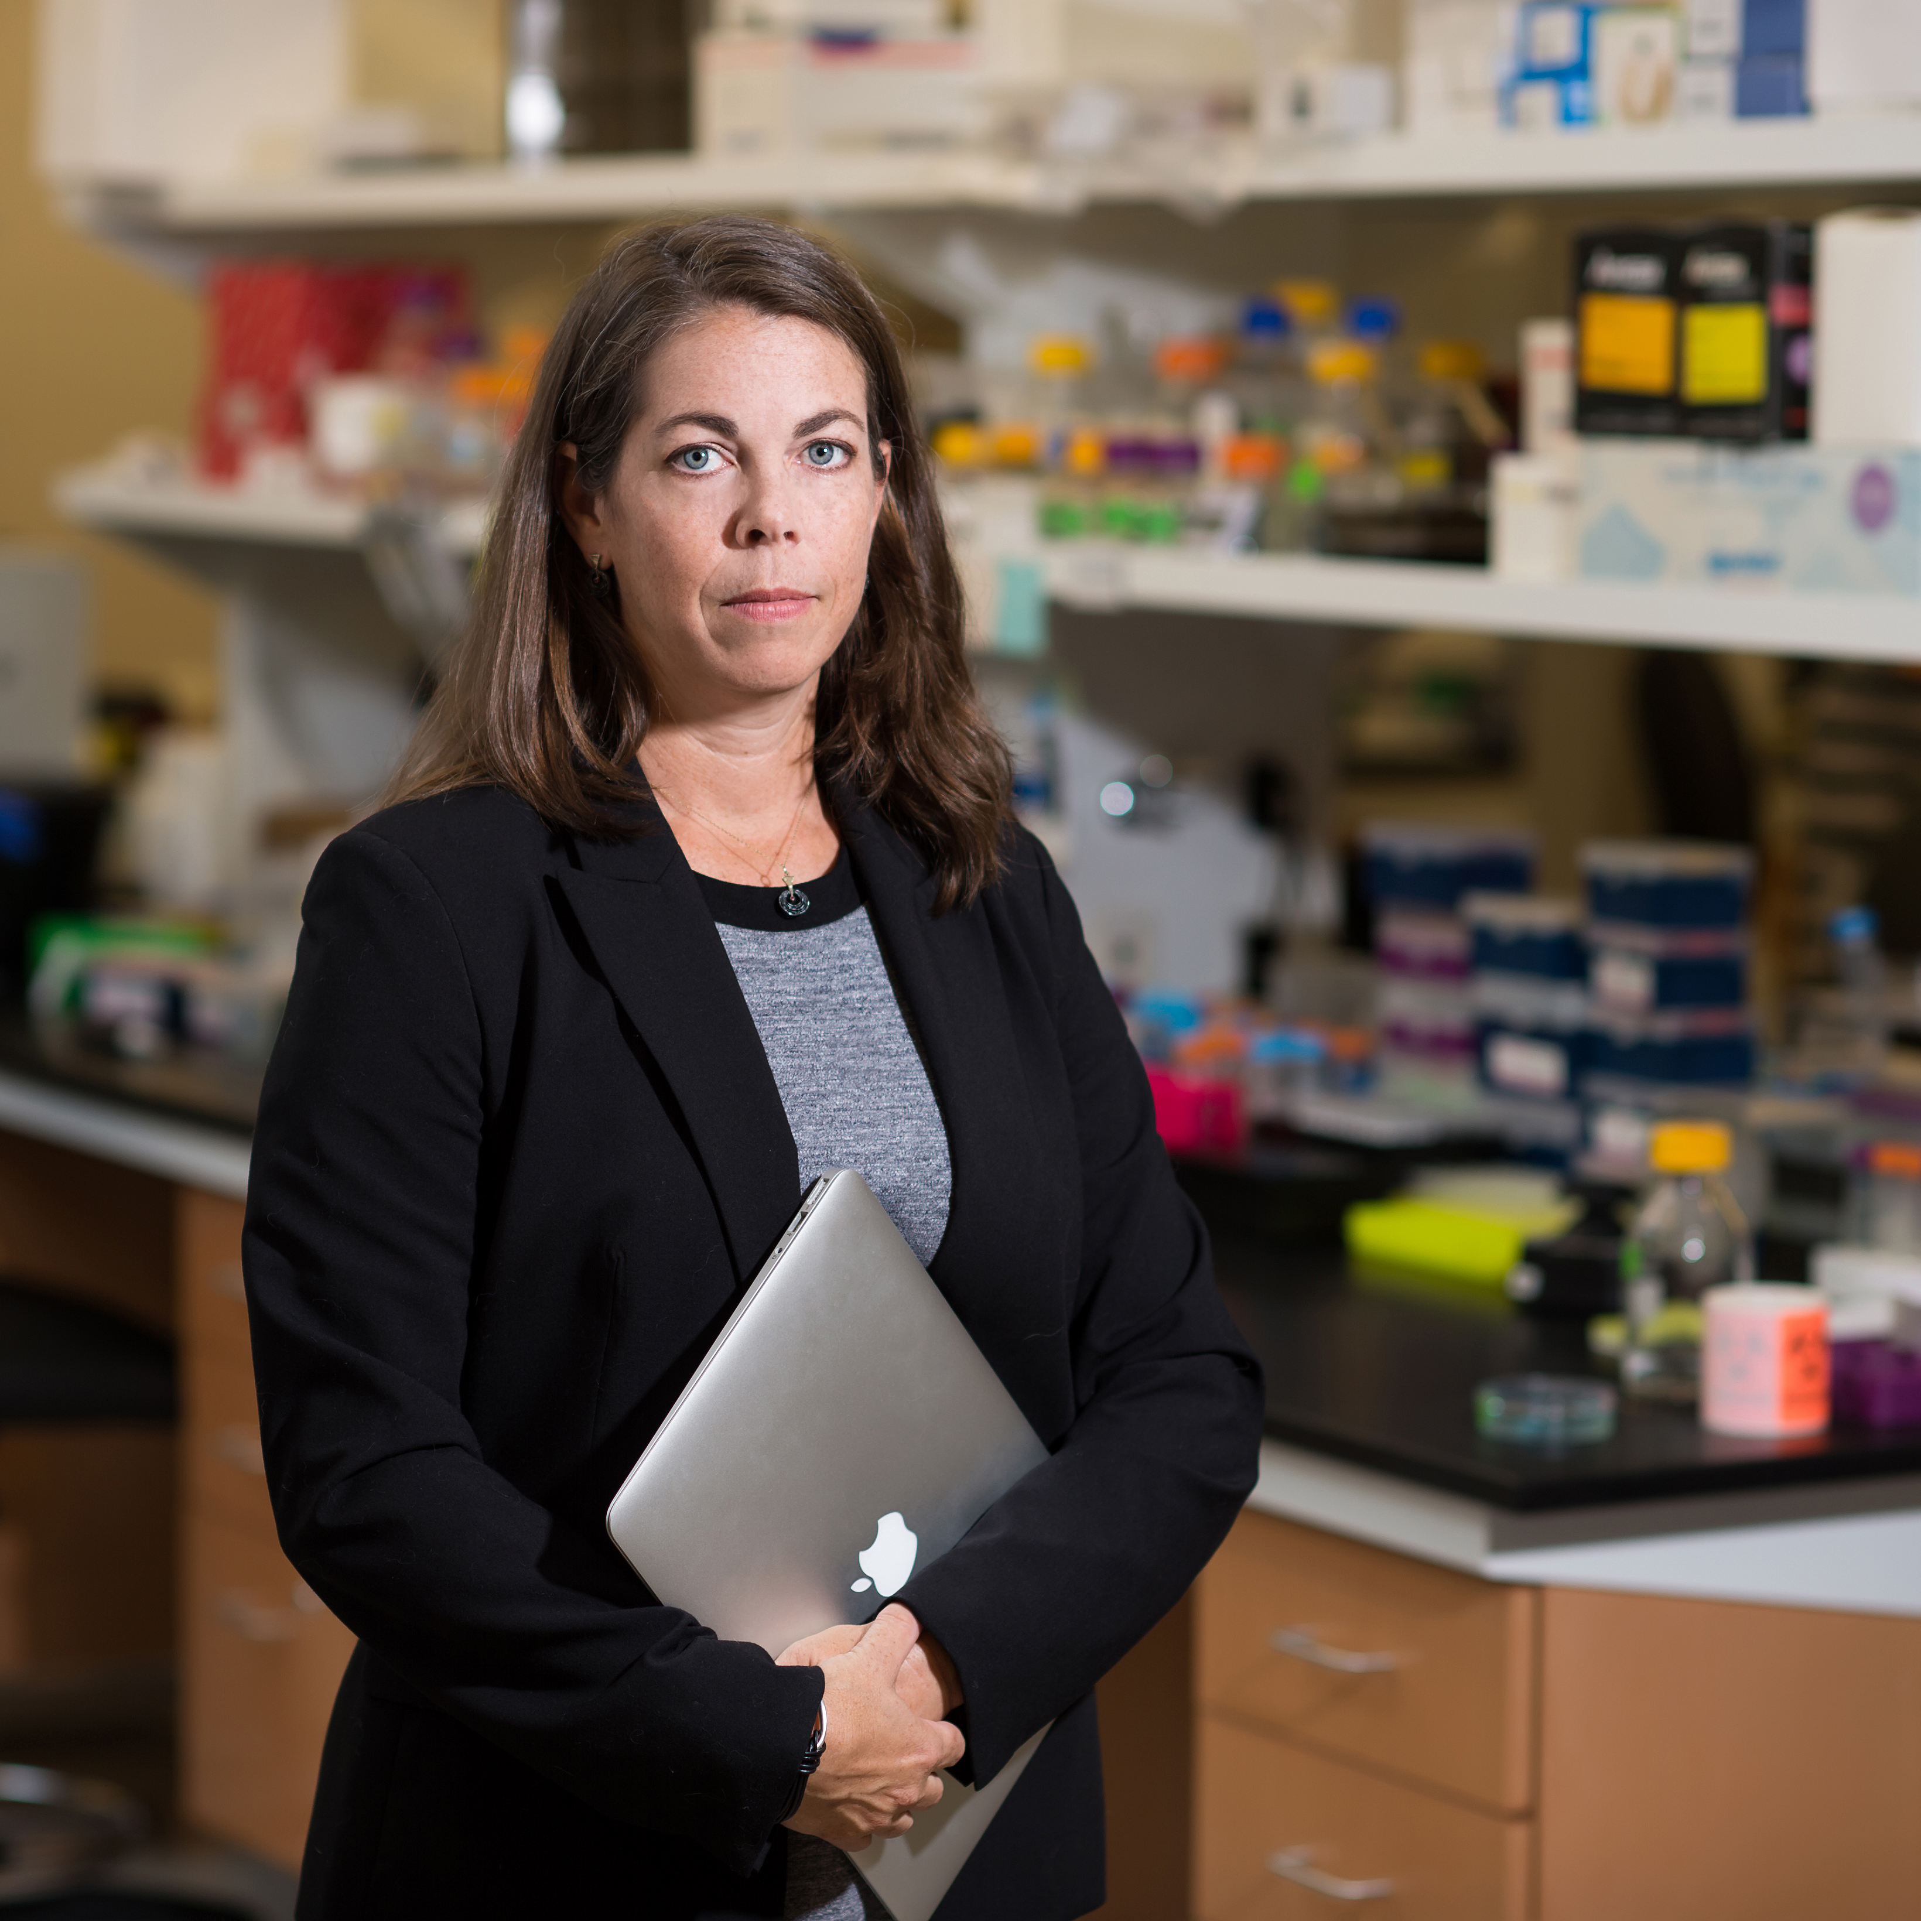
Ethical, Legal, and Social Implications (ELSI)
Research Program
ELSI Friday Forum & ELSI Conversations
    Fridays at 12:00 pm ET on ELSIhub
Document 24
Notes:
A unique feature of ELSIhub is their monthly ELSI Friday Forums. Held on the second Friday of each month, ELSI Friday Forums discuss a wide range of topics examined through an ELSI lens.
* Past forums discussed the issues of addressing racism in research and clinical practice * and the intersection between genomics and infectious disease. * The March Forum will consider ethical and legal implications of DNA technologies that impact migrants entering or resident in the United States.
All talks are recorded and archived on ELSIhub. To listen to the talks in real time and participate in live discussion, you must register in advance on the ELSIhub website.
* In addition, on February 26, ELSIhub will launch a new six-week series of themed one-hour networking discussions on ELSI research. This initial series, called ELSI Conversations, focuses on presentations that were originally accepted for the 2020 ELSI Congress, which was canceled due to the COVID-19 pandemic.
45

Slide 46


Training and Career Development
    Response to Training Task Force Recommendations
  Release date:
  December 9, 2020
  Applications due:
  May 25, 2021
FOAs Under Development:
F99/K00 – NHGRI Predoctoral to Postdoctoral Transition Award to Promote Diversity
K18 – Short-term Mentored Research Career Enhancement Award to Promote Diversity
Document 25
Notes:
Following the recommendations of the Training Task Force of this Council, NHGRI published two Program Announcements (or PARs) this past December that have an application due date of May 2021. The PARs are intended to increase the involvement of genetic counselors and data scientists in genomics research.
* Meanwhile, there are two Funding Opportunity Announcements (or FOAs) under development (one for a F99/K00 mechanism and one for a K18 mechanism), which aim to enhance the diversity of the genomics workforce at the trainee and faculty level.

Slide 47
Director’s Report Outline
General NHGRI Updates
General NIH Updates
General Genomics Updates
NHGRI Extramural Research Program
NIH Common Fund/Trans-NIH
NHGRI Communications, Policy, and Education
NHGRI Intramural Research Program
Notes:
Moving on to the NIH Common Fund and other trans-NIH efforts.
47

Slide 48
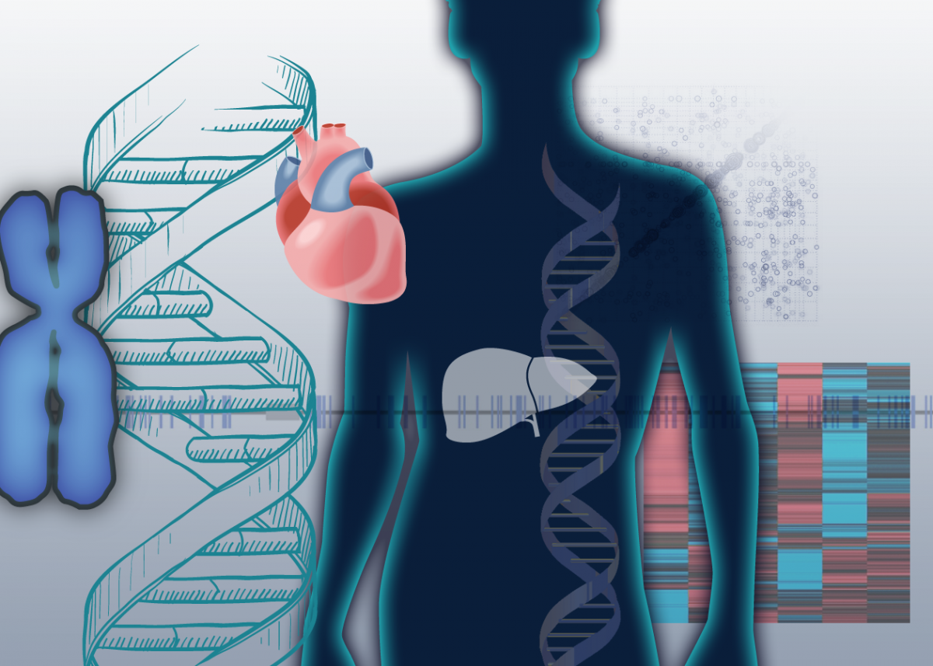
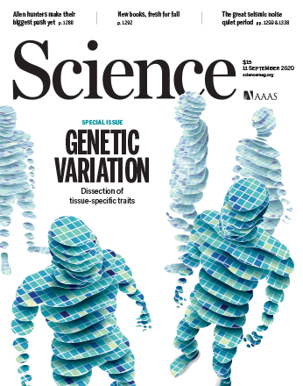
Genotype-Tissue Expression (GTEx) project
September 2020: GTEx Version 8 data release
Document 26
Notes:
More than 10 years ago, the Common Fund’s Genotype-Tissue Expression (or GTEx) project was established to characterize genetic effects on the transcriptome across human tissues and to link these regulatory mechanisms to trait and disease associations. The efforts of the GTEx Consortium have led to the development of numerous tools and the establishment of a database and a tissue bank that can be used by many researchers around the world.
* In September 2020, the final set of analyses from the GTEx Consortium were published. This was associated with a Version 8 data release, which represents the largest atlas of human gene expression and catalog of trait loci to date. For this final phase of the project, * 14 manuscripts were published in Science, Science Advances, and non-Science journals, and these summarized the results from the analyses of the Version 8 GTEx release.
The Version 8 data release includes increased numbers of tissues and individuals, which allows for more accurate mapping of putative trait-causing genomic variants and identification of cell type-specific differences in gene expression. The increased size of the dataset also provides the power to link genomic variation to gene expression on both cis and trans interactions across the genome. As a result, cis and trans effects in addition to population- and sex-specific differences in gene expression can be detected. These findings set the stage for future exploration into the effects of common and rare genomic variants that underlie the gamut of human genomic variation.
48

Slide 49


Library of Integrated Network-based
Cellular Signatures (LINCS)
    >700 attendees
Document 27
Notes:
The Library of Integrated Network-based Cellular Signatures (or LINCS) is a Common Fund program intended to create a network-based understanding of biology by cataloging changes in gene expression and other cellular processes. LINCS uses computational tools to integrate this diverse information for the development of new biomarkers and therapeutics.
LINCS is now concluding after 10 years as a Common Fund program, and LINCs investigators are finalizing the LINCS resources. The LINCS Consortium held its final symposium in a virtual format in November 2020. The symposium highlighted the impact that LINCS has had on the research community by featuring work from both LINCS investigators and external investigators who have leveraged LINCS resources. * Over 700 attendees joined the symposium.
Video recordings from the LINCS Virtual Symposium are available on the BD2K-LINCS Data Coordination and Integration Center YouTube channel.
49

Slide 50

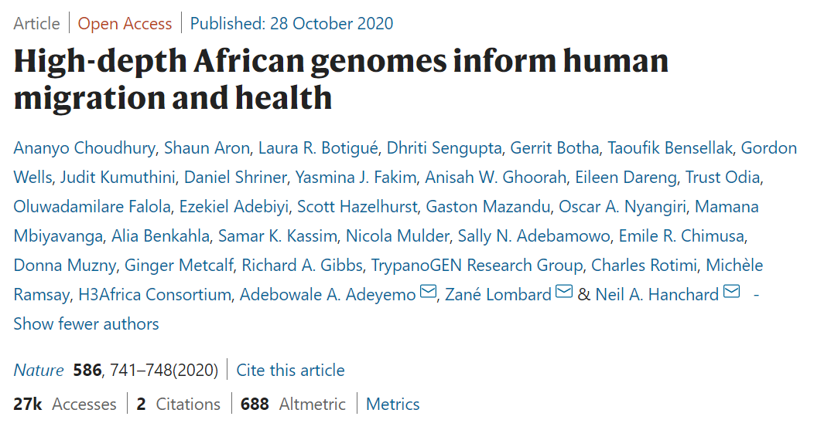
Human Heredity and Health in Africa (H3Africa)
Growing Publication Record
    440+ publications to date
Document 28
Notes:
The central goal of the Common Fund Human Heredity and Health in Africa (or H3Africa) program is to develop a sustainable and collaborative African genomics research enterprise.
* In its ninth year, H3Africa continues to make progress on its goal of publishing in international journals, with over 440 such publications to date.
* For example, last October, findings from H3Africa’s initial large-scale genome-sequencing effort were published in Nature. The article presented analyses of whole-genome sequences from 426 individuals representing 50 ethnolinguistic groups from the continent, reflecting the rich genomic diversity across Africa. The investigators catalogued over 3 million novel genomic variants, complex patterns of admixture, evidence of natural selection, and previously unknown migration events. The study represents a major milestone for African genomics research, as it was predominantly led by local researchers using community resources.
50

Slide 51


Human Heredity and Health in Africa (H3Africa)
Continued International Collaborations
    Virtual Consortium Meeting: >150 attendees
    ClinGen and H3Africa Rare Disease Working Group
Document 28
Notes:
Additionally, H3Africa researchers continue to collaborate globally.
* Capitalizing on the virtual format, the 16th H3Africa Consortium meeting held last September included >150 attendees that spanned the globe and included participants outside the H3Africa community. Many of the international participants gave presentations and participated in discussion panels, allowing for a rich exchange of ideas.
* The H3Africa Rare Disease Working Group has ongoing interactions with ClinGen, and the two groups recently hosted a three-day workshop. Topics included gene and variant curation, ClinVar submission, and other ClinGen tools and activities.
51

Slide 52

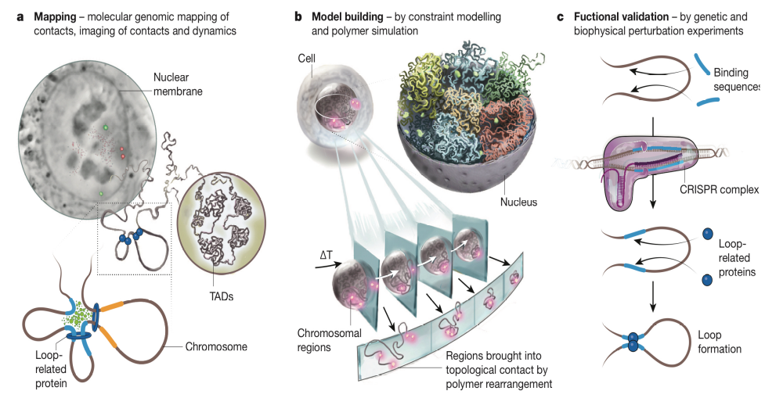
4D Nucleome (4DN)
30 Awards:
    Chromatin dynamics and function
    Data integration, modeling, and visualization
    Nuclear organization in human health and disease
    New investigator projects in human health and disease
    Data center and organizational hub
Mapping
Modeling
Function
Phase II kickoff meeting in December 2020
Document 29
Notes:
The 4D Nucleome (or 4DN) is an NIH Common Fund program whose goal is to study the organization of the nucleus in both space and time. In 2020, the program started its second phase, with a focus on understanding the role of nuclear organization in disease and biological processes (such as gene expression).
* This figure from the 4DN marker paper illustrates the three program objectives: mapping, modeling, and function. * Last Fall, NIH issued 30 awards for the second phase focused on chromatin dynamics and function; data integration, modeling, and visualization; nuclear organization in human health and disease; new investigator projects in human health and disease; and a data center and an organizational hub.
* Finally, 4DN held a Phase II kickoff meeting in December 2020.
52

Slide 53



Document 30
Notes:
The goal of the NIH All of Us Research Program is to speed up health research discoveries, enabling new kinds of individualized healthcare. To make this possible, the program is building one of the world’s largest and most diverse databases for health research.
* In December, the All of Us Research Program began returning genetic results to those participating in the program. Participants currently are given the choice to receive information about their genetic ancestry and a small number of non-health related traits. Over time, the program plans to offer information about pharmacogenomic variants and health-related genomic variants, based on guidelines of the American College of Medical Genetics and Genomics. All of Us plans to make genetic data available to researchers in approximately one year.
* The All of Us Research Program has also released updates to the Research Hub, which includes expanded health data and upgraded tools. Key features of this data release include the first set of Fitbit data, as well as information about research participants’ experience during the COVID-19 pandemic. These COVID-related data were collected through a series of survey questions on mental health, social distancing, and economic impacts.
53

Slide 54

Due Date: April 6, 2021
Document 30
Notes:
NIH has released Funding Opportunity Announcements for a new Common Fund initiative, Nutrition for Precision Health, which will be powered by the All of Us Research Program. This initiative aims to generate insights leading to more tailored nutritional recommendations based on individual differences.
This is the first NIH-led study to leverage the All of Us participant cohort and infrastructure to expand data collection and drive new discoveries. The six funding opportunities call for organizations to provide leadership in multiple areas, including nutrition science, clinical research design and implementation, metabolomics, metagenomics, machine learning and artificial intelligence, bioethics, and more.
* Applications are due on April 6, 2021.
54

Slide 55
Director’s Report Outline
General NHGRI Updates
General NIH Updates
General Genomics Updates
NHGRI Extramural Research Program
NIH Common Fund/Trans-NIH
NHGRI Communications, Policy, and Education
NHGRI Intramural Research Program
Notes:
Moving on to NHGRI activities in the areas of communications, policy, and education.
55

Slide 56
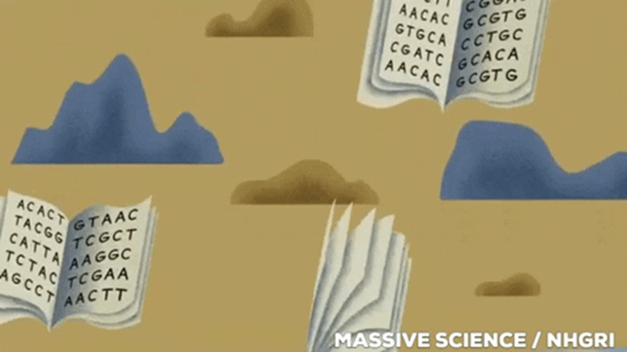
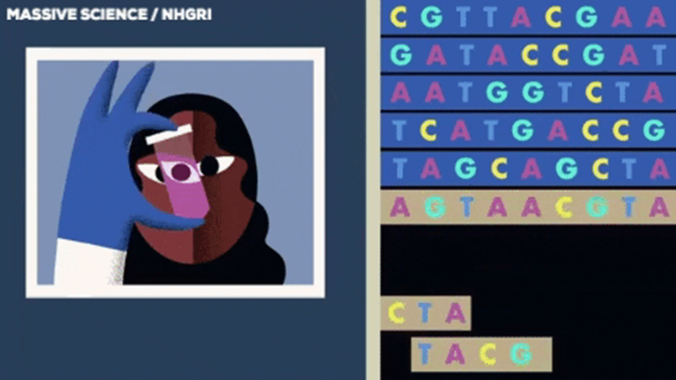
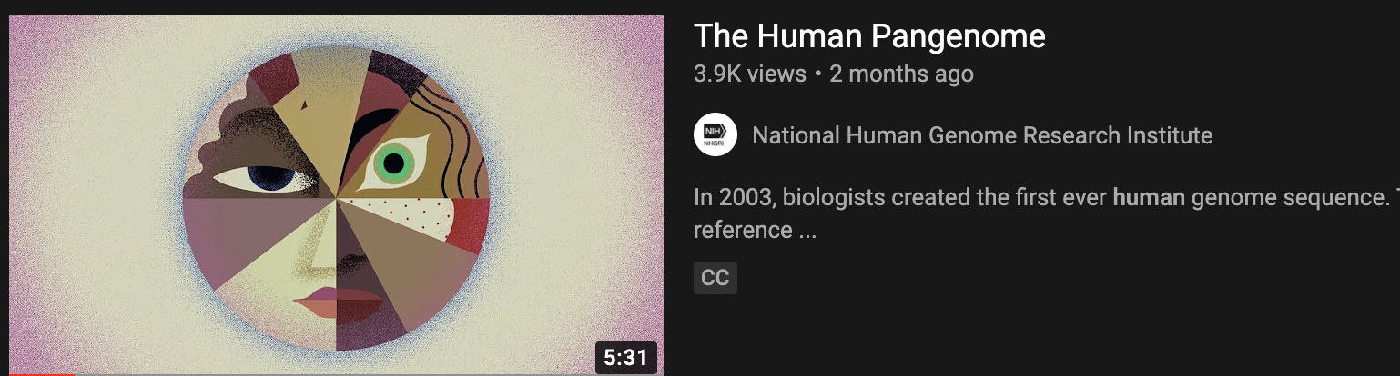
Human Pangenome Video
Document 31
Notes:
In November, NHGRI's Communications and Public Liaison Branch released a short video in collaboration with the science company Massive Science. The video highlights the Telomere-to-Telomere Consortium's work to complete the genome and render it gapless and the Human Pangenome Reference Program's efforts to generate reference sequences that embody all of human diversity.
The video has garnered thousands of views within the last two months. It also received immensely positive feedback on social media channels from the scientific community and general audiences, who thought the video explained an important genomics topic in an accessible manner.
56

Slide 57


Genome: Unlocking Life’s Code Exhibition’s
Return to the Smithsonian
Document 32
Notes:
In the Spring 2021 and after a seven-year tour of North America, the Genome: Unlocking Life’s Code exhibition is scheduled to return to the Smithsonian National Museum of Natural History in Washington DC. Recognizing that much has happened in genomics since its opening in 2013, the exhibition is being updated and refreshed to highlight new discoveries and technological advances.
Please continue to check the exhibition’s website and follow it on social media for the most up-to-date program information, including details about its re-opening at the National Museum of Natural History later this year.
57

Slide 58



Family Health History Social Media Campaign
Notes:
In November, NHGRI’s Education and Community Involvement Branch and Communications and Public Liaison Branch launched a Family Health History Awareness social media campaign in honor of Family Health History Awareness Month. The goals of the campaign were to foster a virtual community among healthcare provider educators, improve working knowledge of family health history in clinical and informal settings, and share best practices when gathering information.
The campaign leveraged Facebook stories, a Q&A session with NHGRI’s Clinical Director Ben Solomon, and a Twitter chat that reached over 194,000 people and engaged more than 1,500 users.
58

Slide 59


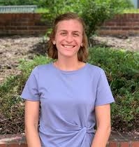

New ISCC-PEG Scholars Program
A Genomics Education Opportunity
    Samantha Bailey, Pharm.D., Ph.D.
    Rene Begay, M.P.H.
    Kelsey Ellis, M.S.
    Katherine Robinson, Pharm.D.
Document 33
Notes:
NHGRI’s Inter-Society Coordinating Committee for Practitioner Education in Genomics (or ISCC-PEG) created a new scholars’ program to facilitate student interactions with healthcare and educator professionals working in genomics education. This program provides selected scholars exposure to the broader genomics community and experts in the field, with the opportunity to work on a genetics/genomics-related education projects under the mentorship of an ISCC-PEG member. The appointment is for two years, and each scholar will have their travel funded to attend the annual ISCC-PEG in-person meeting. Shown here are the four scholars selected in October from a pool of 26 applicants.
59

Slide 60
Director’s Report Outline
General NHGRI Updates
General NIH Updates
General Genomics Updates
NHGRI Extramural Research Program
NIH Common Fund/Trans-NIH
NHGRI Communications, Policy, and Education
NHGRI Intramural Research Program
Notes:
60
And finally, moving on to NHGRI’s Intramural Research Program.

Slide 61

New Genomic Science and
Health Equity Fellowship Program
    Use genetic, genomic, and pharmacogenomic approaches to advance minority health and health equity
    Research methodology and medical product development processes that facilitate delivery of drugs, biologics, and devices
    First fellow will start Summer/Fall 2021
Document 34
Notes:
In January, NHGRI’s Intramural Research Program established the Genomic Science and Health Equity Fellowship Program in partnership with the Food and Drug Administration’s Office of Minority Health and Health Equity.
* This program will prepare fellows to use genetic, genomic, and pharmacogenomic approaches to advance minority health and health equity. * Fellows will be trained in the research methodology and medical product development processes that facilitate the delivery of drugs, biologics, and devices from the bench to the bedside.
* The fellowship is currently open for applications, and the selected fellow will start in Summer or Fall of 2021. The first fellow will be co-mentored by researchers from NHGRI, FDA, and the NIH Clinical Center to pursue genomics research related to blood transfusion support for patients with sickle cell disease. Eligibility requirements and application guidelines for this exciting opportunity are available on the program webpage on genome.gov.
61

Slide 62
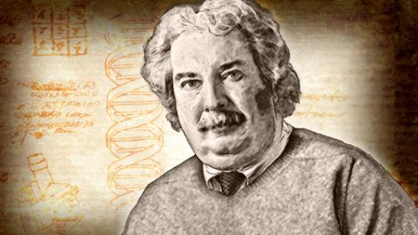
Retirement of NHGRI Intramural Investigator
Alec Wilson, Ph.D.
Document 35
Notes:
Alec Wilson retired from NHGRI in September 2020. Alec was recruited to the NHGRI Intramural Research Program in 1995 and, until his retirement, served as the Co-Chief of the Computational and Statistical Genomics Branch. Over the course of his remarkable 40-year career, the overarching goal of Alec’s research program was the identification of genomic variants that influence quantitative traits. Of note, Alec will continue to remain involved at NHGRI as a Scientist Emeritus.
62

Slide 63

New NHGRI Intramural Investigator
Neil Hanchard, M.D., Ph.D.
Document 36
Notes:
Neil Hanchard has joined NHGRI as an investigator within the newly named Center for Precision Health Research (formerly the Medical Genomics and Metabolic Genetics Branch) in the Institute’s Intramural Research Program. Neil will head the Childhood Complex Disease Genomics Section within the Center and will lead efforts to use genomic and genetic tools to understand complex pediatric diseases and traits in diverse populations. He was previously a faculty member at Baylor College of Medicine.
63

Slide 64

Royal Swedish Academy of Sciences’ Crafoord Prize
Dan Kastner, M.D., Ph.D.
Document 37
Notes:
NHGRI’s Scientific Director and Director of the Institute’s Intramural Research Program, Dan Kastner, has been awarded the prestigious Crafoord Prize in Polyarthritis by the Royal Swedish Academy of Sciences for his pioneering work in “establishing the concept of autoinflammatory diseases.” His work is also described in a recent CNN story.
64

Slide 65

    NHGRI Scientific Director Search
    Dan Kastner will step down as NHGRI Scientific Director
    Search for the next NHGRI Scientific Director begins in mid-March
Notes:
And on a related note…
Having served as NHGRI Scientific Director since October 2010, Dan Kastner has announced that he will step down as Scientific Director to focus on his research program and clinical activities. This transition will occur once a new Scientific Director has been selected and assumes the position.
* As a result, I am launching a major search to identify the next NHGRI Scientific Director. Applications will be accepted starting in mid-March. This is an immensely important leadership position at NHGRI, with the responsibility for overseeing the entire Intramural Research Program and its now >$120 million annual budget. Anyone with thoughts about this search, including suggestions for potential candidates, should feel free to contact me directly, and I will share that information with the Search Committee.
65

Slide 66
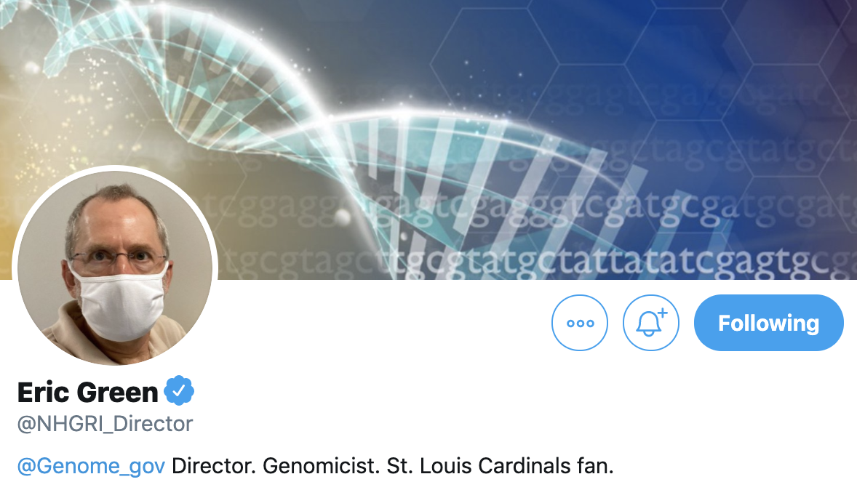
NHGRI Director on Twitter
Document 38
Notes:
Before closing, let me remind you that I can be followed on Twitter at @NHGRI_Director, where I communicate regularly about NHGRI and genomics to various stakeholders.

Slide 67

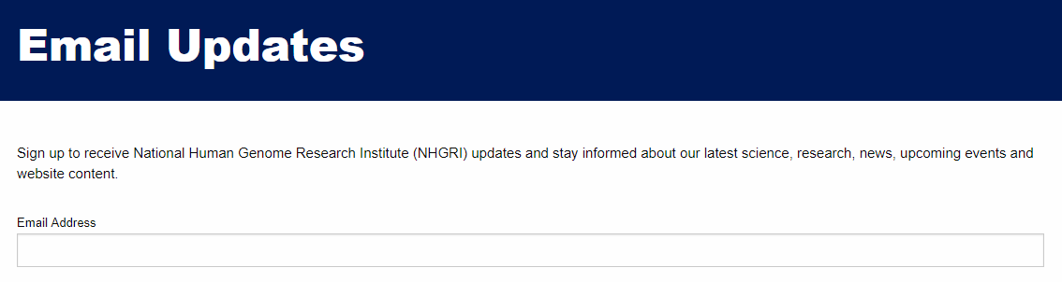
Document 39
Notes:
And for those of you who only want to hear from me once a month, you are welcome to sign up to receive my monthly email update (called The Genomics Landscape) on the NHGRI website (genome.gov) by subscribing under “Email Updates.”
67

Slide 68


Thanks!
Special Thanks!
Notes:
Finally, a personal thanks to the many NHGRI staff members who contributed the slides and associated materials that I just reviewed in my Director’s Report. As always, a group effort is essential for getting such a large amount of information conveyed efficiently at each Council meeting.
An additional thanks to the NHGRI communications group and web team for making my Director’s Report into an electronic resource.
And * a special thanks to the usual ‘ringleader’ for helping me prepare my Director’s Report, Kris Wetterstrand (* shown here on the right). This is a throwback photo from February 12, 2001, when Kris held up one end of chromosome 1 (well, actually a graphic of it) at the press conference covering the publications describing the draft sequence of the human genome.
68

Slide 69
Notes:
69

