Slide 1



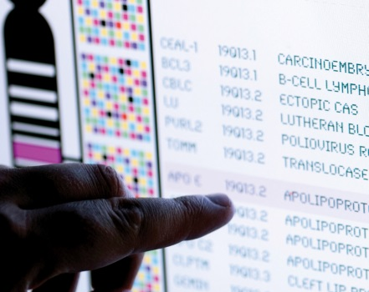
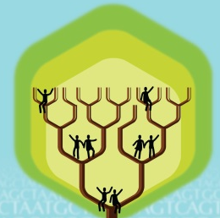
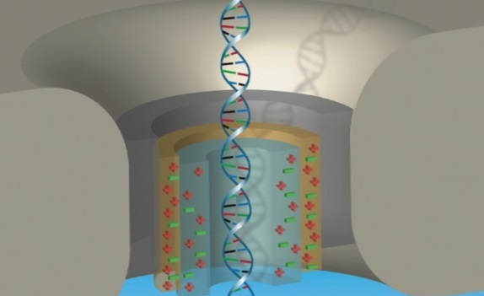


DIRECTOR’S REPORT
Eric Green, M.D., Ph.D.
Director, NHGRI
September 2023
Notes:
I would again like to welcome all of you to this Open Session of the National Advisory Council for Human Genome Research meeting, including those who are here with me in person and those who are joining remotely.
As with the rest of the Open Session, my Director’s Report presentation is being videorecorded, and that recording will be made available as a permanent archive on NHGRI’s website (genome.gov).

Slide 2
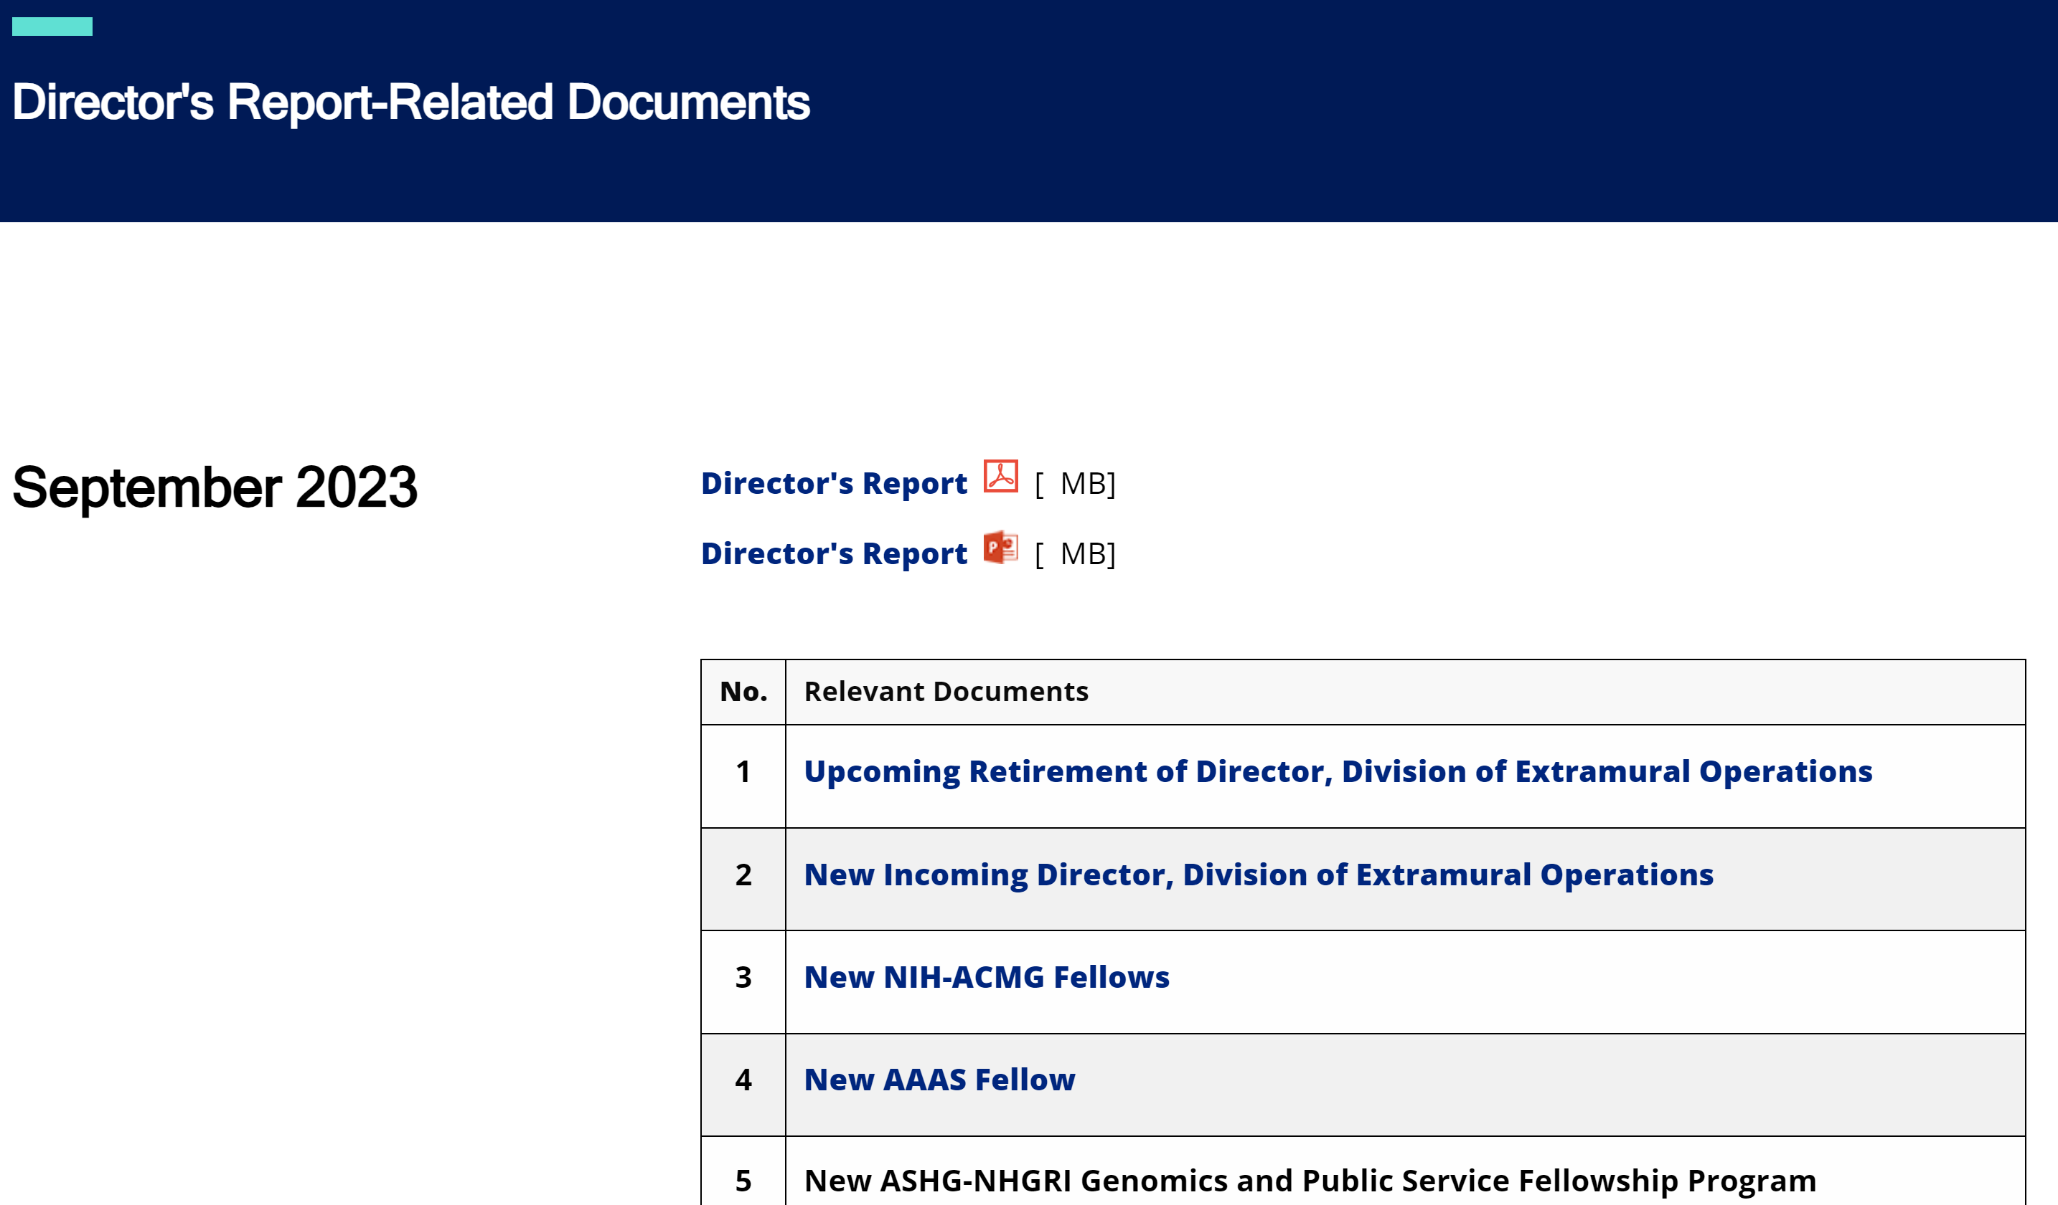

genome.gov/DirectorsReport
Document #
Notes:
For those who are new to our Council meetings, I want to make you aware of the ‘electronic resource’ that has been developed for my Director’s Report. This resource, which is analogous to the supplemental materials of a published paper, can be accessed at the URL shown here.
The slides that I will show during my Director’s Report are also available electronically at this site – * in both PDF and PowerPoint formats.
* When there are documents or relevant websites associated with a particular slide, you will find a “Document #” indicated on the bottom right of that slide; that “Document #” references materials that can be accessed and/or downloaded from the webpage shown here. This dedicated webpage and all linked documents will be archived on genome.gov as part of the historical record of this Council meeting.

Slide 3
Open Session Agenda
  Special Celebration:
    100th Meeting of the NACHGR
  Eric Green
  Presentation:
    Research Priorities for Office of Data Science Strategy
  Susan Gregurick
  Concept Clearance:
    Machine Learning and Artificial Intelligence Tools to Advance Genomic Translational Research
    Sandhya Xirasagar
Notes:
Following my Director’s Report, * we will have a brief celebration of the 100th meeting of the National Advisory Council for Human Genome Research.
Then, there will be a number of other presentations during the rest of this Open Session. My Director’s Report is tailored around those presentations, and I will not discuss in detail the topics that others will cover.
* After lunch, Susan Gregurick, Director of the NIH Office of Data Science Strategy, will present on Research Priorities for Office of Data Science Strategy.
This will be followed by five concept clearances presented by extramural program directors.
* First, Sandhya Xirasagar will present a concept clearance entitled Machine Learning and Artificial Intelligence Tools to Advance Genomic Translational Research.

Slide 4
Open Session Agenda
  Concept Clearances:
    NHGRI Technology Development Coordinating Center
    Stephanie Morris
    Genomic Medicine eConsult Service
    Renee Rider
    Genomic Research Experiences for Data Scientists
  Sandhya Xirasagar
    Research Experiences in Genomic Research for Genetic Counselors
  Heather Colley
Notes:
Next, * Stephanie Morris will present a concept clearance entitled NHGRI Technology Development Coordinating Center.
* Then, Renee Rider will present a concept clearance entitled Genomic Medicine eConsult Service.
* Then, Sandhya Xirasagar will present a concept clearance entitled Genomic Research Experiences for Data Scientists.
* And finally, Heather Colley will present a concept clearance entitled Research Experiences in Genomic Research for Genetic Counselors.

Slide 5
Open Session Agenda
  Presentations:
    Genomics & Society Working Group
  Malia Fullerton
    NHGRI Office of Communications and History of Genomics Program
    Sarah Bates & Christopher Donohue
    Using Machine Learning and Artificial Intelligence Methods in History of Genomics Archival Research
    Spencer Hong & Thomas Stoeger
    Clinical Sequencing Evidence-Generating Research
    Gail Jarvik & Kyle Brothers
Notes:
Following the concept clearances, * we will hear from Malia Fullerton, Chair of the Genomics & Society Working Group of this Council, who will provide an annual report from that working group.
* Then, Sarah Bates, NHGRI Communications Director, and Christopher Donohue, NHGRI Historian, will present on the activities of the NHGRI Office of Communications and History of Genomics Program, respectively.
* We will then delve deeper into genomics history with Spencer Hong, a graduate student in Luís Nunes Amaral’s research group at Northwestern University, and Thomas Stoeger, a postdoctoral fellow also in the Amaral lab, who will present on Using Machine Learning and Artificial Intelligence Methods in History of Genomics Archival Research.
* Finally, Gail Jarvik, and Kyle Brothers, both investigators in the Clinical Sequencing Evidence-Generating Research program, will provide a final report from that program.

Slide 6
Director’s Report Outline
General NHGRI Updates
General NIH Updates
General Genomics Updates
NHGRI Extramural Research Program
NIH Common Fund/Trans-NIH
NHGRI Communications, Policy, and Education
NHGRI Intramural Research Program
Notes:
For the rest of my Director’s Report, I will cover the seven areas listed here, which reliably provide a useful framework for reviewing the relevant topics.

Slide 7
Director’s Report Outline
General NHGRI Updates
General NIH Updates
General Genomics Updates
NHGRI Extramural Research Program
NIH Common Fund/Trans-NIH
NHGRI Communications, Policy, and Education
NHGRI Intramural Research Program
Notes:
And I will start with some general NHGRI updates.

Slide 8
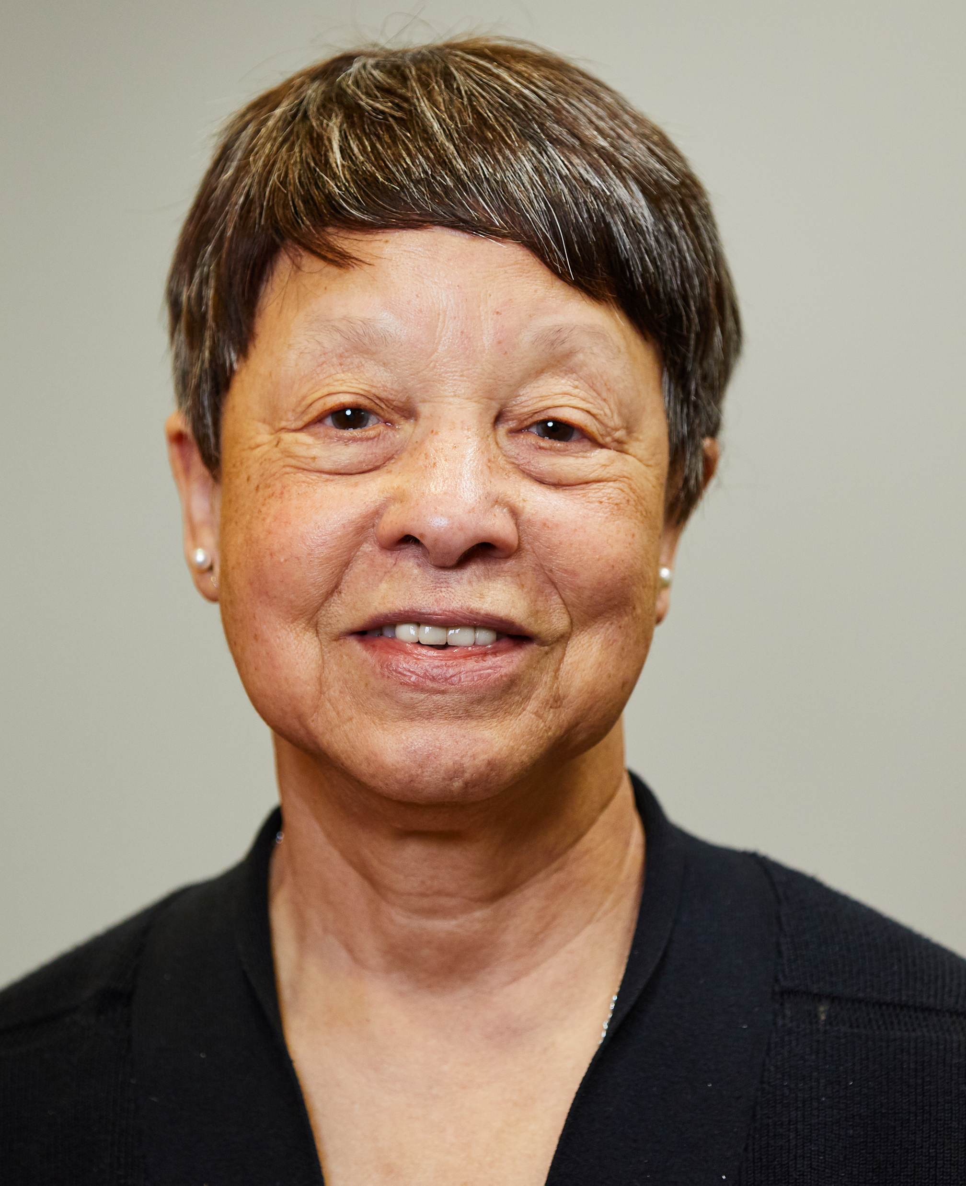
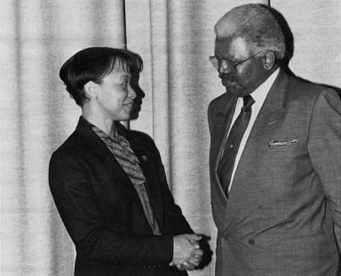
Upcoming Retirement of Director,
Division of Extramural Operations
Bettie Graham, Ph.D.
Document 1
Notes:
After more than 50 years of service in the U.S. government and 34 years at what is now NHGRI, Bettie Graham will be retiring at the end of 2023. * Bettie began her scientific career at Baylor College of Medicine, from which she was the first person of color to earn a Ph.D.; her government service then began with her time in the Peace Core teaching in Nigeria. In 1989, she joined the then NIH Office of Genome Research, which would become NHGRI, and has since led the institute in developing and managing many programs relevant to genomics. In addition, the entire NIH community has benefitted from her wisdom and dedication in serving the extramural training programs.
That only begins to touch on the full list of contributions to NHGRI (totaling well beyond her number of years of federal service!). While we all believe that Bettie deserves some rest and relaxation, she is a person who is happiest when doing things, so we know she will be taking time to enjoy her many other pursuits, among them * winning medals in fencing on the international stage.
From now until her retirement at the end of the year, Bettie will serve as Outgoing Director of the NHGRI Division of Extramural Operation, helping to train her successor.

Slide 9
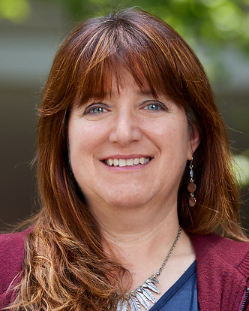
New Incoming Director, Division of
Extramural Operations
Jennifer Troyer, Ph.D.
Document 2
Notes:
And that successor is Jennifer Troyer. For the past 10 years, Jen has worked as a program director in NHGRI’s Division of Genome Sciences. During that time, she managed grant portfolios related to comparative genomics and methods for studying genome structure and function. She served as the NIH lead for the NIH Common Fund’s Human Heredity and Health in Africa (or H3Africa) initiative, which facilitated fundamental research into diseases in Africa and helped develop infrastructure, resources, training, and ethical guidelines to support sustainable African research. She also co-managed the Developmental Genotype-Tissue Expression (or dGTEx) program, which is establishing a resource database and tissue bank for studying gene expression during human development.
Before joining NHGRI, Jen was the technology development project lead for the Genomics Core at the National Cancer Institute (or NCI). Prior to that, she directed a research program at NCI, in which she studied the genetics and evolution of viral-host interactions. She completed a postdoctoral fellowship at NCI and at Colorado State University after receiving a B.A. in biology from Earlham College and a Ph.D. in genetics from the University of Connecticut.

Slide 10

New Extramural Program Director
Ian Nova, Ph.D.
Notes:
In June, Ian Nova joined NHGRI as an extramural program director in the Division of Genome Sciences. Ian oversees a portfolio of grants in genomic technology development, focusing on novel tools for nucleic acid sequencing, as well as grants in NHGRI’s Small Business Program.
Prior to joining NHGRI, Ian was a postdoctoral researcher at Delft University of Technology in the Netherlands, where he worked on the development of technologies for protein sequencing, and at the University of Washington, where he worked on developing technologies for nucleic acid sequencing and single-molecule enzymology.
Ian received a B.S. in bioengineering from Santa Clara University and a Ph.D. in molecular engineering and sciences from the University of Washington.

Slide 11

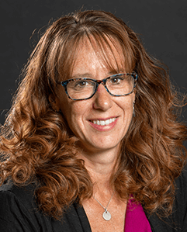
New NIH-ACMG Fellows
Jessica Chong,
P.A.-C.
Karyn Roberts,
Ph.D., R.N.
Document 3
Notes:
The NIH-ACMG Genomic Medicine Program Management Fellowship is a partnership involving NHGRI; the National Heart, Lung, and Blood Institute; the National Institute on Minority Health and Health Disparities; the All of Us Research Program; and the American College of Medical Genetics and Genomics (or ACMG). The fellowship prepares health practitioners (such as physicians, physician associates, genetic counselors, and nurse practitioners) to manage research and implementation programs in genomic medicine. The two new NIH-ACMG Fellows for 2023-2025 are Jessica Chong and Karyn Roberts.
Jessica attended North Carolina State University. She then completed her physician assistant studies and obtained a M.S. degree in Health Sciences at George Washington University. She has worked in pediatric medicine for ten years, with a special interest in neuromuscular and genetic diseases. Jessica has been a sub-investigator in multiple clinical trials; she has also treated and managed patients receiving disease-modifying therapies, including gene therapy and anti-sense oligonucleotide therapies.
Karyn is a pediatric nurse, previously practicing in the emergency department. She obtained her Ph.D. in Nursing Science in 2019 from the University of Illinois at Chicago. Working in academia since 2012, Karyn was most recently an Assistant Professor at the University of Wisconsin-Milwaukee School of Nursing and as an Adjunct Assistant Professor at Northwestern Feinberg School of Medicine’s Department of Pediatrics.

Slide 12
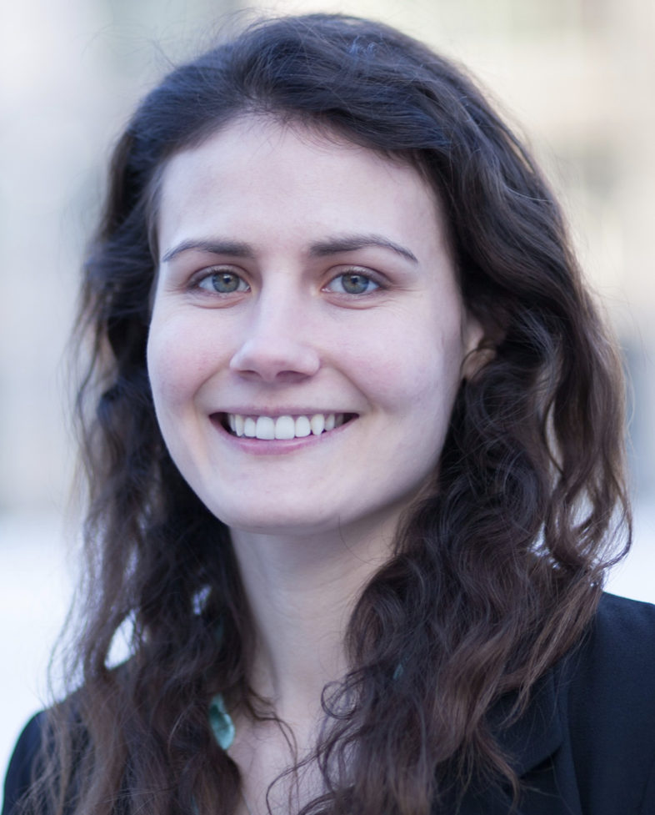
New AAAS Fellow
Molly Bird, Ph.D.
Document 4
Notes:
NIH partners with the American Association for the Advancement of Science (or AAAS) to provide one- to two-year Science and Technology Policy Fellowships at NIH. The fellowship provides opportunities for scientists and engineers to learn first-hand about policymaking and contribute their knowledge and analytical skills in the policy realm.
Molly Bird recently joined NHGRI as a AAAS Fellow. Molly completed her Ph.D. in Biological Engineering from MIT. She will be working with Chris Gunter in NHGRI’s Office of the Director to perform grant program evaluations and map NHGRI’s activities onto the 2020 NHGRI Strategic Vision. She will also be working with Cristina Kapustij in the Policy and Program Analysis Branch to assist in program analysis, drafting the institute’s Congressional Justification, and studying state legislation related to genomics.

Slide 13
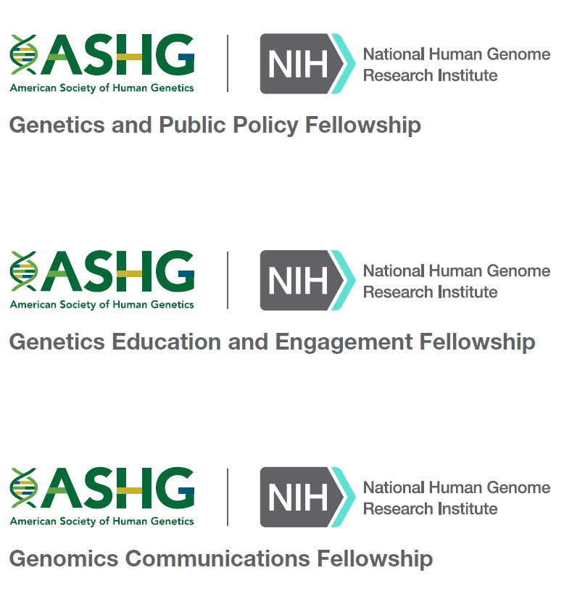


New ASHG-NHGRI Genomics and Public Service Fellowship Program
Applications open on October 1, 2023
Document 5
Notes:
As was announced in June of this year, NHGRI has awarded the American Society of Human Genetics (or ASHG) a five-year, $7.1-million contract to support a new Genomics and Public Service Fellowship Program, which will provide early stage professionals with experiences relevant to a range of genomics careers. Through this program, participants will embark on experiences at ASHG, NHGRI, and/or additional locations to gain valuable skills for various careers in genetics and genomics. The program is designed for two groups of fellows, one for those at the graduate level and one for those at the postbaccalaureate level.
* The graduate-level fellowships will build upon an existing partnership with ASHG, involving the Genetics and Public Policy Fellowship and the Genetics Education and Engagement Fellowship, which have already trained dozens of fellows. Now, a new component, the Genomics Communications Fellowship, will be added to offer experiences in the swiftly changing science media landscape that is relevant to genomics.
* The new postbaccalaureate group will involve a new ASHG-NHGRI Postbaccalaureate Genomics Analyst Fellowship, which will provide recent college graduates with training in the oversight and administration of research-funding programs at the forefront of genomics and in the leadership of the fields of human genetics and genomics at ASHG.
* Applications for all of these fellowships will open on October 1, 2023.

Slide 14
Director’s Report Outline
General NHGRI Updates
General NIH Updates
General Genomics Updates
NHGRI Extramural Research Program
NIH Common Fund/Trans-NIH
NHGRI Communications, Policy, and Education
NHGRI Intramural Research Program
Notes:
Moving on to general NIH updates.

Slide 15
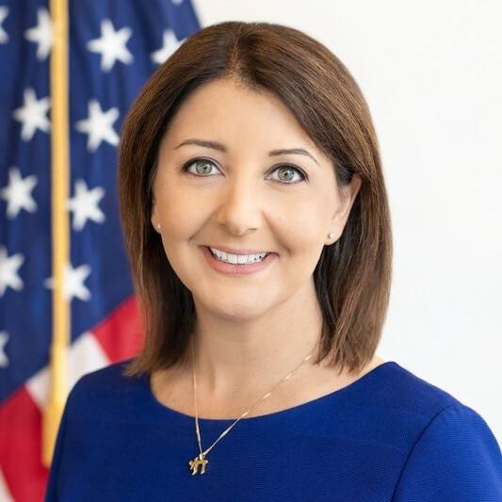

New Director, Centers for Disease
Control and Prevention
Mandy Cohen,
M.D., M.P.H.
Document 6
Notes:
In July, Mandy Cohen, a physician and former North Carolina Health Secretary, was appointed Director of the Centers for Disease Control and Prevention (or CDC). Mandy is one of the nation’s top physicians and health leaders, with experience leading large and complex organizations. She was a senior official in the Obama Administration and previously worked with current Surgeon General Vivek Murthy.

Slide 16
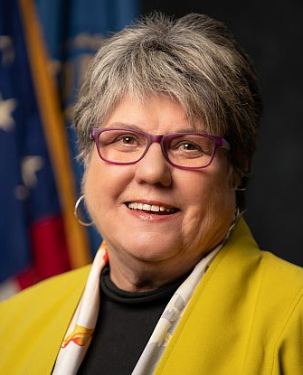
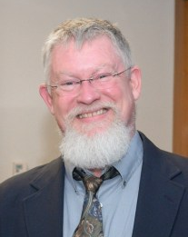

Retirement of Director, National Library of Medicine
Patricia Brennan,
R.N., Ph.D.
Stephen Sherry,
Ph.D.
Document 7
Notes:
Patti Brennan will retire from NIH and her role as Director of the National Library of Medicine (or NLM) on September 30, 2023. For the past seven years, Patti has served as the NLM Director, during which NLM extended access to health information and further acquired and preserved globally available biomedical literature using modernized approaches.
* While NIH conducts a search for the next NLM Director, Stephen Sherry, who currently serves as Director of NLM’s National Center for Biotechnology Information and NLM Associate Director for Scientific Data Resources, will serve as the Acting NLM Director.

Slide 17
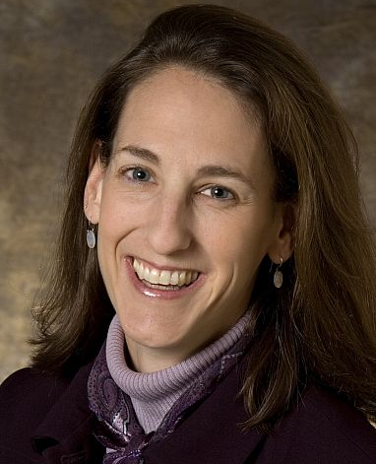

New Associate Director, NIH Behavioral and
Social Sciences Research
Jane Simoni, Ph.D.
Document 8
Notes:
Jane Simoni was recently appointed the NIH Associate Director for Behavioral and Social Sciences Research and Director of the NIH Office of Behavioral and Social Sciences Research (or OBSSR). Jane joins NIH after over two decades at the University of Washington, where she was Professor and Director of Clinical Training in the Department of Psychology.

Slide 18
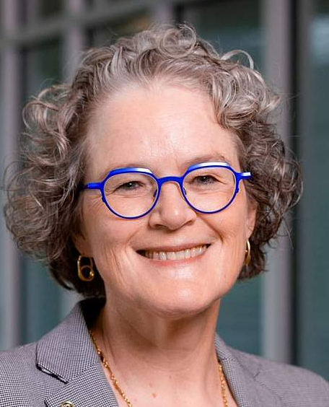

New Director, National Institute of Allergy and Infectious Diseases
Jeanne Marrazzo, M.D.
Document 9
Notes:
Jeanne Marrazzo was recently selected to be the next Director of the National Institute of Allergy and Infectious Diseases (or NIAID). Jeanne is an infectious disease specialist, joining NIH from the University of Alabama at Birmingham, where she served as the Director of the Division of Infectious Diseases since 2016. Prior to that role, she was a Professor of Medicine at the University of Washington. She is expected to begin her new role as NIAID Director later this Fall.

Slide 19
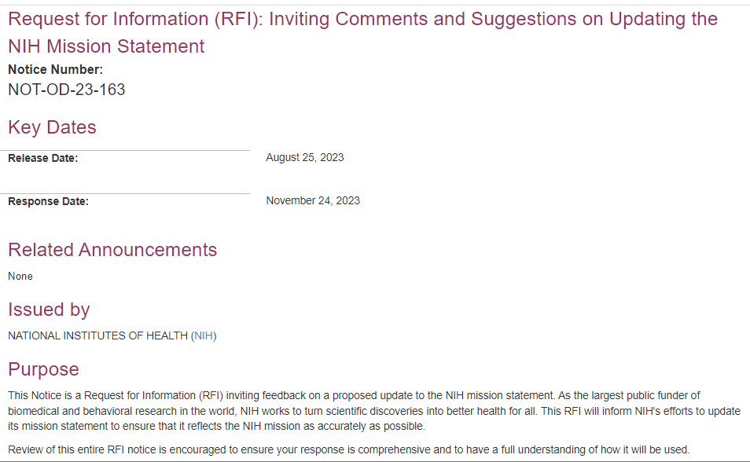
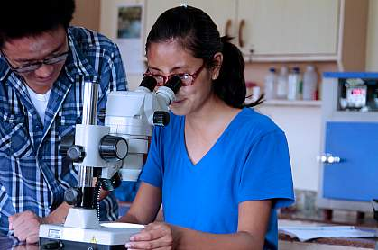
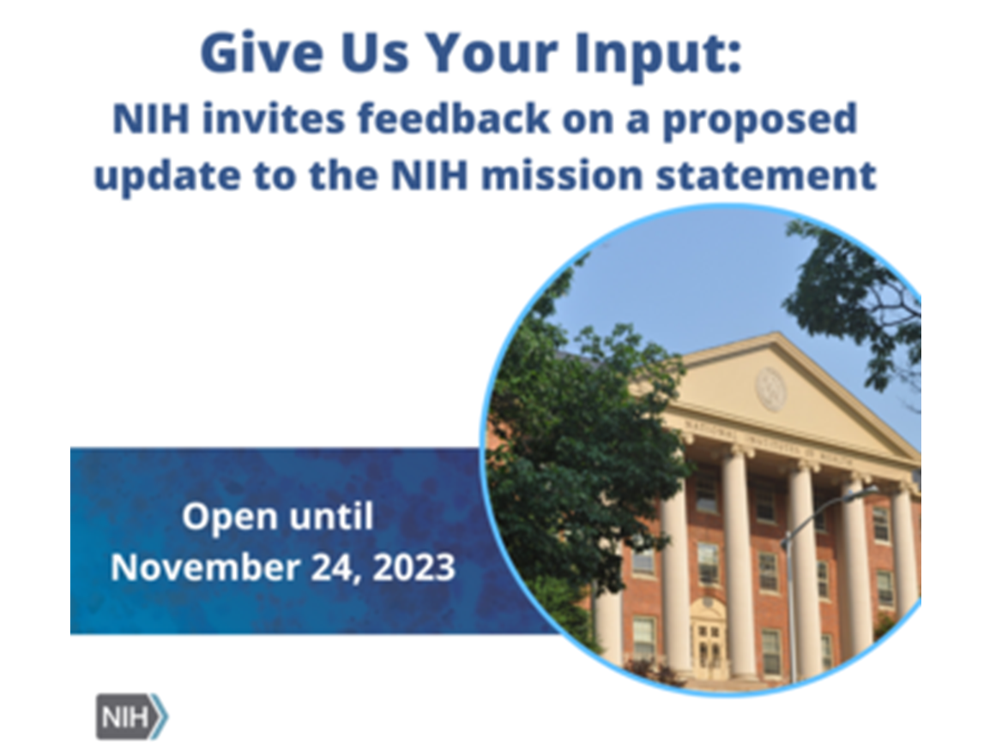
NIH Mission Statement: Request for Information
Document 10
Notes:
NIH recently issued a Request for Information (or RFI) inviting feedback on a proposed update to the NIH mission statement. As the largest public funder of biomedical and behavioral research in the world, it is important that NIH’s mission statement accurately reflects our goal of turning scientific discoveries into better health for all.
NIH is seeking input about this broadly from staff, NIH-funded institutions, scientific and professional societies, the clinical practice community, advocacy organizations, and the public. Responses will be accepted through November 24, 2023.

Slide 20
Fiscal Year 2024 Appropriations
Chamber | Agency | Fiscal Year 2024 Draft L-HHS Appropriation | Fiscal Year 2023 Enacted L-HHS Appropriation | 2023-2024 Difference $ | 2023-2024 Difference %
House | NIH | $44 B | $46.8 B | -$2.8 B | -6%
 | NHGRI | $663.2 M | $660.51 M | $2.69 M | +0.4%
Senate | NIH | $47.8 B | $46.8 B | $943 M | +2%
 | NHGRI | $663.2 M | $660.51 M | $2.69 M | +0.4%
Document 11
Notes:
Government funding will run out on September 30 unless a budget or a Continuing Resolution (or CR) is passed by the U.S. Congress.
As of now, a new budget is uncertain as the released House and Senate Labor Health and Human Services, Education, and related agencies (or L-HHS) bill shows quite different topline numbers, particularly for the Department of Health and Human Services and for NIH. * For NIH, the House proposed a $44 billion budget, a cut of $2.8 billion from Fiscal Year 2023 enacted levels, * while the Senate proposed $47.8 billion, $3.7 billion higher than the House and a $943 million increase from Fiscal Year 2023 funding levels.
* NHGRI specifically has the same allocation from the House and Senate, $663.2 million, a $2.69 million increase from Fiscal Year 2023’s $660.51 million budget. Considering inflation and likely increases in personnel costs, this is not really much of an increase.
The Senate and House are now back in session after their August recess. Prior to that recess, the Senate passed all 12 appropriations bills out of committee, while the House only passed 1. With just 11 working days for the House left, and quite different numbers released for major bills like L-HHS, a continuing resolution seems likely while the chambers decide on final numbers.

Slide 21
Director’s Report Outline
General NHGRI Updates
General NIH Updates
General Genomics Updates
NHGRI Extramural Research Program
NIH Common Fund/Trans-NIH
NHGRI Communications, Policy, and Education
NHGRI Intramural Research Program
Notes:
Moving on to general genomics updates.

Slide 22
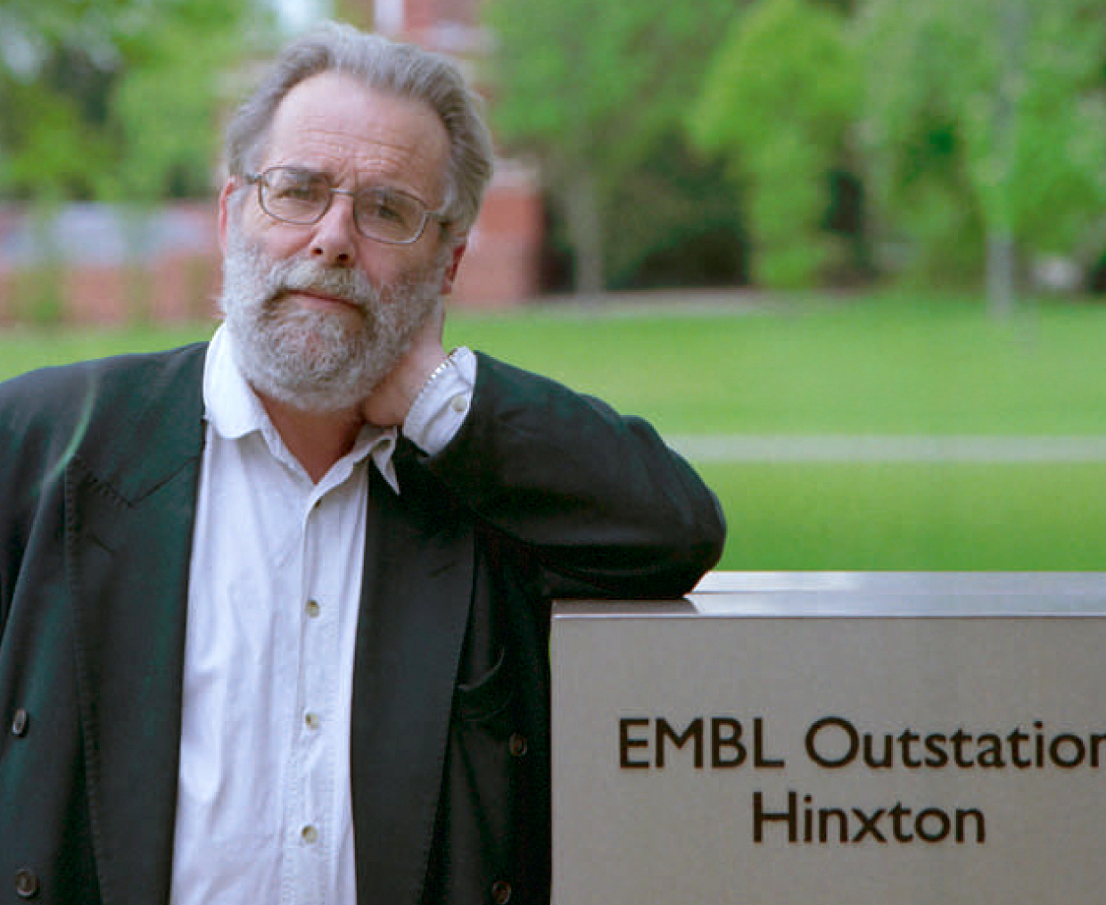

Mourning the Loss of Michael Ashburner
Michael Ashburner, Ph.D., Sc.D., F.R.S.
Document 12
Notes:
Michael Ashburner, former Joint Head and Co-Founder of the European Bioinformatics Institute of the European Molecular Biology Laboratory, passed away in July. Michael was an English biologist and Professor in the Department of Genetics at University of Cambridge. For most of his career, he analyzed the genetics of the fruit fly, Drosophila melanogaster. In 1989, he published the massive and highly regarded “Drosophila: A Laboratory Handbook,” and he was part of the research group that first completed that organism’s genome sequence in 2000.
Michael was also a Founder of FlyBase, a major database for researchers using Drosophila, and a Co-Founder of the Gene Ontology Consortium, a project to deﬁne the taxonomy of gene function. He was an inspiration to thousands of scientists across the globe and will be greatly missed.

Slide 23
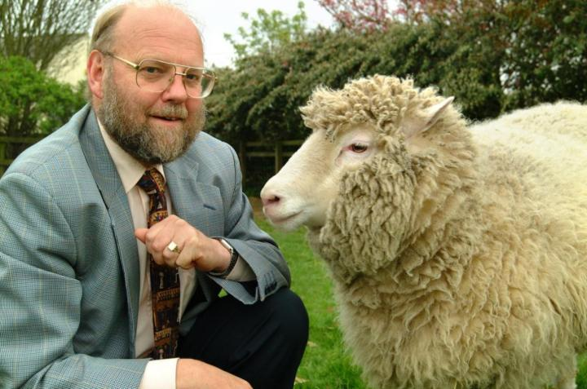
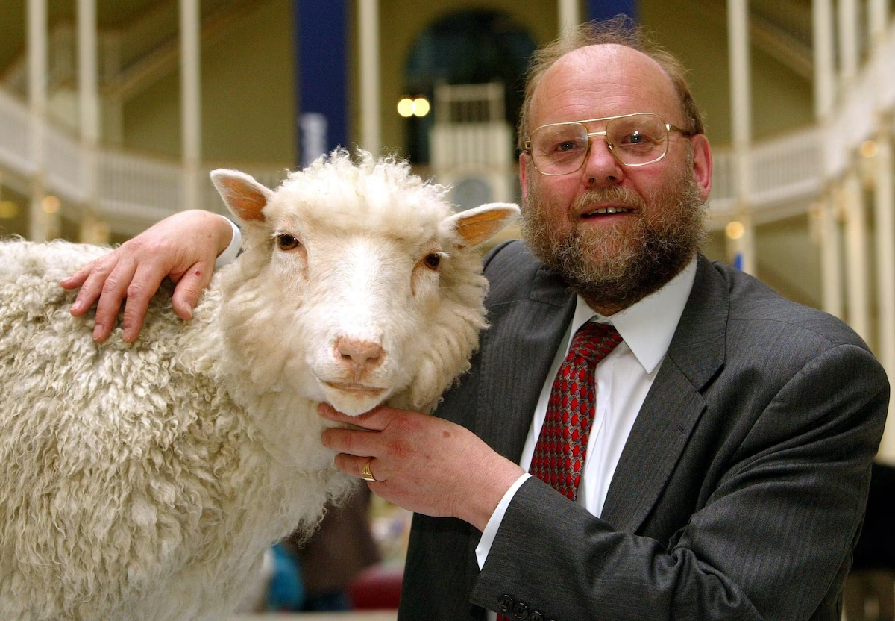
Mourning the Loss of Ian Wilmut
Ian Wilmut, Ph.D., O.B.E., F.R.S., F.Med.Sci., F.R.S.E.
Document 12
Notes:
Earlier this month, Sir Ian Wilmut, the cloning pioneer whose work was critical to the creation of Dolly the sheep in 1996 (the first cloned adult mammal), passed away. Dolly’s creation was not just a tremendous technological achievement, it also set off a global discussion about the ethics of cloning. Trained in embryology, Ian and a group of scientists also became the first to breed a calf from a frozen embryo in 1973. His other research focused on using cloning techniques to make stem cells that could be used in regenerative medicine. He was knighted in 2008 and retired from research in 2012, though the legacy of his work in cloning Dolly the sheep continues to this day.

Slide 24
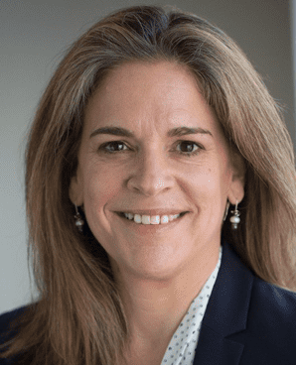

Departure of Chief Executive Officer,
American Society of Human Genetics
Mona Miller, M.P.P.
Document 13
Notes:
The American Society of Human Genetics (or ASHG) has announced that after six years as Chief Executive Officer (or CEO), Mona Miller will step down from that role on November 15, shortly after the 2023 ASHG Annual Meeting. Mona joined ASHG in July 2017 and has led it through a period of substantial strategic growth and operational transformation, all while navigating the unprecedented challenges of the COVID-19 pandemic. She has been a great friend and partner to NHGRI generally and me personally. A search committee, chaired by ASHG President-Elect Bruce Gelb, has been formed and will now work to identify the next ASHG CEO.

Slide 25

Double Helix: The Musical
Document 14
Notes:
On the entertainment front, earlier this summer, a musical about Rosalind Franklin’s role in the discovery of DNA’s double-helical structure debuted at the Bay Street Theater in Sag Harbor, New York. Written by Madeline Myers and starring actress Samantha Massell, Double Helix tells the true story of the race to discover the structure of DNA in the 1950s and follows Rosalind Franklin as she contends with adversity, misogyny, and antisemitism.

Slide 26


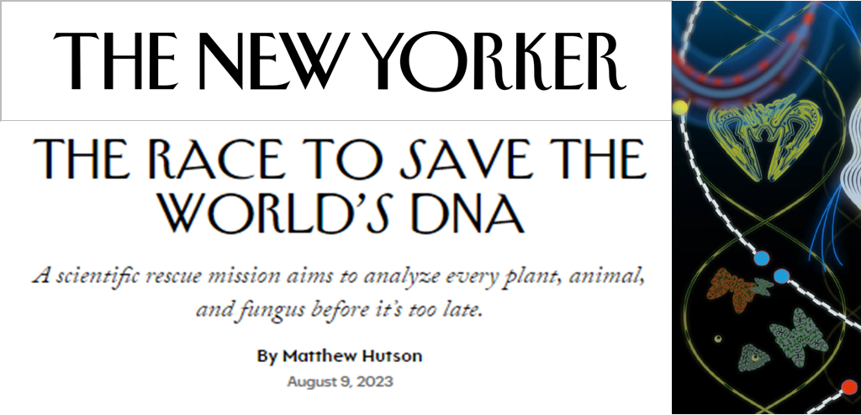
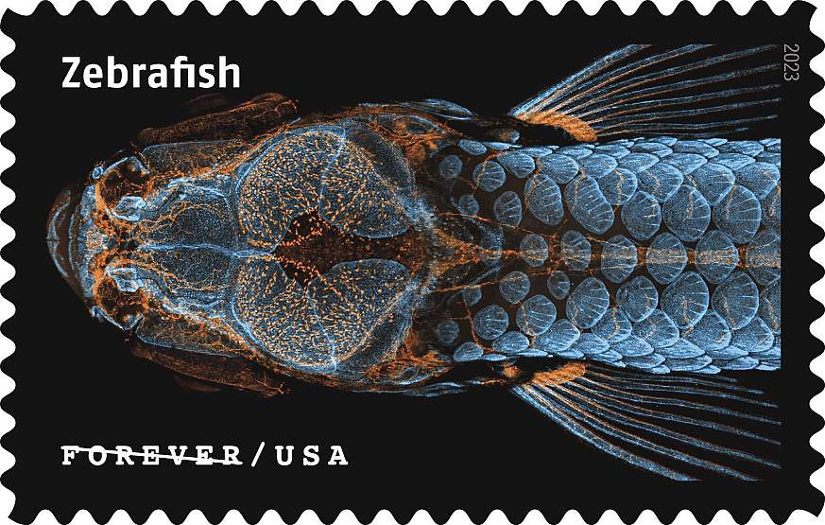
Genomes in the “News…”
Document 15
Notes:
With this being a special Council meeting (our 100th), we decided to resurrect the highly popular “Genomes in the News…” slide, something not seen since before the COVID-19 pandemic. Today, I have two items to mention to you.
* A recent article published in The New Yorker describes efforts of the Earth BioGenome Project to sequence a genome from every plant, animal, and fungus species on the planet.
* Also, an image of a juvenile zebrafish, a common model for genetics and genomics research, was recently included as one of the U.S. Postal Service’s “Life Magnified” postage stamps. The image was taken by Daniel Castranova, an aquatic research specialist, with assistance from former trainee Bakary Samasa, both from the Eunice Kennedy Shriver National Institute for Child Health and Development.

Slide 27
Director’s Report Outline
General NHGRI Updates
General NIH Updates
General Genomics Updates
NHGRI Extramural Research Program
NIH Common Fund/Trans-NIH
NHGRI Communications, Policy, and Education
NHGRI Intramural Research Program
Notes:
Moving on to the NHGRI Extramural Research Program.

Slide 28

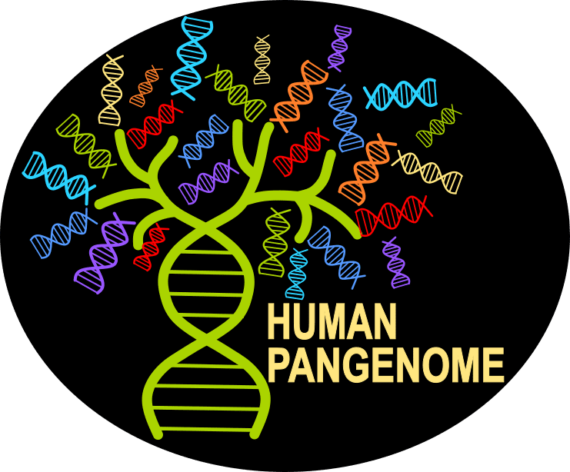


My Week in St. Louis
Notes:
I just returned from a whirlwind week in my hometown of St. Louis, where I attended three NHGRI extramural consortia meetings. The consortia were the Genomics Research Enhances Genetics of Rare Disease (or GREGoR) Consortium, the Human Pangenome Research Consortium (or HPRC), and the Impact of Genomic Variation on Function (or IGVF) Consortium.
The week included a “cross-consortium” day, where the agenda was specifically designed to facilitate data and information sharing and interaction among the consortia.
Given the recency of these meetings, extramural staff will provide proper reports from those gatherings at the February Council meeting. I personally found my week-long stay in St. Louis to be both exhilarating and exhausting. To give you a flavor of how much I packed into one week, I will give you a brief visual tour.

Slide 29

    Human Genome Reference Program
    Program renewal
    Applications received for two components
    Third component:
      Open competition for Informatics Tools for the Pangenome
      Applications due on November 1, 2023
Document 16
Notes:
The Human Genome Reference Program (or HGRP) represents NHGRI’s continued commitment to maintaining and advancing the reference human genome sequence. The program aims to generate at least 350 high-quality reference human genome sequences and incorporate them into a pangenome reference for the research community. Data from phased diploid genomes of 150 individuals, generated using multiple DNA-sequencing platforms, are available for download from multiple repositories.
* Last February, Council approved the renewal of this program. This was followed by the release of three new funding announcements. Applications have now been received for two components of the planned program: a limited competition for the High-Quality Reference Genomes Production Center and for the Coordinating Center.
* The third component is an open competition for Informatics Tools for the Pangenome. The emphasis of this funding opportunity is on the development of tools to advance compelling use cases of the human pangenome reference that are relevant to different sectors of the genomics community. The first application due date for this funding announcement is November 1.

Slide 30

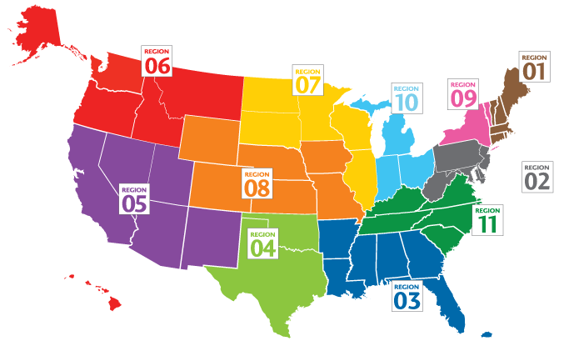
    Human Developmental Genotype-Tissue
    Expression (dGTEx)
Organ Procurement
Organizations (OPOs)
Donor Screening:
  120 donors
  ~30 donors per age group
  4 developmental age groups
Document 17
Notes:
The Developmental Genotype-Tissue Expression Consortium (or dGTEx) aims to establish a resource database and associated tissue bank to study gene-expression patterns in multiple different tissues during human and non-human primate development.
* For the human dGTEx effort, the National Disease Research Interchange, in partnership with multiple Organ Procurement Organizations (or OPOs) across the U.S., began to approach families to learn whether they may be interested in pediatric tissue donation for the dGTEx project. OPOs are organized into eleven regions across the U.S., with each region containing one to ten OPOs. dGTEx is partnering with at least one OPO in four of these regions, as circled on the map.
* Donor screening aims to recruit at least 120 donors, with approximately 30 donors from the following developmental age groups: post-natal, early childhood, pre-pubertal, and post-pubertal. The goal is to collect approximately 30 tissue types from each donor.

Slide 31
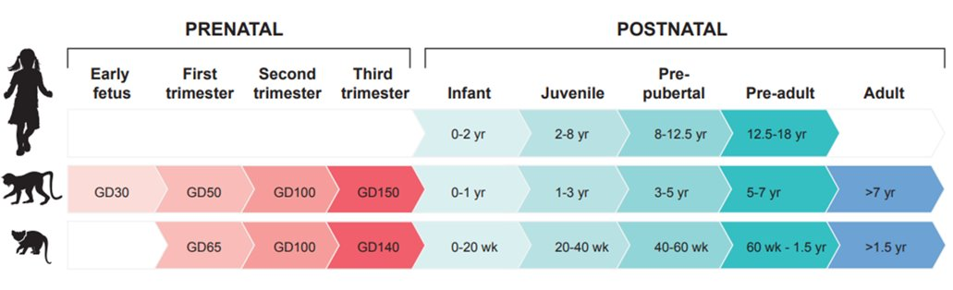

    Non-Human Primate Developmental Genotype-Tissue Expression (dGTEx)
GD = Gestational Day
  Rhesus macaque sampling to date:
    18 macaques across 7 developmental stages
    766 samples from 54 distinct tissues
Document 17
Notes:
In parallel, the non-human primate dGTEx effort aims to catalog and analyze transcriptional profiles from a wide variety of tissues at multiple developmental stages from two species of non-human primates: the rhesus macaque (an old-world monkey) and the common marmoset (a new-world monkey). In comparison to human dGTEx, macaque tissue samples are being collected from nine developmental stages, ranging from early fetus to adult. Marmoset tissue samples are being collected from eight stages, ranging from first trimester to adult.
* To date, the non-human primate effort has sampled 18 macaques across seven of the nine developmental stages, with about 766 samples total from 54 distinct tissues. Marmoset sampling is expected to begin soon.

Slide 32
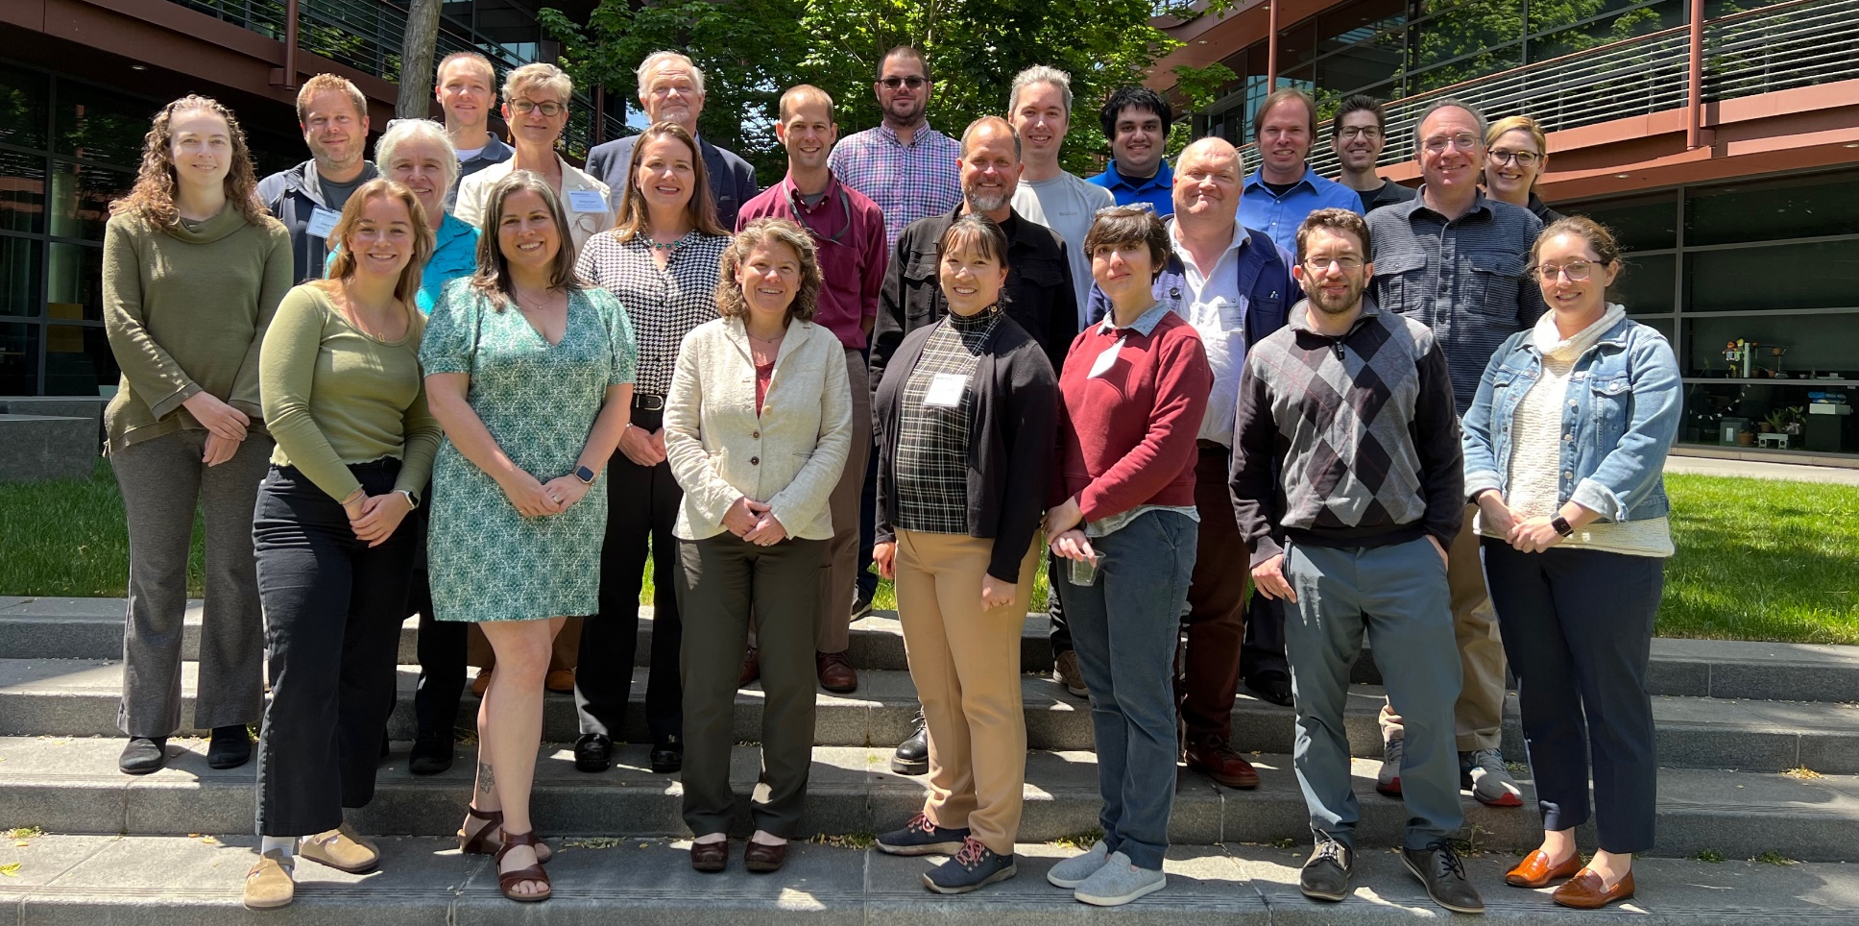
GREGoR Consortium
First In-Person GREGoR Meeting
  Focused discussion of high-priority research themes
Document 18
Notes:
NHGRI’s Genomics Research Elucidates Genetics of Rare Disease (or GREGoR) Consortium aims to increase the proportion of Mendelian disorders with an identified genetic cause. Past efforts in discovering the genetic causes of rare diseases have primarily focused on whole-exome sequencing. While this has generally been successful, the causes of more than half of rare disease cases have not been elucidated using this approach. GREGoR is developing new ways to tackle those more difficult cases and create a new paradigm for approaching rare disease gene discovery.​
​
In May, the GREGoR Consortium hosted its first in-person meeting at the Stanford University School of Medicine. During the meeting, the group discussed several high-priority research themes. These included making GREGoR data more useful to the research community; the impact of reference genome sequences on diagnosis; how to effectively apply long-read DNA sequencing, RNA-seq, and other –omic technologies for rare disease diagnoses; and how to most effectively share information about candidate genes and genomic variants, both internally and externally.

Slide 33
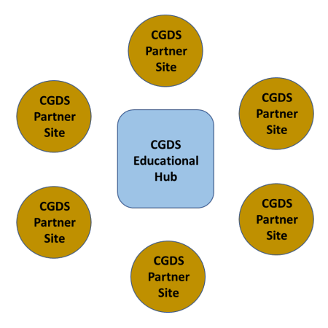
    Educational Hub for Enhancing Diversity in Computational Genomics and Data Science
"The Hub" will leverage AnVIL and All of Us platforms to increase access to educational and research opportunities in CGDS
  Awarded to North Carolina Agricultural and Technical State University
Funding opportunity:
  Broadening Opportunities for Computational Genomics and Data Science Education
Document 19
Notes:
Earlier this month, NHGRI launched the Educational Hub for Enhancing Diversity in Computational Genomics and Data Science (or “The Hub” for short). The program is led by NHGRI, with co-funding from the Office of Data Science Strategy, the National Institute of Minority Health and Health Disparities, and the All of Us Research Program. Its goal is to leverage AnVIL and All of Us platforms to increase access to educational and research opportunities in computational genomics and data science for undergraduate and masters’ degree students enrolled at institutions that serve students from backgrounds historically underrepresented in genomics research. This includes Historically Black Colleges and Universities, Hispanic-Serving Institutions, Tribal Colleges and Universities, and women’s colleges. The Hub grant was awarded to North Carolina Agricultural and Technical State University, one of the nation’s largest historically Black universities.
* In a parallel effort, NHGRI intends to solicit applications to broaden opportunities for computational genomics and data science education. Specifically, a new Notice of Funding Opportunity will support faculty members at institutions with a historic mission to serve underrepresented populations in biomedical research to develop computational genomics and data science educational content that makes use of cloud-computing resources. These institutions will be referred to as "The Partner Sites." Together, The Hub and The Partner Sites will create a community of institutions working collectively to define, develop, and test educational content that integrates computational genomics and data science into their existing biomedical science curricula.

Slide 34




    Genomic Analysis, Visualization, and
    Informatics Lab-space (AnVIL)
    AnVIL renewed for Phase II
    Addition of the AnVIL Clinical Resource (ACR)
Document 20
Notes:
The NHGRI Genomic Data Science Analysis, Visualization, and Informatics Lab-space (or AnVIL) is a federated cloud-based infrastructure and software platform that provides an analysis and computing environment for genomics research.
* The AnVIL program, led by Michael Schatz of Johns Hopkins University and Anthony Philippakis at the Broad Institute, was recently renewed, marking the launch of its second phase. During the next five years, the groups will continue to enhance and expand the AnVIL platform. Key objectives include adding analysis tools and workflows, improving interoperability with other cloud-based resources, and providing more educational offerings.
* This renewal also includes the introduction of the AnVIL Clinical Resource (or ACR), which is led by Robert Carrol at Vanderbilt University Medical Center. The ACR will bring together a broad range of experts to integrate a suite of genomics-based clinical tools into the existing AnVIL ecosystem. The ACR will help AnVIL reduce barriers to genomic medicine research in cloud environments.
With these new features, AnVIL is working towards its goals of creating a multi-functional platform for genomic data science.

Slide 35
















Multi-Omics for Health and Disease
Disease Study Sites
‘Omics Production Center
  Krzysztof Kiryluk
  Joseph McCormick
  Lida Chatzi
  Tanika Kelly
  Louise Laurent
  Stephanie Christenson
DSS
  Gary Patti
Data Analysis & Coordinating Center
  Zhiping Weng
Document 21
Notes:
On September 12, NHGRI, in collaboration with the National Cancer and Institute the National Institute of Environmental Health Sciences, funded the Multi-Omics for Health and Disease Consortium, with the goal of advancing the application of multi-omic technologies to study health and disease in ancestrally diverse populations.​
​
The consortium will have three components. * First, the six Disease Study Sites will enroll participants and capture phenotypic and environmental exposure data to define associations with healthy and disease states in a number of clinical conditions. The Disease Study Sites are located at Columbia University, University of Texas Health Science Center in Houston, University of Southern California, University of Illinois at Chicago, and University of California (with sites at both the San Diego and San Francisco campuses).
* Second, the ‘Omics Production Center, located at Washington University, will utilize high-throughput molecular assays to produce genomic, epigenomic, transcriptomic, proteomic, and metabolomic data. * Third, the Data Analysis and Coordination Center, located at the University of Massachusetts Chan Medical School, will focus on coordinating protocol development, data analysis, consortium logistics, and the production and release of a multi-dimensional dataset that will be made freely available to the scientific community.​

Slide 36
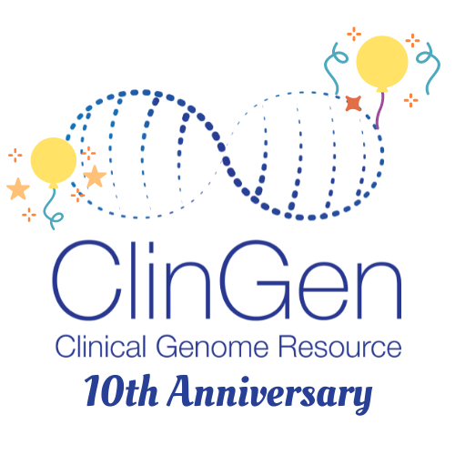
    Clinical Genome Resource (ClinGen)
    10th Anniversary
American Society of Human Genetics
  November 2, 2023
  Lunch reception
American College of Medical Genetics & Genomics
  March 12-16, 2024
Curating the Clinical Genome
  May 9-10, 2024
Stay tuned for event updates in the coming year!
Document 22
Notes:
The Clinical Genome Resource (or ClinGen) evaluates and disseminates information about the clinical relevance of genes and genomic variants for use in precision medicine and research.
ClinGen was launched in 2013, and so we are now celebrating its 10th anniversary. With roughly 40 consortium members and a partnership with ClinVar, ClinGen set out to improve data sharing of genomic variant interpretations; create standard frameworks to curate clinically relevant genes and variants; and disseminate the curated results and training materials through clinicalgenome.org. Now 10 years later, ClinGen is associated with over 2,000 disease experts, laboratory directors, genetic counselors, and other research members from over 50 countries, all contributing to ClinGen data sharing and curation efforts.
For its 10th anniversary, ClinGen is holding a number of celebratory events. The kick-off event, a lunch reception, will take place at this Fall’s American Society of Human Genetics meeting (here in Washington, D.C.) on November 2. Additional events are being planned for the American College of Medical Genetics and Genomics annual meeting in March 2024 and the Curating the Clinical Genome meeting in May 2024.
Please visit ClinGen's website to stay informed about these events and look for other updates on ClinGen's progress. Happy 10th Birthday, ClinGen!

Slide 37
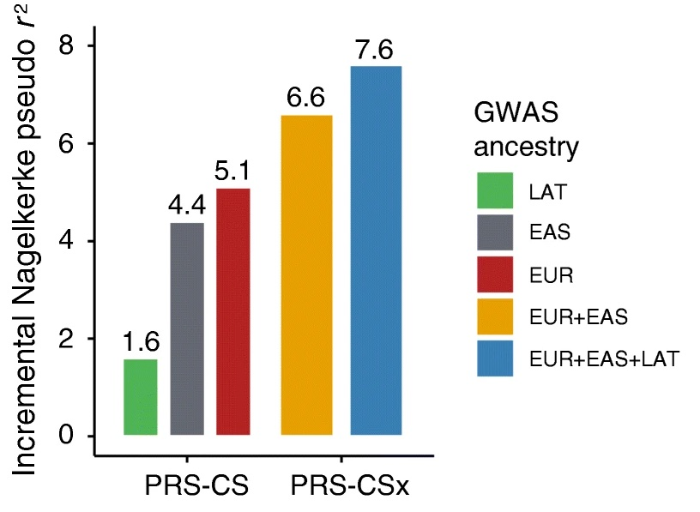
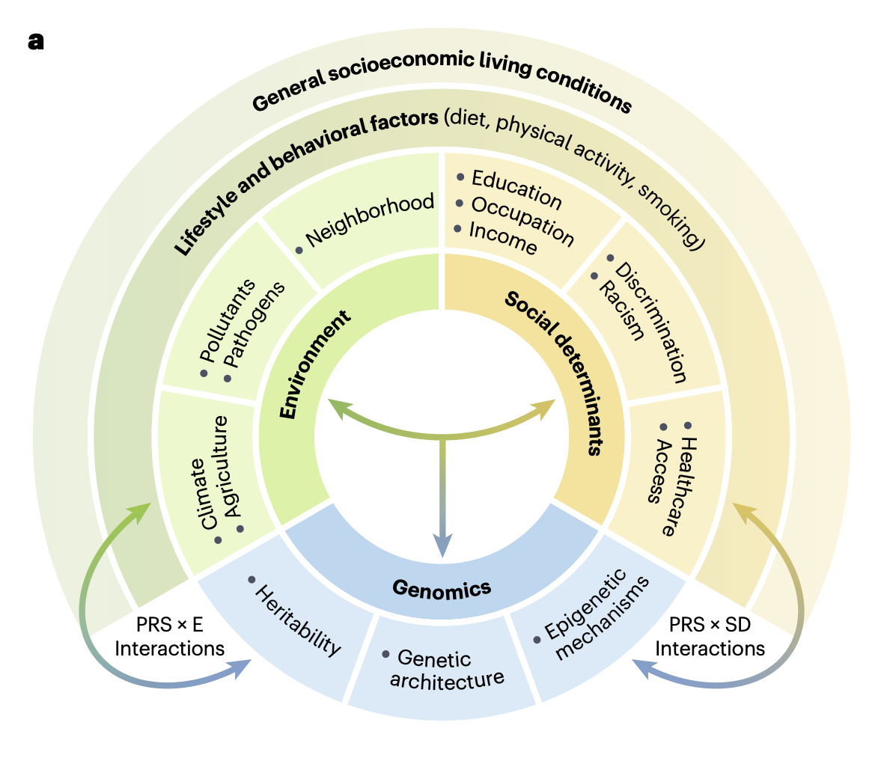
Polygenic Risk Methods in Diverse Populations (PRIMED) Consortium
Developing improved PRS models across multiple disease domains and populations
Recent review: “Principles and methods for transferring polygenic risk scores across global populations”
Document 23
Notes:
The Polygenic Risk Methods in Diverse Populations (or PRIMED) Consortium is developing and refining methods for polygenic risk scores (or PRS) to improve the prediction of disease risk in ancestrally diverse populations.
* Multiple PRIMED Sites are developing and evaluating PRS models for various traits, including cardiovascular disease, diabetes, and cancer. These efforts demonstrate the benefit of using data from diverse populations to build models with better predictions. The bar graph shown here, which is from the Diabetes Polygenic Risk Scores in Multiple ancestries (or D-PRISM) Site, demonstrates that including Latino populations improved prediction of type 2 diabetes incidence.
* A cross-consortium paper was recently published in Nature Reviews Genetics, entitled “Principles and methods for transferring polygenic risk scores across global populations." This review summarizes genetic and non-genetic factors that affect the transferability of polygenic risk scores across populations. This diagram illustrates the complex relationship among risk factors for health outcomes, including environmental, social, and genomic factors.

Slide 38
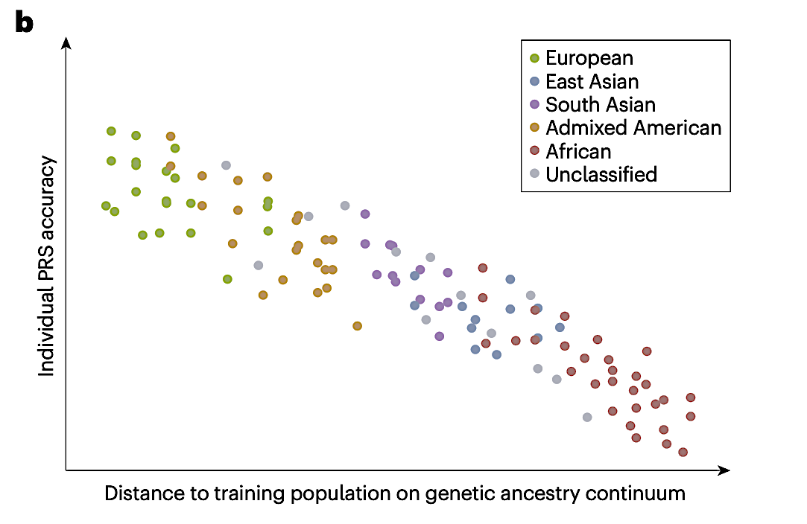

Polygenic Risk Methods in Diverse Populations (PRIMED) Consortium
Advancing PRS methods to recognize the continuous nature of genomic variation
Pioneering Consortium secondary use of data in AnVIL
Document 23
Notes:
PRIMED is also advancing PRS methods to recognize the continuous nature of genomic variation. The scatterplot shown here illustrates how PRS prediction accuracy varies among individuals across a continuum of genetic ancestry. This conceptual shift aligns PRIMED findings with the recent National Academies of Science, Engineering, and Medicine recommendations on the use of population descriptors in genetics research.
* Finally, PRIMED is pioneering consortium secondary use of data in AnVIL, with a number of technical and policy innovations that enable the consortium’s ability to manage data access and collaborative analysis in AnVIL workspaces.

Slide 39
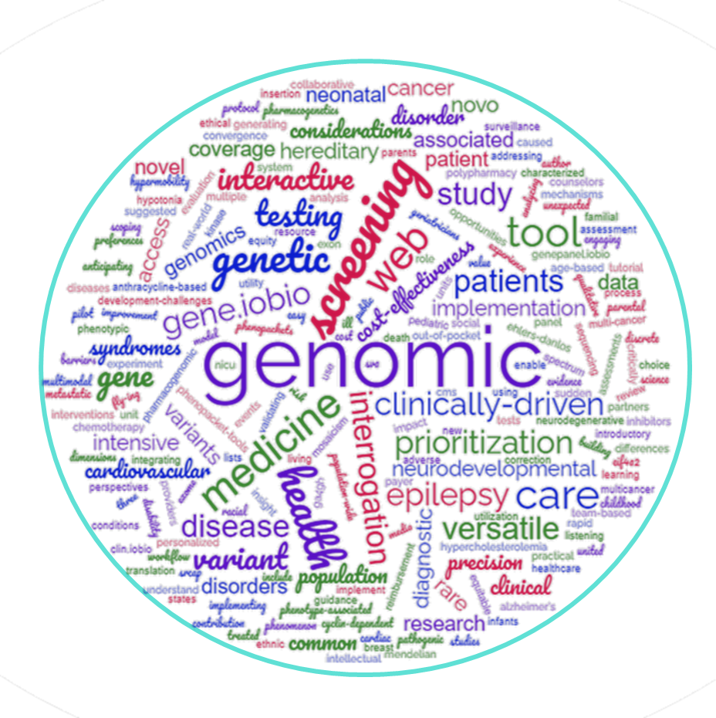
Advancing Genomic Medicine Research (AGMR)
Publication Titles
Scientific Area | #
Pharmacogenomics | 3
Computational Methods for Clinical Genomics | 5
Demonstrating Effectiveness of Genomic Medicine | 9
Health Disparities, Health Equity, and Access to Genomic Medicine | 1
Return of Results and Outcome Research | 8
Electronic Medical/Health Records-related Genomic Studies | 5
Total | 31
NIH Funding Source | #
Only AGMR | 5
Multiple NIH Grants | 26
Total | 31
Document 24
Notes:
The Advancing Genomic Medicine Research (or AGMR) program recently completed its third year. AGMR encourages applications that “stimulate innovation and advance understanding of when, where, and how best to implement the use of genomic information and technologies in clinical care” that are broadly applicable to genomic medicine and are significant beyond a single disease.
The funded research has already resulted in 31 publications. Some characteristics of those papers are shown in the table on the left. For example, those 31 papers distribute themselves across multiple scientific areas. Furthermore, most of the publications listed several NIH grants as their funding sources; however, five were solely funded by NHGRI. The word cloud on the right was created using the titles of those 31 publications.

Slide 40
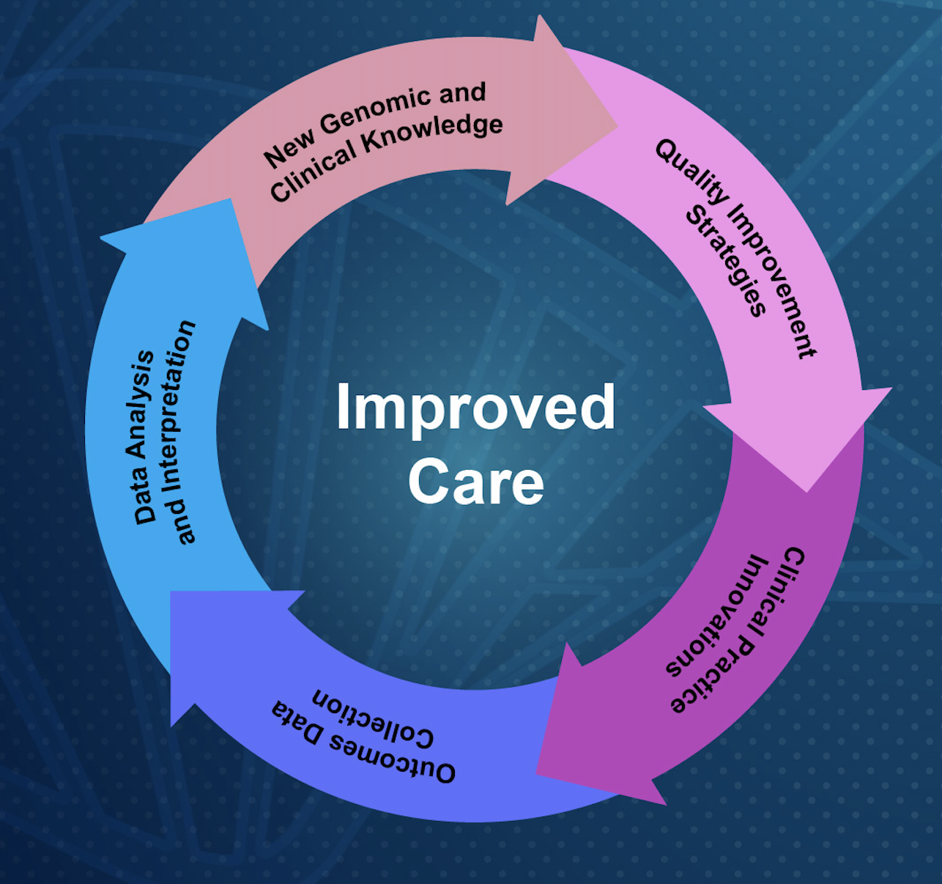

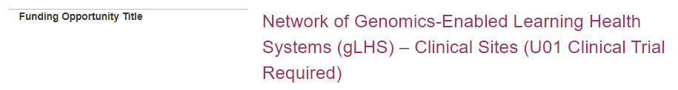
Genomics-Enabled Learning Health Systems (gLHS)
    Establish a Network to identify and create LHS tools and resources to improve adoption of genomics into clinical care
    New Funding Opportunity Announcements:
      Applications due on November 07, 2023
Document 25
Notes:
The Network of Genomics-Enabled Learning Health Systems (or gLHS) aims to establish a network of institutions, including resource-limited institutions, that are using learning health system approaches. These institutions will identify and create learning health system tools and resources to improve approaches for the adoption of genomics into clinical practice.
* Two new Request for Applications (or RFAs) were recently published: one for clinical sites and one for a coordinating center. Up to six clinical sites will be funded. * Applications are due on November 7, 2023.

Slide 41
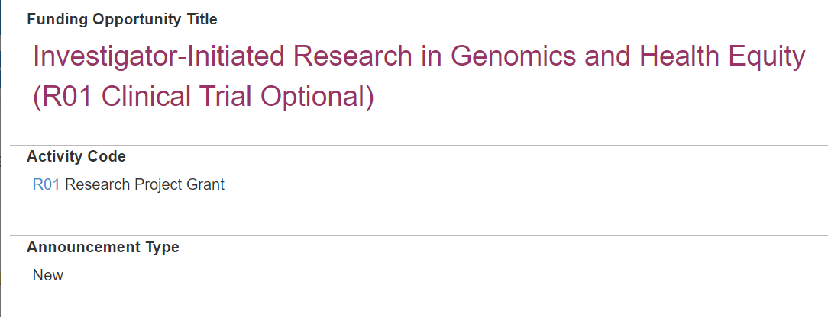
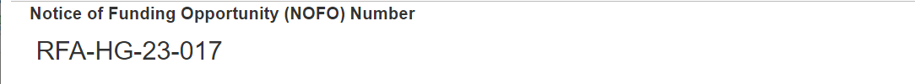
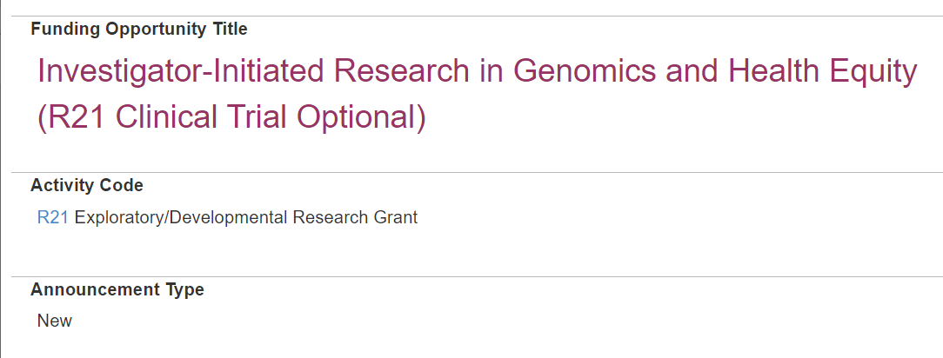
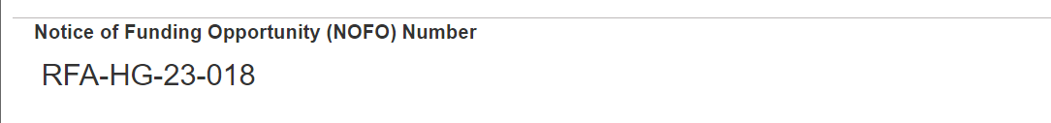
    Genomics and Health Funding Opportunities
    Support investigator- initiated research in genomics and health equity (R01 and R21)
    Research spanning across genomics research areas
    Collaboration with NIA, NCI, All of Us, and ORWH
    Applications due on
    November 8, 2023
Document 26
Notes:
In June, NHGRI published two related Requests for Applications (or RFAs) to support investigator-initiated research in genomics and health equity. Both R01 and R21 applications will be supported.
* Research spanning across multiple genomics research areas will be supported, with examples given in the RFAs.
* These RFAs were published in collaboration with four other NIH components: the National Institute on Aging, the National Cancer Institute, the All of Us Research Program, and the Office of Research on Women’s Health.
* Applications are due on November 8, 2023.

Slide 42

Nov 8-9, 2023
Bethesda MD
Genomic Medicine XV: Genomics and Population Screening
November 8-9, 2023
Identify needs, opportunities, and challenges for using genomics in population screening
Review current state of population genomic screening in U.S. and the available evidence of the impact of such screening
Examine obstacles and opportunities for expanded population screening
Identify research directions to inform expanded screening
Document 27
Notes:
On November 8 and 9, 2023, the Genomic Medicine Working Group of this Council will host its 15th roughly-annual genomic medicine meeting on Genomics and Population Screening here in Bethesda.
The goal of the meeting is to identify needs, opportunities, and challenges for using genomics in population screening. It will gather roughly 30 experts in genomics, preventive medicine, population screening, community engagement, and related fields.
* The meeting will review the current state of population genomic screening in the U.S. and the available evidence of the impact of such screening (on things like outcomes and cost). It will also examine obstacles and opportunities for expanded population screening as well as identify research directions to inform expanded screening (where appropriate).
The meeting will be co-chaired by Council member Gail Jarvik and will be livestreamed on NHGRI’s YouTube channel, GenomeTV. Details will be posted on the meeting webpage on genome.gov as they become available.

Slide 43


NHGRI Funding Opportunity for
Early Stage Investigators
Supporting Talented Early Career Researchers in Genomics
RFA-HG-22-001
Applications due on
February 27, 2024
Document 28
Notes:
NHGRI is committed to supporting researchers through their early career stages, enabling them to make the next scientific breakthroughs in genomics. NHGRI welcomes applications from new and early stage investigators through standard routes, known as Parent Announcements.
We also have a specific funding opportunity targeted to researchers with Early Stage Investigator status. This opportunity, called “Supporting Talented Early Career Researchers in Genomics,” utilizes the R01 grant mechanism. The next application deadline is on February 27, 2024.

Slide 44
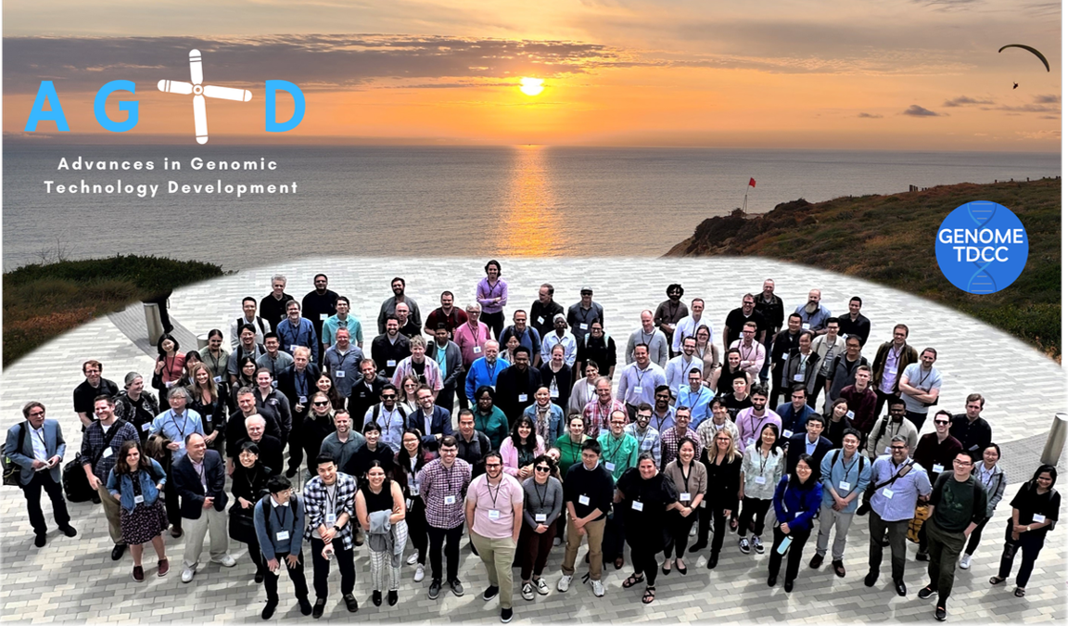
Genome Technology Program
Advances in Genomic Technology Development
2023 Hybrid Meeting
      Commercialization opportunities
      Engagement with NHGRI consortia
      Overviews of NHGRI programs
Document 29
Notes:
NHGRI’s Genome Technology Program continues to promote innovative technology development, paving the way towards the expanded use of genomics in both basic and clinical research.
The annual Advances in Genomic Technology Development grantee meeting was hosted by the University of California, San Diego at the Sanford Consortium in La Jolla, California this past June. Over 140 people attended in-person, while 21 participated virtually. The meeting provided an opportunity to share new research developments, discuss challenges, and work to push the genomics field forward. Meeting topics covered the full breadth of our Genome Technology Program, including nucleic acid sequencing and synthesis, protein-DNA interactions, and genome-wide methods for advancing functional genomics.
* The meeting also included sessions focused on commercialization opportunities, engagement with NHGRI consortia, and overviews of NHGRI programs.

Slide 45

Small Business Program
Funding Opportunities
    PAR-23-219: SBIR/STTR Commercialization Readiness Pilot Program Technical Assistance and Late-Stage Development
    NOT-HG-22-007: Methods Development for Genomic Studies of Genetic Variation, Function, and Disease
    NOT-HG-21-038: Genomics Education Interactive Digital Media Resources (SBIR/STTR)
Document 30
Notes:
Through the Small Business Program, NHGRI supports U.S. companies working across the genomics space, especially in areas with significant commercialization potential, such as genomic technology development, computational genomics and data science, and genomic medicine.
Along with applications that come in under the broad omnibus, also known as “parent” solicitations, NHGRI is participating in three additional calls for small business applications.
* The first focuses on the Commercialization Readiness Pilot program. * The second encourages applications with computational or experimental approaches focused on elucidating the relationship between genetic variation, function, and disease. * The third encourages applications for digital media resources to enhance genomics education. All three of these calls for applications have standard receipt dates.

Slide 46

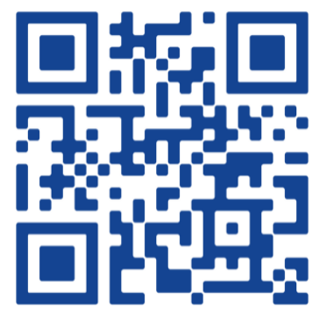
    Ethical, Legal, and Social Implications (ELSI) Research Program
    ELSIcon2024: The 6th ELSI Congress
Reimagining the Benefits of Genomic Science
    SAVE THE DATE
    June 10-12, 2024
    Columbia University | NYC
    Abstract submission open from September 5 to December 1, 2023
Add the event to your calendar!
Document 31
Notes:
The Ethical, Legal, and Social Implications (or ELSI) Research program supports research that anticipates, explores, and addresses implications of genomics for individuals, families, and communities.
The 6th ELSI Congress (or ELSICon) will be held June 10-12, 2024 at Columbia University, featuring both in-person and virtual components. The theme for the 2024 Congress is Reimagining the Benefits of Genomic Science. ELSIcon invites researchers, practitioners, trainees, and other scholars to share their latest ELSI research. Abstract submission opened on September 5 and closes December 1, 2023.

Slide 47

Diversity Action Plan
    PAR-22-268, Initiative to Maximize Research Education in Genomics: Diversity Action Plan
    Support undergraduates and post- baccalaureates from diverse backgrounds
    Next application due date
    is November 15, 2023
Document 32
Notes:
The NHGRI Extramural Training Program aims to prepare a talented and diverse genomic workforce by providing both institutional and individual funding through a variety of mechanisms, including individual fellowship and career development awards, institutional awards, and diversity supplements. Programs are offered at the undergraduate, postbaccalaureate, graduate, postdoctoral, and faculty levels.
The NHGRI Extramural Training Program has reissued the Diversity Action Program. This program seeks to support a pool of undergraduates and post-baccalaureates from diverse backgrounds, including those from groups underrepresented in the biomedical and behavioral sciences, to pursue further studies or careers in genomics research. The next application due date is November 15, 2023.

Slide 48
Diversity Research Supplements
    PA-23-189: Research Supplements to Promote Diversity in Health-Related Research
    Enhance the diversity of the research workforce by recruiting, mentoring and supporting individuals from diverse backgrounds
    Applications accepted throughout the
    fiscal year until May 15
Document 32
Notes:
The NHGRI Extramural Training Program would like to highlight a supplementary funding opportunity entitled Research Supplements to Promote Diversity in Health-Related Research. These supplements would provide funds to enhance the diversity of the research workforce by recruiting, mentoring, and supporting individuals ranging from high school students up to postdoctoral researchers and eligible investigators from diverse backgrounds.
With a rolling deadline, applications will be accepted throughout the fiscal year until May 15. Applications are currently being accepted for consideration in Fiscal Year 2024.

Slide 49
Director’s Report Outline
General NHGRI Updates
General NIH Updates
General Genomics Updates
NHGRI Extramural Research Program
NIH Common Fund/Trans-NIH
NHGRI Communications, Policy, and Education
NHGRI Intramural Research Program
Notes:
Moving on to the NIH Common Fund and other trans-NIH efforts.

Slide 50
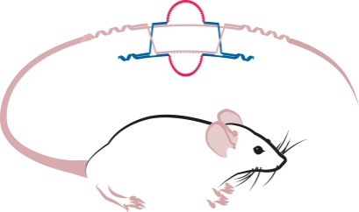

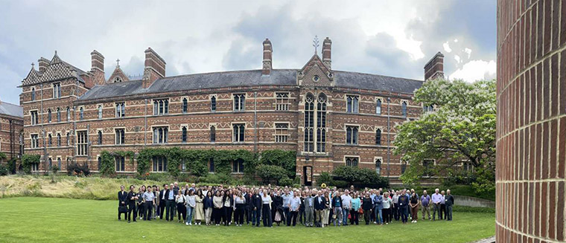
Knockout Mouse Phenotyping Project (KOMP2)
International Mouse Phenotyping Consortium Annual Conference, July 2023
Online Workshop: “Home Cage Monitoring in Behavioral Phenotyping”
NIH Office for Data Science Strategy supplement to KOMP2
Document 33
Notes:
The Knockout Mouse Phenotyping Project (or KOMP2) is a trans-NIH research program focused on generating a comprehensive resource of null mutant mice and their phenotype information. KOMP2 is a founding member of the worldwide International Mouse Phenotyping Consortium (or IMPC) that comprises 21 centers in 15 countries. To date, KOMP2 investigators have developed and phenotyped approximately 5,500 strains of knockout mice, contributing to the more than 10,000 strains created by the IMPC.
* The IMPC Annual Conference, held in July, brought together >150 attendees from the mouse and human genetics communities. Talks focused on the utility of the mouse model for rare and common diseases, big data challenges, and new directions of environmental impact, gene therapy, and gene editing.
* KOMP2 is continuing its education and outreach programs, most notably through a series of online workshops. The next event, which is being held at the end of this month, will discuss “Home Cage Monitoring in Behavioral Phenotyping.”
* The NIH Office for Data Science Strategy awarded a supplement to KOMP2’s coordinating center at the European Bioinformatics Institute, reflecting ongoing trans-NIH support for KOMP2. The supplement supports the exploration of cloud solutions and capabilities for KOMP2 big data analysis.
[HOLD FOR CONFIRMATION FROM MAYA AND COLIN ON ODSS SUPPLEMENT]

Slide 51
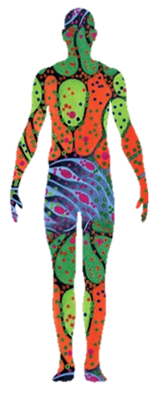
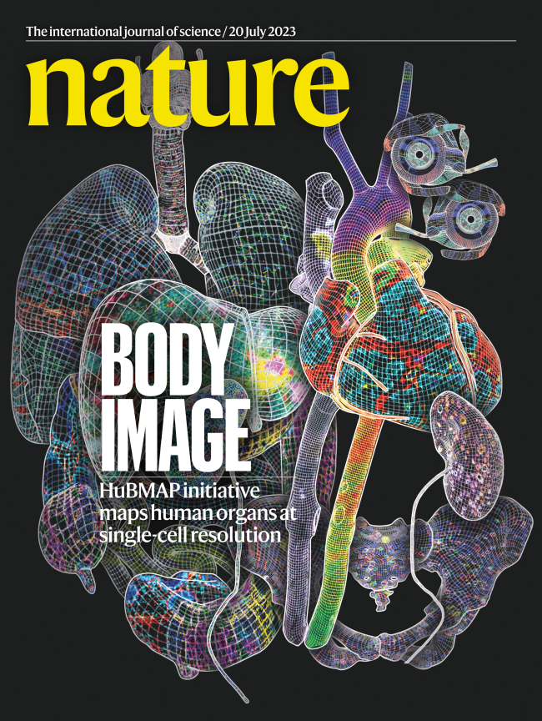
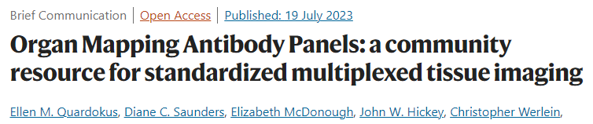
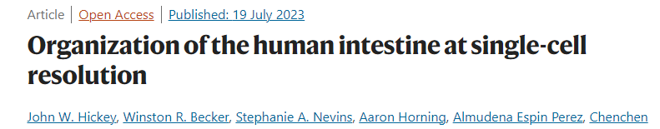
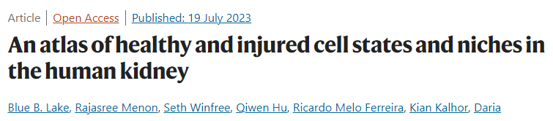
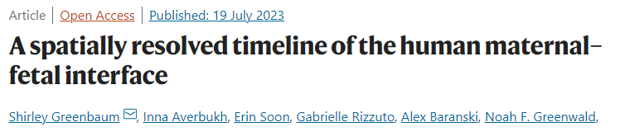

Human Biomolecular Atlas Program (HuBMAP)
    Nature cross-journal collection released July 20, 2023
Document 34
Notes:
The NIH Common Fund’s Human Biomolecular Atlas Program (or HuBMAP) aims to develop an open, global framework for creating comprehensive mappings of the human body at a cellular resolution, which will help determine how relationships among cells affect the health of a person.
HubMAP was recently featured in a special cross-journal collection that included 11 papers in Nature, along with companion papers in other journals. The collection highlights the progress made by more than 400 researchers across 60 sites since the program’s inception in 2018.
* The papers dive into the tools that HubMAP has developed, including organ-mapping antibody panels that provide community-validated resources for multiplexed spatial imaging. They also showcase progress in generating multimodal spatial maps across organs, including * regional specialization of the intestine, * cell types and neighborhoods in healthy and diseased kidney tissue, and * the mapping of protein and transcriptional data across the maternal-fetal interface.
* The collection includes a perspective highlighting advances and prospects for HuBMAP as the project continues to generate datasets and comprehensive 3D maps of the healthy human body.

Slide 52


Somatic Mosaicism Across Human Tissues (SMaHT)
Network kickoff meeting in May 2023
Hackathon with GREGoR & HGSVC
Document 35
Notes:
The Somatic Mosaicism Across Human Tissues (or SMaHT) network is an NIH Common Fund initiative aiming to build a greater understanding of somatic mosaicism, which refers to the unique post-conception changes in DNA that can vary from cell to cell within an individual. Key outcomes of this network involve developing a catalog of somatic genomic variants, developing innovative DNA sequencing and analysis tools, and forming a data workbench that integrates with other datasets.
* This past May, the NIH Office of Strategic Coordination held the network’s kickoff meeting. The purpose of the meeting was to discuss the goals of the network as well as foster connections necessary for effective network collaborations.
* The SMaHT network also participated in the recent Pan-Structural Variation Hackathon event that focused on the building of pipelines to analyze large datasets for structural genomic variant mapping, Mendelian disease discovery, identification of somatic and mosaic genomic variants, and other research applications. This event involved other NHGRI groups, including GREGoR and the Human Genome Structural Variation Consortium (or HGSVC).

Slide 53


    NIH Cloud Platform Interoperability Effort (NCPI)
    NCPI accepted as a 2024 GA4GH Driver Project
Document 36
Notes:
The goal of the NIH Cloud Platform Interoperability Effort (or NCPI) is to implement guidelines and technical standards to create a trans-NIH, cloud-based, federated data ecosystem in order to facilitate end-user analyses across participating cloud platforms. NCPI was launched in 2019 and involves extensive collaborations with the NHGRI Analysis Visualization and Informatics Lab-space (or AnVIL) program as well as other cloud-based programs and resources supported by the National Cancer Institute, the National Heart, Lung, and Blood Institute, the NIH Common Fund, and the National Library of Medicine. NCPI is currently supported by the NIH Office of Data Science Strategy.
NCPI was recently accepted as a 2024 Global Alliance for Genomics and Health (or GA4GH) Driver Project. Recall that GA4GH is an international standards organization for genomics, and driver projects are real-world genomic data initiatives that help develop and pilot GA4GH standards and tools. To ensure that driver projects mirror the objectives and values of GA4GH, all applications undergo evaluation by an international review board and are assessed relative to a set of criteria. GA4GH will announce the full set of accepted driver projects at their annual meeting later this month.

Slide 54
Director’s Report Outline
General NHGRI Updates
General NIH Updates
General Genomics Updates
NHGRI Extramural Research Program
NIH Common Fund/Trans-NIH
NHGRI Communications, Policy, and Education
NHGRI Intramural Research Program
Notes:
Moving on to NHGRI activities in the areas of communications, policy, and education.

Slide 55

Refresh of NHGRI Homepage for genome.gov
Document 37
Notes:
In July, the NHGRI Office of Communications launched a refreshed homepage for Genome.gov (the institute’s website), which included more user-friendly navigation, greater accessibility options, and increased responsiveness and performance.
These changes are based on data collected about user behavior, site performance, and market trends, with over 1,200 recorded sessions and information about half a million pageviews gathered in 2022. Changes include a larger search bar; a more prominent navigation bar with descriptive icons; a more interactive, simplified layout with less scrolling; increased accessibility with side buttons for dark/light mode; font sizing and text-to-voice; and an expanded footer for more evergreen content about training, funding, and careers, as well as special initiatives.
Planned future improvements include search engine optimization to increase site traffic and enhanced user experience and engagement, so that visitors can more efficiently find resources of interest.

Slide 56

    A Complete Human Y Chromosome Sequence
Document 38
Notes:
The NHGRI-funded Telomere-to-Telomere (or T2T) Consortium recently completed the first gapless sequence of a human Y chromosome, publishing their findings in Nature at the end of August. This complements the consortium’s previous achievement of generating truly complete sequences for the other 23 human chromosomes. We finally now have complete sequences of all human chromosomes, as the Y chromosome was the last human chromosome to be completely sequenced. Previously, more than 50% of the Y chromosome was not fully sequenced due to its highly repetitive DNA regions. Completing a Y chromosome sequence was only now possible with new DNA sequencing technologies and analysis methods, some of which were developed by the Consortium.
The efforts of NHGRI’s Office of Communication helped to garner significant media attention for this genomics accomplishment. Such coverage pointed to how the complete Y chromosome sequence may aidin future studies about human health, fertility, evolution, and genealogy. Notable news outlets reporting on this development included Science magazine, CNN, New Scientist, and Reuters, among others.

Slide 57

Virtual Reunion of the Human Genome Project 'G5'
Document 39
Notes:
As I mentioned at the last Council meeting, NHGRI recently convened a discussion involving some of the major leaders that got the Human Genome Project across the finish line 20 years ago – in 2003. That group was dubbed the ‘G5’ and included leaders of the five genome-sequencing centers that produced the largest amount of the project’s human genome sequence data.
An edited video of that reunion-derived discussion has now been released. In this video, you will hear the G5 leaders talk about how they were not entirely sure if a human genome sequence could be generated by the projected end of the Human Genome Project; how the G5 navigated the competition with the private sector to get the human genome sequence generated; how the mute button on a phone could be used liberally during the weekly conference calls when emotions ran high; how international collaborations were central to the success of the Human Genome Project; how each person – and institution – had a distinct persona during G5 interactions; and how important it is to remember the G5 colleagues who have passed away since the end of the Human Genome Project.
To motivate you to now watch the nearly 2-hour video on NHGRI’s YouTube channel, GenomeTV, here is a ~3-minute teaser.

Slide 58

NHGRI History of Genomics Program
ArchivesSpace
Document 40
Notes:
The NHGRI History of Genomics Program will soon be launching a new website powered by the open-sourced application called ArchivesSpace.
ArchivesSpace is utilized by academic and research institutions around the world, including the National Library of Medicine, for managing and sharing archival collections with the public. NHGRI’s new ArchivesSpace site now provides public access to vast amounts of highly significant historical materials preserved by the institute.
The first two collections featured on this new site are the Francis Collins Collection and the Elke Jordan Collection. Together, these two collections include >125 boxes of fully digitized paper documents amassed by both Drs. Collins and Jordan during their tenure at NHGRI, which spanned from 1990 to 2006. The History of Genomics Program staff has meticulously assembled digital finding aids for these collections with extensive metadata that allow users to fully search through these important historical materials.

Slide 59


NHGRI History of Genomics Program
Archival Spotlight: 1st Meeting of NHGRI Advisory Council
Document 40
Notes:
To commemorate the 100th meeting of the National Advisory Council for Human Genome Research, the NHGRI History of Genomics Program staff did some of their own digging in their ArchivesSpace site. The very first meeting of this Advisory Council was held at the Hyatt Regency Hotel in Bethesda, Maryland. The National Center for Human Genome Research (or NCHGR) Director and Council Chair at the time, James Watson, was actually absent from that first meeting; therefore, then Executive Secretary and NCHGR Deputy Director, Elke Jordan, presided.
Shown here are three pages of materials from that inaugural meeting. The first page on the left is a summary of the meeting, which contains a list of the Council members who were present at the inaugural meeting – including future NCHGR/NHGRI Director Francis Collins. The second page in the middle is a copy of the adjournment page signed by both Jordan and Watson on April 29, 1991. And the last page on the right is a copy of the agenda from that inaugural meeting.

Slide 60


    2023 Virtual Short Course in Genomics
Document 41
Notes:
Last month, 22 teachers became students again and participated in NHGRI’s Education and Community Involvement Branch’s (or ECIB’s) Short Course in Genomics. The Short Course is held annually for middle school, high school, community college, and tribal college science educators and provides an opportunity for STEM educators to hear live lectures and receive teaching resources from leading NIH researchers, clinicians, and staff. The virtual course featured eight lectures from NHGRI intramural investigators and hands-on computational teaching activities presented by guests from Cold Spring Harbor Laboratory’s DNA Learning Center and the Smithsonian Environmental Research Center.
The virtual format of the Short Course used for the last four years has had its advantages, including the ability to increase the number of participants, re-engage course alumni, and provide easier access to participants from rural and disadvantaged communities. To date, the Short Course has provided over 200 educators with highly interactive and engaging professional development in genomics.

Slide 61


    New Gene-Environment Interactions Lesson Plans
    NHGRI collaboration with National Science Teaching Association
    Teacher training webinars
      68 teacher participants
    2022 Lesson Plans statistics:
      10K clicks
      1.6M impressions
      940,000 students served
Document 42
Notes:
ECIB collaborated with the National Science Teaching Association (or NSTA) to develop a new set of 8 lesson plans and an abbreviated "playlist" of 4 lesson plans, all designed for high school biology teachers to explore the concepts of genomic variation and gene-environment interactions using phenomenon-based inquiry practices.
These lesson plans are aligned with the Next-Generation Science Standards, which have been adopted by 20 states and D.C. and have influenced the state standards in 24 additional states (representing a total of 71% of all U.S. K-12 students).
* In August, the NSTA hosted two webinars to demonstrate the new lesson plans with 68 teacher participants. * This project builds on a collaboration with NSTA in 2022, which involved developing a 7-lesson unit and playlist that together got considerable uptake – as demonstrated by the indicated numbers of clicks and impressions, not to mention the estimated 940,000 students who have experienced these lesson plans to date.

Slide 62

Healthcare Professionals’ Genomics Education Week
    New educational resources:
      Nursing Genomics Frequently Asked Questions
      Pharmacogenomics Learning Series
      Patient Module: Autism Spectrum Disorder and Vaccines
# of impressions
YouTube Playlist
Document 43
Notes:
In June, the NHGRI Education and Community Involvement Branch hosted another successful Healthcare Professionals’ Genomics Education Week. The week featured 15 webinars presented by the Inter-Society Coordinating Committee for Practitioner Education in Genomics and a number of professional organizations, including the American Heart Association, the National Cancer Institute, the Pharmacogenomics Knowledgebase, the Clinical Pharmacogenetics Implementation Consortium, Jackson Laboratory, Oncology Nursing Society, and the Society of Physician Assistants in Genetics and Genomics. In addition to live webinars, presentations were recorded and are available on YouTube, with those videos already having over 1,000 views.
* Three new educational resources, created by members of the Inter-Society Coordinating Committee for Practitioner Education in Genomics, were released during the week, which includes Nursing Genomics Frequently Asked Questions, Pharmacogenomics Learning Series, and a new interactive, simulated patient module, "Autism Spectrum Disorder and Vaccines.“
62

Slide 63
Director’s Report Outline
General NHGRI Updates
General NIH Updates
General Genomics Updates
NHGRI Extramural Research Program
NIH Common Fund/Trans-NIH
NHGRI Communications, Policy, and Education
NHGRI Intramural Research Program
Notes:
And finally, moving on to NHGRI’s Intramural Research Program.

Slide 64

    Retirement of Intramural Investigator
    William Pavan, Ph.D.
Notes:
Bill Pavan is retiring from NIH at the end of September 2023 following a distinguished 29-year career at the institute. Bill joined NHGRI in 1994 and has studied genome function and gene pathways in development and disease as the Head of the Genomics, Development, and Disease Section within NHGRI’s Intramural Research Program.
Over the course of his scientific career, Bill has authored over 140 papers and mentored numerous scientists who have gone to lead their own research programs. Some of Bill's notable achievements include discovering the neural crest transcription factor that is associated with melanoma and Waardenburg syndrome type 4. He also helped identify the lysosomal transmembrane protein, NPC1, whose mutation results in Niemann-Pick disease, type C.
Bill's dedication to mentoring trainees and fostering an inclusive environment has made him a remarkable colleague and friend to everyone at NHGRI. We thank him for his service and wish him a wonderful retirement!

Slide 65



New Deputy Scientific Directors,
NHGRI Intramural Research Program
Paul Liu,
Ph.D.
Sara Chandros Hull, Ph.D.
Shawn Burgess, Ph.D.
Notes:
Paul Liu will be stepping down as Deputy Scientific Director of the NHGRI Intramural Research Program after serving 12 years in that role. The Intramural Research Program has benefited greatly from his outstanding leadership role over the last dozen years. Paul will continue as a Senior Investigator in NHGRI's Translational and Functional Genomics Branch.​
* Meanwhile, two individuals – Sara Hull and Shawn Burgess – have been selected to become the new Deputy Scientific Directors of the NHGRI Intramural Research Program, effective October 1.
Sara joined NIH 24 years ago and is currently an NHGRI Associate Investigator, Director of the NHGRI Bioethics Core, and Chair of the NIH Intramural Institutional Review Board. Shawn has been at NHGRI for 22 years, serving as Senior Investigator and Head of the Developmental Genomics Section in the NHGRI Translational and Functional Genomics Branch.

Slide 66



30th Anniversary of the NHGRI
Intramural Research Program
Todd Golub, M.D.
Document 44
Notes:
The NHGRI Intramural Research Program is celebrating it’s 30th anniversary this year. Established on October 1, 1993, this program has grown into a well-regarded genetics and genomics research program with excellent depth and breadth.
* This year, the Jeffrey M. Trent Lectureship in Cancer Research will help celebrate the 30 years of the NHGRI Intramural Research Program. That lecture will be given by Todd Golub, Director of the Broad Institute of MIT and Harvard, on November 13. Please check genome.gov for more information about the lecture, including how to view it virtually.

Slide 67


New York Academy of Medicine Medal for Distinguished Contributions in Biomedical Science
Charles Rotimi, Ph.D.
Document 45
Notes:
Charles Rotimi, Director of NHGRI’s Intramural Research Program, was recently awarded the Academy Medal for Distinguished Contributions in Biomedical Science by the New York Academy of Medicine. This honor is given annually to an accomplished investigator dedicated to using biomedical research findings to advance human health. Charles was given this award in part for his efforts to increase diversity in genomics as a matter of a social justice.

Slide 68




    2024 Breakthrough Prize in Life Sciences
Ellen Sidransky,
M.D.
Thomas Gasser, M.D., Ph.D.
Andrew Singleton, Ph.D.
Document 46
Notes:
NHGRI intramural Senior Investigator, Ellen Sidransky, along with Thomas Gasser of the University of Tübingen and Andrew Singleton of the Intramural Research Program at the National Institute on Aging, have been named recipients of the 2024 Breakthrough Prizes in Life Sciences. They will receive this honor at a future awards ceremony for identifying risk genes for Parkinson’s disease, which implicated autophagy and lysosomal biology as critical contributors to the pathogenesis of the disease.

Slide 69


Genomic Science and Health Equity
Postdoctoral Fellowship
Training to use genetic, genomic, and pharmacogenomic approaches to advance minority health and health equity
Next year’s fellowship
application available soon
Lauren Edgar, DNP, MSN-Ed., RN, FNP
Document 47
Notes:
The Genomic Science and Health Equity Postdoctoral Fellowship is a joint training program established by NHGRI and the FDA Office of Minority Health and Health Equity. The program prepares fellows to use genetic, genomic, and pharmacogenomic approaches to advance minority health and health equity, while developing skills to understand the delivery of drugs, biologics, and devices from the bench to the bedside.
* Lauren Edgar, the second Genomic Science and Health Equity Postdoctoral Fellow, began in August 2023. Lauren will be mentored by Laura Koehly from the NHGRI intramural Social and Behavioral Research Branch. Her research interests include understanding barriers to patient participation in genomic and rare disease clinical trials and developing community action plans to address education and resource awareness gaps.
* Next year’s fellowship applications will be available soon on genome.gov.

Slide 70






    NHGRI Intramural Research Highlights
Characterization of leukemia progression in the Cbfb-MYH11 knockin mice by single cell RNA sequencing
Patients' perspectives on prenatal screening results that suggest maternal cancer: A qualitative analysis
Haplotype-based analysis resolves missing heritability in oculocutaneous albinism type 1B
Document 48
Notes:
The NHGRI Intramural Research Program has once again been very productive since the last Council meeting. A few of their many research highlights include:
* Paul Liu and his group studied leukemia-initiating cells in a mouse model of human myeloid leukemia. Using flow cytometry and single-cell RNA sequencing, they identified the cell population that initiates and drives disease progression. The disease-specific markers found in this study may provide insight into earlier detection and targeted treatment of leukemia.
* Diana Bianchi and her group led an analysis to explore the perspectives of patients who received non-invasive prenatal testing results that also suggest maternal cancer. They found that participants viewed the ability to detect cancer as an added benefit to prenatal testing and felt that these results should be disclosed to patients.
* Stacie Loftus, Bill Pavan, and colleagues found previously missed genomic variants linked to albinism. The group was only able to detect these variants by resolving haplotypes. This study highlights the importance of analyzing haplotypes, and since different albinism-related gene variants have different effects, identifying this missing heritability can help people with albinism better understand their health and predict disease outcomes.

Slide 71




‘One-Stop-Shop’ to Stay Connected
genome.gov/stayconnected
Document 49
Notes:
Before I end my Director’s Report, I want to again remind you about a * user-friendly, one-stop-shop for staying connected with me and NHGRI. By visiting this web page through this convenient URL and then scrolling down, * you get a menu of nine major resources associated with the institute.
This includes links for the genome.gov website, my The Genomics Landscape monthly newsletter, and my Twitter feed. Also on this page, there are convenient links to the 2020 NHGRI Strategic Vision, the NHGRI brochure, our Talking Glossary of Genomic and Genetic Terms, our Building a Diverse Genomics Workforce Action Agenda, NHGRI’s YouTube channel (GenomeTV), and the NHGRI History of Genomics Program’s set of oral histories. And if those sites are not what you are looking for, * scrolling down further reveals recordings of some selected talks of mine as well as some of my recent podcasts and op-eds.
I hope people find this one-stop-shop helpful when trying to stay connected with me and NHGRI.

Slide 72


Thanks!
Special Thanks!
Notes:
Finally, a personal thanks to the many NHGRI staff members who contributed the slides and associated materials that I just reviewed in my Director’s Report. As always, a group effort is essential for getting such a large amount of information conveyed efficiently at each Council meeting.
An additional thanks to the NHGRI Office of Communications staff for creating the electronic resource associated with my Director’s Report.
And * a special thanks to the usual ‘ringleader’ for helping me prepare my Director’s Report, Kris Wetterstrand. * Kris is pictured here virtually with the Human Pangenome Reference Consortium, that I mentioned earlier in my Director’s Report.

