Slide 1



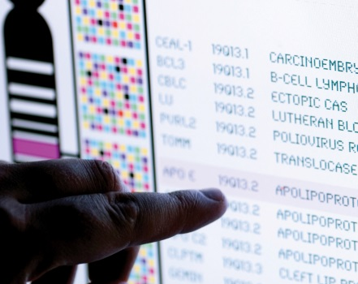
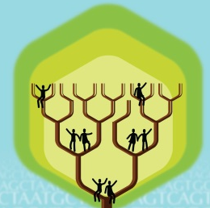
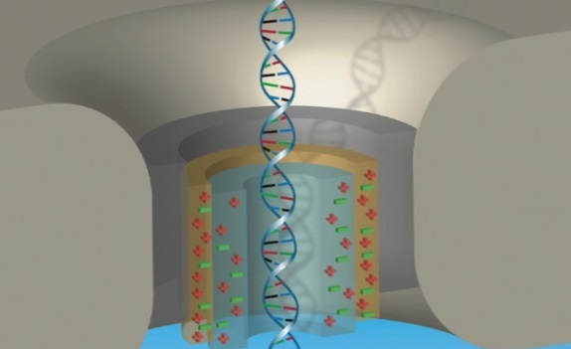


DIRECTOR’S REPORT
Eric Green, M.D., Ph.D.
Director, NHGRI
September 2022
Document #
Notes:
I would again like to welcome all of you to this Open Session of the National Advisory Council for Human Genome Research meeting. I am thrilled to finally be back giving this Director’s Report in front of a live audience, although I also appreciate those who are not in this room and are watching me remotely.
As with the rest of the Open Session, my Director’s Report presentation is being videotaped, and that recording will be made available as a permanent archive on NHGRI’s website (genome.gov).
1

Slide 2
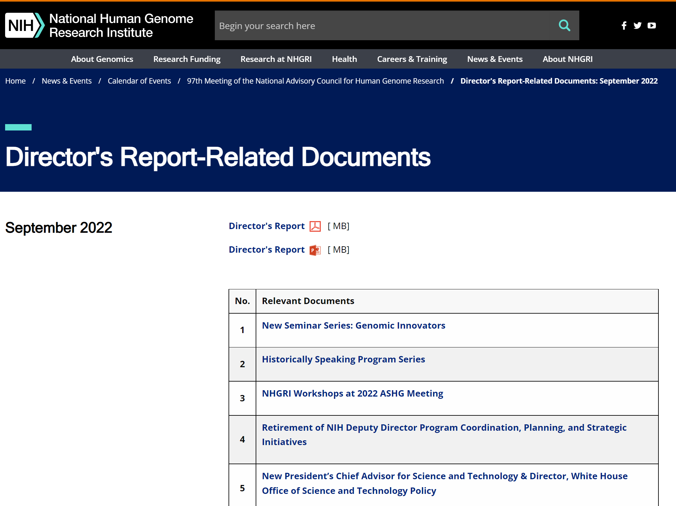

genome.gov/DirectorsReport
Document #
Notes:
For those who are new to our Council meetings, I want to make you aware of the ‘electronic resource’ that is developed for my Director’s Report. Analogous to the supplemental materials of a published paper, this resource can be accessed at the URL shown here.
The slides that I will show during my Director’s Report are also available electronically at this site – * both in PDF and PowerPoint formats.
* When there are documents or relevant websites associated with a particular slide, you will find a “Document #” indicated on the bottom right of that slide; that “Document #” references materials that can be accessed and/or downloaded from the webpage shown here. This dedicated webpage and all linked documents will be archived on genome.gov as part of the historic record of this Council meeting.
2

Slide 3
Open Session Agenda
  Presentations:
    NIAMS Research – Focus on Genomics and Genetics
    Lindsey Criswell
    Genomics & Society Working Group of Council Annual Report
    Malia Fullerton
Notes:
There will be a number of other presentations during the Open Session of this Council meeting. My Director’s Report is tailored around those presentations, and I will not discuss in detail the topics that others will cover.
* Following my Director’s Report, Lindsey Criswell, Director of NIH’s National Institute of Arthritis and Musculoskeletal and Skin Diseases (or NIAMS), will speak about “NIAMS Research – Focus on Genomics and Genetics.”
* Next, Malia Fullerton, Chair of the Genomics & Society Working Group of this Council, will give the annual report from that group.
3

Slide 4
Open Session Agenda
  Concept Clearances:
    Genomic Community Resources PAR Renewal
  Chris Wellington
    Genomics and Health Equity Initiatives RFAs
  Lucia Hindorff
    Entry Level Training Modules (ELM) PAR
  Renee Rider
    Center for Inherited Disease Research Contract Renewal
  Lawrence Brody
Notes:
After those presentations, there will be four concept clearances presented by NHGRI extramural program staff.
* First, Chris Wellington will present a concept clearance on the “Genomic Community Resources PAR Renewal.”
* Second, Lucia Hindorff will present a concept clearance on “Genomics and Health Equity Initiatives RFAs.”
* Third, Renee Rider will present a concept clearance on the “Entry Level Training Modules (ELM) PAR.”
* Lastly, Larry Brody will present a concept clearance on the “Center for Inherited Disease Research Contract Renewal.”
4

Slide 5
Open Session Agenda
  Presentations:
    Human Genome Reference Program
    Deanna Church and Martin Hirst
    Capturing RNA Sequences & Transcript Diversity Meeting
    Jennifer Strasburger and Brenton Graveley
Notes:
After that, there will be two reports.
* Deanna Church and Martin Hirst will provide an update about the Human Genome Reference Program.
* Finally, Jennifer Strasburger and Brenton Graveley will provide a summary about the “Capturing RNA Sequences & Transcript Diversity Meeting.”
5

Slide 6
Director’s Report Outline
General NHGRI Updates
General NIH Updates
General Genomics Updates
NHGRI Extramural Research Program
NIH Common Fund/Trans-NIH
NHGRI Communications, Policy, and Education
NHGRI Intramural Research Program
Notes:
For the rest of my Director’s Report, I will cover the seven areas listed here, which reliably provide a useful framework for reviewing the relevant topics.
6

Slide 7
Director’s Report Outline
General NHGRI Updates
General NIH Updates
General Genomics Updates
NHGRI Extramural Research Program
NIH Common Fund/Trans-NIH
NHGRI Communications, Policy, and Education
NHGRI Intramural Research Program
Notes:
7
And I will start with some general NHGRI updates.

Slide 8
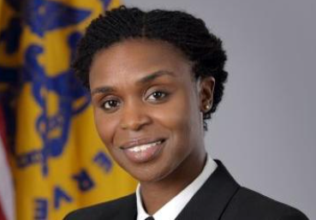
    New Extramural Program Director
    Iman Martin, Ph.D., M.P.H., M.Sc.
Notes:
I will start with new members of the NHGRI staff.
Lieutenant Commander Iman Martin recently joined the Division of Genomic Medicine as a Program Director. Iman is a member of the Commissioned Corps of the Public Health Service. She was most recently at the U.S. Department of Defense, Defense Health Agency and the Department of Homeland Security U.S. Coast Guard, although she was previously stationed at NIH’s National Heart, Lung, and Blood Institute and National Cancer Institute. She is passionate about NHGRI’s mission and programs, bringing depth and breadth in genetic epidemiology, multiplex omics, quantitative methods, health equity, social determinants of health, emerging infections, and complex chronic diseases.

Slide 9
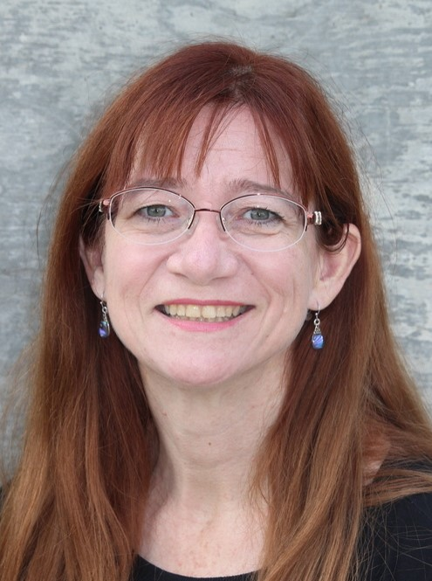
    New Extramural Program Director
    Renee Rider, M.S., J.D., L.C.G.C.
Notes:
Renee Rider is another new Program Director in the Division of Genomic Medicine. Renee is an experienced genetic counselor who recently completed the NIH-American College of Medical Genetics and Genomics fellowship in Genomic Medicine Program Management. She is excited to continue working at NHGRI, where she has become a valuable member of the Implementing Genomics in Practice (or IGNITE) Pragmatic Clinical Trials team. Renee previously worked at the Veterans’ Administration, the University of Utah Alzheimer’s Center, and the Utah Birth Defects Network.

Slide 10
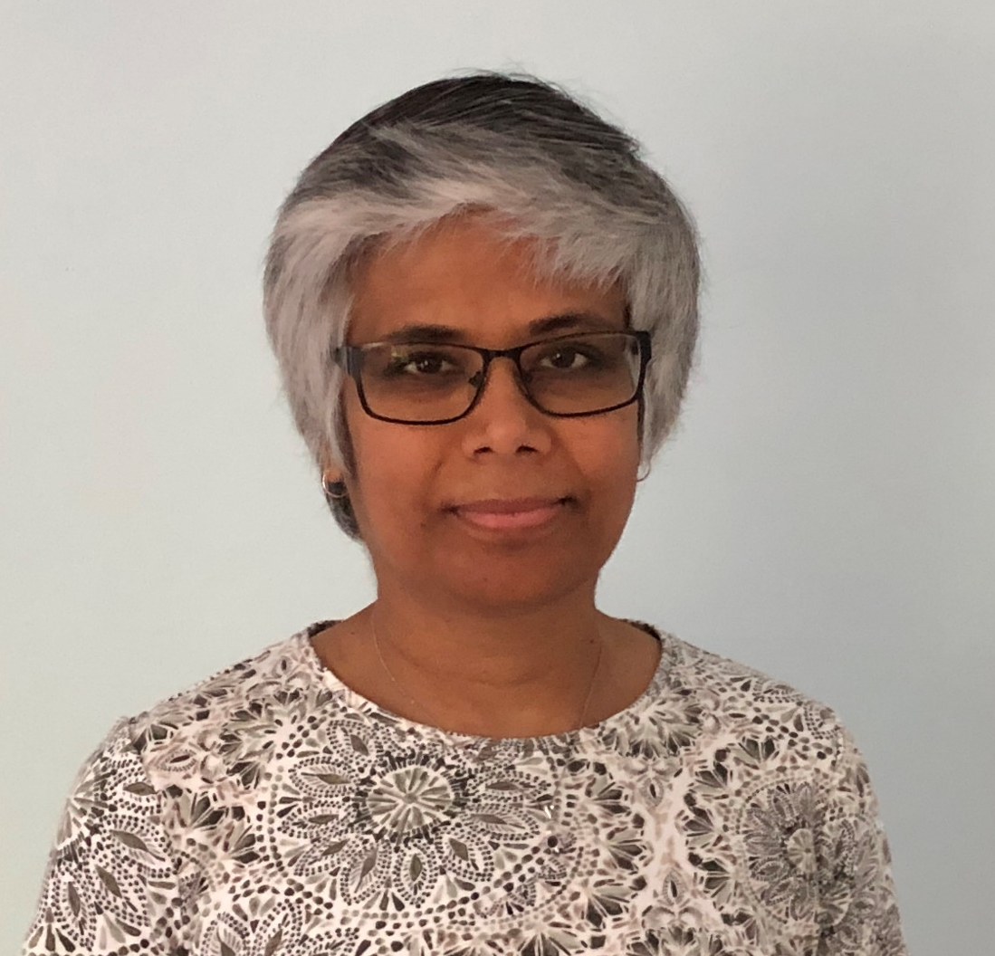
    New Extramural Program Director
Sandhya Xirasagar, Ph.D.
Notes:
Sandhya Xirasagar is a new Program Director in NHGRI’s Office of Genomic Data Science. Prior to joining NHGRI, Sandhya was at the National Institute of Allergy and Infectious Diseases, where she led their Clinical Genomics and Laboratory Informatics Initiatives. She has extensive leadership experience in the development of genomics repositories. Sandhya will be involved in developing, promoting, supporting, and coordinating genomic data science activities across NHGRI. She will also oversee a portfolio of extramural grants focused on the model organism databases, machine learning, and training to foster genomics and data science expertise in a diverse workforce.

Slide 11
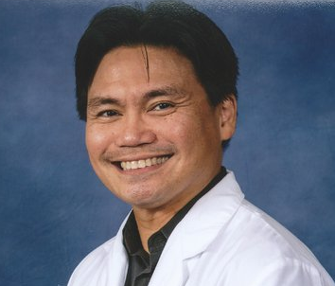
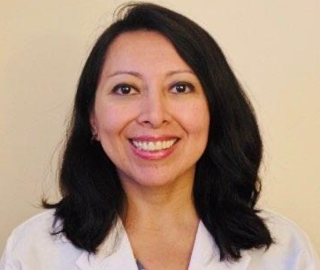
New NIH-ACMG Fellows
    Julius Militante, Ph.D., R.N.
    Veronica Abraham, M.D., M.P.H., M.Sc.
Notes:
NHGRI welcomes two new NIH-American College of Medical Genetics and Genomics Fellows for 2022-2024: Julius Militante and Veronica Abraham. Julius grew up in the Philippines and received his Ph.D. in Pharmacology from Texas Tech. He performed postdoctoral research in molecular pharmacology at the Max Planck Institute for Experimental Medicine, Washington University, and the Albert Einstein College of Medicine. He was an assistant professor of Biology at the University of Michigan in Flint before earning his B.S. degree in nursing.
Veronica is a primary care medical doctor with interests in public health and genetics. She obtained her M.D. degree in Quito, Ecuador and a Masters in Public Health from Drexel University. To further her knowledge in genetics, she has been taking genetics training courses and recently obtained a graduate degree in genetic counseling from Boise State University.

Slide 12
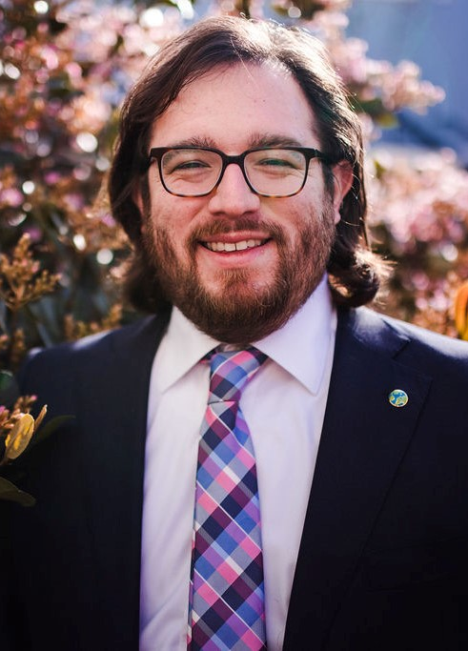
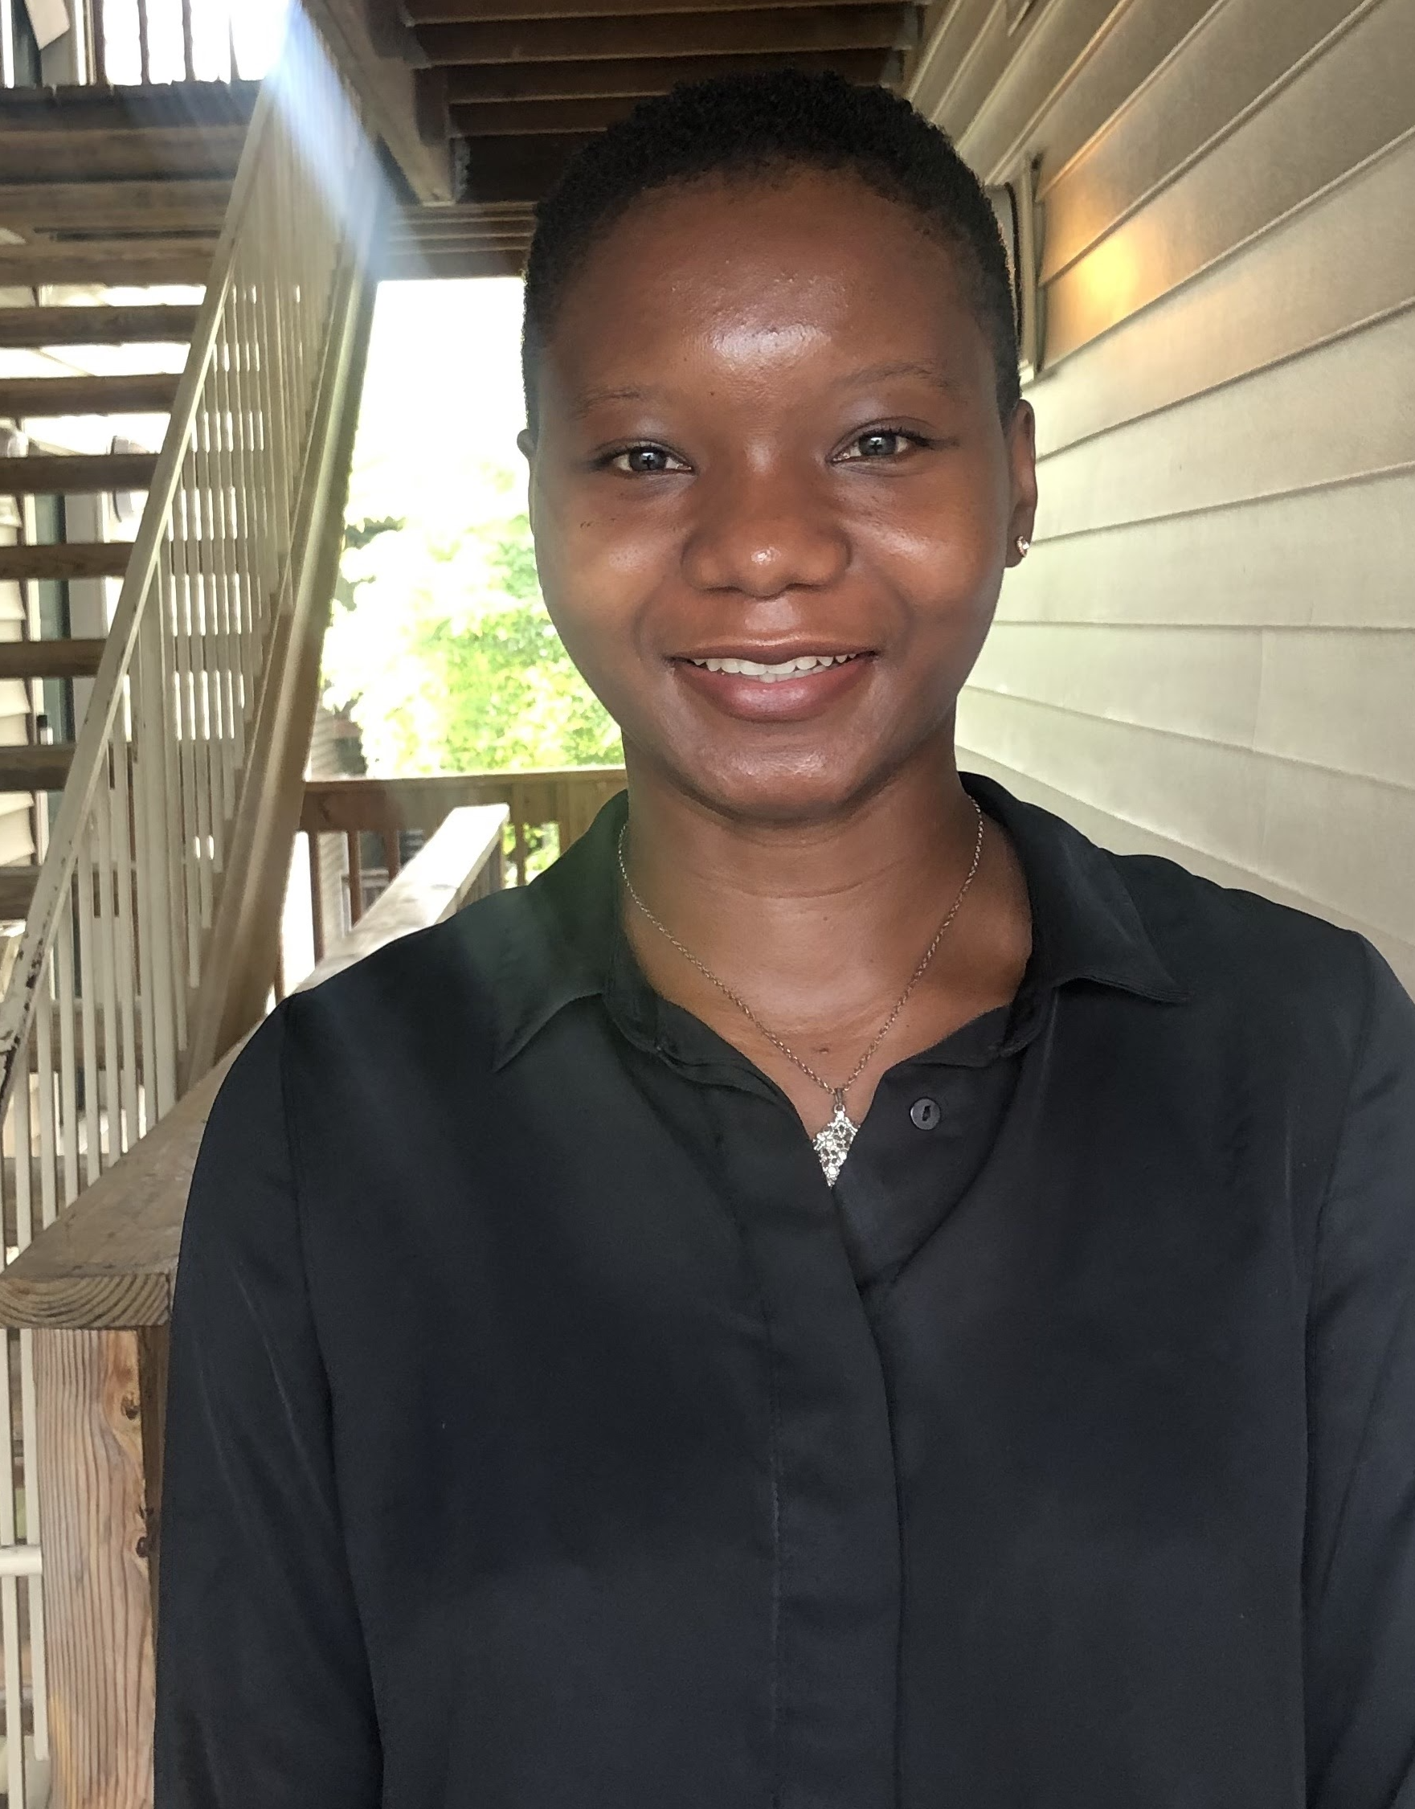
New ASHG-NHGRI Fellows
Albert Hinman, Ph.D.
Genetics & Public Policy Fellow
Nancy Sey, Ph.D.
Genetics & Education Fellow
Notes:
NHGRI’s Division of Genomics and Society partners with the American Society of Human Genetics (or ASHG) in sponsoring two fellowships each year.
The Genetics & Public Policy Fellowship provides individuals an opportunity to work in NHGRI’s Policy and Program Analysis Branch, at ASHG, and in Congress. This year’s fellow is Albert Hinman, who completed his Ph.D. in Genetics at Stanford University and recently finished a Science Policy Postdoctoral Fellowship at the Engineering Biology Research Consortium connected with the University of California, Berkeley.
The Genetics & Education Fellowship program provides fellows an opportunity to work in NHGRI’s Education and Community Involvement Branch and at ASHG in developing educational programs for a wide range of audiences; the fellow may also do a rotation with a public or private organization involved in genetics and genomics education. This year’s fellow is Nancy Sey, a recipient of a Gilliam Fellowship from the Howard Hughes Medical Institute and a Ph.D. in Neuroscience from University of North Carolina.

Slide 13
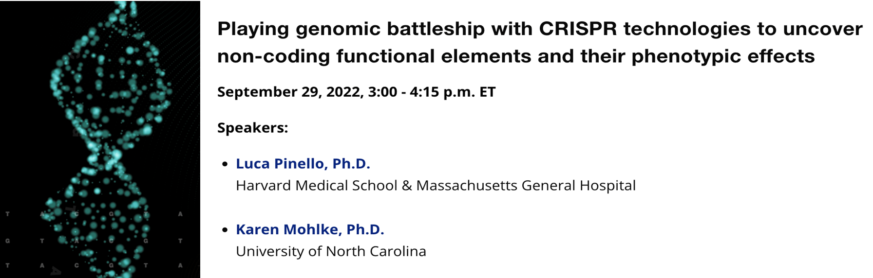
    New Seminar Series: Genomic Innovators
    An early career researcher and an established researcher
    Topics that showcase creative ways early career investigators are accelerating genomics research
Document 1
Notes:
Beginning in September 2022, NHGRI will host a new seminar series based on its Genomic Innovators Award Program, which supports innovative work by early career genomics investigators who are part of consortia or other team-science efforts. Each seminar will pair an early career researcher with a more established researcher. Their presentations will cover specific topics that showcase the creative ways that early career investigators are accelerating genomics research.
The first such seminar will take place on September 29 and will feature talks by Luca Pinello and Karen Mohlke.

Slide 14
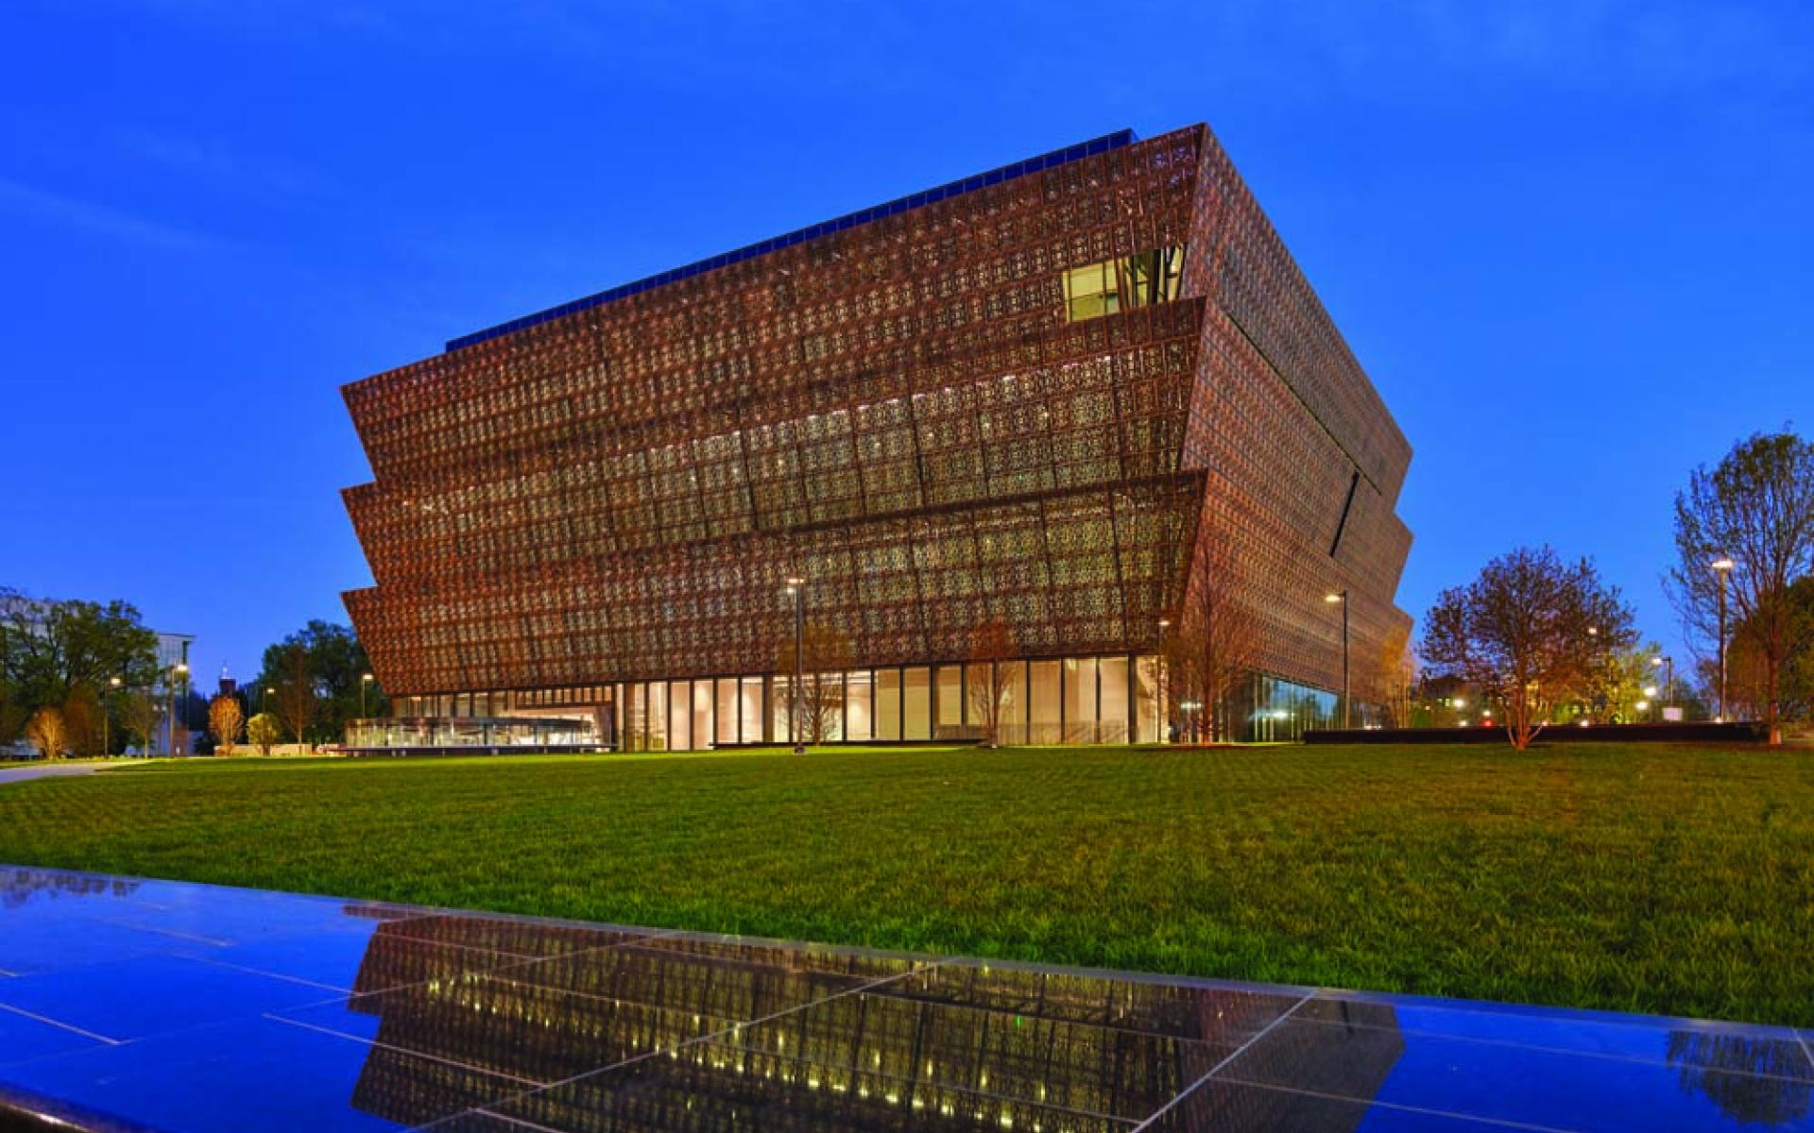


    Historically Speaking Program Series
    Four-part program series focused on advances made by African Americans in biomedical research and genomics
    Next programs: October 20, November 15, and December 6
Document 2
Notes:
NHGRI and the Smithsonian’s National Museum of African American History and Culture, with support from the Foundation for the National Institutes of Health, have partnered for a four-part series, entitled “Historically Speaking.” This series aims to underscore the advances made by African Americans in biomedical research and genomics. It also helps to showcase opportunities to increase diversity and equity in biomedical research.
The second program in this series will occur on October 20 at the Oprah Winfrey Theater and will also be broadcast live for online viewing. Akilah Johnson of the Washington Post will moderate a panel with senior researchers affiliated with NIH. The researchers will discuss why they chose a career in biomedicine, recount their experiences with mentors, discuss the barriers they overcame in their careers, and share how they promote more diversity in the field. NHGRI’s intramural researcher Neil Hanchard will be among the panelists.
There also will be two additional programs as part of this series on November 15 and December 6.

Slide 15


NHGRI Workshops at 2022 ASHG Meeting
    Applying for NIH Grants: Strategies for Success
      Wednesday, October 26
    NHGRI Building a Diverse Workforce – Listening to the Voices of Trainees and Early Stage Scientists
      Thursday, October 27
Document 3
Notes:
NHGRI program staff will host two ancillary workshops at the 2022 ASHG Meeting.
* The first, entitled “Applying for NIH Grants: Strategies for Success,” will provide an inside look at the NIH funding process as well as provide tips and tools for successful grant writing. This workshop will feature informational presentations, a panel discussion, and a question-and-answer session with NIH and grantees at different career stages. This session will take place on October 26 and will have an option for remote participation.
* The second, entitled “NHGRI Building a Diverse Workforce – Listening to the Voices of Trainees and Early Stage Scientists,” is designed for trainees and early stage researchers and will feature discussions about professional opportunities in genomics, including for those from groups traditionally underrepresented in the field. This session will take place on October 27.
15

Slide 16
Director’s Report Outline
General NHGRI Updates
General NIH Updates
General Genomics Updates
NHGRI Extramural Research Program
NIH Common Fund/Trans-NIH
NHGRI Communications, Policy, and Education
NHGRI Intramural Research Program
Notes:
Moving on to general NIH updates.
16

Slide 17

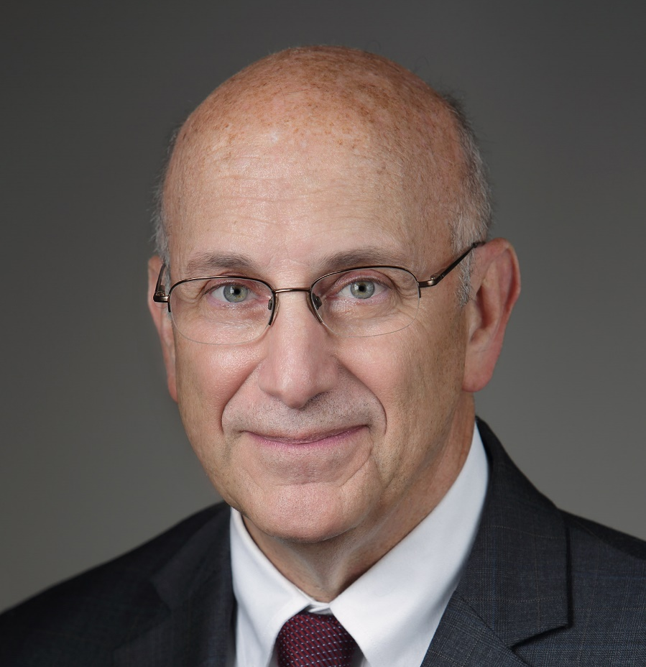

Retirement of NIH Deputy Director for Program
Coordination, Planning, and Strategic Initiatives
James Anderson, M.D., Ph.D.
Robert Eisinger, Ph.D.
Document 4
Notes:
In June, Jim Anderson retired as the NIH Deputy Director for Program Coordination, Planning, and Strategic Initiatives. Jim had held this position for nearly 12 years. In this role, Jim had overseen a broad range of NIH research portfolios, including the NIH Common Fund.
* While a search for Jim’s successor is conducted, Robert Eisinger has returned to NIH to serve in this role in an acting capacity. Bob left the NIH in April 2022 to become Director of Innovation for FasterCures at the Milken Institute’s Center for Accelerating Medical Solutions.

Slide 18
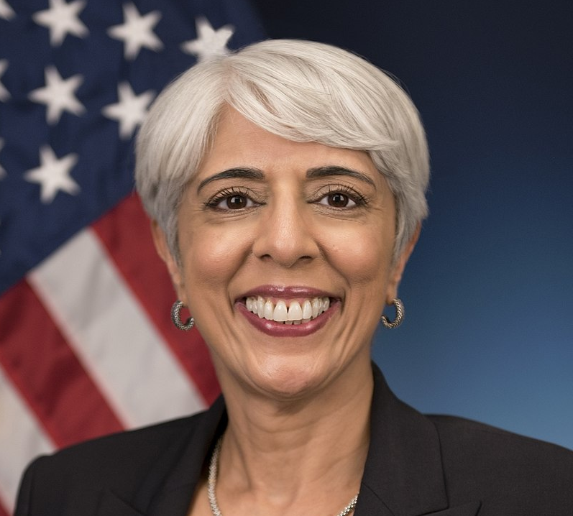

New President’s Chief Advisor for Science and Technology & Director, White House Office of Science and Technology Policy
Arati Prabhakar, Ph.D.
Document 5
Notes:
In June, President Biden announced his intention to nominate Arati Prabhakar as his Chief Advisor for Science and Technology and also Director of the White House Office of Science and Technology Policy. In this capacity, she will be a member of the President’s Cabinet. The nomination was approved by the Committee on Commerce, Science, and Transportation and awaits approval by the full Senate.
Formerly, she led the National Institute of Standards and Technology and the Defense Advanced Research Projects Agency (also known as DARPA).

Slide 19


New Director, Advanced Research
Projects Agency for Health (ARPA-H)
Renee Wegryzn, Ph.D.
Document 6
Notes:
Last week, President Biden announced his intention to appoint Renee Wegryzn as the inaugural Director of the Advanced Research Projects Agency for Health (or ARPA-H). ARPA-H aims to conduct high-impact biomedical and health research with a mission “to benefit the health of all Americans by catalyzing health breakthroughs that cannot readily be accomplished through traditional research or commercial activity.”
Renee is currently the Vice President of business development at Ginkgo Bioworks and Head of Innovation at Concentric by Gingko. Formerly, she was a program director in the Biological Technologies Office at the Defense Advanced Research Projects Agency (or DARPA), where she launched programs focused on innovating how we tackle infectious diseases, increase the resilience of the bioeconomy, and institute important tools for biosecurity.

Slide 20
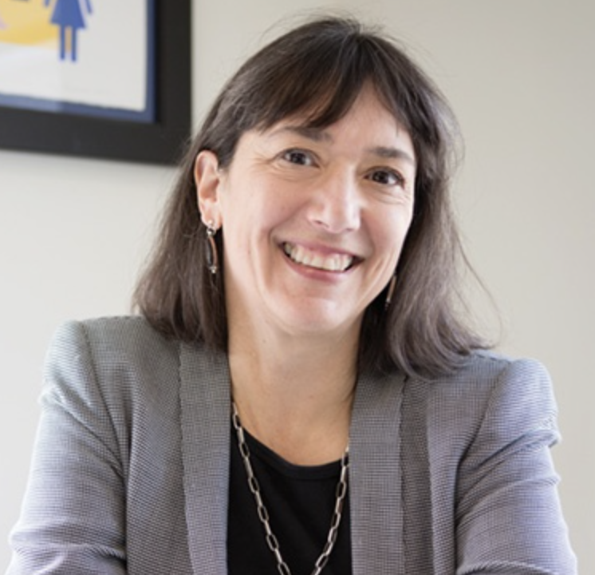

New Director, National Cancer Institute
Monica Bertagnolli, M.D.
Document 7
Notes:
In August, President Biden announced that he intends to appoint Monica Bertagnolli as the 16th Director and first female Director of the National Cancer Institute. Monica is currently the Richard E. Wilson Professor of Surgery in the area of surgical oncology at Harvard Medical School, a surgeon at Brigham and Women’s Hospital, and a member of the Gastrointestinal Cancer and Sarcoma Disease Center at the Dana-Farber Cancer Institute.

Slide 21
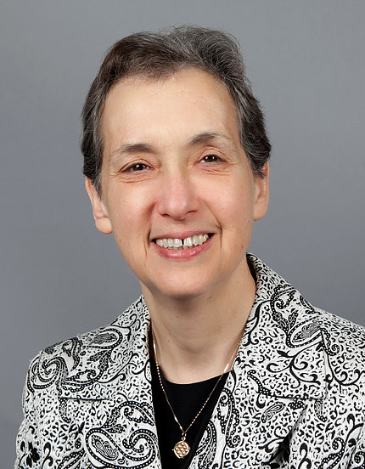

New NIH Acting Deputy Director
for Intramural Research
Nina Schor, M.D., Ph.D.,
Document 8
Notes:
Nina Schor has been appointed the NIH Acting Deputy Director for Intramural Research, succeeding Michael Gottesman, who served in this position for 29 years. Nina had been serving as the Deputy Director of the National Institute of Neurological Disorders and Stroke.

Slide 22


New Director, NIH Office of Equity,
Diversity, and Inclusion
Kevin Williams, J.D.
Document 9
Notes:
In June, Kevin Williams was appointed Director of the NIH Office of Equity, Diversity, and Inclusion. As the Director, Kevin will guide the strategic direction for NIH on diversity, equity, inclusion, and accessibility matters and will serve as the NIH Equal Employment Opportunity Officer. He joins NIH from the U.S. Federal Trade Commission, where he most recently held the position of Deputy Executive Director.

Slide 23

    NIH Data Management and Sharing Policy
Effective January 25, 2023
Policy Requirements:
  Submission of Data Management and Sharing Plan
  Compliance with any institute/center-approved plan(s)
NHGRI preparing for implementation of this policy
Document 10
Notes:
NIH is gearing up to implement its new Data Management and Sharing Policy, * which will become effective on January 25, 2023, and supersedes the 2003 Data Sharing Policy. Under the new Data Management and Sharing Policy, NIH will require researchers to prospectively plan for how scientific data will be preserved and shared.
Specifically, investigators will be required to * submit a Data Management and Sharing plan that outlines how scientific data and any accompanying metadata will be managed and shared, taking into account any potential restrictions or limitations. * The plan must comply with any institute- or center-approved plan for data management and sharing.
* NHGRI has been actively preparing for the implementation of this policy in accordance with the NIH requirements, with plans to make publicly available those details on NHGRI’s website, genome.gov, in the near future.

Slide 24
Fiscal Year 2023 Appropriations
 | FY2022 Enacted Labor-HHS Appropriation | FY2023 House Committee Passed | % Increase | FY2023 Senate Committee Majority Draft | % Increase
NIH | $45 B | $47.5 B | 5.56% | $48.0 B | 6.66%
NHGRI | $639.062 M | $659.233 M | 3.16% | $658.873 | 3.10%
Document 11
Notes:
Government funding will run out on September 30 unless a Fiscal Year 2023 budget or a continuing resolution is passed. Right now, Congress is expected to pass a continuing resolution at some point before the end of the fiscal year that will fund the government through December 16.
* Earlier this summer, the House Appropriations Committee approved the Labor-HHS bill, which includes a 3.16% increase for NHGRI – the typical increase for most NIH institutes and centers. The bill still needs approval from the full House.
* On the other side, the Senate Appropriations majority unveiled their draft Labor-HHS bill in late July. The Senate version proposes a similar budget for NHGRI, with a 3.1% increase.
24

Slide 25
Director’s Report Outline
General NHGRI Updates
General NIH Updates
General Genomics Updates
NHGRI Extramural Research Program
NIH Common Fund/Trans-NIH
NHGRI Communications, Policy, and Education
NHGRI Intramural Research Program
Notes:
Moving on to general genomics updates.
25

Slide 26
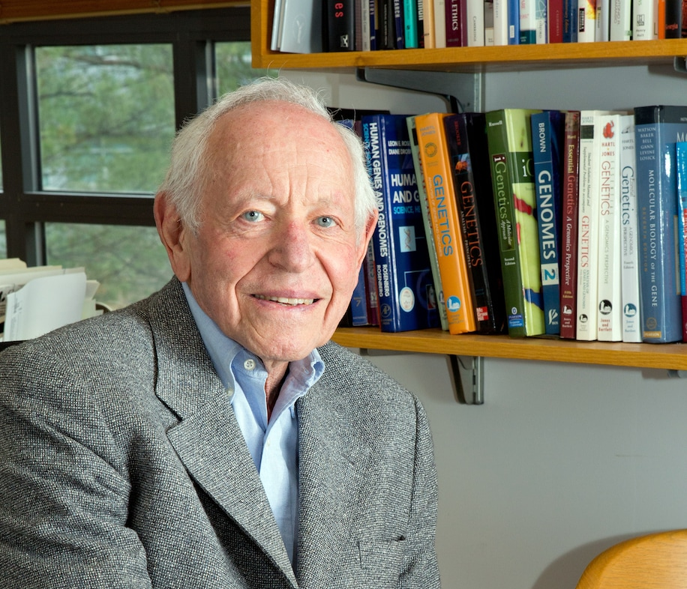

Mourning the Loss of Leon Rosenberg
Document 12
Notes:
Leon Rosenberg, a renowned physician and geneticist known for clarifying the biochemical basis of metabolic disorders, passed away in July. He was 89. Leon was a leading figure in medical genetics, conducting influential research and training generations of scientists. He served as Dean of the Yale School of Medicine, oversaw research at the pharmaceutical company Bristol-Myers Squibb, and later chronicled his lifelong struggle with bipolar disorder in an effort to destigmatize mental illness.
26

Slide 27

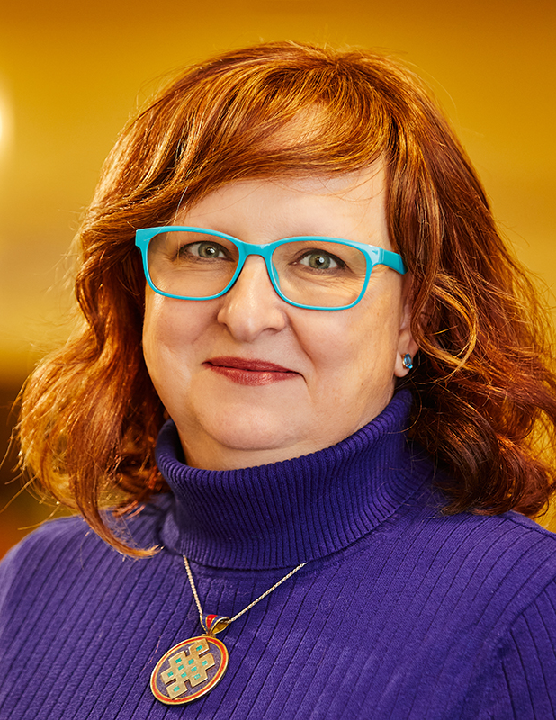

New Leadership,
American Society of Human Genetics
Bruce Gelb, M.D.
Chris Gunter, Ph.D.
Document 13
Notes:
Bruce Gelb has been elected the 2024 President (and 2023 President-Elect) of the American Society of Human Genetics. Bruce is the Dean for Child Health Research; Director and Gogel Family Professor at the Mindich Child Health and Development Institute; Professor of Pediatrics and Genetics and Genomic Sciences; and Co-Director of the Cardiovascular Genetics Program – all at the Icahn School of Medicine at Mount Sinai.
* Back at NHGRI, Chris Gunter, Senior Advisor to the NHGRI Director for Genomics Engagement and Head of the Engagement Methods Unit within the institute’s Social and Behavioral Research Branch, has been elected a member of the American Society of Human Genetics Board of Directors.
27

Slide 28
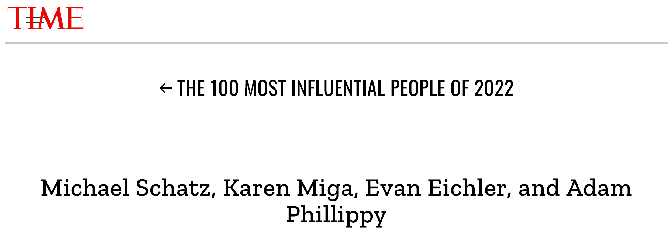
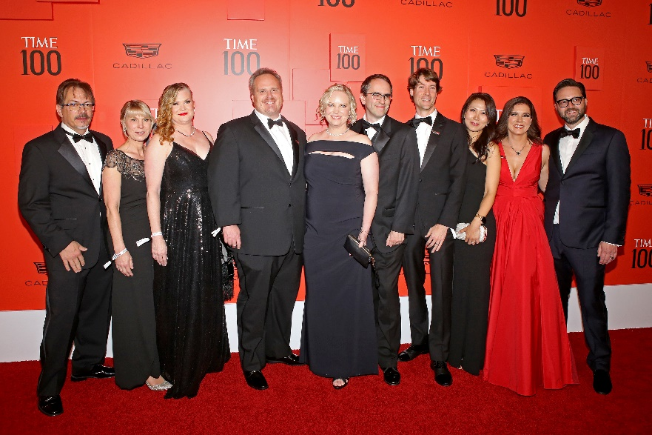

Time 100 Most Influential People of 2022
Document 14
Notes:
Representing the Telomere-to-Telomere Consortium, Adam Phillippy, Karen Miga, Evan Eichler, and Michael Schatz were named to Time magazine’s 100 Most Influential People of 2022. These four led the consortium to complete the first gapless sequence of the human genome. It was gratifying to see such genomics luminaries featured on the red carpet!
28

Slide 29
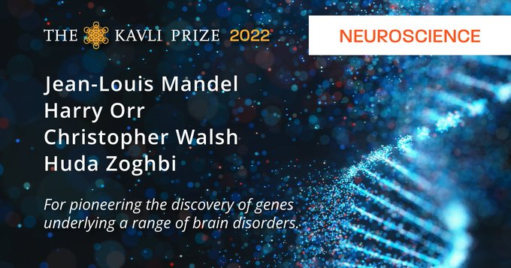
Kavli Prize in Neuroscience
Document 15
Notes:
Jean-Louis Mandel, Harry Orr, Christopher Walsh, and Huda Zoghbi were recently awarded the Kavli Prize in Neuroscience for the discovery of genes underlying a range of serious brain disorders and elucidating the pathways by which these genes work.

Slide 30

New World Health Organization
Science Council Report
Document 16
Notes:
In July, the World Health Organization (or WHO) Science Council published a report on “Accelerating access to genomics for global health.” The WHO report argues that it is not justifiable ethically or scientifically for less-resourced countries to gain access to genomic technologies long after rich countries.
To promote the adoption or expanded use of genomics, the report’s recommendations address four themes: advocacy, implementation, collaboration, and associated ethical, legal, and social issues. The report highlights NIH’s Human Heredity and Health in Africa program as an example of a collaborative arrangement that promotes the optimal use of new genomic information.

Slide 31
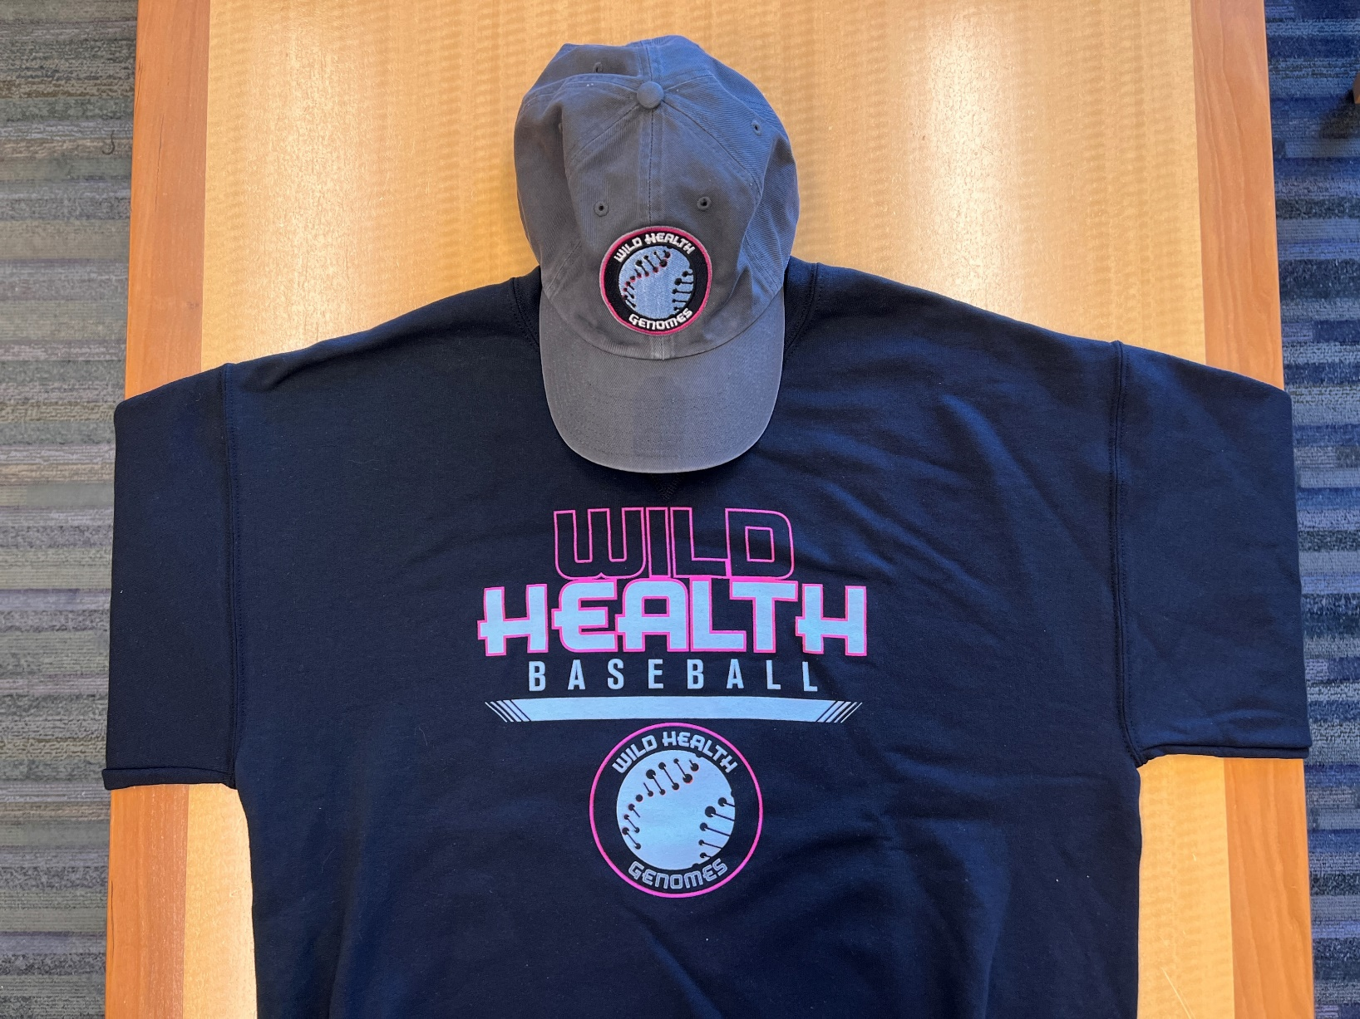

Does Life Get Any Better Than This?
Genomics + Baseball
Notes:
Here is a feel-good development, which personally makes me wonder – does life get any better than this? As many of you know, I am a huge baseball fan, especially loyal to my St. Louis Baseball Cardinals. In fact, my love of baseball actually rivals my love of genomics. Earlier this year, I become emotionally overwhelmed (in other words, verklempt) when I came to learn that my two passions had * come together: genomics and baseball.
Specifically, a new minor league baseball team in Lexington, Kentucky had its debut season, and the team’s name is the * “Kentucky Wild Health Genomes.” I was so pleased to see professional baseball embrace the science of genomics and weave it into their culture, and I would like to believe that baseball fans attending the games of this new team actually know what a genome is and are also fans of the Human Genome Project.
* My generous policy group was kind enough to buy me this hat and sweatshirt, appreciating that I am almost certainly the biggest combined genomics-baseball geek in the world!
31

Slide 32
Director’s Report Outline
General NHGRI Updates
General NIH Updates
General Genomics Updates
NHGRI Extramural Research Program
NIH Common Fund/Trans-NIH
NHGRI Communications, Policy, and Education
NHGRI Intramural Research Program
Notes:
Moving on to the NHGRI Extramural Research Program.
32

Slide 33
Human Genome Reference Program
    Towards a Complete Reference of Human Genome Diversity
Generating 350 high-quality reference human genome sequences
  Initial 45 diploid genome sequences released
  Pangenome representations available
Embedded ELSI efforts
International outreach: GA4GH & H3Africa
Document 17
Notes:
The Human Genome Reference Program (or HGRP) reflects NHGRI’s `continued commitment to refining, maintaining, and adding diversity and quality to the reference human genome sequence. * The multi-component program aims to generate 350 high-quality reference genome sequences from human participants of diverse genetic ancestry.
* Initial data for high-quality, phased diploid genome sequences from 45 individuals have been released and are available in multiple repositories. These sequences have been included in an initial pangenome representation; the results are available via the Human Pangenome Reference Consortium web page.
* The embedded Ethical, Legal, and Social Implications (or ELSI) efforts in the program continue to provide guidance in critical areas related to establishing an inclusive human pangenome reference sequence, such as participant consent, engagement with diverse communities, and understanding how best to describe the diversity of genomes represented in the reference.
* The program has most recently been expanding outreach with potential international partners, including the Global Alliance for Genomics and Health (or GA4GH), the Human Hereditary and Health in Africa (or H3Africa) consortium, and others. Deanna Church and Martin Hirst will give a more extensive update on the program later in this Council meeting.

Slide 34
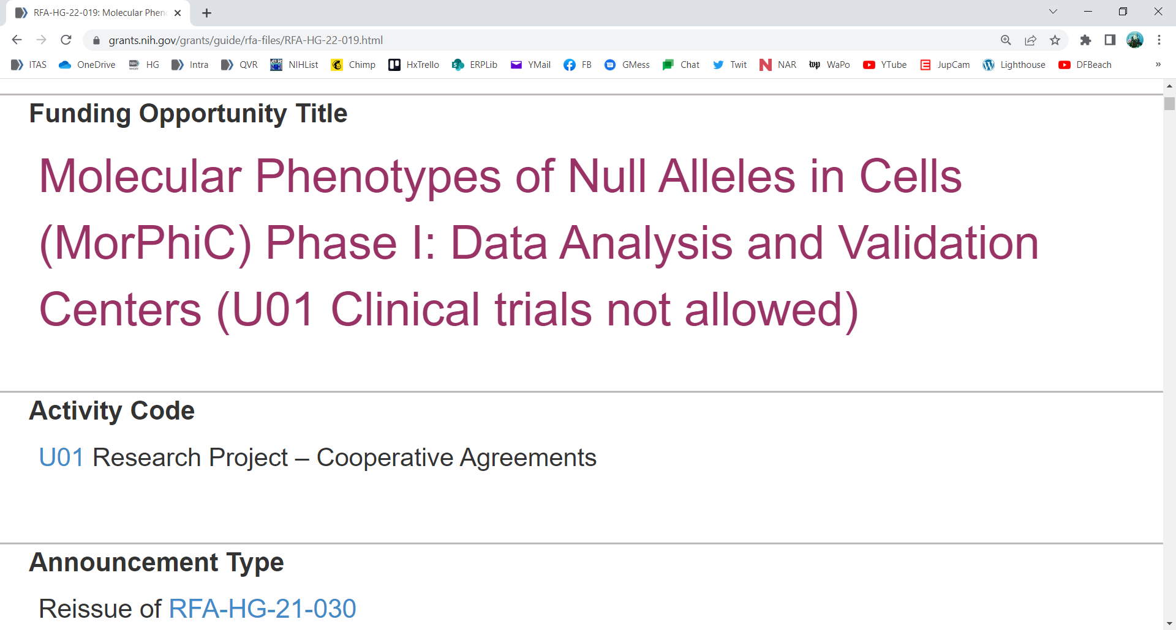

    Molecular Phenotypes of Null Alleles in Cells (MorPhiC)
New Funding Opportunity Announcement:
  RFA-HG-22-019 Data Analysis and Validation Center
  Pre-applicant webinar was held in September
  Applications due November 1, 2022
Document 18
Notes:
This past August, NHGRI launched the Molecular Phenotypes of Null Alleles in Cells (or MorPhiC) Consortium, which aims to develop an extensive catalog of molecular and cellular phenotypes for null alleles of every human gene.
In its first phase, the program will optimize available methods to knock out 1,000 genes; evaluate the utility of various cell lines and organoids; explore multiple molecular and cellular assay; develop analyses to understand the utility of, and requirements for, the data; and disseminate the results to the community.
* NHGRI recently published a new Funding Opportunity Announcement for Data Analysis and Validation Centers that will join the Consortium. These centers will undertake data analysis and modeling to evaluate and help ensure the utility of MorPhiC data. A pre-application webinar was held earlier this month. A recording of the event and Frequently Asked Questions about the FOA will be available on the MorPhiC website. Applications are due on November 1, 2022.
34

Slide 35
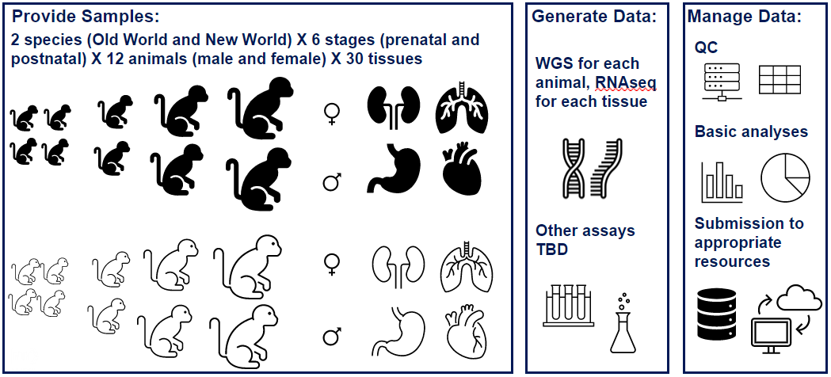
    Non-Human Primate Developmental Genotype-Tissue Expression Project (NHP dGTEx)
    Multispecies NHP dGTEx Research Center
    Oregon Health and Science University
      PI: Donald Conrad
    Broad Institute
      PI: Kristin Ardlie
    Yale University
      PI: Nenad Sestan
    Massachusetts Institute of Technology
      PI: Guoping Feng
Document 19
Notes:
This summer, NHGRI launched the Non-Human Primate Developmental Genotype-Tissue Expression Project (or NHP dGTEx). Serving to augment and complement the Human dGTEx Project, this program aims to catalog and analyze transcriptional profiles of a wide variety of tissues from post-mortem non-human primates. This program is led by NHGRI with co-funding from the Office of Research Infrastructure Programs and the National Institute of Mental Health.
The Multispecies NHP dGTEx Research Center was awarded to the Oregon Health and Science University, in partnership with the Broad Institute, Yale University, and the Massachusetts Institute of Technology. The Principal Investigators for each component of the center are listed here. The center will provide high-quality tissue samples, generate whole-genome sequence and RNAseq data, manage data-quality control, analyze gene-expression patterns in both bulk tissues and single cells, and ensure that the data and samples are accessible to the research community.
35

Slide 36

Capturing RNA Sequence and Transcript Diversity, from Technology Innovation to Clinical Application Workshop
    Comprehensive characterization of the true diversity of all RNAs and their modifications
    Recordings available online
    Presentation later today
Document 20
Notes:
This past May, NHGRI and the National Institute of Environmental Health Sciences hosted a workshop entitled “Capturing RNA Sequence and Transcript Diversity, from Technology Innovation to Clinical Application.”
* This workshop brought together leaders in the RNA field to discuss the current capabilities, needs, and prospects for comprehensive characterization of the true diversity of all RNAs and their modifications at a chemical and structural level.
* The recordings from the workshop are now available on the meeting website, and * there will be a presentation summarizing the workshop later in this Council meeting.
36

Slide 37


















European
ancestry
Diverse populations
    Lack of ancestral diversity across genomic datasets is a barrier to understanding and managing disease risk in diverse populations
    6/10 clinical sites recruiting enhanced diversity cohort
Document 21
Notes:
In July 2020, the Electronic Medical Records and Genomics (or eMERGE) Network, comprising ten clinical sites and a coordinating center, launched a nationwide prospective study to evaluate the impact of polygenic risk scores on participant and clinician behaviors and decision-making.
* The lack of ancestral diversity across genomic datasets is a barrier to understanding and managing disease risk in diverse populations, and we all recognize that people currently represented in large-scale genomic studies are overwhelmingly of European genetic ancestry.
* We must move toward developing and using genomic datasets that better represent the full diversity of humanity to ensure accurate and equitable implementation of genomic medicine.
* Six of the ten eMERGE sites are now recruiting an enhanced diversity cohort comprising with at least 75% of the participants being from racial or ethnic minority populations, underserved populations, or populations experiencing poorer medical outcomes.

Slide 38
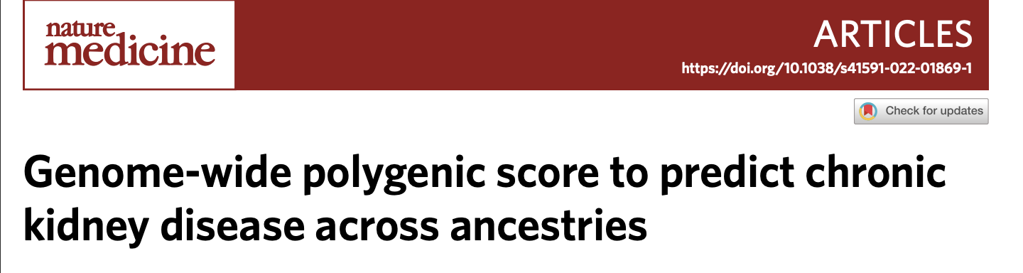
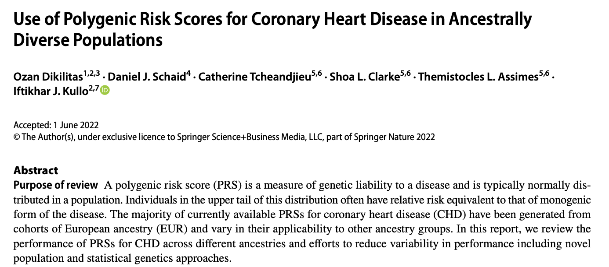
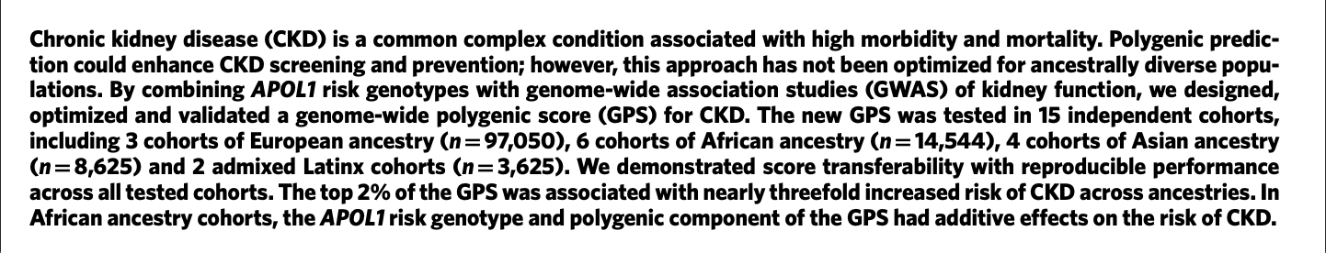
    Generation of polygenic risk scores for ancestrally diverse populations
Document 21
Notes:
The Network has also made considerable progress in generating polygenic risk scores (or PRS) for ancestrally diverse populations. Several recently published papers highlight this work.
* The first paper on chronic kidney disease reports an optimized and validated polygenic risk score for ancestrally diverse populations derived from published and unpublished data.
* The second paper on coronary heart disease reviews the performance of polygenic risk scores for coronary heart disease in ancestrally diverse populations. The eMERGE Network will begin to apply these findings by returning polygenic risk score results to 25,000 patients in a prospective cohort study starting in the fall.

Slide 39

Multi-Omics for Health and Disease
Funding Opportunities:
  Disease Study Sites
    RFA-HG-22-008
  Omics Productions Center(s)
    RFA-HG-22-009
  Data Analysis and Coordination Center
    RFA-HG-22-010
  Pre-application webinar: September 26, 2022
  Letters of intent due: October 18, 2022
  Application due date: November 19, 2022
Document 22
Notes:
Earlier this month, NHGRI published three funding opportunities, in collaboration with the National Institute of Environmental Health Sciences and the National Cancer Institute, to establish the Multi-Omics for Health and Disease Consortium. The goal of this consortium is to advance the application of multi-omic technologies to study health and disease in ancestrally diverse populations.
The consortium will consist of three components: * First, up to six Disease Study Sites that will enroll participants and capture phenotypic and environmental exposure data to study clinical conditions for which integrative multi-omics would be particularly impactful in defining associations with healthy and disease states. * Second, one or two Omics Production Centers that will utilize high-throughput molecular assays to produce: genomic, epigenomic, transcriptomic, proteomic, and metabolomic data. * And finally, one Data Analysis and Coordination Center that will focus on coordinating protocol development, consortium logistics, and the production and release of a multi-dimensional dataset that is available to the scientific community.
* A pre-application webinar will be held on September 26, 2022. Materials from that webinar, including answers to Frequently Asked Questions, will be made available soon after. Letters of intent for these funding opportunities are due by October 18, 2022, and applications are due on November 19, 2022.

Slide 40












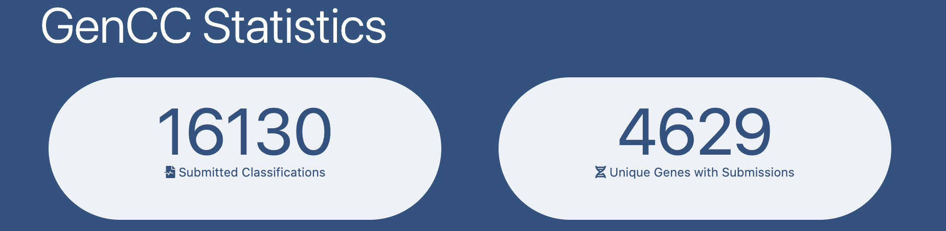




    Clinical Genome Resource (ClinGen)
    Gene Curation Coalition (GenCC)
Members
Submitted Classifications
Genomics England
PanelApp
King Faisal
Specialist Hospital and Research Center
PanelApp
Australia
Classifications
Genes
Document 23
Notes:
The Clinical Genome Resource (or ClinGen) evaluates and disseminates the clinical relevance of genes and genomic variants for use in precision medicine and research.
* In recognition of the need for harmonized standards and terminologies to define the evidence base for a gene’s role in disease, ClinGen joined forces with other public resources and diagnostic laboratories to launch the Gene Curation Coalition (or GenCC). This global effort brings together groups committed to sharing gene-disease validity knowledge to: (1) clarify the overlap between curation efforts and ensure interoperability; (2) develop consistent terminology for validity assessment, inheritance, allelic requirement and mechanism of disease; and (3) collaborate on gene curation efforts. * To date, the GenCC database contains 16,130 submitted classifications on 4,629 unique genes.
In May 2022, GenCC published its flagship paper in Genetics in Medicine, * and in June, it was featured in the journal’s podcast GenePod. Both the paper and the podcast include discussions around data harmonization and global collaboration in the context of gene curation.

Slide 41
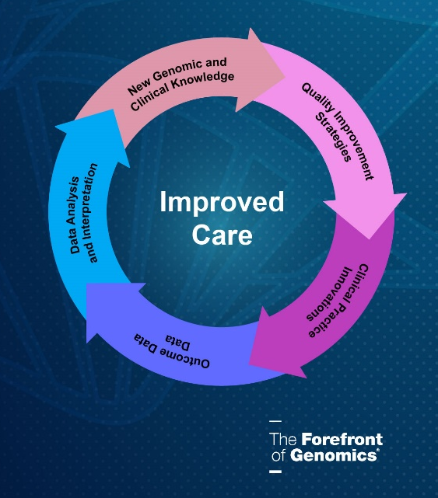
    Genomic Medicine XIV:
    Genomic Learning Healthcare Systems (gLHS)
Explore real-world examples of gLHS
Examine barriers and identify potential solutions from current, successful gLHS
Share solutions and develop collaborations to facilitate gLHS implementation
Document 24
Notes:
The Genomic Medicine Working Group of this Council hosted its 14th Genomic Medicine Meeting last month, in this case, a virtual workshop entitled “Genomic Learning Healthcare Systems (or gLHS).” The workshop’s goal was to discuss progress and identify generalizable solutions to genomic medicine implementation challenges through gLHS.
The objectives of the meeting were to: * explore real-world examples of gLHS, * examine barriers and identify potential solutions from current, successful gLHS, and * share solutions and develop collaborations to facilitate gLHS implementation.
The workshop report and video recording will soon be available on NHGRI’s website, genome.gov.

Slide 42
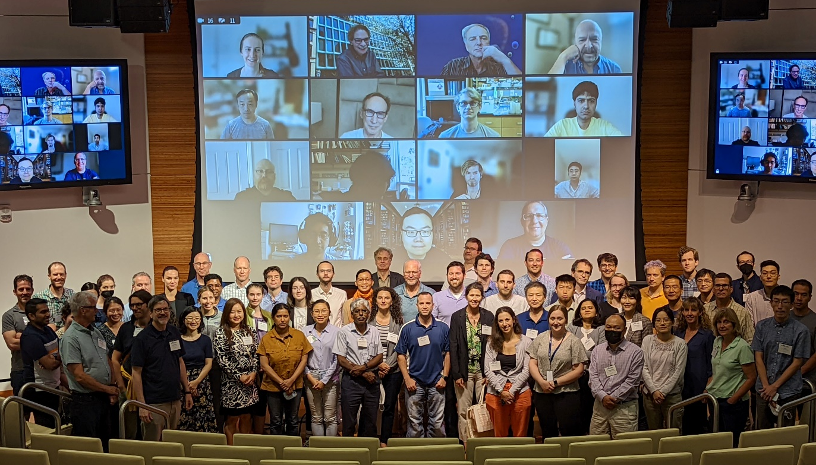
Technology Development Program
2022 Advances in Genomic Technology Development Meeting
      Meeting Topics:
      Current Research
        Genome Structure & Function
        Functional Genomics
        New Sequencing Technology
        RNA Sequencing
        Nanopore Sequencing
        Nucleic Acid Synthesis
      Strategies for Commercialization
      Trainee Career Paths
Document 25
Notes:
NHGRI’s Technology Development Program continues to promote groundbreaking work, paving the way towards the expanded use of genomics in both basic and clinical research along with genomic medicine implementation.
The 2022 Advances in Genomic Technology Development meeting was hosted by the Technology Development Coordinating Center at the Jackson Laboratory in Farmington, Connecticut this past July. For the first time in three years, the community gathered in-person to share new research developments, discuss challenges, and work to push the field forward. The hybrid meeting also had a virtual component.
* Major meeting topics ranged across the breadth of current research in our Technology Development Program, covering the key topic areas listed here. The meeting also included sessions on strategies for commercialization and trainee career paths.
42

Slide 43

Technology Development Program
Funding Opportunities
    Transformative Nucleic Acid Sequencing Technology Innovation and Early Development
      RFA-HG-21-006 (R01, also linked R21 and R43/R44)
      Final due date: February 2, 2023
    Advancing Genomic Technology Development for Research and Clinical Application
      NOT-HG-21-018, Notice of Special Interest (NOSI)
      R01, R21, R41/R42, and R43/R44
      Standard receipt dates
Document 25
Notes:
I would also like to highlight two funding opportunities for the NHGRI Technology Development Program with upcoming receipt dates.
* The program continues to support nucleic acid sequencing innovation and early development. The application due date for the third and final round of this announcement is February 2, 2023, as detailed here.
* There is also a broader opportunity to advance genomic technology development for research and clinical application via a Notice of Special Interest (or NOSI) that has standard receipt dates, as detailed here.
43

Slide 44

Small Business Program
Funding Opportunities
    Development of Highly Innovative Tools
    and Technology for Analysis of Single Cells
      PA-20-025 (STTR R41/R42 and linked SBIR R43/R44)
    Small Business Initiatives for Innovative Diagnostic Technology for Improving Outcomes for Maternal Health
      NOT-EB-21-001, Notice of Special Interest (NOSI)
    Genomics Education Interactive Digital Media Resources (SBIR/STTR)
      NOT-HG-21-038, Notice of Special Interest (NOSI)
    These funding opportunities have standard due dates
Document 26
Notes:
Through the Small Business Program, NHGRI supports U.S. companies working across the genomics space, especially in areas with significant commercialization potential, such as genomic technology development, computational genomics, data science, and genomic medicine. Along with the funding opportunities coming out of the NHGRI Technology Development Program and the broad omnibus solicitation, NHGRI is participating in three additional funding opportunities for small business applications.
* The first of these focuses on development of highly innovative tools and technology for analysis of single cells. * The second calls for innovative diagnostic technology for improving outcomes for maternal health. * The final one supports interactive digital media resources for genomics education.
* All three of these funding opportunities have standard receipt dates.
44

Slide 45

    Genomics Workforce Diversity Funding Opportunities
    PAR-21-143: NHGRI Predoctoral to Postdoctoral Transition Award for a Diverse Genomics (F99/K00) Workforce
    Due date: December 8
    PA-21-071: Research Supplements to Promote Diversity in Health-Related Research
    Due date: Ongoing
Document 27
Notes:
The NHGRI Extramural Training Program aims to prepare a talented and diverse genomics workforce by providing both institutional and individual funding through a variety of mechanisms, including individual fellowships and career development awards, institutional awards, and diversity supplements. Programs are offered at the undergraduate, postbaccalaureate, graduate, postdoctoral, and faculty levels.
Two recently released funding opportunities focused on genomics workforce diversity.
* The first is the NHGRI Predoctoral to Postdoctoral Transition Award for a Diverse Genomics Workforce, which will support graduate students as they complete their doctoral dissertation and transition to a postdoctoral research position. Applications are due December 8.
* The second is Research Supplements to Promote Diversity in Health-Related Research, which offers the opportunity for existing grants to support individuals from diverse backgrounds, including from groups underrepresented in health-related research. Individuals can include high-school or college students as well as individuals from more advanced career stages. NHGRI will accept applications for such supplements throughout the fiscal year until May 15.
45

Slide 46
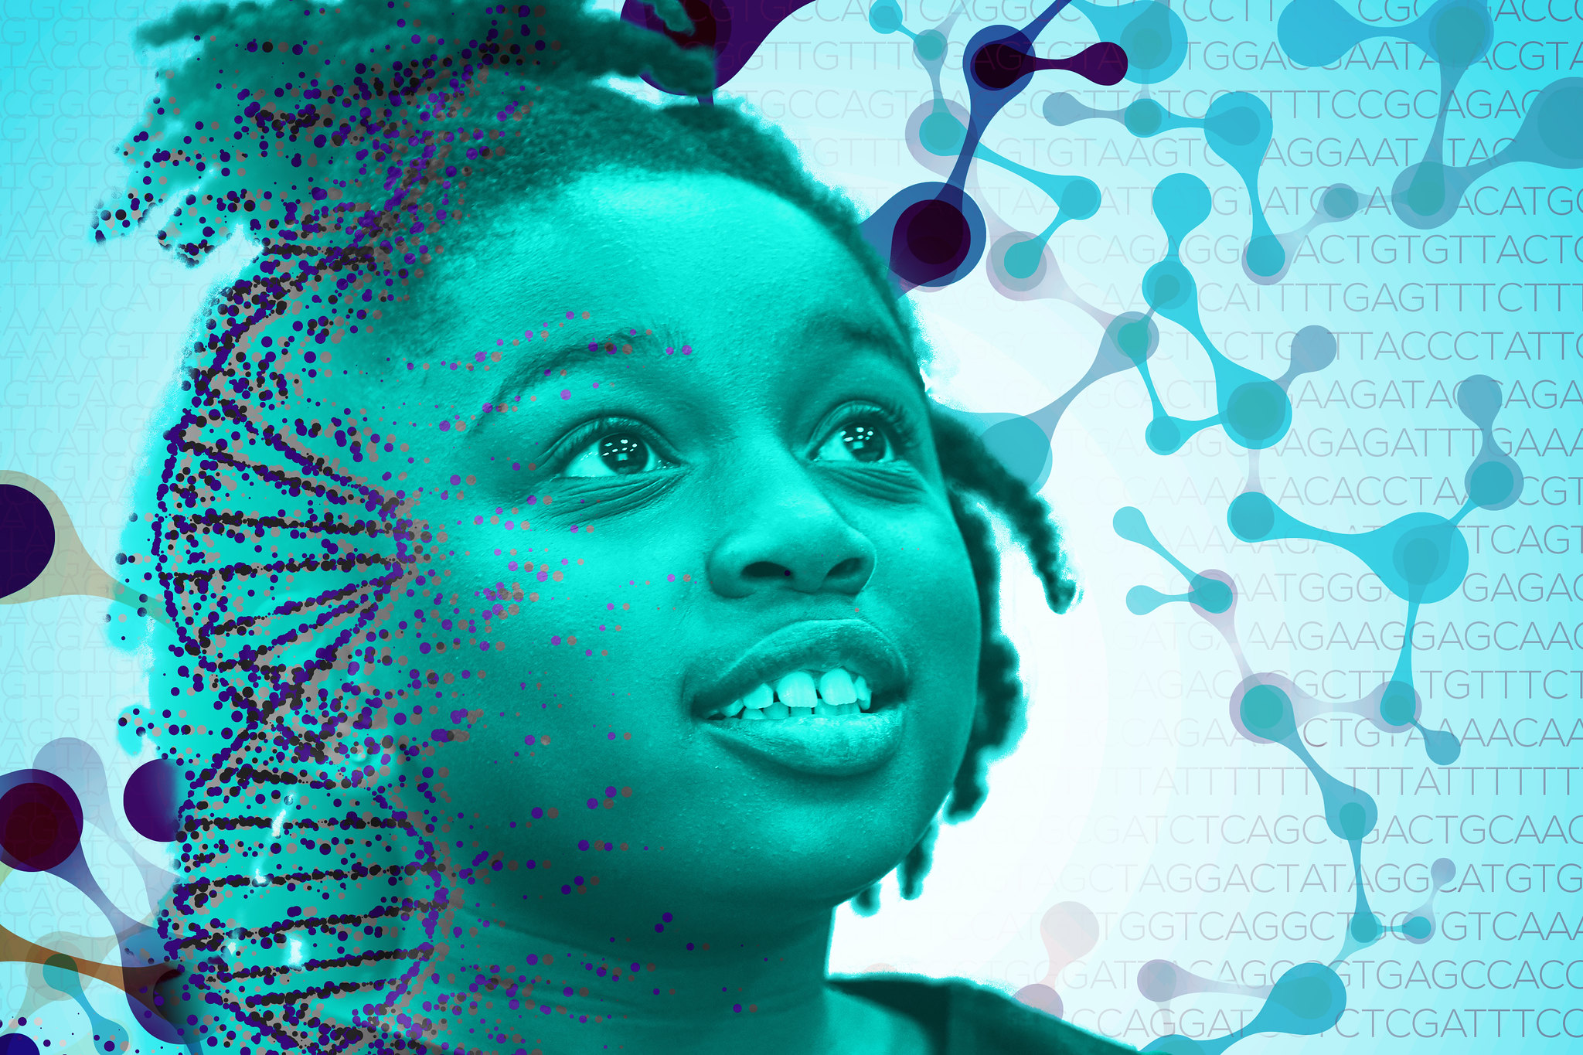
Diversity Centers for Genome Research
Diversity Centers for Genome Research | U54 | UG3/UH3
 | NOT-HG-22-030 | NOT-HG-22-031
Estimated due date: November 29, 2022
Document 27
Notes:
NHGRI is excited to introduce a new extramurally funded program entitled the Diversity Centers for Genome Research. The program aims to increase the diversity of the genomics workforce through funding innovative research projects, genomics education, and training at Minority Serving Institutions with a mission to serve historically underrepresented populations.
* This program will be associated with two funding opportunities. It is expected that both opportunities will expand the pool of diverse genomic scientists and clinicians by supporting cutting-edge genomics research projects, capacity building, and training in genomics. The first planned funding opportunity is a U54 center program, which will support a multi-investigator, interdisciplinary team to carry out 2-3 interrelated, innovative genomics research projects, foster genomics research experiences and career development, and engage the community. The second planned funding opportunity is a phased UG3/UH3 to support the development and enhancement of genomics research projects, genomic career development, and community engagement.
* The first due date for the opportunities is estimated to be November 29, 2022.
46

Slide 47
    GREAT Program
Principal Investigator | MSI/Idea-Eligible Institution | Research Intensive Institutions
Nathaniel Jue | California State University, Monterey Bay | UC Santa Cruz
Jose Garcia-Arraras | University of Puerto Rico, Rio Campus | U. Pittsburgh U. Wisconsin UC Santa Cruz UT Southwestern UC San Francisco Harvard University
Due date: July 1, 2023
Document 27
Notes:
The Genome Research Experiences to Attract Talented Undergraduates into the Genomic Field to Promote Diversity (or GREAT) Program supports collaborations between (1) Minority Serving Institutions (or MSI) or Individual with Disabilities Education Act (or IDEA)-eligible institutions; and (2) research-intensive institutions or organizations that have a prominent genomics research training environment.
The institutional collaborations provide research educational activities and experiences in NHGRI mission areas and career development for undergraduates enrolled at MSI or IDEA-eligible institutions. Shown here are the initial awards for this new program.
Led by Nathaniel Jue, the California State University (at Monterey Bay) will be collaborating with the University of California (at Santa Cruz) to train students in bioinformatics, computational biology, and other fields of genomics.
Led by Jose Garcia-Arraras, the University of Puerto Rico will be collaborating with a variety of institutions to allow students to gain hands-on research experience and participate in workshops in the fields of genomics and bioinformatics.
The due date to apply for next year’s awards is July 1, 2023.
47

Slide 48
R01 Opportunities for Early Career Researchers
    New Investigators to Promote Workforce Diversity in Genomics, Bioinformatics, or Bioengineering and Biomedical Imaging Research
      RFA-HG-21-041
      Early Stage Investigators and New Investigators
      Applications due February 22, 2023
    Supporting Talented Early Career Researchers in Genomics
      RFA-HG-22-001
      Early Stage Investigators
      Applications due February 28, 2023
Document 27
Notes:
NHGRI is committed to supporting talented researchers early in their careers. This includes two funding opportunities for independent research R01 projects targeted at this career stage.
* The first is entitled “New Investigators to Promote Workforce Diversity in Genomics, Bioinformatics, or Bioengineering and Biomedical Imaging Research.” This opportunity includes participation by NHGRI, the National Institute of Biomedical Imaging and Bioengineering, and the All of Us Research Program; it is intended to support early stage investigators and new investigators from diverse backgrounds, including those from groups underrepresented in the health-related sciences. The next application due date is February 22, 2023.
* The second funding opportunity is entitled “Supporting Talented Early Career Researchers in Genomics.” This opportunity is intended to support early stage investigators and the next application due date is February 28, 2023.
48

Slide 49
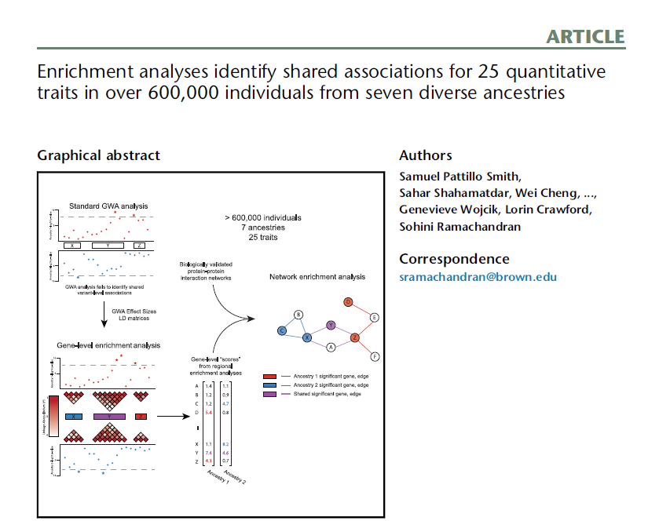
    Extramural Investigator-Initiated Highlights
    >600K individuals from representing 7 ancestry groups from PAGE study, UK Biobank, & Biobank Japan
    Over 1000 gene-level associations for 25 traits
    Enrichment of mutations in genes associated with triglyceride levels
Document 28
Notes:
NHGRI supports the development of resources, approaches, and technologies that will accelerate genomics research as described in the 2020 NHGRI Strategic Vision. We recognize that the institute is known for funding consortia-based projects and cooperative agreements. However, we want to emphasize that we also welcome novel and innovative investigator-initiated applications that follow the NIH standard schedule for submission, review, and award. I would like to briefly highlight some publications deriving from NHGRI’s extramural investigator-initiated research portfolio.
* First, Samuel Smith and colleagues performed a large-scale enrichment analyses in over 600,000 individuals representing seven ancestry groups from the Population Architecture using Genomics and Epidemiology (or PAGE) Study, the UK Biobank, and Biobank Japan. These findings were published in the American Journal of Human Genetics in March.
This analysis, which was partially funded by an NHGRI R01 award, aggregated SNP-phenotype associations at multiple genomic levels (from genes to genomic regions to pathways) and multiple ancestries in order to better understand the architecture of complex disease. The researchers identified over 1000 gene-level associations across 25 different traits and also reported an enrichment of mutations in genes associated with triglyceride levels across multiple ancestry groups.

Slide 50
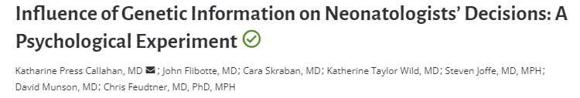
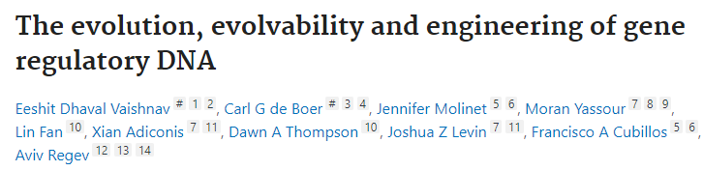
    Extramural Investigator-Initiated Highlights
    Trainee Highlights
Document 28
Notes:
Second, I would like to highlight publications from NHGRI-supported trainees.
* Katherine Callahan, a trainee on the University of Pennsylvania’s ELSI T32 grant, published a recent paper in Pediatrics that reported how neonatologists use genomic information in clinical care and concluded that specialists need to recognize bias in interpreting ambiguous genetics results.
* Carl de Boer, a K99/R00 awardee at the University of British Columbia, published a recent paper in Nature that provides a general framework for designing regulatory sequences and addressing fundamental questions in regulatory evolution.

Slide 51
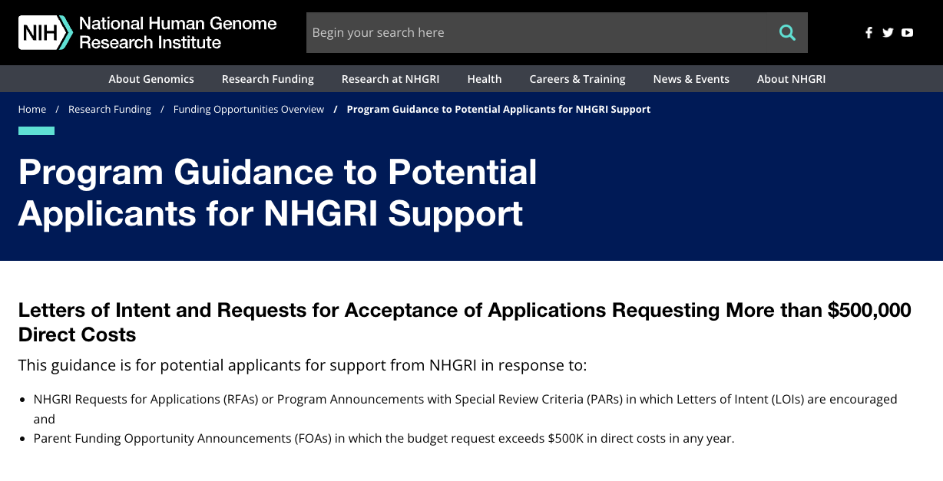
    NHGRI Review of Requests for Applications with >$500K Direct Costs
    Encourages requests be submitted at least eight weeks prior to anticipated submission date
    Details specific items to include in the request letter
Document 29
Notes:
NHGRI has refined its guidance to grant applicants requesting more than $500K direct cost in a single year. * This guidance is summarized on NHGR’s website, genome.gov, and in a recent NIH Guide notice.
NIH Policy requires applicants who seek research support of greater than $500K in direct costs in a single year to seek permission to submit the application at least six weeks before the intended submission date.
* To ensure adequate time for review and consideration of requests, NHGRI strongly encourages such requests be sent to an NHGRI Program Director at least eight weeks prior to the anticipated submission date. This extended timeframe has been found to better serve the applicants’ needs.
* The revised guidance also includes a detailed list of items that applicants should include as part of their request.
51

Slide 52

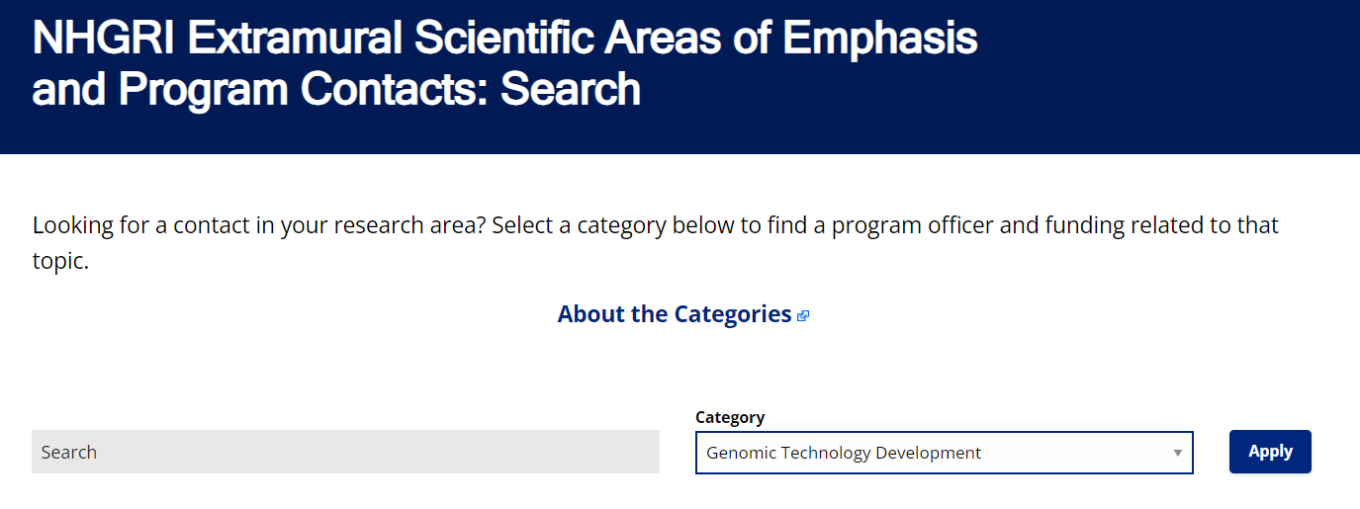
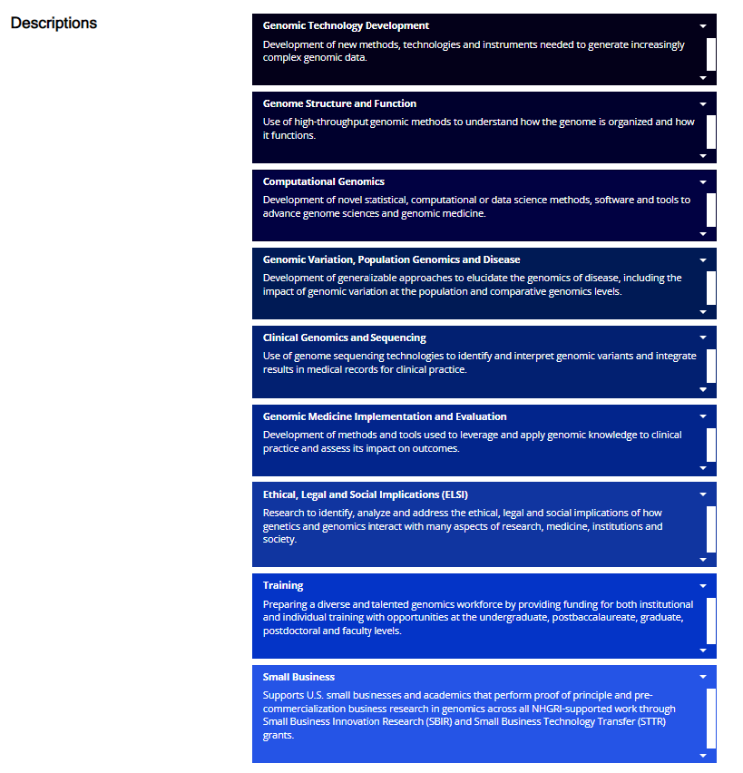
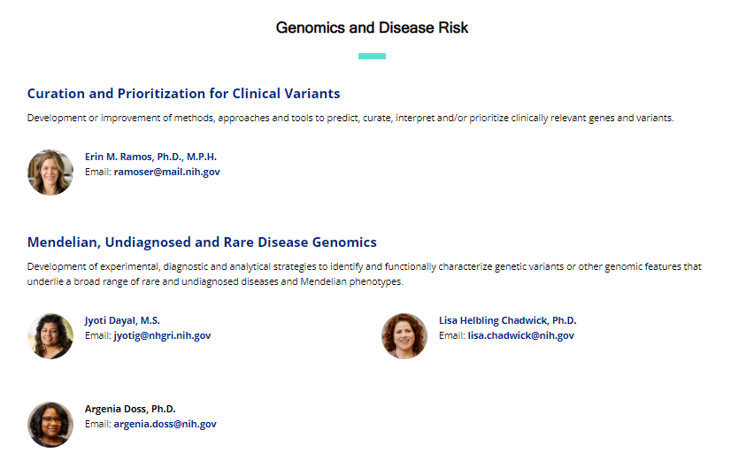
    Scientific Areas of Emphasis and Extramural Research Program Contacts Webpage
Document 30
Notes:
NHGRI encourages all applicants to reach out to program staff during the development of an application to ensure that it aligns with NHGRI’s strategic priorities. To facilitate this, the institute recently updated its website, genome.gov, to include a section on Scientific Areas of Emphasis and Extramural Program Contacts.
* The overview page for this section summarizes the major areas of research that NHGRI supports, such as: Genomic Technology Development; Computational Genomics; Genomic Medicine Implementation and Evaluation; Ethical, Legal, and Social Implications Research; and Training.
* The search page provides additional details for the major scientific areas. Specifically, each area is broken into subcategories, and each subcategory includes a brief description of the type of research supported as well as contact information for one or more program directors. * This page also includes a search function that allows the reader to quickly find the area they are inquiring about and who to contact.
52

Slide 53
Director’s Report Outline
General NHGRI Updates
General NIH Updates
General Genomics Updates
NHGRI Extramural Research Program
NIH Common Fund/Trans-NIH
NHGRI Communications, Policy, and Education
NHGRI Intramural Research Program
Notes:
Moving on to the NIH Common Fund and other trans-NIH efforts.
53

Slide 54
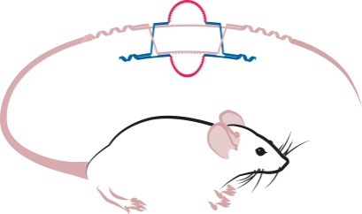





Knockout Mouse Phenotyping Project (KOMP2)
Trans-NIH program supported by 18 institutes/centers
  NCI, NEI, NHGRI, NHLBI, NIA, NIAAA, NIAID, NIAMS, NICHD, NIDA, NIDCD, NIDCR, NIDDK, NIEHS, NINDS, NCCIH, ORIP, & ORWH
Awards funded for a final five-year project period
Document 31
Notes:
The Knockout Mouse Phenotyping Program (or KOMP2) launched in 2011 as a NIH Common Fund and trans-NIH program. KOMP2 collaborates with the International Mouse Phenotyping Consortium (or IMPC) to knockout and characterize protein-coding genes in the mouse genome. Over the past 10 years, KOMP2 investigators have created and phenotyped approximately 5,500 strains of knockout mice, serving as a major contributor to the over 10,000 strains created by the larger IMPC program.
* With NIH Common Fund funding ending, KOMP2 has transitioned to a trans-NIH program supported by 18 NIH institutes and centers, as * listed here. The objective of this final phase is to make a substantive contribution to the completion of high-priority human-mouse orthologs. Specifically, the program will generate an additional 1,200 mutant mouse lines using CRISPR/Cas9 technology, perform a series of phenotyping assays, and make mice and data readily available to the research community.
* Awards for these efforts were made this summer to three production centers at * UC Davis, The Jackson Laboratory, and Baylor College of Medicine, as well as to a Data Coordination Center at EBI-Hinxton. The total funding will be $42 million over the five-year period.
54

Slide 55

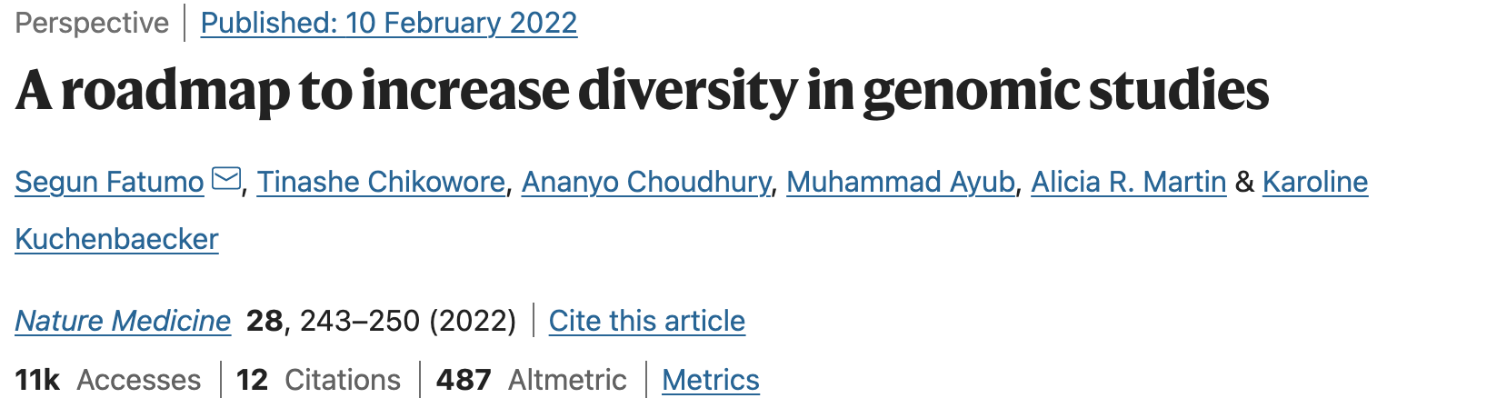
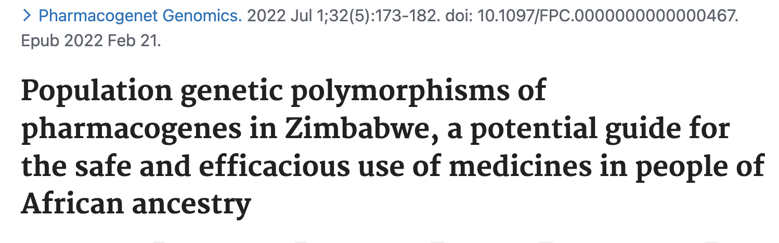
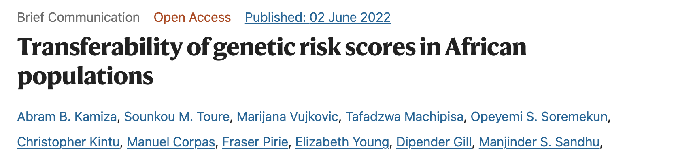
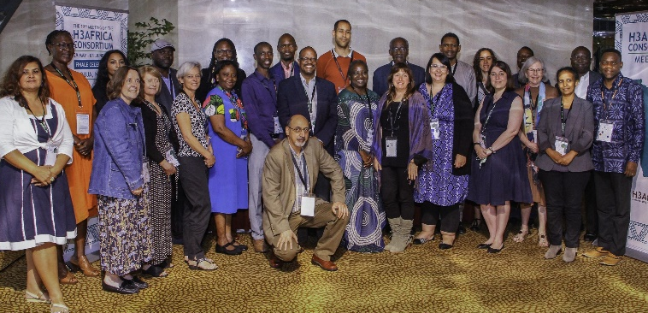
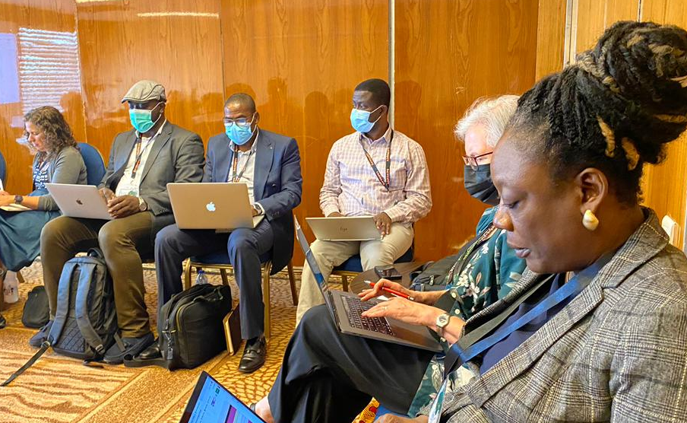
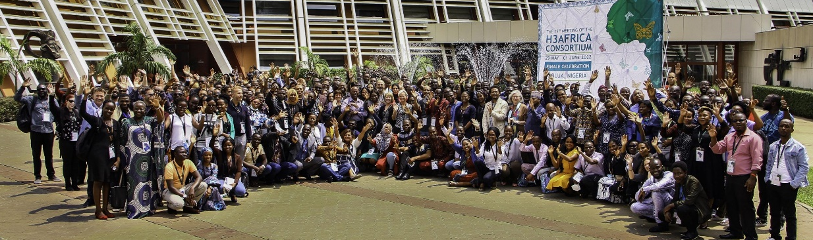
Human Heredity & Health in Africa (H3Africa)
  >700 publications
  >50 in 2022
  Consortium meeting - Celebration of 10 Years
    Session on African population descriptors
ASHG Presidential Symposium on African Genomics
Document 32
Notes:
The central goal of the Human Heredity and Health in Africa (or H3Africa) program has been to develop a sustainable and collaborative African genomics research enterprise. H3Africa has now completed its tenth and final year of NIH Common Fund support.
* H3Africa investigators have over 700 publications contributing to the advancements of genomic studies of African populations, with over 50 published so far this year. Recent examples highlight how the H3Africa program is contributing to the body of work on increasing diversity in genomics research, implementing pharmacogenomics in Africa, and transferability and use of polygenetic risk scores.
* These topics were also discussed at the most recent consortium meeting in Abuja, Nigeria in June, when, after an almost three-year hiatus, many members of the H3Africa community were finally able to reconvene in person. Others joined virtually. Of note was a session on population descriptors in genomics research, allowing a forum for stakeholders from Africa to contribute input into the U.S. National Academies consideration of this topic.
* Finally, several H3Africa investigators will be participating in the Presidential Symposium on African Genomics at the upcoming ASHG meeting. This session is being organized by NHGRI Scientific Director and current ASHG President, Charles Rotimi.
55

Slide 56


Harnessing Data Science for Health Discovery and Innovation in Africa (DS-I Africa)
RFA-RM-22-023: Harnessing DS-I Africa: Partnership for Innovation Research Projects (U01) Due date: September 28, 2022
RFA-RM-22-022: Harnessing DS-I Africa: Research Education Program (UE5) Due date: September 28, 2022
Document 33
Notes:
While the current H3Africa program is wrapping up, a new NIH Common Fund program, Harnessing Data Science for Health Discovery and Innovation in Africa (or DS-I Africa), is just completing its first year. This program supports use of data science technologies to produce innovative solutions for the most pressing issues in healthcare, public health, and health research in Africa.
The initial awards for seven collaborative research hubs, seven training programs, four ELSI research projects, and the open data science platform and coordinating center were made last year.
* There are two Funding Opportunity Announcements now open for additional DS-I Africa projects: one for U01 Partnership for Innovation Research Projects to expand the DS-I Africa network into new research areas and one for UE5 Research Education Programs to provide innovative training courses that support the data science goals of the program. Due dates for both of these are at the end of this month.
56

Slide 57

    Bridge to Artificial Intelligence (Bridge2AI)
Data Generation Project Awards (OT2):
Precision Public Health: Yael Bensoussan, USF
AI/ML in Clinical Care: Eric Rosenthal, Massachusetts General
Functional Genomics: Trey Ideker, UCSD
Salutogenesis: Aaron Lee, University of Washington
Goals of Bridge2AI
    Use biomedical grand challenges to generate flagship AI-ready data sets
    Emphasize ethical AI best practices for biomedicine
    Promote diverse teams
Bridge Center Awards (U54):
Administration/Ethics Cores: Lucila Ohno-Machado, UCSD
Tool Optimization and Skills/Workforce Dev. Cores: Alex Bui, UCLA
Teaming and Standards Cores: Monica Munoz-Torres, UC-Anschutz
Document 34
Notes:
Bridge to Artificial Intelligence (or Bridge2AI) is a NIH Common Fund program that will set the stage for widespread use of artificial intelligence (or AI) in healthcare research. The goals of the program are to generate flagship AI-ready datasets centered around biomedical grand challenge questions, to emphasize ethical AI best practices for biomedicine, and to promote diverse teams who span the boundary separating AI and healthcare research.
Bridge2AI is funding these four Data Generation Projects using an Other Transactions mechanism. These groups will focus on the following areas: AI analyses of human voice recordings as a biomarker for health; ICU data to build predictive models for adverse health events; spatiotemporal architecture of human cells and their use in interpretable genotype-phenotype learning; and Type 2 diabetes as a model to show how a person’s health is restored after disease.
Bridge2AI will also fund a BRIDGE (or coordinating) Center for the program that will be comprised of six cores across these three U54 awards. The Bridge Center will integrate and disseminate the activities, knowledge, and practices from all the other components.
NHGRI is playing a prominent role in the oversight of Bridge2AI.

Slide 58
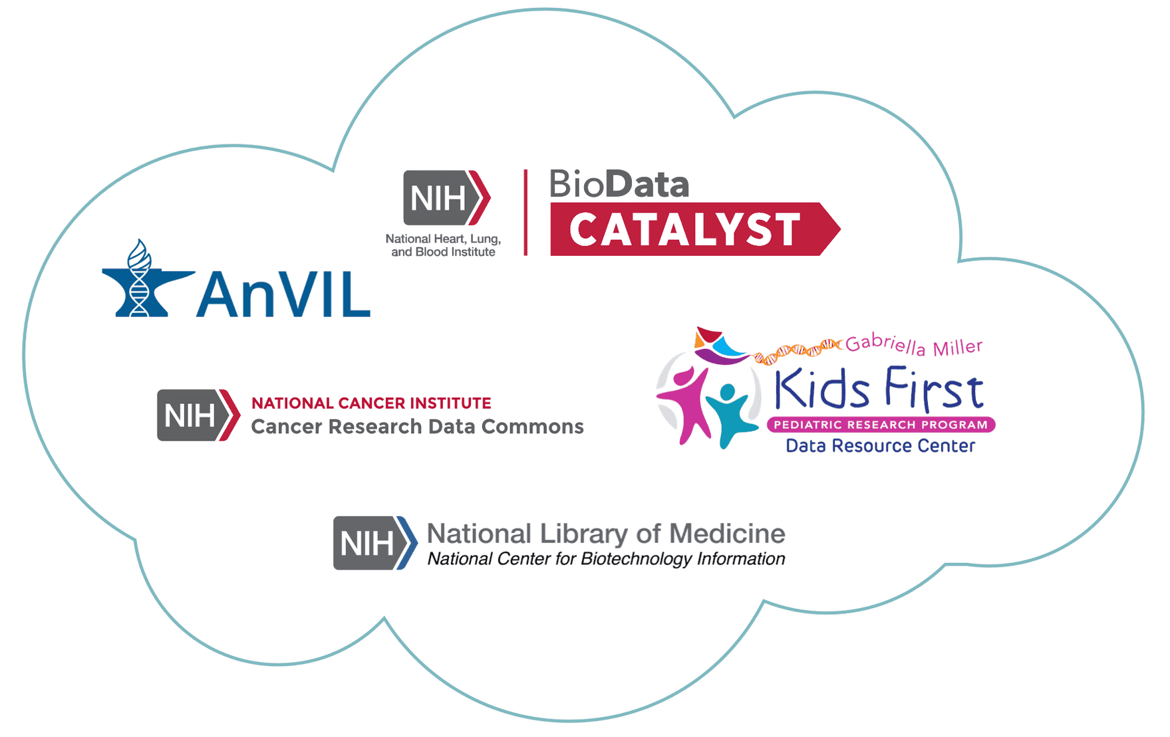
    NIH Cloud Platform Interoperability (NCPI)
    Establish a trans-NIH, cloud-based federated data ecosystem
    Coming soon: NCPI Administrative Coordination Center award funded by the NIH Office of Data Science Strategy
Document 35
Notes:
The goal of the NIH Cloud Platform Interoperability (or NCPI) efforts is to establish and implement guidelines and technical standards to create a trans-NIH, cloud-based, federated data ecosystem in order to facilitate end-user analyses across participating cloud platforms. NCPI was launched in late 2019 and is a collaboration of the NHGRI Analysis Visualization and Informatics Lab-space (or AnVIL) program with other cloud-based programs and resources supported by the National Cancer Institute, the National Heart, Lung, and Blood Institute, the NIH Common Fund, and the National Library of Medicine.
This past March, the NIH Office of Data Science Strategy released a Research Opportunity Announcement to establish an Administrative Coordination Center for NCPI. This center will provide technical, administrative, and coordination support for the NCPI program and will assist NIH with the establishment of projects that aim to improve the technical interoperability of NIH cloud resources. This center award is expected to be made by no later than the end of this fiscal year.

Slide 59




NIH Common Fund Office of Strategic Coordination
Office of Strategic Coordination
Douglas Sheeley, Sc.D.
Deputy Director
Re-engineering the
Research Enterprise (RRE)
Catalytic Data Resources (CDR)
Transformational Science and Discovery (TSD)
Cheryl Anne Boyce, Ph.D.
Chris Kinsinger, Ph.D.
Ananda Roy, Ph.D.
Assistant Director
Assistant Director
Assistant Director
Document 36
Notes:
The Common Fund is overseen by the Office of Strategic Coordination under the leadership of its Director, Betsy Wilder. This past year this office added additional members to its leadership team.
* Douglas Sheeley has taken on the new role as Deputy Director. He initially joined the office in 2019 as a program leader and has served as coordinator for various NIH Common Fund programs.
In addition, the NIH Common Fund programs have reorganized, forming three new branches and have appointed three new Assistant Directors to lead these branches: * Cheryl Anne Boyce for Re-engineering the Research Enterprise, * Chris Kinsinger for Catalytic Data Resources, and * Ananda Roy for Transformational Science and Discovery.

Slide 60
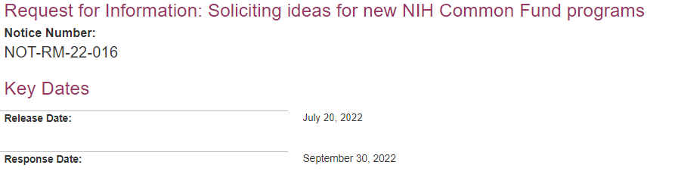
Soliciting Ideas for New NIH Common Fund Programs
Responses due: September 30, 2022
Document 36
Notes:
In addition to appointing new leadership, the NIH Common Fund is now soliciting ideas for future scientific programs that will catalyze discovery across all biomedical and behavioral research. These programs create a space where investigators and multiple NIH institutes and centers collaborate on innovative research expected to address high-priority challenges for the NIH as a whole and make a broad impact on the scientific community. NIH Common Fund programs are transformative, collaborative, time-limited, multidisciplinary, and ambitious.
This Request for Information (or RFI) is now open, and NIH encourages responses that address the greatest opportunities or challenges in biomedical research today and explain what makes it the right time to address this idea through a NIH Common Fund program. These submissions are due at the end of September and may result in programs that will be supported in Fiscal Year 2025 or beyond.
60

Slide 61
Director’s Report Outline
General NHGRI Updates
General NIH Updates
General Genomics Updates
NHGRI Extramural Research Program
NIH Common Fund/Trans-NIH
NHGRI Communications, Policy, and Education
NHGRI Intramural Research Program
Notes:
Moving on to NHGRI activities in the areas of communications, policy, and education.
61

Slide 62



    Conversations with trailblazing science communicators
Document 37
Notes:
In June, NHGRI held its final event in the highly successful Genomics and the Media virtual series, with the finale featuring Magdalena Skipper, Editor-in-Chief of Nature. Magdalena discussed modern scientific publishing and the effects of open access on both genomics research and science communication.
This last lecture capped off the popular series, * which featured the trailblazers in science communication shown here and demonstrated the various approaches for communicating about genomics, as well as the unique challenges and opportunities that different communication media can bring.

Slide 63

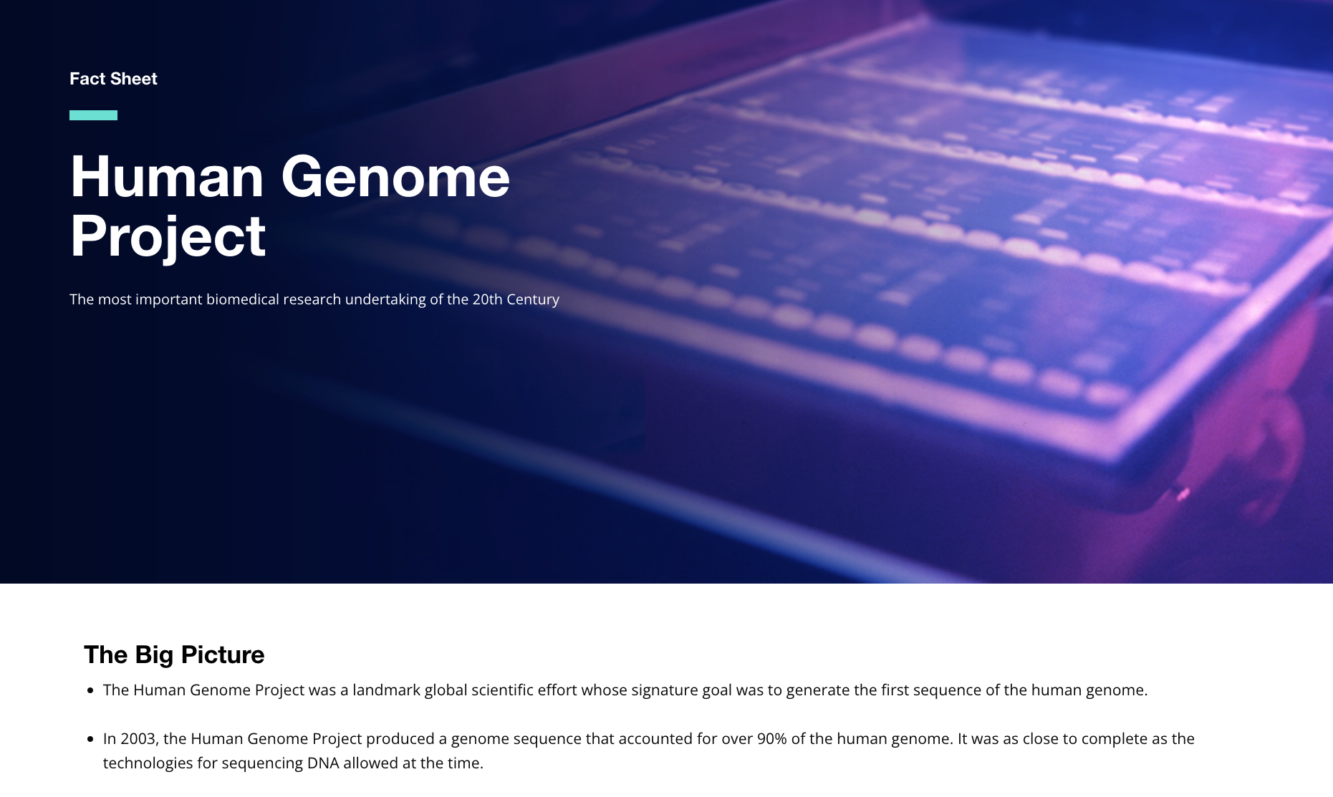
NHGRI History of Genomics Program
10-Year Anniversary
“The History of Genomics Told Through Machine Learning” lecture
New Human Genome Project fact sheet
Feature story
Social media
Document 38
Notes:
This past August marked the 10-year anniversary of NHGRI’s History of Genomics Program. This milestone was featured throughout the month with a new spotlighted item every week.
* First, we hosted a lecture by Luis Amaral from Northwestern University and his doctoral student, Spencer Hong, entitled "The History of Genomics Told Through Machine Learning." The lecture covered these researcher’s work that employs machine-learning technology to study NHGRI’s History of Genomics Program document archive. The tools that they are developing provide more efficient and effective processes to understand the breadth of the institute's historical archive collections.
* Other commemorative activities included the release of a new Human Genome Project fact sheet and the * publication of a feature story that details the origins of NHGRI’s History of Genomics Program, starting when Francis Collins left NHGRI in 2008 and the dilemma of how to preserve the historical legacy that he left behind, up through more recent efforts relating to eugenics, scientific racism, ableism, and disability.
* There was also social media promotion of the anniversary, including several clips from a recent interview that I gave about the origins and evolution of the program.
63

Slide 64

NHGRI History of Genomics Program
Future Events
Irreducible Subjects: Disability and Genomics in the Past, Present, and Future
October 6-7, 2022
The Promise and Perils of Social and Behavioral Genomics January 2023
Document 38
Notes:
On October 6 and 7, the History of Genomics Program, together with the University at Buffalo Center for Disability Studies, will hold a two-day symposium entitled “Irreducible Subjects: Disability and Genomics in the Past, Present, and Future.”
The symposium will address historical and present-day constructions of disability and ableism, with a focus on the history and lived experiences of people with disabilities in the context of genetics and genomics. The event aims to develop a fuller account of the lives and experiences of people with disabilities. Conversations will link disability rights to wider NIH discussions around inclusivity, intersectionality, equity, and social justice.
* A roundtable meeting entitled “The Promise and Perils of Social and Behavioral Genomics” is being planned for January 2023. The discussion at this gathering will focus on the historical uses of genetics and genomics in social and behavioral research, including the historical connections of research into the genetics of social mobility and educational attainment with antisemitism, eugenics, and scientific racism.
64

Slide 65
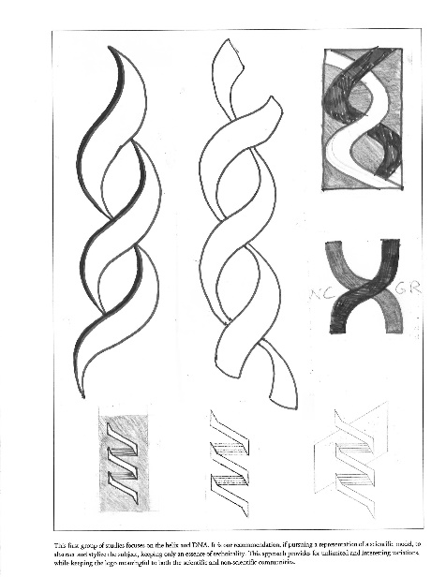






NHGRI History of Genomics Program
Archival Highlight
Notes:
A recent discovery at NHGRI made me think that it might be fun to include some sort of ‘archival highlight’ in each of my Director’s Reports that would feature an interesting element associated with the institute’s History of Genomics Program’s vast and growing archive. So, here is a pilot to see if such a regular feature is indeed entertaining.
At times, collecting historical things about genomics is like archeology – when you dig and dig, you occasionally unearth something really interesting! At NHGRI, we have recently been doing quite a bit of office cleaning and moving to adjust to the new work routines brought about by the COVID-19 pandemic; some of this includes finally clearing out and reviewing files in cabinet drawers that have been ignored for years. In one recent file clean out, we unearthed a 1990 document called * “A Scrapbook of Logo Ideas for the National Center for Human Genome Research, which summarized some early conceptualizations for designing the then-center’s first logo. This document provides a glimpse into our organization’s self-identity 32 years ago, shortly after the launch of the Human Genome Project.
* Here are a subset of the ideas in that scrapbook for our first logo, some interesting and some incredibly old-fashioned looking (but then again, it was the 1990’s!). * And then there were images like these, which to be honest, I cannot figure what the heck they were intending to represent! As you may recall, ultimately * this was our first logo, which NHGRI used until about 7 or 8 years ago.
65

Slide 66


    2022 Virtual Short Course in Genomics
Document 39
Notes:
Last month, 53 teachers became students again and enrolled in the NHGRI Education and Community Involvement Branch’s 2022 Short Course in Genomics. The course is held annually for middle school, high school, community college, and tribal college science educators and provides an opportunity for STEM educators to hear lectures and receive teaching resources from leading NIH researchers, clinicians, and staff. This virtual course featured a mix of live lectures, question and answer sessions with NIH scientists, workshops, and hands-on virtual activities.
This year, NHGRI partnered with Cold Spring Harbor Laboratory’s DNA Learning Center; the Smithsonian Environmental Research Center; and Operation Outbreak. For the first time since 2020, local participants were offered an optional, in-person guided tour of the Genome: Unlocking Life’s Code exhibition at the Smithsonian’s National Museum of Natural History.
Although the in-person experience is difficult to replicate online, the virtual format of the last three years has had its advantages, including the ability to increase the number of participants, re-engage course alumni, and provide easier access to participants from rural and disadvantaged communities.

Slide 67

NHGRI Genomic Education Resources (GenomeEd)
G2C2
# of impressions
GenomeEd
Document 40
Notes:
The Genetics/Genomics Competency Center (or G2C2) has been a valued resource for healthcare provider educators and learners alike for over 10 years. However, it was time to refresh this repository of genomics education resources, which was accomplished both by a thorough review for relevancy and currency as well as a move to its new home at genome.gov/GenomeEd.
The new site incorporates filters to help genetic counselors, nurses, pharmacists, physician assistants, and physicians quickly browse materials by topic and format, including the ability to find resources that qualify for continuing education credits.
GenomeEd will be the new accessible and memorable name for this valuable genomics education repository. The full name will be “Genomics Education Resource Center.” The GenomeEd Review Committee will evaluate new submissions, and GenomeEd is expected to grow to upskill the genomic literacy of healthcare professionals. A communications and dissemination plan is in progress.
67

Slide 68


Healthcare Professionals’ Genomics Education Week
Social Media Campaign 2022
# of impressions
Document 41
Notes:
In June, NHGRI’s Education and Community Involvement Branch hosted another successful Healthcare Professionals’ Genomics Education Week on social media, disseminating genomics education resources for healthcare professionals. Twitter posts using the event’s hashtag increased dramatically as events were hosted throughout the week with more than four million impressions.
The Inter-Society Coordinating Committee for Practitioner Education in Genomics (or ISCC-PEG) hosted the event. Their Direct-to-Consumer Genetic Testing Project Group held a panel discussion with more than 150 registrants. Other groups hosting programs included the American Heart Association, Pharmacogenomics Knowledge Base, Oncology Nursing Society, Association for Molecular Pathology, and the Minority Genetic Professionals Network. The topics covered over the week included pharmacogenomics, cancer genomics, cardiovascular genetics, molecular pathology, and an entertaining and educational “Rare Diseases Genomics Trivia” quiz.
68

Slide 69
Director’s Report Outline
General NHGRI Updates
General NIH Updates
General Genomics Updates
NHGRI Extramural Research Program
NIH Common Fund/Trans-NIH
NHGRI Communications, Policy, and Education
NHGRI Intramural Research Program
Notes:
69
And finally, moving on to NHGRI’s Intramural Research Program.

Slide 70


New Member, American Philosophical Society
Francis Collins, M.D., Ph.D.
Document 42
Notes:
NHGRI intramural investigator, Francis Collins, was recently elected to the American Philosophical Society. Election to the American Philosophical Society honors extraordinary accomplishments in all fields.
Congratulations, Francis!

Slide 71





    NHGRI Intramural Research Highlights
Patagonian sheepdog: Genomic analyses trace the footprints of extinct UK herding dogs to South America
Aberrant methylmalonylation underlies methylmalonic acidemia and is attenuated by an engineered sirtuin
Whole-genome sequencing reveals de-novo mutations associated with nonsyndromic cleft lip/palate
Document 43
Notes:
The NHGRI Intramural Research Program has once again been very productive since the last Council meeting. A few of their many research highlights include:
* Elaine Ostrander and her group used whole-genome SNP data to analyze the population structure and interbreed relationships between the Patagonian sheepdog and 175 recognized other dog breeds. The researchers found data that implicates the Patagonian sheepdog as the closest living representation of the common ancestor of modern UK herding dog breeds.
* Chuck Venditti and his group used a modified sirtuin that is resistant to methyl-malonylation and delivered it through a vector to mice models of methylmalonic acidemia. The researchers found that targeting sirtuin can reduce symptoms, demonstrating a proof-of-concept gene therapy strategy for this rare disease.
* Debo Adeyemo and his group conducted whole-genome sequencing on African individuals with sporadic cases of nonsyndromic cleft lip (with or without cleft palate) and their unaffected parents. The researchers found numerous de novo mutations that are directly involved in the cause and development of clefting.

Slide 72




‘One-Stop-Shop’ to Stay Connected
genome.gov/stayconnected
Document 44
Notes:
Before I end my Director’s Report, I want to again remind you about a * user-friendly, one-stop-shop for staying connected with me and NHGRI. By visiting this web page through this convenient URL and then scrolling down, * you get a menu of nine major resources associated with the Institute.
This includes links for the genome.gov website, The Genomics Landscape monthly newsletter, and my Twitter feed. I should pause here and point out that, last month, I went above 10K Twitter followers – something that I and my social media team are very proud of; we are grateful to those who are following me!
Also on this page, there are convenient links to the 2020 NHGRI Strategic Vision, the NHGRI brochure, our Talking Glossary of Genomic and Genetic Terms, our Building a Diverse Genomics Workforce Action Agenda, the GenomeTV channel of YouTube, and the NHGRI History Program’s set of oral histories. And if those sites are not what you are looking for, * scrolling down further reveals recordings of some selected talks of mine as well as some of my recent * podcasts and op-eds.
I hope people find this one-stop-shop helpful when trying to stay connected with me and NHGRI.
72

Slide 73


Thanks!
Special Thanks!
Notes:
Finally, a personal thanks to the many NHGRI staff members who contributed the slides and associated materials that I just reviewed in my Director’s Report. As always, a group effort is essential for getting such a large amount of information conveyed efficiently at each Council meeting.
An additional thanks to the NHGRI Office of Communications staff for creating the electronic resource associated with my Director’s Report.
And * a special thanks to the usual ‘ringleader’ for helping me prepare my Director’s Report, Kris Wetterstrand. Kris is pictured here (* in the upper-right corner of this Zoom room), meeting with leadership of the NIH Intramural Sequencing Center to gather information about an upcoming story in The Genomics Landscape about the center’s 25th anniversary.
73

Slide 74
Notes:
74

