Slide 1
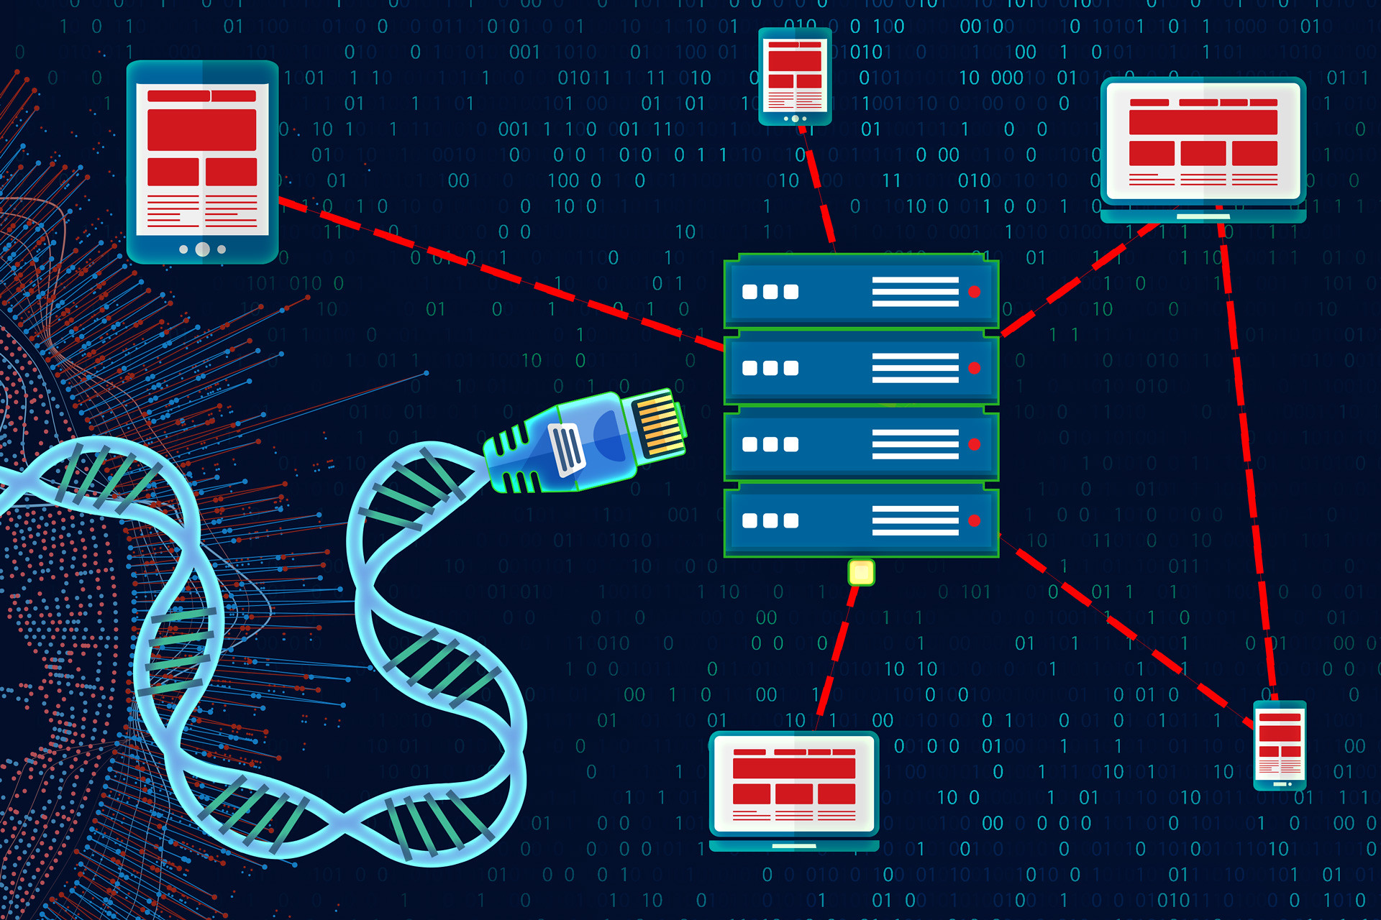
Enhancing Reuse of NHGRI’s Data Assets
Shurjo K. Sen
Office of Genomic Data Science
February 12, 2024
Notes:
The title slide looks stellar with titles that span one to three lines.

Slide 2
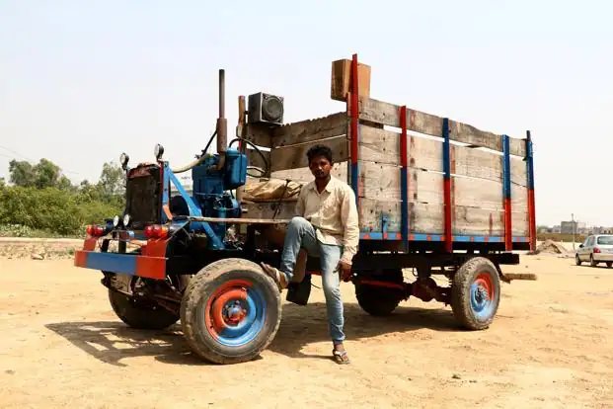
2
Notes:
A blank slide option provides an empty canvas for sharing your work.

Slide 3
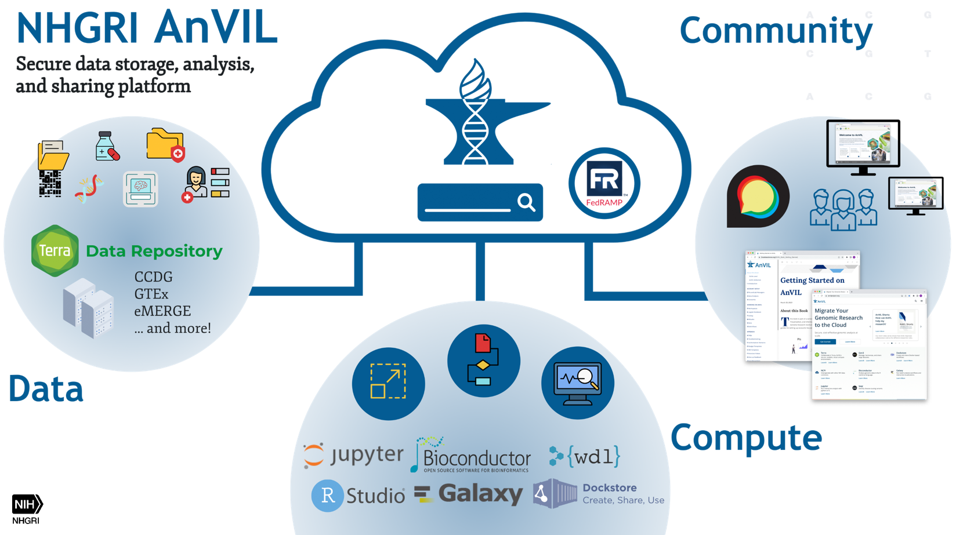
NHGRI AnVIL

Slide 4
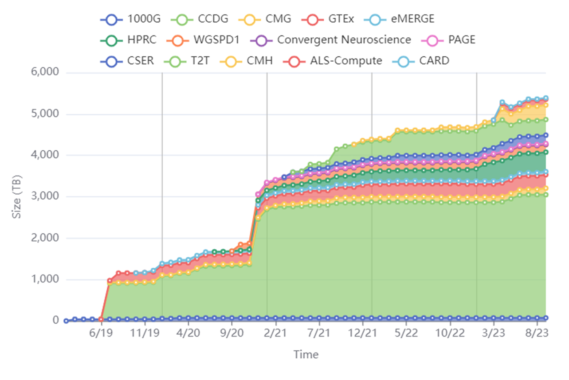
Data assets on AnVIL
Nearly 6 petabytes, over 600,000 genomes, and growing every day!!!
Notes:
Come from all Streams!

Slide 5

Getting input from the community
NHGRI-hosted AnVIL Community Workshop – October 2021
AnVIL External Consultants Committee recommended exploring avenues to actively engage the broader genomics community
Recurrent theme in email and in-person requests from the community to program staff

Slide 6

Information wants to be free
Notes:
If you have any questions, contact the NHGRI Communications and Public Liaison Branch at nhgri_communications@nih.gov.

Slide 7
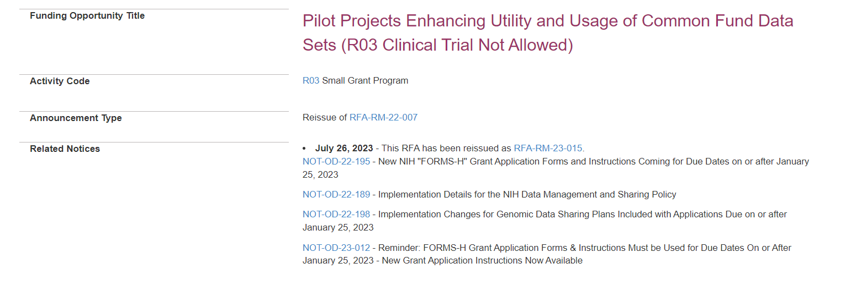
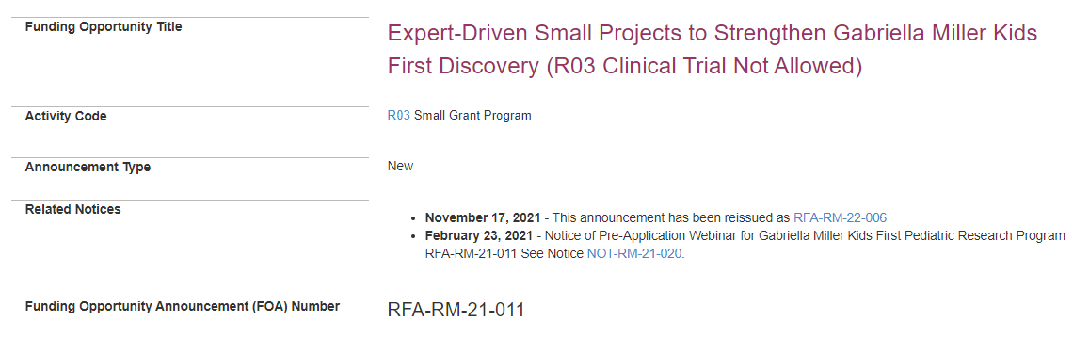
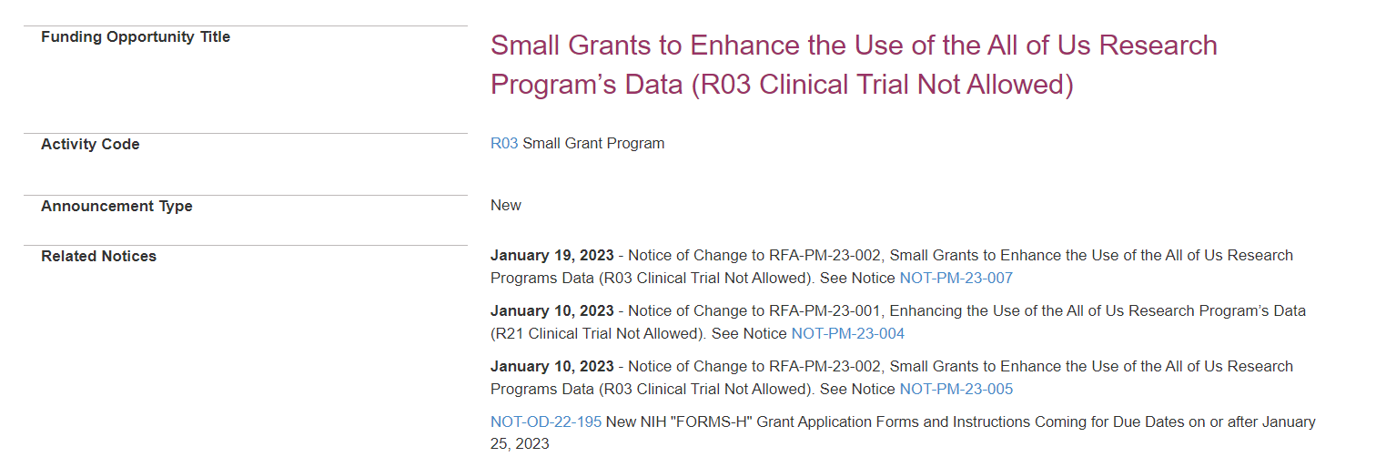
Maximizing usage of NIH data assets
Common Fund Data Ecosystem
Kids First
All of Us

Slide 8
Enhancing Reuse of NHGRI’s Data Assets
Bringing the genomics community to AnVIL data
Support secondary analyses of existing NHGRI-funded datasets for generating new hypotheses
Focused research projects that can be carried out in a short period of time with limited resources
Analyses may be used to gather preliminary results to lay the foundation for future R21 or R01 applications

Slide 9
Scope of secondary analyses
Utilization of individual datasets in novel scientific contexts
Analyses combining two or more phenotypically different AnVIL datasets or cohorts
Analyses combining AnVIL-hosted data with data available on other NIH cloud platforms
Applicants can onboard their own data and tools within the context of secondary analyses

Slide 10
Programmatic structure
RFA for R03 Small Grant Program applications
NHGRI will host pre-application webinar series showcasing breadth of AnVIL data sets
Experimental costs and generation of new data are not in scope
User support by AnVIL Training and Outreach Team

Slide 11
Budgetary structure
Two-year non-renewable projects, budget cap $120K total costs/year
Budget includes salary, compute costs, and travel to annual meeting
Applicants commit to following AnVIL’s cost overrun safeguards
Target FY25 start; subsequent rounds of awards in FY26 and FY27 (synchronized to end with 2nd cycle of the AnVIL program in FY28)
6-8 awards/funding cycle ($720K - $960K in FY25; $1,440K-$1,920K in FY26; $1,440K-$1,920K in FY27; $720K-$960K in FY28)

Slide 12
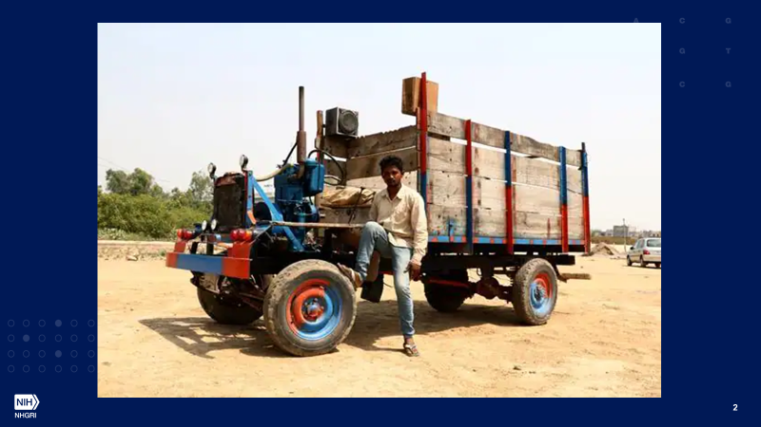
Summary
A concept to maximize the return on NHGRI’s data investments
Turning data into newer hypotheses and discoveries
Real-world test of AnVIL’s value for the genomics community

Slide 13

Questions?
Acknowledgements
Valentina Di Francesco, Helen Thompson, Chris Wellington and the OGDS team

