Slide 1

Concept Clearance for RFA on
Population Screening in Primary Care
February 12, 2024
Simona Volpi, Alanna Kulchak Rahm, Teri Manolio
NHGRI

Slide 2

Purpose
NHGRI proposes 3 RFAs for an implementation and evidence generation pilot program of population screening for common, actionable genomic conditions predominantly in the primary care setting. Specifically, the multi-site program will:
select, implement, and evaluate screening for 4-8 genomic conditions in diverse populations and clinical settings;
use established strategies for meaningful community engagement to design, conduct, and evaluate outcomes of screening; and
develop effective strategies for connecting patients screening positive to follow-up care.

Slide 3

Screening
“Tier 1” genomic conditions identified by the Centers for Disease Control and Prevention (CDC): hereditary breast and ovarian cancer (HBOC), Lynch syndrome, and familial hypercholesterolemia (FH).
These conditions at present are poorly ascertained by the healthcare system and patients are often unaware of them until they present with late-stage disease.
Notes:
Screening for genomic variants that substantially increase risk of developing common, complex diseases has been established as a cost-effective strategy for three “Tier 1” genomic conditions identified by the Centers for Disease Control and Prevention (CDC): hereditary breast and ovarian cancer (HBOC), Lynch syndrome, and familial hypercholesterolemia (FH).
These conditions at present are poorly understood by the healthcare system and patients are often unaware of them until they present with late-stage disease.

Slide 4

PCPs
Primary care providers (PCPs) are typically the “first line” for managing preventive care.
Gaps for this workforce include efficiency measures, knowledge, confidence, and a robust informatics infrastructure to support decision-making.
Picking a few high-value, high-evidence screening tests that are straightforward to implement and understand
Notes:
In many preventive approaches such as lipid screening or mammography screening and others, primary care providers (PCPs) are typically the “first line” for managing preventive care.
Gaps for this workforce include efficiency measures, knowledge, confidence, and a robust informatics infrastructure to support decision-making. These gaps can be bridged by linking clinical centers experienced in providing genomic screening with PCPs.
Introducing genomic testing gradually into the primary care space, picking a few high-value, high-evidence screening tests that are straightforward to implement and understand, is likely to be more successful than adopting a very large number (such as the current ACMG 3.2 secondary findings list) all at once.

Slide 5

Community Engagement
Community engagement is critical to conducting successful genomic research and providing effective care.
Incorporate community values, concerns, and aspirations into decision-making and establishing meaningful, ongoing partnerships.
Use implementation science.
Notes:
Community engagement, defined as the process of working collaboratively with a community to address issues that impact the well-being of the group, is critical to conducting successful genomic research and providing effective care, particularly in marginalized communities.
This entails proactively seeking out community values, concerns, and aspirations, then incorporating those into decision-making and establishing meaningful, ongoing partnerships.
Implementation science can be used to explore engagement across a number of different stakeholder types, including patients, families, communities, clinicians, health systems, and payers.

Slide 6
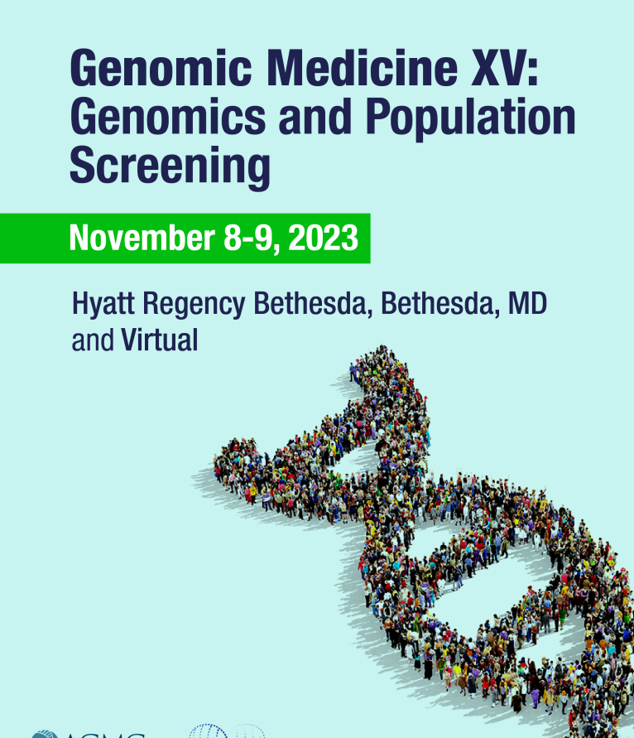
GMXV meeting
A strong recommendation of the GMXV meeting was to support pilot studies of
implementing population screening for Tier 1 conditions in primary care
near-ready genomic conditions that need that “last mile” of evidence to justify implementation.
Notes:
Last fall, the Genomic Medicine Working Group of the National Advisory Council on Human Genome Research convened leaders in genomic medicine and related fields in its 15th Genomic Medicine (GMXV) meeting to examine the current state of population genomic screening in the U.S.
A strong recommendation of the GMXV meeting was to support pilot studies of implementing population screening for Tier 1 conditions in primary care as well as near-ready genomic conditions that need that “last mile” of evidence to justify implementation. They recommended the genomics community engage with the prevention research community to co-develop these genomic prevention research projects

Slide 7

Scope and Objective
Coordinating Center, Sequencing Center and 4-5 Clinical Groups
Select, implement, and evaluate screening of unselected adults for 4-8 genomic conditions with the strongest evidence for effectiveness of screening in preventing disease or reducing its severity.
CDC Tier 1 conditions and to conditions with a strong but perhaps not yet convincing evidence base such as HFE hemochromatosis, ATTR cardiomyopathy, APOL1 hypertension or other conditions that investigators might propose.
Pilot - 20,000 participants, each undergoing exome sequencing and reporting only on CDC Tier 1 genes and other genes selected by the Steering Committee.
Each CG will be expected to enroll 5,000 participants and complete screening and return results within a 24-month period.
Notes:
The program will consist of a Coordinating Center (CC) and 4-5 Clinical Groups (CGs) experienced in providing genomic testing and interpretation, teamed with PCPs working in diverse settings and populations. “Diverse clinical settings” refers to healthcare settings outside specialized medical centers, such as community hospitals, family medicine clinics, and primary care practices.
Awardees will collaborate to select, implement, and evaluate screening of unselected adults for roughly 4-8 genomic conditions with the strongest evidence for effectiveness of screening in preventing disease or reducing its severity.
Consideration for selection and implementation of conditions should be given to the CDC Tier 1 conditions and to conditions with a strong but perhaps not yet convincing evidence base such as HFE hemochromatosis, ATTR cardiomyopathy, APOL1 hypertension or other conditions that investigators might propose.
The program will enroll, screen, and follow approximately 20,000 participants, each undergoing exome sequencing and reporting only on CDC Tier 1 genes and other genes selected by the Steering Committee.
Each CG will be expected to enroll 5,000 participants and complete screening and return results within a 24-month period.

Slide 8

Outcomes
What is the uptake, feasibility, and potential sustainability of genomic screening in primary care for patients and clinicians?
What strategies will be necessary for overcoming biases and barriers in population screening? What information/education are needed for clinicians? Are those strategies leading to patients being seen in referral?
What type of follow up is available? How reachable is the follow up for patients and how often do patients pursue it?
What are the potential costs incurred/avoided when implementing a genomic population screening?
Notes:
Outcomes from the program will address some of the following questions:

Slide 9
Funds Anticipated
$7M/year
  4-5 Clinical Groups
  1 Coordinating Center
  1 Sequencing Center
  5 years total
Notes:
We reviewed this concept with a small subgroup of Council. They were largely enthusiastic but expressed concern about the budget, which we subsequently increased from $6M to $7M.

Slide 10
Discussion
Dr. Gail Jarvik
Dr. Iftikhar Kullo
Dr. Nancy Cox
Dr. Lynn Jorde
Notes:
Dr. Jarvik and Dr. Kullo were both part of that group along with Dr. Cox and Dr. Jorde and I would like to ask Gail to start the discussion.

Slide 11
Back up slides

Slide 12
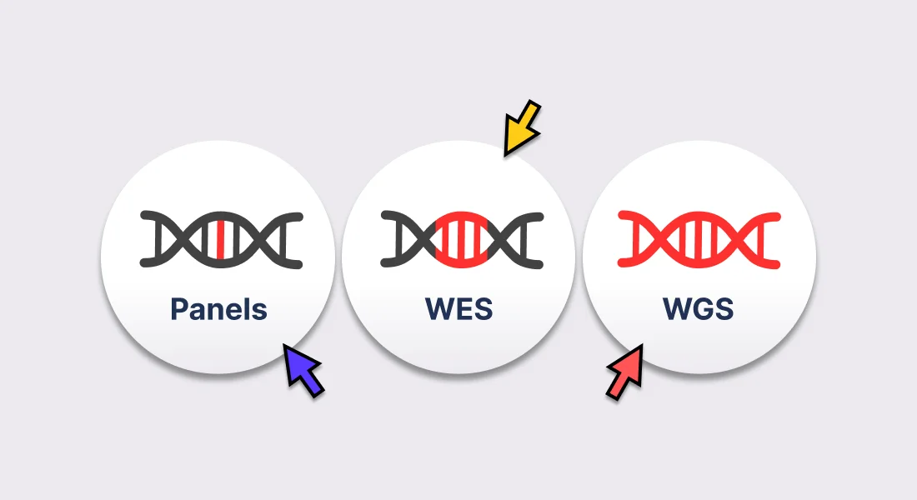
WES vs targeted panel
Pros
Cons
Faster start-up time with readily available WES pipelines
Faster turnaround time without need for batching
Lower cost
Will provide implementation outcomes on clinician adoption and implementation
Will provide implementation outcomes on barriers/facilitators/needs for patients
Richer resulting dataset
Will likely require ROR of all ACMG 81 Ifs rather than a small subset, complicating the process for PCPs
WES seq sharing will be required per GDSP even if only subset returned to clinician/patient
May not provide real-world implementation outcomes related to clinician uptake of simple, small-scale, “pilot” screening
May not provide real-world implementation outcomes related to patient uptake or clinical utility due to more complicated (or research directed) consent process

Slide 13
WES vs targeted panel
Simpler and less intimidating for clinicians and patients to understand
IFs are unlikely
All generated data returned to clinician and patient, nothing “held back”
Will provide data on clinician offering and patient uptake for those that do get offered the test
Longer start-up time due to gene/variant selection followed by set up and validation
Higher cost due to set up
Longer turnaround time due to need for batching
May not provide real-world implementation outcomes for clinical processes or costs due to customized nature and set up time
Unlikely to provide real-world assessment of provider adoption/satisfaction due to slow process and TAT could impact adoption

Slide 14
Outcomes
Patient and provider-centered outcomes like satisfaction, access, health behavior changes, empowerment/engagement, knowledge
  What are the conditions that are acceptable or not in different settings/communities?
  What education/support is needed for the clinicians as well as the patients? What is the effect of those on health behavior changes and/or other empowering aspects?
System outcomes such as cost incurred/avoided, utilization, visibility/reputation, patient experience
  What is the reach and how equitable is it? who do clinicians offer the test to and who does accept?
  What adaptations are needed to equitably implement the tests and to connect to care to equitably influence health outcomes?

