Slide 1

Genomic Medicine Working Group Update
Teri Manolio, M.D., Ph.D.
February 12, 2024

Slide 2

NACHGR Genomic Medicine Working Group Members
Carol Bult Jackson Labs
Rex Chisholm Northwestern
Pat Deverka Deverka Consulting
Geoff Ginsburg All of Us Research Program
Gillian Hooker Concert Genetics
Gail Jarvik U Washington
George Mensah NHLBI
Casey Overby Taylor Johns Hopkins
Dan Roden Vanderbilt
Marc Williams Geisinger
NHGRI
Eric Green Erin Ramos
Teri Manolio Robb Rowley
Jahnavi Narula

Slide 3




Genomic Medicine Working Group
Charge
Assist in advising NHGRI on research needed to evaluate and move genomics into routine medical practice
Review current progress, identify research, implementation, and education gaps and approaches for filling them
Identify and publicize key advances
Plan genomic medicine meetings on timely themes
Facilitate collaborations, coordination, long-term availability of genomic resources

Slide 4


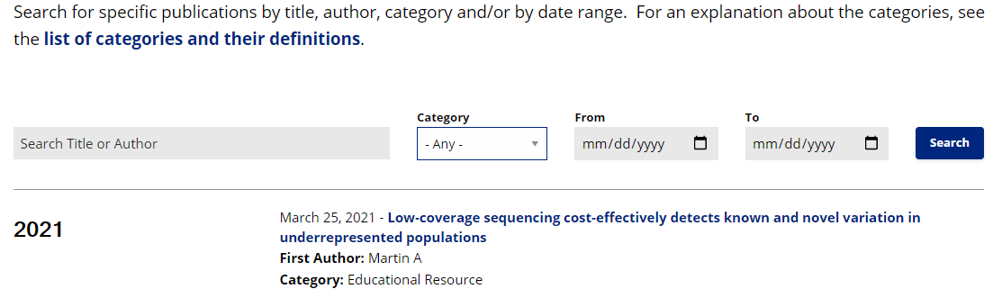
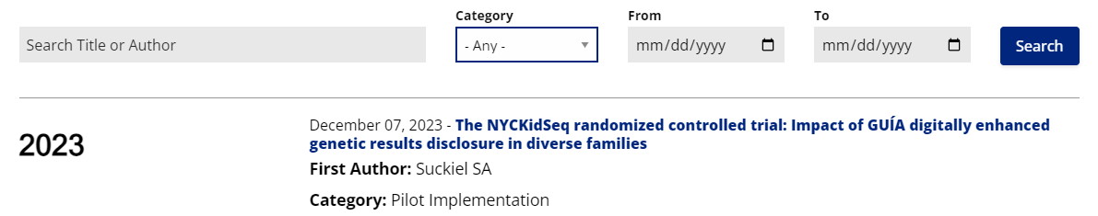

Slide 5
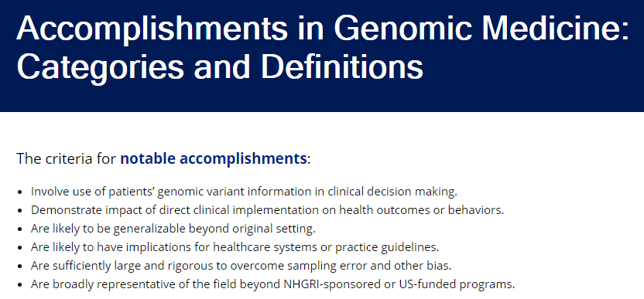
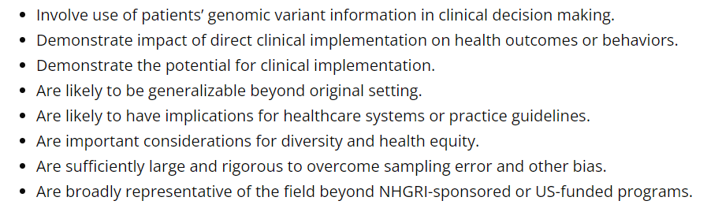
Categories:
Genomic Medicine Resource | Oncology | Variant Classification
Pilot Implementation | Undiagnosed Diseases | Impact/Outcomes
Systematic Implementation | Gene-Disease Validation | Secondary Findings
Risk Assessment/Prediction | Sequencing | Health Disparities
Pharmacogenomics |  | Other

Slide 6
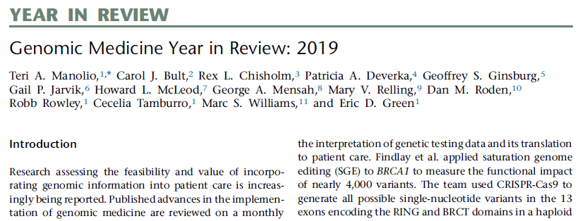
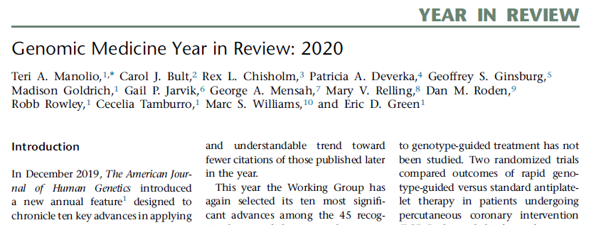
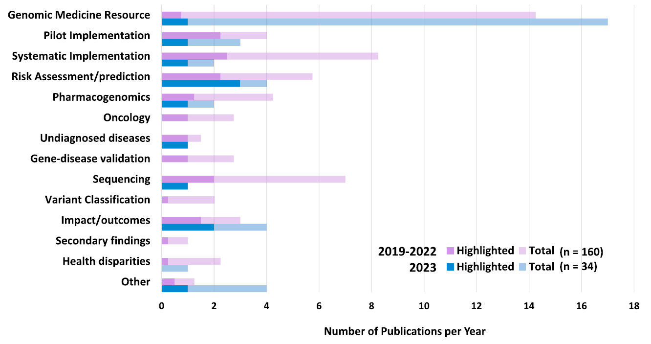
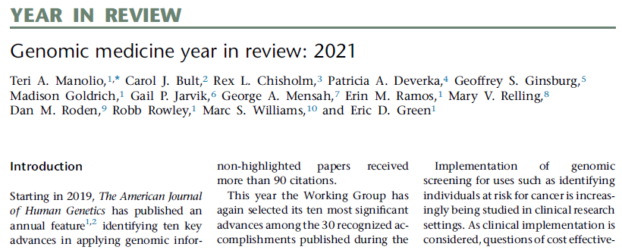
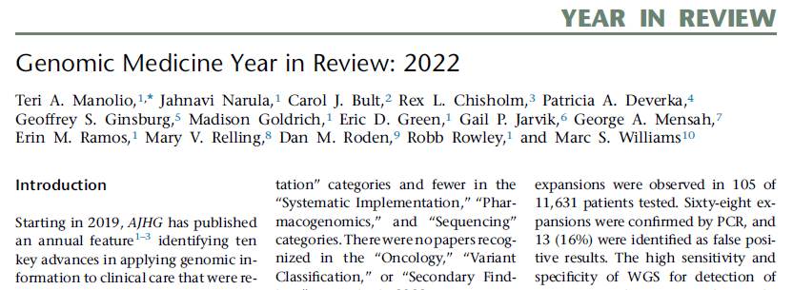
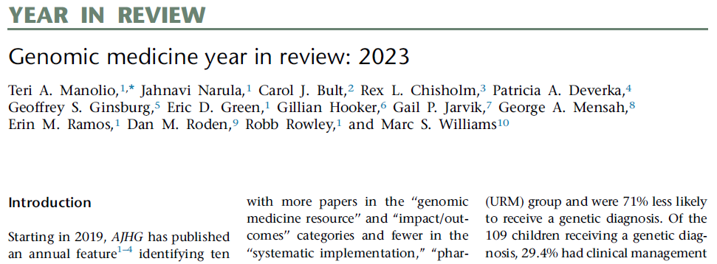
Am J Hum Genet 2019;105:1072-75.
Am J Hum Genet 2020;107:1007-10.
Am J Hum Genet. 2021;108:2210-14.
Am J Hum Genet. 2022;109:2101-104.
Send a nomination to GMWG@nih.gov
Am J Hum Genet. 2023;110:1992–95.

Slide 7
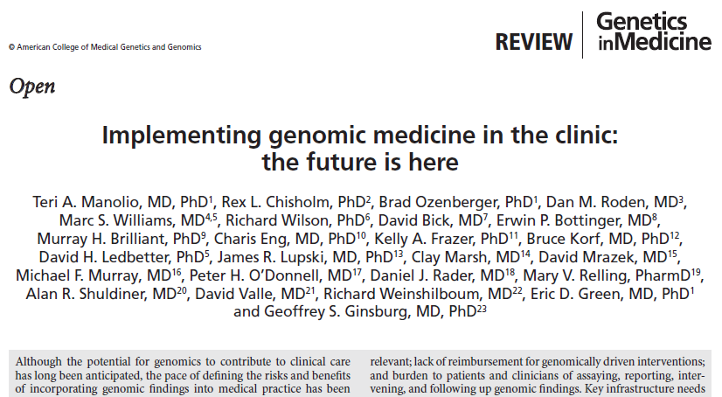






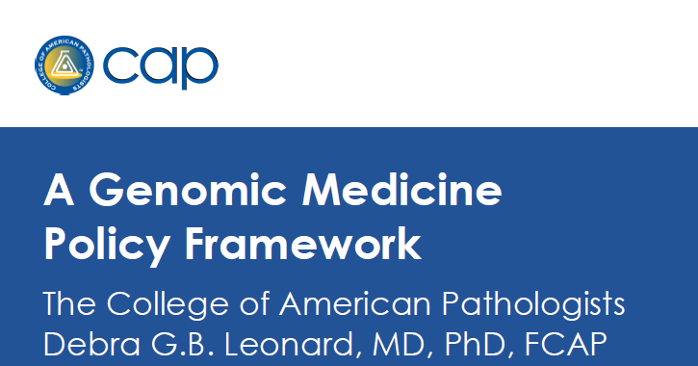
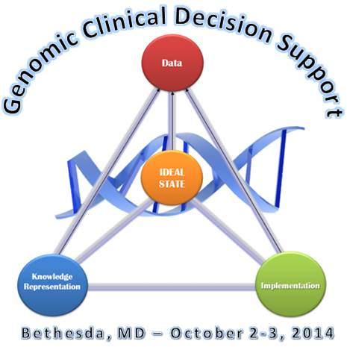





Genomic Medicine Colloquium, June 2011
GM II: Forming Collaborations, Dec 2011
GM III: Stakeholders, May 2012
GM IV: Physician Education, Jan 2013
GM X: PGx Implementation, May 2017
GM XI: Clinical Implementation, Sept 2018
GM XII: Genomics and Risk Prediction, May 2019
GM V: Federal Strategies, May 2013
GM VI: Global Leaders, Jan 2014
GM IX: Bedside Back to Bench, April 2016
GM VIII: NHGRI’s Genomic Medicine Programs, June 2015
GM VII: Genomic CDS, Oct 2014
Global Leaders in Genomic Medicine
2014
Notes:
Addressed isolation by promoting genomic medicine community, meetings

Slide 8



Genomic Medicine Colloquium, June 2011
GM II: Forming Collaborations, Dec 2011
GM III: Stakeholders, May 2012
GM IV: Physician Education, Jan 2013
GM X: PGx Implementation, May 2017
GM XI: Clinical Implementation, Sept 2018
GM XII: Genomics and Risk Prediction, May 2019
GM V: Federal Strategies, May 2013
GM XIII: Clinical Informatics Research Agenda, Feb 2021
GM XIV: Genomic Learning Healthcare Systems, Aug 2022
GM VI: Global Leaders, Jan 2014
GM IX: Bedside Back to Bench, April 2016
GM VIII: NHGRI’s Genomic Medicine Programs, June 2015
GM VII: Genomic CDS, Oct 2014
Global Leaders in Genomic Medicine
2014
GM XV: Population Screening and Genomics, Nov 2023
Notes:
Addressed isolation by promoting genomic medicine community, meetings

Slide 9













Key Products of Genomic Medicine Meetings
Population Screening Concept
RFA-HG-24-001
PAR-24-106/7
eConsults
PA-18-167
Variant, Function, Disease
Employers Health and Wellness
GenCC
NOT-HG-22-011
Patient-Centered Informatics
NOT-HG-20-020
Genomic Medicine Modules
15
13
14
12
11
10
ISCC-PEG
9
8
7
6
ADOPT-PGx
Clin Action
5
4
G2MC
RFA-HG-23-041/2
Genomic LHS
3
2
1
IHCC

Slide 10

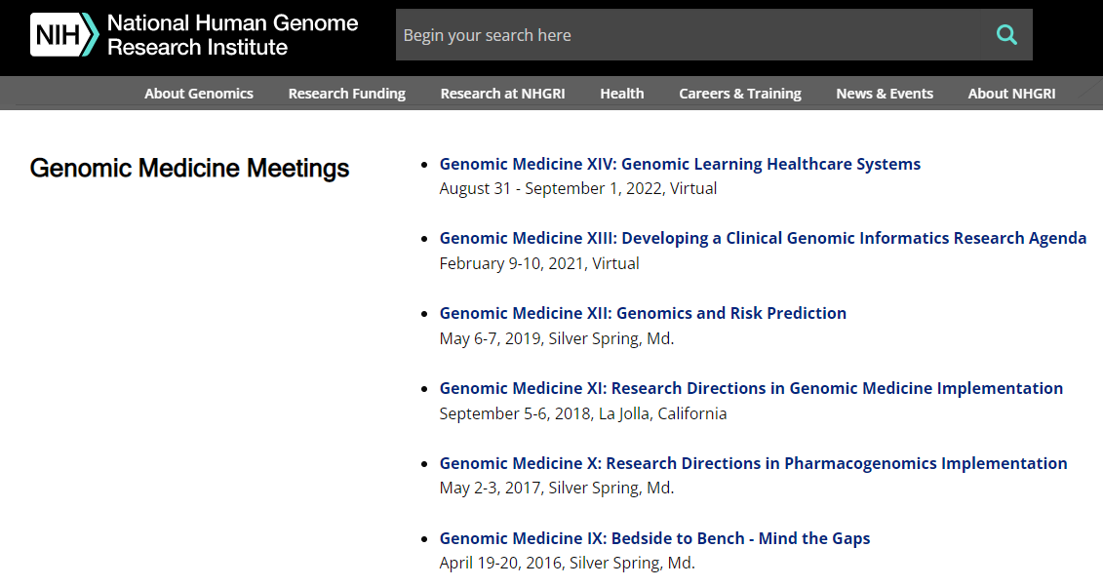

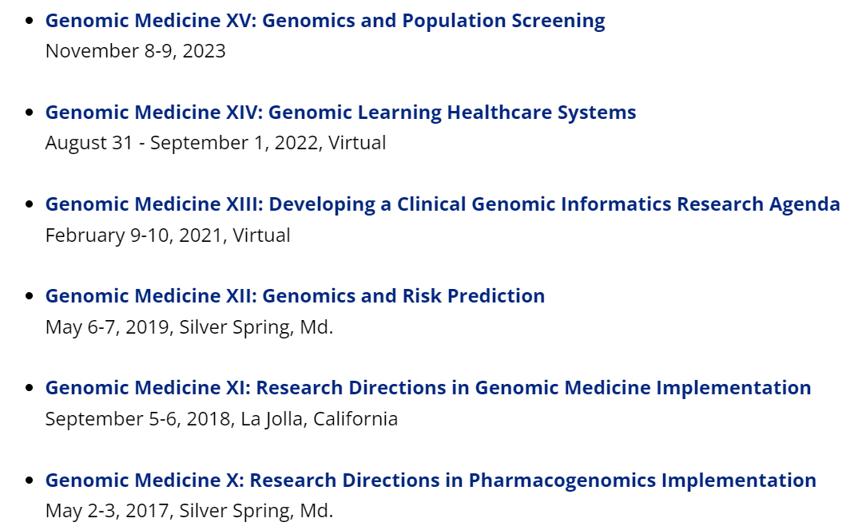
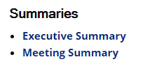
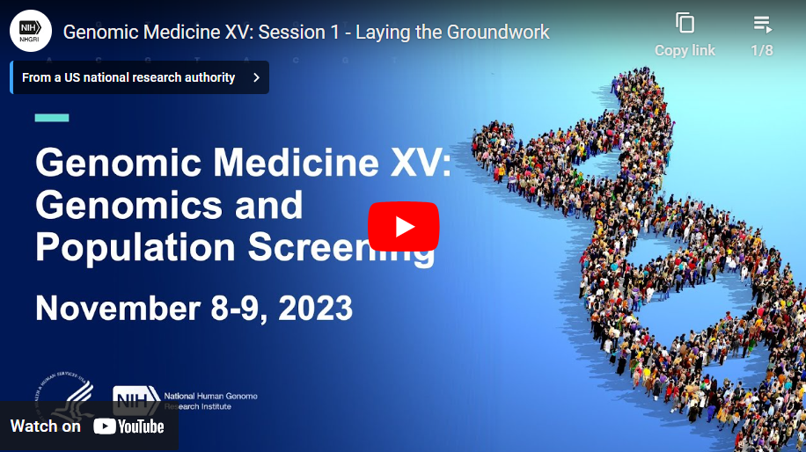
Genomic Medicine Meetings

Slide 11
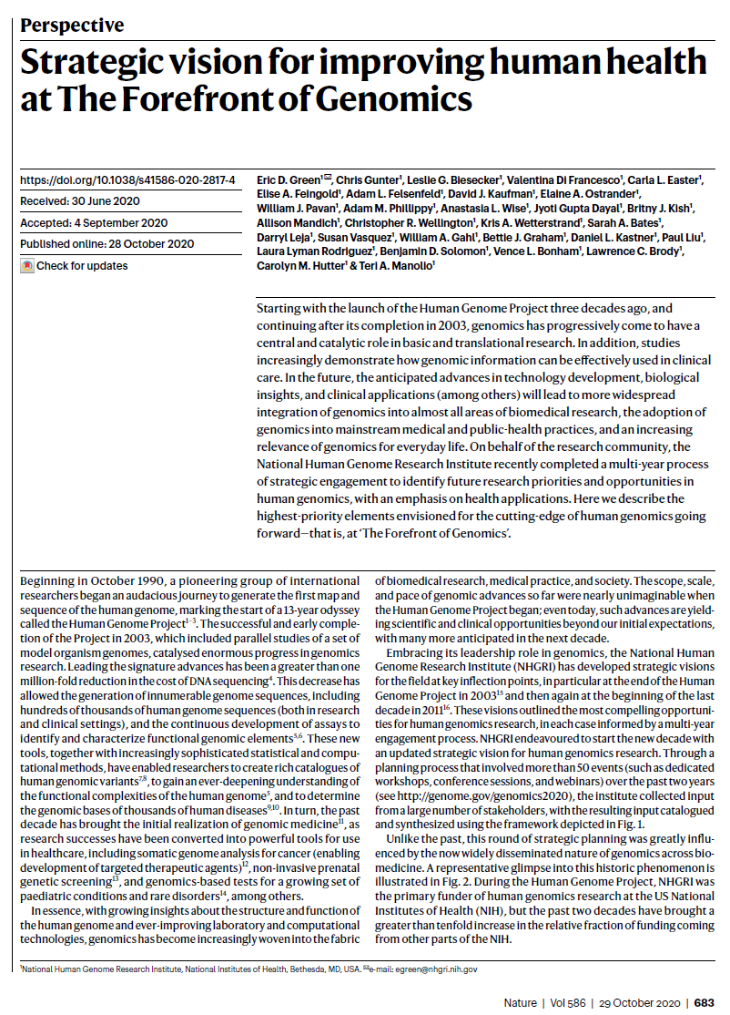
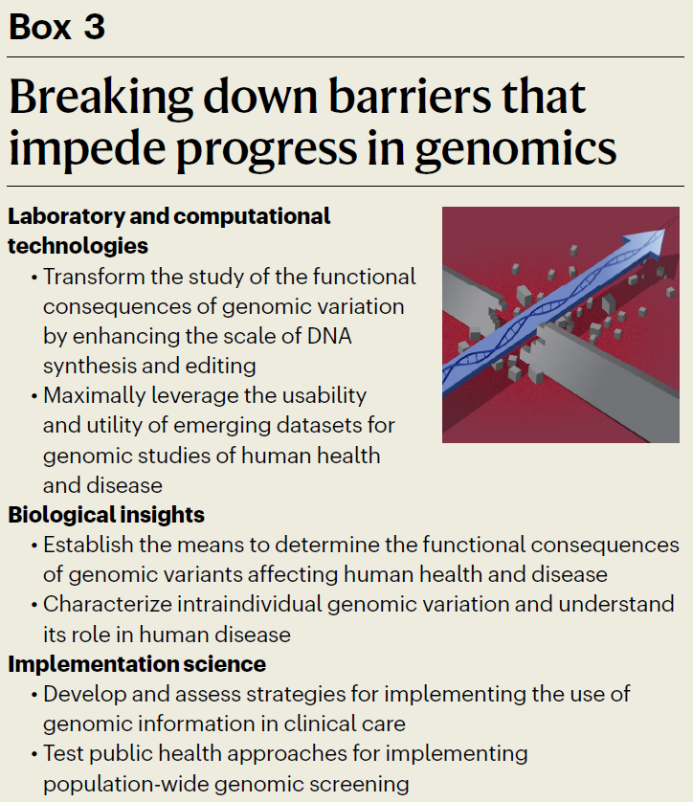
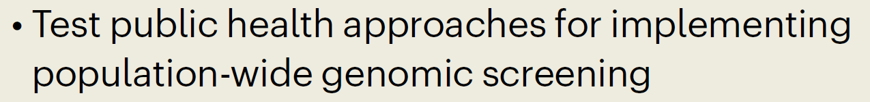
2020 NHGRI Strategic Vision
Green E. et al. Nature, 2020; 586:683-92.
Notes:
October 2020
11

Slide 12

Nov 8-9, 2023, Bethesda
Planning Group: Jonathan Berg, Gail Jarvik, Bruce Korf, George Mensah
Objectives:
Review the current state of population genomic screening in the U.S.
Examine obstacles and opportunities for expanded screening and available evidence of the impact of screening on outcomes and cost
Identify research directions to inform expanded screening as appropriate

Slide 13
Genomic Medicine XV Recommendations – Screening Pilot
Engagement and equity
Pilot studies for near-Tier 1 conditions, including engagement of prevention research community
Approaches to ensure equitable implementation of population screening and follow-up
Data management and analysis
Methods for storage, access, and transportability of screening data within and among health systems, research enterprise
Development or improvement of evidence-based models for evaluating genomic screening tests
Development of a probabilistic model for adding genes for screening, similar to Richards criteria – ACMG effort beginning to address
Improved estimates of numbers needed to screen, penetrance, natural history of conditions

Slide 14
Genomic Medicine XV Recommendations – Screening Pilot
Clinical workflow and communication
Methods to reduce complexity of, and standardize, pre-test consent and ordering
Methods enabling labs to link genetic results reports with physician consultation and CDS tools
Potential roles for artificial intelligence in reporting and following up screening results
Methods to support ongoing contact/communication with patients as genomic knowledge changes
Approaches for setting realistic expectations for genomic screening, mitigating risks of false reassurance, and facilitating accurate communication of results within families
To avoid the risks of false reassurance, individuals with a negative screening result (>98% of all who are tested) should receive effective communication that standard cancer and cardiovascular screening tests are still recommended. – Guzauskas et al., Ann Intern Med 2023, PMID: 37155986

Slide 15
NHGRI’s Genomic Medicine Research Program and FY23 Funds
Program | Goal | $M | Years
eMERGE | Develop, implement, and disseminate multi-ethnic genomic risk assessment and management tools for clinical use | 17.0 | FY07-25
IGNITE | Conduct pragmatic clinical trials of genomic interventions (APOL1 testing and PGx for pain and depression treatment) | 7.7 | FY13-24
ClinGen¹ | Develop and disseminate consensus information on genes and variants relevant to clinical care | 14.5 | FY13-24
Investigator-Initiated | Advancing genomic medicine research, genetic counseling processes, dissemination and implementation | 26.0 | FY15-
Other Contributions | AnVIL Clinical Resource, HRSA, UDN, BGTC, OMIM, CPIC, PharmGKB, WHO Genomics | 6.8 | varying
Training⁷ | Institutional training grants, fellowships, courses | 4.8 | FY16-
PRIMED^{1,2} | Improve applicability of PRS in diverse populations | 6.9 | FY21-25
Multi-Omics¹⁻³ | Advance application of multi-omic technologies to study health and disease in diverse populations | 11.2 | FY23-27
PhenX^{2,4-6} | Web-based toolkit of recommended measurement protocols including genomic medicine, SDOH | 1.8 | FY07-26
¹⁻⁶Co-funded by: ¹NCI, ²NIMHD, ³NIEHS, ⁴OBSSR, ⁵NINDS, ⁶NHLBI. ⁷Bulk funded in training budget. Not exactly genomic med.
Notes:
Total ~$777M, 31% NIH CF.

Slide 16
NHGRI Funding for Genomic Medicine, 2011-2023
Genomic Medicine Dollars (in millions)
Fiscal Year

Slide 17
NHGRI Funding for Genomic Medicine, 2011-2023
500
450
400
350
300
250
200
150
100
50
0
Genomic Medicine Dollars (in millions)
NHGRI Extramural Dollars (in millions)
Fiscal Year

Slide 18

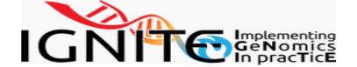




Timeline of NHGRI Genomic Medicine Programs + PRIMED, Omics
You are here
Program |  |  | Fiscal Year
 |  | … | 14 | 15 | 16 | 17 | 18 | 19 | 20 | 21 | 22 | 23 | 24 | 25 | 26 | 27 | 28 | 29 | 30 | 31
eMERGE |  |  |  |  |  |  |  |  |  |  |  |  |  | ?
IGNITE
 |  |  |  |  |  |  |  |  |  |  |  |  |  |  | ?
 |  |  |  |  |  |  |  |  |  |  |  |  |  |  | ?
Advancing Genomic Medicine RFA |  |  |  |  |  |  |  |  |  |  |  |  |  |  | ?
MOHD |  |  |  |  |  |  |  |  |  |  |  |  |  |  |  |  | ?
Population Screening? |  |  |  |  |  |  |  |  |  |  |  |  |  | ?
PRS Trial? |  |  |  |  |  |  |  |  |  |  |  |  |  |  |  |  |  |  | ?
EHR Integration/ Data Ecosystem? |  |  |  |  |  |  |  |  |  |  |  |  |  |  | ?
Feb 2024
!
Ending
Renewal Phases
?
Projected Phases

Slide 19
Investigator-Initiated Funding as Percent of Genomic Medicine Research Funding, 2015-2023
Percent Investigator-Initiated (%)
Fiscal Year
Fiscal Year

Slide 20
Advancing Genomic Medicine Research (AGMR)
RFAs-HG-23-032/033
Purpose: “…solicit proposals that stimulate innovation and advance under- standing of when, where, and how best to implement the use and sharing of genomic information and technologies in clinical care provided to all persons irrespective of racial/ethnic background or socioeconomic status.”
Broadly applicable (not specific disease, condition, gene)
NCI co-funding
Include ancestrally diverse and underrepresented populations
Requires Plan for Enhancing Diverse Perspectives (PEDP)
Encourages studies addressing health disparities
Examples
Implementing genomic medicine
Facilitating analysis of clinical genomic data
Improving clinical access to and sharing of genomic data

Slide 21
2020 Strategic Vision: Genomic Medicine Research Opportunities
Test public health approaches for implementing population-wide genomic screening
Apply multiple “omics” approaches for comprehensive characterization of disease presentation, progression, and response to treatment; develop predictive tools for onset or worsening of disease and/or response to therapy
Design and use genomic learning healthcare systems for knowledge generation and improvements in clinical care
  Develop a genomic medicine eConsult service
Develop a genomics-based clinical informatics research strategy to improve detection, treatment, and reporting of genetic disorders in clinical settings

Slide 22
2020 Strategic Vision: Genomic Medicine Research Opportunities
Test public health approaches for implementing population-wide genomic screening
Apply multiple “omics” approaches for comprehensive characterization of disease presentation, progression, and response to treatment; develop predictive tools for onset or worsening of disease and/or response to therapy
Design and use genomic learning healthcare systems for knowledge generation and improvements in clinical care
  Develop a genomic medicine eConsult service
Develop a genomics-based clinical informatics research strategy to improve detection, treatment, and reporting of genetic disorders in clinical settings

Slide 23
2020 Strategic Vision: Genomic Medicine Research Opportunities
Test public health approaches for implementing population-wide genomic screening
Apply multiple “omics” approaches for comprehensive characterization of disease presentation, progression, and response to treatment; develop predictive tools for onset or worsening of disease and/or response to therapy
Design and use genomic learning healthcare systems for knowledge generation and improvements in clinical care
  Develop a genomic medicine eConsult service
Develop a genomics-based clinical informatics research strategy to improve detection, treatment, and reporting of genetic disorders in clinical settings

Slide 24
2020 Strategic Vision: Genomic Medicine Research Opportunities
Test public health approaches for implementing population-wide genomic screening
Apply multiple “omics” approaches for comprehensive characterization of disease presentation, progression, and response to treatment; develop predictive tools for onset or worsening of disease and/or response to therapy
Design and use genomic learning healthcare systems for knowledge generation and improvements in clinical care
  Develop a genomic medicine eConsult service
Develop a genomics-based clinical informatics research strategy to improve detection, treatment, and reporting of genetic disorders in clinical settings

Slide 25
2020 Strategic Vision: Genomic Medicine Research Opportunities
Test public health approaches for implementing population-wide genomic screening
Apply multiple “omics” approaches for comprehensive characterization of disease presentation, progression, and response to treatment; develop predictive tools for onset or worsening of disease and/or response to therapy
Design and use genomic learning healthcare systems for knowledge generation and improvements in clinical care
  Develop a genomic medicine eConsult service
Develop a genomics-based clinical informatics research strategy to improve detection, treatment, and reporting of genetic disorders in clinical settings

Slide 26
2020 Strategic Vision: Genomic Medicine Research Opportunities
Test public health approaches for implementing population-wide genomic screening
Apply multiple “omics” approaches for comprehensive characterization of disease presentation, progression, and response to treatment; develop predictive tools for onset or worsening of disease and/or response to therapy
Design and use genomic learning healthcare systems for knowledge generation and improvements in clinical care
  Develop a genomic medicine eConsult service
Develop a genomics-based clinical informatics research strategy to improve detection, treatment, and reporting of genetic disorders in clinical settings

Slide 27








Many Thanks…
Genomic Medicine Program Investigators and Participants
Veronica Abraham
Zo Bly
Marcus Brown
Christine Chang
Jessica Chong
Heather Colley
Priscilla Crockett
Jyoti Dayal
Carmen Demetriou
Eric Green
Peggy Hall
Sarah Hutchison
Deanna Ingersoll
Rongling Li
Alanna Kulchak Rahm
Esperes Mfwilwakanda Iman Martin
Joannella Morales
Jahnavi Narula
Weini Ogbagiorgis
Erin Ramos
Renee Rider
Karyn Roberts
Robb Rowley
Alessandra Serrano- Marroquin
Simona Volpi
Nephi Walton
Riley Wilson
NSIGHT
Newborn Sequencing
Carol Bult, Rex Chisholm, Pat Deverka, Geoff Ginsburg, Gillian Hooker, Gail Jarvik, George Mensah, Casey Overby Taylor, Dan Roden, Marc Williams

Slide 28
Additional Initiative Ideas
Increase uptake of cascade screening (Feb 2021)
Promote collaboration on and distribution of shareable custom genomic applications in Cerner and Epic (Oct 2021)
Develop and distribute a standard set of outcome measures from genomic LHS (Oct 2021)
Evidence generation– additional clinical trials?

