Slide 1


Advancing genomic medicine through Genome Informed Risk Assessment - the eMERGE Network update
Eimear Kenny on behalf of the eMERGE Network
Feb 12 2024 Virtual NHGRI Council Meeting

Slide 2
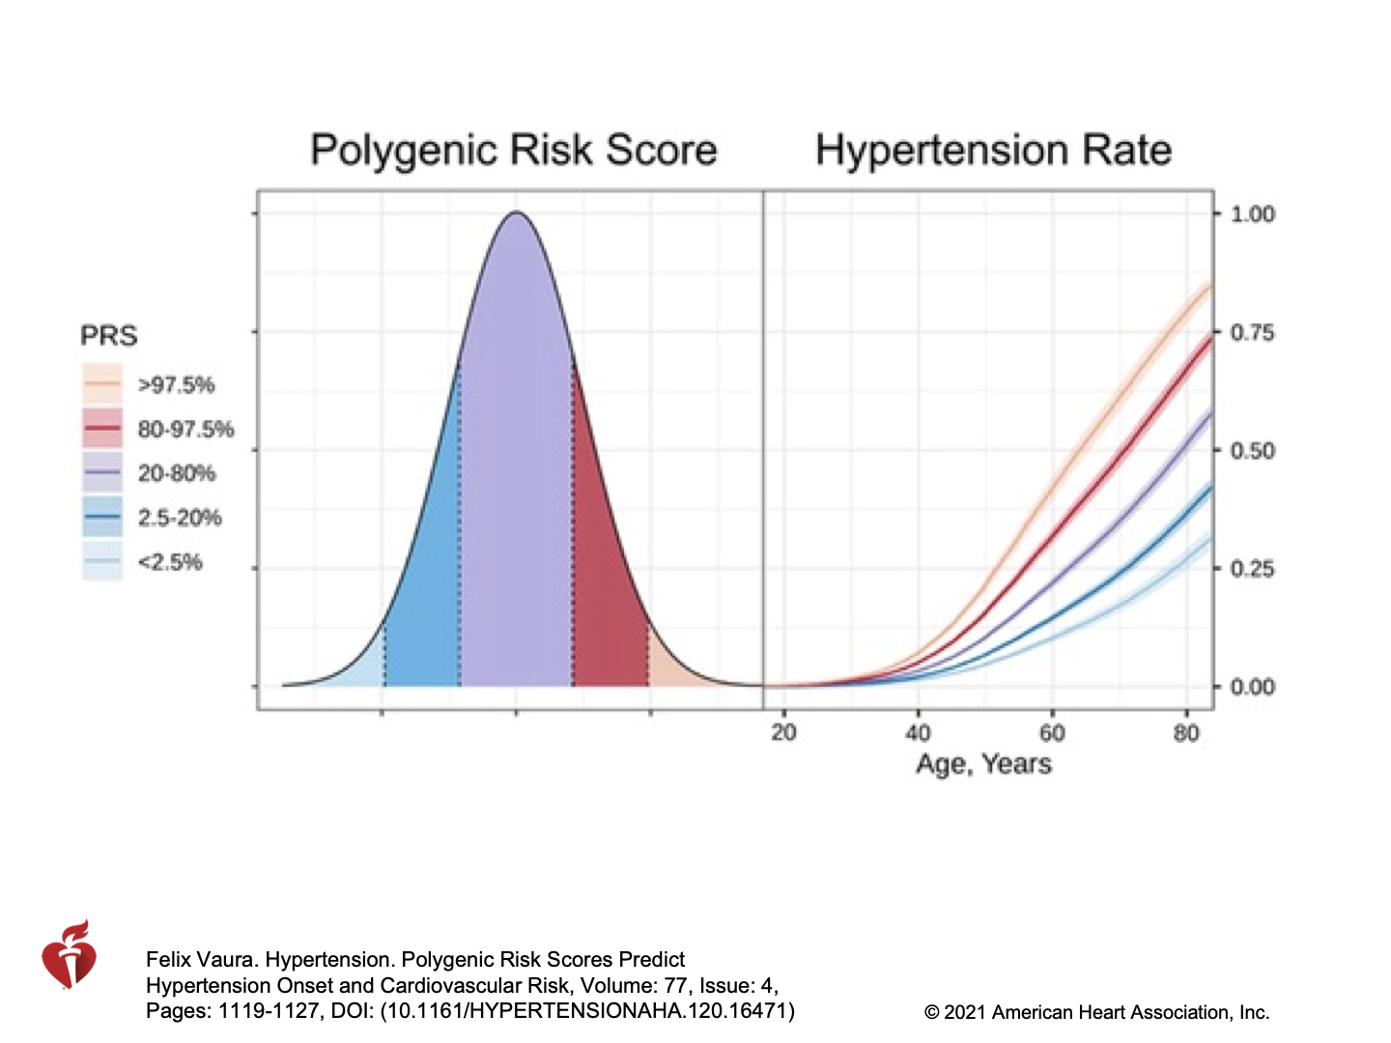
Utility of Genomic Risk and Common, Complex Disease
Vaura et al, Hypertension, 2021
Notes:
Advancements in polygenic risk scores (PRS) over the past five years have focused on efforts to improve disease risk prediction, diagnostic accuracy, and the identification of individuals who may benefit from targeted preventive interventions.

Slide 3
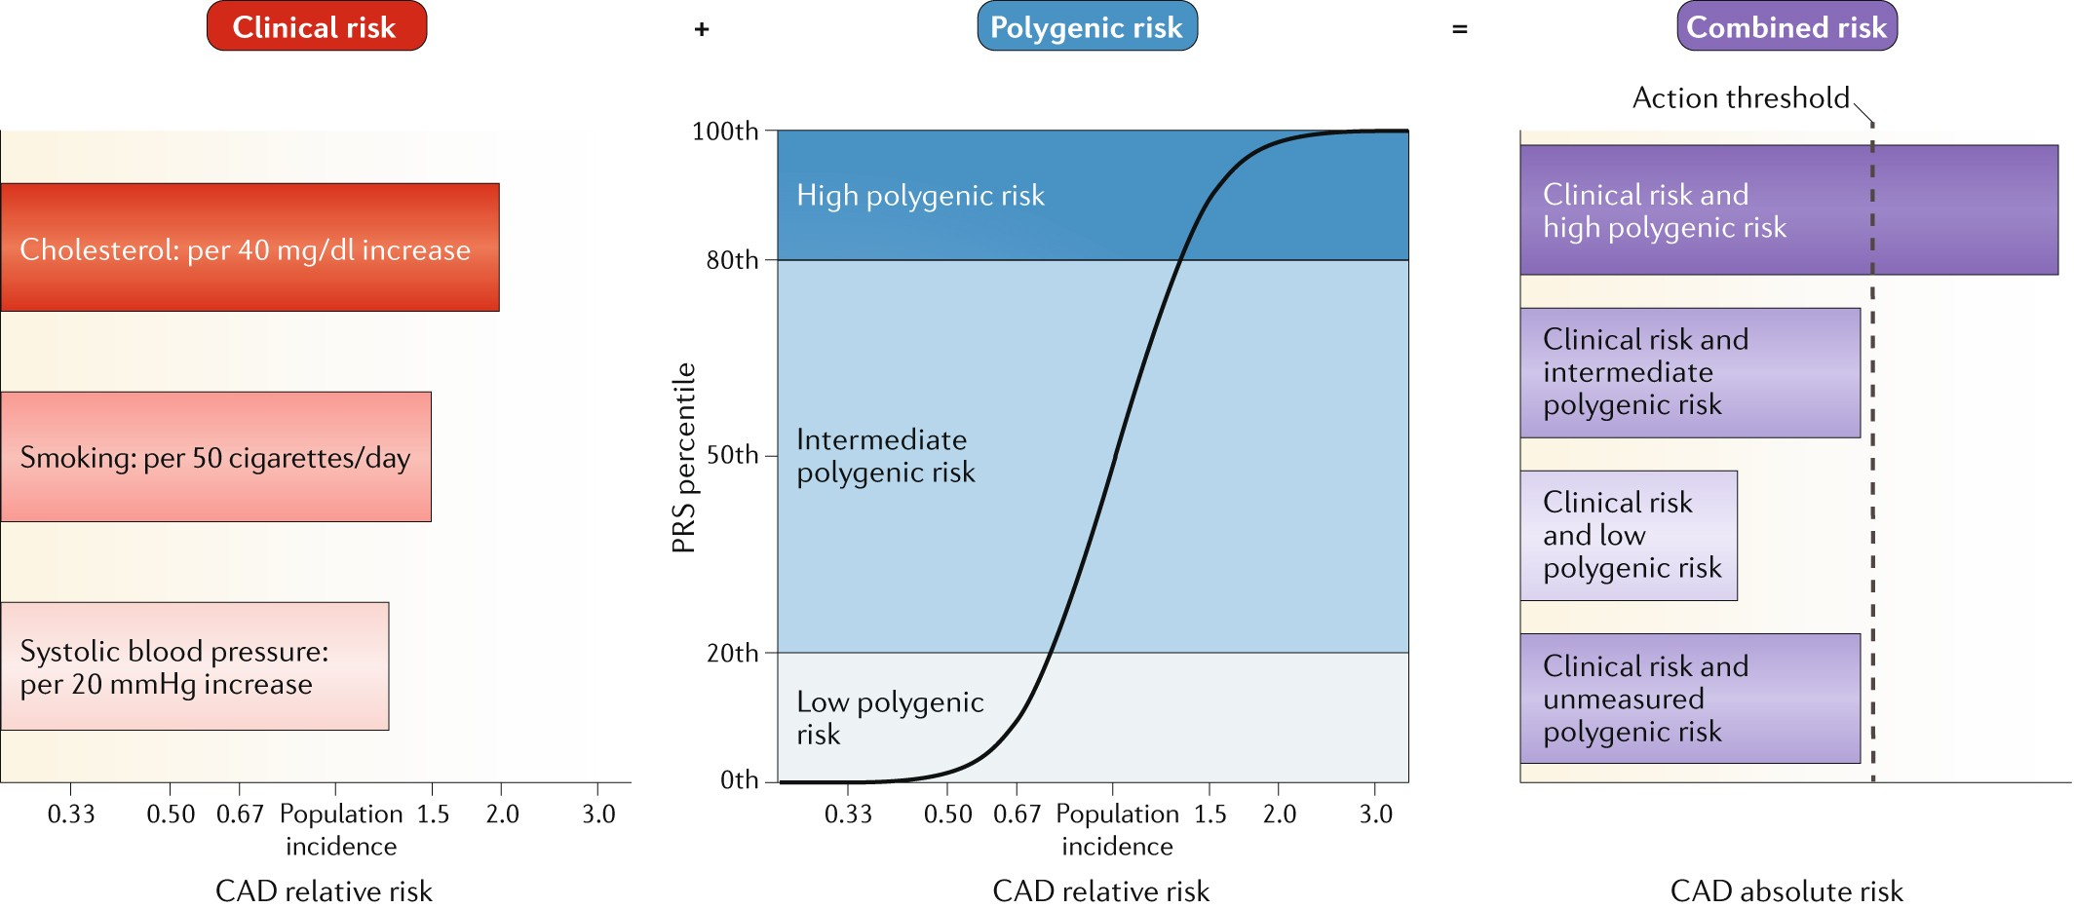
There is still much unknown about the utility of polygenic risk scores for common diseases
No clinical guidelines regarding the ordering or use of PRS in care
Torkamani et al, 2018

Slide 4
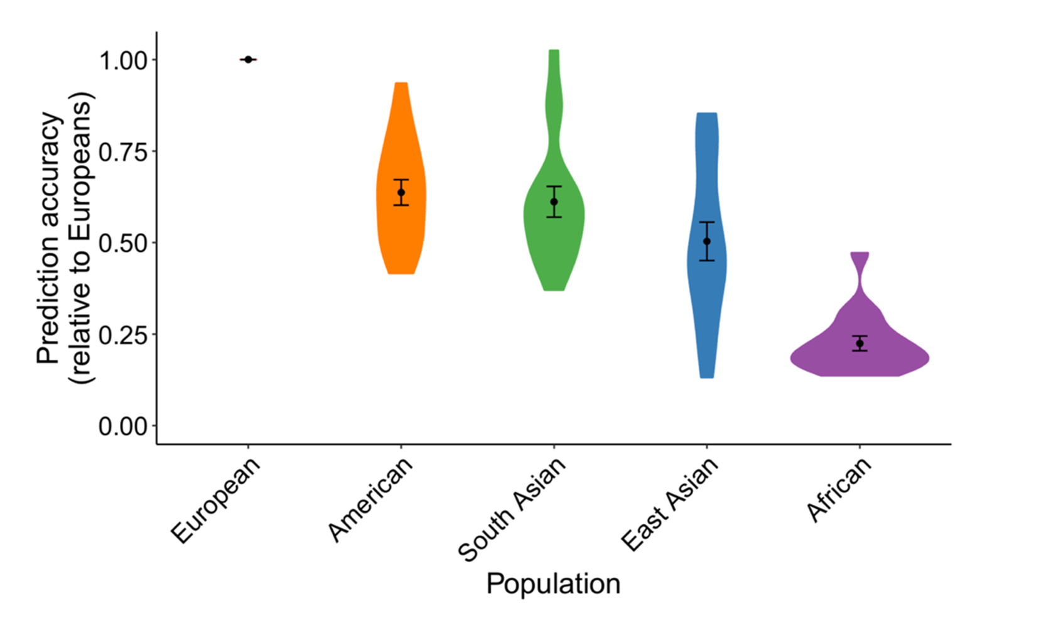
PRS often have reduced accuracy across genetic ancestries
Martin, Nature Genetics 2019
Notes:
PMID: 30926966; accuracy is R2
If ancestry specific snps aren’t present in training set, model doesn’t perform in validation as well
Problem is compounded by fact self reported ancestry is used ind development which doesn’t necessarily reflect genetic ancestry

Slide 5
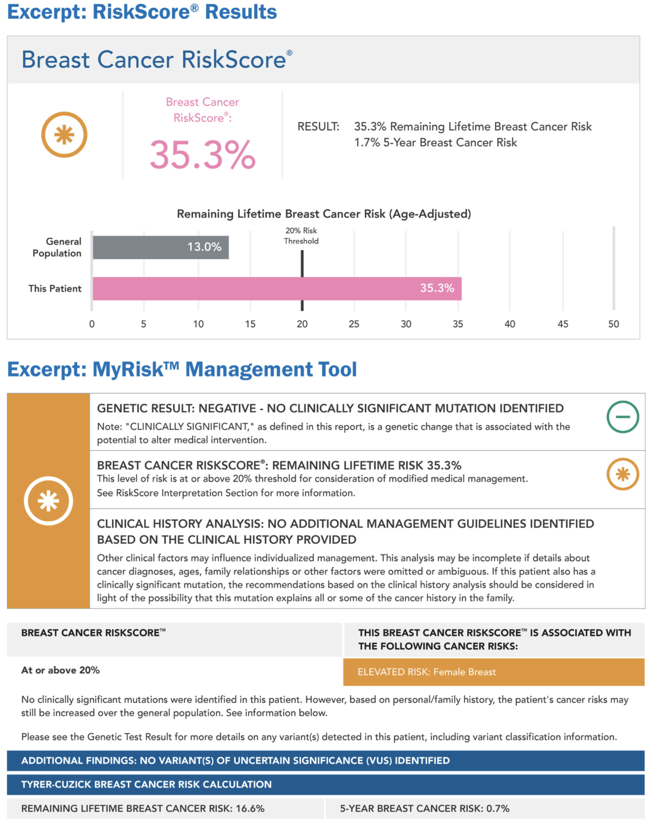
We are already starting to see this risk information in clinical practice.
Source:https://myriad.com/imaging/risk-assessment/

Slide 6
Meeting a dual challenge
Effectively communicating complex genetic risk information to both healthcare providers and patients to inform clinical decision-making.

Slide 7
Meeting a dual challenge
Effectively communicating complex genetic risk information to both healthcare providers and patients to inform clinical decision-making.
Need for standardized frameworks and protocols to ensure regulatory compliance, clinical utility, and the ethical use of PRS across various healthcare settings.

Slide 8
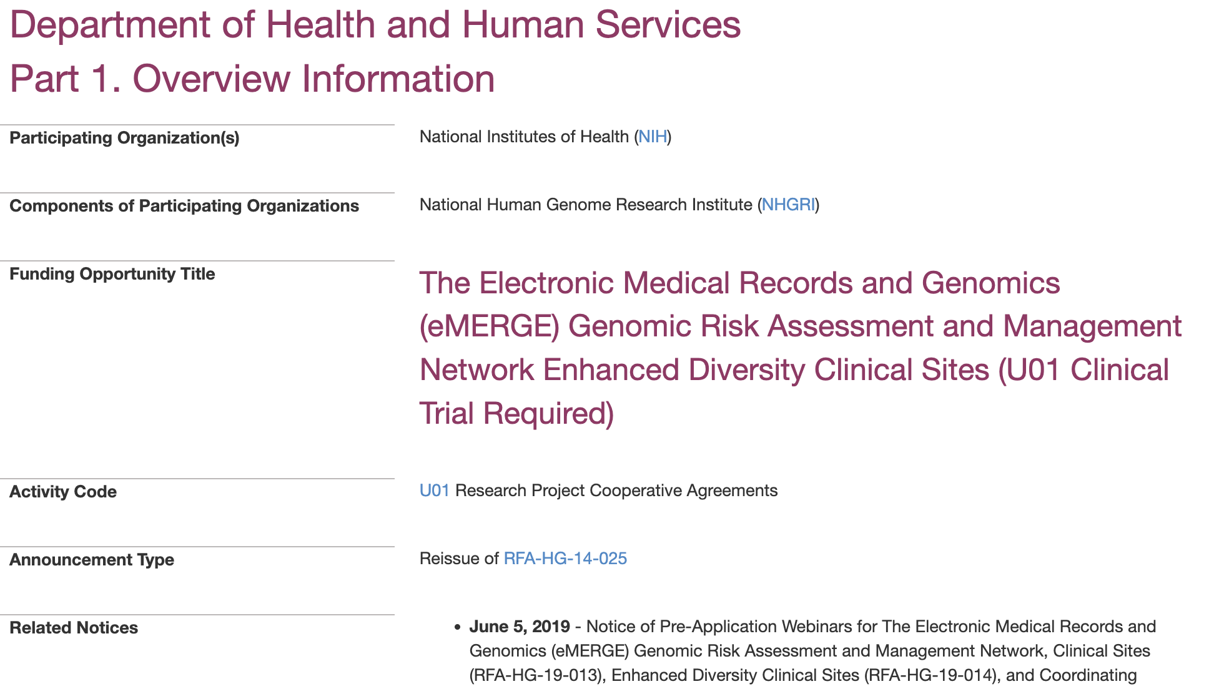

Slide 9

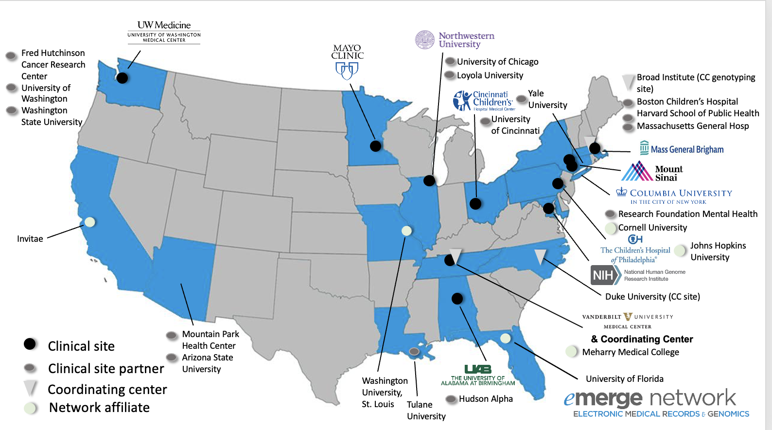
The Electronic Medical Records and Genomics (eMERGE) Genomic Risk Assessment and Management Network
https://emerge-network.org
Notes:
Where we started….2019 RFA

Slide 10


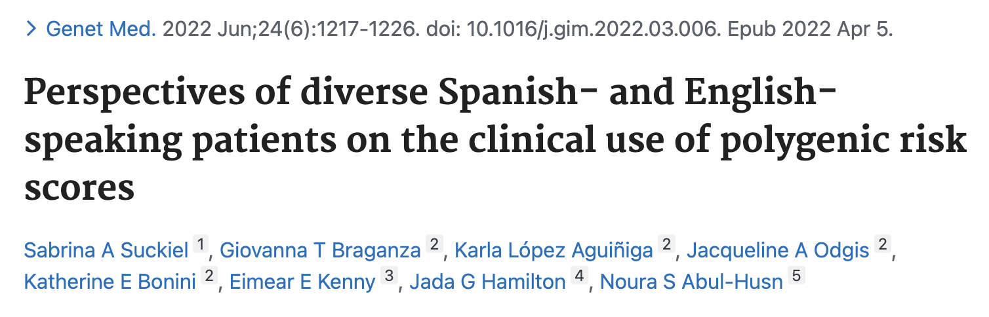


In-depth assessment of the perspectives of diverse patients on the use of clinical PRS
Interest and perceived utility were high
Identified barriers and potential for psychological distress that could hinder access and widespread adoption
Most people preferred in person return of results
Patients' attitudes toward polygenic risk information
Patients and communities
  Patient-centered insights can help tailor strategies for delivering clinical PRS in diverse populations
Sabrina Suckiel
Dr. Noura Abul-Husn,

Slide 11
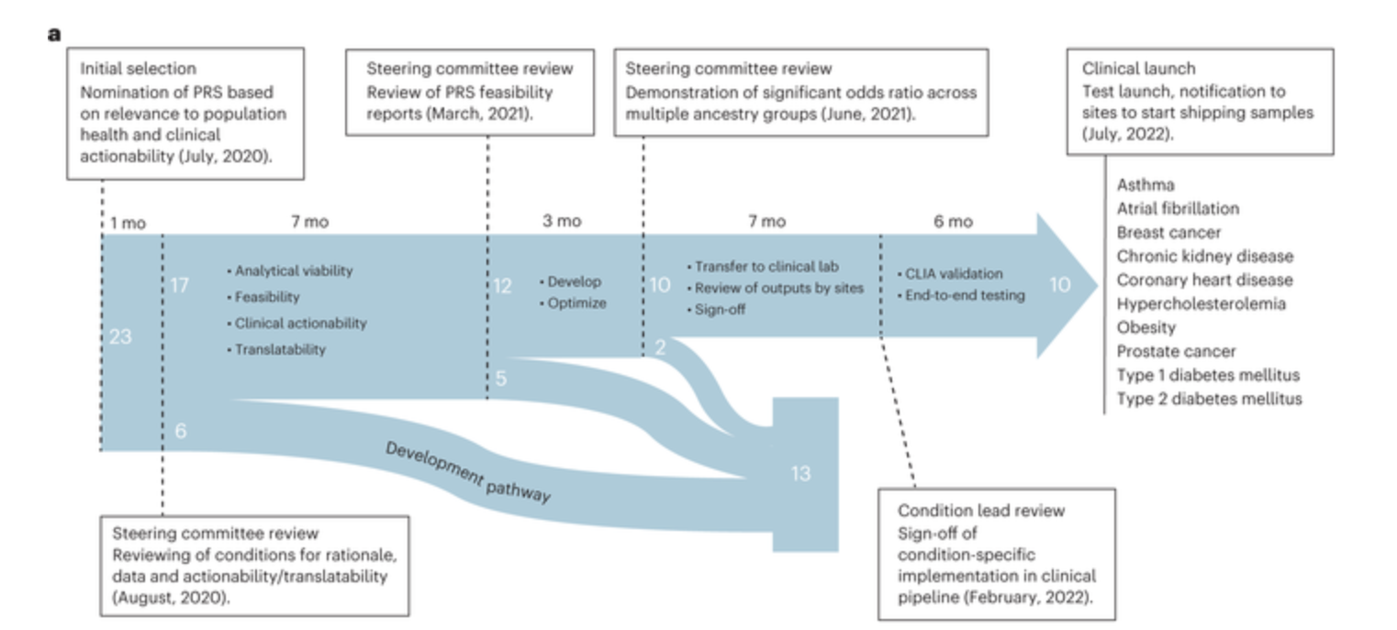
Developing clinical PRS tests for 10 conditions
Lennon NJ…. Kenny EE. Selection, optimization, and validation of ten chronic disease polygenic risk scores for clinical implementation in diverse populations. Nature Medicine [Accepted] (2024)

Slide 12



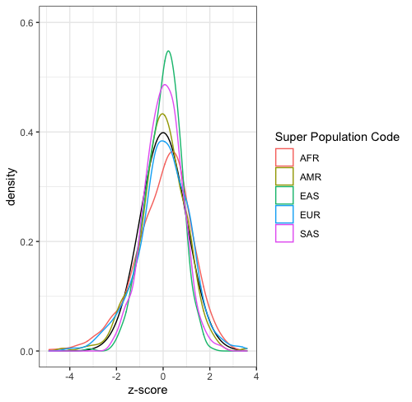
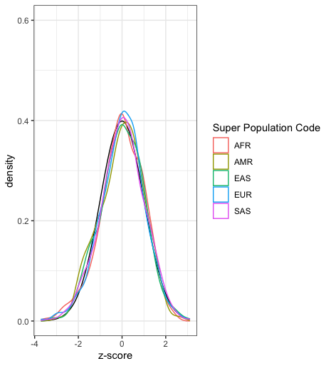

Ancestry adjustments of PRS
Niall Lennon,PhD
Chris Kachulis, PhD
Khera et al (Nat. Genet 2018) adjusted the mean for each population to normalize ancestry differences.
New method developed at Broad integrated adjustments in mean and variance, and corrects for representation bias.
Created a reference panel with genotype data from the diverse ancestry groups from All of Us Research Project.
Notes:
Broad built on this approach, used means and variance to adjust
Normalized peaks & tails, important bc emerge classifies high risk as top 2%
Different cut off would mean different proportions of each pop would be classified as ‘high risk’
Without adjustment could run into scenario where AA never receives ‘high risk’ designation; even if absolute risk slightly differs this adjustment ensures equity
results in uneven representation of different groups in the PRS high risk category; PMID: 30104762

Slide 13
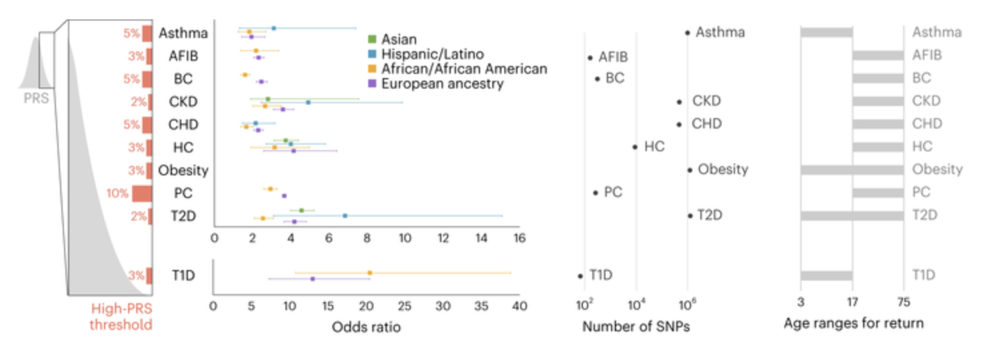
Calibration and validation of PRS for 10 conditions in diverse populations in children and adults
Lennon NJ…. Kenny EE. Selection, optimization, and validation of ten chronic disease polygenic risk scores for clinical implementation in diverse populations. Nature Medicine [Accepted] (2024)

Slide 14
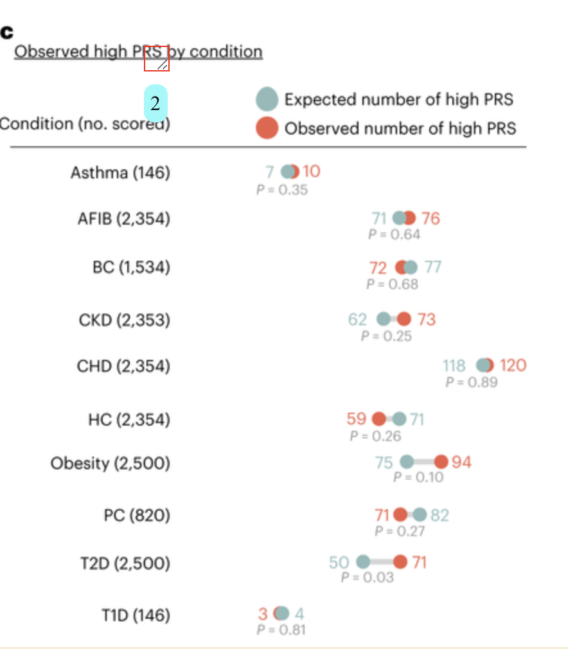
Observed high PRS by condition
Condition (no. scored)
Lennon NJ…. Kenny EE. Selection, optimization, and validation of ten chronic disease polygenic risk scores for clinical implementation in diverse populations. Nature Medicine [Accepted] (2024)

Slide 15
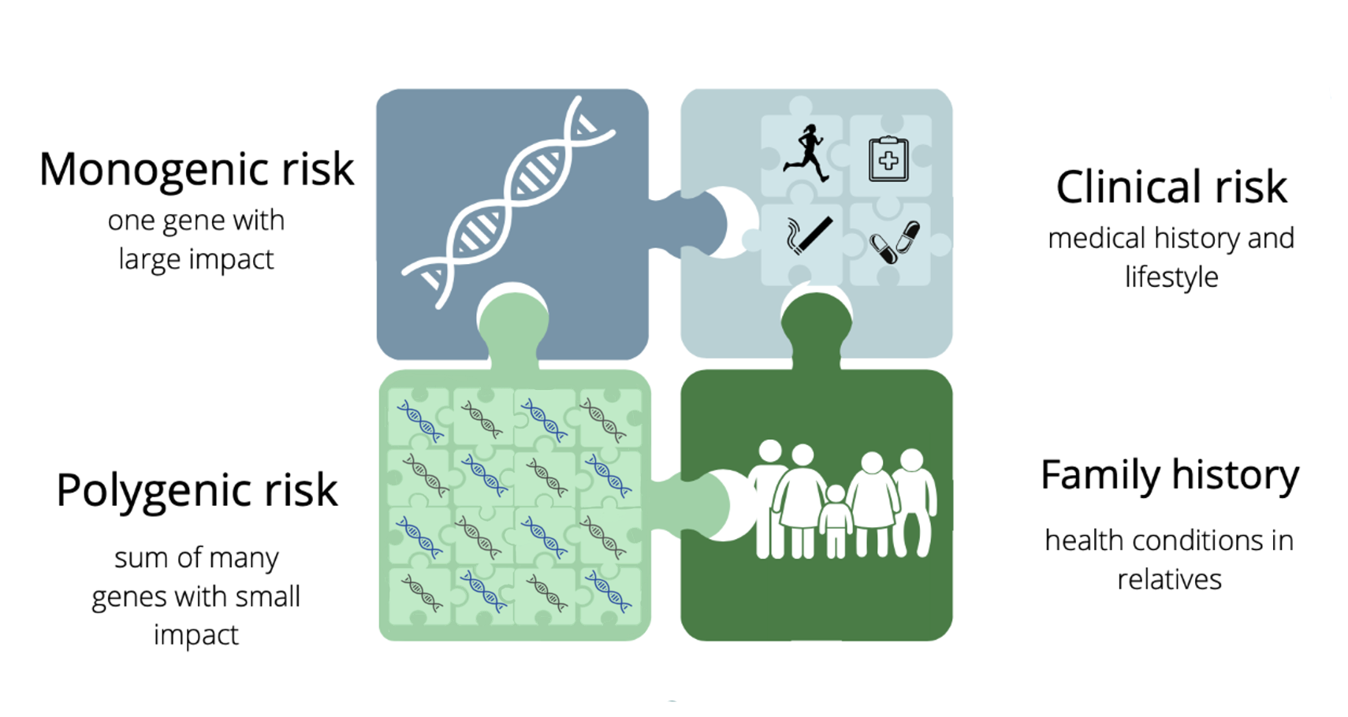


GIRA: Genome Informed Risk Assessment
The GIRA is a research report that combines a polygenic risk score with monogenic risk, clinical risk, and family history to comprehensively assess disease risk.
Notes:
The genome informed risk assessment or GIRA will also included known other risk factors for disease such as demographics, clinical risk factors, family history and monogenic risk.
Family History Clinical risk factors are specific to the conditions screened
Breast cancer includes clinical risk factors of reproductive history and hormone exposure; and family history of breast and ovarian cancer
Heart disease includes clinical risk factors such as smoking history, blood pressure and cholesterol levels and family history of heart disease
Conditions also consider demographic factors of age, sex and race

Slide 16
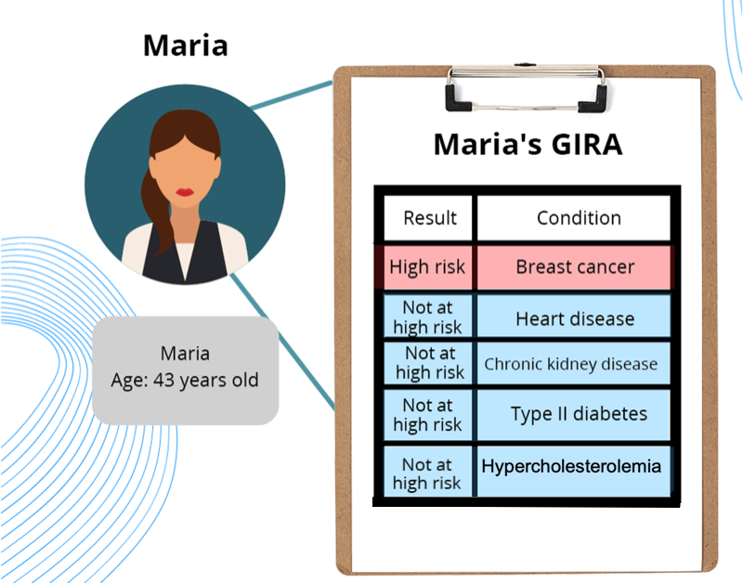
GIRA: Genome Informed Risk Assessment
The GIRA will include risk results for 11 specified conditions and management recommendations for high-risk results.
Notes:
Risk results reported as either “high risk” or “not high risk”

Slide 17
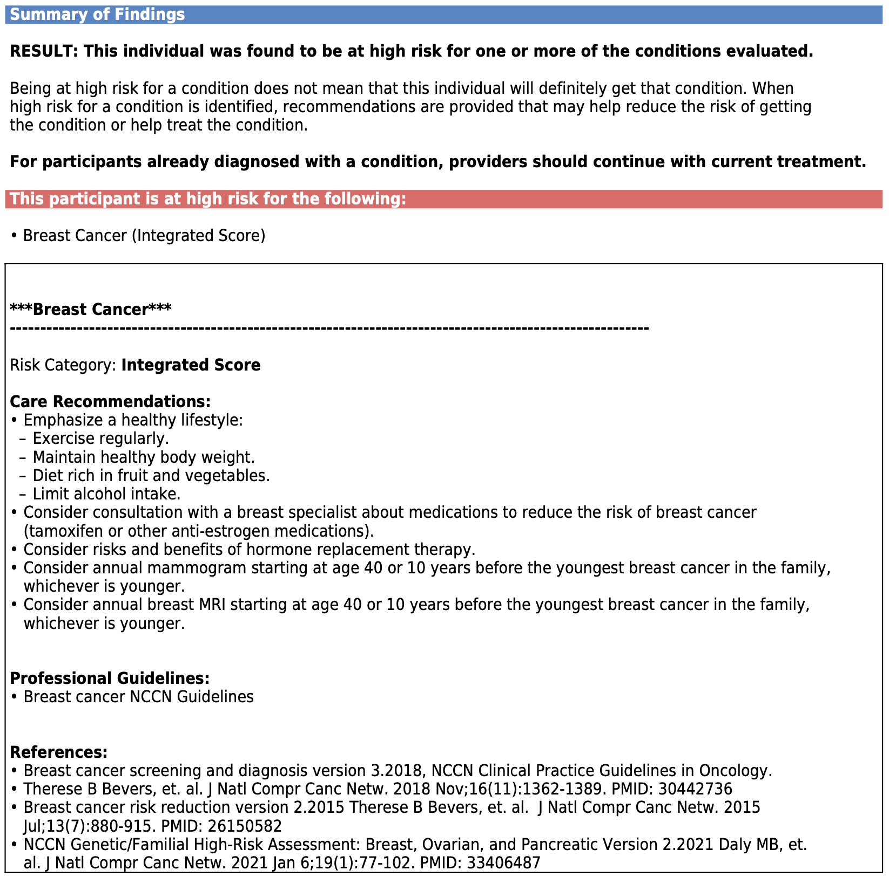
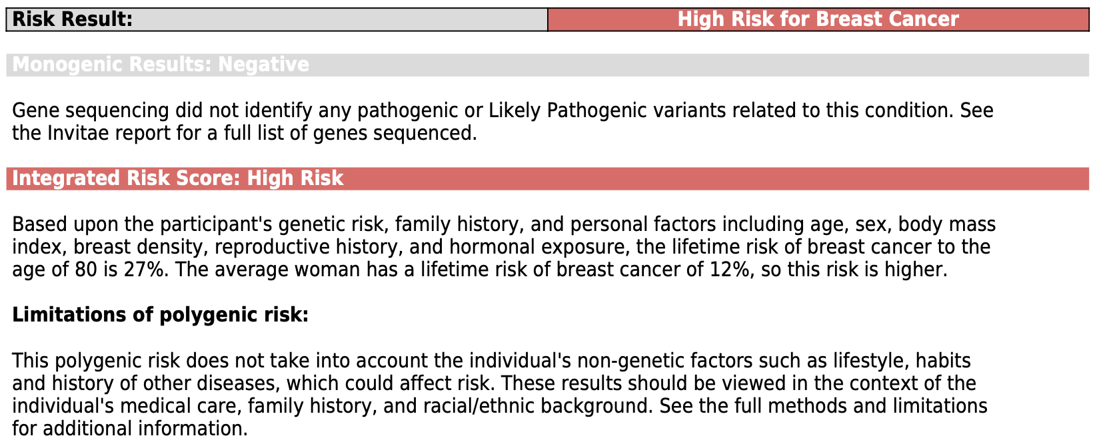
Condition Specific Report and Recommendations
Condition description
Explanation of high risk
eMERGE network screening and risk reduction recommendations
Recommendation to share results with providers
Notes:
Mention that there will be an invitae and broad report attached
This is when patients may come back to their provider for guidance
Bring up again that there are no clinical guidelines for PRS

Slide 18
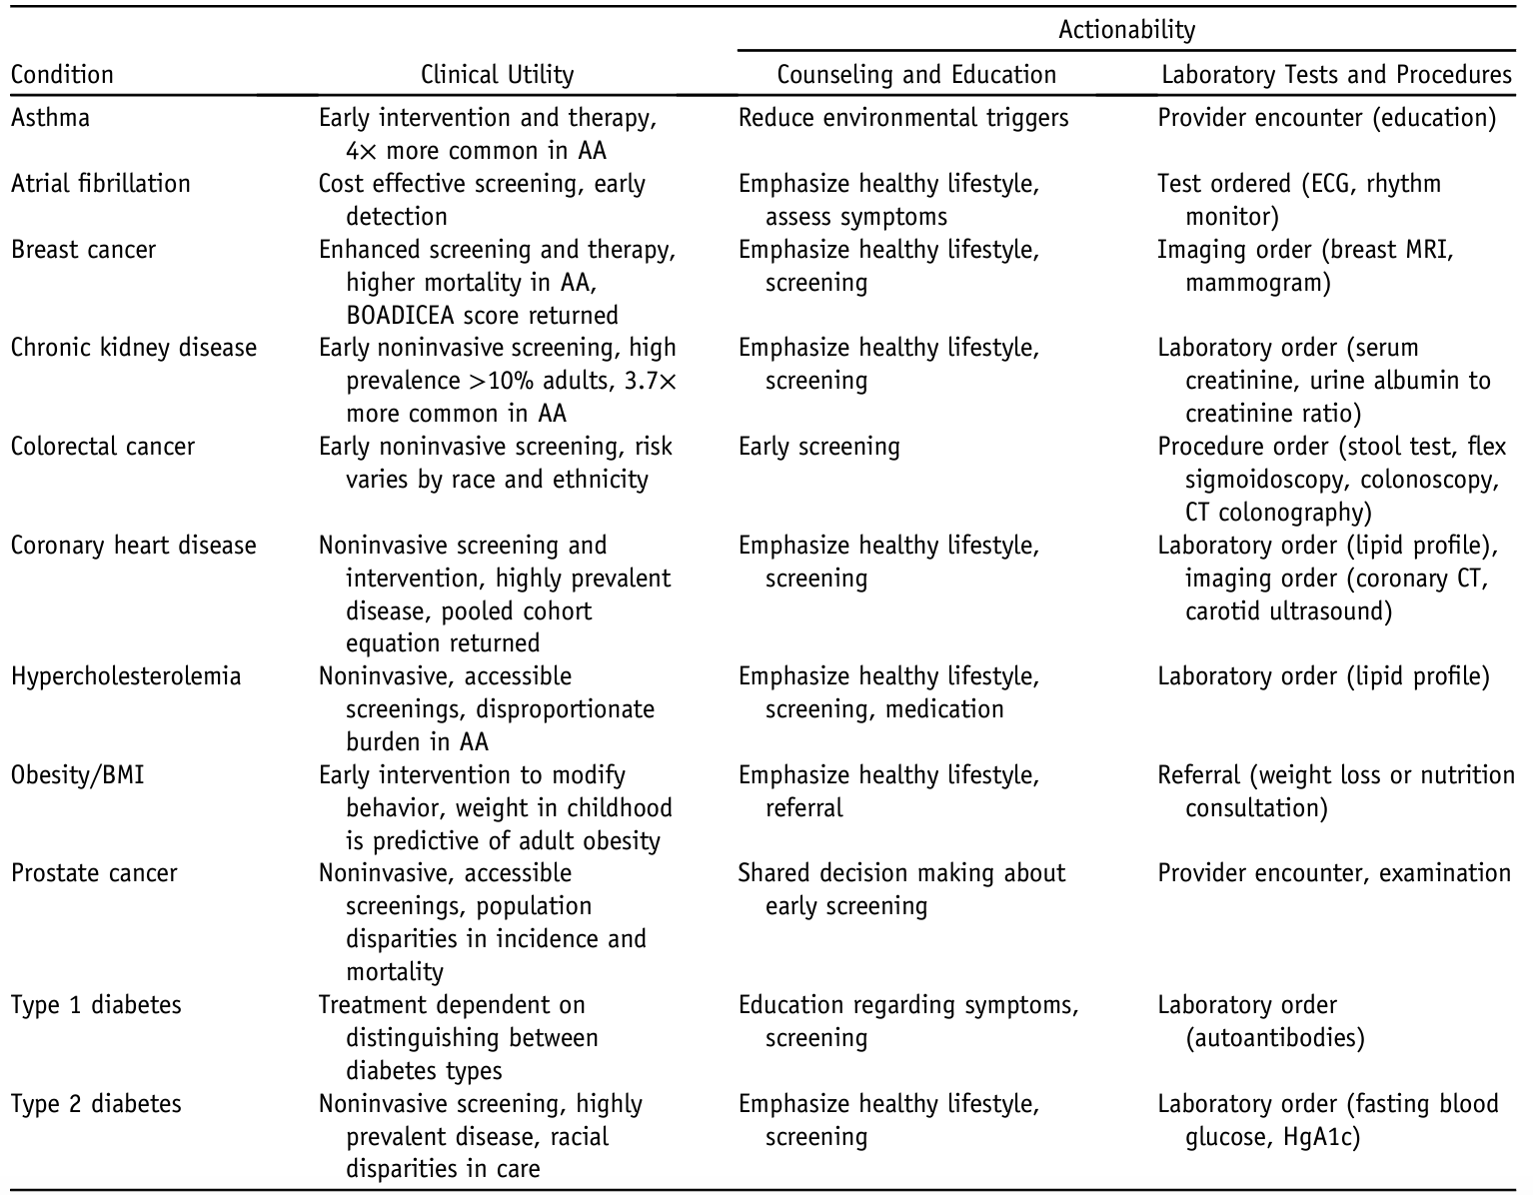

Slide 19
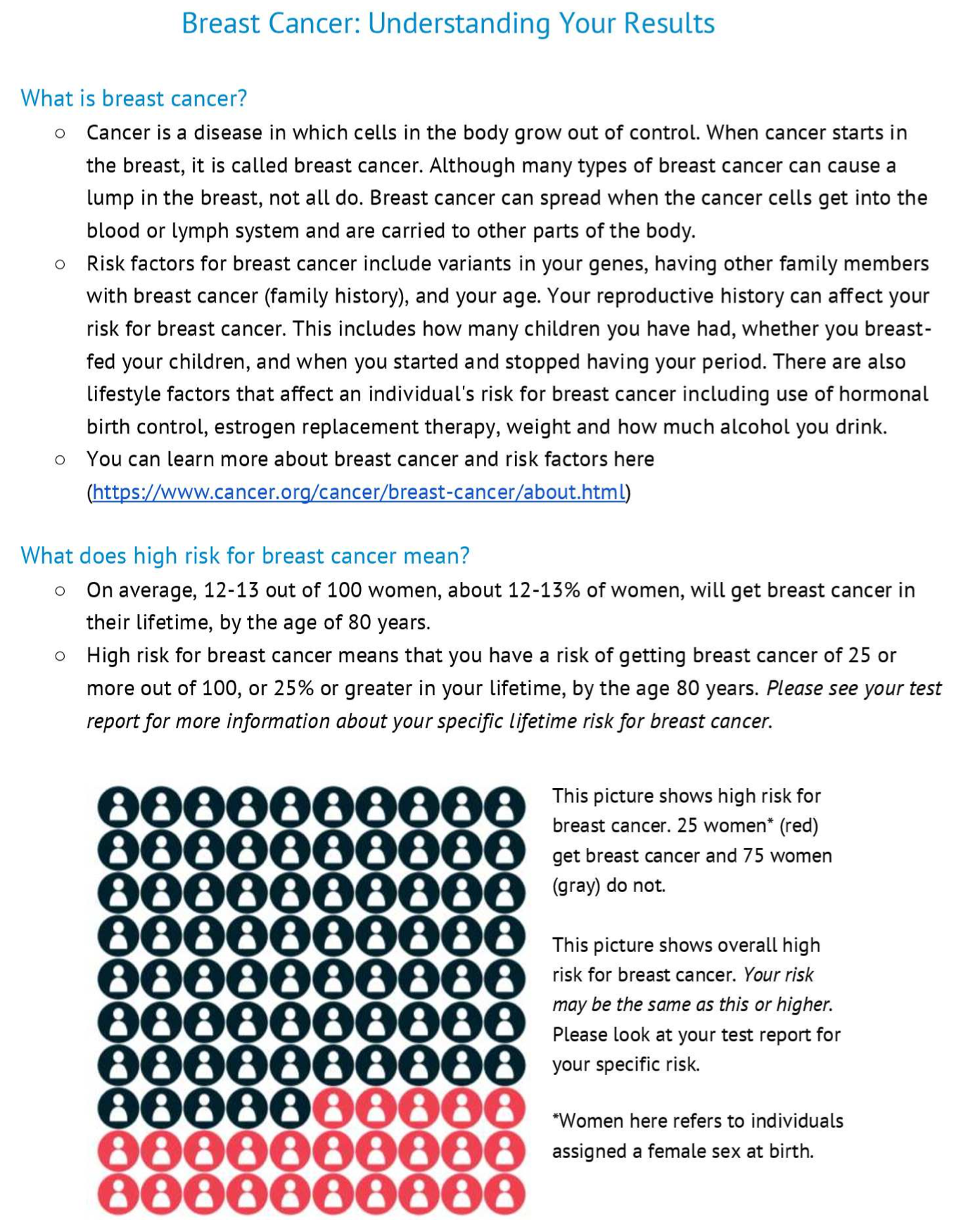
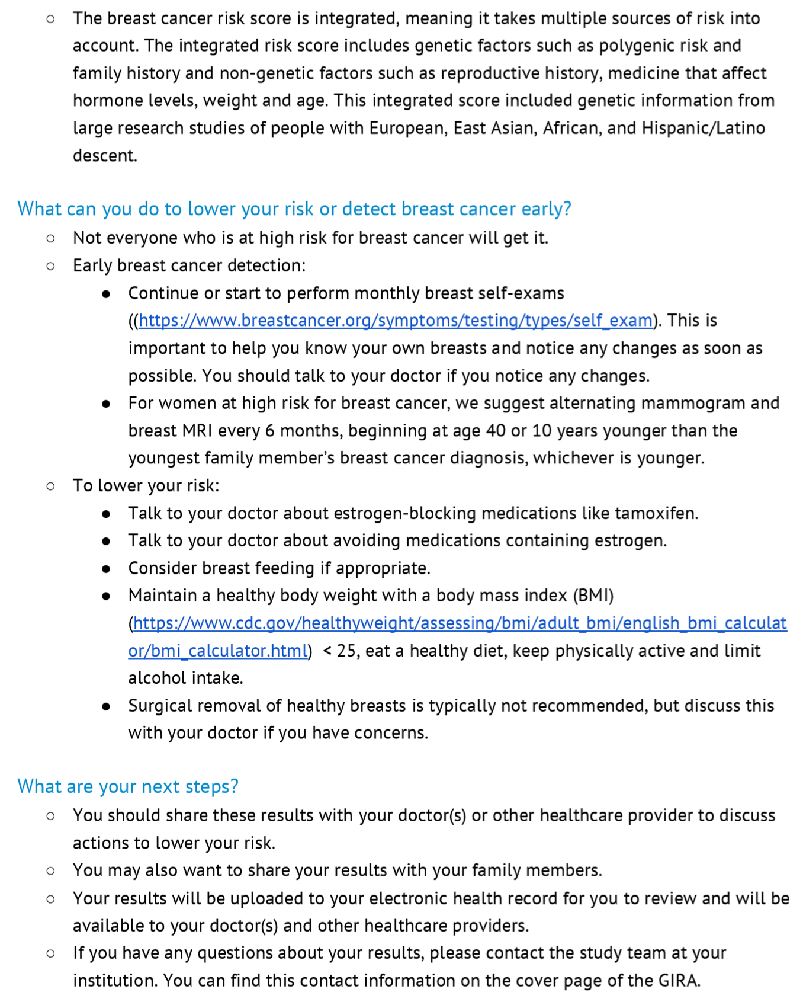
Patient Information Pages

Slide 20
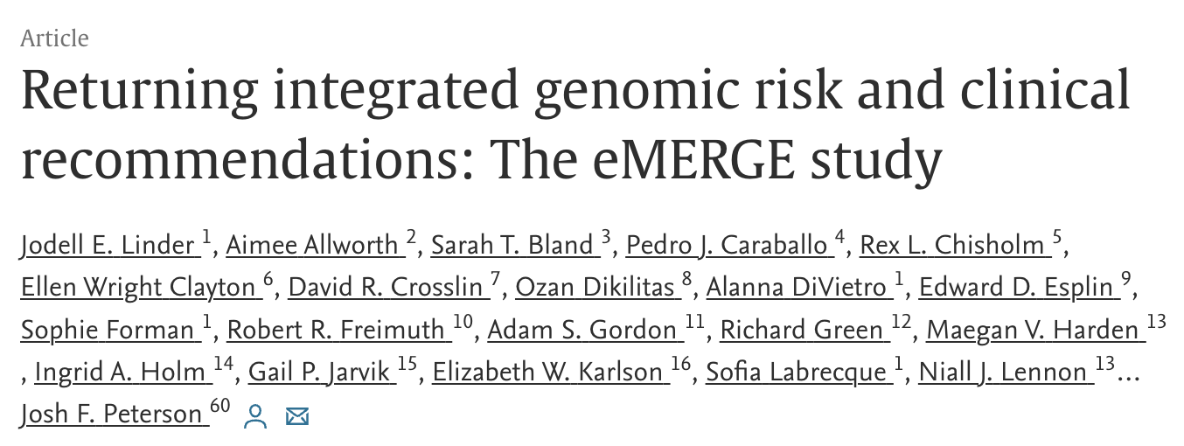
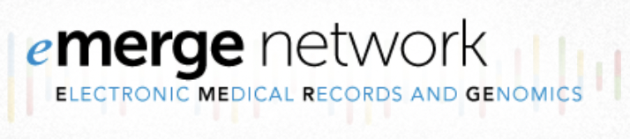
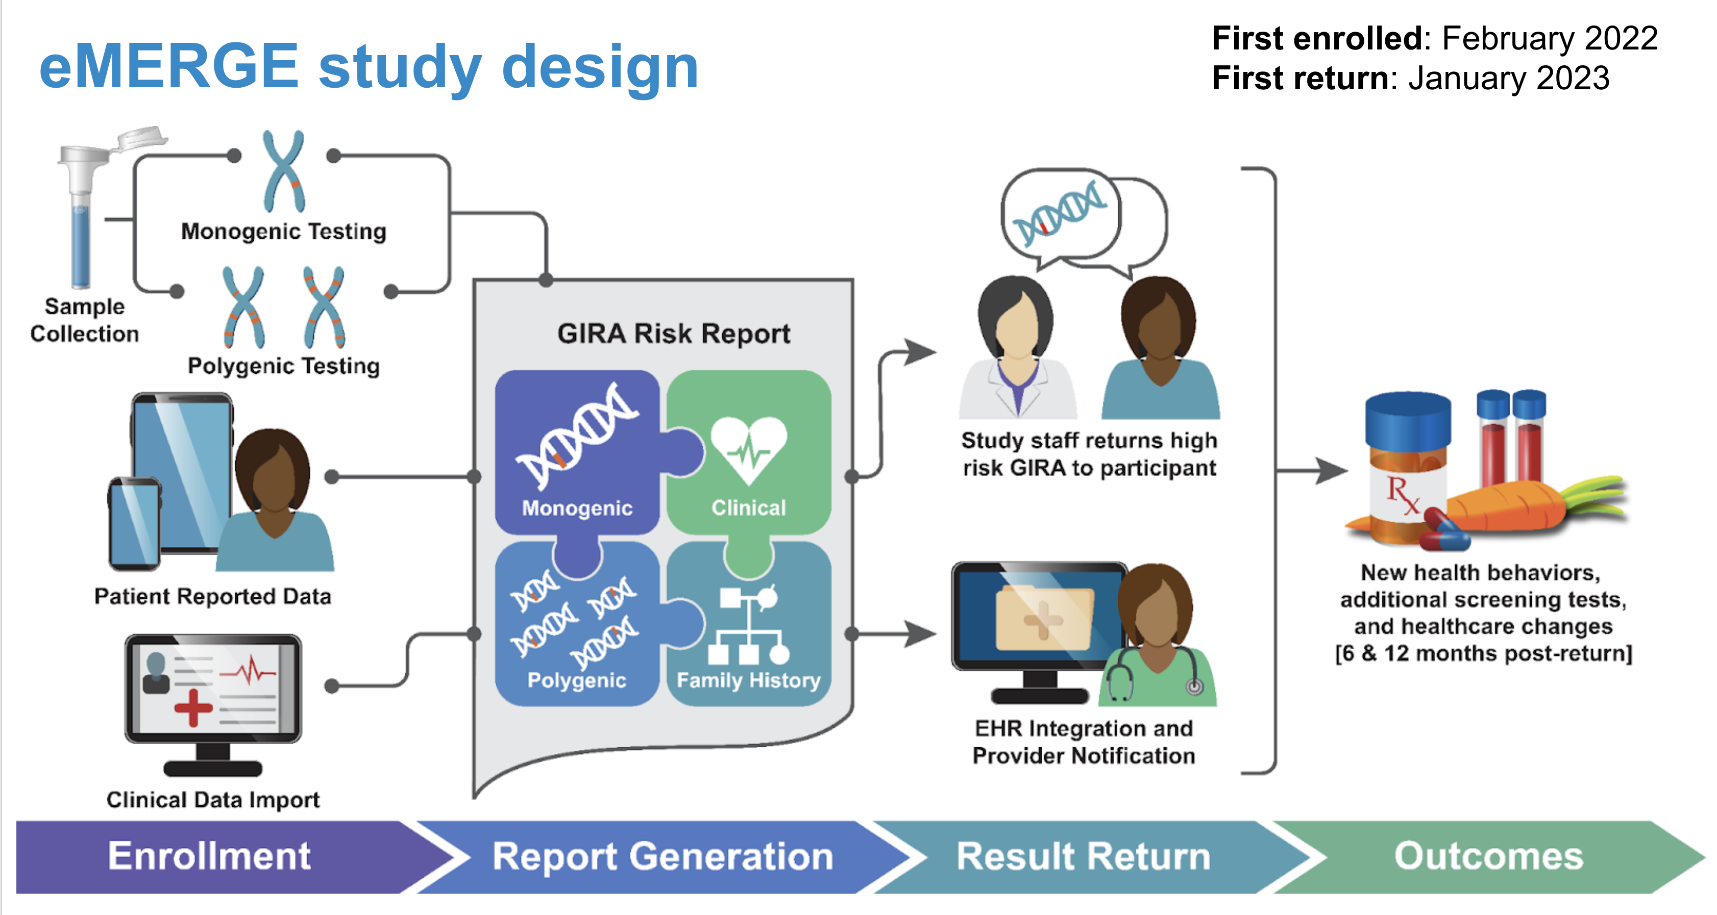
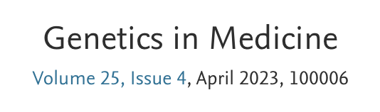

Slide 21
Powered by informatics engine across network

Slide 22
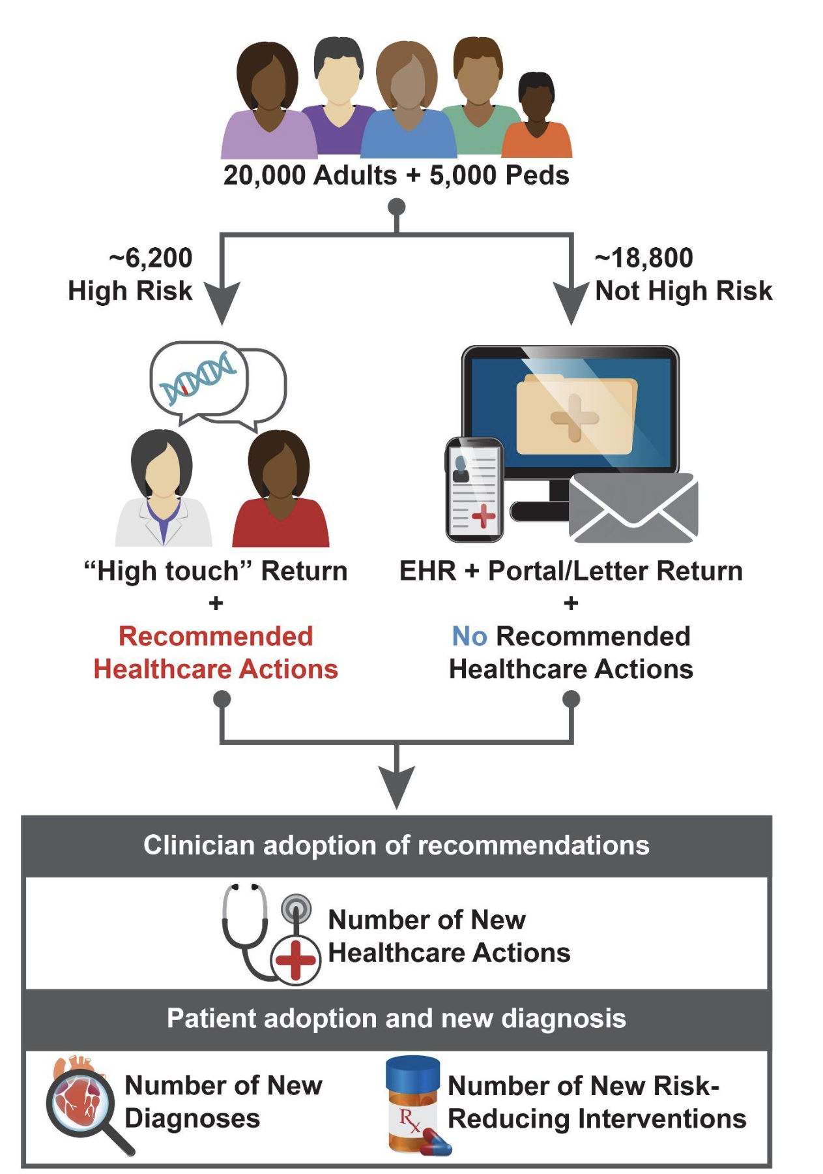
Outcome of interest: Determine if health care actions associated with care recommendations are more common among the high risk group.
Also collecting: Rx, Dx, CPT, referrals, labs results, lab orders, patient surveys, provider surveys, and GC attitudes

Slide 23
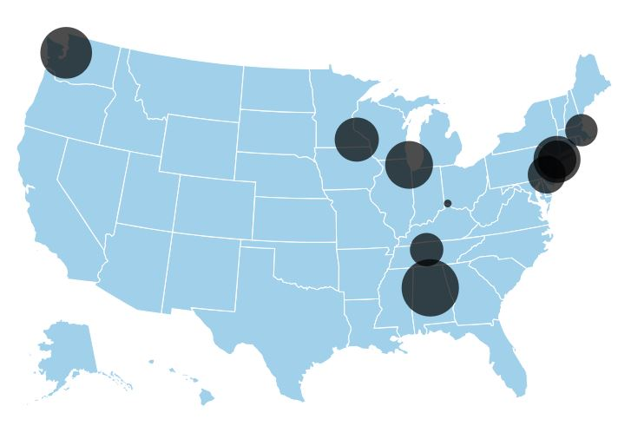
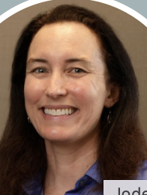


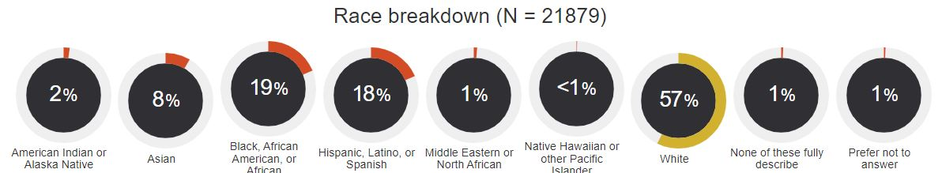
Current enrollment (January 26th)
UW: 2692
MGB: 2005
Total network recruitment: 21,879
Pediatrics: 13%
Racial & ethnic minorities: 47%
Female at birth: 66%
Sexual orientation minority: 12%
Mayo: 2388
NU: 2509
CHOP:
2149
Mt. Sinai: 2122
CCHMC:616
VUMC: 1934
Columbia: 2538
UAB: 2926
Jodie Jackson
Josh Peterson

Slide 24
 |  | Monogenic | PRS | Family history | Clinical risk
Pediatric only (3 to 17 years) | Asthma | None | Trigger | Displayed | Displayed
 | Type 1 diabetes | None | Trigger | None | None
Pediatric and adult (3 to 75 years) | Obesity/BMI | None | Trigger | Displayed | Displayed
 | Type 2 diabetes | None | Trigger | Displayed | Displayed
Adult only (18 to 75 years) | Atrial fibrillation | Trigger | Trigger | Trigger | None
 | Breast cancer (female) | BOADICEA lifetime score ≥ 25% |  |  | None
 | Chronic kidney disease | None | Trigger | Trigger | Displayed
 | Colorectal cancer | Trigger | None | None | None
 | Coronary heart disease | Trigger | Trigger | Trigger | None
 | Hypercholesterolemia | Trigger | Trigger | Displayed | None
 | Prostate cancer (male) | Trigger | Trigger | Trigger | None

Slide 25
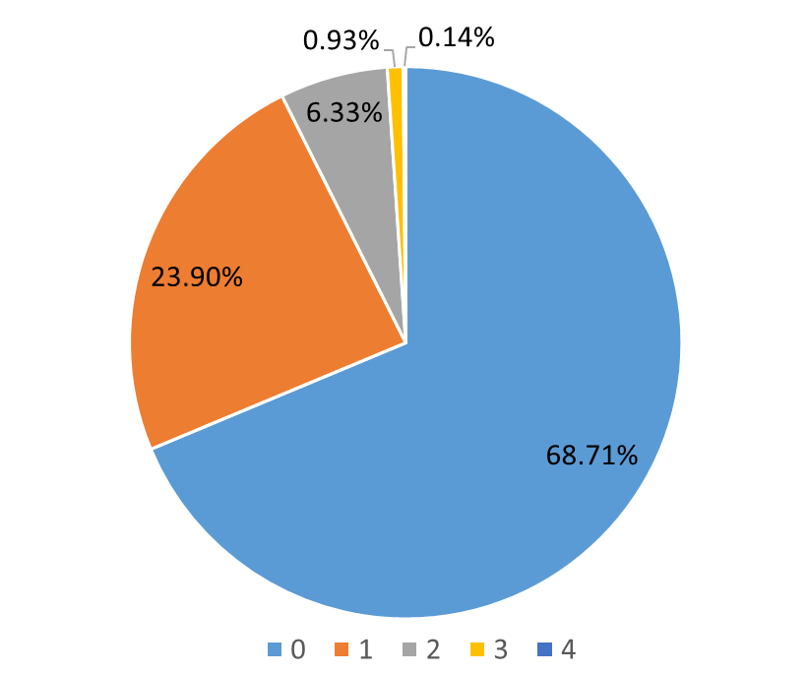
GIRA returned (1/26/2024)
Number of high risk conditions per individual
53
8
GIRA returned: 5707
Adult: 4489
Pediatric: 1218
High risk returned*: 1780
High PRS: 899
P/LP Monogenic: 118
Family Hx: 1027
BOADICEA: 71
31.2% of returns are high risk
361
1364
3921
*Overlap between triggers
# of individuals with 0, 1, 2, 3, or 4 risk conditions

Slide 26
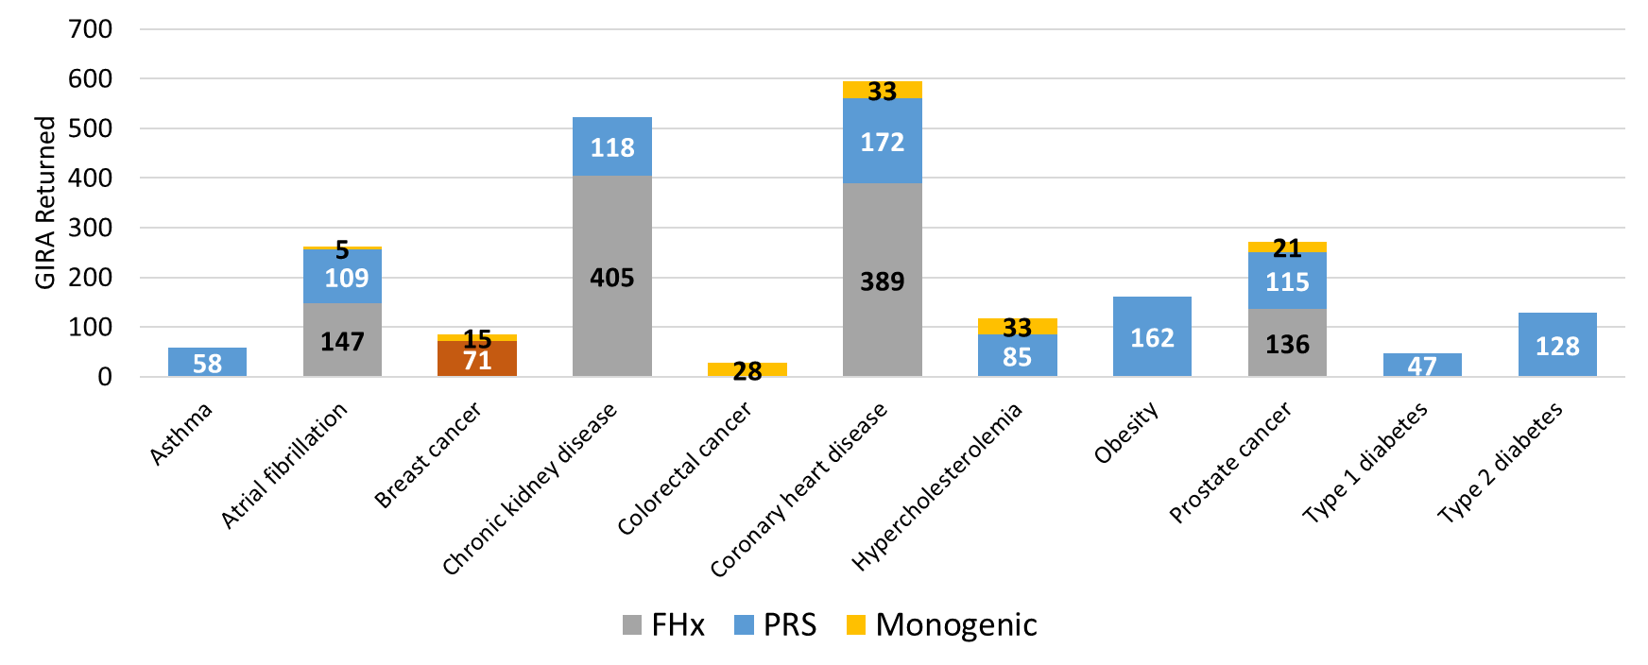
High risk GIRA returned by unique trigger (1/26/2024)
594
523
261
272
86
118
BOADICEA
Breast cancer triggered by BOADICEA (# orange) and monogenic only w/o BOADICEA (# yellow)

Slide 27
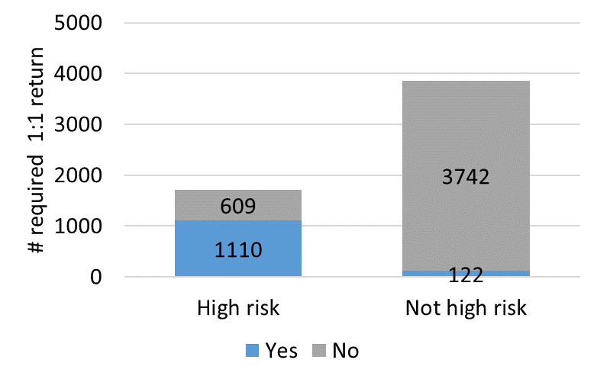
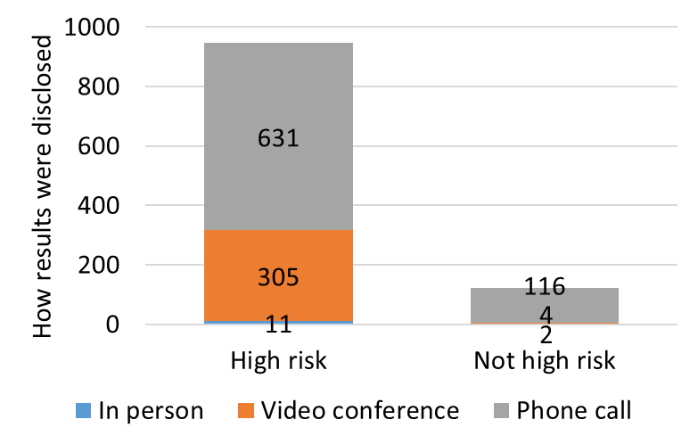
GIRAs by return type (1/26/2024)
N=949
N=3864
N=1719
N=122
Some high risk are not returned 1:1 due to only having FHx risk (N = 604)
FHx triggers alone (A Fib, CKD, CHD, or PCa) with no other GIRA conditions present were returned by 1:1 method 136 times.
Notes:
‘Not high risk’ returned 1:1 for ‘other’ for reason.

Slide 28


Type 1 Diabetes in children (preliminary first look)
Outcome | High Risk Observed (%) (N=16) | Non-HR Comparator Observed (%) (N= 825) | Anticipated High Risk (150) | Anticipated Non-HR Comparator
Primary
EHR: Autoantibody screening | 50% (8/16) | 0% | 75 | ~0
(EHR: Glucose screening, urinalysis) | NA | NA | NA | NA
EHR: Referral to endocrine | 12.5% (2/16) | 0.4% (3/825) | 18 | ~1
EHR: T1D Counselling (PCP) | 43.75% (7/16) | 0% (0/825) | 65 | 0
Other
Survey: Diet/lifestyle | 0% (N=0/2) | 10.8% (4/37) | N/A | N/A
ALL
Any Primary | 38 | <1 | 75 (/150) | <3 (/450)
Any Outcomes | 39 | 4 | 75 (/150) | ~45 (/450)
Dr. John Connolly

Slide 29

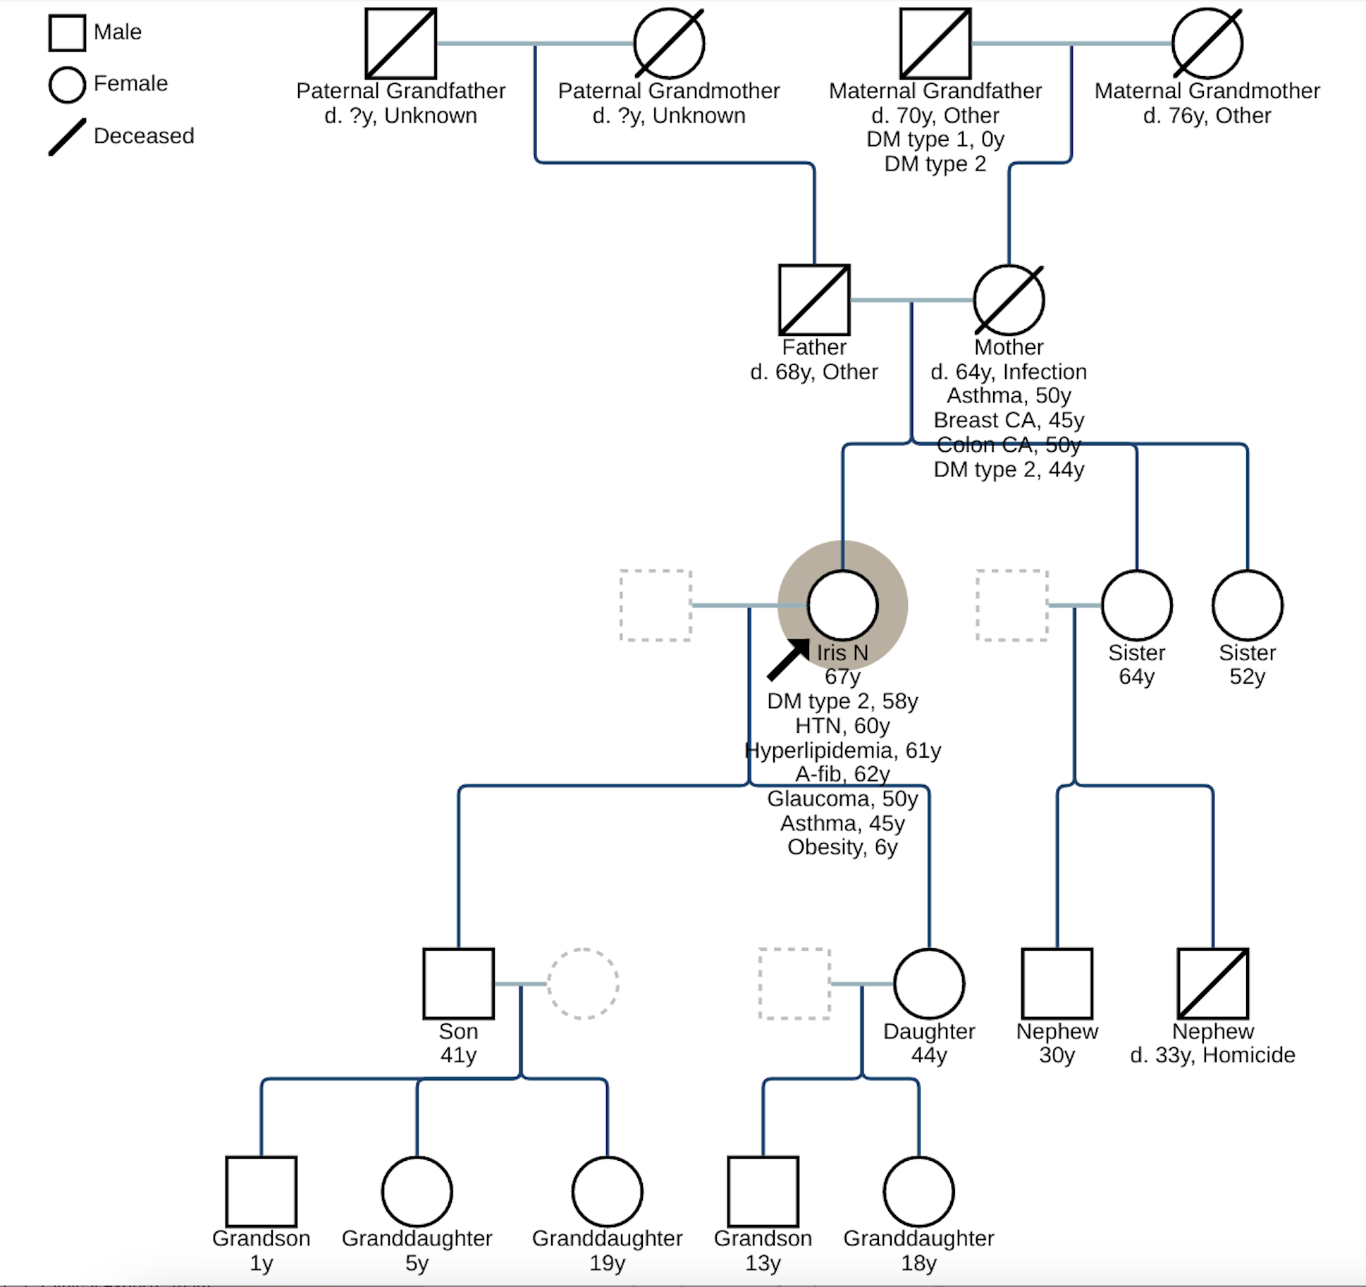
Breast Cancer in women
67 year old female participant of Puerto Rican ancestry with a variety of co-morbidities, no previous genetic testing
Sabrina Suckiel
Jackie Odgis
Genome-Informed Risk Assessment
Monogenic | Negative
PRS | Breast cancer high-risk (z score = 2.2)
Family history | Significant family history of breast cancer
Integrated risk score (Boadecia*) | 29.7% lifetime risk for breast cancer
* Includes PRS
High breast cancer risk results in care recommendations, including considering annual breast MRI screenings
Breast CA,
45y
Notes:
PRS does not necessarily explain prevalent disease in this participant (Afib, hyperlipidemia, Obesity)
High-risk cutoff is 25 for the IS – daughter just recently diagnosed.
Boadecia + with PRS

Slide 30
eMERGE: priming PCPs for integrating GIRA into practice
PCP introduced to the eMERGE study and clinical PRS
PCP receives additional education on the components of a genome-informed risk assessment and result disclosure process
PCP interacts with genomic risk information via the patient’s high-risk GIRA in the EHR
PCP engages with GC who provides additional information for specific clinical scenario
In conversation with patient, proceed with scheduled mammogram, and consider MRI afterward.
Key moments that build familiarity with genomic medicine
Notes:
“This pt is routinely scheduled for a mammogram, with prior normal ones in the past. As I am not familiar with this genetic screening, is there a specific benefit to MRI in her given prior normal mammogram and no dense breasts noted?”
EHR review shows that the PCP spoke with the participant to discuss results and to consider MRI. Patient decided to defer MRI for now. She is going to have her annual mammogram and they will re-consider an MRI based on those results.
PCP consider recommendations, decision was to proceed with upcoming scheduled mammogram, based on those results potentially do MRI. We will capturing outcomes data and following up with review after mammogram to understand how this plays out.
Primary Care Provider (PCP) informed the study GC of participant’s routine screening mammograms, which have been normal. As the PCP was unfamiliar with this type of genetic screening, they requested information from the GC on MRI benefits for this participant. The participant decided to defer breast MRI until they had their results from upcoming mammogram.

Slide 31

eMERGE: developing evidence for appropriate use of genetic risk information in routine clinical care
Rapid and scalable integration of GIRA at 10 clinical sites nationally
Ethical considerations.:
Patient and provider attitudes
Calibrated and validated multi-ethnic PRS
Regulatory considerations:
Developed CLIA- and NYS-certified PRS tests
Developed research GIRA clinical report
Clinical decision support:
Developed care recommendations
Local BPA/informatics support
Clinical utility
Primary and secondary outcomes (through July 2026)
Provider attitudes

Slide 32
Future opportunities for integrating genetic risk
eMERGE IV delivered in silico development through clinical implementation for GIRA across many different clinical scenarios
Primed to tackle more sophisticated risk stratification schema (AI/ML)
Incorporate more datatypes (exposome/methylation)
Utilize more sophisticated outcome assessment tools (digital health apps)

Slide 33
Sabrina Suckiel
Dr. Noura Abul-Husn,
VUMC CC members
Jodie Jackson
Josh Peterson, PI
Brian Aloisi
Melissa Basford, MBA
Robert Carroll, PhD
Alanna DiVietro, MPH
Hillary Duckman
Sophie Forman
Michael Holmes
Sofia Labrecque
Brad Malin, PhD
Lynn Seabolt, MS RD
Henry Walker
Broad, Genotyping
Maegan Harden
PI, Niall Lennon, PhD
Chris Kachulis, PhD
Edyta Malolepsza
NHGRI
Robb Rowely
Teri Manolio
Other program staff
Jackie Odgis
Dr. John Connolly
Duke, MeTree
Lori Orlando, MD
Teji Rakhra-Burris
Matt Gauger
Jodie Jackson
Josh Peterson
ALL 10 CLINICAL SITES!!
Niall Lennon,PhD
Chris Kachulis, PhD

