Slide 1
Program Evaluation of the NHGRI Centers of Excellence in Genomic Science (CEGS) Program
NACHGR Meeting
2/12/24
Chris Gunter, Molly Bird, Maya VanZanten: NHGRI
Joshua Heath, Brian Knafou, Kayla Ingram, and Alexis Helsel: Ripple Effect, Inc.

Slide 2
Why are we establishing a formal evaluation capability at NHGRI now?
We are required by NIH, HHS, and above to show evidence for our decision-making processes.
We are also increasingly being asked to show evidence for “impact,” effects of policies, grant spending, and “success” of multiple programs.

Slide 3
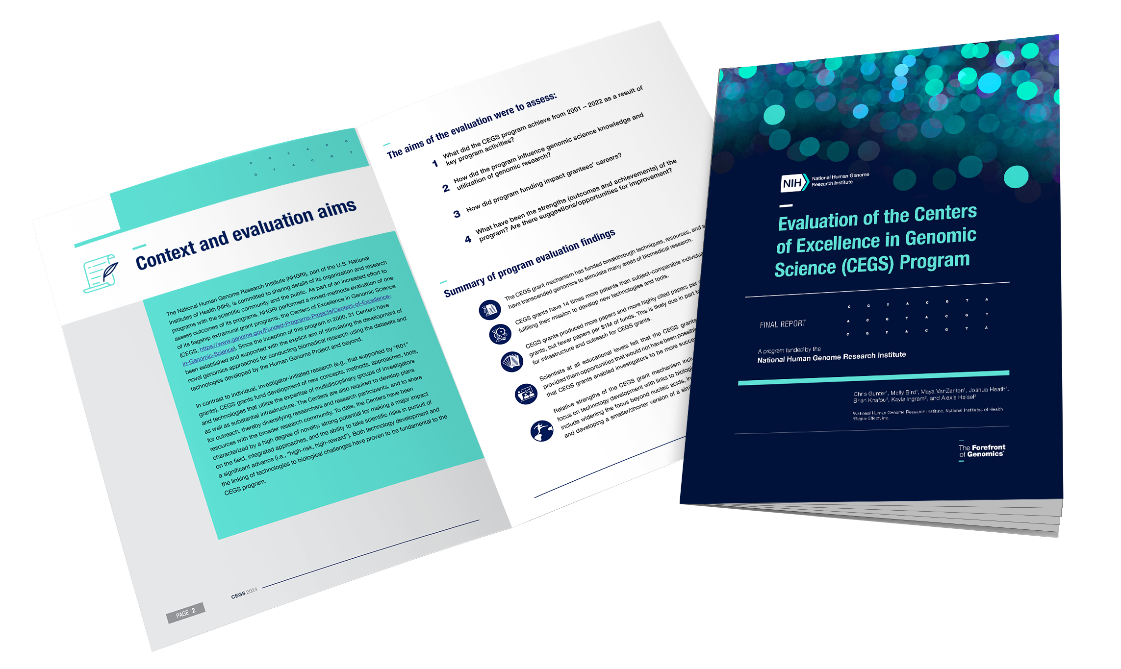
NHGRI will continue its commitment to transparency and program assessment
We are conducting mixed-methods program evaluations and plan to publish the results both in public formats and in peer-reviewed journals.
Thanks to Darryl Leja, NHGRI

Slide 4

Mixed-methods program evaluation of NHGRI “flagship” grant mechanism
P50 or RM1 mechanism
High-risk, high-reward
Team of multiple investigators at the same or multiple institutions
Focus on transformative approaches and outputs
Education / outreach required
Developing tools / methods / resources and sharing those with community

Slide 5
Centers of
Excellence in
Genomic
Science (CEGS)
Evaluation
Inputs
Outputs
Outcomes
Participants
What was invested
What was done
Evaluation measures
Short term
(knowledge)
Medium term
(utilization)
Long term
(impact/legacy)
Grant recipients at multiple institutions
Program staff
Trainees
Genomics field
Other scientific fields
Grant funds
CEGS/DGSci time and skills
NIH support and grant management
Institutional support and grant management
Creation of new mechanism
Creation of new network of sites
Periodic examination of funding decisions and updating criteria
Support for genomic research
Publications
Citations
Tech transfer/licensing
Additional / subsequent research grants
Trainees graduated
Diversity plans
Advanced genomics research
Developed novel methods and resources
Opened new areas of inquiry
Catalyzed change in NHGRI extramural program areas
Supported goals of previous NHGRI strategic vision
Informed goals of 2020 NHGRI strategic vision
Research regarded as leading the field of genomics
PI’s obtained other funding to advance work
Enhanced collaboration
Advanced new PI careers
Generated breakthroughs in genomic science that would not have been possible otherwise
Techniques and methods used by other fields
Inspired other institutes / centers to emulate program
Increased diversity in field
Assumptions
Genomics methods will disseminate and be valued beyond the field.
RM1 mechanism functions differently than R01’s.
External factors
Congressional interest, other policy makers, government regulations, and approval processes
Support for genomic science from scientific community and public

Slide 6
Evaluation Questions
What did the CEGS program achieve from 2001 – 2022 as a result of key program activities?
How did the CEGS program influence genomic science knowledge and utilization of genomics research?
How did program funding influence grantees’ careers?
What have been the strengths (outcomes and achievements) of the program? Are there suggestions/opportunities for improvement?

Slide 7



Evaluation Methodologies
Interviews of 28 Principal Investigators (PI’s)
Quantitative Outputs & Comparison Group Analysis
Survey Analysis
Survey of CEGS researchers
Descriptive analysis
Open-ended item coding and thematic analysis
Publications and citations
Patents applied for & awarded
Grants and grant success
Coding
Thematic analysis

Slide 8


Evaluation Methodologies
Interviews of 28 Principal Investigators (PI’s)
Quantitative Outputs & Comparison Group Analysis
Survey Analysis
Survey of CEGS researchers
Descriptive analysis
Open-ended item coding and thematic analysis
Publications and citations
Patents applied for & awarded
Grants and grant success
Coding
Thematic analysis

Slide 9
Comparison Group Identification
Comparison group criteria
  R01s
  Funded by NHGRI
  FY2001-FY2021
  Direct funding within 5-10% of CEGS funding each year
  Similar topic area as CEGS as screened by NHGRI staff
  No CEGS PIs
 | CEGS Grants | Comparison R01 Grants
Number of Grants | 31 | 245
Number of Unique Contact PIs | 36 | 224
Cumulative Direct Funding | $387 million | $374 million
Average Direct Funding Amount | $12 million | $1.5 million
Average Grant Length | 5 years | 3 years
Notes:
In addition to the survey, we utilized quantitative methods to analyze CEGS award outcomes alongside a complementary comparison group to better understand and interpret the impact of CEGS. The use of a comparison group is critical in program evaluation to better contextualize the interpretation of outcomes. Without a comparison group, it can be difficult to determine if an outcome of interest, such as the number of publications, is high or low.
A big part of this analysis was the identification of a comparison group of R01s, as described on this slide. The Comparison R01 grants were chosen by NHGRI personnel with the help of Ripple Effect. And they were chosen to be as comparable as possible to the CEGS grants.
All of the comparison R01 grants started within 1 year of new CEGS grants, received a similar amount of annual and cumulative direct funding, and topic areas were similar to those of the CEGS grants as screened by NHGRI staff. Once an R01 was selected for inclusion in the analysis, all subsequent years of funding for that R01 were kept in the analysis.
Additionally, any R01 grant with a CEGS PI was excluded from the comparison group analysis.
The final comparison group consisted of 245 R01s and were within 3% of the total cumulative direct funding for CEGS.

Slide 10
CEGS Grants vs. Comparison R01s
- - - CEGS grants
Notes:
This graph shows how the CEGS and Comparison R01 grants included in the analysis compared to one another year by year.
The bars represent the percent of the total CEGS and Comparison R01 grants that were included in the analysis that received funding for each year. We looked at this as a percentage as opposed to numbers because the numbers varied so widely.
The lines represent the cumulative direct funding for each group.
As we can see in the graph, the percent of grants that received funding and the direct funding received per year for the CEGS and Comparison R01 grants were pretty similar between 2001 and 2021. One exception was in 2010, during which year there were not enough available R01s that met the inclusion criteria to match to the CEGS grant direct funding that year.
ARRA: NIH has received new funds for Fiscal Years 2009 and 2010 as part of the American Recovery & Reinvestment Act of 2009 (Recovery Act), Pub. L. No. 111-5. The NIH has designated at least $200 million in FYs 2009 – 2010 for a new initiative called the NIH Challenge Grants in Health and Science Research. https://www.genome.gov/Pages/About/Budget/RecoveryAct/ARRA2009NIH-NHGRIChallengeGrants.pdf
https://www.genome.gov/27534233/2009-news-feature-nhgri-uses-recovery-act-funds-to-accelerate-genome-research-to-improve-human-health
“The National Human Genome Research Institute (NHGRI) has awarded more than $113 million provided by the American Recovery and Reinvestment Act. The new awards, added to NHGRI's regularly appropriated $367 million budget, will stimulate ground-breaking research ranging from studies aimed at understanding the human genome to those intended to lead to improvements in the prevention, diagnosis and treatment of human illness.”

Slide 11
CEGS & Comparison Group Analysis Metrics
Publications
Patents
Grants
Publications produced
Number of patent applications
Applications (Type 1)
Citations received
Awards won (Type 1)
Journal Impact Factor (JIF)
Number of patents awarded
R01 applications (Type 1)
Journal Citation Index (JCI)
Percent of patents expired due to non-payment of fees
R01 awards won (Type 1)
Relative Citation Ratio (RCR)
Direct funding (All award types)
NIH Percentile
Patent Citations
Citation Lag
Total funding (All award types)
Notes:
This slides shows the metrics used for the comparison group analyses and as a reminder.
For the publication analysis, we collected data on publications produced, citations received, journal metrics, like journal impact factor, relative citation ration, NIH percentile, and citation lag.
For the patents analysis, we collected data on the number of pending patent applications, the number of patents awarded, the percent of patents that expired due to non-payment of fees, and the number of patent citations by other patents.
For the subsequent grant analysis, we collected data on all NIH grant applications, grants awarded and looked at R01s more specifically, for Type 1 grants. We also collected data on direct and total funding for all grant types.
Publications and patents were identified based on acknowledgement of the CEGS or comparison R01 grants. And the grants analysis was based on CEGS and comparison R01 contact PIs.

Slide 12
Evaluation Methodologies
Interviews of 28 Principal Investigators (PI’s)
Quantitative Outputs & Comparison Group Analysis
Survey Analysis
Survey of CEGS researchers
Descriptive analysis
Open-ended item coding and thematic analysis
Publications and citations
Patents applied for & awarded
Grants and grant success
Coding
Thematic analysis

Slide 13







Survey Participant Demographics
5
MINUTES
average time to complete survey
Percentage of Participants by CEGS Cohort
230 GRANT PERSONNEL
invited to complete online survey
62
PARTICIPANTS
27% response rate
DESCRIPTIVE STATISTICS
calculated in R for close-ended questions
69% identified as Male
60%* identified as White
39% were Postdoctoral Fellows during CEGS Grant
* - 11% did not wish to answer
Notes:
As previously mentioned, 230 individuals were invited to participate in the CEGS survey, and 62 with complete responses were included in the final analysis for a 27% response rate. In order to analyze the survey, data descriptive statistics were utilized.
Of the respondents, 69% identified as male, No participants identified as having a disability (yet,11% of participants indicated that they did not wish to respond), and 39% were postdoctoral fellows during the CEGS grant.
As seen in the figure on the right, 50% of the survey respondents were from the most recent cohort of CEGS researchers from 2022-2023.

Slide 14
Evaluation Question 1: What did the CEGS program achieve from 2001 – 2022 as a result of key program activities?
CEGS labs have contributed to genomics advancements in all areas targeted and supported by the CEGS mechanism: new technologies, new methods, new resources, and new understanding of biological problems.
14

Slide 15
Evaluation Question 1: What did the CEGS program achieve from 2001 – 2022 as a result of key program activities?
Survey question: To what extent have your lab’s CEGS grant projects resulted in the following advances in genomics?
15
Notes:
Categories taken directly from the CEGS program announcements

Slide 16
CEGS funding contributed to breakthrough techniques, resources, and approaches, including
Techniques:
RNA-Seq
Single cell ATAC-Seq
Perturb-Seq
Orthogonal Cas9 proteins used in parallel for genome editing
Resources:
Human Cell Atlas
Atlas of Variant Effects
Collaborative Cross
Stickleback model system
Approaches:
Single cell genomics
Epigenetic epidemiology
16

Slide 17

Evaluation Question 1: What did the CEGS program achieve from 2001 – 2022 as a result of key program activities?
CEGS labs have contributed to genomics advancements in all areas targeted and supported by the CEGS mechanism: new technologies, new methods, new resources, and new understanding of biological problems.
Investigators felt that the biggest success of their grants included the areas above, but also pointed to changing the course of science and training.
  “I think the high-risk, high-reward aspect of CEGS and just the general vibe it sends out is one of the crown jewels in the entire NIH system.”
17

Slide 18










PI’s: What was the biggest success of your CEGS?
Freedom to take risks
Change biology/ create new fields
Biological questions
New resources
Collaborations
People/training
New technology or method
Education /outreach
Link between biology and technology
Difficulty/challenge

Slide 19
Evaluation Question 2: How did the CEGS program influence genomic science knowledge and utilization of genomics research?
CEGS grants produced more papers and more highly cited papers per grant than comparison R01 grants, but fewer papers per $1M of investment in each grant type. This is likely due in part to the additional requirements for infrastructure and outreach for CEGS grants.
19

Slide 20
Publication Metrics
Publication Characteristic | CEGS Grants (n=31) | Comparison Grants (n=245)
Number of Unique Publications | 1,871 | 4,746
Number of Publications Per Grant (Median) | 39 | 12
Average Cost of Publication | $206,612 | $78,850
Publications per $1,000,000 | 5 | 13
Notes:
The first part of the comparison analysis looked at the publications produced by the CEGS and Comparison R01 grants and the citations accrued by those publications.
As we can see in the table on the left and the graph on the right, the Comparison R01 grant produced many publications overall and more publications per year than the CEGS grants.
However, the median number of publications produced by CEGS grant was 39 and the median number of publications produced by the Comparison R01 grants was 12.
As we can see, on average CEGS grants produced more publications per grant than the comparison R01 grants, but because there were 8x more comparison R01 grants than CEGS grants, the comparison grants produced more than 2.5 times as many publications per 1 million in direct funding than the CEGS grants.

Slide 21
RCR, NIH Percentile, Citation Lag, & Journal Metrics
Citation Metrics | CEGS Grants Publications (n=1,871) | Comparison Grants Publications (n=4,746)
RCR (Median) | 1.6 | 1.2
NIH Percentile (Median) | 68 | 57
Citation Lag (Median) | 119 days | 154 days
JIF (Median) | 13 | 9
JIF Percentile (Median) | 93 | 89
Notes:
In this slide we look we contextualize the citation data by looking at Relative Citation Ratio, NIH Percentile, citation lag, and impact factor.
Relative citation ratio (RCR) is a time and field normalized metric used to measure article impact that is normalized at a value of 1. CEGS grants publications had a median RCR of 1.6, meaning that CEGS grants publications received 60% more citations that other publications in the same year and in the same field, while comparison grants publications had a median RCR of 1.2
NIH percentile compares the RCR of articles against NIH-funded publications. CEGS grants publications had a median NIH percentile of 68, meaning that those articles had a higher RCR than 68% of NIH funded publications, the Comparison grants publications had a median RCR of 57.
The median CEGS grants publications received its first citation 119 days after publication, and the median comparison grants publication received its first citation 154 days after publication.
RCR and NIH percentile relate to the article impact, while impact factor looks at the kinds of journals these articles were published in.
Impact factor is a rough proxy for journal quality, and it measures how many citations an average article in a journal received in the last two years. Impact factor percentile is a rank measurement of impact factors for journals in a particular field.
The median CEGS grants publication had an impact factor of 13 and impact factor percentile of 93, the median Comparison grants publication had an impact factor of 9 and an impact factor percentile of 89.

Slide 22
Evaluation Question 2: How did the CEGS program influence genomic science knowledge and utilization of genomics research?
CEGS grants produced more papers and more highly cited papers per grant than comparison R01 grants, but fewer papers per $1M of investment in each grant type. This is likely due in part to the additional requirements for infrastructure and outreach for CEGS grants.
CEGS grants were 14 times more likely than comparator NHGRI R01’s to produce a patent. In keeping with this finding, scientists praised the contributions of the CEGS as going beyond “standard” genomic science to enable transformative approaches and discoveries. Methods developed within CEGS grants have gone on to be used in grant applications that study many human conditions and that received funding from all areas of biomedical research.
22

Slide 23
Patent Analysis Metrics
Patent Characteristics | CEGS Grants (n=31) | Comparison Grants (n=245)
Patents Awarded | 126 | 96
Patent Applications | 102 | 36
Total Patents | 228 | 132
Patents per Grant | 7.4 | 0.5
Grants With at Least One Patent | 65% (20) | 16% (107)
Median Patent Citations | 20 | 12
Patents Awarded per $10,000,000 | 3.3 | 2.6
Notes:
Moving on from our publications analysis. This slide shows the major results from our patent analysis.
As we can see in the table, relative to the comparison R01 grants, the CEGS grants were acknowledged in a greater number pending patent applications and awarded patents.
The CEGS grants averaged 7.4 patents per grant and the comparison R01 grants average 0.5 patents per grant.
65% of the CEGS grants had at least one patent, while 16% of the comparison R01 grants had at least one patent.
Additionally, the patents which acknowledged a CEGS grant received more citations for other patents, than patents that acknowledge Comparison R01.
When looking at the funding metrics, we found that the CEGs grants produced 3.3 awarded patents and the Comparison R01 grants produced 2.6 awarded patents per $10 million in direct grant funding.

Slide 24
PI’s: CEGS enable science that transcends a narrow scientific focus
  [with an individual-lab R01 grant], “you don't think about what the problem [is] in front of the community, right? The CEGS basically ask you to solve the problem in front of the community.”
  “I think that's been a huge boon to genomic science. That's the kind of funding that I find most useful actually, is when there's an opportunity to swing for the fences. Do science that, you know, may not necessarily be successful, but if it does it's going to change things. And even if it's unsuccessful in its original goals, you know that interesting discoveries will come from it.”

Slide 25
Dissemination of techniques over time
RNA-Seq
*development of RNA-Seq was supported in part by P50HG002357, a CEGS that was funded from FY2001-2012

Slide 26
Dissemination of techniques over time scATAC-Seq
(single cell Assay for Transposase-Accessible Chromatin using sequencing )
*development of single cell ATAC-Seq was supported in part by P50/RM1HG007735, a CEGS that was funded from FY2014-2023

Slide 27
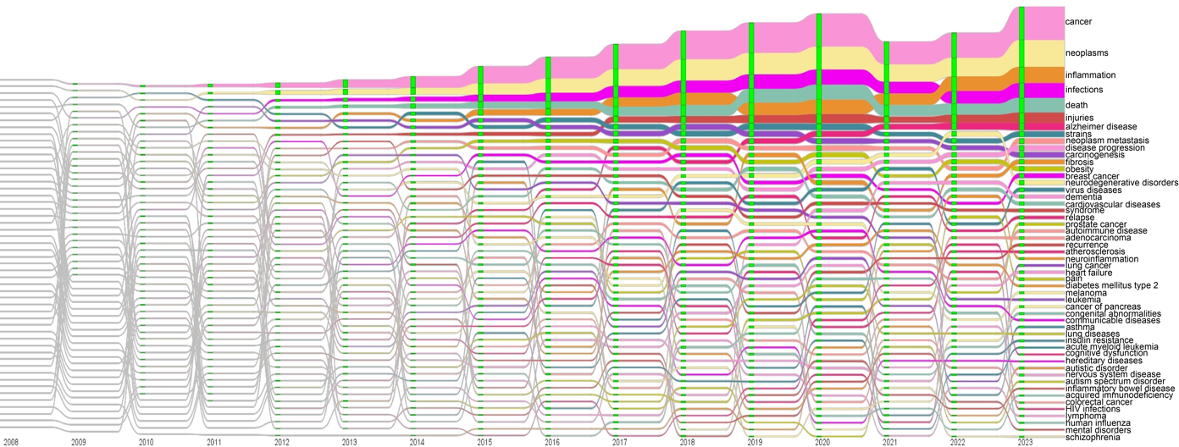
Dissemination of techniques into many fields: RNA-Seq
*NIH-awarded, type 1 and 2 grants that mention "RNA-Seq" were analyzed with the IN-SPIRETM software. The medical conditions studied in these grants are shown above.
Notes:
More description:
fiscal years on the x-axis. The width and relative position of each bar represent how many grants were mapped to that medical condition in that fiscal year. Green vertical lines show which conditions were active in each fiscal year.

Slide 28
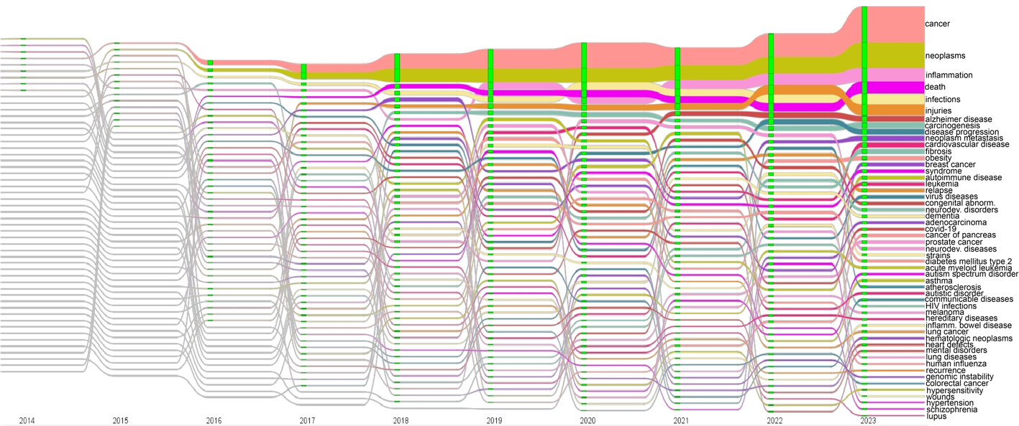
Dissemination of techniques into many fields: scATAC-Seq
*NIH-awarded, type 1 and 2 grants that mention "scATAC-Seq" were analyzed with the IN-SPIRETM software. The medical conditions studied in these grants are shown above.
Notes:
More description:
fiscal years on the x-axis. The width and relative position of each bar represent how many grants were mapped to that medical condition in that fiscal year. Green vertical lines show which conditions were active in each fiscal year.

Slide 29
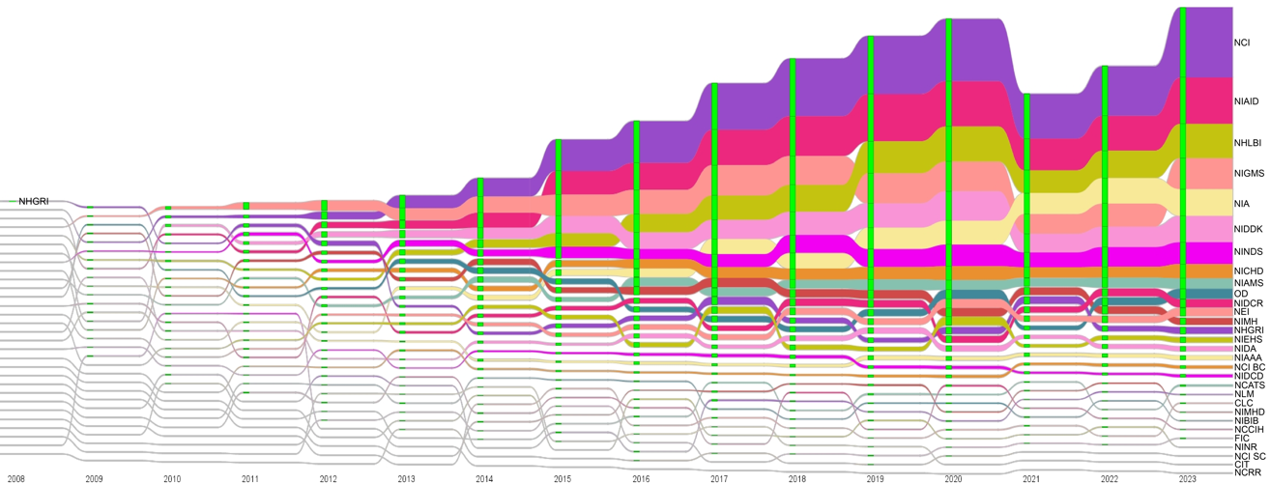
Dissemination of techniques into funding by many NIH institutes/centers: RNA-Seq
*NIH-awarded, type 1 and 2 grants that mention "RNA-Seq" were analyzed with the IN-SPIRETM software. The funding institutes/centers for these grants are shown above.
Notes:
More description:
fiscal years on the x-axis. The width and relative position of each bar represent how many grants were mapped to that funding institute/center in that fiscal year. Green vertical lines show which funding institutes/centers were active in each fiscal year. Note: NHGRI was the only funding IC in FY2008 (using these filters)

Slide 30
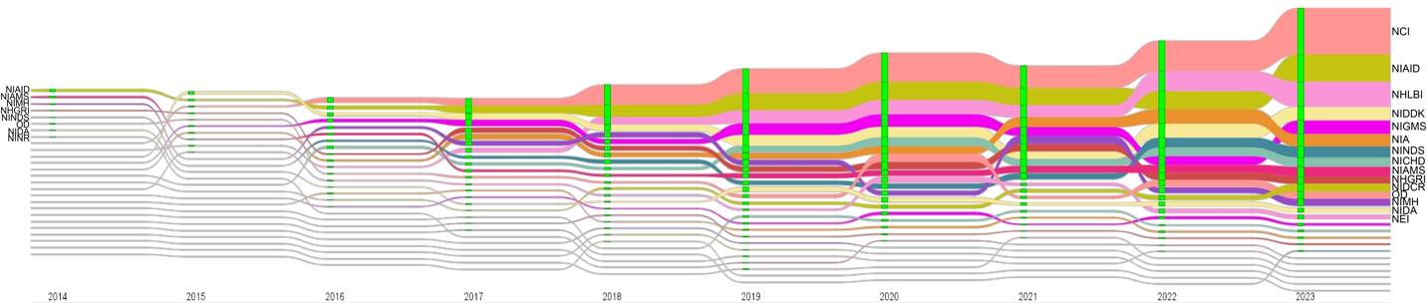
Dissemination of techniques into funding by many NIH institutes/centers: scATAC-Seq
*NIH-awarded, type 1 and 2 grants that mention "scATAC-Seq" were analyzed with the IN-SPIRETM software. The funding institutes/centers for these grants are shown above.
Notes:
More description:
fiscal years on the x-axis. The width and relative position of each bar represent how many grants were mapped to that funding institute/center in that fiscal year. Green vertical lines show which funding institutes/centers were active in each fiscal year. (Note: funding ICs with relevant grants in FY2014 are also labeled on the left)

Slide 31
Evaluation Question 3: How did program funding influence grantees’ careers?
The CEGS program had a positive impact on careers by directly improving grant funding levels for investigators, and by allowing personnel at many levels to create or participate in outreach activities that helped to encourage others to pursue science as well.
Survey Results: Participation in Education and Outreach Activities
31

Slide 32
NIH Grant Metrics – Subsequent Funding
Yearly Averages | CEGS Grantees – Pre-Grant (n=36) | CEGS Grantees – Post-Grant (n=31)
Applications | 1.06 | 1.7
Awards | 0.39 | 0.38
R01 Applications | 0.54 | 0.66
R01 Awards | 0.16 | 0.10
Total Direct Funding | $680,314 | $1,179,259
CEGS grantees submitted more applications and received more direct funding after receiving their CEGS grant.

Slide 33
NIH Grant Metrics – Subsequent Funding
Yearly Averages | CEGS Grantees – Pre-Grant (n=36) | CEGS Grantees – Post-Grant (n=31) | Comparison Grantees – Pre-Grant (n=187) | Comparison Grantees – Post-Grant (n=214)
Applications | 1.06 | 1.7 | 0.97 | 1.2
Awards | 0.39 | 0.38 | 0.27 | 0.35
R01 Applications | 0.54 | 0.66 | 0.53 | 0.61
R01 Awards | 0.16 | 0.10 | 0.11 | 0.10
Total Direct Funding | $680,314 | $1,179,259 | $281,814 | $754,988
Comparison R01 grantee group also submitted more grants after receiving their R01’s and received more direct funding.

Slide 34
Evaluation Question 4: What have been the strengths (outcomes and achievements) of the program? Are there suggestions/opportunities for improvement?
Strengths:
Fostering collaborations, coordination, and networking.
Supporting ambitious, high-risk, and high-reward research.
  “We really developed an entirely new methodology. We, unfortunately, also found out its limitations….Which is probably a good thing... it was the only way to do this work that otherwise probably never would've seen the light of day.”
  “if the program is doing what it's supposed to do, you will walk out of the CEGS meeting feeling like a quarter to a third of the stuff isn't going to work.”
34

Slide 35
Evaluation Question 4: What have been the strengths (outcomes and achievements) of the program? Are there suggestions/opportunities for improvement?
Strengths:
3. Providing freedom and flexibility in research.
4. Enabling technology development in an NIH grant.
  “It was often people who are already doing technology development and willing to take those risks who were now looking at the NIH saying, ‘Who is willing to be accepting of this kind of tech development?’ And there aren't too many mechanisms. CEGS is one. And the other one - P41 Centers originally from NCRR and then from GM.”
35

Slide 36
Evaluation Question 4: What have been the strengths (outcomes and achievements) of the program? Are there suggestions/opportunities for improvement?
Suggestions/Opportunities for Improvement (1/3):
Survey participants mentioned a need for more workshop and training opportunities, as well as more targeted outreach of diverse populations.
Investigators felt that NHGRI should ensure that CEGS go beyond nucleic acids.
  “I think the drawing hard lines of once it's not nucleic acid-based, it's no longer within the purview of the NHGRI, has been a disservice to genome biology as a whole…. it limits our ability to actually understand the impact of genome biology on everything from evolution to general biology to disease processes.”
36

Slide 37
Evaluation Question 4: What have been the strengths (outcomes and achievements) of the program? Are there suggestions/opportunities for improvement?
Suggestions/Opportunities for Improvement (2/3):
Investigators expressed concerns about the flat budgets over time.
  “if you're going to ask big things of people, you have to deliver enough resources for them to do the big thing or else be creative about how to scope it. And I worry that in particular, the outreach and education are components that will really suffer with smaller budgets.”
  “I think that the fact that inflation has eroded the value of the CEGS budget and now it's been cut by almost 20 percent, I do really worry. You know, we wrote our renewal, and I worry that in order to meet the mandate of the CEGS, the budget is too small.”
37

Slide 38
Evaluation Question 4: What have been the strengths (outcomes and achievements) of the program? Are there suggestions/opportunities for improvement?
Suggestions/Opportunities for Improvement (3/3):
4. Several investigators suggested NHGRI consider a shorter and/or smaller CEGS-like grant program that would also be high-risk, high-reward while maintaining the emphasis on “tool development linked to driving biological projects.”
  “try to carve out a program for, like, a junior CEGS. Maybe they're shorter, maybe they're only two or three years, and maybe they're smaller. Maybe they're only two or three investigators, and they're only $300,000 or $400,000 a year, right? But the ask is, these are [wild], out of left field ideas.”
  “I think having some miniature version of the CEGS that's a little more feasible -- you have more of them and more people can take from them, I think that would be a very interesting concept that hasn't been addressed.”
38
Notes:
“

Slide 39
Thank you to:
Ripple Effect team: Lex Helsel, Joshua Heath, Brian Knafou, Kayla Ingram
NHGRI Coordinator: Yewande Komolafe
NHGRI Qualitative Analyses: Molly Bird and Maya VanZanten
NHGRI Extramural Program Staff
Survey and Interview Participants
NIAID CHAVI-ID evaluation team and DPCPSI for advice

Slide 40
National Human Genome Research Institute
Questions, Ideas, & Discussion

